Slide 1
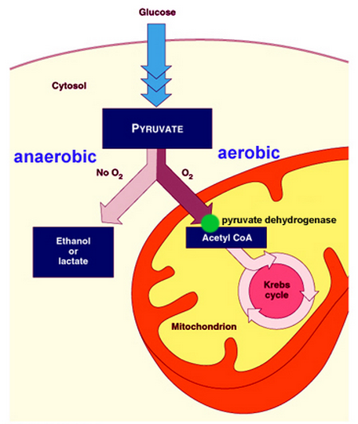
3 new terms to learn, can you define them and give examples of organisms:
1. Obligate anaerobes
2. Facultative anaerobes
3. Obligate aerobes
1. Clostridium, denitrifying bacteria
2. Yeast
3. Muscle cells in mammals

Slide 2

Anaerobic Respiration
Describe and explain anaerobic respiration in mammals and yeast including why anaerobic respiration produces a much lower yield of ATP than aerobic respiration.
Suggest the benefits of being able to respire anaerobically

Slide 3
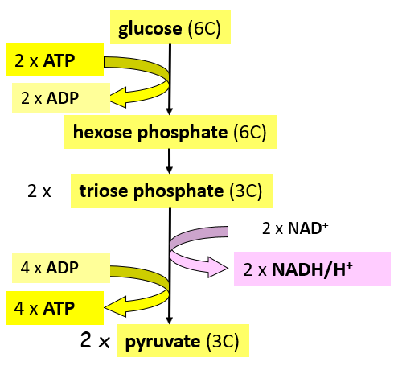
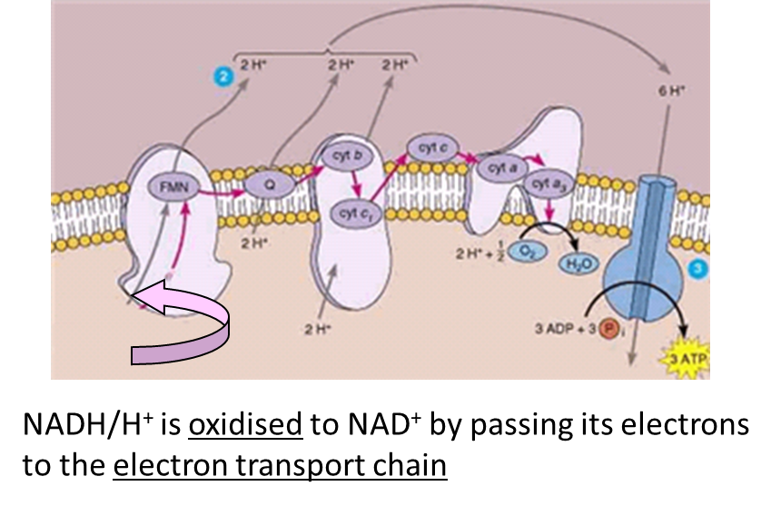
What happens to reduced NAD under aerobic conditions?

Slide 4

Explain why this cannot happen when oxygen is absent
If there is no oxygen to act as the final electron acceptor, then the electron transport chain stops, meaning reduced NAD cannot become re-oxidised
Glycolysis will stop if the cell runs out of oxidised NAD – no ATP will be produced and the cell will die. Anaerobic respiration allows glycolysis to continue by re-oxidising reduced NAD

Slide 5
SPOT THE DIFFERENCE
You will get 10 seconds to study each of the following 4 slides. The 1st and the 3rd slides show the structure of pyruvate and the 2nd and 4th slides show the structure of lactate.
Use that time to work out one structural difference between the two substances
PYRUVATE
vs
LACTATE

Slide 6
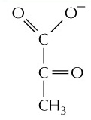
SPOT THE DIFFERENCE
PYRUVATE

Slide 7
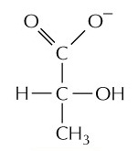
SPOT THE DIFFERENCE
LACTATE

Slide 8
SPOT THE DIFFERENCE
PYRUVATE

Slide 9
SPOT THE DIFFERENCE
LACTATE

Slide 10
PYRUVATE
LACTATE
Two hydrogen atoms!

Slide 11


1 TO THINK ABOUT:
You have 1 minute to discuss with 1 person
“The structure of lactate has two more hydrogen atoms than the structure of pyruvate”
Using all that you’ve seen and learnt in the last few minutes, can you suggest the source of the hydrogen atoms that are needed for this conversion?

Slide 12
In animals: Lactate fermentation
In animals, the enzyme lactate dehydrogenase removes hydrogens from NADH/H+ and transfers then to pyruvate, converting it into lactate
NADH is oxidised to NAD⁺ so it can accept hydrogen, allowing triose phosphate to be converted into pyruvate – therefore glycolysis continues allowing ATP to be synthesised by substrate-level phosphorylation
Lactate dehydrogenase
2x
lactate (3C)
Notes:
Lactic acid is lactate plus one proton. Terms used interchangeably.

Slide 13
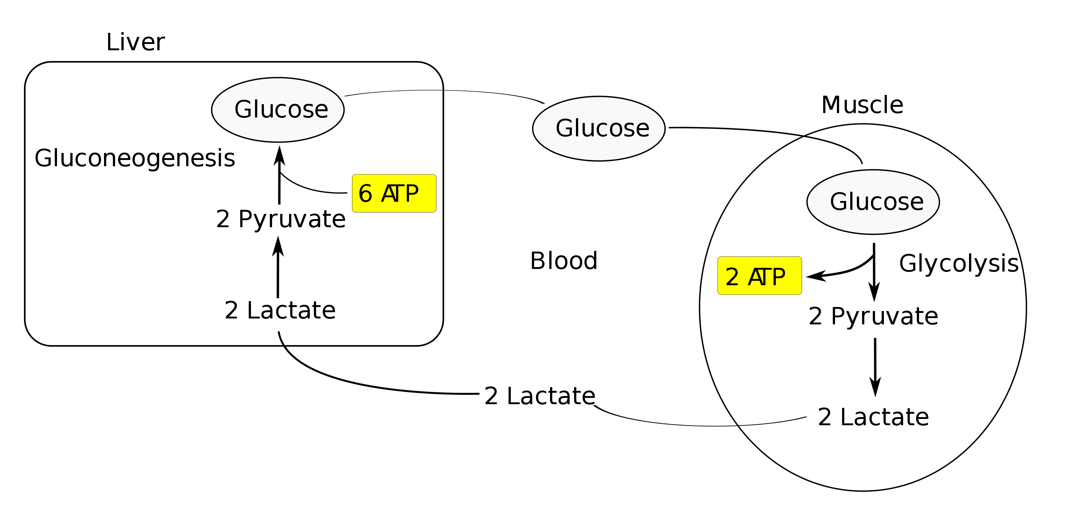
The fate of lactate
Lactate can be used in two ways:
In cells:
Oxidation back to pyruvate by well-oxygenated muscle cells, heart cells, and brain cells
  Pyruvate is then directly used to fuel the Krebs cycle
2. In the liver:
Conversion to glucose via gluconeogenesis and released back into circulation:
  This process requires energy from ATP.
  This process requires oxygen
  If blood glucose concentrations are high, the glucose can be used to build up the liver's glycogen stores.
The Cori Cycle:
Transported to liver in blood stream

Slide 14
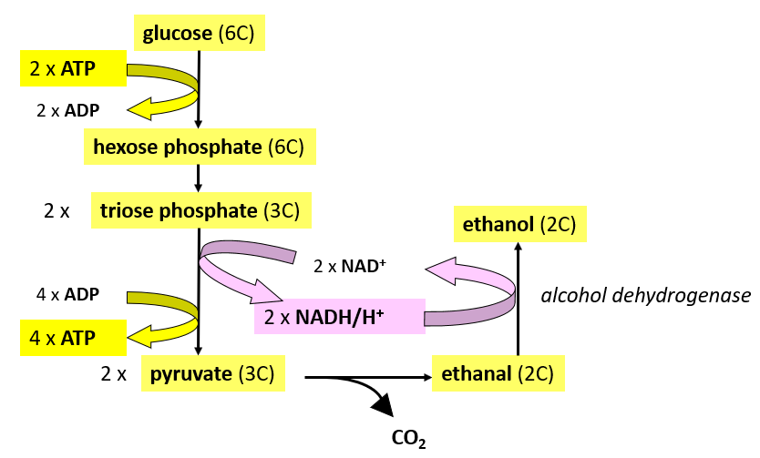
In yeast: Alcoholic Fermentation
Pyruvate is decarboxylated to form ethanal (1C removed as CO₂)
The enzyme alcohol dehydrogenase removes hydrogens from NADH and transfers them to ethanal, reducing it into ethanol.
Glycolysis can continue as NAD is available again.
2x
2x

Slide 15
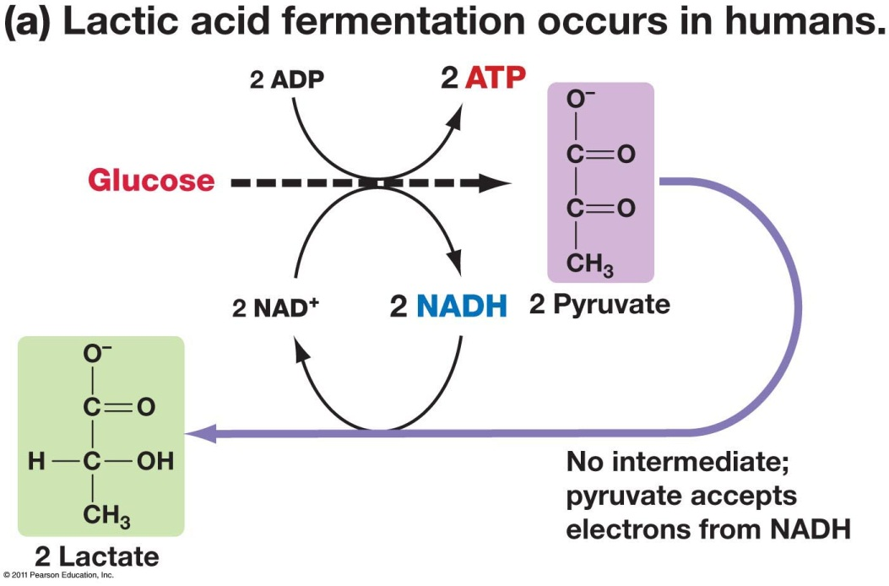
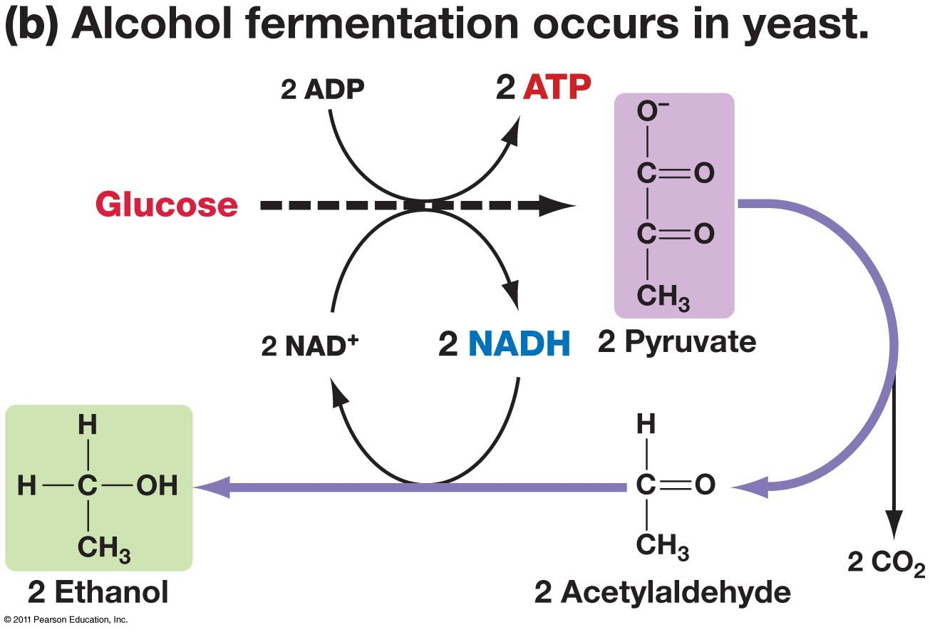
Happens in mammals.
Produces lactate.
NAD⁺ reduced in glycolysis to NADH and H⁺, NADH then used to reduce pyruvate to lactate.
NAD⁺ regenerated.
Glycolysis can continue in low [O₂].
Small amount of ATP can thus still be produced.
Happens in yeast cells.
Produces ethanol.
Pyruvate decarboxylated to form ethanal (acetylaldehyde).
NAD⁺ reduced in glycolysis to NADH and H⁺, NADH then used to reduce ethanal to ethanol.
NAD⁺ regenerated.
Glycolysis can continue in low [O₂].

Slide 16

Why isn’t anaerobic respiration as good at releasing energy as aerobic ?
Only one energy releasing stage (glycolysis).
Only 2 ATP produced per glucose molecule.
No Krebs or oxidative phosphorylation as these need O₂(g).
Therefore ATP yield is lower.

Slide 17
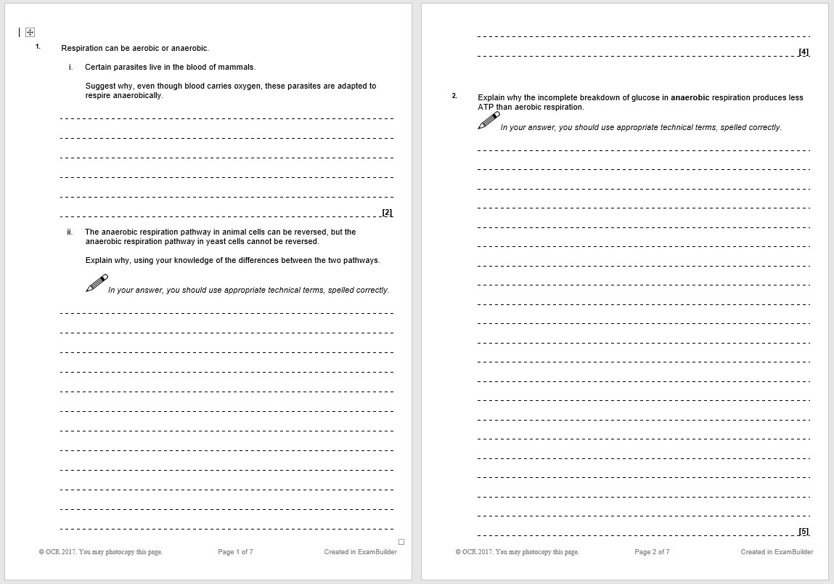
Test yourself:

Slide 18
Do!
Anaerobic Respiration
Does not involve the …… reaction or ……….. cycle or oxidative phosphorylation
Anaerobic respiration does not require ………….. to take place
If a little extra ……….. is required but not enough oxygen to increase aerobic respiration, anaerobic respiration is an alternative pathway
Alcoholic fermentation and ……….. fermentation are the two types
They both take place in the ………….
They both start with ……………..
They occur in different organisms and different processes occur involving the pyruvate.
Anaerobic respiration releases much less energy – only …… ATP per one glucose, from glycolysis – but some biological ……….. will still be able to keep going
Lactate Fermentation
Occurs in …………. and some bacteria
Reduced NAD transfers hydrogen to pyruvate to form …………. and ………..
NAD can then be reused in …………..
Lactate is produced it causes a low ……… and muscle …………..
Too much lactate is toxic, cells remove it into the ………….. The liver converts back to ……….. in a process called gluconeogenesis
……………………
………
pyruvate
…………(……….. acid)
NAD is regenerated so ………… can continue
Reduced
NAD
NAD
Alcoholic Fermentation
Occurs in yeast cells and plant cells
Carbon dioxide is removed to form ……………
Reduced NAD transfers hydrogen to ethanal to form …………. and NAD
NAD can then be reused in …………….
…..…
pyruvate
……….
……………
NAD is regenerated so …………….. can continue
Notes:
Print the 2 review slides on a pages with the 2 do slides back to back and give to students

Slide 19
Review!
Anaerobic Respiration
Does not involve the link reaction or Kreb’s cycle or oxidative phosphorylation
Anaerobic respiration does not require oxygen to take place
If a little extra ATP is required but not enough oxygen to increase aerobic respiration, anaerobic respiration is an alternative pathway
Alcoholic fermentation and lactate fermentation are the two types
They both take place in the cytoplasm
They both start with glycolysis
They occur in different organisms and different processes occur involving the pyruvate.
Anaerobic respiration releases much less energy – only 2 ATP per one glucose, from glycolysis – but some biological processes will still be able to keep going
Lactate Fermentation
Occurs in mammals and some bacteria
Reduced NAD transfers hydrogen to pyruvate to form lactate and NAD
NAD can then be reused in glycolysis
Lactate is produced it causes a low pH and muscle fatigue
Too much lactate is toxic, cells remove it into the bloodstream. The liver converts it back to glucose in a process called gluconeogenesis
Reduced
NAD
NAD
pyruvate
Lactate (lactic acid)
NAD is regenerated so glycolysis can continue
Reduced
NAD
NAD
Alcoholic Fermentation
Occurs in yeast cells and plant cells
Carbon dioxide is removed to form ethanal
Reduced NAD transfers hydrogen to ethanal to form ethanol and NAD
NAD can then be reused in glycolysis
CO₂
pyruvate
ethanal
ethanol
NAD is regenerated so glycolysis can continue

