Slide 1
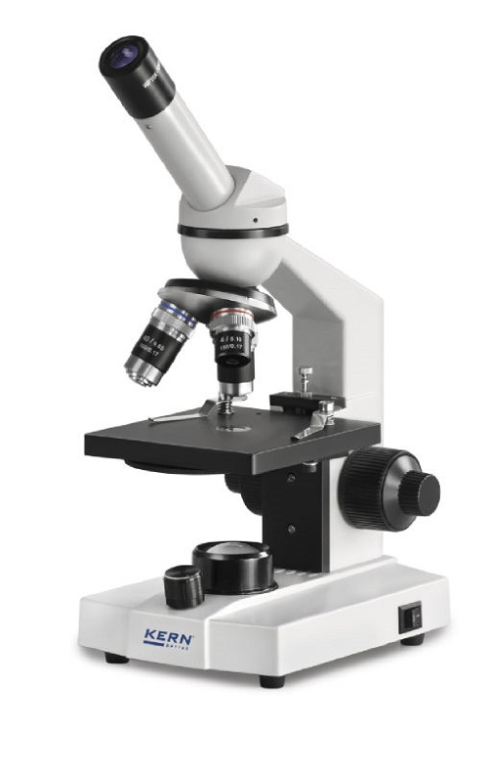
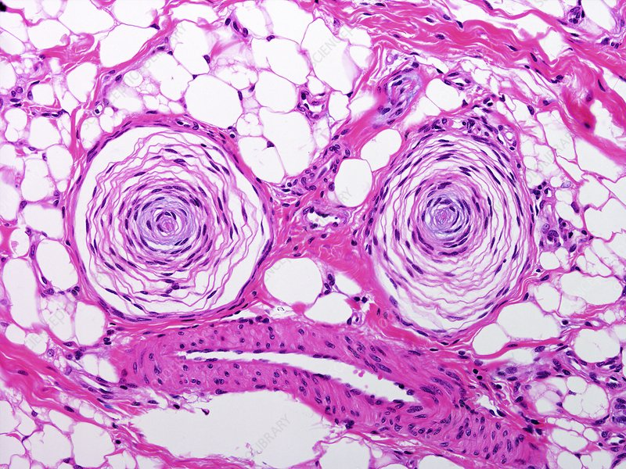
Skin histology
Identify the Pacinian corpuscle under the microscope

Slide 2
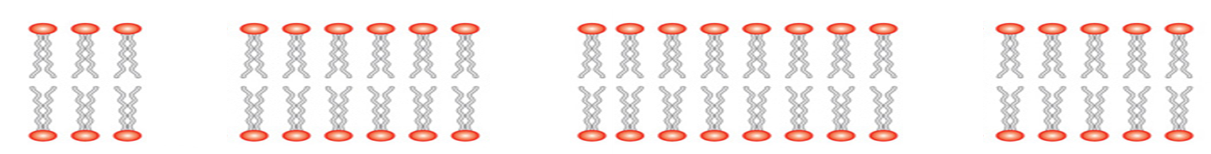
Notes:
Print to use for playdoh task

Slide 3
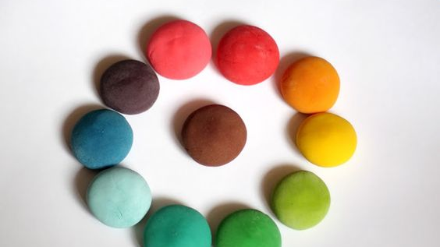
No notes!
Use the playdoh to depict how resting potential is maintained within a neurone.
Annotate around your image to explain what is happening

Slide 4
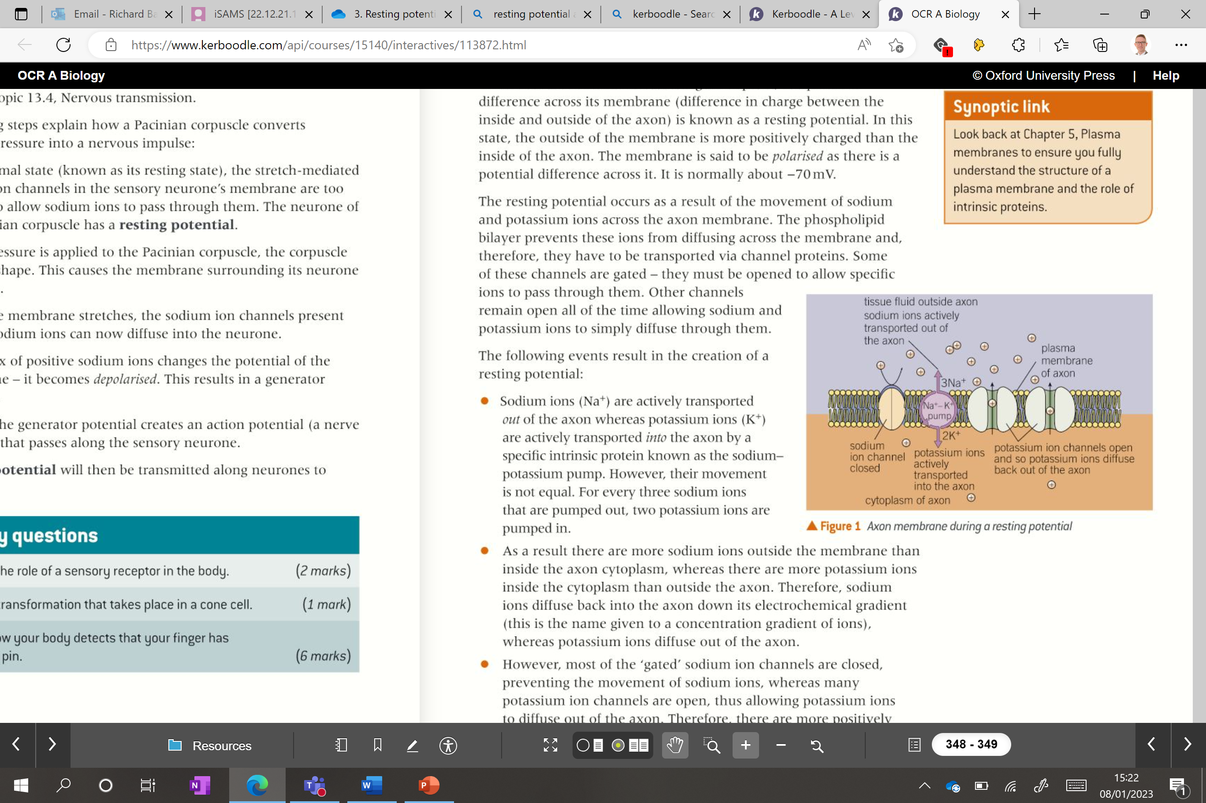
Producing a resting potential
Na⁺ ions are actively transported
K⁺ ions are actively transported in
The movement is uneven, x3 Na⁺ go out and x2 K⁺ go in each time.
4. HOWEVER….
Most of the “gated” Na+ ion channels are closed, preventing the movement of Na+.
Most K+ ion channels are open allowing them to diffuse out of the axon.
4. Meaning more Na⁺ ions outside the membrane and more K⁺ ions inside
5. Leaving the inside of the cell more negatively charged
3. This SHOULD mean Na+ ions will diffuse back into the axon and K+ will diffuse out of the axon, down the electrochemical gradients.

Slide 5
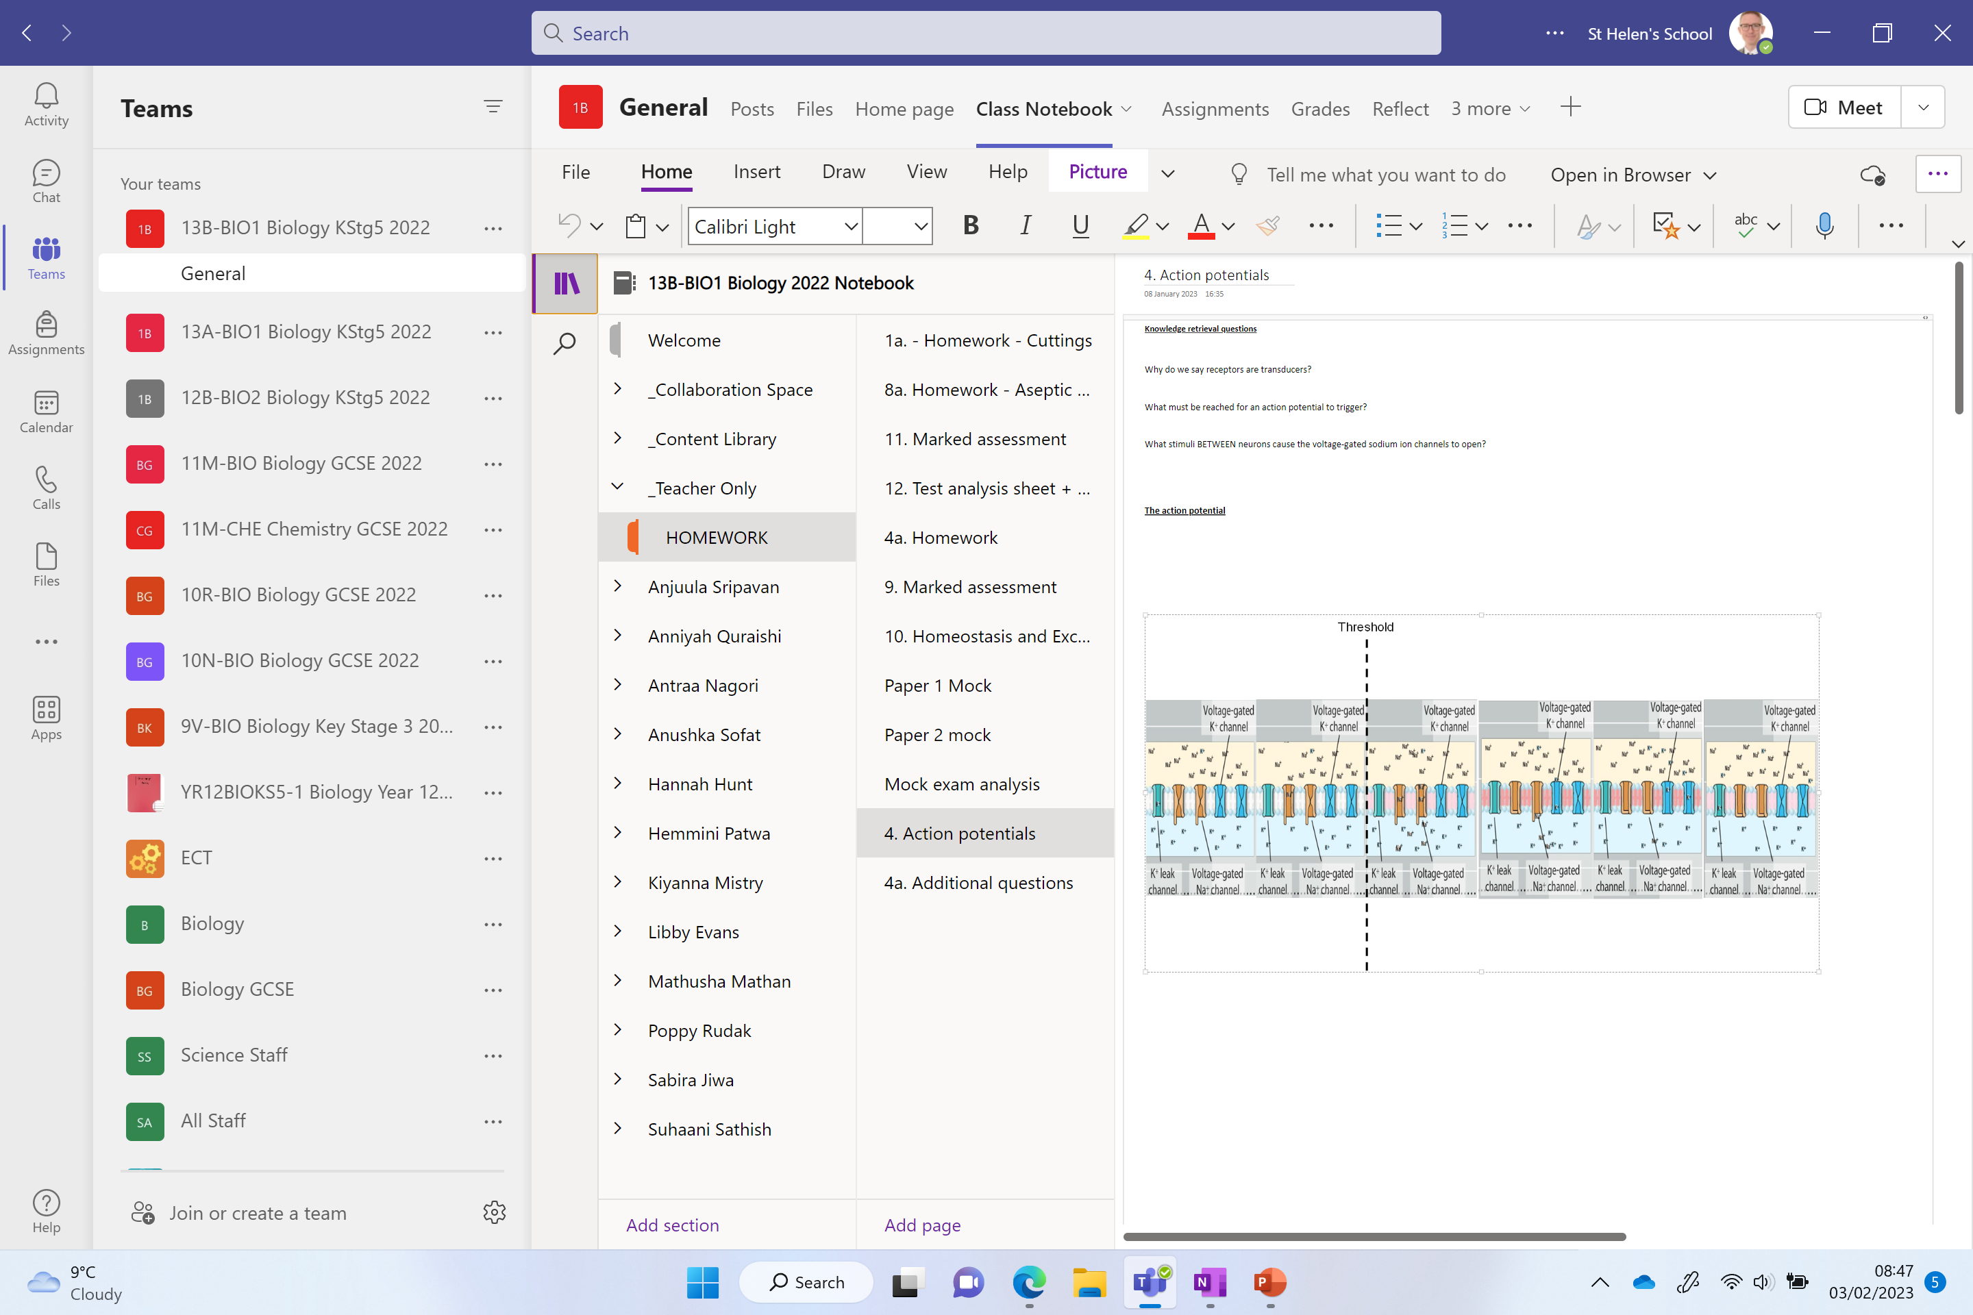

Slide 6
Knowledge retrieval questions
Why do we say receptors are transducers?
They convert energy in one form (such as light, heat or
sound) into an electrical impulse.
What must be reached for an action potential to trigger and action potential in a receptor?
Generator potential / threshold
What stimuli BETWEEN neurons cause the ligand-gated sodium ion
channels to open?
Neurotransmitters attaching to receptors

Slide 7
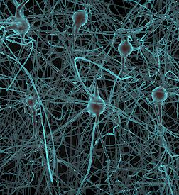
Action Potentials

Slide 8
Propagation of an action potential along a non-myelinated neurone

Slide 9
We know what resting potential is…
An action potential is…
A brief change in the potential difference across cell surface membranes of neurones.
This is caused by an inward movement of sodium ions followed by the outward movement of potassium ions;
it rapidly travels along the length of a neurone.

Slide 10
Sodium ion channels along the axon
Why are they closed?
What opens them?
Voltage-gated sodium ion channels

Slide 11
Recap
Start with Pacinian corpuscle stretch mediated Na⁺ ion channel AND Voltage gated Na⁺ ion channel – on whiteboard receiving the stimuli

Slide 12
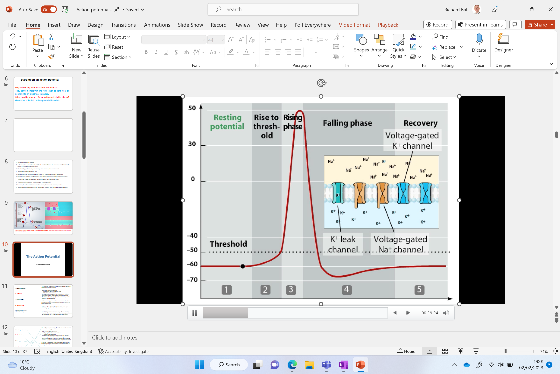
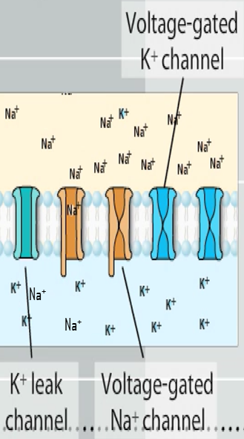
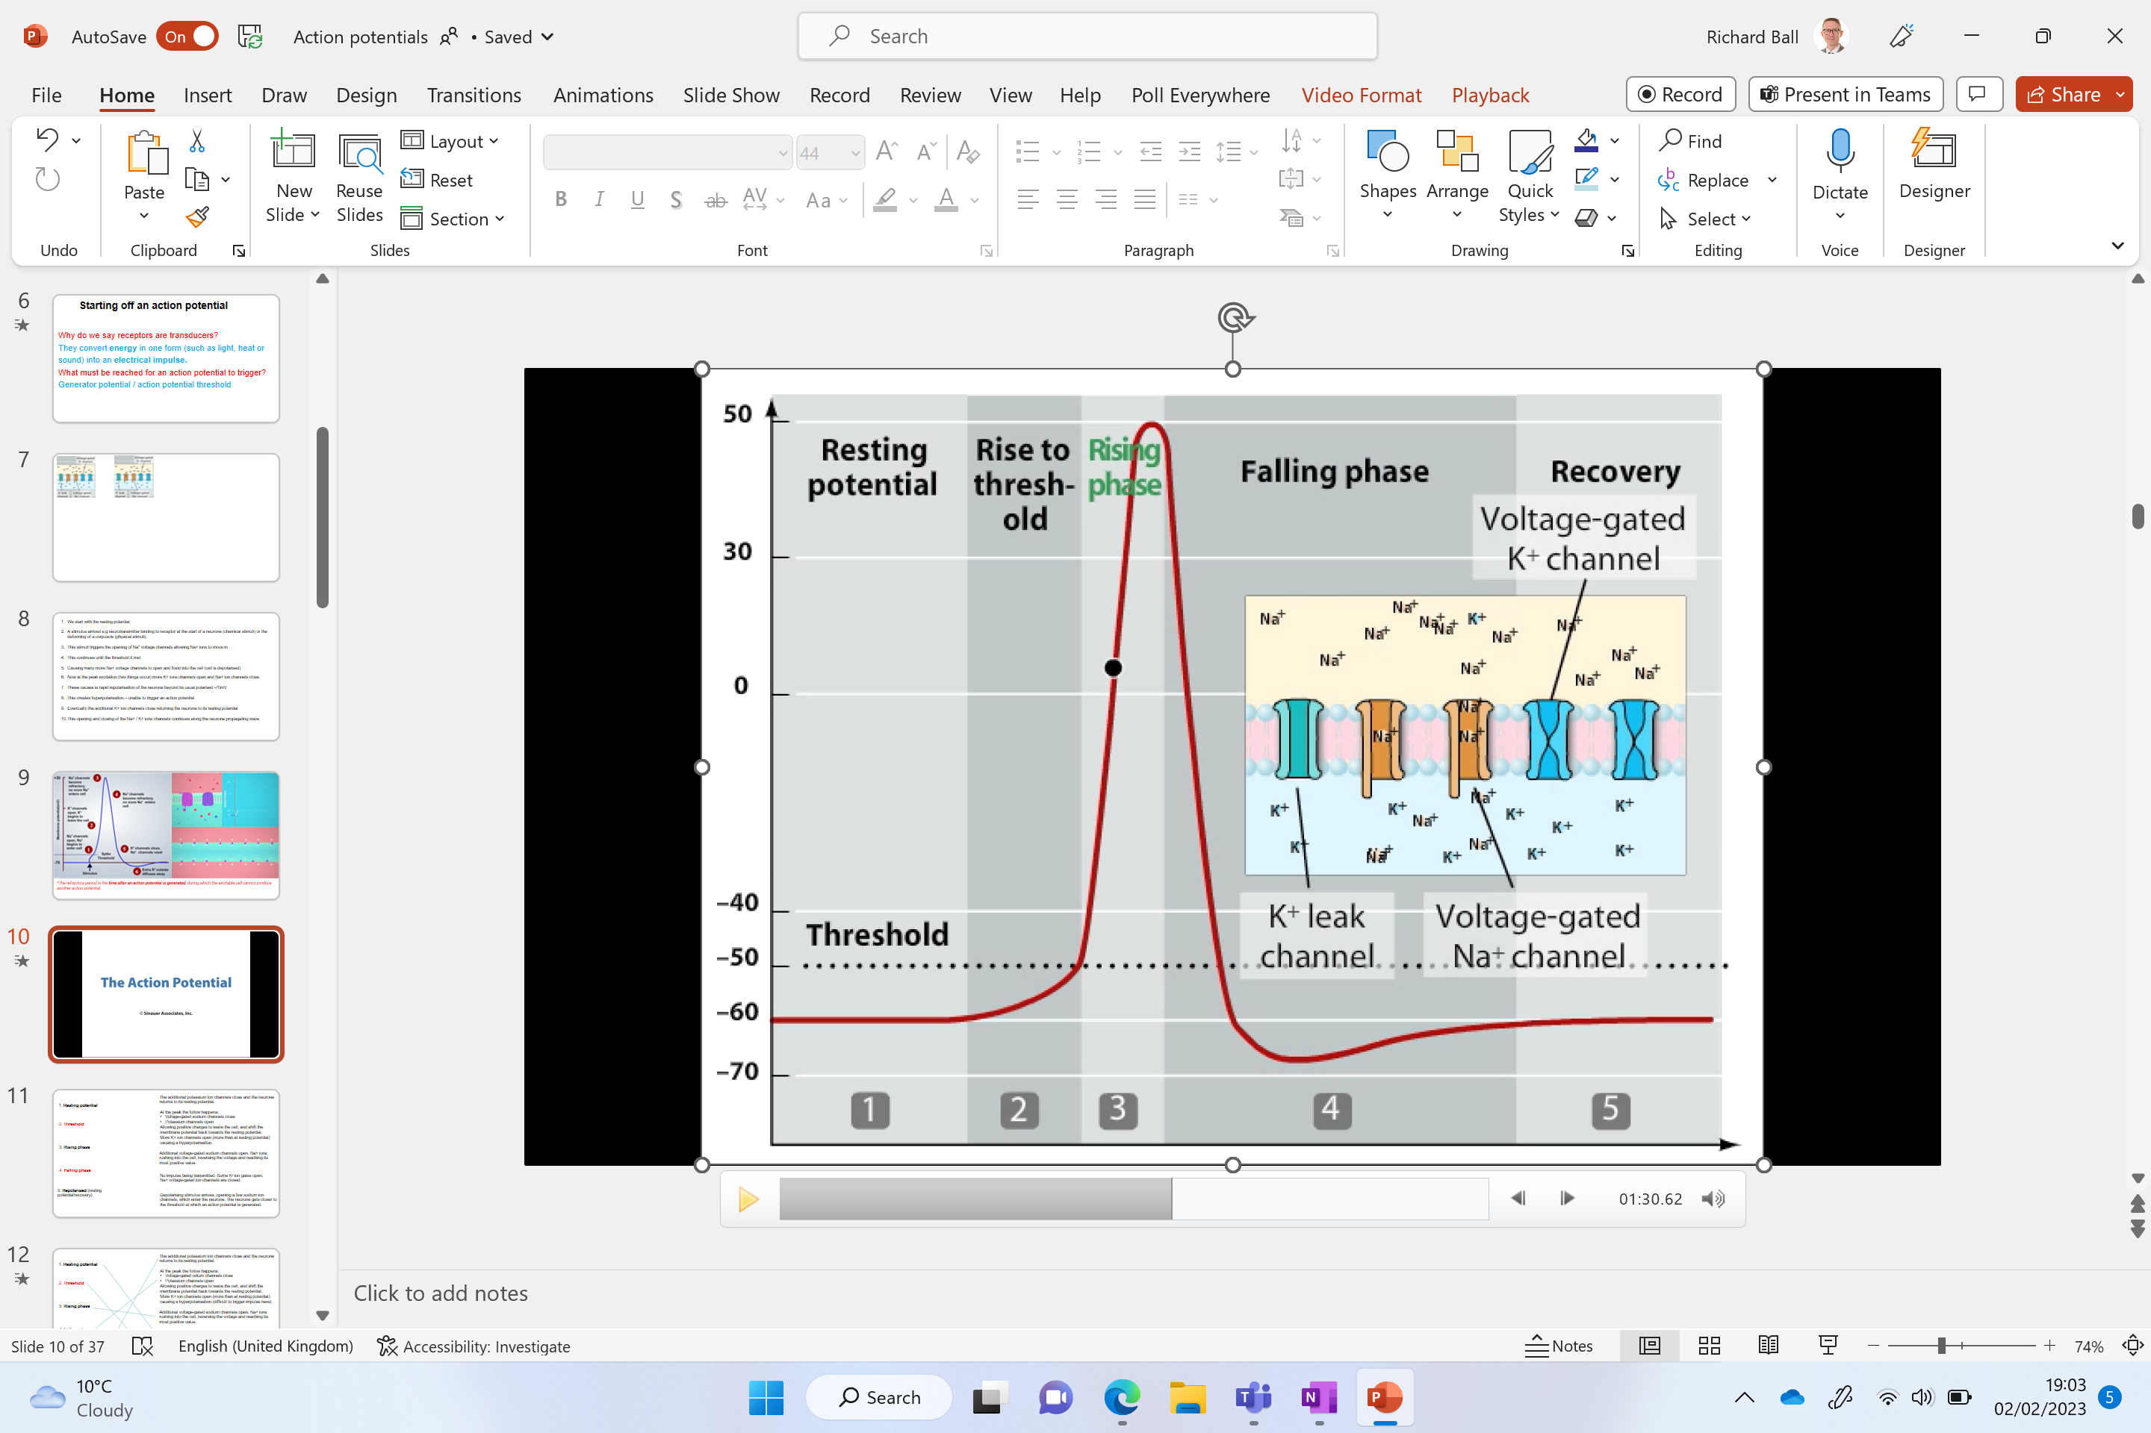
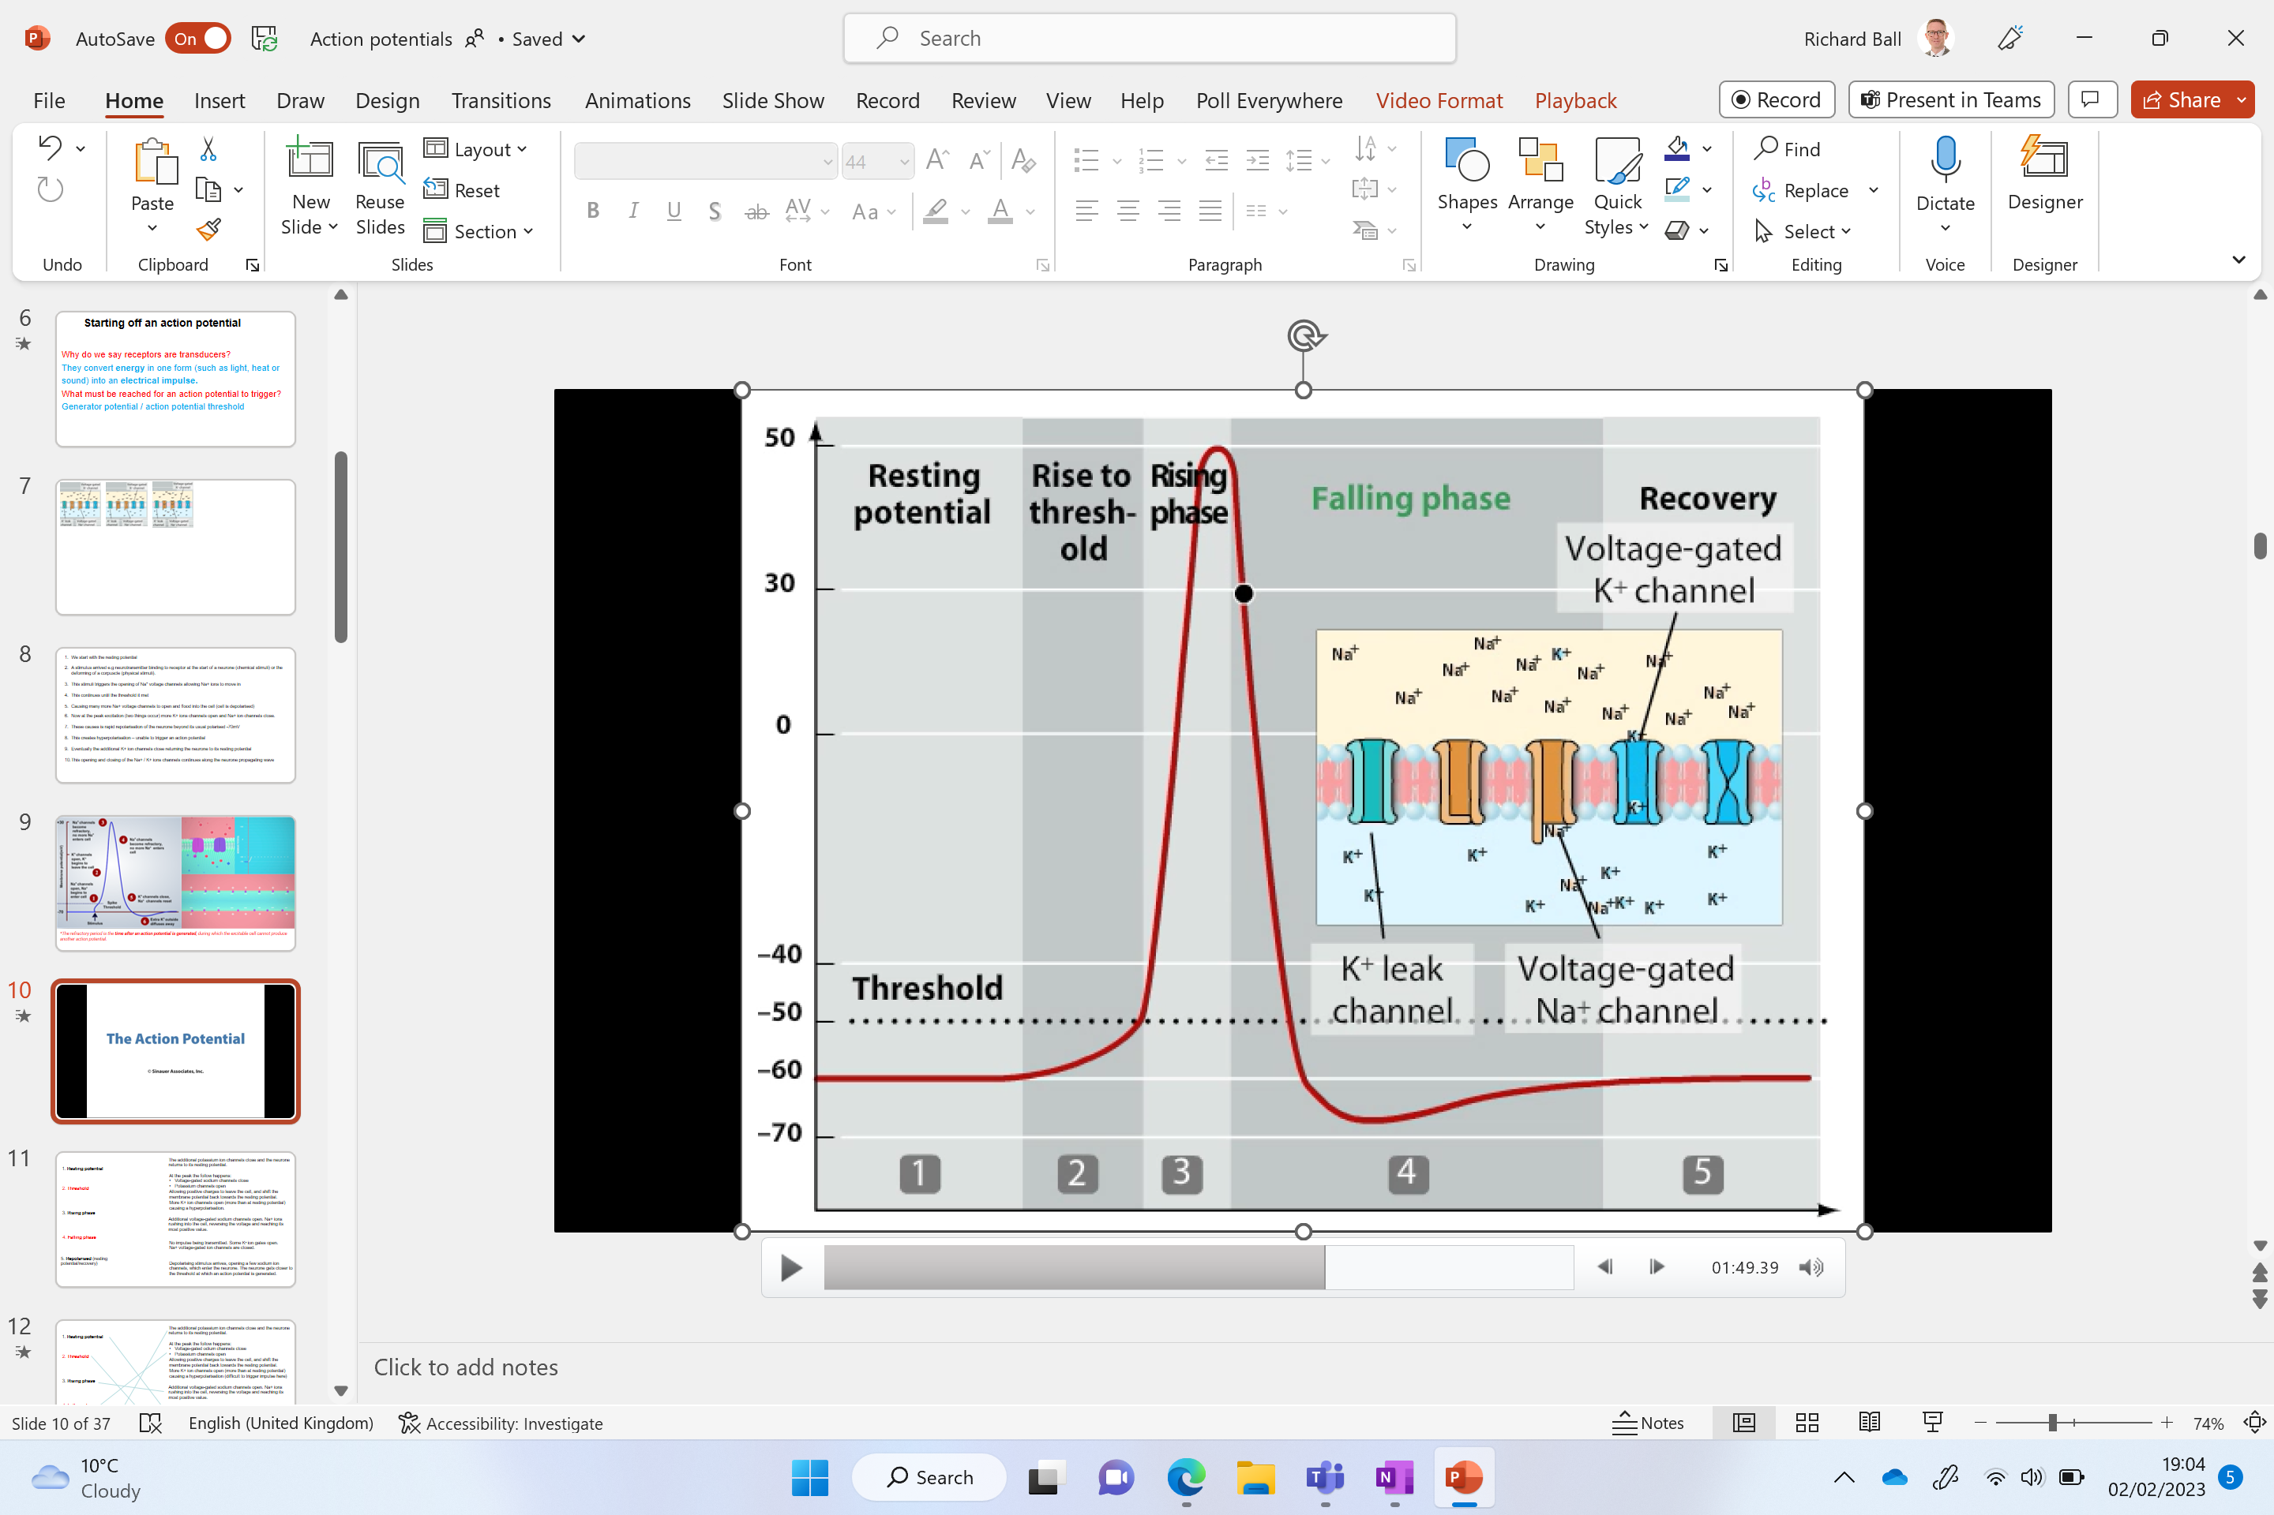
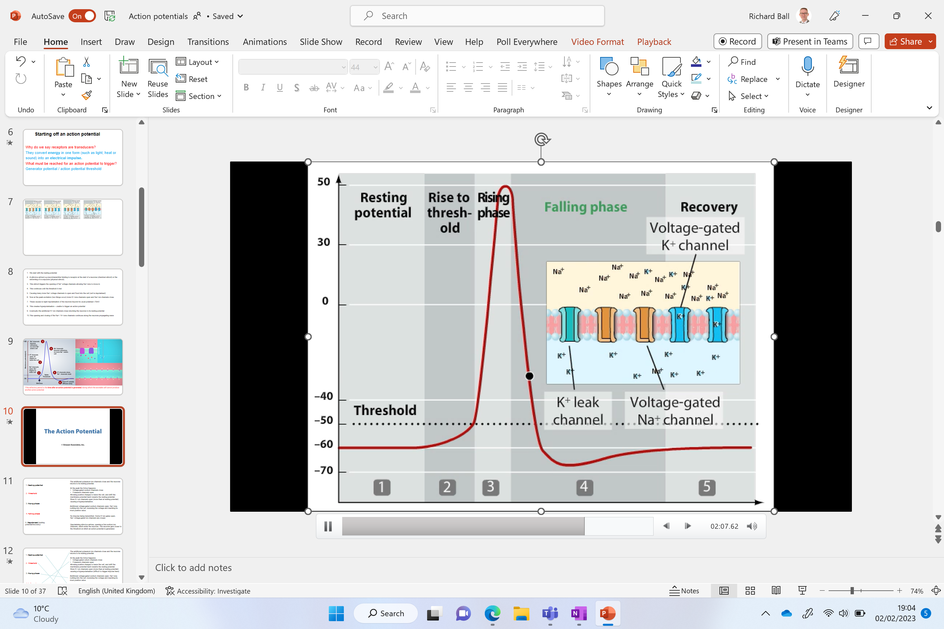
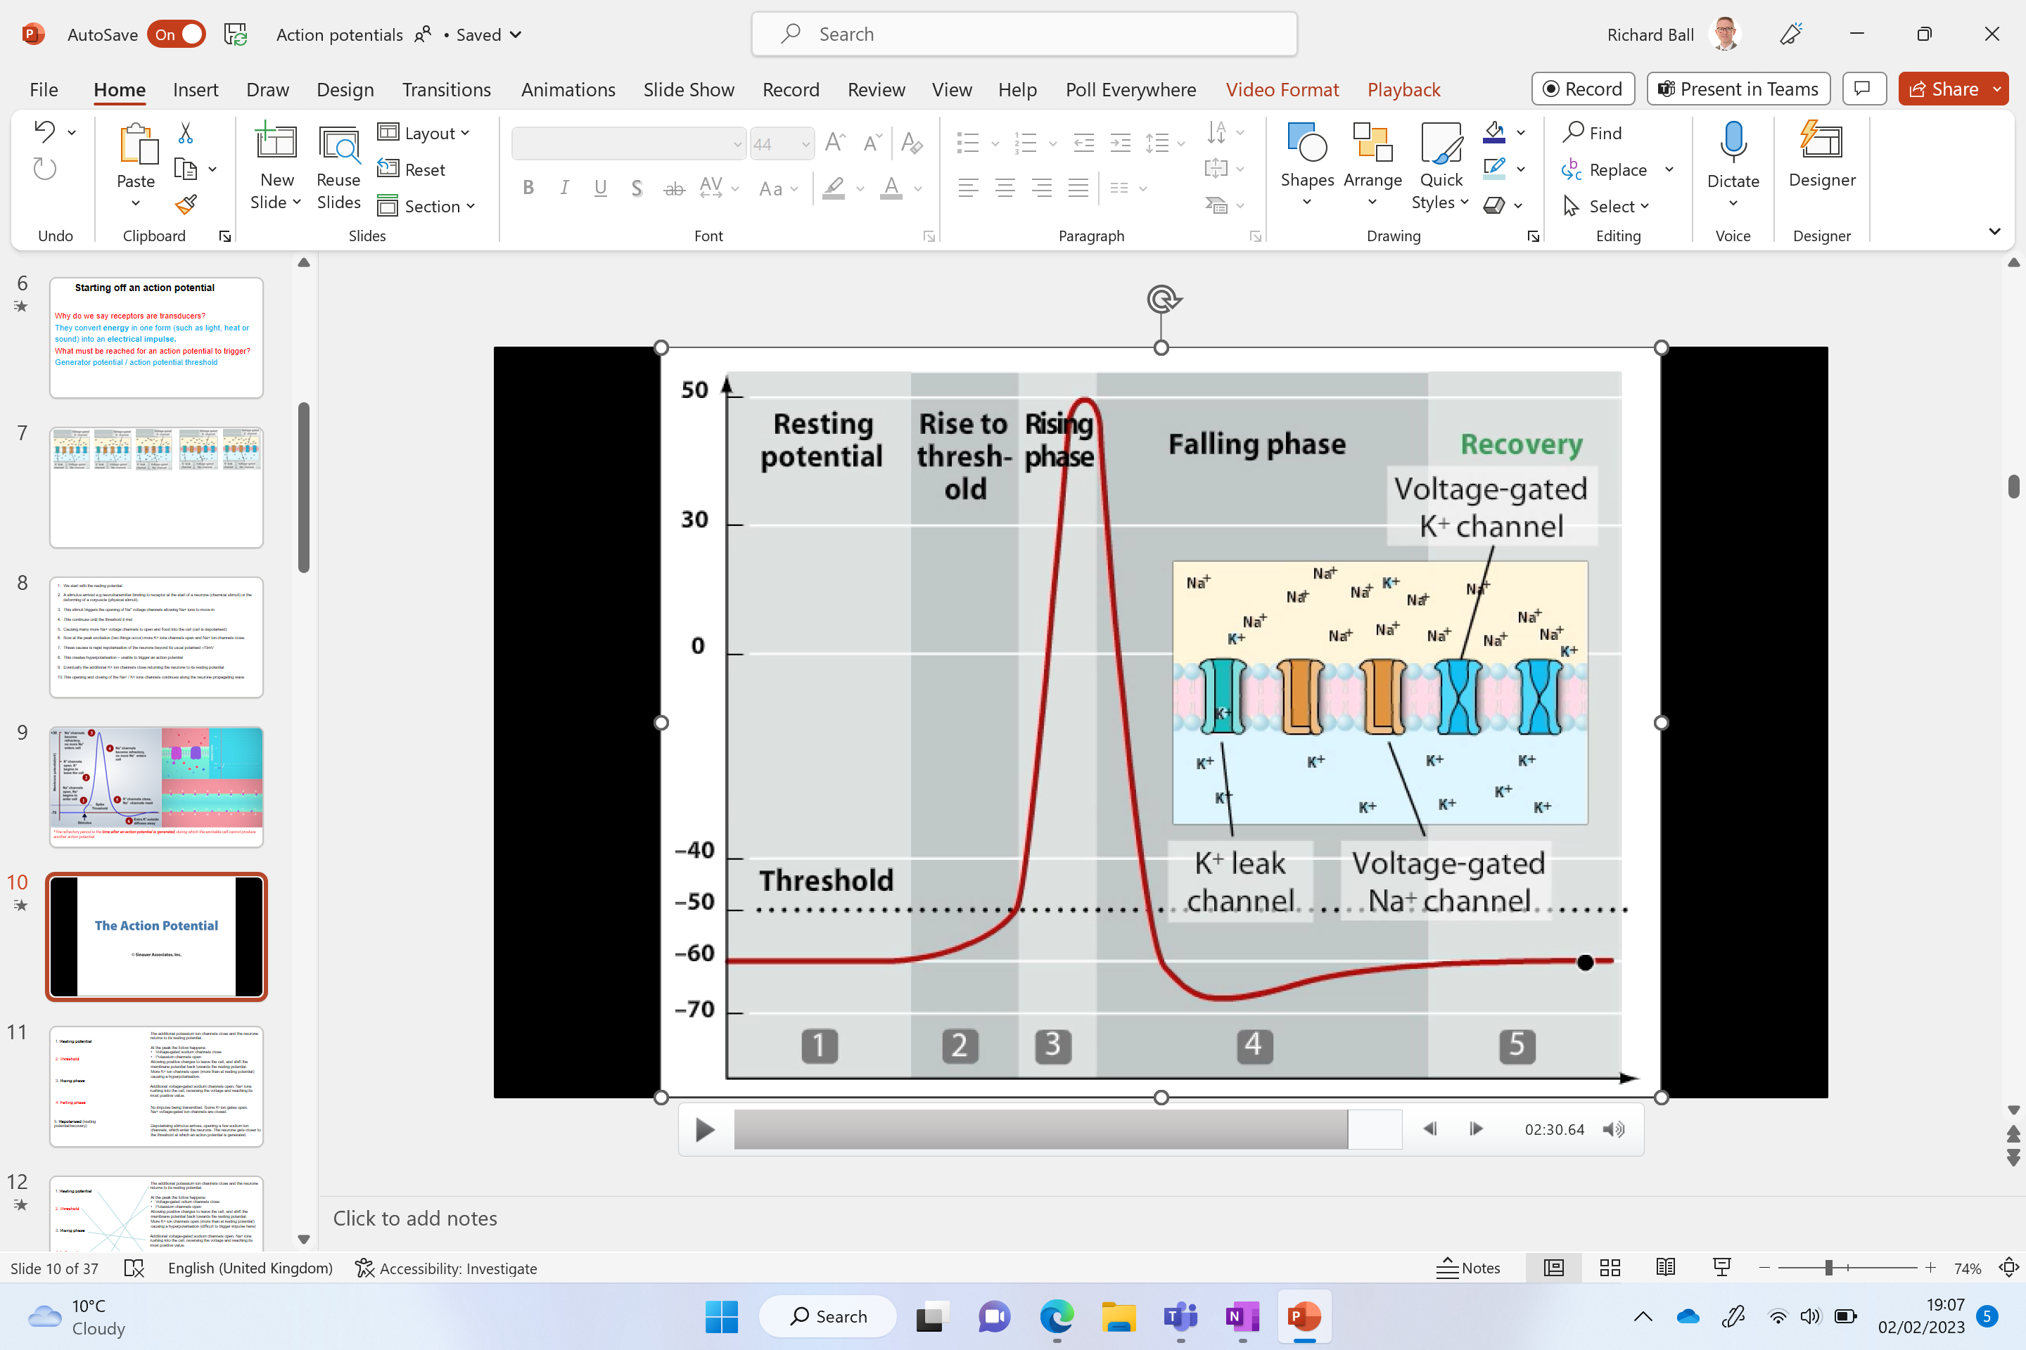
Threshold
Notes:
When a maximum potential difference of around 40+mV is reached the Na+ voltage-gated ion channels close – they actually open at one end quickly (allowing diffusion in) but are slowly closing at the other end simultaneously (and are completely close when around 40+mV is reached inside the cell)

Slide 13
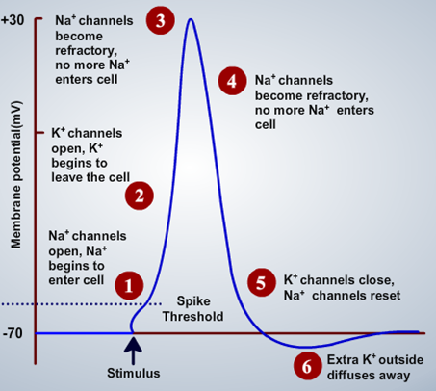
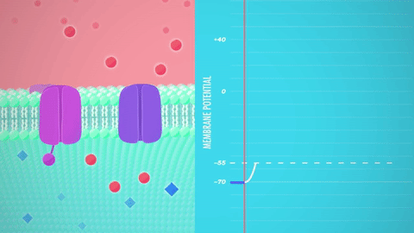
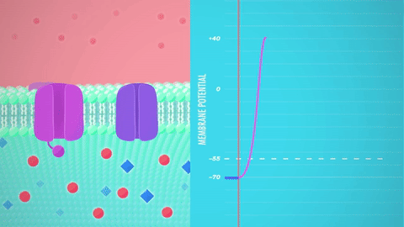
*The refractory period is the time after an action potential is generated, during which the excitable cell cannot produce another action potential.

Slide 14


Slide 15
We start with the resting potential
A …………… arrived e.g neurotransmitter binding to receptor at the start of a neurone (chemical stimuli) or the deforming of a Pacinian ………….. (physical stimuli).
This stimuli triggers the …………… of Na⁺ voltage or Na⁺ stretch-mediate channels to open allowing Na+ ions to ………… in down their electrochemical gradient.
This continues until the …………… threshold it met
Once met this causing many more ….. voltage channels to open and flood into the cell (the cell is d……..…….)
Now at the peak excitation (two things occur) more ……. voltage gated ions channels open and ……. voltage gated ion channels close.
K⁺ ions diffuse out of the ………...
This causes a rapid ……………………. of the neurone beyond its usual polarised -70mV
This creates ………………….. – it is difficult to trigger a new action potential during this stage
Eventually the additional K+ ion channels ………. returning the neurone to its ………….. potential
This ……………. and ………….. of the Na+ / K+ ions channels continues along the neurone propagating wave
Notes:
Hyperpolarisation – prevents the wave moving backwards / link to intercalated discs within cardiac muscle prevent the wave of excitation moving in the wrong direction

Slide 16
We start with the resting potential
A stimulus arrived e.g neurotransmitter binding to receptor at the start of a neurone (chemical stimuli) or the deforming of a Pacinian corpuscle (physical stimuli).
This stimuli triggers the opening of Na⁺ voltage or Na⁺ stretch-mediate channels to open allowing Na+ ions to diffuse in down their electrochemical gradient.
This continues until the generator threshold it met
Once met this causing many more Na⁺ voltage channels to open and flood into the cell (the cell is depolarised)
Now at the peak excitation (two things occur) more K+ voltage gated ions channels open and Na⁺ voltage gated ion channels close.
K⁺ ions diffuse out of the axon.
This causes a rapid repolarisation of the neurone beyond its usual polarised -70mV
This creates hyperpolarisation – it is difficult to trigger a new action potential during this stage
Eventually the additional K+ ion channels close returning the neurone to its resting potential
This opening and closing of the Na+ / K+ ions channels continues along the neurone propagating wave
Notes:
Hyperpolarisation – prevents the wave moving backwards / link to intercalated discs within cardiac muscle prevent the wave of excitation moving in the wrong direction

Slide 17
KEY POINT
What type of feedback is the opening of voltage-gated sodium ions channels?
This creates a positive feedback loop that causes more sodium channels to open and more sodium ions to enter

Slide 18
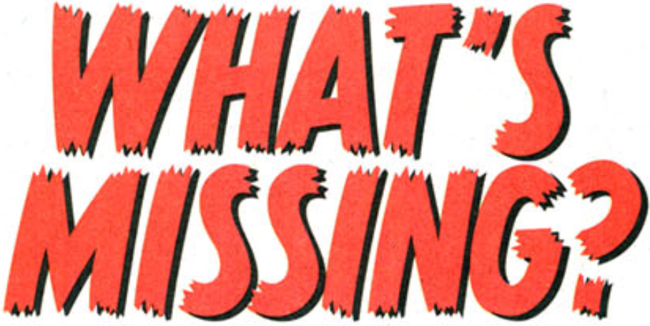

Slide 19
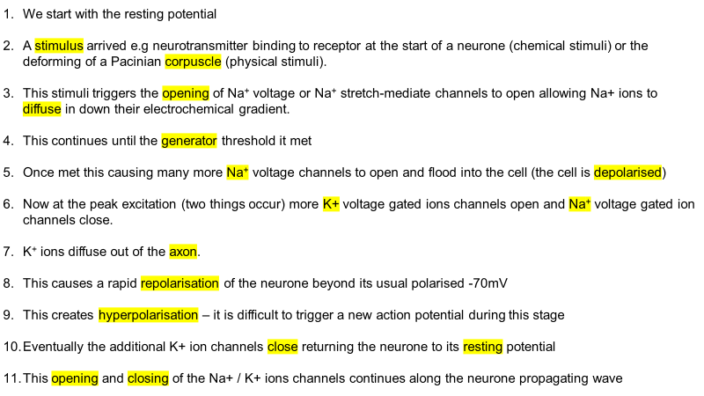
Rules
Part of the process is missing
You have 10 seconds to write down on your whiteboard what's missing

Slide 20
We start with the resting potential
A stimulus arrived e.g neurotransmitter binding to receptor at the start of a neurone (chemical stimuli) or the deforming of a Pacinian corpuscle (physical stimuli).
This stimuli triggers the opening of Na⁺ voltage or Na⁺ stretch-mediate channels to open allowing Na+ ions to diffuse in down their electrochemical gradient.
This continues until the generator threshold it met
Once met this causing many more Na⁺ voltage channels to open and flood into the cell (the cell is depolarised)
Now at the peak excitation (two things occur) more K+ voltage gated ions channels open and Na⁺ voltage gated ion channels close.
K⁺ ions diffuse out of the axon.
This causes a rapid repolarisation of the neurone beyond its usual polarised -70mV
This creates hyperpolarisation – it is difficult to trigger a new action potential during this stage
Eventually the additional K+ ion channels close returning the neurone to its resting potential
This opening and closing of the Na+ / K+ ions channels continues along the neurone propagating wave
Notes:
Hyperpolarisation – prevents the wave moving backwards / link to intercalated discs within cardiac muscle prevent the wave of excitation moving in the wrong direction

Slide 21
We start with the resting potential
A stimulus arrived e.g neurotransmitter binding to receptor at the start of a neurone (chemical stimuli) or the deforming of a Pacinian corpuscle (physical stimuli).
This stimuli triggers the opening of Na⁺ voltage or Na⁺ stretch-mediate channels to open allowing Na+ ions to diffuse in down their electrochemical gradient.
This continues until the generator threshold it met
Once met this causing many more Na⁺ voltage channels to open and flood into the cell (the cell is depolarised)
Now at the peak excitation (two things occur) more K+ voltage gated ions channels open and Na⁺ voltage gated ion channels close.
K⁺ ions diffuse out of the axon.
This causes a rapid repolarisation of the neurone beyond its usual polarised -70mV
This creates hyperpolarisation – it is difficult to trigger a new action potential during this stage
Eventually the additional K+ ion channels close returning the neurone to its resting potential
This opening and closing of the Na+ / K+ ions channels continues along the neurone propagating wave
Notes:
Hyperpolarisation – prevents the wave moving backwards / link to intercalated discs within cardiac muscle prevent the wave of excitation moving in the wrong direction

Slide 22
We start with the resting potential
A stimulus arrived e.g neurotransmitter binding to receptor at the start of a neurone (chemical stimuli) or the deforming of a Pacinian corpuscle (physical stimuli).
This stimuli triggers the opening of Na⁺ voltage or Na⁺ stretch-mediate channels to open allowing Na+ ions to diffuse in down their electrochemical gradient.
This continues until the generator threshold it met
Once met this causing many more Na⁺ voltage channels to open and flood into the cell (the cell is depolarised)
Now at the peak excitation (two things occur) more K+ voltage gated ions channels open and Na⁺ voltage gated ion channels close.
K⁺ ions diffuse out of the axon.
This causes a rapid repolarisation of the neurone beyond its usual polarised -70mV
This creates hyperpolarisation – it is difficult to trigger a new action potential during this stage
Eventually the additional K+ ion channels close returning the neurone to its resting potential
This opening and closing of the Na+ / K+ ions channels continues along the neurone propagating wave
Notes:
Hyperpolarisation – prevents the wave moving backwards / link to intercalated discs within cardiac muscle prevent the wave of excitation moving in the wrong direction

Slide 23
We start with the resting potential
A stimulus arrived e.g neurotransmitter binding to receptor at the start of a neurone (chemical stimuli) or the deforming of a Pacinian corpuscle (physical stimuli).
This stimuli triggers the opening of Na⁺ voltage or Na⁺ stretch-mediate channels to open allowing Na+ ions to diffuse in down their electrochemical gradient.
This continues until the generator threshold it met
Once met this causing many more Na⁺ voltage channels to open and flood into the cell (the cell is depolarised)
Now at the peak excitation (two things occur) more K+ voltage gated ions channels open and Na⁺ voltage gated ion channels close.
K⁺ ions diffuse out of the axon.
This causes a rapid repolarisation of the neurone beyond its usual polarised -70mV
This creates hyperpolarisation – it is difficult to trigger a new action potential during this stage
Eventually the additional K+ ion channels close returning the neurone to its resting potential
This opening and closing of the Na+ / K+ ions channels continues along the neurone propagating wave
Notes:
Hyperpolarisation – prevents the wave moving backwards / link to intercalated discs within cardiac muscle prevent the wave of excitation moving in the wrong direction

Slide 24
We start with the resting potential
A stimulus arrived e.g neurotransmitter binding to receptor at the start of a neurone (chemical stimuli) or the deforming of a Pacinian corpuscle (physical stimuli).
This stimuli triggers the opening of Na⁺ voltage or Na⁺ stretch-mediate channels to open allowing Na+ ions to diffuse in down their electrochemical gradient.
This continues until the generator threshold it met
Once met this causing many more Na⁺ voltage channels to open and flood into the cell (the cell is depolarised)
Now at the peak excitation (two things occur) more K+ voltage gated ions channels open and Na⁺ voltage gated ion channels close.
K⁺ ions diffuse out of the axon.
This causes a rapid repolarisation of the neurone beyond its usual polarised -70mV
This creates hyperpolarisation – it is difficult to trigger a new action potential during this stage
Eventually the additional K+ ion channels close returning the neurone to its resting potential
This opening and closing of the Na+ / K+ ions channels continues along the neurone propagating wave
Notes:
Hyperpolarisation – prevents the wave moving backwards / link to intercalated discs within cardiac muscle prevent the wave of excitation moving in the wrong direction

Slide 25
We start with the resting potential
A stimulus arrived e.g neurotransmitter binding to receptor at the start of a neurone (chemical stimuli) or the deforming of a Pacinian corpuscle (physical stimuli).
This stimuli triggers the opening of Na⁺ voltage or Na⁺ stretch-mediate channels to open allowing Na+ ions to diffuse in down their electrochemical gradient.
This continues until the generator threshold it met
Once met this causing many more Na⁺ voltage channels to open and flood into the cell (the cell is depolarised)
Now at the peak excitation (two things occur) more K+ voltage gated ions channels open and Na⁺ voltage gated ion channels close.
K⁺ ions diffuse out of the axon.
This causes a rapid repolarisation of the neurone beyond its usual polarised -70mV
This creates hyperpolarisation – it is difficult to trigger a new action potential during this stage
Eventually the additional K+ ion channels close returning the neurone to its resting potential
This opening and closing of the Na+ / K+ ions channels continues along the neurone propagating wave
Notes:
Hyperpolarisation – prevents the wave moving backwards / link to intercalated discs within cardiac muscle prevent the wave of excitation moving in the wrong direction

Slide 26
We start with the resting potential
A stimulus arrived e.g neurotransmitter binding to receptor at the start of a neurone (chemical stimuli) or the deforming of a Pacinian corpuscle (physical stimuli).
This stimuli triggers the opening of Na⁺ voltage or Na⁺ stretch-mediate channels to open allowing Na+ ions to diffuse in down their electrochemical gradient.
This continues until the generator threshold it met
Once met this causing many more Na⁺ voltage channels to open and flood into the cell (the cell is depolarised)
Now at the peak excitation (two things occur) more K+ voltage gated ions channels open and Na⁺ voltage gated ion channels close.
K⁺ ions diffuse out of the axon.
This causes a rapid repolarisation of the neurone beyond its usual polarised -70mV
This creates hyperpolarisation – it is difficult to trigger a new action potential during this stage
Eventually the additional K+ ion channels close returning the neurone to its resting potential
This opening and closing of the Na+ / K+ ions channels continues along the neurone propagating wave
Notes:
Hyperpolarisation – prevents the wave moving backwards / link to intercalated discs within cardiac muscle prevent the wave of excitation moving in the wrong direction

Slide 27
We start with the resting potential
A stimulus arrived e.g neurotransmitter binding to receptor at the start of a neurone (chemical stimuli) or the deforming of a Pacinian corpuscle (physical stimuli).
This stimuli triggers the opening of Na⁺ voltage or Na⁺ stretch-mediate channels to open allowing Na+ ions to diffuse in down their electrochemical gradient.
This continues until the generator threshold it met
Once met this causing many more Na⁺ voltage channels to open and flood into the cell (the cell is depolarised)
Now at the peak excitation (two things occur) more K+ voltage gated ions channels open and Na⁺ voltage gated ion channels close.
K⁺ ions diffuse out of the axon.
This causes a rapid repolarisation of the neurone beyond its usual polarised -70mV
This creates hyperpolarisation – it is difficult to trigger a new action potential during this stage
Eventually the additional K+ ion channels close returning the neurone to its resting potential
This opening and closing of the Na+ / K+ ions channels continues along the neurone propagating wave
Notes:
Hyperpolarisation – prevents the wave moving backwards / link to intercalated discs within cardiac muscle prevent the wave of excitation moving in the wrong direction

Slide 28


Slide 29
We start with the resting potential
A stimulus arrived e.g neurotransmitter binding to receptor at the start of a neurone (chemical stimuli) or the deforming of a Pacinian corpuscle (physical stimuli).
This stimuli triggers the opening of Na⁺ voltage or Na⁺ stretch-mediate channels to open allowing Na+ ions to diffuse in down their electrochemical gradient.
This continues until the generator threshold it met
Once met this causing many more Na⁺ voltage channels to open and flood into the cell (the cell is depolarised)
Now at the peak excitation (two things occur) more K+ voltage gated ions channels open and Na⁺ voltage gated ion channels close.
K⁺ ions diffuse out of the axon.
This causes a rapid repolarisation of the neurone beyond its usual polarised -70mV
This creates hyperpolarisation – it is difficult to trigger a new action potential during this stage
Eventually the additional K+ ion channels close returning the neurone to its resting potential
This opening and closing of the Na+ / K+ ions channels continues along the neurone propagating wave
Notes:
Hyperpolarisation – prevents the wave moving backwards / link to intercalated discs within cardiac muscle prevent the wave of excitation moving in the wrong direction

Slide 30
Skin histology
Identify the Pacinian corpuscle under the microscope

Slide 32
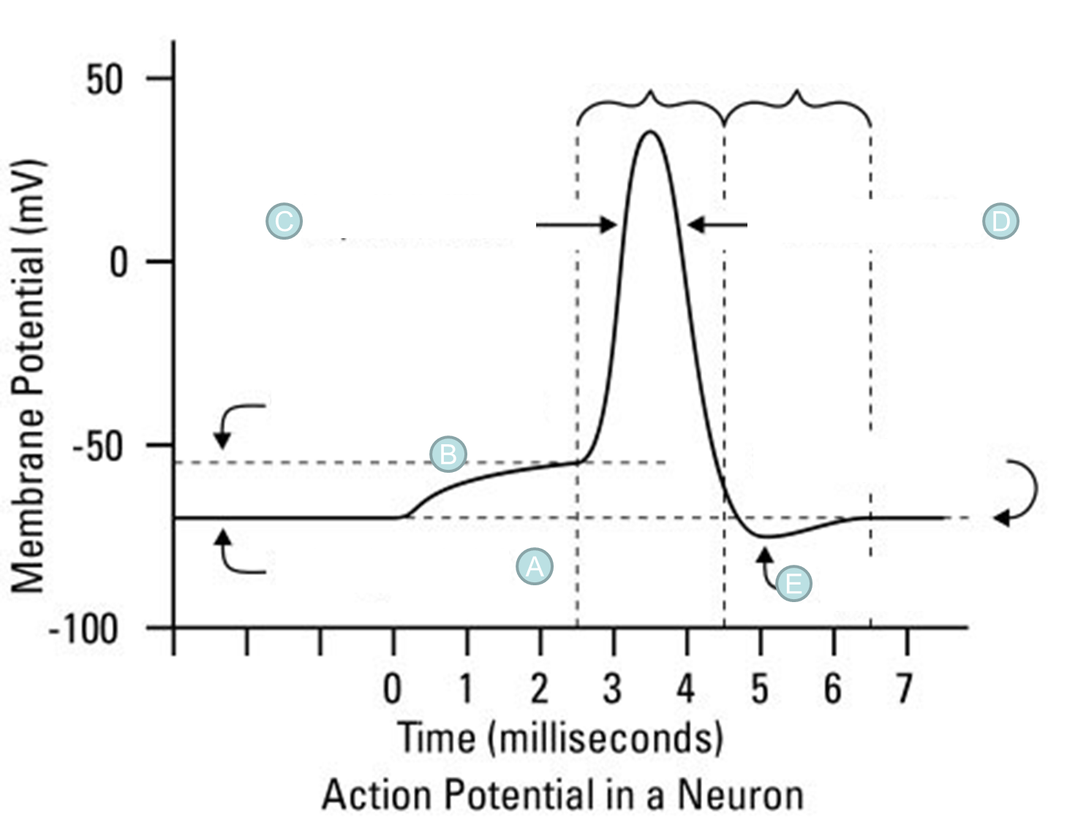
Annotate A-E with as much detail as you can to explain how an action potential occurs through the axon

Slide 33
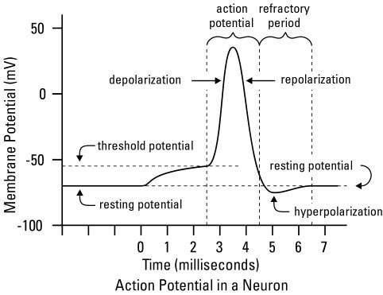
C
D
B
A
E

Slide 34
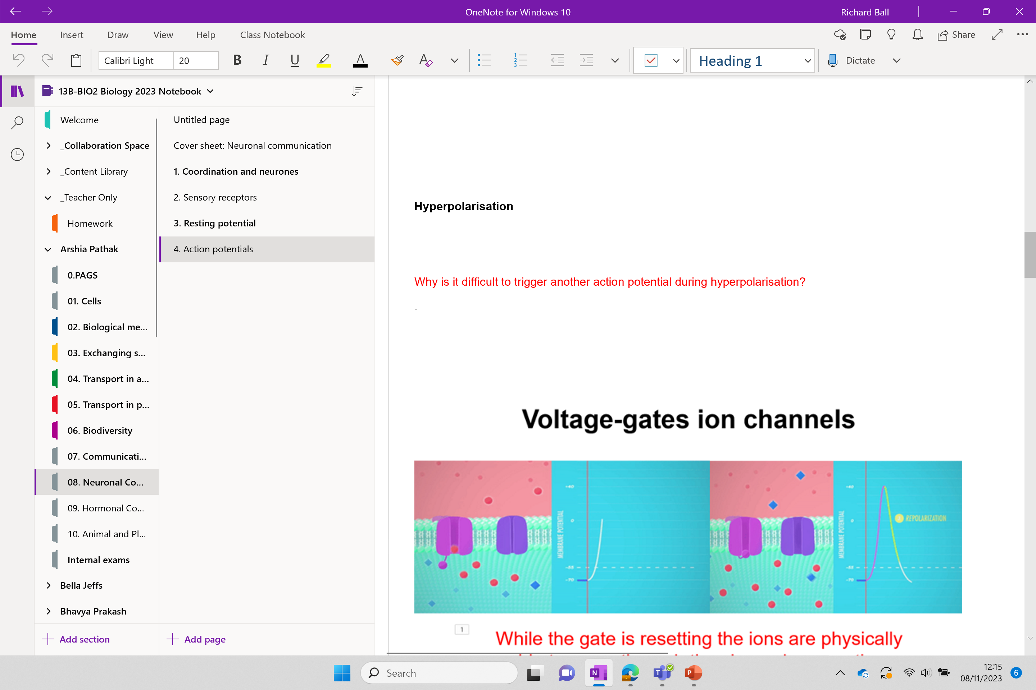

Slide 35
Threshold
Notes:
When a maximum potential difference of around 40+mV is reached the Na+ voltage-gated ion channels close – they actually open at one end quickly (allowing diffusion in) but are slowly closing at the other end simultaneously (and are completely close when around 40+mV is reached inside the cell)

Slide 36
The additional potassium ion channels close and the neurone returns to its resting potential.
1. Resting potential
At the peak the follow happens:
Voltage-gated sodium channels close
Potassium channels open
Allowing positive charges to leave the cell, and shift the membrane potential back towards the resting potential.
More K+ ion channels open (more than at resting potential) causing a hyperpolarisation (difficult to trigger impulse here)
2. Threshold
3. Rising phase
Additional voltage-gated sodium channels open. Na+ ions rushing into the cell, reversing the voltage and reaching its most positive value.
4. Falling phase
No impulse being transmitted. Some K⁺ ion gates open. Na+ voltage-gated ion channels are closed.
5. Repolarised (resting potential/recovery)
Depolarising stimulus arrives, opening a few sodium ion channels, which enter the neurone. The neurone gets closer to the threshold at which an action potential is generated.

Slide 37
The additional potassium ion channels close and the neurone returns to its resting potential.
1. Resting potential
At the peak the follow happens:
Voltage-gated sodium channels close
Potassium channels open
Allowing positive charges to leave the cell, and shift the membrane potential back towards the resting potential.
More K+ ion channels open (more than at resting potential) causing a hyperpolarisation (difficult to trigger impulse here)
2. Threshold
3. Rising phase
Additional voltage-gated sodium channels open. Na+ ions rushing into the cell, reversing the voltage and reaching its most positive value.
4. Falling phase
No impulse being transmitted. Some K⁺ ion gates open. Na+ voltage-gated ion channels are closed.
5. Repolarised (resting potential/recovery)
Depolarising stimulus arrives, opening a few sodium ion channels, which enter the neurone. The neurone gets closer to the threshold at which an action potential is generated.

Slide 38
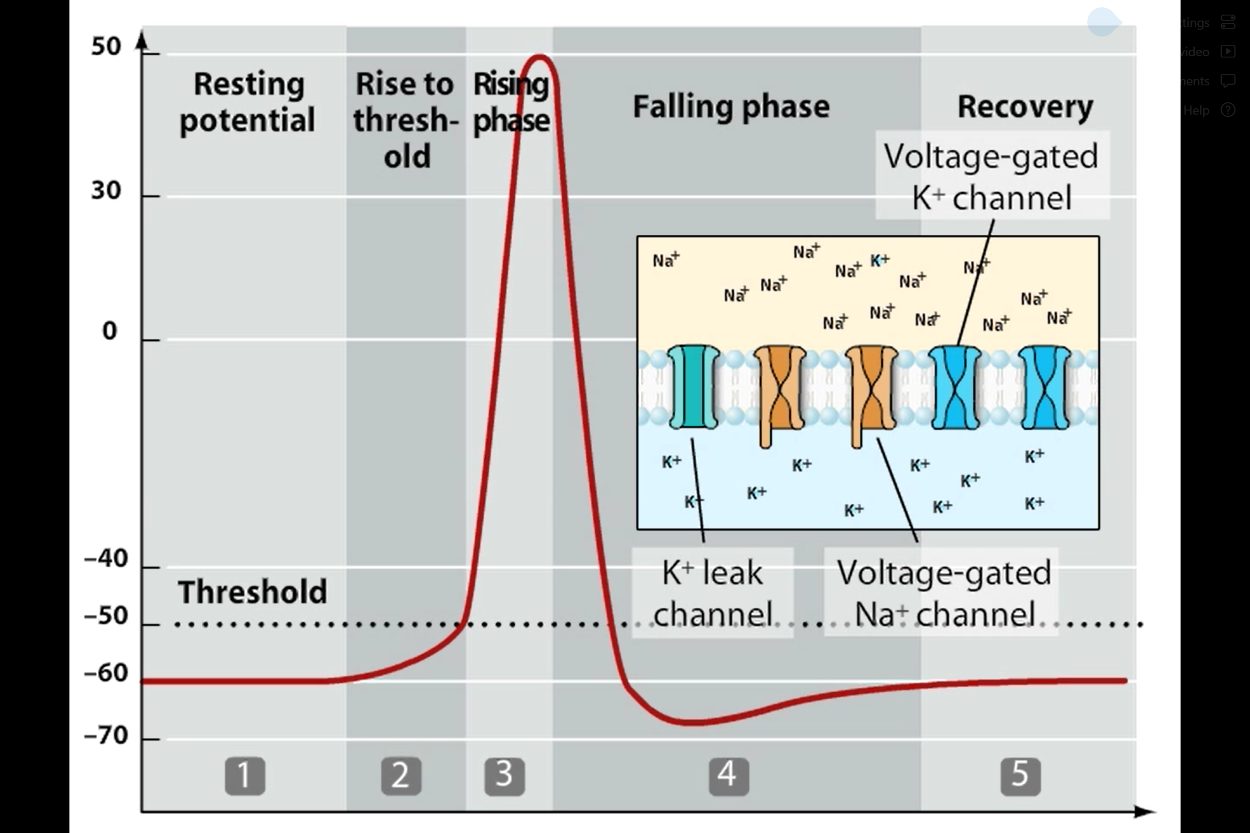
1. Resting potential - No impulse being transmitted. Some K⁺ ion gates open. Na+ voltage-gated ion channels are closed.
2. Threshold – Depolarising stimulus arrives, opening a few sodium ion channels, which enter the neurone. The neurone gets closer to the threshold at which an action potential is generated.
3. Rising phase – Additional voltage-gated sodium channels open. Na+ ions rushing into the cell, reversing the voltage and reaching its most positive value.
4. Falling phase – At the peak the follow happens:
Voltage-gated sodium channels close
Potassium channels open
Allowing positive charges to leave the cell, and shift the membrane potential back towards the resting potential.
More K+ ion channels open (more than at resting potential) causing a hyperpolarisation.
5. Repolarised (resting potential/recovery). The additional potassium ion channels close and the neurone returns to its resting potential.
Notes:
2. EG pressure open the stretch mediated sodium ion channels

Slide 39
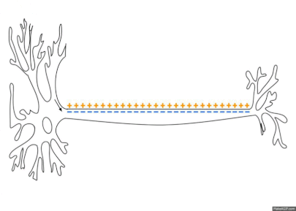
Notes:
Na+ ions attracted towards the negative charge further down the axon opening the sodium voltage-gated channels further down

Slide 40
Hyperpolarisation
Why is it difficult to trigger another action potential during hyperpolarisation?
C
D
B
A
E

Slide 41
Voltage-gates ion channels
While the Na+ voltage ion gate is resetting (closing) the ions are physically unable to move through the channel, preventing another action potential being triggered.

Slide 42
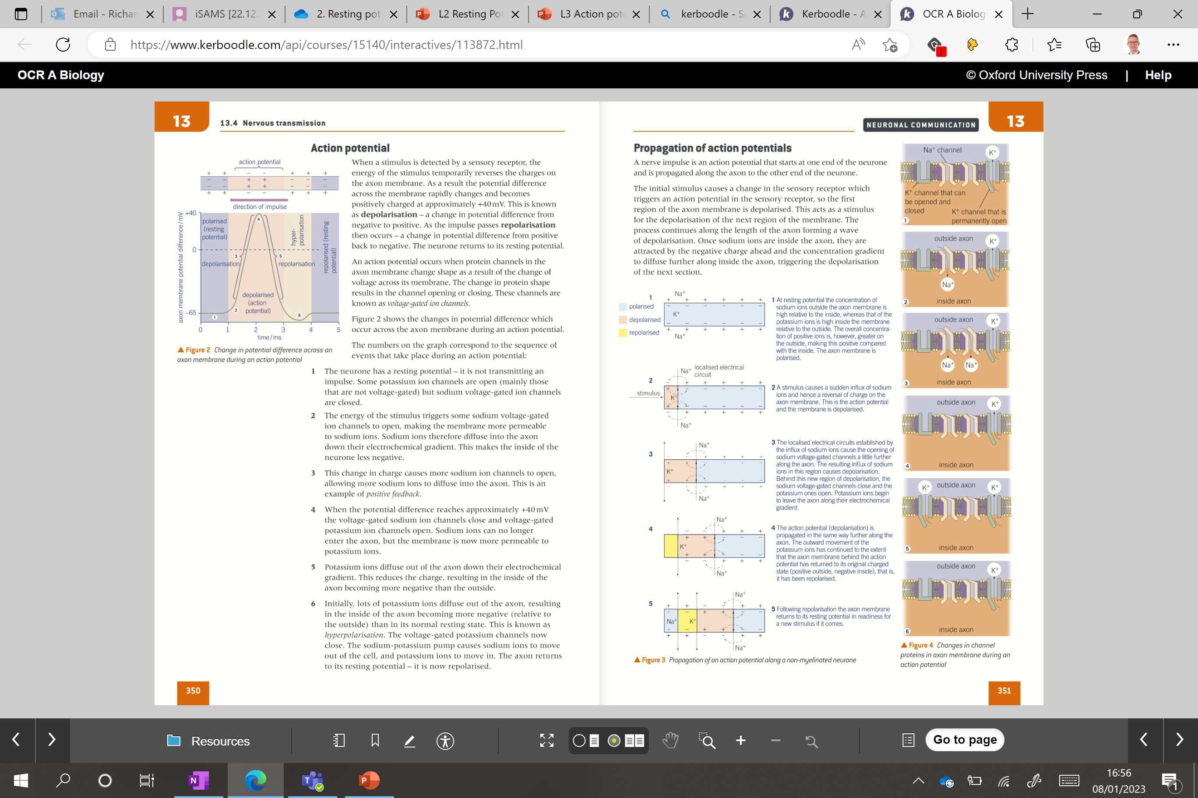
The Refractory Period
The region of the axon that depolarised as the action potential passed along now undergoes repolarisation to return to its resting potential.
After the action potential there is a short period of time when the axon cannot be excited again.
Sodium voltage-gated channels remain closed (prevent Na+ movement).
This is known as the refractory period.
This is important because it prevents the propagation of an action potential going backwards along the axon, keeping it unidirectional.

Slide 43
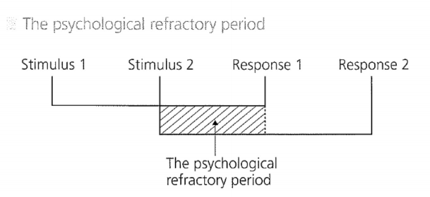
Not on spec

Slide 44
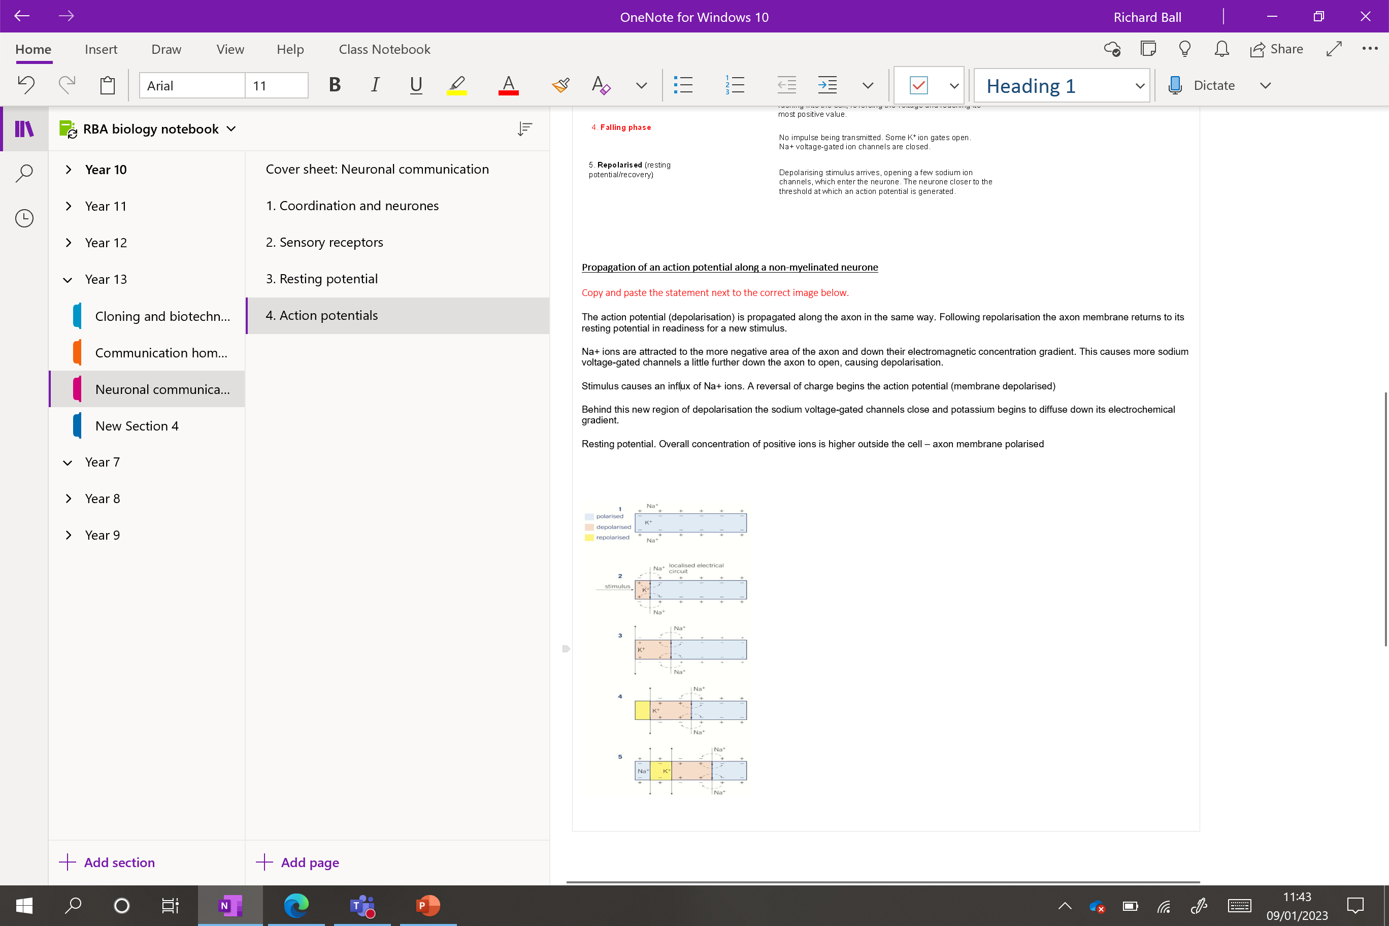

Slide 45
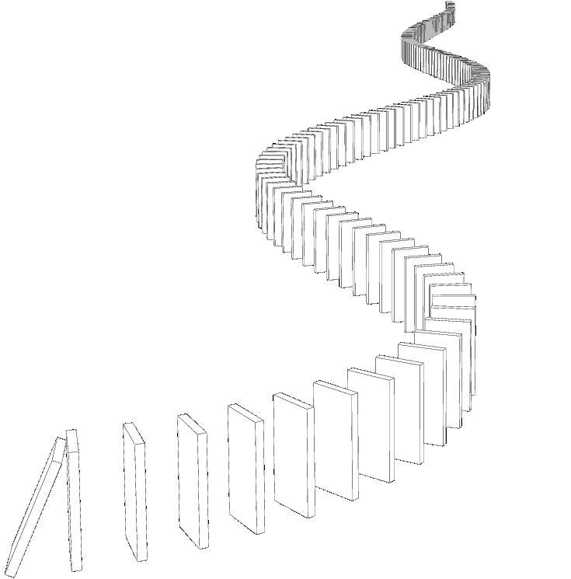

Slide 46
Resting potential. Overall concentration of positive ions is higher outside the cell – axon membrane polarised
Stimulus causes an influx of Na+ ions. A reversal of charge begins the action potential (membrane depolarised)
Na+ ions are attracted to the more negative area of the axon and down their electromagnetic concentration gradient. This causes more sodium voltage-gated channels a little further down the axon to open, causing depolarisation.
Behind this new region of depolarisation, the sodium voltage-gated channels close and potassium begins to diffuse down its electrochemical gradient.
The action potential (depolarisation) is propagated along the axon in the same way. Following repolarisation, the axon membrane returns to its resting potential in readiness for a new stimulus.
Notes:
Why does the presence of Na+ cause more Na voltage-gated channels to open?

Slide 47
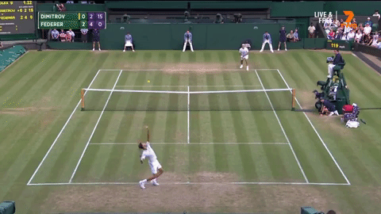
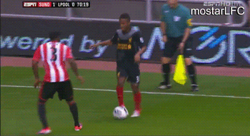

Slide 48
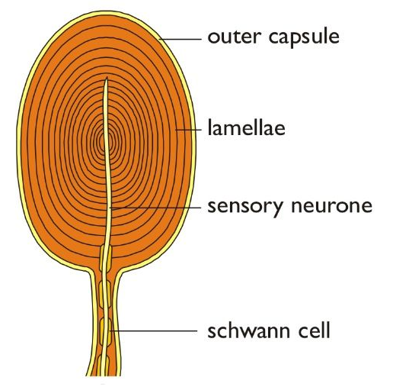
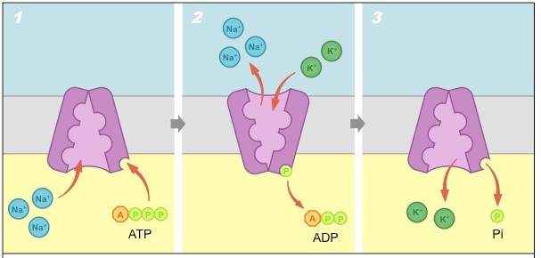
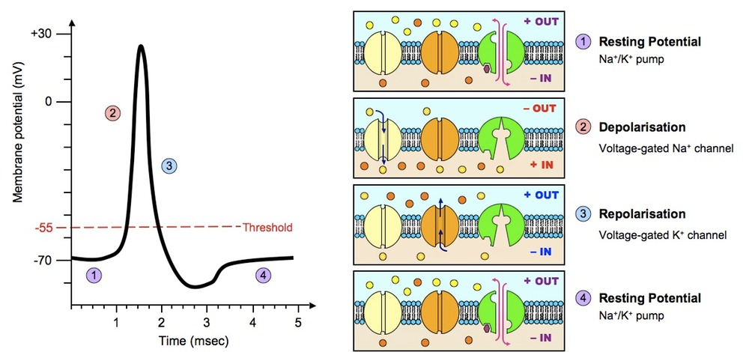

Slide 49

What is this?
Notes:
Myelin is non-conductive

Slide 50
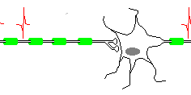
Saltatory conduction
Depolarisation of the axon only occurs at the nodes of Ranvier (no myelin present).
Here Na⁺ ions can pass through the protein channel.
Notes:
Myelinated axons transfer electrical impulses faster than non-myelinated axons.
Depolarisation of the axon only occurs at the nodes of Ranvier (no myelin present).
Here Na⁺ ions can pass through the protein channel.
The creates longer localised circuits between adjacent nodes.
The action potential then jumps from one node to another in a process called saltatory conduction.
This is much faster than a wave of depolarisation along the whole length of the axon membrane.
Opening and closing channels takes time. So, reducing the number of times this happens speeds up the action potential transmission.
Long term – this process is also more energy efficient. Repolarisation requires ATP in the sodium pump. Reducing this requirement using saltatory conduction makes the conduction of an impulse more efficient.

Slide 51
Propagation of an action potential along a myelinated neurone

Slide 52
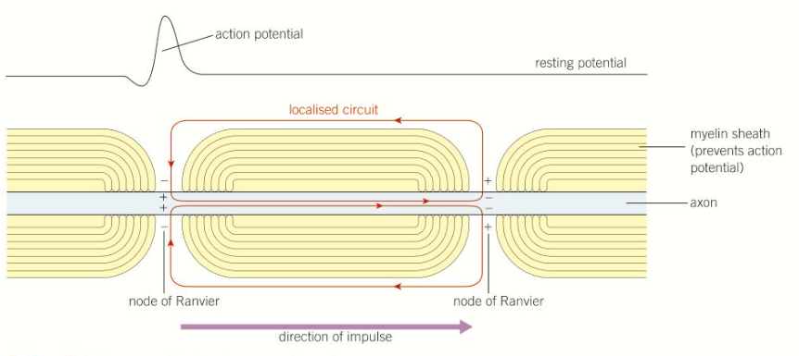

Slide 53
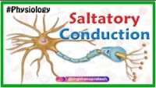

Slide 54
Complete the missing gaps and then copy and paste into the correct order below
Here Na⁺ ions ……… pass through the protein channel.
The action potential then ………….. from one node to another in a process called ………….. conduction.
Long term – this process is also more energy efficient. Repolarisation requires ……. in the ………… pump. Reducing this requirement using saltatory conduction makes the conduction of an impulse ………. efficient.
This is much ………… than a wave of depolarisation along the whole length of the axon membrane.
Myelinated axons transfer electrical impulses ……….. than non-myelinated axons.
Opening and closing channels takes time. So, ………….. the number of times this happens speeds up the ……….. potential transmission.
Depolarisation of the axon only occurs at the nodes of …………… (no myelin present).
This creates longer localised circuits between adjacent ………….

Slide 55
Saltatory conduction
Myelinated axons transfer electrical impulses faster than non-myelinated axons.
Depolarisation of the axon only occurs at the nodes of Ranvier (no myelin present).
Here Na⁺ ions can pass through the protein channel.
This creates longer localised circuits between adjacent nodes.
The action potential then jumps from one node to another in a process called saltatory conduction.
This is much faster than a wave of depolarisation along the whole length of the axon membrane.
Opening and closing channels takes time. So, reducing the number of times this happens speeds up the action potential transmission.
Long term – this process is also more energy efficient. Repolarisation requires ATP in the sodium pump. Reducing this requirement using saltatory conduction makes the conduction of an impulse more efficient.

Slide 56

Explain how an action potential is produced
Talk for 1 minute. No erms, hesitations or incorrect information

Slide 57
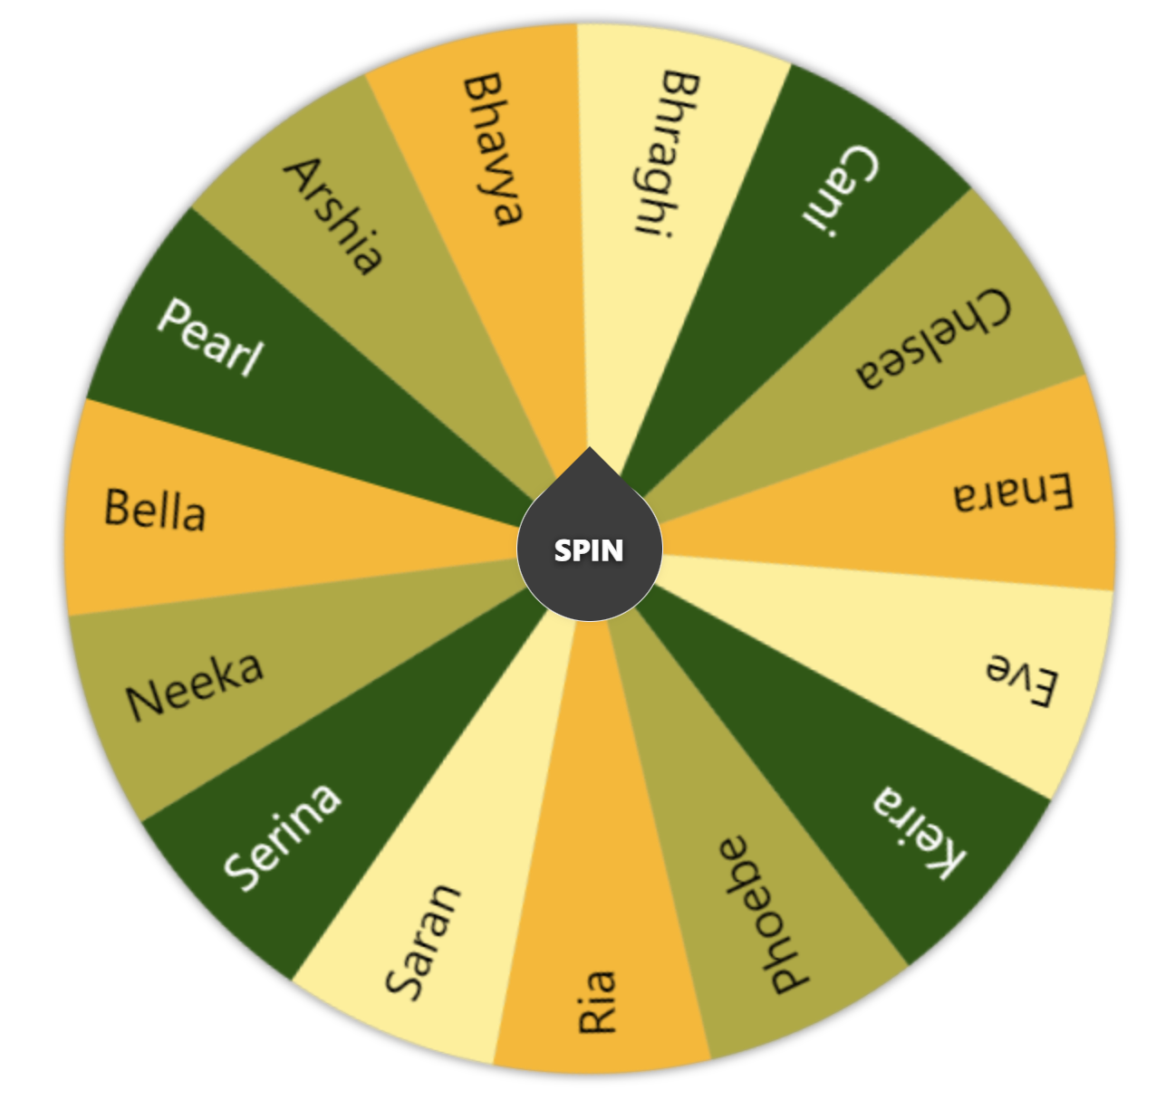

Slide 58
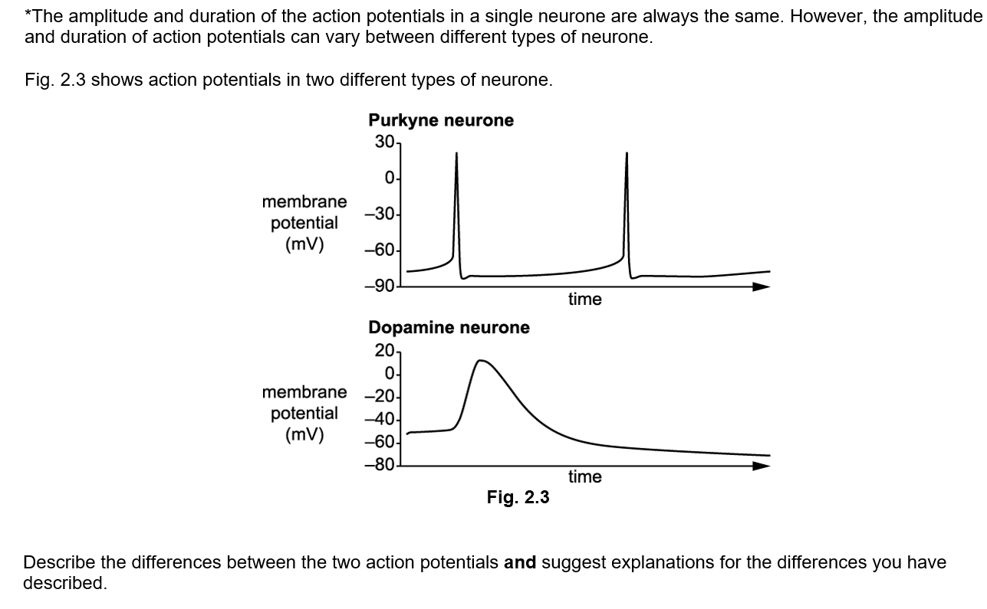
Starter task – complete question on paper
(4 marks)

Slide 59
Descriptions
Dopamine neurone:
has a less negative resting potential / is less polarised /
Depolarisation shows less change
Action potential peak is lower/less positive
No clear refractory period
Action potential duration is longer
Repolarisation is slower
Explanations
Resting potential set up by:
Different type/number of sodium/potassium pumps in neuron membrane
Different type/number of potassium ion channels
Steeper sodium ion gradient in the Purkyne neurone
Different type/more voltage-gated sodium and potassium ion channels in the Purkyne neurone
(4 marks)

Slide 60
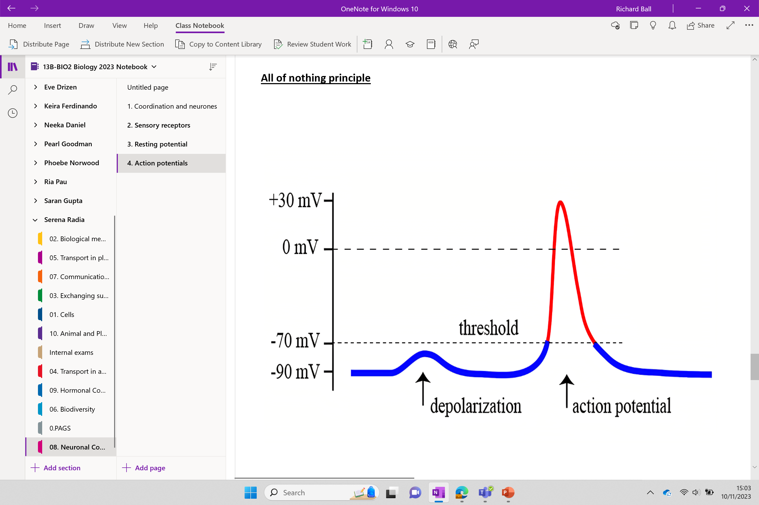

Slide 61
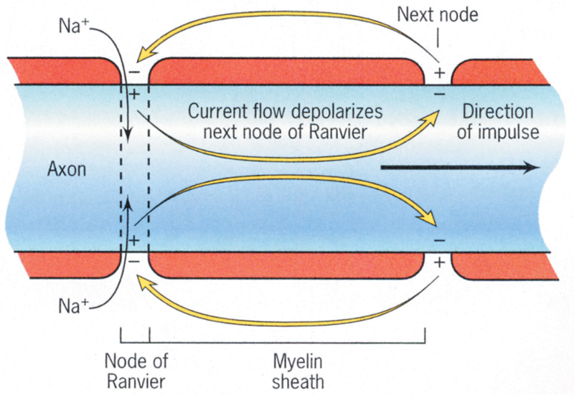
R
E
C
A
P
Notes:
Membrane unable to depolarise – but ions can still move along the axon inside – until the next node of Ranvier triggering Na+ voltage ions channels to open

Slide 62
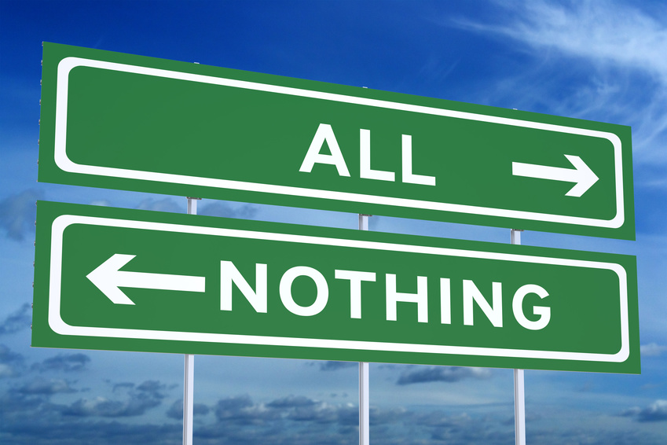

Slide 63
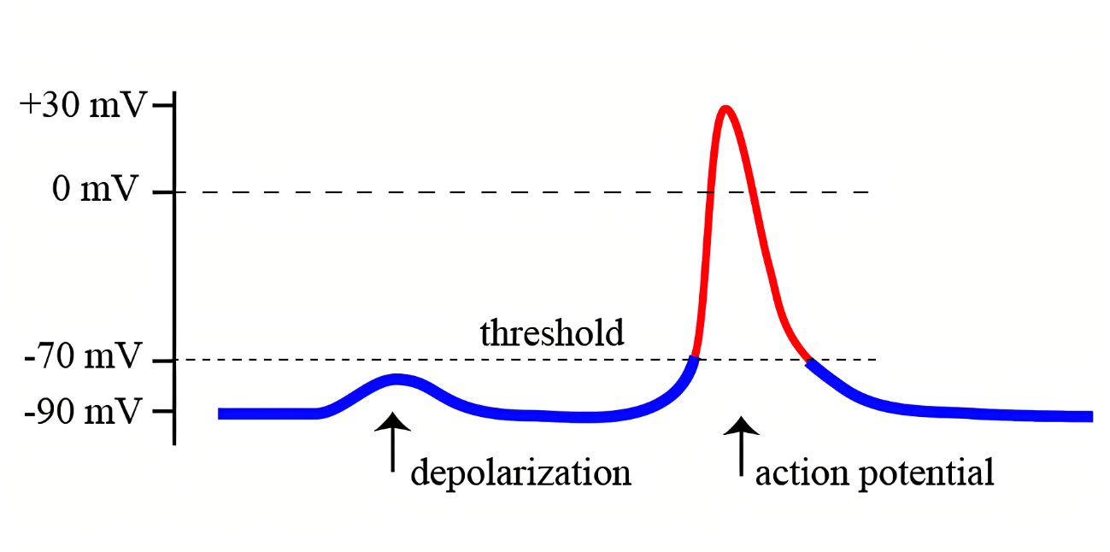
All-or-nothing principle
A certain level of stimulus (threshold value) will always triggers an action potential. (All)
Failure to reach the threshold will result in no action potential triggered. (Nothing)
No matter how large the stimulus, the same sized action potential will always be triggered.
However…..

Slide 64
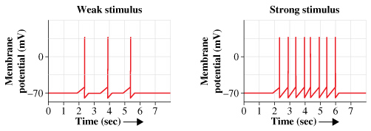
The size of the stimulus does affect the number of action potentials that are generated in a given time.
The larger the stimulus the more frequently the action potentials are generated.

Slide 65
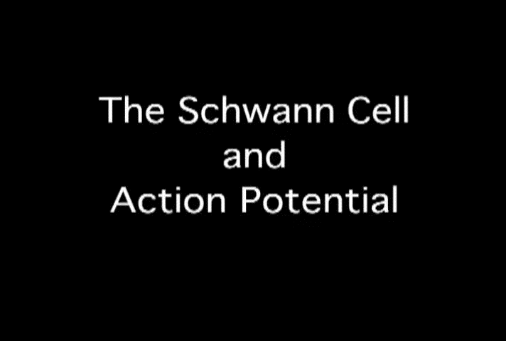

Slide 66
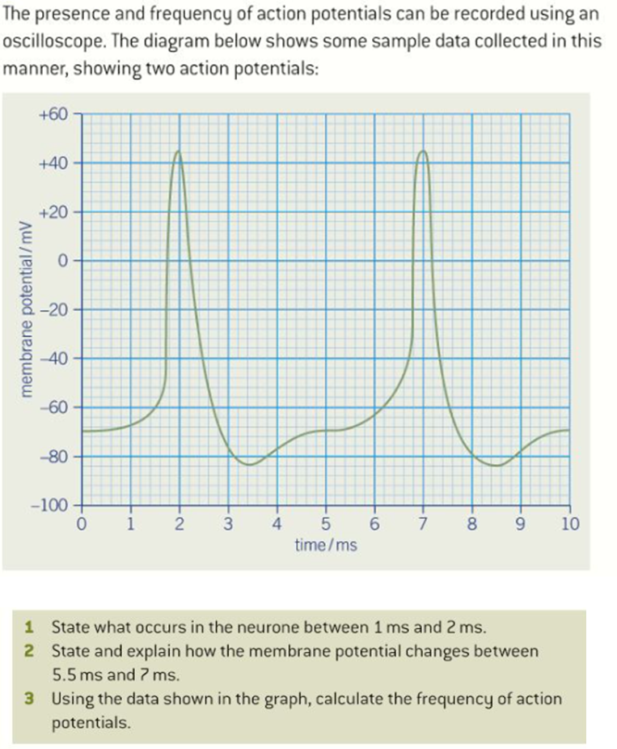
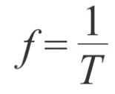
1. Depolarisation/potential across membrane goes from negative to positive (1)
2. Any 4 from:
At 5.5 ms, the inside of the membrane is negatively charged (–70 mV) with respect to the outside of the membrane (1)
because there is a higher concentration of Na+/sodium ions outside the membrane (1)
stimulus causes (voltage-gated) sodium ion channels to open (1)
Na+ ions diffuse into the neurone (1)
down electrochemical gradient (1)
this increases the potential of the inside of the membrane / makes the inside of the membrane more positive to +44 mV.
(1)
3. Time between action potentials = 5 ms (1)
Frequency = 1 ÷ time = 1 ÷ 0.005 (1)
Frequency = 200 action potentials per second / 200 Hz (1)
(1)
(4)
(3)

Slide 67
Taboo.

Slide 68
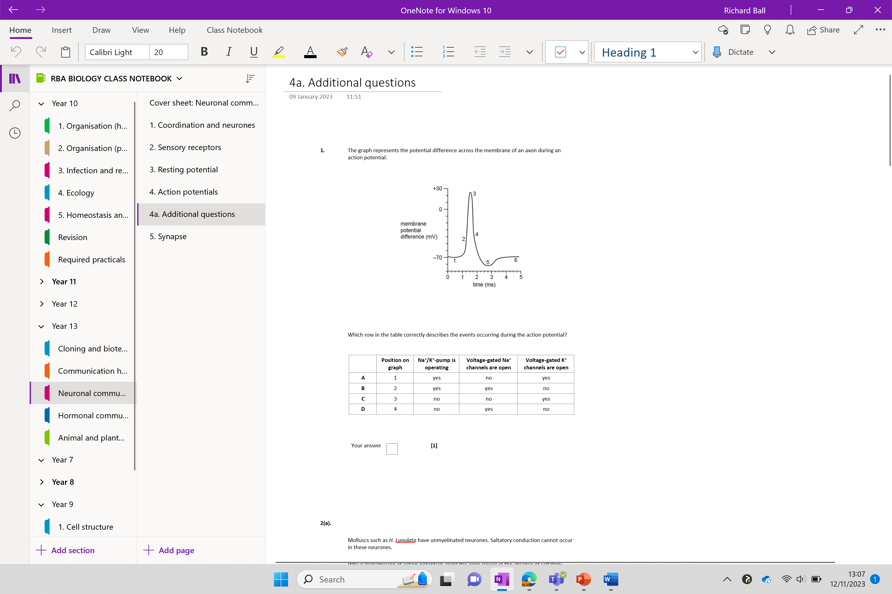
Additional questions
4a. Additional questions

Slide 69
Explain how an action potential is produced
Talk for 1 minute. No erms, hesitations or incorrect information

Slide 71
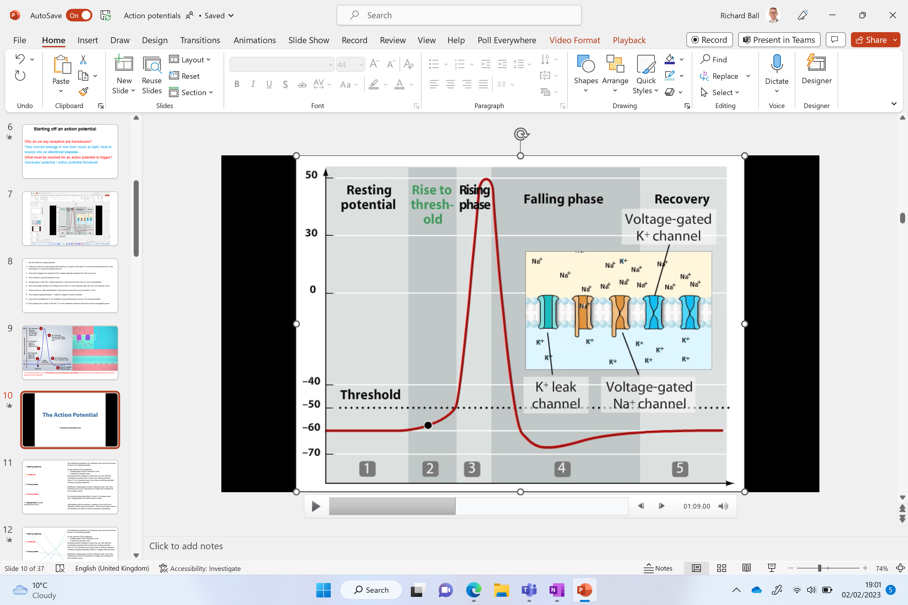
Action potential story board (no notes, include annotations and diagrams)
Create a
storyboard to show
how an action
potential is
propagated along
an unmyelinated axon

Slide 72
Recap video
Next slide or additional questions available

Slide 73
Describe resting potential and explain how it is maintained (6 marks)
-70mV
No signal transmission
The cell is polarised – there is a difference in charge between the inside and the outside of the cell axon. The inside is more negative.
The inside of a nerve cell is negative compared to the outside.
The inside contains negatively charged organic ions which cannot move out of the cell
There is a high concentration of K+ ions inside the cell and a much lower concentration outside the cell
There is a low concentration of Na⁺ inside the cell and a high concentration outside the cell
K⁺ ions diffuse out of the neurone along their concentration gradient. This leaves the inside of the cell more negative compared to the outside.
The negatively charged inside then attracts the positively charged K⁺ ions back into the cell. It also attracts a very small amount of Na⁺ ions.
The gradients of Na⁺ and K⁺ ions are maintained by a sodium-potassium pump. This actively removes Na+ from the inside of the cell and transports K+ into it.

