Slide 1
Cambridge International AS Level Computer Science (9618) – Revision Notes
Ethical Issues and Intellectual Ownership
This pack is intended for students to who are taking CIE AS Level in Computer Science, either in preparation for their AS exam, or more likely alongside year 2 of the course to improve fluency, recall and pace on AS topics. It could be used as lesson starters, or supplied to students for independent use.

Slide 2



Chapter
10
Ethical Issues and Intellectual Ownership
A LEVEL COMPUTER SCIENCE

Slide 3




10.1
10.2
10.3
Ethical Principles in Computing
Professionalism in Computing
Computing for the Public Good
10.4
Intellectual Property and Copyright in Computing
Chapter
Outline
10.5
Software Licensing and Legal Considerations
10.6
Ethical Implications of Artificial Intelligence

Slide 4


10.1 Ethical Principles in Computing
Definition
Ethics can be defined as a set of moral principles that guide individuals to distinguish right from wrong and determine appropriate conduct.
What is right can be considered from one of the following viewpoints: philosophical, religious, legal or pragmatic.

Slide 5

Subtopic 1
10.2 Professionalism in Computing
Code of ethics for professionals
Irrespective of their specific field of expertise, all professionals are anticipated to behave in a morally upright manner.
A professional can seek ethical guidance by becoming a member of a suitable professional association.

Slide 6
Subtopic 1
10.2 Professionalism in Computing
Example: IEEE-CS/ACM Joint Task Force Software Engineering code of conduct
Public
Client and Employer
Management
Colleagues
Software engineers should act consistently with the public interest, ensuring that their work enhances the well-being of society.
Software engineers must act in a manner that is loyal and beneficial to their clients and employers while maintaining professional integrity.
Software engineers should manage their work reasonably and ensure that it is consistent with the law, policies, and standards in place.
Software engineers should be fair and supportive to their colleagues, promoting a collaborative and respectful work environment.
Product
Judgement
Profession
Self
Software engineers should ensure that their products and related modifications meet the highest professional standards possible.
Software engineers must maintain integrity and independence in their professional judgment, striving to produce high-quality work that reflects their expertise.
Software engineers must advance the integrity and reputation of the profession, fostering an environment that encourages the growth and sharing of knowledge and skills.
Software engineers must continually enhance their professional development and expertise, ensuring they remain competent and committed to ethical conduct.

Slide 7
Subtopic 1
10.2 Professionalism in Computing
Applying these codes of conduct: A software engineer is developing a new application for a healthcare company that stores sensitive patient data.
Public
Client and Employer
Management
Colleagues
The engineer needs to ensure that the application complies with all privacy regulations and safeguards patient data, acting in the best interest of the public.
The engineer must prioritize the interests of the healthcare company, ensuring that the application meets the company's needs while being honest and transparent about any limitations or challenges.
The engineer needs to manage the project efficiently, following all relevant laws and regulations related to healthcare data storage and ensuring that the application aligns with industry standards.
The engineer should maintain open communication and provide support to colleagues involved in the project, fostering a collaborative environment that encourages the sharing of ideas and best practices.
Product
Judgement
Profession
Self
The engineer should aim for a high-quality application that is secure, efficient, and reliable, prioritizing the integrity and functionality of the software.
The engineer should make decisions that prioritize the security and privacy of patient data, even if it requires additional resources or time.
The engineer should actively participate in relevant professional communities, staying up-to-date with best practices and contributing to the advancement of knowledge in the field of software engineering.
The engineer should seek continuous professional development, staying informed about advancements in healthcare data security and updating their skills accordingly, ensuring they remain a competent and ethical professional.

Slide 8


10.3 Computing for the Public Good
Definition
Public good/interest in product development or project initiation refers to creating solutions that serve the broader community's welfare, addressing critical needs, and adhering to ethical and legal standards for the betterment of society.

Slide 9
10.3 Computing for the Public Good
Past
In the past, there are a few examples where large sums of money were wasted because of rather simplistic errors.

Slide 10

10.3 Computing for the Public Good
Healthcare.gov
The initial launch of Healthcare.gov, the online health insurance marketplace established by the Affordable Care Act, encountered significant technical issues, leading to a loss of public funds. The cost of the website's development and subsequent repairs amounted to hundreds of millions of taxpayer dollars. The incident highlighted the importance of meticulous planning and testing in the implementation of large-scale public projects.

Slide 11

10.3 Computing for the Public Good
Defense Integrated Military Human Resources System (DIMHRS):
The implementation of DIMHRS, an ambitious project by the U.S. Department of Defense to integrate multiple military personnel and pay systems into a single platform, encountered numerous technical challenges and delays. The project, which was eventually terminated in 2010 after spending approximately $1 billion, resulted in the loss of substantial public funds and highlighted the complexities of integrating large-scale information systems within government agencies.

Slide 12
10.3 Computing for the Public Good
Public concern about the nature of an endeavour
Influential corporations using their leverage over smaller companies
Firms offering systems with no assurance of protection against unauthorised entry
Entities attempting to hide details of a security breach within their system
Personal information sent between individuals being retained and accessed by security agencies
Social platforms enabling the transmission of offensive or unlawful material
Internet search engines furnishing search outcomes without consideration for content accuracy.

Slide 13



10.4 Intellectual Property and Copyright in Computing
Copyright
Individual
Organisation
Copyright provides exclusive legal rights to creators over their original works, preventing others from copying, distributing, or reproducing the work without permission.
Copyright safeguards the exclusive rights of an entity over its original works, preventing unauthorized use, reproduction, or distribution by others without explicit permission.

Slide 14





10.4 Intellectual Property and Copyright in Computing
Examples of creations that can be copyrighted:
Article
YouTube videos
Computer Program
Film
Music

Slide 15


10.4 Intellectual Property and Copyright in Computing
Reasons why copyrights exist:
Protection from unauthorized use
Economic reward for creativity
Copyright safeguards the creator's rights, preventing others from using their work without permission or appropriate compensation, ensuring they retain control over its use and distribution.
Copyright ensures that creators receive due compensation for their efforts, encouraging the production of new works and fostering a creative environment by providing financial incentives for innovation and originality.

Slide 16




10.4 Intellectual Property and Copyright in Computing
Typical copyright laws:
A mandatory registration stipulating the work's creation date.
A specific timeframe during which copyright protection remains applicable.
An established protocol for handling the copyright of an individual in the event of their demise.
A standardized approach for indicating copyright, such as the utilization of the '@' symbol.

Slide 17

10.4 Intellectual Property and Copyright in Computing
Usage of copyrighted work (Example):

Slide 18


10.5 Software Licensing and Legal Considerations
Commercial Software
Commercial software refers to proprietary programs or applications that are developed, distributed, and sold for financial gain or profit. Customers pay a fee to use, not to own the program.
Eg.Top 8 paid apps
Commercial Software
Open or free licensing

Slide 19




10.5 Software Licensing and Legal Considerations
Different payment options for a commercial software
One-time purchase: A single payment for perpetual access to the software.
Subscription-based: Regular monthly or yearly payments for ongoing access and updates.
Educational pricing: Discounted rates for students, educators, or educational institutions.
Per-user licensing: Fees based on the number of users or devices utilizing the software.
Commercial Software
Open or free licensing

Slide 20


10.5 Software Licensing and Legal Considerations
Shareware and freeware
Shareware
Freeware
Software distributed on a trial basis, often allowing limited use before requiring payment for continued usage or advanced features.
Freeware is software that is distributed free of charge, allowing users to use, copy, and distribute it without any time limit.
Whichever license is obtained, the source code of the program will not be provided.
Commercial Software
Open or free licensing

Slide 21
10.5 Software Licensing and Legal Considerations
Conditions when we need to use a commercial software:
Trial period assessment: Shareware allows users to evaluate the software's capabilities before committing to a purchase, enabling informed decisions about its suitability for specific business needs.
Cost-effective solutions: Freeware provides useful tools and applications at no cost, making it an attractive option for individuals or organizations with limited budgets.
Functionality: The software is available for immediate use and provides the functionality required.
Commercial Software
Open or free licensing

Slide 22

10.5 Software Licensing and Legal Considerations
Open source software
Open-source software refers to computer software with its source code made available and licensed, typically under a license allowing users to study, change, and distribute the software to anyone and for any purpose.
Commercial Software
Open or free licensing

Slide 23
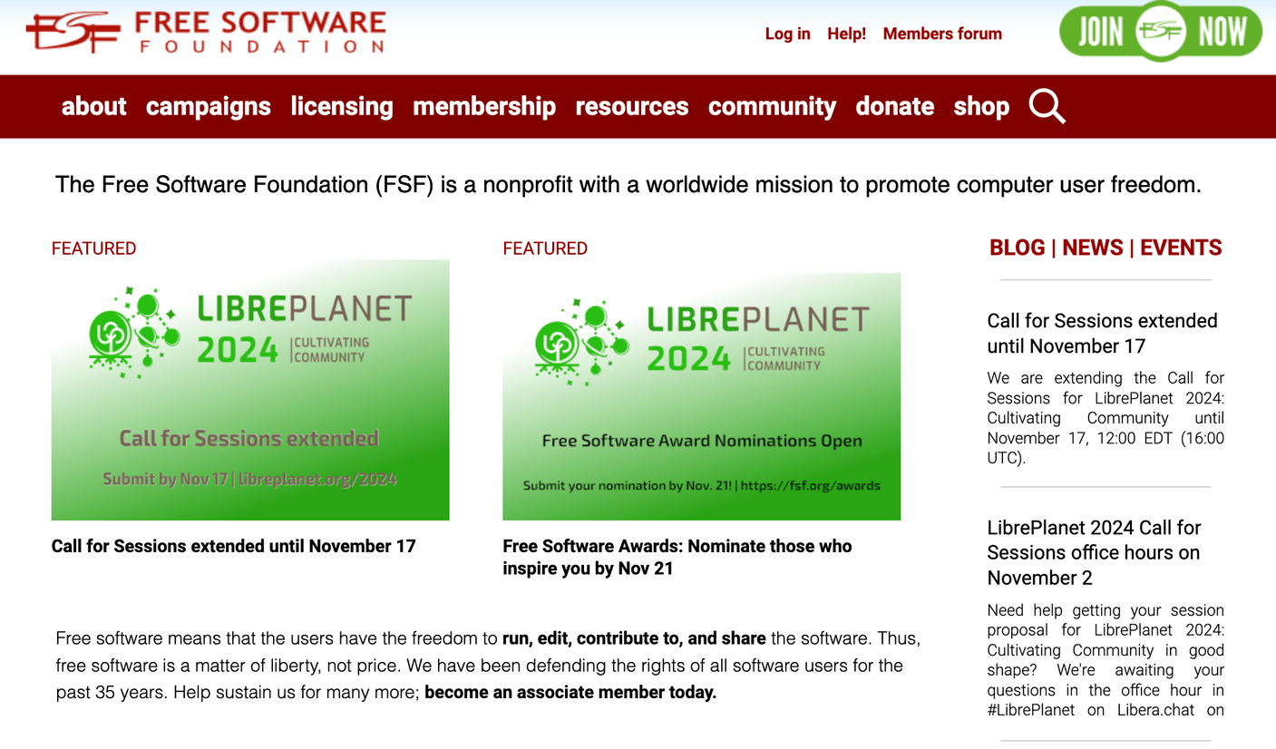

10.5 Software Licensing and Legal Considerations
Free software foundation
Commercial Software
Open or free licensing

Slide 24
10.5 Software Licensing and Legal Considerations
Copyleft
Copyleft, as defined by the Free Software Foundation, is a concept that permits users to modify and distribute software, as long as they guarantee the same freedoms to others. This principle ensures that the software remains open and freely accessible to all.
Commercial Software
Open or free licensing

Slide 25
10.5 Software Licensing and Legal Considerations
Conditions to use a open source software:
Cost-effective solutions: Open-source software provides cost-effective alternatives for individuals and organizations with limited budgets, minimizing the need for expensive proprietary software.
Customization and flexibility: Industries with specific technical requirements can benefit from open-source software, allowing for customization and tailored solutions that might not be available with commercial software
Community support and collaboration: Open-source software often comes with a supportive community of developers and users, providing a collaborative environment for troubleshooting, improvement, and shared development.
Commercial Software
Open or free licensing

Slide 26
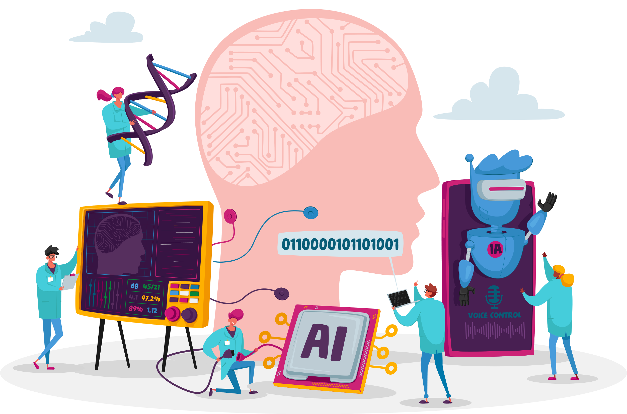
10.6 Ethical Implications of Artificial Intelligence
Subtopic 1
Artificial Intelligence
General AI, also known as artificial general intelligence, refers to AI systems or machines with human-like cognitive abilities capable of performing various tasks across multiple domains, exhibiting intelligence and understanding akin to human reasoning.

Slide 27



10.6 Ethical Implications of Artificial Intelligence
Subtopic 1
Problem Solving
The cognitive process of identifying and resolving issues or obstacles to achieve a specific goal. For example:
Using algorithms to find the most efficient route for a delivery service.
Using statistical models to identify patterns in healthcare data and optimize patient treatment plans.
Problem Solving
Linguistics
Perception
Reasoning
Learning

Slide 28
10.6 Ethical Implications of Artificial Intelligence
Subtopic 1
Linguistics
Voice identification and vocal replication methods have already been created and are currently being utilized. For example:
Problem Solving
Linguistics
Perception
Reasoning
Learning

Slide 29

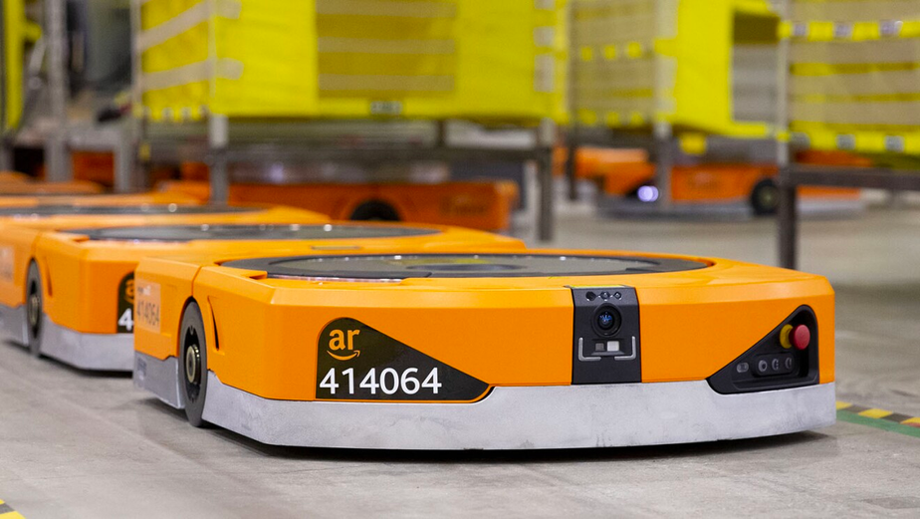
10.6 Ethical Implications of Artificial Intelligence
Subtopic 1
Perception
The cognitive ability to interpret and understand sensory information from the environment.
For example:
Amazon's robot AI uses advanced sensors and machine learning to efficiently navigate warehouses and assist in packaging and transporting products.
Tesla Self Driving Car.
Problem Solving
Linguistics
Perception
Reasoning
Learning

Slide 30

10.6 Ethical Implications of Artificial Intelligence
Subtopic 1
Reasoning
Draw conclusions based on data patterns to make informed predictions.
Analyzing historical data to predict market trends and make informed investment decisions in financial trading.
Problem Solving
Linguistics
Perception
Reasoning
Learning

Slide 31


10.6 Ethical Implications of Artificial Intelligence
Subtopic 1
Learning
The acquisition of knowledge or skills through study, experience, or being taught, aka machine learning.
Machine learning algorithms analyze various features of the email content and user behavior to discern patterns indicative of spam, subsequently filtering out unwanted messages.
Machine learning models utilize past user behavior and preferences to suggest relevant products, analyzing purchase history and browsing patterns to tailor personalized recommendations.
Problem Solving
Linguistics
Perception
Reasoning
Learning

Slide 32

10.6 Ethical Implications of Artificial Intelligence
Subtopic 1
Potential negative impacts of AI
Insufficient data protection by companies can lead to potential misuse, breaches, and unauthorized access, compromising individuals' privacy and security.
AI advancements may contribute to unemployment as automation and intelligent systems gradually replace certain human tasks, leading to workforce displacement and job insecurity.
Potential AI errors or system failures can result in car accidents as autonomous vehicles rely on machine learning algorithms and sensors to navigate road conditions, posing risks in complex and unpredictable driving scenarios.
Robot manufacturing and disposal can have a significant environmental impact, contributing to electronic waste, resource depletion, and energy consumption during production and disposal processes.
AI's increasing capabilities may eventually replace certain expert roles such as doctors, potentially altering the dynamics of healthcare services and human interaction, raising ethical concerns and questions about the quality of care.

