Slide 1
Cambridge International
AS Level Computer Science
(9618) – Revision Notes
Security, Privacy, and Data Integrity
This pack is intended for students to who are taking CIE AS Level in Computer Science, either in preparation for their AS exam, or more likely alongside year 2 of the course to improve fluency, recall and pace on AS topics. It could be used as lesson starters, or supplied to students for independent use.

Slide 2



Chapter
9
Security, privacy and data integrity
A LEVEL COMPUTER SCIENCE

Slide 3




9.1
9.2
Understanding Data Integrity, Privacy, and Security
Vulnerabilities in Computer Systems and Data Storage
9.3
Safeguarding Computer Systems: Security Measures
Chapter
Outline
9.4
Data Protection Techniques and Security Measures
9.5
Data validation and verification

Slide 4

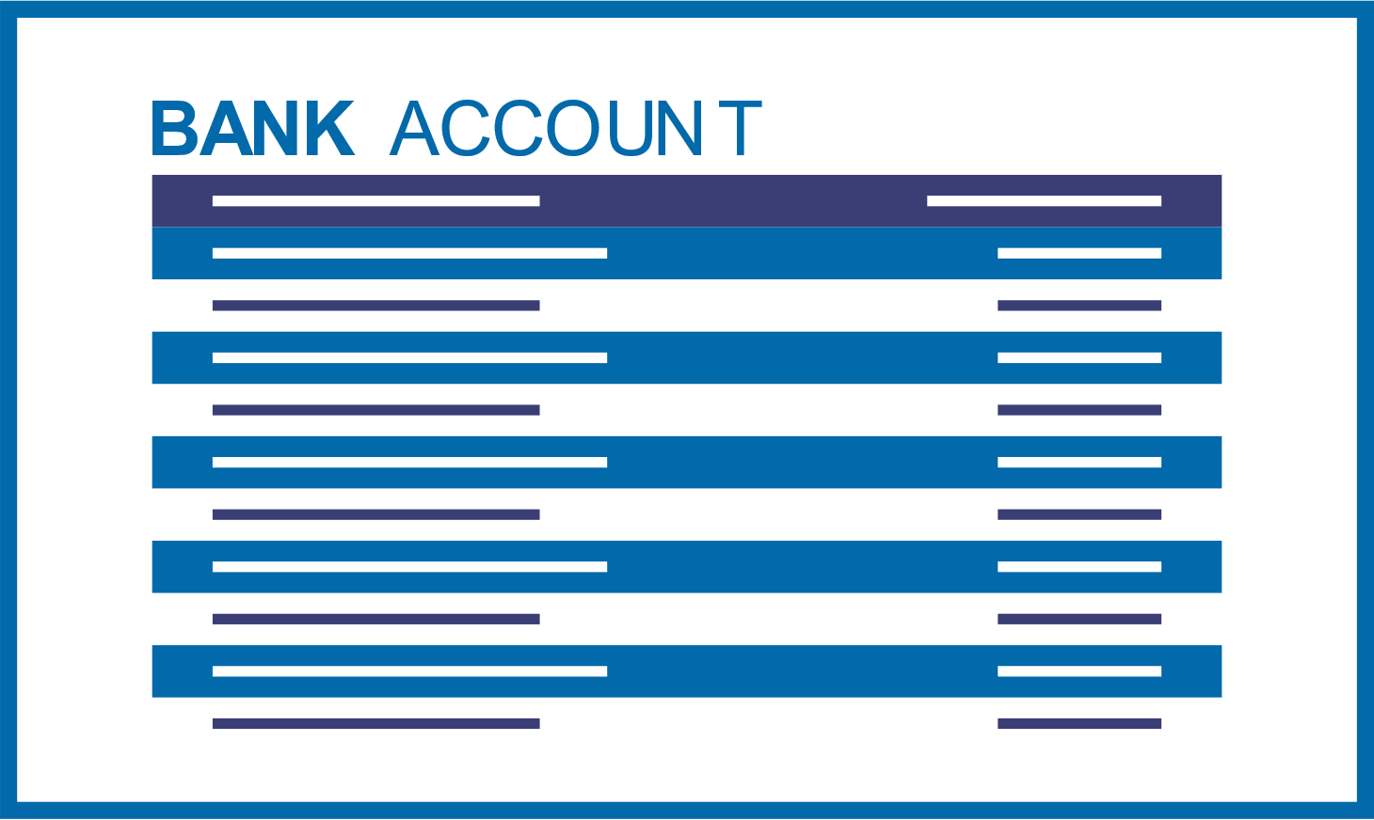

9.1 Understanding Data Integrity, Privacy, and Security
Data Integrity
Data integrity refers to the accuracy, consistency, and reliability of data throughout its lifecycle, ensuring that data remains unaltered and reliable from creation to deletion.
Eg.
Data Integrity
Data Privacy
Data Security

Slide 5

9.1 Understanding Data Integrity, Privacy, and Security
Data Privacy
Data privacy refers to the protection of sensitive or personal information from unauthorized access, use, or disclosure, ensuring that individuals have control over how their data is collected, stored, and shared by organizations or entities.
Eg.
Data Integrity
Data Privacy
Data Security

Slide 6

9.1 Understanding Data Integrity, Privacy, and Security
Data Protection Law
Data protection laws are legal regulations that govern how organizations collect, process, store, and share individuals' personal data, ensuring individuals' privacy and data security.
Purpose
Ensure that organisations only use data for purposes understood and agreed by the individual.
It requires organisations to guarantee the confidentiality and the consistency of this data.
It serves as a deterrent
Data Integrity
Data Privacy
Data Security

Slide 7

9.1 Understanding Data Integrity, Privacy, and Security
Data Security
Data security refers to the protection of digital data from unauthorized access, corruption, or theft throughout its lifecycle.
System security guarantees that the system remains capable of performing the required tasks for users, with access limited to authorized personnel only.
However, ensuring data security does not itself guarantee either data integrity or data privacy.
Data Integrity
Data Privacy
Data Security

Slide 8
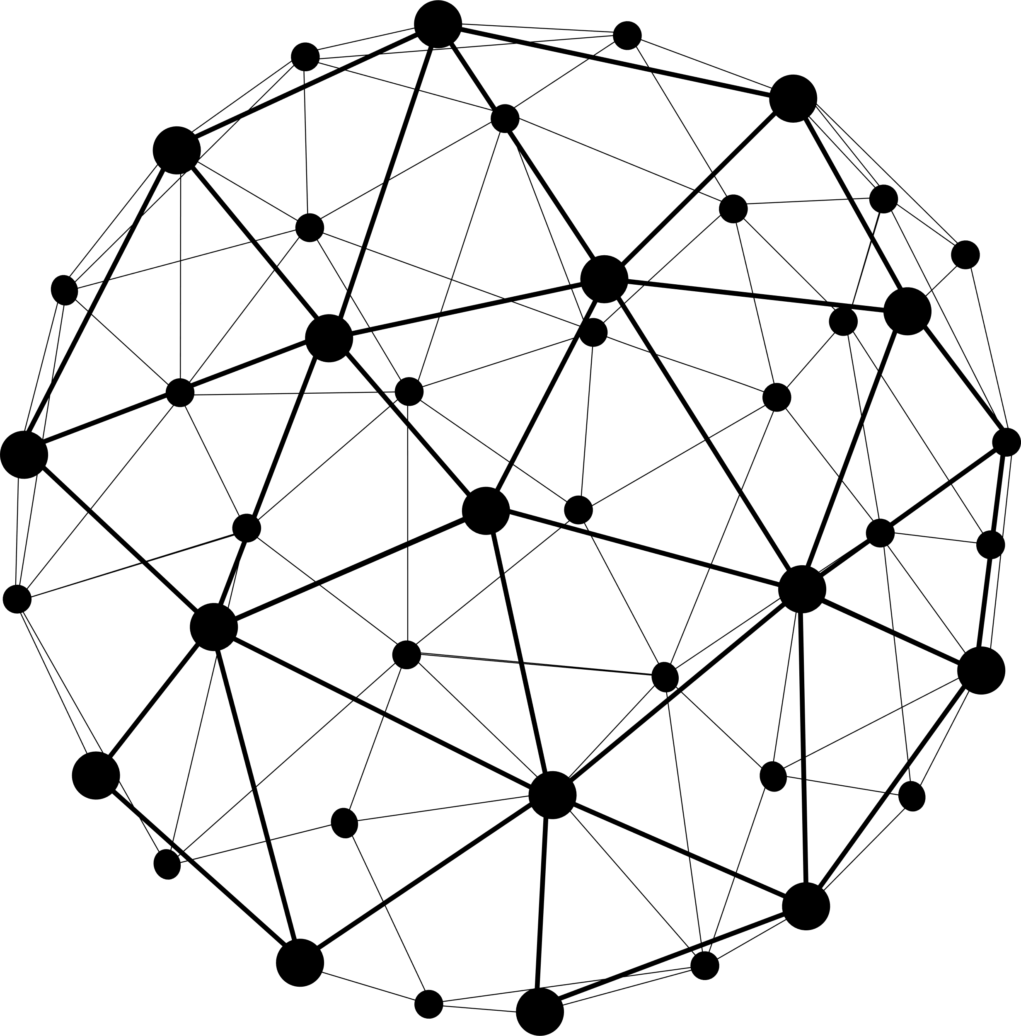




9.2 Vulnerabilities in Computer Systems and Data Storage
Subtopic 1
Source of Threat: Networks and The Internet
All the devices are connected to networks.
One troubling aspect involves the hacker, an individual determined to obtain unauthorized entry into a computer system, often with the goal of accessing sensitive data, deleting files, or disrupting the system's operations.
Networks and the Internet
Malware
Vulnerability arising from user activity
Vulnerability arising from the system itself

Slide 9

9.2 Vulnerabilities in Computer Systems and Data Storage
Subtopic 1
Source of Threat: Malware
Malware refers to malicious software designed to disrupt, damage, or gain unauthorized access to a computer system or network.
Networks and the Internet
Malware
Vulnerability arising from user activity
Vulnerability arising from the system itself

Slide 10





9.2 Vulnerabilities in Computer Systems and Data Storage
Subtopic 1
Virus
Worm
Logic Bomb
Trojan Horse
Spyware
Self-replicating malicious code damaging computer programs and files.
Self-replicating malware spreading through networks, exploiting vulnerabilities.
Malicious code triggering on specific conditions causing damage.
Malware disguised as legitimate software, allowing unauthorized access.
Software gathering information without user consent, often for advertising.
Bot
Phishing
Pharming
Keylogger
Automated software performing repetitive tasks, often for malicious purposes.
Fraudulent attempts to obtain sensitive information through deceptive communication (email).
Redirecting users to fake websites to steal sensitive information.
Software recording keystrokes, capturing sensitive data, and passwords.
Networks and the Internet
Malware
Vulnerability arising from user activity
Vulnerability arising from the system itself

Slide 11
9.2 Vulnerabilities in Computer Systems and Data Storage
Subtopic 1
Vulnerability arising from user activity
Involve malware
Do not involve malware
  Clicking on suspicious email attachments or links.
  Downloading files from untrusted sources.
  Visiting unsecured or malicious websites.
  The use of weak passwords (common, related to users, short).
  When a user fails to identify a phishing or pharming attempt, consequently disclosing confidential data.
Malware
Vulnerability arising from user activity
Vulnerability arising from the system itself

Slide 12
9.2 Vulnerabilities in Computer Systems and Data Storage
Subtopic 1
Vulnerability arising from within the system itself
Operating System
Buffer Overflow
As the operating system becomes more intricate, it presents more chances for security vulnerabilities. Hence, regular updates address newly identified weaknesses.
A buffer overflow occurs when a program stores excessive data, potentially overwriting adjacent memory and leading to unexpected behavior or system crashes, which can be exploited by hackers.
Networks and the Internet
Networks and the Internet
Malware
Vulnerability arising from user activity
Vulnerability arising from the system itself

Slide 13




9.3 Safeguarding Computer Systems: Security Measures
Disaster Recovery
Disasters like floods and earthquakes necessitate continuity plans to ensure uninterrupted operations.
Disaster recovery contingency plans, based on risk assessment, include provisions for activating an alternative system, such as a readily available Hot Site.
Back up plan
Disaster Recovery
Safe System Update
User Authentication
Firewall
Digital Signature
Anti virus software
Good Practice

Slide 14

9.3 Safeguarding Computer Systems: Security Measures
Safe system update
Due to continuous operations, system updates require testing. Running original and updated systems for a peconcurrently ensures uninterrupted service.
Disaster Recovery
Safe System Update
User Authentication
Firewall
Digital Signature
Anti virus software
Good Practice

Slide 15
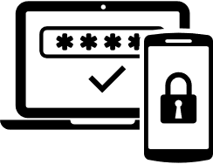





9.3 Safeguarding Computer Systems: Security Measures
User authentication
User authentication is the process of verifying the identity of a user attempting to access a system. It is essential for ensuring data security, preventing unauthorized access, and protecting sensitive information from potential breaches or misuse.
Associate a password with each account.
Applicable to both hardware and software
Authentication Methods
Biometric Authentication.
Security Token
Disaster Recovery
Safe System Update
User Authentication
Firewall
Digital Signature
Anti virus software
Good Practice

Slide 16


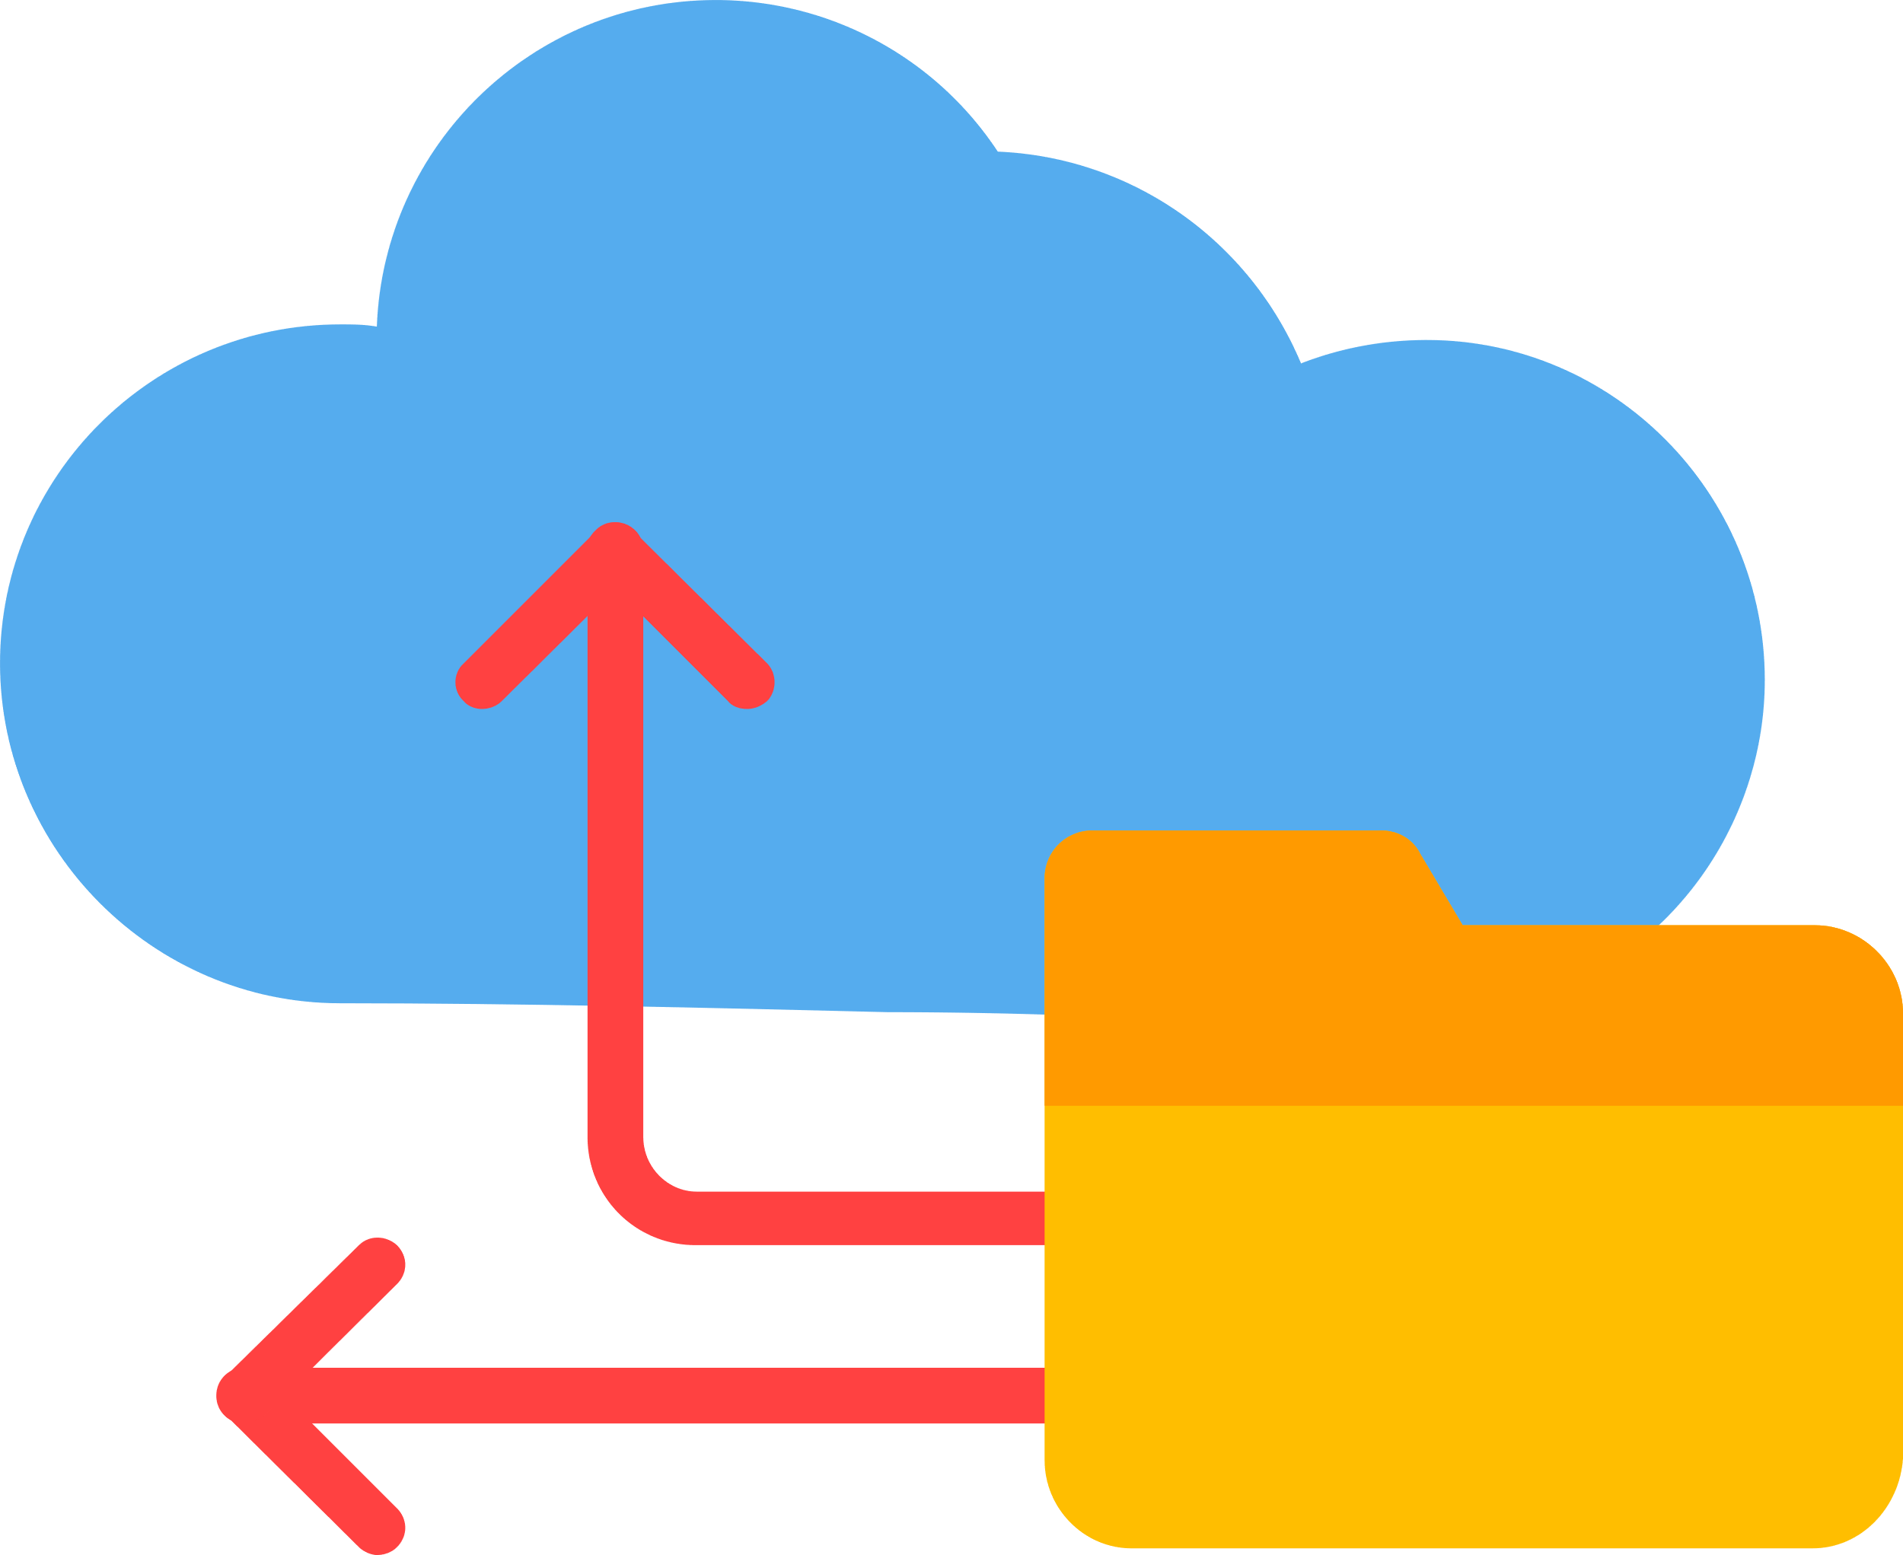
9.3 Safeguarding Computer Systems: Security Measures
Good Practice
Ensuring the computer is not left switched on unattended.
Preventing observation during computer access and avoiding written login details.
Backup data regularly and securely.
Disaster Recovery
Safe System Update
User Authentication
Firewall
Digital Signature
Anti virus software
Good Practice

Slide 17

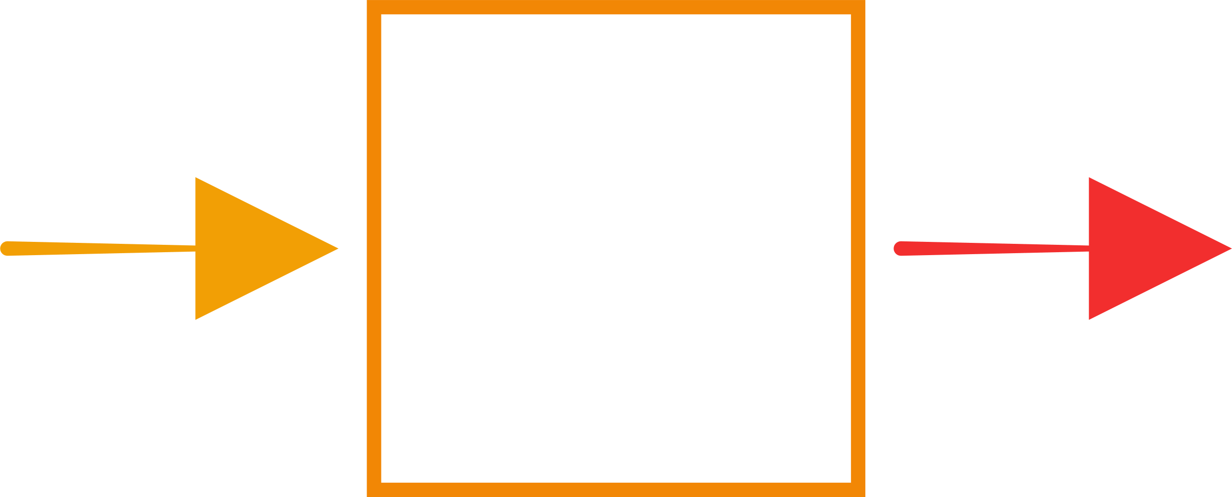

9.3 Safeguarding Computer Systems: Security Measures
Firewall
A firewall is a security system that monitors and controls incoming and outgoing network traffic, based on predetermined security rules, to protect a system or network from unauthorized access or cyber threats.
* A firewall can be a hardware or a software
Data
Disaster Recovery
Safe System Update
User Authentication
Firewall
Digital Signature
Anti virus software
Good Practice

Slide 18
9.3 Safeguarding Computer Systems: Security Measures
Digital signature
A digital signature is crucial for ensuring data integrity and authentication, safeguarding computer systems from unauthorized access and tampering.
Discuss more in chapter 21 ...
Disaster Recovery
Safe System Update
User Authentication
Firewall
Digital Signature
Anti virus software
Good Practice

Slide 19

9.3 Safeguarding Computer Systems: Security Measures
Anti Virus Software
Antivirus software is a security program that regularly scans, detects, prevents, and removes malicious software or threats from computer systems to safeguard against potential infections and data breaches.
Disaster Recovery
Safe System Update
User Authentication
Firewall
Digital Signature
Anti virus software
Good Practice

Slide 20



9.4 Data Protection Techniques and Security Measures
Possible causes of accidental loss of data
Disk get corrupted or destroyed
The system crashes
The file is erased or overwritten by mistake
The location of the file is forgotten
Recovering from data loss
Restricting access to data
Protecting data content

Slide 21
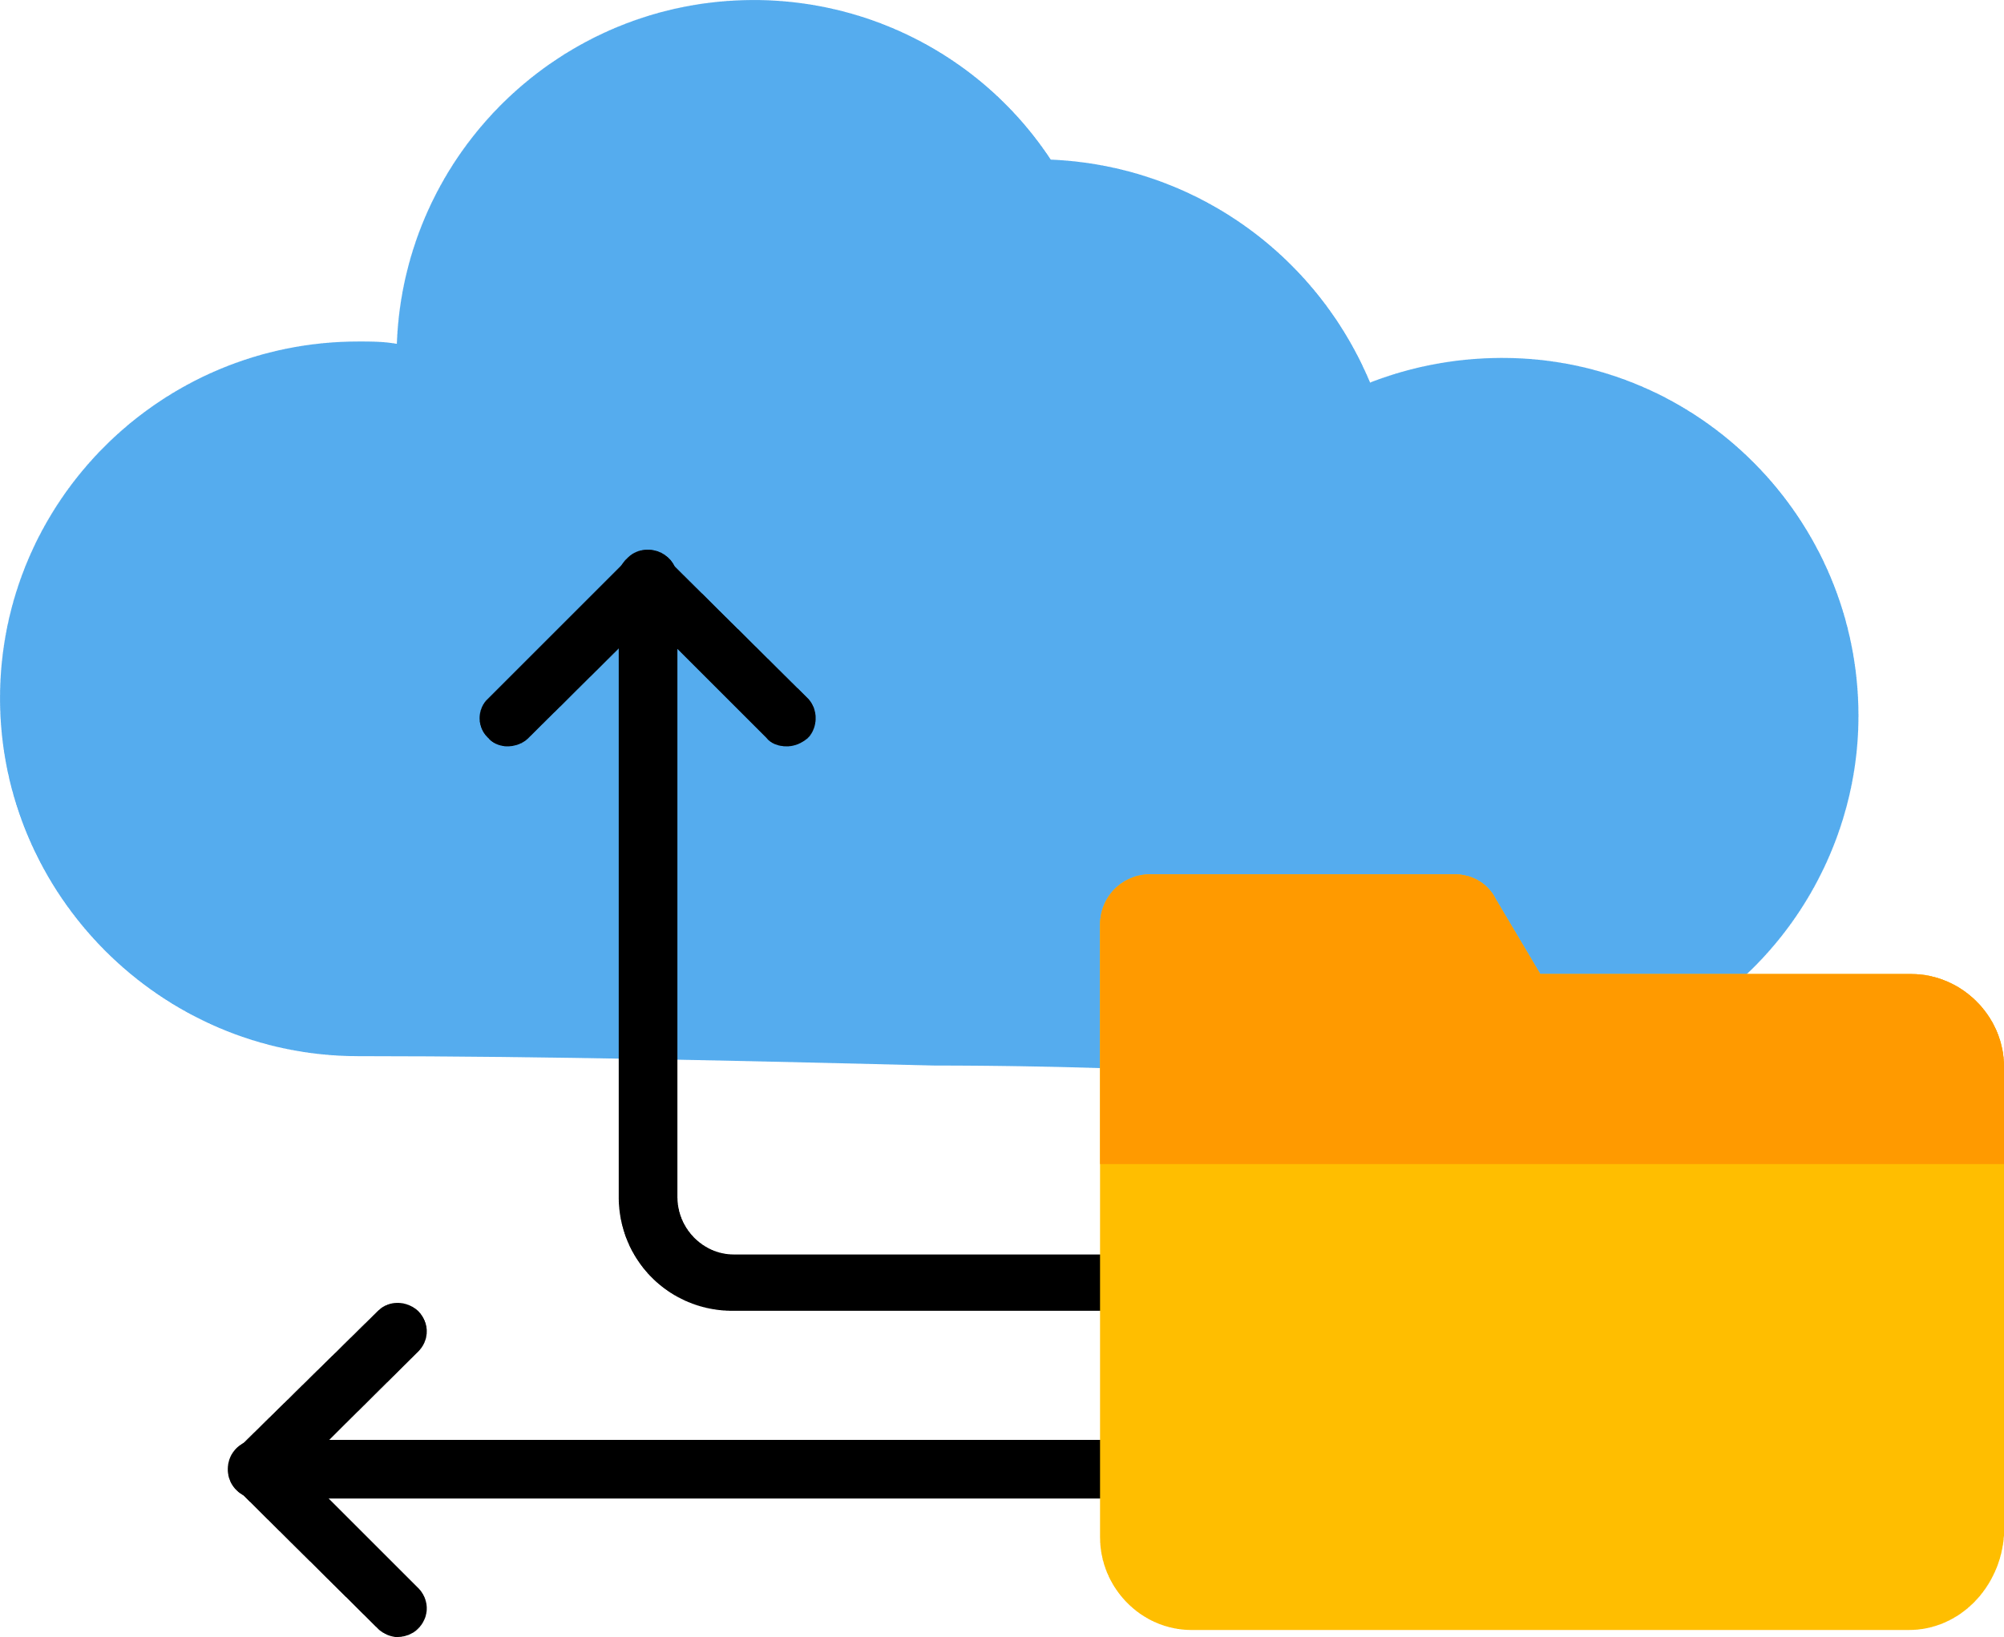
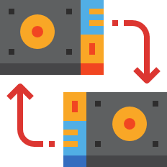
9.4 Data Protection Techniques and Security Measures
Recovering from data loss
There are two methods to do this:
Backup Program
Backup software typically automates the process of creating copies of data files, enabling scheduled (daily, weekly or monthly) backups to protect against data loss or system failures. For safety purposes, the backup disk will be stored away from the system in a fire -proof and flood-proof location.
To ensure accurate data backup, a backup program temporarily halts file modifications during copying while simultaneously recording changes elsewhere in the system caused by ongoing use.
Disk Mirroring
Disk mirroring is a data storage technique that duplicates data from one disk to another in real-time, ensuring redundancy and immediate accessibility in case of primary disk failure.
Recovering from data loss
Restricting access to data
Protecting data content

Slide 22


9.4 Data Protection Techniques and Security Measures
Restricting access to data
Restricting access to data is crucial to protect sensitive information from unauthorized users and potential security breaches.
Authorisation Policy
An authorization policy outlines the rules and guidelines determining the access levels and permissions granted to users or entities within a system or organization.
Example
In the school's ICT lab, students are authorized for limited data access, while teachers and IT staff have broader permissions for managing and controlling data within the system.
Recovering from data loss
Restricting access to data
Protecting data content

Slide 23

9.4 Data Protection Techniques and Security Measures
Protecting data content
Data can be made unreadable if thr stored data is encrypted (more in Chapter 21).
Recovering from data loss
Restricting access to data
Protecting data content

Slide 24

9.5 Data validation and verification
Highlighter
Validation of data entry
Validation of data entry is the process of ensuring that data entered into a system meets specific criteria and is accurate, complete, and consistent.
Validation of data entry
Verification of data entry
Check Digit
Verification during data transfer

Slide 25

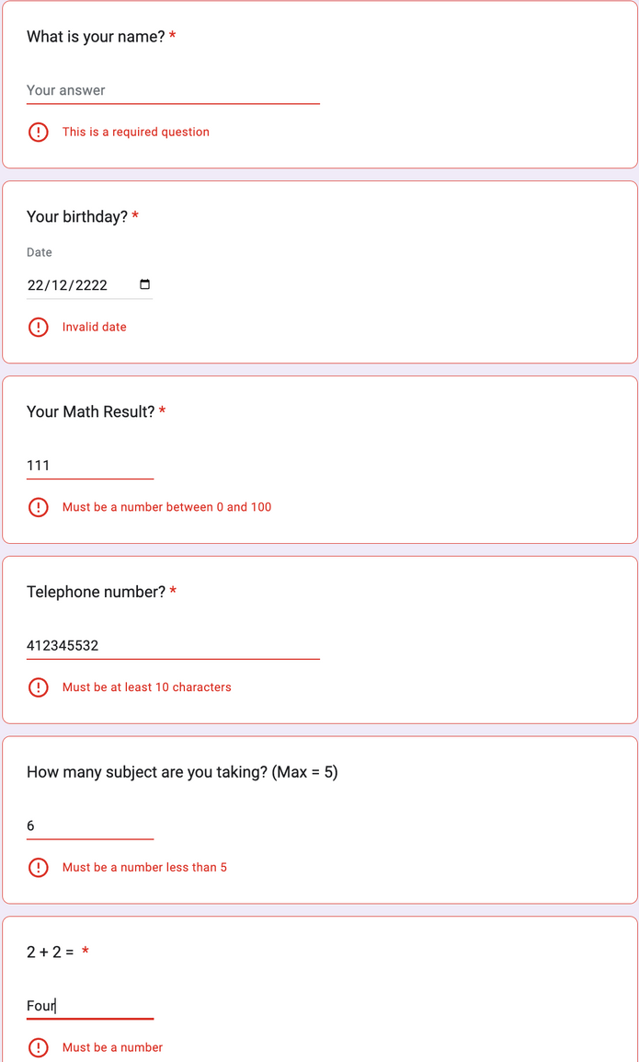
9.5 Data validation and verification
Highlighter
Presence Check
Format Check
Range Check
Length Check
Limit Check
Type Check
Validation of data entry
Verification of data entry
Check Digit
Verification during data transfer

Slide 26
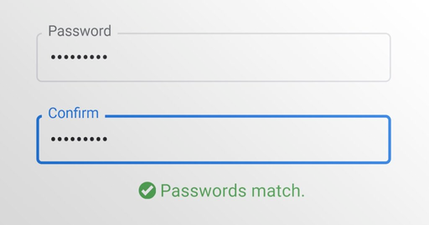

9.5 Data validation and verification
Verification of data entry
Verification of data entry is the process of confirming the accuracy and correctness of data entered into a system by cross-checking against a reliable source or through double-entry.
Double Entry
Visual Check
Validation of data entry
Verification of data entry
Check Digit
Verification during data transfer

Slide 27
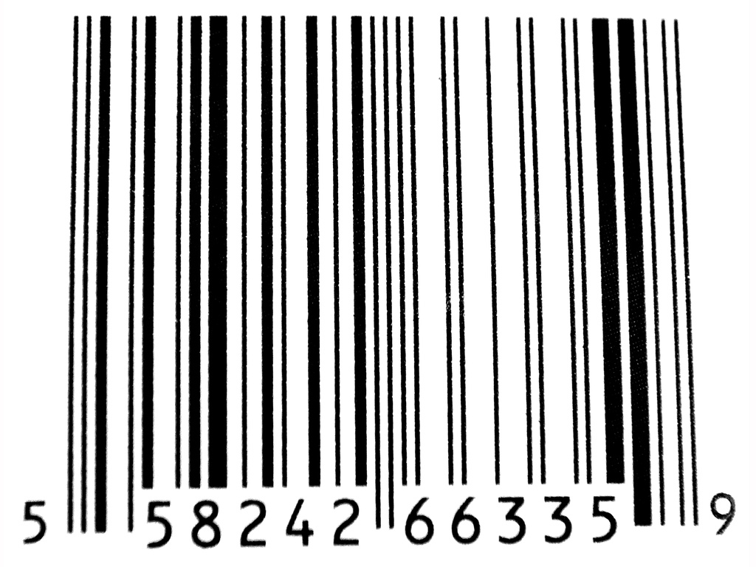

9.5 Data validation and verification
Check Digit
In the International Standard Book Number (ISBN) system, a check digit is calculated based on the other digits in the ISBN. It is added to the end of the ISBN to ensure that the ISBN is entered or scanned correctly, thus reducing the risk of errors in data entry or transmission.
Validation of data entry
Verification of data entry
Check Digit
Verification during data transfer

Slide 28
9.5 Data validation and verification
Verification during data transfer
To ensure data integrity during transmission, verification techniques are employed to assess properties linked with the bit pattern, identifying any discrepancies that may result from bit flips or data corruption.
Parity Check
Parity block check
Checksum
*able to identify whether an error has occurred
*able to identify whether an error has occurred
*able to identify the exact position of an error
Validation of data entry
Verification of data entry
Check Digit
Verification during data transfer

Slide 29
9.5 Data validation and verification
Parity Check
Parity check is a simple error-detection technique that involves adding an extra bit to a binary code to ensure that the total number of ones in the code, including the additional bit, is either even (even parity) or odd (odd parity).
Suppose a seven-bit code is to be sent; how can one verify that no errors have occurred during its transmission?
0
1
1
0
1
0
1
Validation of data entry
Verification of data entry
Check Digit
Verification during data transfer

Slide 30


9.5 Data validation and verification
Parity Check
Use parity check. Assume that we are using even parity, we can assign a parity bit to make sure that the byte contains an even number of ‘1’.
0
0
1
1
0
1
0
1
Parity bit
Validation of data entry
Verification of data entry
Check Digit
Verification during data transfer

Slide 31

9.5 Data validation and verification
Parity Check
At the receiving end, calculate the number of ‘1’ in the data received. If an even number of ‘1’ is the obtained, it shows that no result has occurred.
0
0
1
1
0
1
0
1
Validation of data entry
Verification of data entry
Check Digit
Verification during data transfer

Slide 32

9.5 Data validation and verification
Parity Check
If an error has occurred, there will be an odd number of ‘1’ in the byte, indicating that an error has occurred.
0
0
0
1
0
1
0
1
Validation of data entry
Verification of data entry
Check Digit
Verification during data transfer

Slide 33
9.5 Data validation and verification
Limitation of Parity Check
Parity check is unable to detect an even number of bit errors.
0
0
0
1
0
0
0
1
Validation of data entry
Verification of data entry
Check Digit
Verification during data transfer

Slide 34
9.5 Data validation and verification
Checksum
A checksum is a numerical value calculated from a data packet for the purpose of error detection, ensuring the integrity of the transmitted data.
0
0
1
1
0
1
0
1
= 53
Checksum that will be transmitted along with the data
0
1
0
0
0
0
0
1
= 65
150
0
0
0
0
1
0
0
1
= 9
0
0
0
1
0
1
1
1
= 23
Validation of data entry
Verification of data entry
Check Digit
Verification during data transfer

Slide 35
9.5 Data validation and verification
Checksum
Comparing the checksum before and after transmission will help to identify whether an error has occurred.
0
0
1
1
0
1
0
1
= 53
86 != 150, this shows that an error has occurred.
0
0
0
0
0
0
0
1
= 1
86
0
0
0
0
1
0
0
1
= 9
0
0
0
1
0
1
1
1
= 23
Validation of data entry
Verification of data entry
Check Digit
Verification during data transfer

Slide 36
9.5 Data validation and verification
Parity block check
Let’s say we are transmitting the following seven bytes using even parity:
Parity bit
0
1
1
0
1
0
1
1
0
0
0
0
0
1
0
0
0
1
0
0
1
0
0
1
0
1
1
1
1
0
1
0
0
0
1
1
0
0
1
0
0
1
0
0
1
0
1
1
0
Validation of data entry
Verification of data entry
Check Digit
Verification during data transfer

Slide 37

9.5 Data validation and verification
Parity block check
Set the parity bit.
Parity bit
0
0
1
1
0
1
0
1
0
1
0
0
0
0
0
1
0
0
0
0
1
0
0
1
0
0
0
1
0
1
1
1
1
1
0
1
0
0
0
1
1
1
0
0
1
0
0
1
1
0
0
1
0
1
1
0
Validation of data entry
Verification of data entry
Check Digit
Verification during data transfer

Slide 38

9.5 Data validation and verification
Parity block check
Set the parity byte. It is set in a way that ensures each column has an even number of 1.
0
0
1
1
0
1
0
1
0
1
0
0
0
0
0
1
0
0
0
0
1
0
0
1
0
0
0
1
0
1
1
1
1
1
0
1
0
0
0
1
1
1
0
0
1
0
0
1
1
0
0
1
0
1
1
0
Parity byte
1
1
1
0
0
1
0
0
Validation of data entry
Verification of data entry
Check Digit
Verification during data transfer

Slide 39

9.5 Data validation and verification
Parity block check
Let’s say an error has occurred. Unlike normal parity check, it can detect where exactly the error has occurred.
0
0
1
1
0
1
0
1
0
1
0
0
0
0
0
1
This row does not have an even number of 1!
0
0
0
0
1
0
0
1
0
0
0
0
0
1
1
1
1
1
0
1
0
0
0
1
1
1
0
0
1
0
0
1
1
0
0
1
0
1
1
0
1
1
1
0
0
1
0
0
This column does not have an even number of 1!
Validation of data entry
Verification of data entry
Check Digit
Verification during data transfer

