Slide 1

AQA GCSE Biology
1 - Cells and Microscopes
Eukaryotes, Prokaryotes and Using Microscopes
1
For more help, please visit our website www.exampaperspractice.co.uk

Slide 2
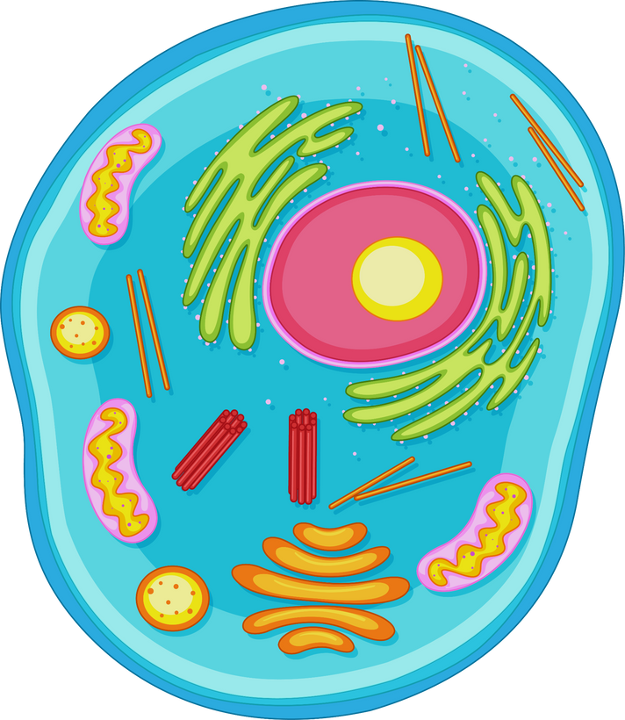
Cells
Specification Point 4.1.1.1 - Eukaryotes and prokaryotes.
Cells are the basic building blocks of an organism.
Cells are the fundamental units of life.
All living creatures are made up of one or more cells:
Animal cells.
Plant cells.
Fungal cells.
Protozoan cells.
Bacterial cells.
Cells are the fundamental building blocks of life.
2
For more help, please visit our website www.exampaperspractice.co.uk

Slide 3
Eukaryotic and Prokaryotic Cells
Eukaryotic cells are complex cells.
Generally, eukaryotic cells contain a nucleus.
There are a few exceptions, for example red blood cells don’t contain a nucleus.
Animals, plants, fungi and protists are all eukaryotic.
Prokaryotic cells are simpler and smaller than eukaryotic cells.
A prokaryotic cell can be 50 times smaller than a eukaryotic cell.
Prokaryotes are always single celled.
Prokaryotes include bacteria.
E. coli is an example of a bacteria that causes food poisoning.
3
For more help, please visit our website www.exampaperspractice.co.uk

Slide 4
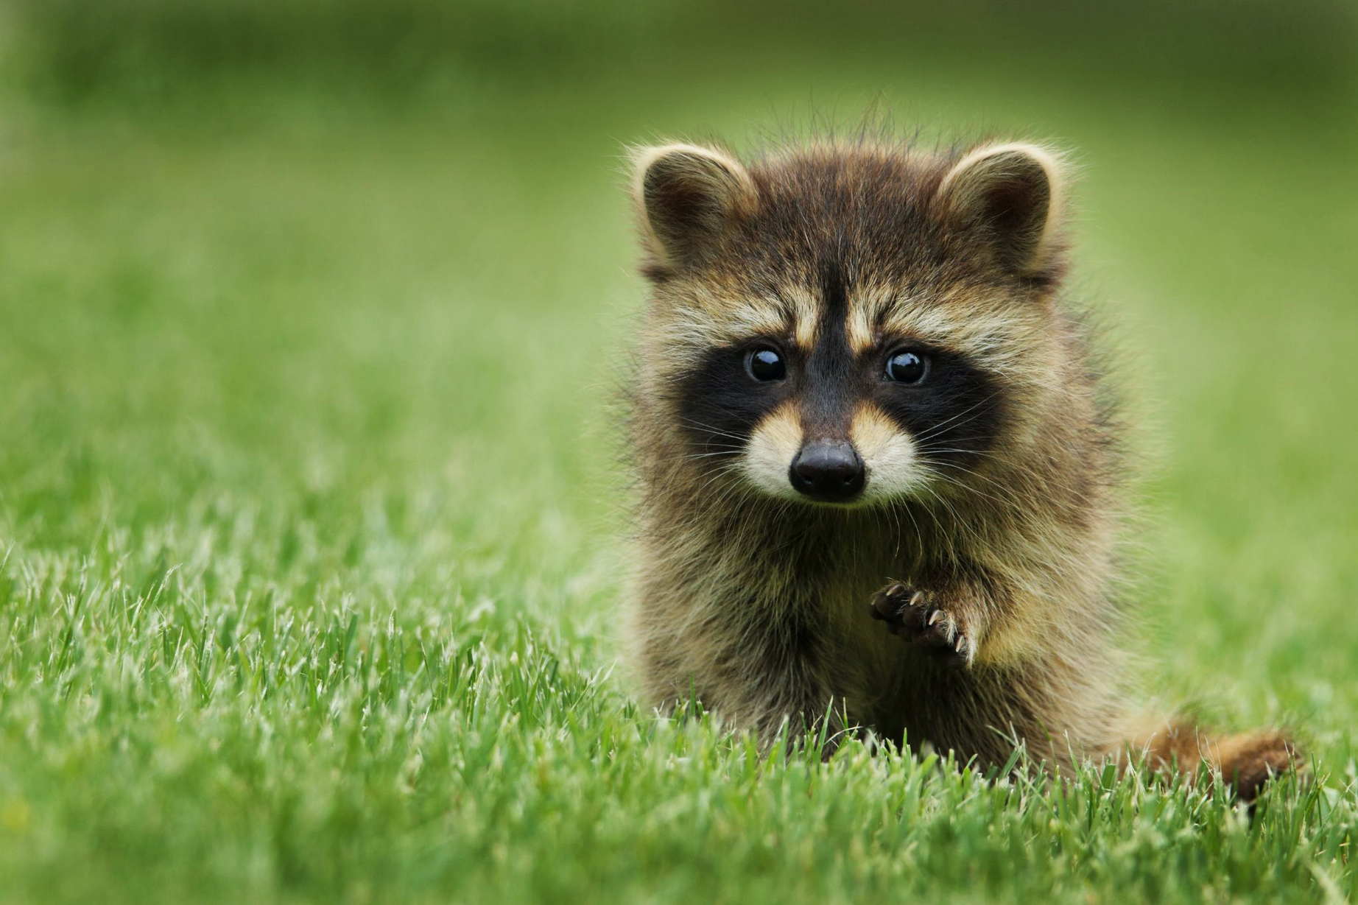
Animal cells are found in mammals, amongst other groups.
Animal cells are eukaryotic.
©2025 Exam Papers Practice. All rights reserved.
4
For more help, please visit our website www.exampaperspractice.co.uk

Slide 5
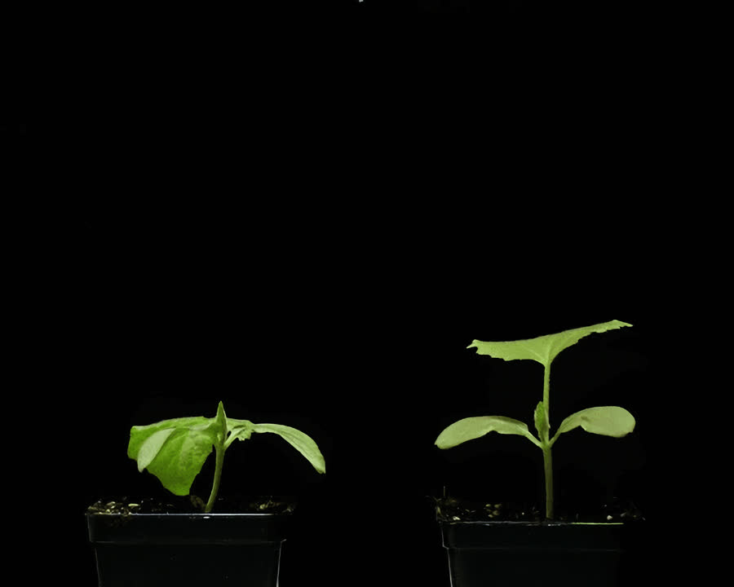
Plant cells are more complex in structure than animal cells.
Plant cells are eukaryotic.
©2025 Exam Papers Practice. All rights reserved.
5
For more help, please visit our website www.exampaperspractice.co.uk

Slide 6
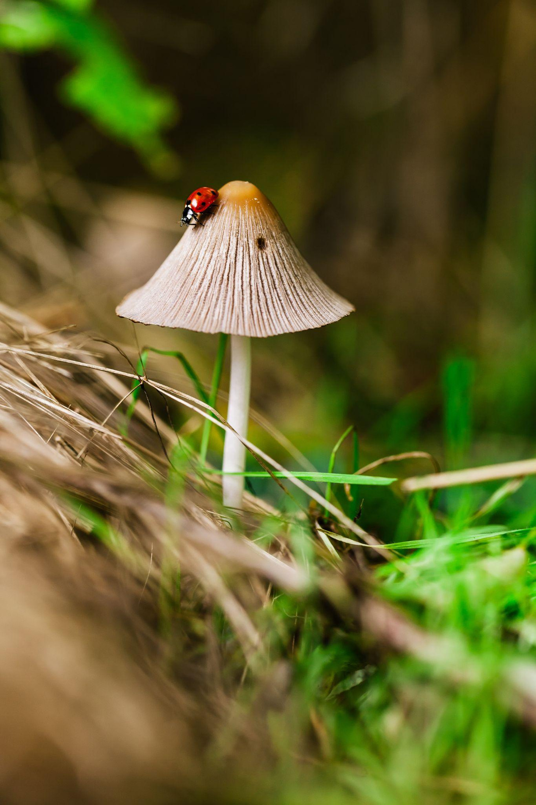
The mushroom is the typical fungus.
Fungal cells are eukaryotic.
©2025 Exam Papers Practice. All rights reserved.
6
For more help, please visit our website www.exampaperspractice.co.uk

Slide 7
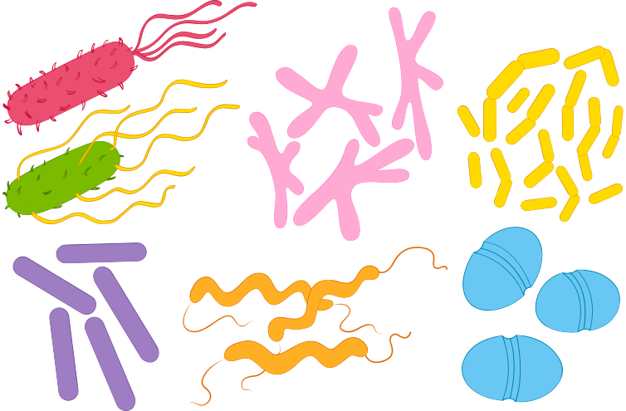
The most famous group of prokaryotic cells are the bacteria.
Bacteria come in many different shapes and sizes.
©2025 Exam Papers Practice. All rights reserved.
7
For more help, please visit our website www.exampaperspractice.co.uk

Slide 8
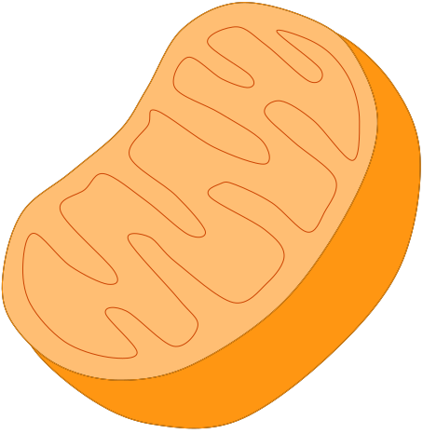
Subcellular Structures
Specification Point 4.1.1.2 - Animal and plant cells.
Subcellular structures are the smallest of the organisational units.
Subcellular structures can be defined as cell structures that are specialised to perform a particular function.
Most eukaryotic cells will have a number of different subcellular structures:
The nucleus.
Mitochondria.
Chloroplasts.
Ribosomes.
©2025 Exam Papers Practice. All rights reserved.
A mitochondrion is a type of subcellular structure and the site for aerobic respiration.
8
For more help, please visit our website www.exampaperspractice.co.uk

Slide 9
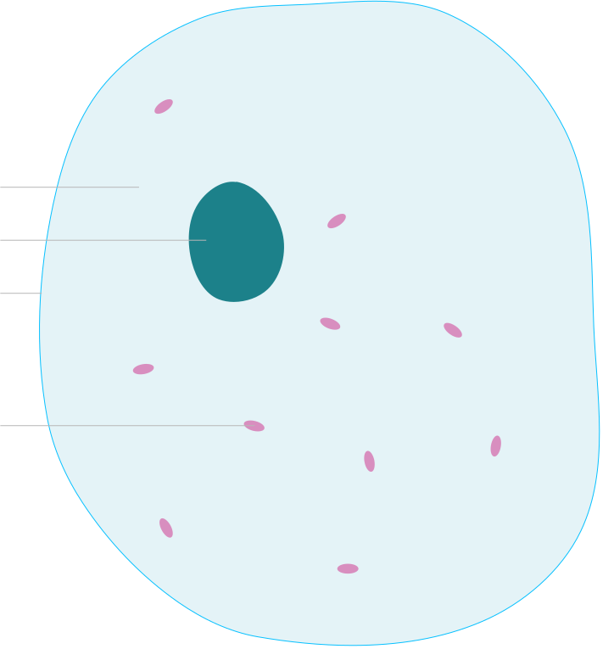
RIBOSOMES
CYTOPLASM
NUCLEUS
CELL MEMBRANE
Subcellular structures are found within cells.
An animal cell is shown here.
MITOCHONDRIA
©2025 Exam Papers Practice. All rights reserved.
9
For more help, please visit our website www.exampaperspractice.co.uk

Slide 10
Common Eukaryotic Subcellular Structures
Animal and plant cells contain some of the same subcellular structures:
The nucleus controls the activity of the cell.
The nucleus is the largest subcellular structure.
It also contains the genetic material for making new cells.
The cell membrane determines what enters and leaves the cell.
The cell membrane is selectively permeable.
This means only certain substances can get in and out of the cell.
The cytoplasm is the site where most metabolic reactions take place.
The cytoplasm is a liquid gel that takes up most of the inner volume of the cell.
Ribosomes are involved in making proteins.
Ribosomes are small subcellular structures that make important proteins like enzymes.
The mitochondria are sites of aerobic respiration.
Mitochondria are referred to as microscopic powerhouses.
Mitochondria create energy for metabolic processes.
©2025 Exam Papers Practice. All rights reserved.
10
For more help, please visit our website www.exampaperspractice.co.uk

Slide 11
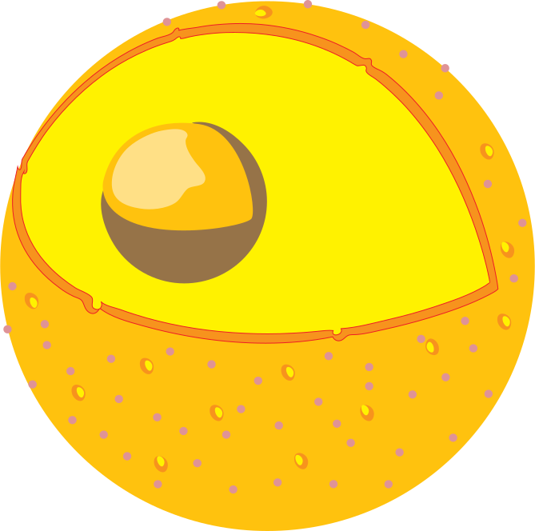
The nucleus controls the activity of the cell.
©2025 Exam Papers Practice. All rights reserved.
11
For more help, please visit our website www.exampaperspractice.co.uk

Slide 12
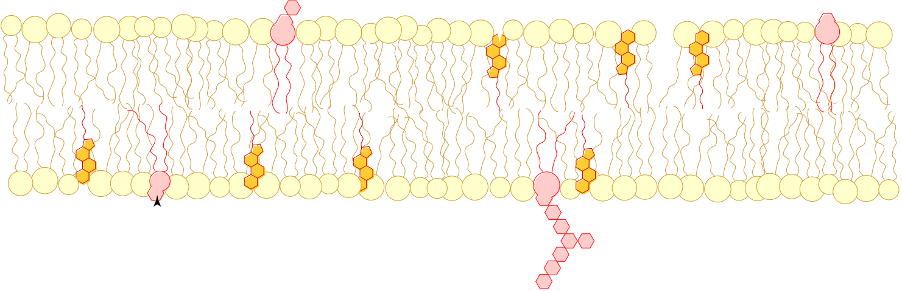
The cell membrane determines what enters and leaves the cell.
©2025 Exam Papers Practice. All rights reserved.
12
For more help, please visit our website www.exampaperspractice.co.uk

Slide 13
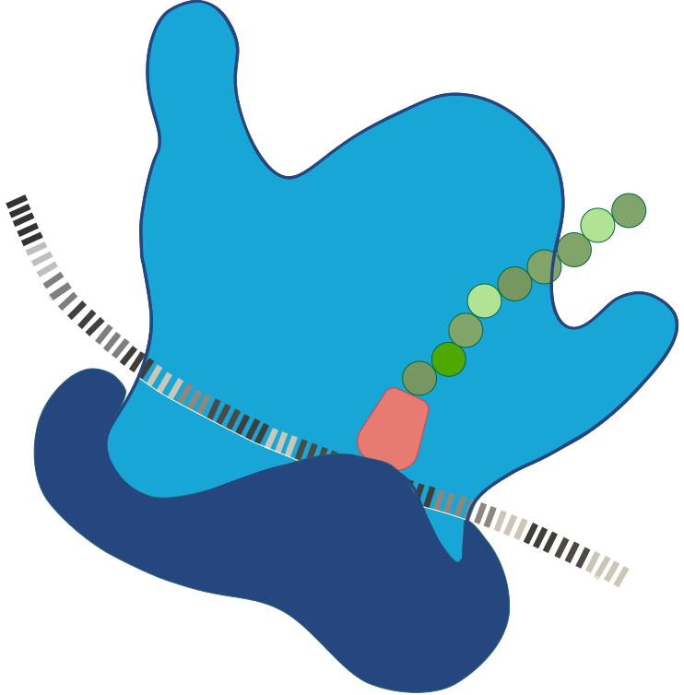
Proteins are made at ribosomes.
©2025 Exam Papers Practice. All rights reserved.
13
For more help, please visit our website www.exampaperspractice.co.uk

Slide 14
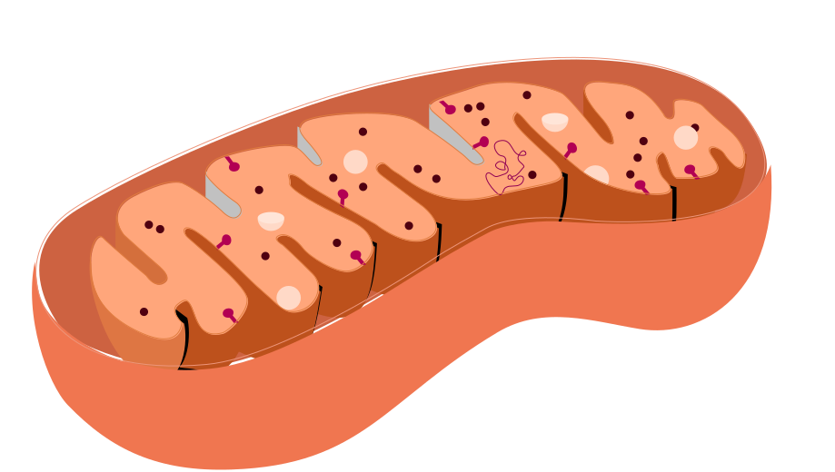
Aerobic respiration takes place inside mitochondria.
©2025 Exam Papers Practice. All rights reserved.
14
For more help, please visit our website www.exampaperspractice.co.uk

Slide 15
Plant Cell Structures
Plant cells are more complicated than animal cells.
Plant cells have a number of extra organelles:
The cell wall provides support and rigidity for the cell.
Plant cell walls are made up of a polysaccharide called cellulose.
Chloroplasts are the site of photosynthesis.
Chloroplasts are filled with a green pigment called chlorophyll.
Chlorophyll absorbs light energy which allows photosynthesis to take place.
The permanent vacuole regulates the water content of the cell.
The permanent vacuole is filled with a fluid called cell sap.
Cell sap is a solution of dissolved sugars and mineral ions.
©2025 Exam Papers Practice. All rights reserved.
15
For more help, please visit our website www.exampaperspractice.co.uk

Slide 16
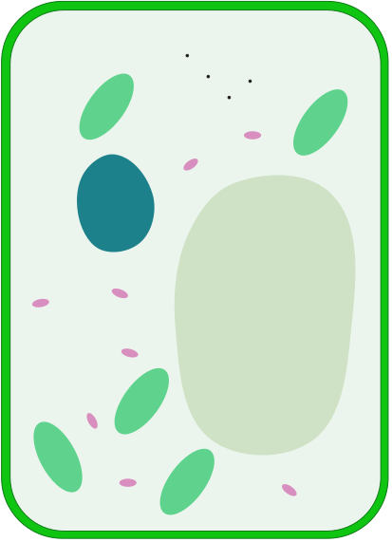
RIBOSOMES
CYTOPLASM
MITOCHONDRIA
NUCLEUS
Plant cells are more complex than animal cells and contain more organelles.
CELL MEMBRANE
CELL WALL
VACUOLE
©2025 Exam Papers Practice. All rights reserved.
CHLOROPLAST
16
For more help, please visit our website www.exampaperspractice.co.uk

Slide 17
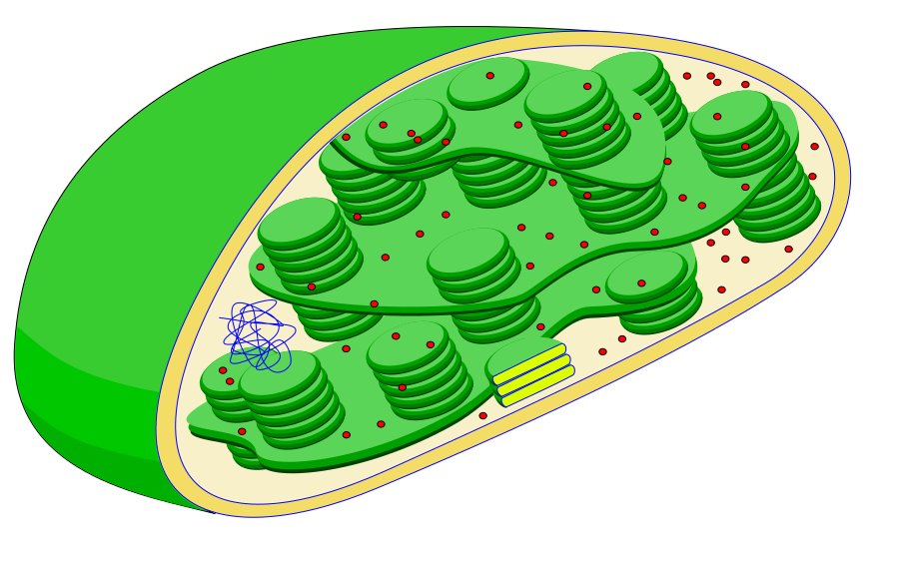
The chloroplast is the site of photosynthesis.
©2025 Exam Papers Practice. All rights reserved.
17
For more help, please visit our website www.exampaperspractice.co.uk

Slide 18
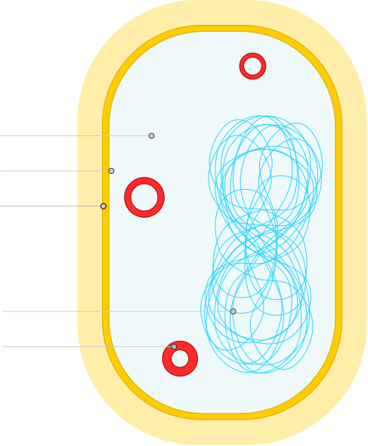
Bacterial Structures
Bacterial cells do not have a ‘true nucleus’.
The genetic material of prokaryotic cells is free floating within the cytoplasm.
Bacteria contain rings of DNA called plasmids.
Plasmids are circular loops of DNA.
Each plasmid is responsible for providing a function to the prokaryote.
Bacteria do not have chloroplasts or mitochondria.
Prokaryotes like bacteria do not contain any membrane-bound organelles whatsoever.
Bacteria have a cell wall.
The bacterial cell wall is usually made from a combination of protein and sugars.
CYTOPLASM
CELL MEMBRANE
CELL WALL
©2025 Exam Papers Practice. All rights reserved.
FREE FLOATING DNA
PLASMID
18
For more help, please visit our website www.exampaperspractice.co.uk

Slide 19
Microscopes
Specification Point 4.1.1.5 - Microscopy.
Microscopes allow us to see objects that are not visible with the naked eye.
Microscopes have been in constant development since the 17th century.
Galileo Galilei is credited with the production of a functional light microscope in 1609.
Light microscopes use light and lenses to create a magnified image of a particular specimen.
Light microscopes can see large organelles, such as the nucleus.
Electron microscopes use a beam of electrons to form an image.
Electron microscopes have a much higher magnification than light microscopes.
They can also see at greater detail - they are said to have a high resolution.
Electron microscopes can see smaller organelles, such as mitochondria and chloroplasts.
©2025 Exam Papers Practice. All rights reserved.
19
For more help, please visit our website www.exampaperspractice.co.uk

Slide 20
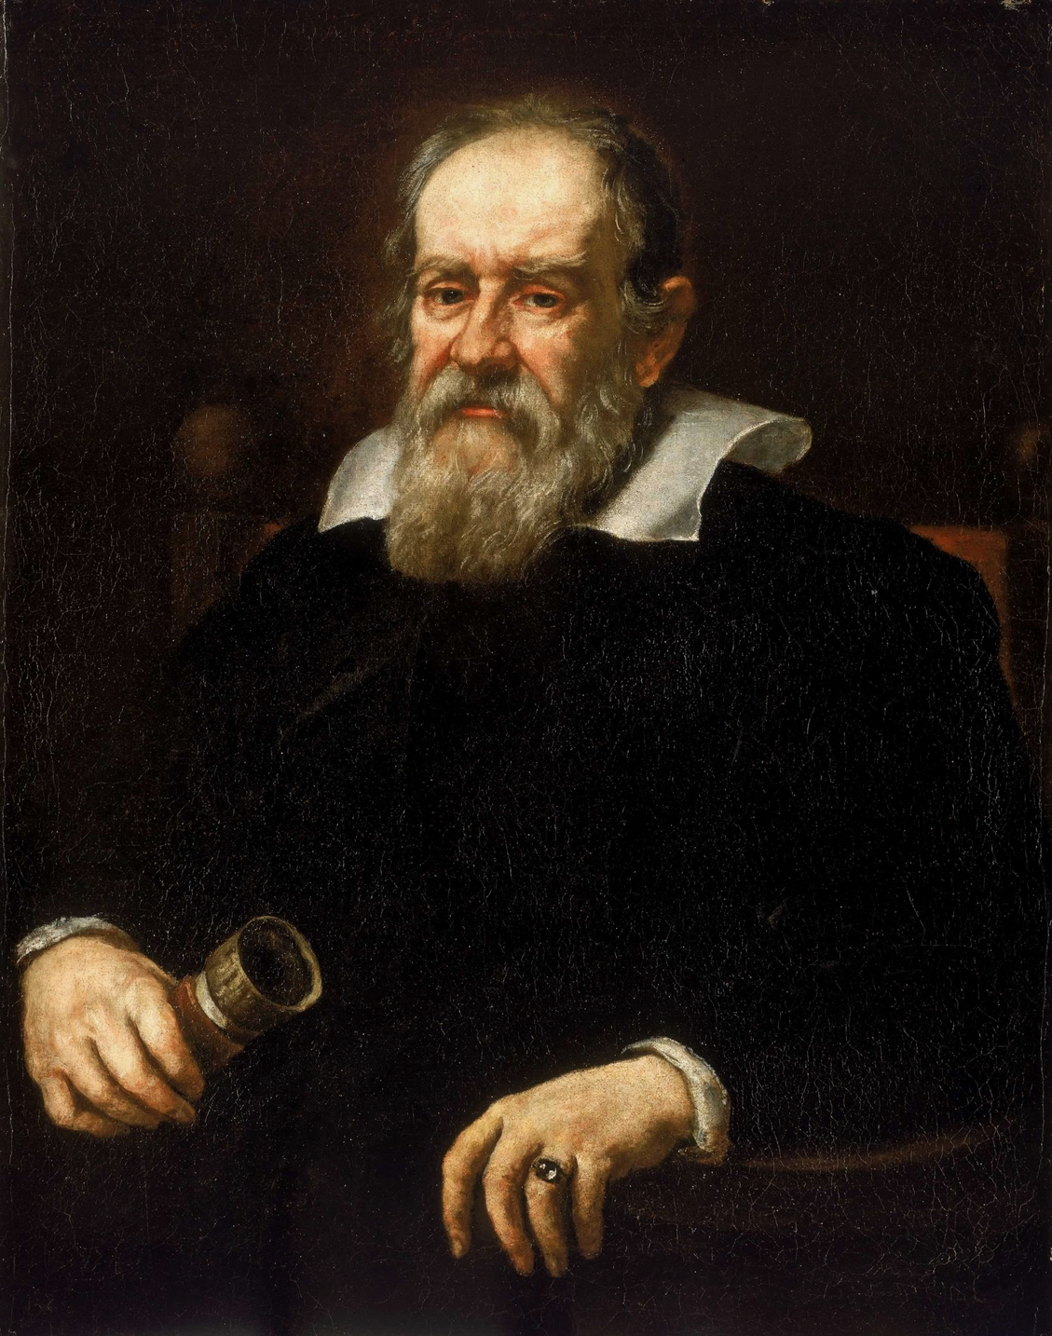
Galileo Galilei is credited with the production of a functional light microscope in 1609.
©2025 Exam Papers Practice. All rights reserved.
20
For more help, please visit our website www.exampaperspractice.co.uk

Slide 21

Magnification is a measure of how much bigger an image is than the real object it represents.
©2025 Exam Papers Practice. All rights reserved.
21
For more help, please visit our website www.exampaperspractice.co.uk

Slide 22
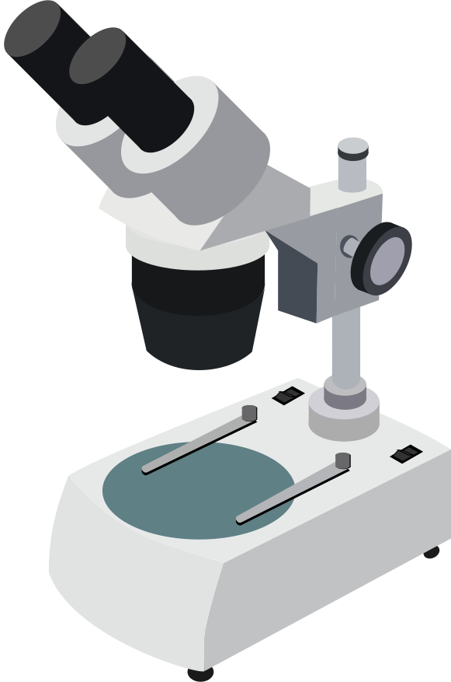
Light microscopes have a maximum magnification of around ×1500 and a maximum resolution of about 0.2 μm.
©2025 Exam Papers Practice. All rights reserved.
22
For more help, please visit our website www.exampaperspractice.co.uk

Slide 23
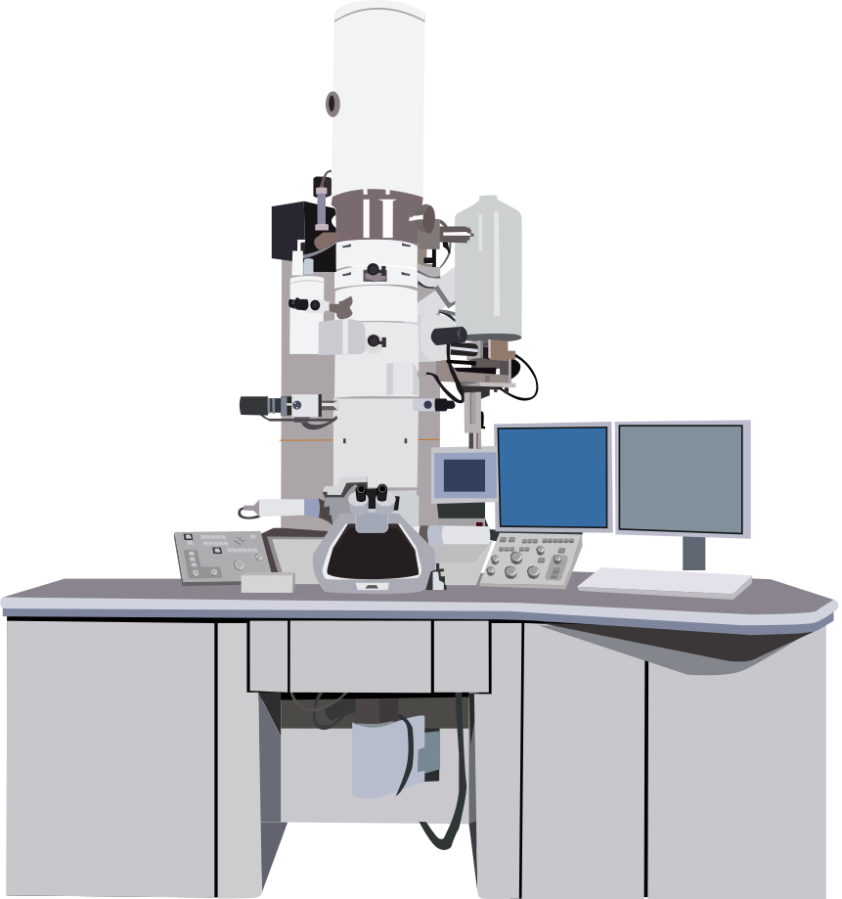
Electron microscopes are much more complex than light microscopes.
Electron microscopes have a maximum magnification of around ×1,500,000 and a maximum resolution of about 0.0002 μm.
©2025 Exam Papers Practice. All rights reserved.
23
For more help, please visit our website www.exampaperspractice.co.uk

Slide 24

Calculating Magnification
Magnification is how much bigger the image is than the real object that you’re looking at:
Magnification can be calculated using the following formula:
Consider a magnified image that is 10 mm wide. The real size of the specimen is 0.05 mm wide.
Therefore the magnification is 10 ÷ 0.05 = ×200
M = magnification
I = image size
O = object or actual size
©2025 Exam Papers Practice. All rights reserved.
24
For more help, please visit our website www.exampaperspractice.co.uk

Slide 25
Microscope Practical
Practical 1 - Use a light microscope to investigate a selection of plant and animal cells.
Cut an onion into sections and remove the top layer using a pair of tweezers.
This tissue is called the epidermis of the onion.
Mount the onion tissue onto a microscope slide.
Add a drop of water to the slide before mounting.
Ensure the onion tissue is lying flat on the slide.
Add a few drops of iodine solution to the slide.
This will stain the onion cells and make them easier to see.
Place a coverslip on top of the slide.
Carefully tilt and lower the coverslip into place.
Try to ensure no air bubbles are trapped in the slide.
Clip the slide into place and select the lowest-powered objective lens.
This lens provides the least magnification.
©2025 Exam Papers Practice. All rights reserved.
25
For more help, please visit our website www.exampaperspractice.co.uk

Slide 26
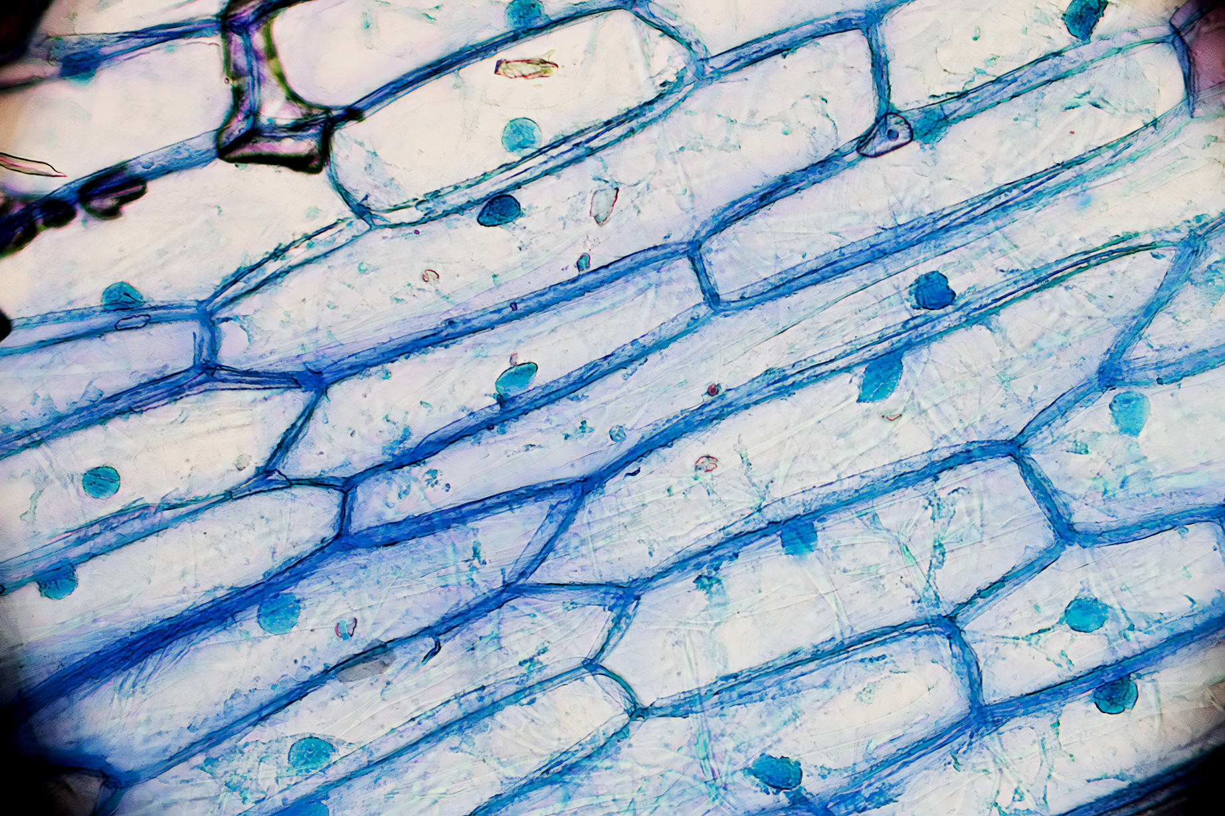
Onion cells are often used for microscopy practicals.
These cells have been stained with iodine to make them easier to see.
©2025 Exam Papers Practice. All rights reserved.
26
For more help, please visit our website www.exampaperspractice.co.uk

Slide 27
Microscope Practical
Use the coarse adjustment knob to move the stage until the coverslip touches the objective lens.
Using the eyepiece, move the coarse adjustment knob to move the stage downwards, into rough focus.
Use the fine adjustment knob to get a clear image of the specimen.
Use different powers of lens to change the magnification.
The most common powers are 4x, 10x and 40x.
Microscope practical.
©2025 Exam Papers Practice. All rights reserved.
27
For more help, please visit our website www.exampaperspractice.co.uk

Slide 28
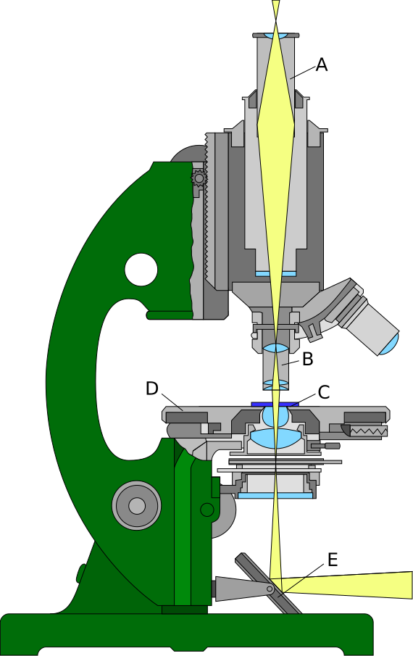
A - Eyepiece
B - Objective Lens
C - Microscope Slide
D - Stage
E - Mirror
Light microscopes are used to look at prepared slides.
©2025 Exam Papers Practice. All rights reserved.
28
For more help, please visit our website www.exampaperspractice.co.uk

