Slide 1

AQA English Language Paper 1 Section A – Q4: Critical Evaluation
This is Kwagblurb who has just started in Year 11, having transferred from Uranus High School.
He knows absolutely nothing about answering Q4.
Write down a list of key points Kwagblurb should know in order to answer Q4.
Create success criteria for Kwagblurb so that he can answer Q4 effectively.
Explain to Kwagblurb how he can evaluate rather than just analyse a text with examples provided.

Slide 2
Learning outcomes
To describe ways of improving our Q4 answers
To explain how student answers can better meet the requirements of the mark scheme
To evaluate the effectiveness of our improved Q4 answers

Slide 3
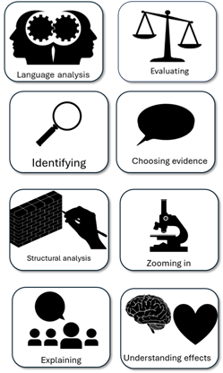
We will work in pairs to explore some example student Q4 answers
There are four different answers for you to explore.
Make notes on what skills the students have included.
Explain why each answer is different to each other through key skills included.
Evaluate which answer is the most successful and explain why, picking out specific examples.

Slide 4
I think the hyena is quite funny because it makes a yipping noise which sounds stupid and the writer wants to make the reader laugh at it.
The hyena is presented as funny by the writer due to its repeated “yip yip yip” noise that is a ridiculous sound and the reader can only laugh at it.
There are times when the hyena is presented as funny to the reader, such as when the writer gives uses the repetition of “yip”, an onomatopoeic sound, clearly with the intention of evoking laughter from the reader.
Despite the hyena being presented as threatening throughout this part of the text, the writer does provide clear moments of humour, such as the repetition of “yip”, an onomatopoeic sound that stands in contrast to the clearly terrified Pi. Perhaps this is to provide comic relief for the reader in such a tense situation.

Slide 5

I think the hyena is quite funny because it makes a yipping noise which sounds stupid and the writer wants to make the reader laugh at it.
Student’s answer
Evaluated the text based on the statement provided
Included examples to support ideas
Evaluated the writer’s use of methods (language and structure)
This student has evaluated the text based on the statement and they did include an example to support their evaluation. Although they explained the writer’s intention, they could have expanded on this in greater detail with language or structure analysis.

Slide 6
The hyena is presented as funny by the writer due to its repeated “yip yip yip” noise that is a ridiculous sound and the reader can only laugh at it.
Student’s answer
Evaluated the text based on the statement provided
Included examples to support ideas
Evaluated the writer’s use of methods (language and structure)
This student has evaluated the text based on the statement and they did include an example to support their evaluation. They have explained the effect of the example on the reader, and they have started to make some language analysis.

Slide 7
There are times when the hyena is presented as funny to the reader, such as when the writer gives uses the repetition of “yip”, an onomatopoeic sound, clearly with the intention of evoking laughter from the reader.
Student’s answer
Evaluated the text based on the statement provided
Included examples to support ideas
Evaluated the writer’s use of methods (language and structure)
This student is thinking about the overall text and whether the hyena is presented as threatening or funny. They analyse the use of repetition and onomatopoeia and explain the writer’s intentions and the effects on the reader.

Slide 8
Despite the hyena being presented as threatening throughout this part of the text, the writer does provide clear moments of humour, such as the repetition of “yip”, an onomatopoeic sound that stands in contrast to the clearly terrified Pi. Perhaps this is to provide comic relief for the reader in such a tense situation.
Student’s answer
Evaluated the text based on the statement provided
Included examples to support ideas
Evaluated the writer’s use of methods (language and structure)
You can see the student is evaluating the text well, considering the statement and how the hyena is presented throughout the extract. They analyse language and explore both the writer’s intentions and the impact of the language on the reader.

Slide 9
When you are thinking about how to answer Q4 in the exam, you could think of a pie chart to show how much you agree or disagree with the statement provided.
You may think the hyena is presented as equally threatening or funny, or you make think it is more threatening or more funny, but you need to think about how you view the text as a whole in relation to the statement.
80%
Funny
20%
Threatening

Slide 10
Evaluative verbs
Verb | Meaning
Ridicules | Makes fun of or mocks something
Questions | To dispute or challenge something
Persuades | To convince us of something or to make us think in a certain way
Enhances | To increase or intensify something
Subverts | To undermine or alter opinions or perspectives on something
Do you remember in previous lessons on Q2 and Q3 we explored the power of analytical verbs in our answers?
You can also use evaluative verbs to boost your answers for Q4.
The writer wants us to see the hyena as funny
The writer tries to persuade us that the hyena is funny rather than terrifying

Slide 11
Evaluative verbs
Verb | Meaning
Ridicules | Makes fun of or mocks something
Questions | To dispute or challenge something
Persuades | To convince us of something or to make us think in a certain way
Enhances | To increase or intensify something
Subverts | To undermine or alter opinions or perspectives on something
Go through your previous Q4 answer that we wrote in the previous lesson and add in at least one of these evaluative verbs to your answer.
The writer wants us to see the hyena as funny
The writer tries to persuade us that the hyena is funny rather than terrifying

Slide 12
Last lesson we wrote our own Q4 answers
Drafting and redrafting is an important activity in English because it helps you to become a more effective English analyst.
Using your learning from today and the success criteria, rewrite your answer.
Your answer for Q4:
Evaluated the text based on the statement provided
Included examples to support ideas
Evaluated the writer’s use of methods (language and structure)
Bonus criteria:
Included evaluative verbs
Considered the whole extract overall when evaluating the text
Verb | Meaning
Ridicules | Makes fun of or mocks something
Questions | To dispute or challenge something
Persuades | To convince us of something or to make us think in a certain way
Enhances | To increase or intensify something
Subverts | To undermine or alter opinions or perspectives on something

Slide 13
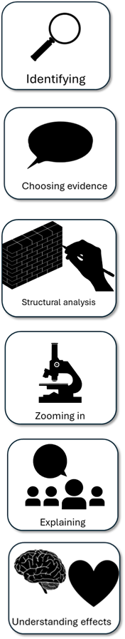
We will now peer assess our new answers
Swap your answers with another student.
Your answer for Q4: |  | What could they add or change to improve their answer?
Evaluated the text based on the statement provided
Included examples to support ideas
Evaluated the writer’s use of methods (language and structure)
Bonus criteria:
Included evaluative verbs
Considered the whole extract overall when evaluating the text

Slide 14
Your answer for Q4: |  | What could they add or change to improve their answer?
Evaluated the text based on the statement provided
Included examples to support ideas
Evaluated the writer’s use of methods (language and structure)
Bonus criteria:
Included evaluative verbs
Considered the whole extract overall when evaluating the text
Notes:
To print out for students

Slide 15
Plenary: Goals
Read the learning outcomes.
How many goals do you think you scored today?
What do you need to learn to improve your final score?
To describe ways of improving our Q4 answers
To explain how student answers can better meet the requirements of the mark scheme
To evaluate the effectiveness of our improved Q4 answers

