Slide 1










AQA English Language Paper 1 Section A – Q4: Critical Evaluation
Last lesson we began to explore Q4, which is all about critical evaluation skills.
What skills do the symbols above represent?
How is Q4 different to Q2 (language analysis) and Q3 (structural analysis)?
Why is evaluating a different skill to analysis? Provide examples.

Slide 2
Identifying
Choosing evidence
Language analysis
Zooming in
Structural analysis
Evaluating
Explaining
Understanding effects
As well as giving our opinions on a statement provided, we also need to include some analysis of how the language and structure impacts on the reader.
We looked at how a text was exciting or hopeful for a reader previously, and we need to explain how the language and structure help the reader to think and feel this.

Slide 3
Learning outcomes
To describe how a student has evaluated the text in a model answer
To explain how we can improve our critical evaluations for Q4
To apply our understanding of Q4 skills to our own answers

Slide 4

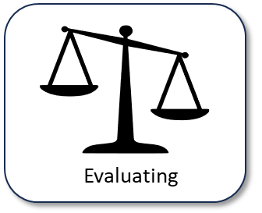
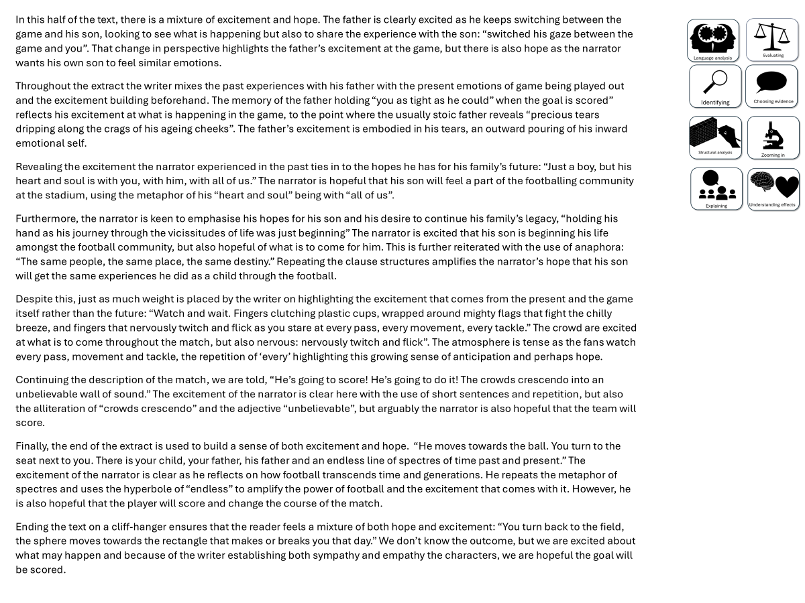
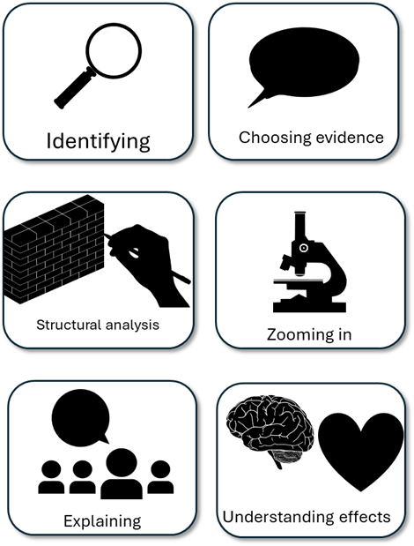
You have been given a good answer for Q4
Go through the answer and find good examples of how the student has evaluated. You could do this through arrows, annotations or highlighting.
Bonus Challenge: Find examples of language or structure analysis.

Slide 5
In this half of the text, there is a mixture of excitement and hope. The father is clearly excited as he keeps switching between the game and his son, looking to see what is happening but also to share the experience with the son: “switched his gaze between the game and you”. That change in perspective highlights the father’s excitement at the game, but there is also hope as the narrator wants his own son to feel similar emotions.
Throughout the extract the writer mixes the past experiences with his father with the present emotions of game being played out and the excitement building beforehand. The memory of the father holding “you as tight as he could” when the goal is scored” reflects his excitement at what is happening in the game, to the point where the usually stoic father reveals “precious tears dripping along the crags of his ageing cheeks”. The father’s excitement is embodied in his tears, an outward pouring of his inward emotional self.
Revealing the excitement the narrator experienced in the past ties in to the hopes he has for his family’s future: “Just a boy, but his heart and soul is with you, with him, with all of us.” The narrator is hopeful that his son will feel a part of the footballing community at the stadium, using the metaphor of his “heart and soul” being with “all of us”.
Furthermore, the narrator is keen to emphasise his hopes for his son and his desire to continue his family’s legacy, “holding his hand as his journey through the vicissitudes of life was just beginning” The narrator is excited that his son is beginning his life amongst the football community, but also hopeful of what is to come for him. This is further reiterated with the use of anaphora: “The same people, the same place, the same destiny.” Repeating the clause structures amplifies the narrator’s hope that his son will get the same experiences he did as a child through the football.
Despite this, just as much weight is placed by the writer on highlighting the excitement that comes from the present and the game itself rather than the future: “Watch and wait. Fingers clutching plastic cups, wrapped around mighty flags that fight the chilly breeze, and fingers that nervously twitch and flick as you stare at every pass, every movement, every tackle.” The crowd are excited at what is to come throughout the match, but also nervous: nervously twitch and flick”. The atmosphere is tense as the fans watch every pass, movement and tackle, the repetition of ‘every’ highlighting this growing sense of anticipation and perhaps hope.
Continuing the description of the match, we are told, “He’s going to score! He’s going to do it! The crowds crescendo into an unbelievable wall of sound.” The excitement of the narrator is clear here with the use of short sentences and repetition, but also the alliteration of “crowds crescendo” and the adjective “unbelievable”, but arguably the narrator is also hopeful that the team will score.
Finally, the end of the extract is used to build a sense of both excitement and hope. “He moves towards the ball. You turn to the seat next to you. There is your child, your father, his father and an endless line of spectres of time past and present.” The excitement of the narrator is clear as he reflects on how football transcends time and generations. He repeats the metaphor of spectres and uses the hyperbole of “endless” to amplify the power of football and the excitement that comes with it. However, he is also hopeful that the player will score and change the course of the match.
Ending the text on a cliff-hanger ensures that the reader feels a mixture of both hope and excitement: “You turn back to the field, the sphere moves towards the rectangle that makes or breaks you that day.” We don’t know the outcome, but we are excited about what may happen and because of the writer establishing both sympathy and empathy for the characters, we are hopeful the goal will be scored.

Slide 6
In this half of the text, there is a mixture of excitement and hope. The father is clearly excited as he keeps switching between the game and his son, looking to see what is happening but also to share the experience with the son: “switched his gaze between the game and you”. That change in perspective highlights the father’s excitement at the game, but there is also hope as the narrator wants his own son to feel similar emotions.
Throughout the extract the writer mixes the past experiences with his father with the present emotions of game being played out and the excitement building beforehand. The memory of the father holding “you as tight as he could” when the goal is scored” reflects his excitement at what is happening in the game, to the point where the usually stoic father reveals “precious tears dripping along the crags of his ageing cheeks”. The father’s excitement is embodied in his tears, an outward pouring of his inward emotional self.
Revealing the excitement the narrator experienced in the past ties in to the hopes he has for his family’s future: “Just a boy, but his heart and soul is with you, with him, with all of us.” The narrator is hopeful that his son will feel a part of the footballing community at the stadium, using the metaphor of his “heart and soul” being with “all of us”.
Furthermore, the narrator is keen to emphasise his hopes for his son and his desire to continue his family’s legacy, “holding his hand as his journey through the vicissitudes of life was just beginning” The narrator is excited that his son is beginning his life amongst the football community, but also hopeful of what is to come for him. This is further reiterated with the use of anaphora: “The same people, the same place, the same destiny.” Repeating the clause structures amplifies the narrator’s hope that his son will get the same experiences he did as a child through the football.
Despite this, just as much weight is placed by the writer on highlighting the excitement that comes from the present and the game itself rather than the future: “Watch and wait. Fingers clutching plastic cups, wrapped around mighty flags that fight the chilly breeze, and fingers that nervously twitch and flick as you stare at every pass, every movement, every tackle.” The crowd are excited at what is to come throughout the match, but also nervous: nervously twitch and flick”. The atmosphere is tense as the fans watch every pass, movement and tackle, the repetition of ‘every’ highlighting this growing sense of anticipation and perhaps hope.
Continuing the description of the match, we are told, “He’s going to score! He’s going to do it! The crowds crescendo into an unbelievable wall of sound.” The excitement of the narrator is clear here with the use of short sentences and repetition, but also the alliteration of “crowds crescendo” and the adjective “unbelievable”, but arguably the narrator is also hopeful that the team will score.
Finally, the end of the extract is used to build a sense of both excitement and hope. “He moves towards the ball. You turn to the seat next to you. There is your child, your father, his father and an endless line of spectres of time past and present.” The excitement of the narrator is clear as he reflects on how football transcends time and generations. He repeats the metaphor of spectres and uses the hyperbole of “endless” to amplify the power of football and the excitement that comes with it. However, he is also hopeful that the player will score and change the course of the match.
Ending the text on a cliff-hanger ensures that the reader feels a mixture of both hope and excitement: “You turn back to the field, the sphere moves towards the rectangle that makes or breaks you that day.” We don’t know the outcome, but we are excited about what may happen and because of the writer establishing both sympathy and empathy the characters, we are hopeful the goal will be scored.
In each of the highlighted sections the student evaluates whether they think the atmosphere is exciting or hopeful.

Slide 7
This student has decided that the atmosphere is both exciting and hopeful in equal measure
In this half of the text, there is a mixture of excitement and hope. The father is clearly excited as he keeps switching between the game and his son, looking to see what is happening but also to share the experience with the son: “switched his gaze between the game and you”. That change in perspective highlights the father’s excitement at the game, but there is also hope as the narrator wants his own son to feel similar emotions.
Straight away they answer the task and evaluate the text.
However, they go on to provide examples and explain their evaluation.
The atmosphere is exciting because of the action taking place on the pitch and how the father is described, but also hopeful as the narrator wants his son to feel the same emotions he did in the past.

Slide 8
This student has decided that the atmosphere is both exciting and hopeful in equal measure
Despite this, just as much weight is placed by the writer on highlighting the excitement that comes from the present and the game itself rather than the future: “Watch and wait. Fingers clutching plastic cups, wrapped around mighty flags that fight the chilly breeze, and fingers that nervously twitch and flick as you stare at every pass, every movement, every tackle.” The crowd are excited at what is to come throughout the match, but also nervous: nervously twitch and flick”. The atmosphere is tense as the fans watch every pass, movement and tackle, the repetition of ‘every’ highlighting this growing sense of anticipation and perhaps hope.
Again, they evaluate the text and answer the task.
They provide a number of examples that show the atmosphere is exciting but also hopeful.
They also explain how each example supports their evaluation of the text.

Slide 9
Let’s look at the mark scheme for Q4
AO4
Evaluate texts critically and support this with appropriate textual references
To get 20/20:
Shows perceptive and detailed evaluation:
• Develops a convincing and critical understanding of ideas
• Shows perceptive understanding of writer’s methods
• Evaluates critically and in detail the impact of the writer’s ideas and
methods on the reader
• Selects a range of judicious textual detail
Student’s answer
Evaluated the text based on the statement provided
Included examples to support ideas
Evaluated the writer’s use of methods (language and structure)
This is what we need to focus on next

Slide 10
Look at this specific section of the student’s answer
Ending the text on a cliff-hanger ensures that the reader feels a mixture of both hope and excitement: “You turn back to the field, the sphere moves towards the rectangle that makes or breaks you that day.” We don’t know the outcome, but we are excited about what may happen and because of the writer establishing both sympathy and empathy the characters, we are hopeful the goal will be scored.
Go through this and find where the student has explored the use of language or structure.
Discuss: How do these analyses help support the students’ evaluation of the text?

Slide 11
Look at this specific section of the student’s answer
Ending the text on a cliff-hanger ensures that the reader feels a mixture of both hope and excitement: “You turn back to the field, the sphere moves towards the rectangle that makes or breaks you that day.” We don’t know the outcome, but we are excited about what may happen and because of the writer establishing both sympathy and empathy for the characters, we are hopeful the goal will be scored.
This contains both language analysis and structural analysis.
The explanations help the student to explain their evaluation of the text because they are successfully arguing that the atmosphere is both exciting and hopeful.
As well as this, they are showing they understand the writer’s methods and the effects they have on the reader.

Slide 12

Q4: Critical evaluation
For this question focus on the second part of the source, from line 22 to the end.
In this part of the source, the atmosphere could be seen as exciting or hopeful.
In your response, you could:
• consider your impressions of how the characters behave
• comment on the methods the writer uses to present the atmosphere as exciting or hopeful.
• support your response with references to the text.
Possible sentence starters to use:
I think the writer shows the atmosphere is very much exciting because…
When we are told that: “…” this reinforces… because…
The use of [technique] reiterates that... because...
Additionally, the atmosphere can be said to be hopeful because…
By describing the stadium as…, we learn that it is exciting because…
This helps us to develop an understanding of the narrator’s thoughts and feelings because… particularly his use of [technique] which…
Plan and write out your answer to this question.
Timed conditions: 30 minutes

Slide 13
Plenary: We will now peer assess our own answers
Swap your answers with another student.
1) What skills did the student use well in their answer?
Example: They explain how they think the atmosphere is more hopeful than exciting.
2) What skills could the student improve on in their answer?
Example: They need to explain why the writer’s methods make the reader think the atmosphere is more hopeful than exciting. They could take about the use of short sentences.

