Slide 1
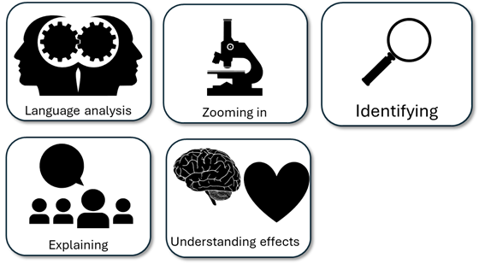
English Language Paper 1 – Q2: Improving Language Analyses
The man says his seat is special to him because he says it is his.
This means the stadium experience is described as being important to him.
Read the student answer to Q2 above.
What skills did they use in their answer?
How could they improve this answer?
Why does this answer not address AO2 effectively? Provide examples.
AO2
Explain, comment on and analyse how writers use language to achieve effects and
influence readers, using relevant subject terminology to support their views

Slide 2
Learning outcomes
To describe ways of improving our Q2 answers
To explain how student answers can better meet the requirements of the mark scheme
To evaluate the effectiveness of our improved Q2 answers

Slide 3


AO2
Explain, comment on and analyse how writers use language to achieve effects and influence readers, using relevant subject terminology to support their views
This is the mark scheme that examiners use to mark Q2:
Shows perceptive and detailed understanding of language:
• Analyses the effects of the writer’s choices of language
• Selects a range of judicious textual detail
• Makes sophisticated and accurate use of subject terminology
Student’s answer
Analysed the effects of the language
Included quotes to support ideas
Included subject terminology to support ideas

Slide 4
The student did include quotes, but…
The man says his seat is special to him because he says it is his.
This means the stadium experience is described as being important to him.
• Selects a range of judicious textual detail
Judicious means showing good judgement and sense.
… They didn’t explain the effects of language on the reader, and one good way to do this is by using a range of quotes that back up your interpretations.

Slide 5
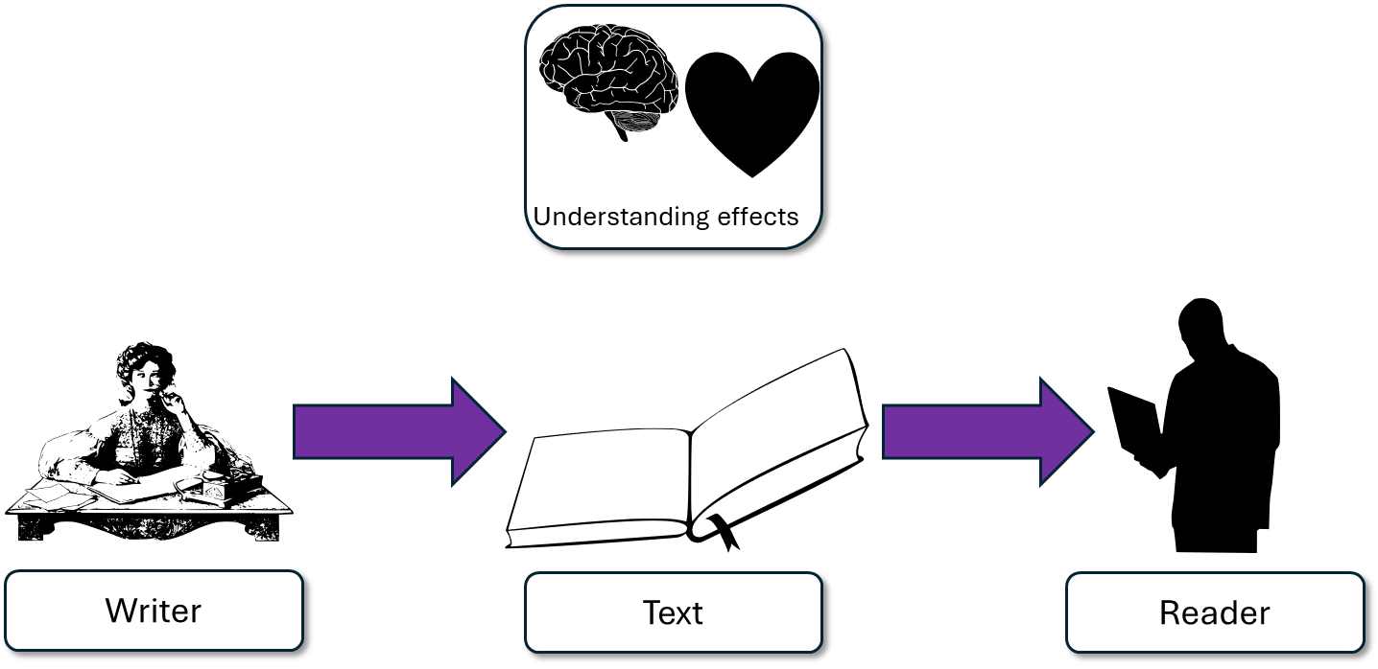
The writer presents the stadium experience as one of sheer joy for the narrator, as well as being very personal to him. “Amongst the masses you find your seat – your seat”. The writer describes the stadium as both impersonal and personal. Although there are masses of seats, the narrator has their own personal one.
This student’s answer uses the same quote but look at how they’ve zoomed in on that quote and explained the effects on the reader.
The narrator says the seat is his, but also uses the second person voice to make us feel as if we’re experiencing his own feelings, so therefore creating empathy.
This makes the stadium feel both impersonal and personal.
The student even goes on to clarify that despite there being thousands of the same seat, this one is special because it is their own.

Slide 6
“I want to convey how powerful this stadium is to the narrator.
“Wow, this isn’t just a stadium, this place is incredibly personal and powerful to the narrator.”
“Amongst the masses you find your seat – your seat”

Slide 7
Let’s help this student to improve part of their answer
This means the stadium experience is described as being important to him.
“A symbol of your ancestors, your people, your future. “
Student’s answer
Analysed the effects of the language
Included quotes to support ideas
Included subject terminology to support ideas
Using your understanding of the Q2 mark scheme, transform this into a more effective answer.

Slide 8
Let’s look at another student’s answer
Similarly, the extract ends with “A symbol of your ancestors, your people, your future.” The stadium is an symbol of the timelessness of the stadium and its impact on the narrator. The repetition of the pronoun and the use of anaphora work together to reiterate just how important the stadium is to the people who go there.
This student’s answer uses the quote we were exploring to explain that the stadium is an integral part of the narrator’s identity.
They go on to zoom in on the quote and analyse the use of both repetition and anaphora to convey the power of the stadium to the narrator and how it is part of their identity.

Slide 9
We should also include some language devices…
Similarly, the extract ends with “A symbol of your ancestors, your people, your future.” The stadium is an symbol of the timelessness of the stadium and its impact on the narrator. The repetition of the pronoun and the use of anaphora work together to reiterate just how important the stadium is to the people who go there.
Similarly, the extract ends with “A symbol of your ancestors, your people, your future.” The stadium represents timelessness of the stadium and its impact on the narrator.
Student 1
Student 2
Discuss: What has the Student 1 included that Student 2 has not?

Slide 10
You must explain your interpretations
Remember that it is crucial that you include explanations as to why the quotes and devices have effects on the reader.
How do those quotes make the reader think and feel?

Slide 11
Last lesson we wrote our own Q2 answers
Drafting and redrafting is an important activity in English because it helps you to become a more effective English analyst.
Using your learning from today and the success criteria, rewrite your answer.
Your answer for Q2
Analysed the effects of the language
Included quotes to support ideas
Included subject terminology (devices) to support ideas
Bonus criteria:
Included analytical verbs
Used a range of quotes to support your ideas

Slide 12



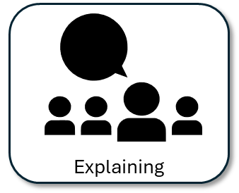

We will now peer assess our new answers
Swap your answers with another student.
Student’s Q2 answer |  | What could they add or change to improve their answer?
Analysed the effects of the language
Included quotes to support ideas
Included subject terminology (devices) to support ideas
Bonus criteria:
Included analytical verbs
Used a range of quotes to support your ideas

Slide 13
Student’s Q2 answer: |  | What could they add or change to improve their answer?
Analysed the effects of the language
Included quotes to support ideas
Included subject terminology (devices) to support ideas
Bonus criteria:
Included analytical verbs
Used a range of quotes to support your ideas
Notes:
To print out for students

Slide 14
Let’s recap Paper 1 Section A so far
Close your exercise books and cover up your notes.
What skills do you need to show for Q1? (4 marks)
What skills do you need to show for Q2? (8 marks)

Slide 15

Q1 Recap
Q1: You are given a short extract from the beginning of the text.
You are given four multiple choice questions: three options in each one.
Put a tick next to the correct answer for each question.
Do not put more than one tick per question.
Identifying

Slide 16
Q2 Recap
Q2: You are given a short extract from the text.
You are asked to explain how the writer describes something in that part of the text.
You must include quotes or evidence to support your ideas.
You should include some language devices.
You must explain how those quotes and devices support your ideas.

Slide 17

Plenary: Pie Chart
Draw a circle.
In your circle colour in a segment of how much you think you understand about answering Q2 effectively.
What else do you need to learn about to make it to 100%?
To describe ways of improving our Q2 answers
To explain how student answers can better meet the requirements of the mark scheme
To evaluate the effectiveness of our improved Q2 answers

