Slide 1
AQA A Level Biology
9 - Eukaryotic Cells
Organelles, Structure and Function

Slide 2
Eukaryotic Cells
Specification Point 3.2.1.1 - Structure of eukaryotic cells.
Eukaryotic cells are complex cells.
  Generally, eukaryotic cells contain a nucleus.
  There are a few exceptions, for example red blood cells don’t contain a nucleus.
Animals, plants, fungi and protists are all eukaryotic.
Eukaryotic cells contain a number of membrane-bound organelles.
  These components make up the cell.
Eukaryotic organisms can be multicellular or unicellular.
  Multicellular organisms consist of many cells.
  Unicellular organisms consist of a single cell.

Slide 3
A typical eukaryotic animal cell.

Slide 4

Animal cells are found in mammals, amongst other groups.

Slide 5
A typical eukaryotic plant cell.

Slide 6
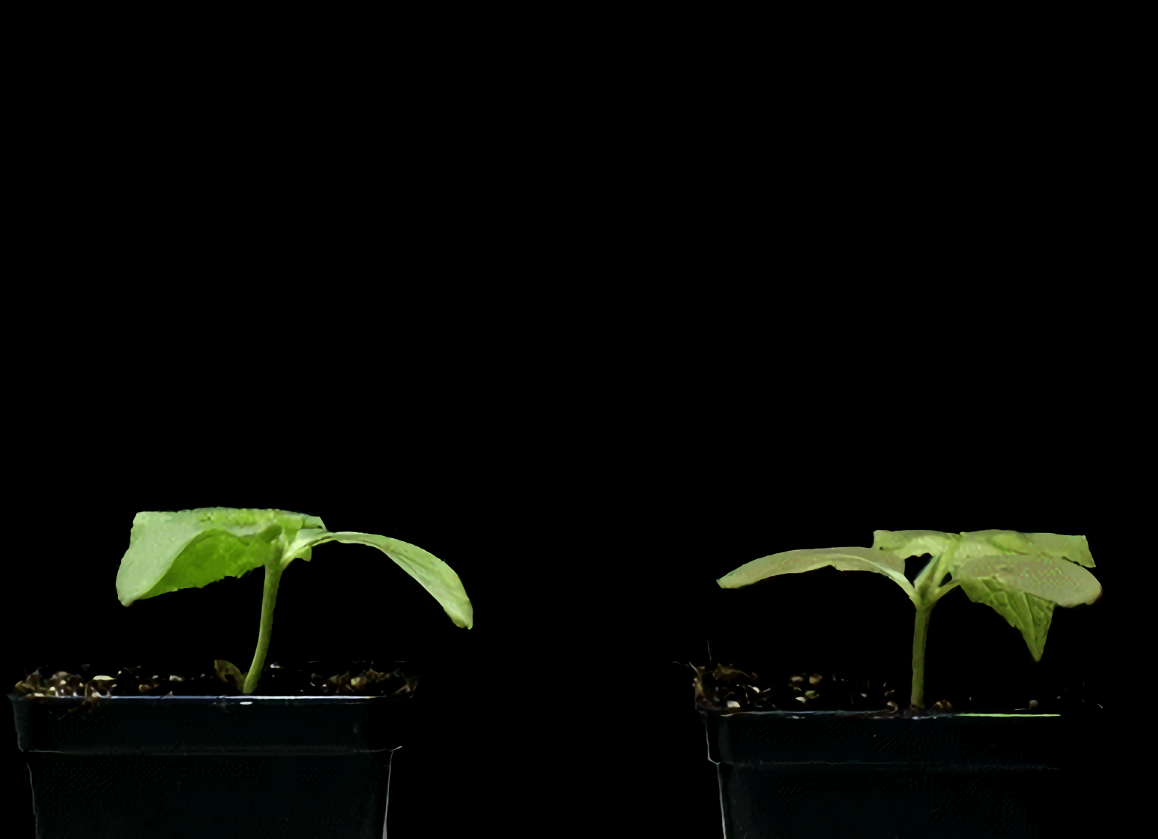
Plant cells are more complex in structure than animal cells.
One addition is that of a cellulose cell wall which helps to provide rigidity and structure to the plant.

Slide 7

Algae
Algae are a type of protist.
  They can be unicellular (Chlorella) or multicellular (seaweed).
Algal cells resemble plant cells.
  Algae contain a cellulose cell wall.
  Algae contain chloroplasts.
The chloroplasts in algae are different to those found in plants.
  They are of a different size and shape.
  There may only be a single chloroplast present in algae.
Algae, such as spirulina, are often found growing in aquatic conditions.

Slide 8
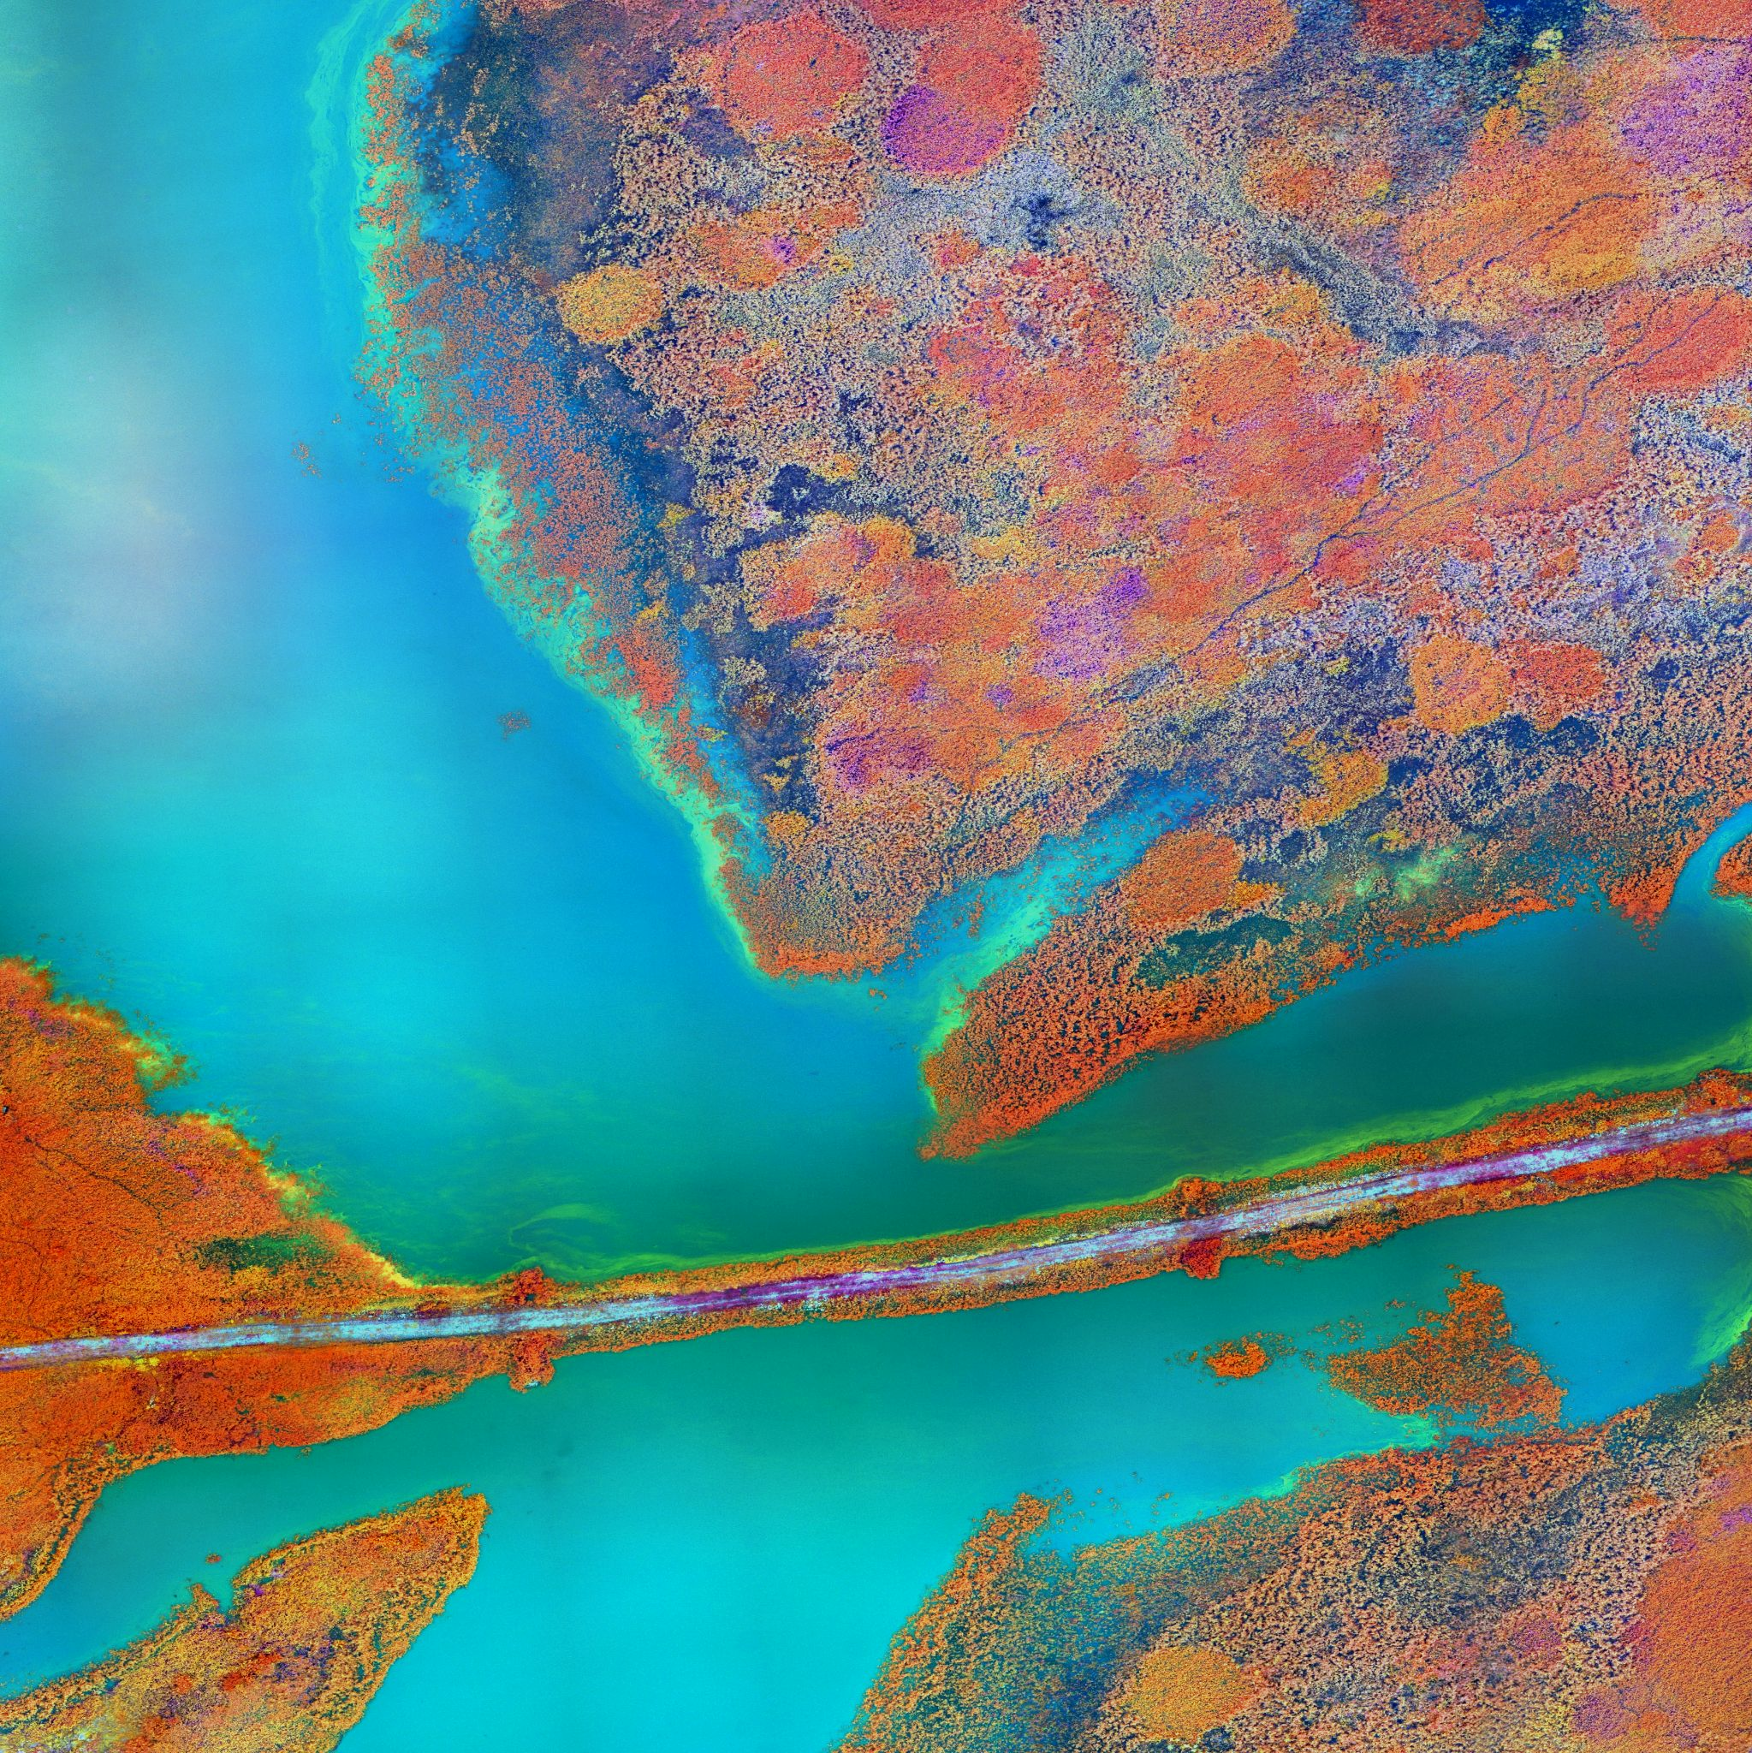
Algal blooms can form in lakes and rivers, causing disruption to natural ecosystems.

Slide 9
Fungi
CHITIN
CELL WALL
Fungal cells can be multicellular or unicellular.
  Multicellular fungi include mushrooms.
  Unicellular fungi include yeast.
Fungal cells resemble plant cells, with some differences:
  The fungal cell wall is made of the polymer chitin, rather than the polysaccharide cellulose.
  Fungal cells do not contain chloroplasts.
Fungal cells most closely resemble plant cells, but they don’t have chloroplasts and their cell wall is made from chitin, rather than cellulose.

Slide 10
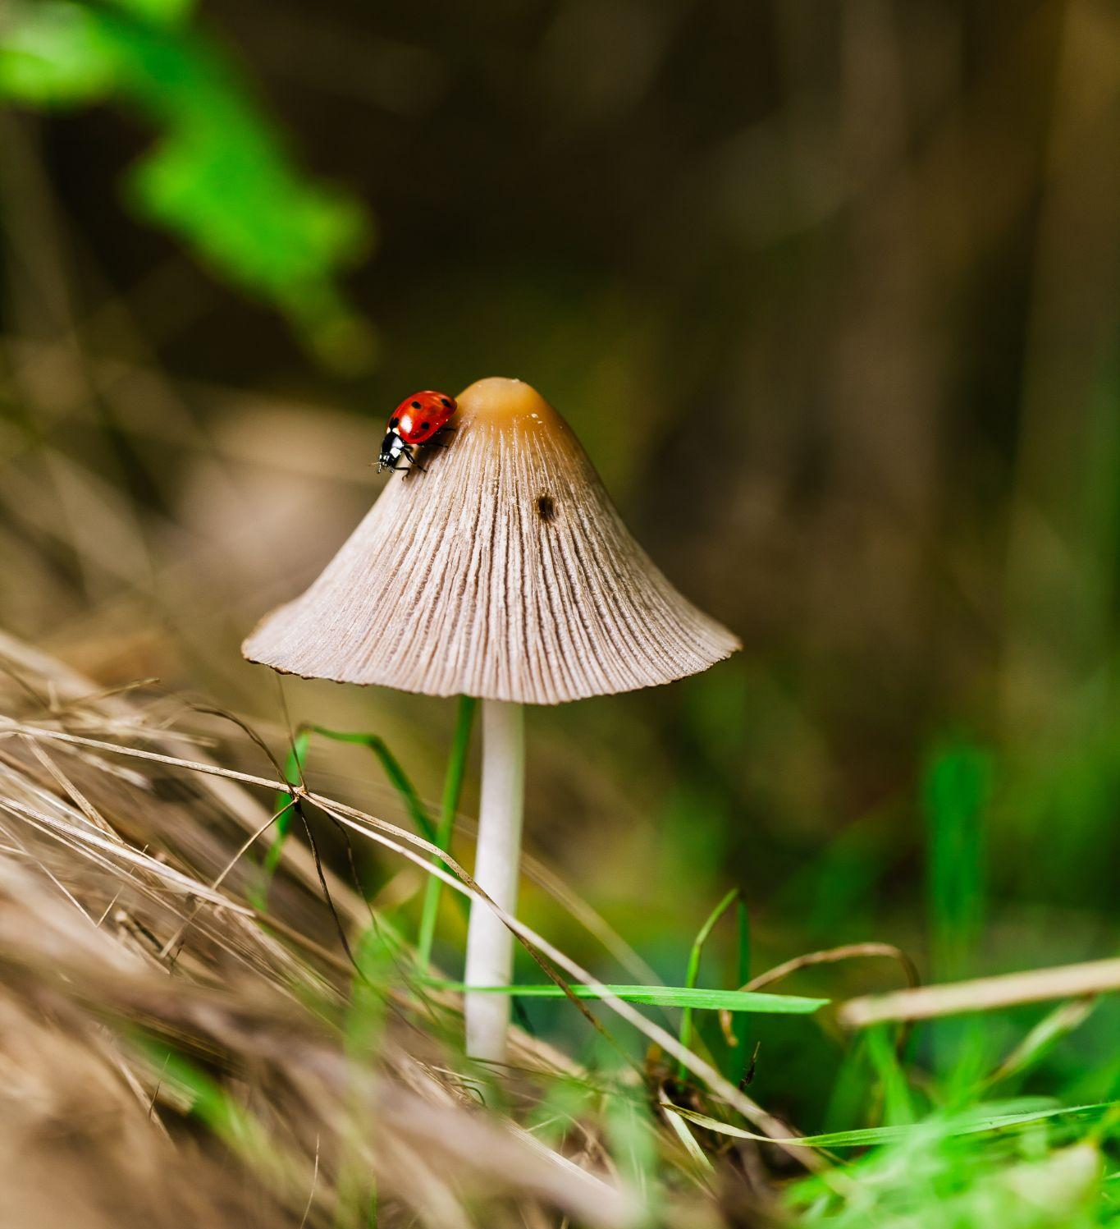
The mushroom is the quintessential fungus.

Slide 11
Functions of Organelles
The cell-surface membrane controls what enters and leaves the cell.
  It is made primarily from phospholipid and proteins.
  It also has receptor molecules on its surface, which allows for cell signalling.
The nucleus controls the activity of the cell.
  The nucleus is surrounded by the nuclear envelope. The envelope itself is full of pores.
  It contains chromosomes and one or more distinct structures called a nucleolus. Each chromosome is full of DNA, the molecular instructions to make proteins.
  The nucleus controls transcription in the cell.

Slide 12
NUCLEAR ENVELOPE
NUCLEOLUS
The nucleus controls all of the cell’s activities.
RIBOSOMES
NUCLEAR PORE

Slide 13
Functions of Organelles
The mitochondria are the powerhouses of the cell.
  Mitochondria have a double membrane.
    The inner membrane is folded to form cristae.
    Inside the cristae is a fluid matrix.
  Mitochondria are the sites of aerobic respiration - they produce ATP.
The chloroplasts are the site of photosynthesis.
  Chloroplasts also have a double membrane.
    The inner membranes are called the thylakoids.
    Thylakoids are stacked into grana.
    Grana are linked by lamellae.
  Some parts of photosynthesis take place in the grana, other parts in the fluid stroma.

Slide 14
A mitochondrion is the site of aerobic respiration.
DNA
MATRIX GRANULE
RIBOSOME
INNER MEMBRANE
MATRIX
ATP SYNTHASE
INTERMEMBRANE SPACE
OUTER MEMBRANE

Slide 15
The chloroplast is the site of photosynthesis.
INNER MEMBRANE
RIBOSOME
OUTER MEMBRANE
GRANUM
DNA
STROMA
THYLAKOID
THYLAKOID MEMBRANE
LAMELLA

Slide 16
Functions of Organelles
The Golgi apparatus processes and packages lipids and proteins.
  The Golgi apparatus is a group of membrane-bound sacs.
  Vesicles are found at the edge of these sacs.
    They store lipids and proteins synthesised by the Golgi and export them out of the cell.
Lysosomes are a type of Golgi vesicle.
  They contain lysozyme, a digestive enzyme.
  Lysosomes can be used to digest invading cells or organelles that have ceased to function.
The ribosome synthesises proteins.
  Ribosomes are very small organelles that float in the cytoplasm.
  They are a mixture of protein and RNA.

Slide 17
The Golgi apparatus processes and packages new lipids and proteins.
VESICLES

Slide 18
PROTEIN
mRNA
LARGE SUBUNIT
Proteins are synthesised at ribosomes.
SMALL SUBUNIT

Slide 19
Functions of Organelles
The rough endoplasmic reticulum (RER) folds and processes proteins.
  The RER is covered with ribosomes.
  The proteins from the ribosomes travel to the RER for further modifications.
The smooth endoplasmic reticulum (SER) makes and processes lipids.
  The SER is similar in structure to the RER but doesn’t have any ribosomes.
Cell walls support cells.
  The cell wall is a rigid structure that surrounds various types of cell.
  Plants, algae and fungi all have cell walls.
The vacuole maintains pressure inside the cell.
  The vacuole is a membrane-bound organelle in the cytoplasm.
  It contains cell sap, a weak solution of salts.
  The membrane itself is called the tonoplast.

Slide 20
RER
NUCLEUS
The RER and SER are closely associated with the nucleus.
SER

Slide 21
CELLULOSE
MICROFIBRILS
Plant cell walls are primarily made up of the polysaccharide cellulose.
CELL WALL
CELL-SURFACE
MEMBRANE

Slide 22
Specialisation
In multicellular organisms, cells will specialise to carry out a particular task.
Epithelial cells in the small intestine have many finger-like projections (villi) on their surface.
  The villi themselves are further folded to form microvilli.
  Both of these specialisations aim to increase surface area for absorption.
Red blood cells have no nucleus.
  This makes more room for the oxygen-carrying compound haemoglobin.
Sperm cells have lots of mitochondria.
  Mitochondria provide energy through respiration.
  This helps the sperm swim relatively long distances to the egg.

Slide 23
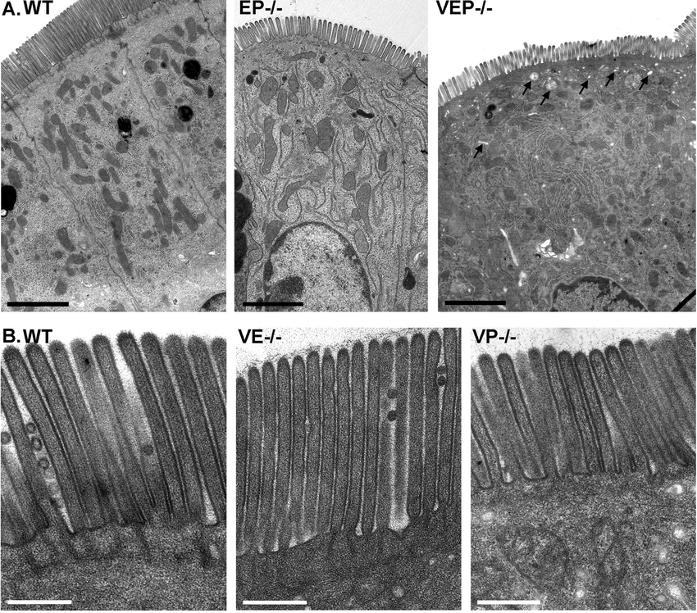
Microvilli on the surface of the larger villi.
These increase their surface area even further.

Slide 24
Red blood cells (or erythrocytes) are enucleated.
This means they do not have a nucleus, which frees up more space for carrying haemoglobin.

Slide 25
Sperm cells are full of mitochondria which are needed to provide energy for swimming.
MITOCHONDRIA

Slide 26
Organisation
Multicellular organisms organise their cells into groups.
A group of cells is called a tissue.
  Epithelial tissue for example.
A group of tissues working together form an organ.
  The heart, brain etc.
Different organs make up an organ system.
  The circulatory system, the digestive system etc.
ORGANELLES
CELLS
TISSUES
INCREASING COMPLEXITY →
ORGANS
ORGAN SYSTEMS

