Slide 1
AQA A Level Biology
8 - ATP, Water and Inorganic Ions
More Biological Molecules

Slide 2
ATP
3.1.6 - ATP.
Energy is important for many biological processes.
  Plants need energy for active transport, DNA replication and protein synthesis.
  Animals need more energy for movement.
Plants and animals use the energy molecule adenosine triphosphate (ATP).
  ATP releases energy in small, manageable quantities.
  ATP is formed from the breakdown of glucose during respiration.
ATP contains the nucleobase adenine.
  It also contains a ribose sugar and three molecules of inorganic phosphate.

Slide 3
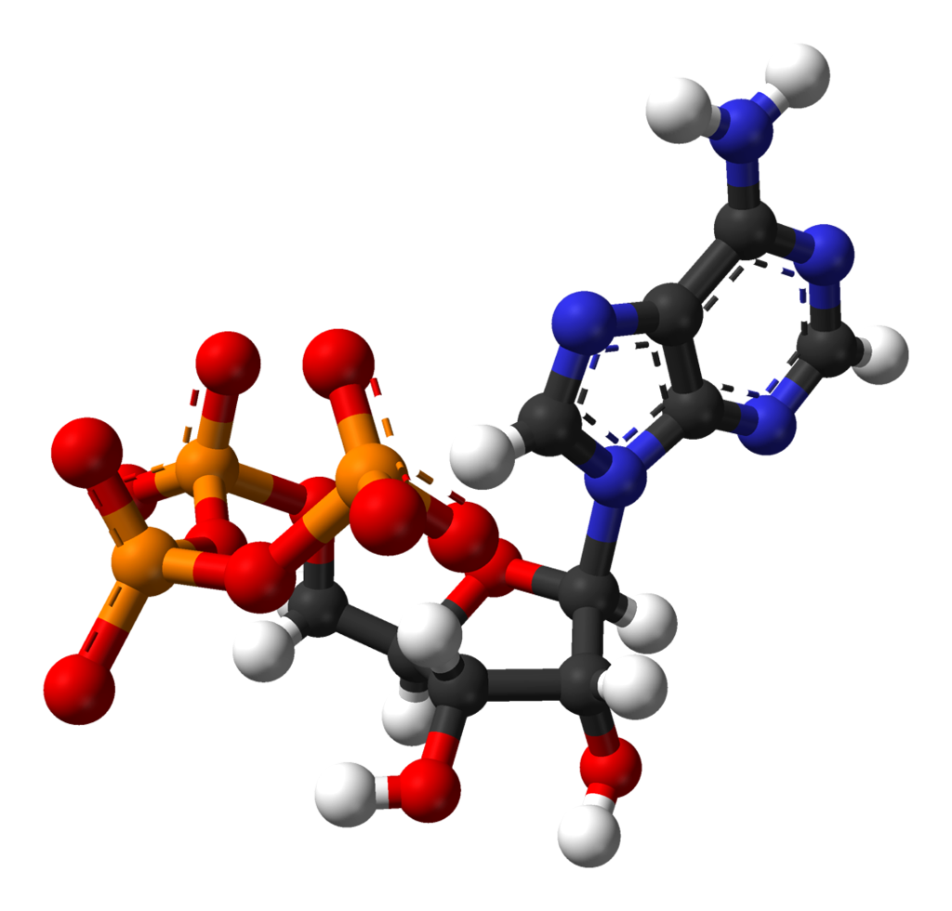
ATP consists of an adenine base, a ribose sugar and three phosphates.
Plants and animals use ATP as a form of energy currency.
ADENINE
PHOSPHATE
RIBOSE

Slide 4
Using ATP
ATP is hydrolysed into ADP (adenosine diphosphate) when the cell requires energy.
During ATP hydrolysis, a phosphate bond is broken.
  This releases a small amount of energy (around 30 kJ/mol).
ATP hydrolysis is catalysed by an enzyme called ATP hydrolase.
ATP is hydrolysed to ADP by the enzyme ATP hydrolase.

Slide 5
Other ATP Reactions
The hydrolysis of ATP can be coupled to other reactions.
  These reactions are likely to require energy.
  This ensures excess energy is not lost needlessly.
ATP can be used to phosphorylate other compounds.
  Phosphorylation often makes compound more reactive.
ATP can be reformed using the enzyme ATP synthase.
  Energy is used in order to resynthesise ATP in a condensation reaction.
ADP is converted to ATP by the enzyme ATP synthase.

Slide 6
Water
3.1.7 - Water.
Water (H₂O) is vital to living organisms and makes up around 80% of the cell’s contents.
Water is a metabolite.
  This means it is involved in lots of different chemical reactions.
  These include condensation and hydrolysis reactions.
Water is a solvent.
  Many substances dissolve in water.
  As many reactions only occur in solution, this makes water essential.
Water is a temperature buffer.
  Water has a high latent heat of vaporisation.
  This means it takes a lot of heat energy for it to evaporate.
  Water therefore helps with temperature control.

Slide 7

Water is also a habitat for many different aquatic species.

Slide 8
Water
Water molecules are cohesive.
  This means they stick together.
  This helps water to transport dissolved solutes around plants.
Water is a polar molecule.
  The electrons in the two hydrogen atoms are pulled towards the oxygen atom.
  This makes the oxygen slightly negatively charged (δ-) and the hydrogens slightly positively charged (δ+).
The difference in charges between neighboring water molecules leads to hydrogen bonding.
  The δ+ hydrogen can attract the δ- oxygen of other water molecules.
  This gives water several useful bonding properties.
δ-
δ+
Water, colloquially referred to as a mickey mouse molecule, can form cohesive hydrogen bonds with other molecules.

Slide 9
Inorganic Ions
3.1.8 - Inorganic ions.
An ion is an atom or molecule with a charge.
Positively charged ions are called cations.
  Sodium ions (Na⁺) and calcium ions (Ca²⁺) are both cations.
Negatively charged ions are called anions.
  Chlorine ions (Cl⁻) and phosphate ions (PO₄³⁻) are both anions.
Inorganic ions don’t contain carbon.
  There are several examples of useful ions in the body.

Slide 10
Uses of Ions
Iron ions are important in haemoglobin.
  Haemoglobin is a quaternary protein with an iron ion (Fe²⁺) in the centre.
  The Fe²⁺ is crucial for transporting oxygen around the body.
The concentration of hydrogen ions determines acidity.
  The pH of a solution is based on the concentration of hydrogen ions (H⁺). The higher the H⁺ concentration, the lower the pH.
  Changes in pH have effects on many enzyme-driven reactions.
Sodium ions help with glucose transport.
  A molecule of glucose may be transported into a cell alongside sodium ions (Na⁺).
  This is referred to as co-transport.
Phosphate groups are found in many key molecules.
  DNA, RNA and ATP all contain phosphate ions (PO₄³⁻).

Slide 11
Haemoglobin is a metalloprotein with an iron (Fe²⁺) core.
When oxygen binds to haemoglobin, oxyhaemoglobin is formed.

Slide 12
ACIDIC
The concentration of hydrogen ions (H⁺) directly influences the acidity or alkalinity of a solution.
Many enzymes are very sensitive to changes in pH.
INCREASING CONCENTRATION OF H⁺
ALKALINE

Slide 13
The DNA backbone requires phosphates (PO₄³⁻) to bind to sugars.
This creates the sugar-phosphate backbone.

