Slide 1
AQA A Level Biology
7 - DNA and RNA
Structure, Function and Replication

Slide 2
DNA and RNA
3.1.5.1 - Structure of DNA and RNA.
DNA and RNA are both types of nucleic acid.
  DNA (deoxyribonucleic acid) stores genetic information.
  RNA (ribonucleic acid) transfers genetic information from the nucleus to the ribosome.
All nucleotides have the same basic structure:
  A phosphate group.
  A pentose sugar.
  A nitrogen-containing base.
PHOSPHATE
NITROGENOUS BASE
A single, functional unit of DNA is called a nucleotide.
PENTOSE
SUGAR

Slide 3
Polynucleotides
Nucleotides join together to form polynucleotides.
  DNA is a polymer of many thousands of nucleotides.
Nucleotides are joined together by condensation reactions.
  A phosphodiester bond will form between the sugar of one nucleotide and the phosphate of another nucleotide.
The chain of sugars and phosphates is referred to as the sugar-phosphate backbone.
PHOSPHODIESTER BOND

Slide 4
DNA Structure
DNA is arranged in a double helix.
  This means that DNA is formed from 2 distinct strands.
  These strands wind around each other to form a helical structure.
DNA is a polymer.
  DNA forms a long chain several billions of base pairs long.
  DNA molecules are coiled tightly in the nucleus of the cell.
PHOSPHATE
DNA contains the pentose sugar deoxyribose. Whilst the phosphate is identical in every DNA monomer, there are 4 different nitrogenous bases: adenine (A), thymine (T), cytosine (C) and guanine (G).
A, T, C, G
DEOXYRIBOSE
SUGAR

Slide 5
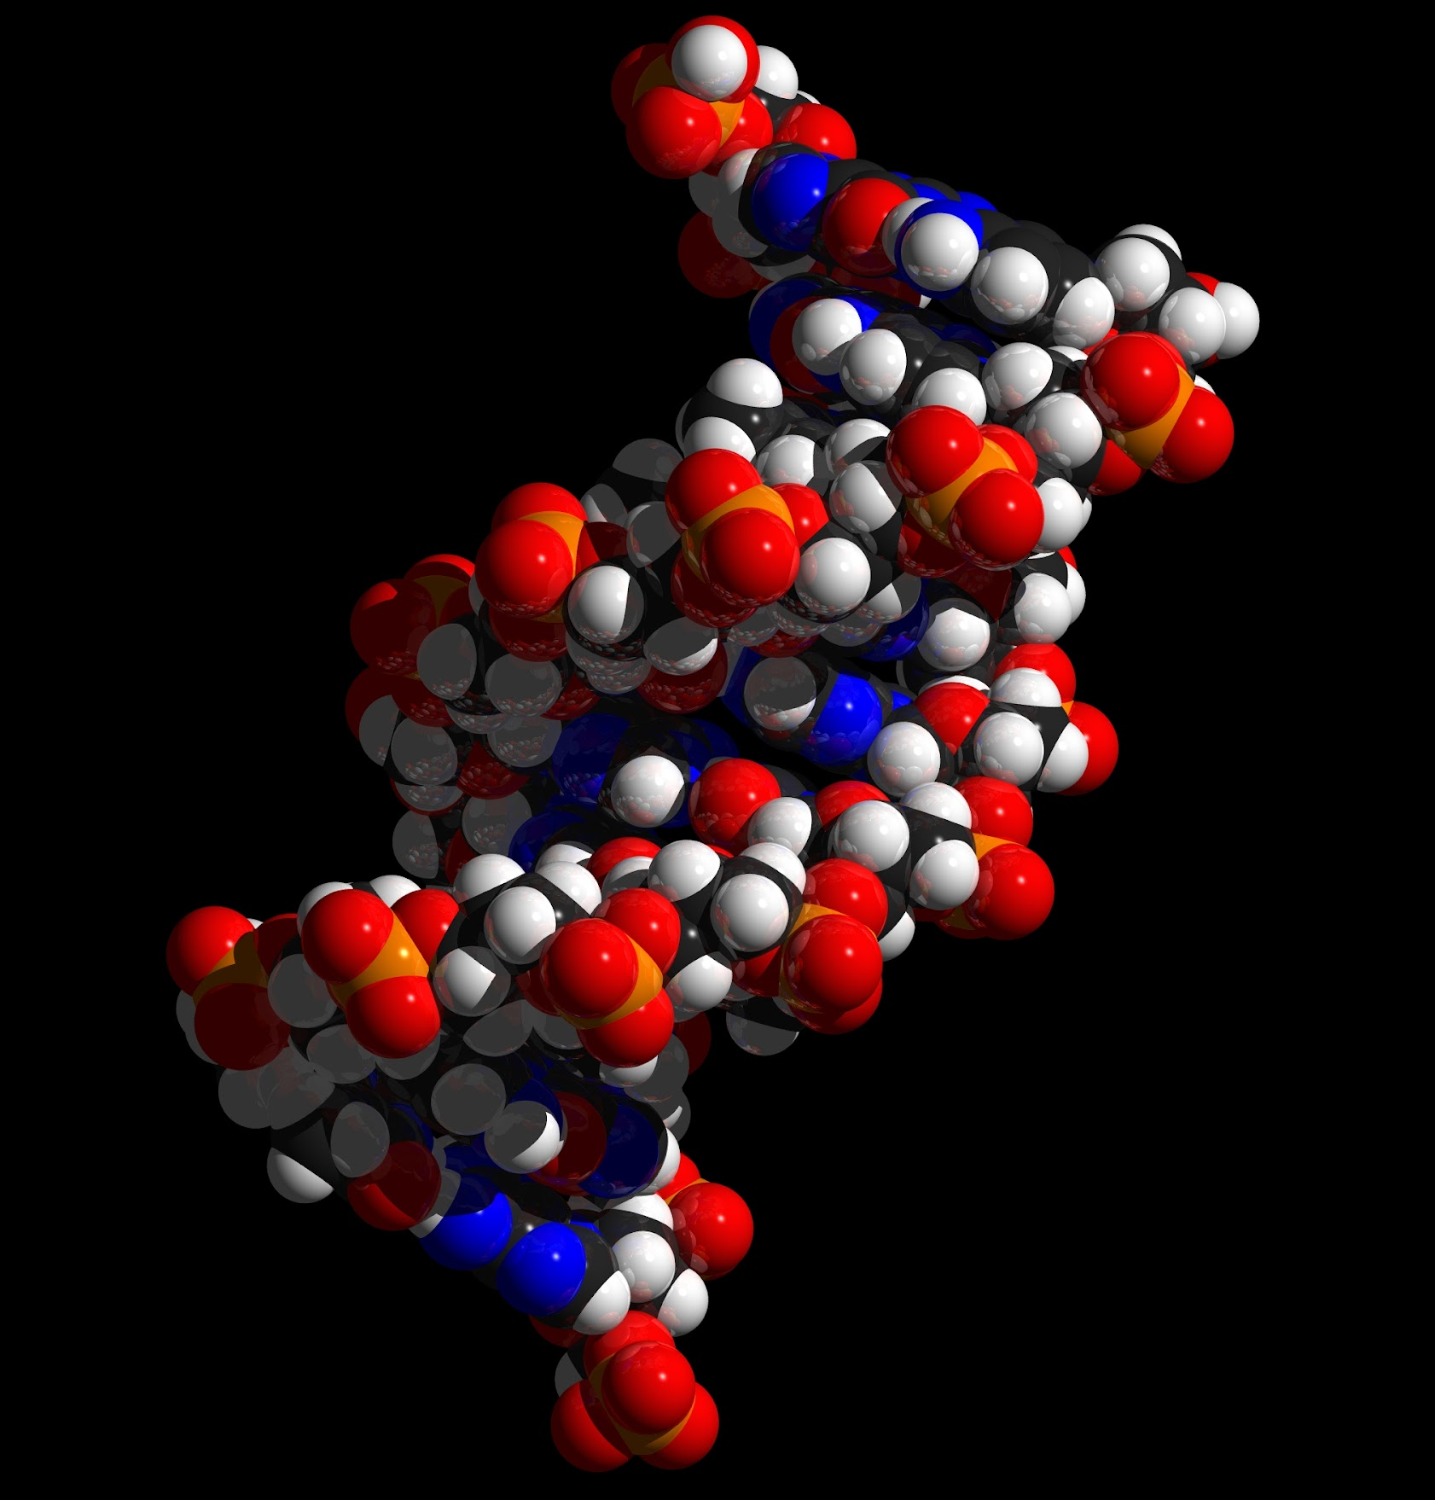
Interactions between nearby DNA monomers leads to coiling in the polymer - a double helix.
As the two strands run in opposite directions, they are referred to as being antiparallel to one another.

Slide 6
Complementary Base Pairing
2 polynucleotide strands can join together by hydrogen bonding.
  Each base can only join with one other base.
  Adenine (A) will always join with thymine (T), forming two hydrogen bonds.
  Guanine (G) will always join with cytosine (C), forming three hydrogen bonds.
There will be equal amounts of complementary bases in the polynucleotide.
A
T
C
G

Slide 7
RNA
RNA is similar in structure to DNA.
  Both contain a phosphate, sugar and nitrogenous base.
RNA has some differences to DNA:
  The sugar in RNA is ribose rather than deoxyribose.
  The base uracil (U) replaces thymine. Uracil pairs with adenine in RNA.
  RNA polynucleotides are mostly single stranded.
PHOSPHATE
The pyrimidine uracil (U) replaces thymine in RNA. Strands of RNA are usually much shorter than DNA.
A, U, C, G
RIBOSE
SUGAR

Slide 8
The structures of DNA and RNA, whilst similar, do have some key differences.
RNA is primarily single stranded, has a ribose sugar and contains a uracil base.

Slide 9
The Genetic Code
DNA carries the genetic code.
  This is a set of molecular instructions for making proteins.
The structure of DNA was first discovered by the biologists James Watson and Francis Crick in 1953.
  Watson and Crick coined the term ‘double-helix’ to help explain the structure of DNA.
The double helix explained how DNA was able to synthesise proteins without itself being used up.
  This would come to be referred to as semi-conservative replication.

Slide 10
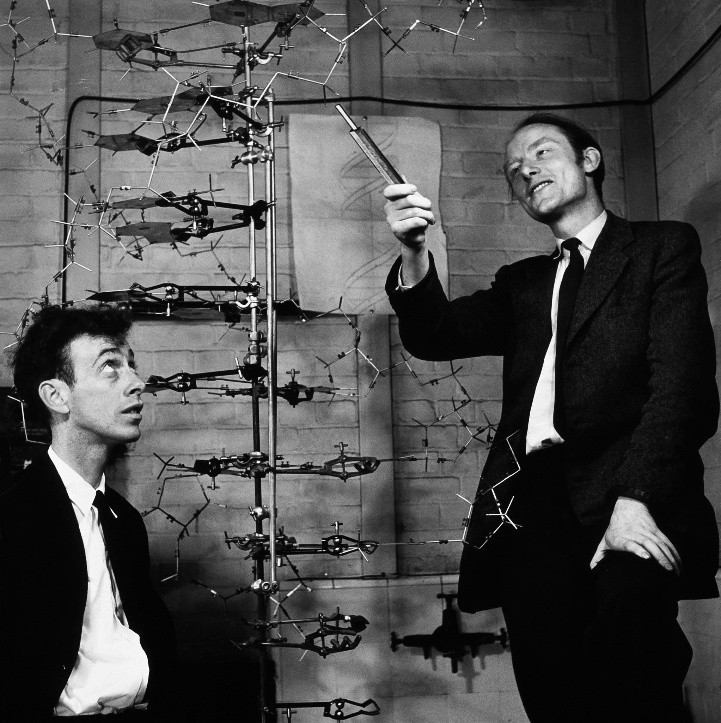
James Watson (R) and Francis Crick (L) discovered the structure of DNA at Cambridge University in 1953.
They won the Nobel Prize for this discovery in 1962.

Slide 11
DNA Replication
The enzyme DNA helicase breaks hydrogen bonds between bases on the 2 different strands.
  This makes the helix unwind.
Each single strand acts as a template for new strands. Free DNA nucleotides are attracted to their complementary exposed bases.
  A will bind with T and C will bind with G.
  Complementary nucleotides will pair through hydrogen bonding.
Phosphodiester bonds between neighboring nucleotides are formed through the action of the enzyme DNA polymerase.
  Each new DNA polymer contains one original strand and one new strand.

Slide 12
DNA Polymerase
Each end of the DNA polymer is slightly different.
  The 5’ end - this refers to the 5th carbon on the deoxyribose sugar which has a phosphate group attached to it.
  The 3’ end - this refers to the 3rd carbon on the deoxyribose sugar which has a hydroxyl group attached to it.
During DNA replication, DNA polymerase is only complementary to the 3’ end.
  This means that the polymerase moves down the DNA template in a 3’ to 5’ direction.
  The new strand is synthesised in a 5’ to 3’ direction.

Slide 13
LIGASE
DNA POLYMERASE
The strands in DNA are antiparallel.
This means the DNA polymerase molecule working on one side of the template strand is moving in the opposite direction to the other DNA polymerase molecule.
3’
5’
3’
5’
5’
3’
DNA POLYMERASE
HELICASE

Slide 14
Semi Conservative Replication
Watson and Crick’s theory about DNA replication was not confirmed until 1958.
Two scientists called Matthew Meselson and Franklin Stahl proved that DNA is replicated semi-conservatively.
  During replication, half of the DNA polymer is conserved and half is new.
  These experiments are now termed the Meselson-Stahl experiments.
Two groups of bacteria were grown for several generations.
  One group was grown in a broth containing the nitrogen isotope ¹⁴N.
  The other group was grown in a broth containing ¹⁵N.
  As the bacteria reproduced, they incorporated the nitrogen into their cells.
A sample of DNA was taken from each colony, and centrifuged.
  The DNA grown in the ¹⁵N settled lower down the test tube than the DNA grown in the ¹⁴N due to its higher density.

Slide 15
Semi Conservative Replication
The bacteria grown in the ¹⁵N was removed and transferred to a broth containing ¹⁴N.
  As the bacteria replicated, they took up some of the ¹⁴N.
  This resulted in a hybrid of ¹⁴N and ¹⁵N DNA.
The DNA was extracted and spun again.
  The DNA settled in the middle of the test tube, between the pure ¹⁴N and ¹⁵N values.
This confirmed that the bacteria was replicating semi-conservatively.

Slide 16
Meselson and Stahl confirmed the semi-conservative nature of DNA replication in an experiment taking place in 1958.
Because strands containing both ¹⁵N and ¹⁴N are incorporated into the DNA polymer, one strand must be conserved and the other must be new.

