Slide 1
AQA A Level Biology
6 - Factors Affecting Enzymes
Enzyme Activity and Inhibition

Slide 2
Factors Affecting Enzymes
Specification Point 3.1.4.2 - Many proteins are enzymes.
We can measure the activity of enzymes in 2 ways:
  How fast a product is made.
  How fast the substrate is broken down.
Enzymes are affected by temperature.
  As with many chemical reactions, as the temperature increases the rate of enzyme activity also increases.
This is due to increased kinetic energy present in the reaction.
  More kinetic energy means there are more collisions between enzyme and substrate molecules.
  A greater number of collisions increases the likelihood of successful collisions.
Successful collisions between enzyme and substrate will form enzyme-substrate (E-S) complexes.

Slide 3
SUBSTRATE
Enzyme and substrate come together in the active site to form an E-S complex.
An increased temperature will increase the likelihood of these substrates both colliding with the active site of the enzyme.
ACTIVE SITE
ENZYME

Slide 4
Denaturation
An increase in temperature makes the bonds inside the enzyme vibrate.
After a certain temperature, the vibrating bonds begin to break.
  This rupturing of bonds changes the shape of the active site.
  The active site and substrate will no longer be complementary to one another so E-S complexes cannot form.
At this point the enzyme is said to be denatured.
  It is no longer functional as a biological catalyst.
If the active site changes shape, it will no longer be complementary to the substrate and is said to have been denatured.

Slide 5
All enzymes have an optimum temperature.
Enzymes in the human body work best at around 37°C. Others, like those found in biological washing powder, have a much higher optimum.
RATE OF REACTION →
OPTIMUM TEMPERATURE
TEMPERATURE (°C) →

Slide 6
pH
Enzymes also have an optimum pH value.
  pH is a measure of acidity or alkalinity.
Most human enzymes work best at a neutral pH of around 7.
Some human enzymes work best at an acidic pH.
  Pepsin, a protein-digesting enzyme found in the stomach, works best at pH 2.
H⁺ and OH⁻ ions can disrupt bonds in the active site of the enzyme.
  Ionic bonds and hydrogen bonds can be broken.
  These affect the tertiary structure of the enzyme.
  E-S complexes will no longer form.

Slide 7
ACIDIC
ALKALINE
All enzymes have an optimum pH.
Most enzymes in the body work best at around pH 7.
RATE OF REACTION →
OPTIMUM pH
pH →

Slide 8
Substrate Concentration
The higher the substrate concentration, the faster the rate of an enzyme-driven reaction.
  The is because there is a higher chance of collisions between enzymes and substrates.
  More active sites are likely to become occupied.
At a certain point, all the enzyme active sites will become saturated.
  This means all the active sites are occupied by substrate.
  Any further increase in substrate will make no difference to the rate of reaction.
This is referred to as the V_{max} of the reaction.
  V_{max} represents the maximum rate achievable by a biological system.

Slide 9
RATE OF REACTION INCREASES WITH SUBSTRATE CONCENTRATION
V_{MAX}
At V_{max} all enzyme active sites are occupied.
Further increases to the substrate concentration will not increase the rate of reaction.
RATE OF REACTION →
½ V_{MAX}
CONCENTRATION OF SUBSTRATE →

Slide 10
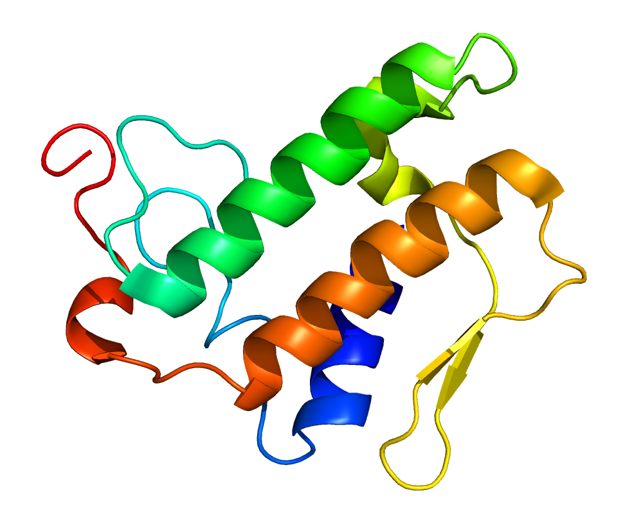
Enzyme Concentration
The more enzymes available, the greater the number of active sites.
  This increases the likelihood of collisions between substrate and active site.
If the amount of substrate is limited, there may be more active sites than available substrate.
  Any increase to the number of active sites is superfluous as there are already enough active sites to deal will all the available substrate.
  Increasing the amount of substrate will counteract this.
The enzyme phospholipase breaks down phospholipids in the digestive system of mammals. Increasing the concentration of phospholipase boosts the number of active sites and increases the rate of digestion.

Slide 11
Enzyme Inhibition
Enzyme activity can be inhibited.
  Inhibitors can either be competitive or noncompetitive.
Competitive inhibitors have a similar shape to the substrate.
  This means they compete with genuine substrates for the enzyme active sites.
  When the competitive inhibitor binds, it blocks the active site, preventing substrate from binding.
  This slows down the rate of reaction.
Non-competitive inhibitors bind to an allosteric site.
  This is a site on the enzyme away from the active site.
  When the inhibitor binds to the allosteric site, a change in the shape of the active site is induced.
  Substrate molecules will no longer fit with the active site.
  This slows down the rate of reaction.

Slide 12
Competitive inhibition occurs when the inhibitor has a similar shape to the substrate. The inhibitor binds to the active site of the enzyme, preventing the substrate from binding.
The effect of competitive inhibition on reaction rate. A high concentration of substrate can minimize the efficacy of a competitive inhibitor.
COMPETITIVE INHIBITOR
ACTIVE SITE
RATE OF REACTION →
ENZYME
NO INHIBITOR
COMPETITIVE INHIBITOR
CONCENTRATION OF SUBSTRATE →

Slide 13
Non-competitive inhibition occurs when the inhibitor has a different shape to the substrate. The inhibitor binds to an allosteric site, changing the shape of the active site and preventing the substrate from binding.
The effect of non-competitive inhibition on reaction rate. As the allosteric site changes the shape of the enzyme’s active site, substrate concentration has no effect on the rate of reaction.
NON-COMPETITIVE INHIBITOR
RATE OF REACTION →
ALLOSTERIC SITE
NO INHIBITOR
NON-COMPETITIVE INHIBITOR
CONCENTRATION OF SUBSTRATE →

Slide 14
Enzyme Controlled Reactions
Practical 1 - Measuring the rate of an enzyme-controlled reaction.
Catalase is an enzyme that helps to breakdown hydrogen peroxide (H₂O₂) into oxygen (O₂) and water (H₂O):
Set up several boiling tubes, each containing the same volume and concentration of H₂O₂.
  Keep the pH constant using a buffer.
Put each boiling tube in a water bath at different temperatures.
  For example at 10°C, 20°C and 30°C.
Add catalase to each boiling tube.
  Add the same volume and concentration to each tube.
Record how much O₂ is given off in the first minute of the reaction.
Catalase experiment video.
Catalase is an enzyme that helps to prevent the buildup of toxic H₂O₂ in cells.

Slide 15
Enzyme Controlled Reactions
Amylase is an enzyme that breaks down starch into maltose.
Starch goes a blue-black colour when iodine is added to it.
Amylase is added to the spotting tile.
  As the starch is broken down, the iodine returns to its orange colour.
The amylase will work at a different rate at different temperatures:
  It will break down the starch slowly at low temperatures.
  It will break down the starch quickly at the optimum temperature.
  At high temperatures the amylase will denature and stop working.
Temperature practical video.

Slide 16
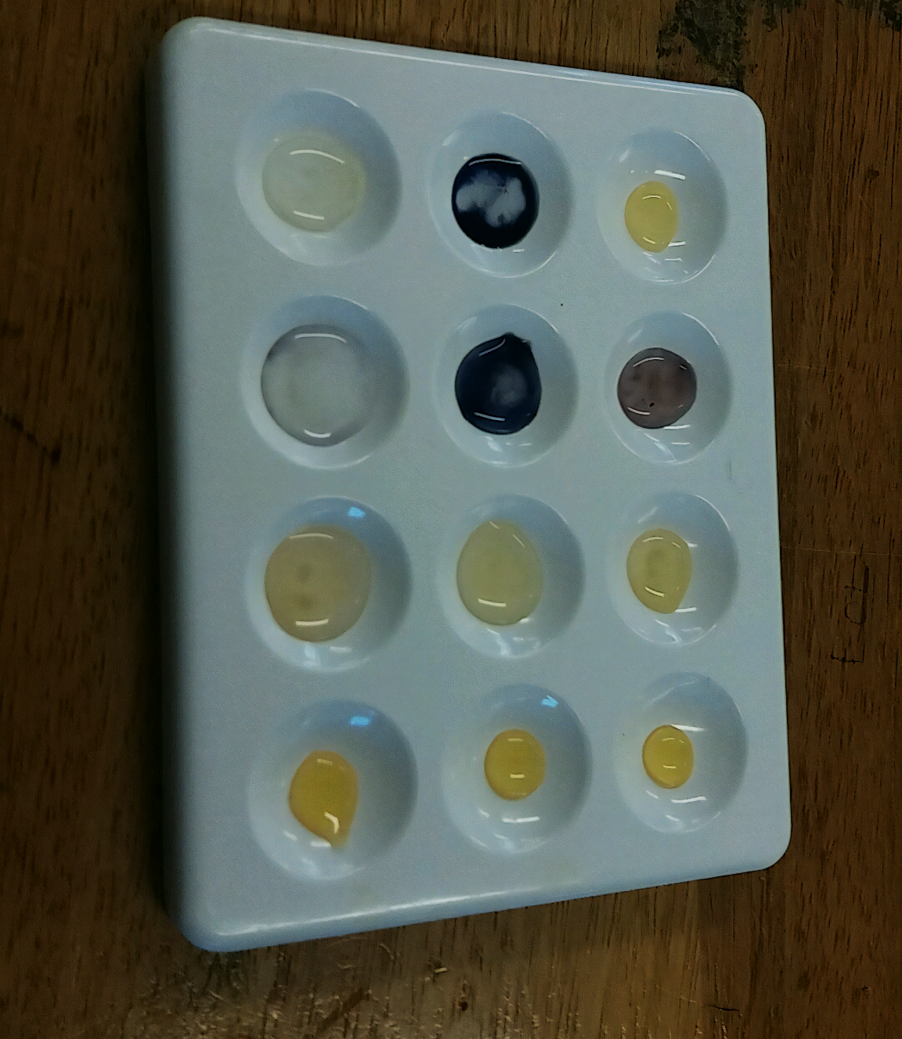
As the amylase enzyme breaks down the starch into maltose, the iodine stain reverts from its blue-black colour to orange.

