Slide 1
AQA A Level Biology
61 - Gene Therapy, Genetic Fingerprinting
DNA Probes, Screening and Gel Electrophoresis

Slide 2
Gene Therapy
Specification Point 3.8.4.2 - Differences in DNA between individuals of the same species can be exploited for identification and diagnosis of heritable conditions.
Gene therapy is an experimental technique that uses genes to treat or prevent disease.
  A mutated allele that causes disease may be replaced with a healthy allele.
  A mutated allele may be silenced or inactivated by inserting a section of DNA in the middle of it.
Somatic gene therapy involves altering the genes of body cells.
  The effects of somatic gene therapy will not be passed on to the patient’s children.
Germline gene therapy involves altering the genes of sex cells.
  The effects of germline gene therapy will be passed on to the patient’s children and subsequent generations.
Many people have ethical concerns over the use of gene therapy.
  Some people are concerned that gene therapy might be used to enhance human traits such as height or intelligence.
  Others are concerned that the high costs associated with gene therapy will mean it is only available to the wealthy.

Slide 3
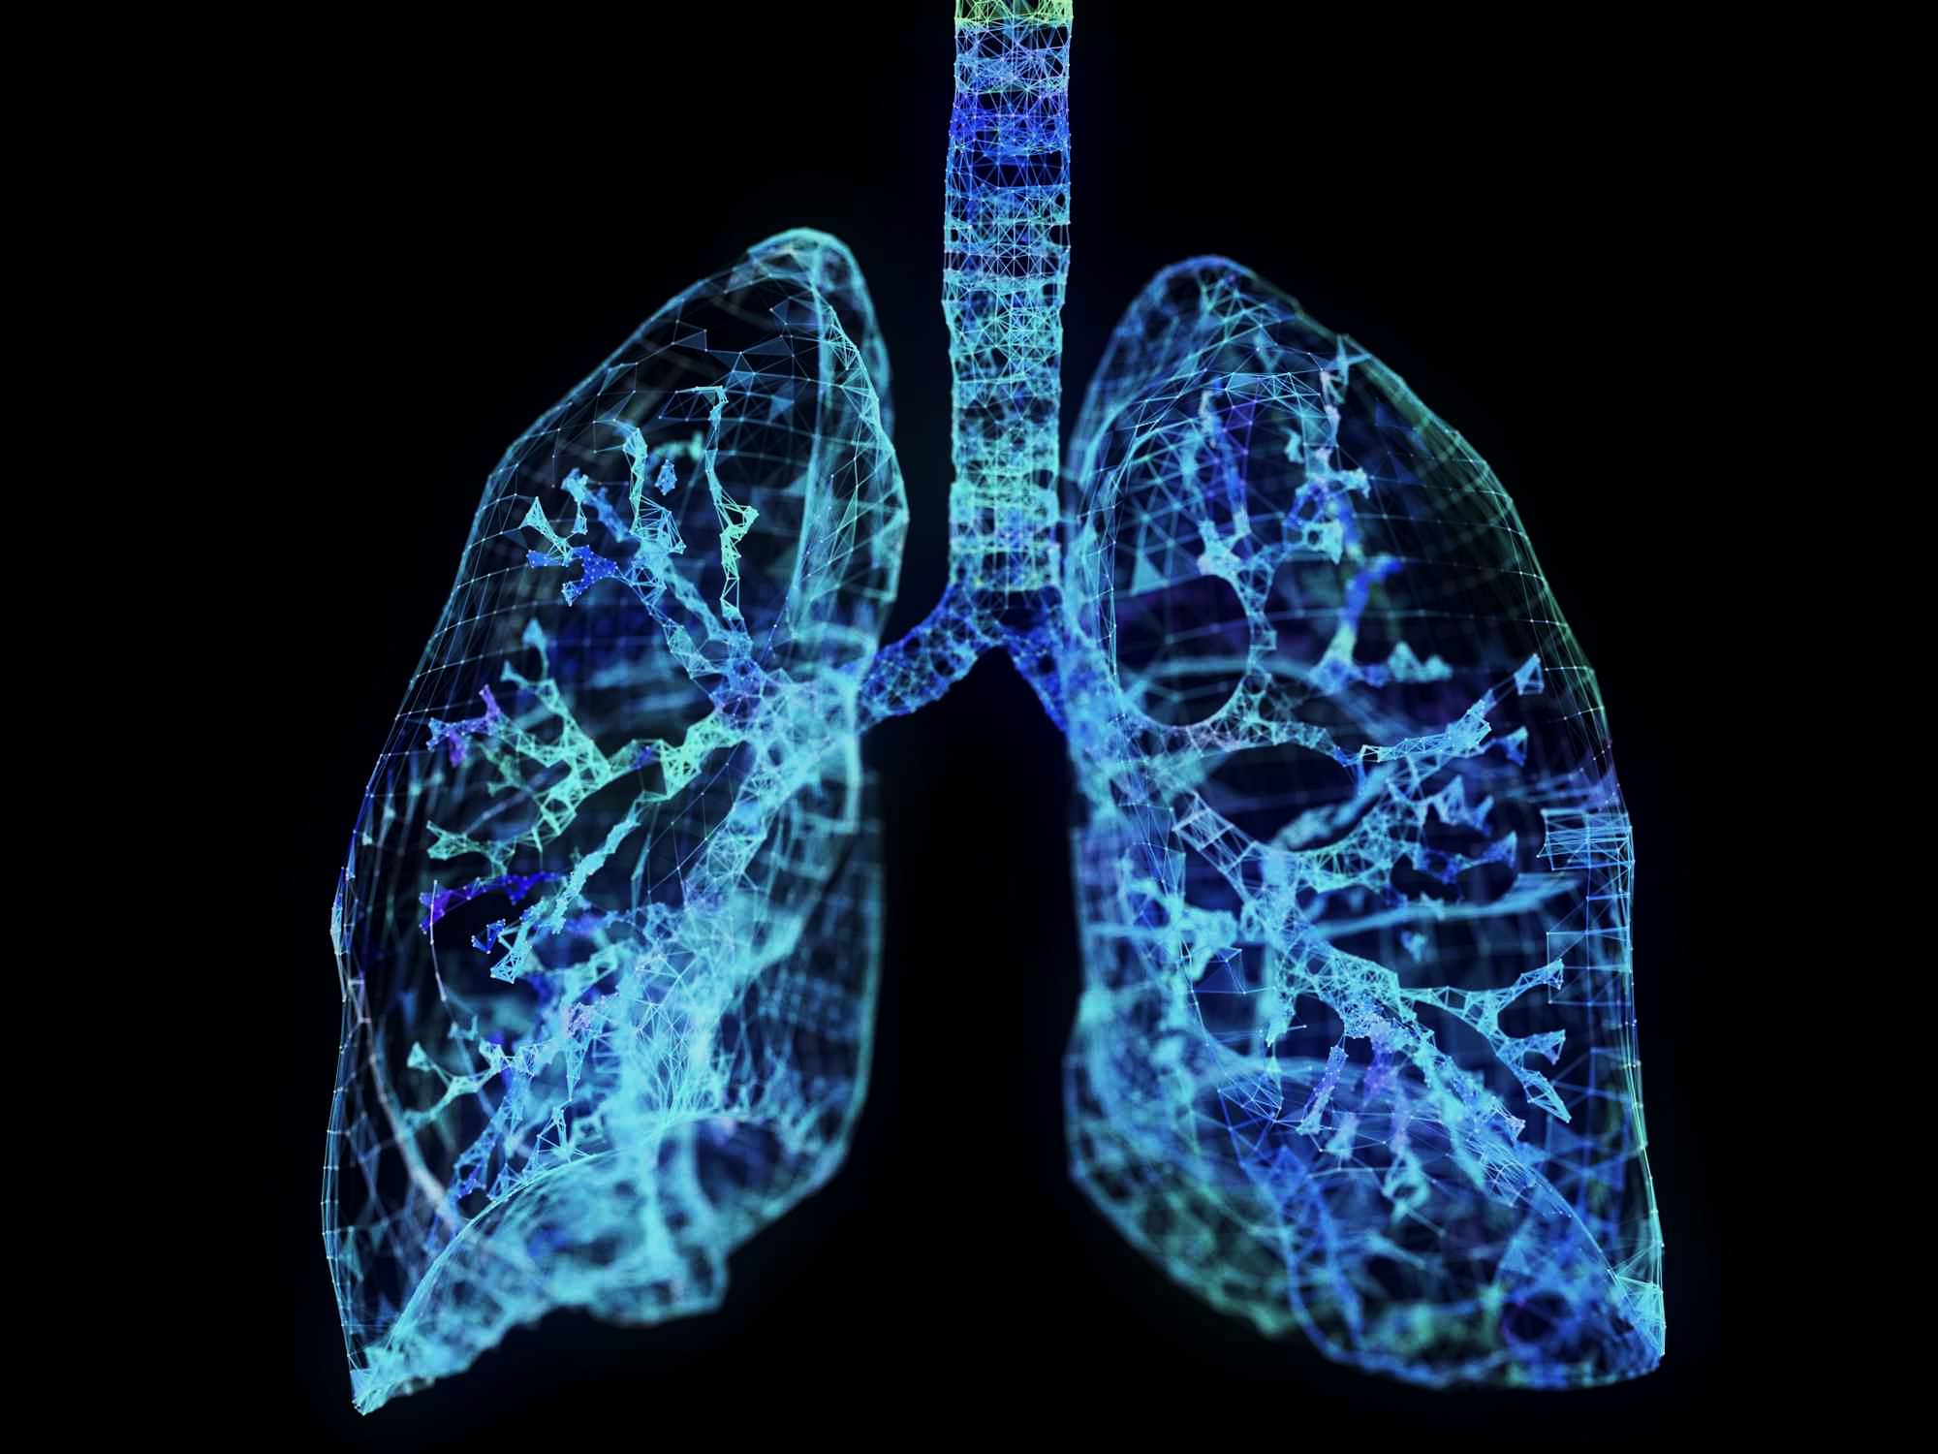
Cystic fibrosis (CF) is a disease of the lungs caused by a faulty gene. Somatic gene therapy for CF directly targets the epithelial tissue lining the lungs. A functioning version of the gene is introduced to the epithelial cells using an inhaler.

Slide 4
DNA Probes
DNA probes can be used to identify abnormal genes.
  A DNA probe is a small, single stranded fragment of DNA that is complementary to the gene of interest.
  Most DNA probes are tagged with a fluorescent marker so that matches can be easily identified.
The DNA fragment is isolated and heated to break hydrogen bonds.
  This separates the 2 strands.
The DNA probe is added to the reaction mixture.
  The mixture is then allowed to cool.
  If the DNA probe is a match for the fragment, it will hybridize to the sample as the hydrogen bonds reform.
The sample is washed to remove any unbound probe.
  UV light is then shone at the sample.
  If the sample fluorescences, the gene of interest was present in the sample.

Slide 5
A sample of DNA is heated to break the hydrogen bonds and separate the strands. A DNA probe is added. If complementary to the gene of interest, it will hybridise with the DNA. A marker attached to the DNA probe will fluoresce under UV light.
DNA PROBE FOR GENE B
GENE A
GENE B

Slide 6
Large numbers of genes can be identified simultaneously using a DNA microarray. Here the DNA probes are immobilised onto a glass plate. If a particular gene is present it will hybridise with the DNA probe and fluoresce under UV light.

Slide 7
Genetic Screening
DNA probes may be used to screen for heritable diseases.
  Certain diseases such as cystic fibrosis and Huntington’s are genetic in nature.
  Early identification of these diseases may offer improved treatment outcomes.
DNA probes may also be used to identify which drugs will work best for a particular disease.
  Trastuzumab is a monoclonal antibody that targets a protein created by a mutated version of the HER2 proto-oncogene.
  This protein is strongly linked to the development of a particular type of breast cancer.
  Trastuzumab is only effective if this mutation is present. It is ineffective against other forms of breast cancer.
Genetic screening may be used in conjunction with genetic counselling.
  Genetic counselling offers advice to individuals and families at risk of genetic disorders.
  Counselling offers education about the likelihood of inheriting a particular genetic disease.
  Counseling may also allow individuals or families to make informed choices about their treatment options.

Slide 8
Women with a family history of breast cancer are routinely screened for genetic mutations. A mutation in the BRCA1 tumour-suppressor gene is strongly linked to breast cancer (80-90% lifetime risk).
Genetic counselling can allow individuals to make informed choices about their health. Some women choose to undergo a preventative mastectomy, where breast tissue is removed to reduce the risk of developing cancer.
REMOVAL OF BREAST TISSUE

Slide 9
Genetic Fingerprinting
Specification Point 3.8.4.3 - Genetic fingerprinting.
Most of an organism’s genome is non-coding.
  This means that it is not responsible for the creation of protein.
Non-coding regions often contain variable number tandem repeats (VNTRs).
  A VNTR is a short sequence of DNA clustered together that is repeated many times.
  The probability of 2 individuals having identical VNTRs is extremely low.
Genetic fingerprinting is a technique that uses VNTRs to identify differences in people’s DNA.
EXAMPLE VNTR
INDIVIDUAL A
INDIVIDUAL B
TAC | TAA | AAC
9 NUCLEOTIDES LONG
TAC | TAA | AAC | TAC | TAA | AAC
2 REPEATS = 18 NUCLEOTIDES LONG
TAC | TAA | AAC | TAC | TAA | AAC | TAC | TAA | AAC
3 REPEATS = 27 NUCLEOTIDES LONG

Slide 10
Gel Electrophoresis
Gel electrophoresis is a process used to separate DNA fragments based on their length using an electric current.
  Different regions of DNA will have VNTRs of differing lengths.
A sample of DNA is obtained and amplified.
  This may be from the individual’s blood or saliva.
  Many copies of the VNTRs are created using PCR.
Restriction endonucleases isolate the VNTRs.
  Restriction endonucleases will cut at the beginning and the end of different VNTR sequences.
  This will create a number of VNTRs, each with a different number of nucleotides.
The DNA mixture is tagged and loaded onto a gel.
  A fluorescent tag is added to the DNA mixture so the VNTR fragments can be easily seen under UV light.
  Electrophoresis gels are commonly made from a polysaccharide called agarose.
  The gel is then covered by an electrically conductive buffer solution.

Slide 11
Gel Electrophoresis
An electric current is passed through the gel.
  The phosphodiester backbone of the DNA is negatively charged.
  The DNA fragments therefore migrate to the end of the gel that is positively charged.
Shorter DNA fragments travel further through the gel than longer fragments.
  DNA fragments are thus separated based on their length.
  This produces a distinctive pattern of banding.
DNA fragments can then be visualised using UV light.
  DNA fragments will glow, allowing us to see the DNA present at different locations along the length of the gel.
Gel electrophoresis video.

Slide 12
LENGTH OF FRAGMENT (BASE PAIRS)
LADDER
SAMPLE A
SAMPLE B
SAMPLE C
1,000 BP
900 BP
800 BP
During gel electrophoresis, fragments will migrate through the gel based on their length. A ladder (which consists of DNA fragments of known lengths) is often added to the gel for comparison.
700 BP
600 BP
500 BP
400 BP
300 BP
200 BP
100 BP

Slide 13
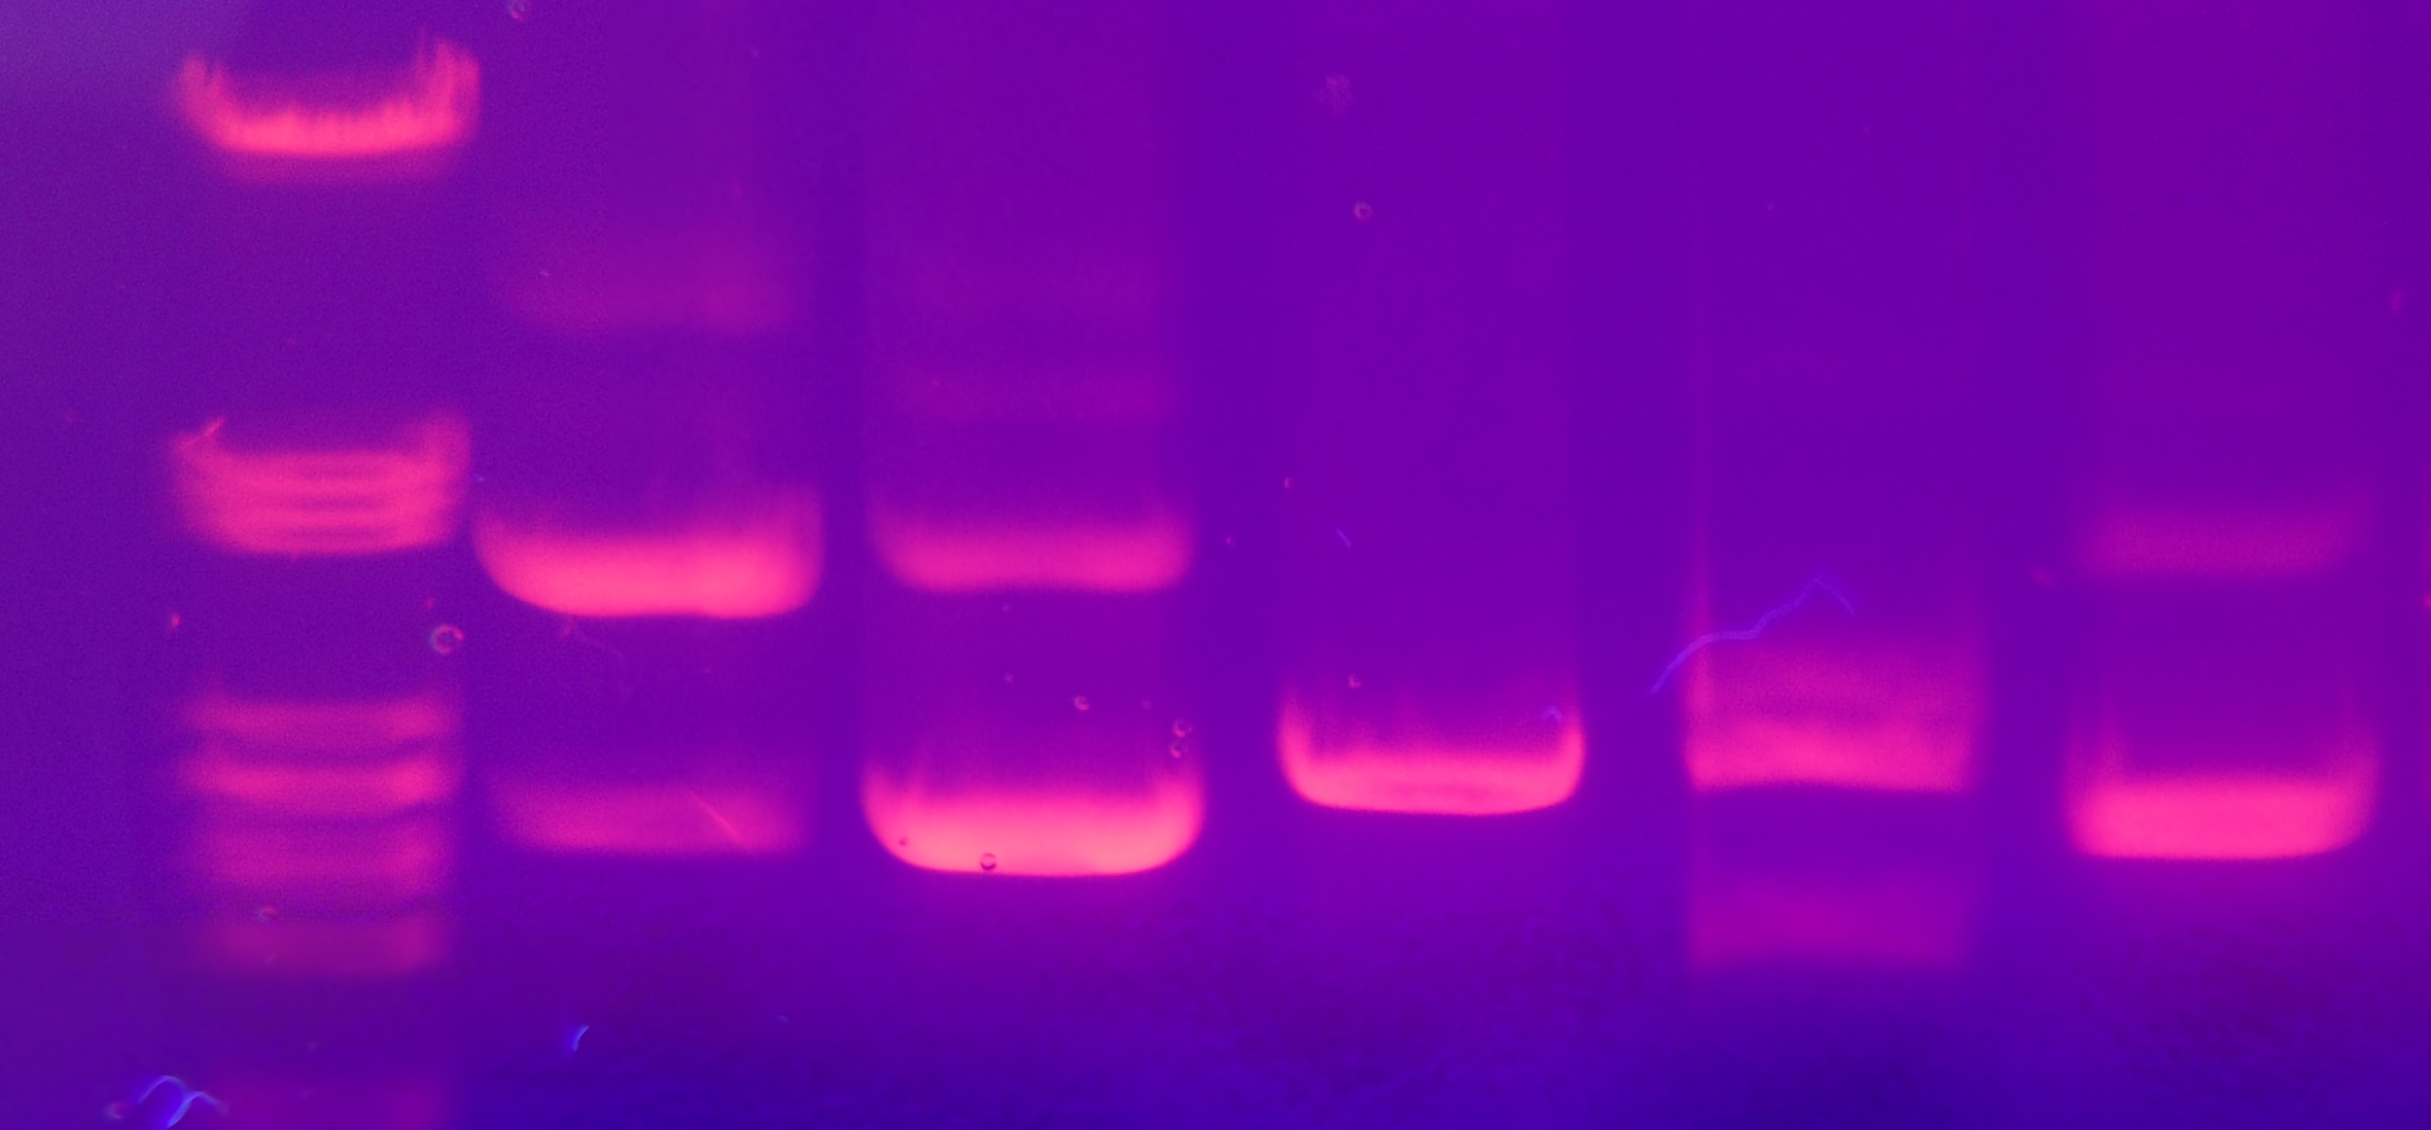
Marked gels can be visualised using UV light. If two VNTR fragments from different samples are the same length, they will appear at the same point in the gel.

Slide 14
Uses of Genetic Fingerprinting
Genetic fingerprinting has a number of applications:
  For determining genetic relationships.
  For identifying suspects using forensic science.
  For making medical diagnoses.
  To prevent inbreeding in plants and animals.
Genetic fingerprinting is often used to determine genetic relationships, most famously when trying to determine the paternity of a child.
  VNTR sequences are inherited through generations.
  Half of the genetic sequences come from each parent.
  Therefore, half of the VNTR bands present in the father will also be present in the offspring.
Genetic fingerprinting can be used to compare the VNTRs of different suspects.
  If DNA evidence is taken from a crime scene, it can be compared with the genetic fingerprints of a number of different suspects.
  If the fingerprint of the suspect and the crime scene match, this proves that the suspect was present at the crime scene, and likely the perpetrator.

Slide 15
LADDER
CRIME SCENE
SUSPECT A
SUSPECT B
SUSPECT C
Gel electrophoresis is often used in forensic science. In this example, only suspect C has the same DNA banding as the crime scene. It is extremely likely that suspect C was the perpetrator of the crime.

Slide 16
Uses of Genetic Fingerprinting
Genetic fingerprinting can be used to identify alleles associated with genetic disorders.
  Electrophoresis of different DNA fragments enables disease variants of particular alleles to be categorised and typed.
Genetic fingerprinting can be used by animal and plant breeders to help prevent inbreeding.
  Inbreeding can lead to a number of health problems for animals and plants.
  Electrophoresis can be used to ensure mates are genetically distinct from each other.
  It can also be used to determine the pedigree (the genetic background) of an animal. Animals with desirable pedigrees will fetch high prices.

Slide 17
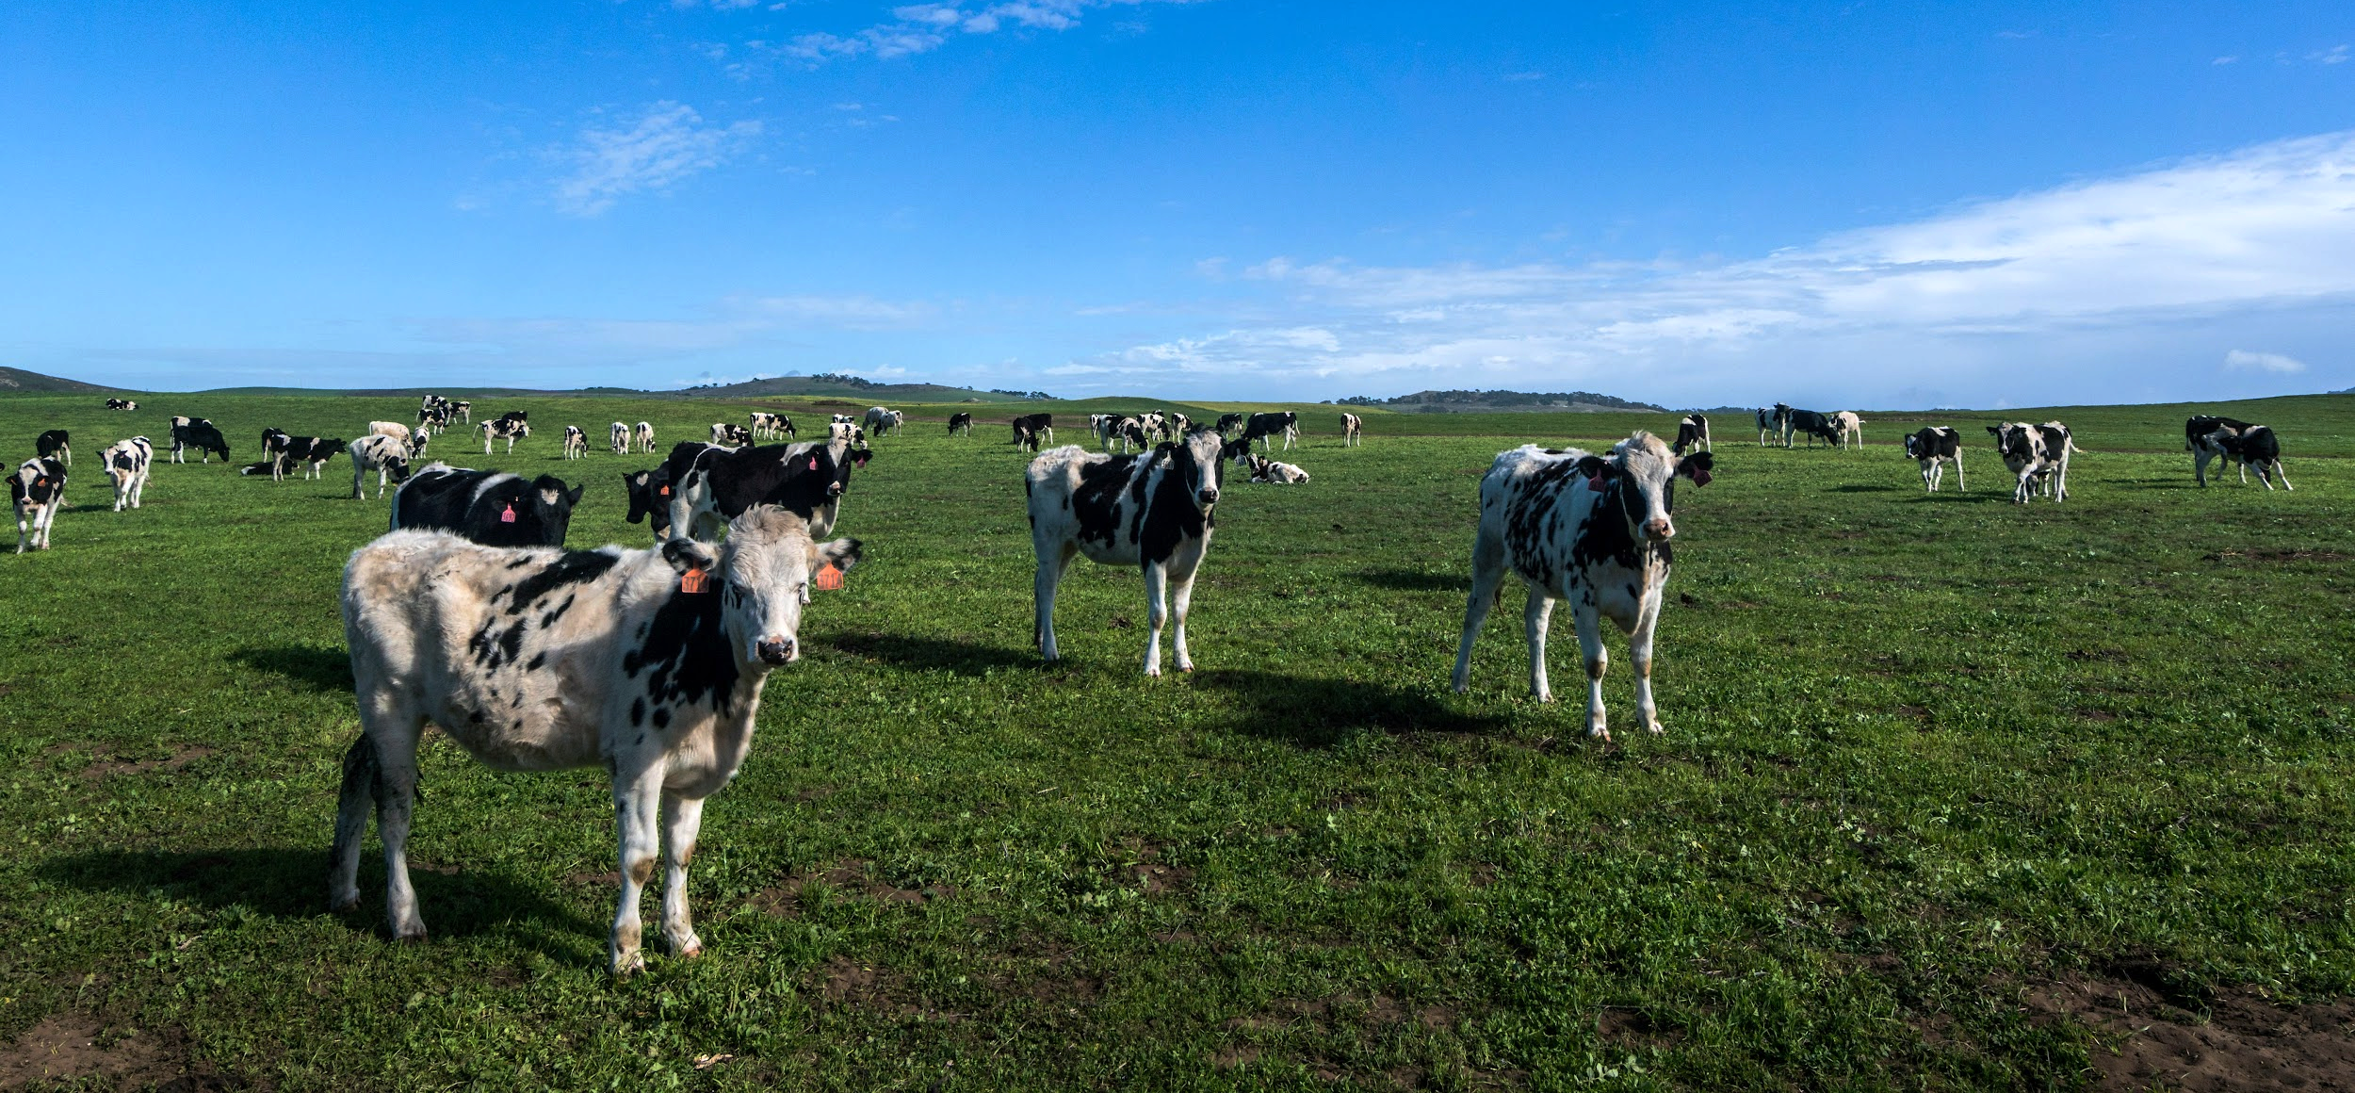
Genetic fingerprinting can be used to ensure a population of livestock is genetically diverse. This can help to prevent health problems associated with inbreeding.

