Slide 1
AQA A Level Biology
60 - Gene Technologies
Genome Sequencing, PCR and Recombinant Techniques

Slide 2
Genome Sequencing
Specification Point 3.8.3 - Using genome projects.
A genome can be defined as the complete collection of an organism’s DNA.
  The human genome consists of approximately 3 billion base pairs.
It is possible to read the genome of an organism using genome sequencing.
  Many organisms, including humans, have had their genomes successfully sequenced.
Historically, genome sequencing was costly and labour-intensive.
  The Human Genome Project (HGP) used multiple rounds of Sanger sequencing.
  In Sanger sequencing, fragments of DNA are separated onto gels. Each base is determined individually.
  The HGP took 13 years to complete and cost nearly $3 billion.
Modern methods of genome sequencing are far quicker and cheaper.
  Pyrosequencing is a modern technique than can sequence 40 million base pairs per hour.

Slide 3
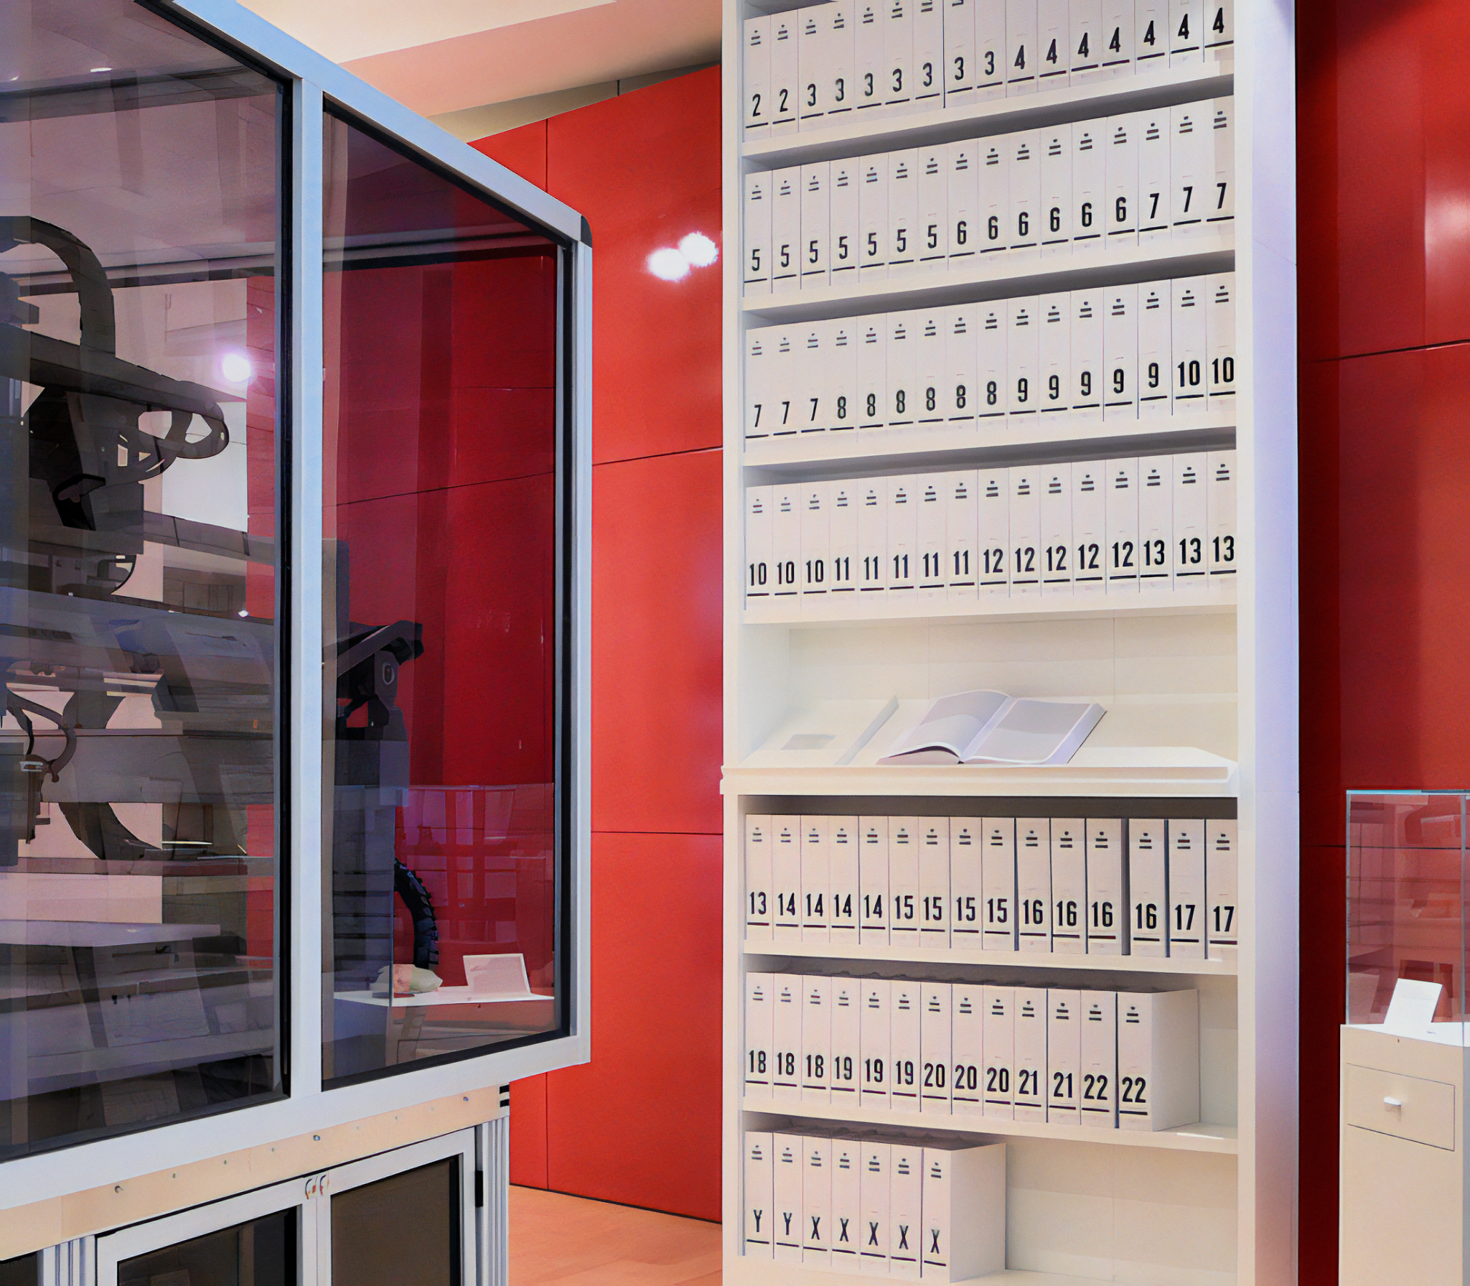
The Human Genome Project was a vast international undertaking.
The first sequence of a complete human genome was published in 2003.

Slide 4
Proteome Sequencing
A proteome can be defined as the complete collection of proteins that are made by a particular organism.
Prokaryotic organisms and viruses have very little non-coding DNA.
  This means that the majority of their genes are expressed in the proteome.
  It is easy to determine which proteins are made by the organism.
Determining the proteome of simple organisms has useful applications:
  It is possible to identify protein-based antigens on the surface of pathogenic bacteria.
  This may help to design vaccines in response to outbreaks of disease.
Eukaryotic organisms have lots of non-coding DNA.
  These regions of DNA are referred to as intronic DNA.
  Eukaryotes also contain regulatory genes - these determine when genes are switched on or off.
  It is much more difficult to determine the proteome of a eukaryotic organism from its genome.

Slide 5
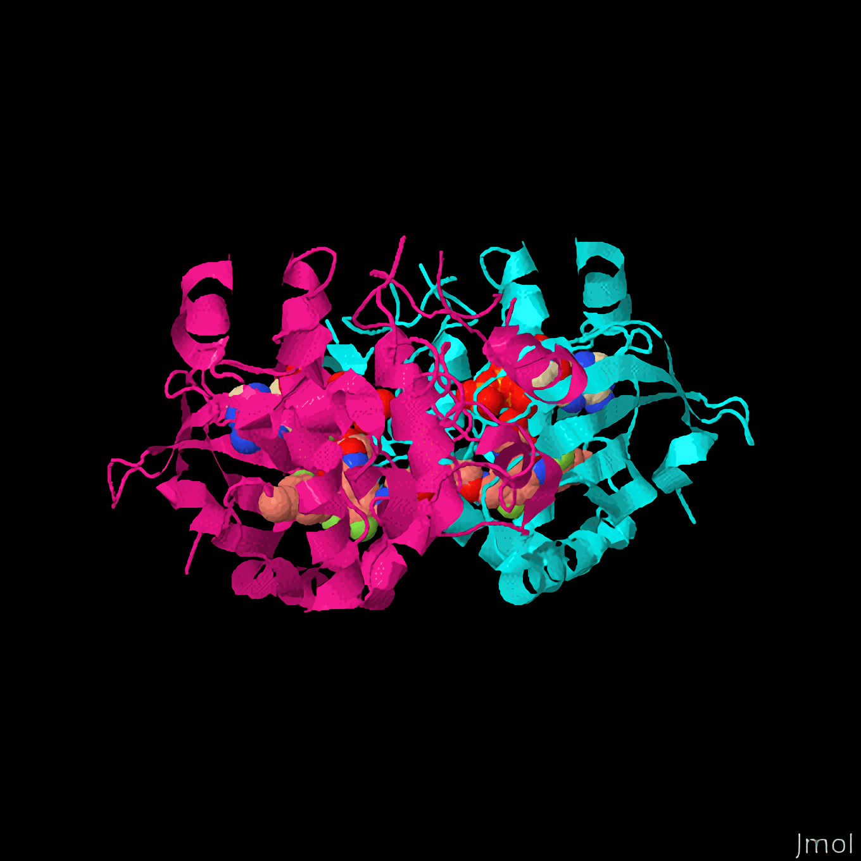
The protein MAP2K. Mutations in the base sequence of the MAP2K gene have been linked to an increased risk of breast cancer.
Proteome sequencing may help to determine how the gene mutations affect the structure and function of the protein.

Slide 6
Recombinant DNA Technology
Specification Point 3.8.4.1 - Recombinant DNA technology.
Recombinant DNA technology is the joining of DNA molecules from 2 different species.
  As DNA is universal (all living organisms use the same DNA codons to make the same amino acids), recombinant genes are likely to be expressed in the recipient organism.
An organism that contains genes from a different species is referred to as a transgenic organism.
  Transgenic organisms are usually bacteria or plants.
  There is, however, much new research into the application of transgenic animals.
Circular rings of bacterial DNA, called plasmids, are often used as vectors.
Transgenic plasmids carry genes from foreign organisms.

Slide 7
Creating DNA Fragments
In order to isolate the desired gene, a DNA fragment must be produced.
There are 3 ways to create a DNA fragment:
  Using the enzyme reverse transcriptase.
  Using restriction endonucleases.
  Using a gene machine.
RNA can be converted into cDNA using reverse transcriptase.
  Most cells only contain 2 copies of a particular gene.
  This means it is difficult to isolate the gene in question.
  When the gene is transcribed, lots of copies of mRNA are produced.
  The mRNA also does not contain any introns (these have been removed by splicing).
  The enzyme reverse transcriptase creates a single strand of complementary DNA (cDNA) from the mRNA transcript.
mRNA
mRNA
REVERSE
TRANSCRIPTASE
cDNA

Slide 8
Creating DNA Fragments
DNA can be isolated using restriction endonucleases.
  Restriction endonucleases are enzymes that recognise palindromic sequences of DNA.
  For a DNA sequence to be considered a palindrome, its complementary strand must read the same in the opposite direction.
  Different restriction enzymes cut DNA at different sequences - referred to as recognition sites.
  If a gene contains a recognition site, restriction enzymes can be used to isolate it from the rest of the DNA.
  This produces sticky ends; single stranded overhangs of DNA.
  Sticky ends are useful because they allow the fragment to bind to complementary sequences when the fragment is inserted into another section of DNA (this is referred to as annealing).
5’ - G A A T T C - 3’
3’ - C T T A A G - 5’
The recognition site for the enzyme EcoR1.
A A T T C T A C T G A C C G
G A T T G A T G A C T T A A
EcoRI creates sticky ends which allows the DNA fragment to anneal with other sections of DNA.

Slide 9
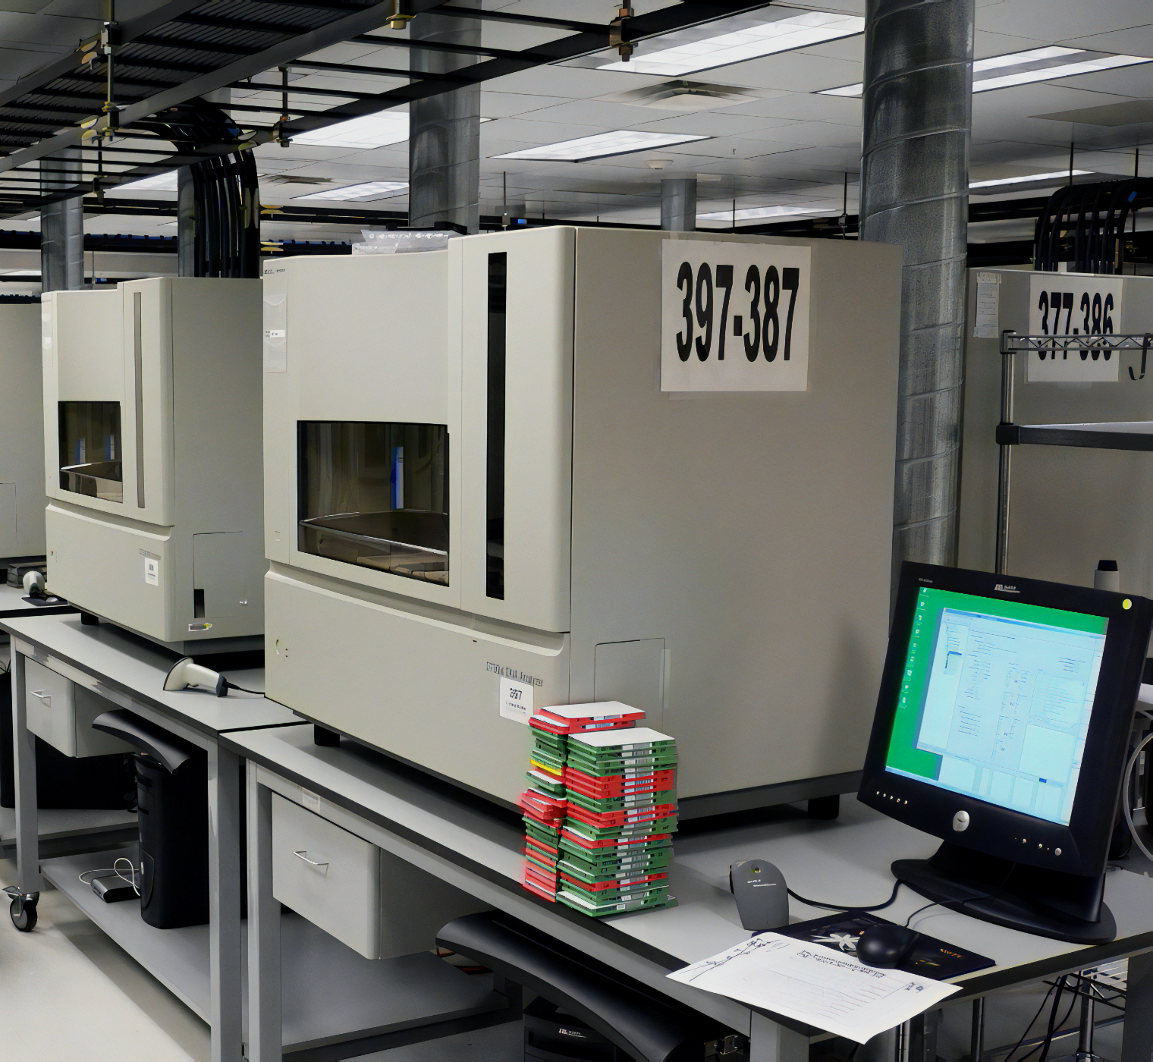
Creating DNA Fragments
Genes can be created using a gene machine.
  A DNA sequence can be designed from scratch, or sourced from a gene registry.
  The first few nucleotides are supported by silica beads.
  A computer determines the correct order to add nucleotides.
  This creates short sections of DNA, referred to as oligonucleotides.
  Oligonucleotides can then be joined together to form a functional gene.
  This is achieved using the enzyme DNA ligase.
Oligonucleotide synthesizers, or gene machines, are an emerging discipline in synthetic biology.

Slide 10
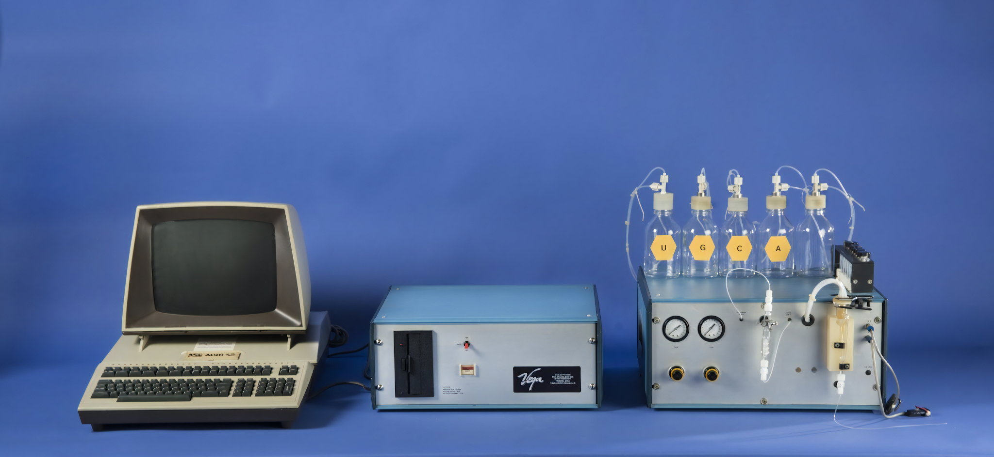
An early iteration of an oligonucleotide synthesizer, more commonly referred to as a gene machine. Gene machines have tremendous potential in biotechnology, as they allow for the creation of functional genes from scratch.

Slide 11
Amplifying DNA Fragments
Once DNA fragments have been isolated, they can be amplified using gene cloning.
Gene cloning involves making multiple copies of a gene.
  In vivo cloning involves transferring the DNA fragment into a host cell. As the cell divides, the fragment is copied.
  In vitro cloning involves making synthetic copies of the DNA fragment. This is achieved using the polymerase chain reaction (PCR).
During in vivo cloning, the DNA fragment is inserted into a vector.
  A vector is used to transport DNA into the host cell.
  Plasmids are commonly used as a vector.
The vector is then inserted into the host cell.
  This usually involves making the host cell more permeable to the vector.

Slide 12
In Vivo Cloning
Restriction endonucleases are used to cut a section out of the plasmid vector.
  These will be the same restriction endonucleases that were used to isolate the DNA fragment.
  The sticky ends found in the plasmid and the DNA fragment will be complementary to each other.
The plasmid and the DNA fragment are mixed together with DNA ligase.
  DNA ligase is an enzyme that permanently joins the plasmid and the DNA fragment together.
  This process is referred to as ligation - phosphodiester bonds are formed between the plasmid and the DNA fragment.
  This creates a recombinant plasmid; it contains DNA from 2 different sources.
The host cell takes up the recombinant plasmid in the process of transformation.
  Plasmids and host cells can be mixed together in a solution of ice-cold calcium chloride.
  The mixture is then subjected to heat shock. It is warmed to 42°C for 2 minutes.
  This causes the bacterial cell wall to increase in permeability and take up the plasmid.

Slide 13
1. PLASMIDS ARE REMOVED FROM BACTERIAL CELLS. THESE PLASMIDS SERVE AS VECTORS
PLASMIDS
2. THE DNA FRAGMENT, CONTAINING THE GENE OF INTEREST, IS ALSO TAKEN FROM ITS CELL
RESTRICTION ENDONUCLEASE
4. THE RESTRICTION ENDONUCLEASE CUTS THE PLASMID OPEN. THE SAME RESTRICTION ENDONUCLEASE CUTS OUT THE GENE OF INTEREST FROM ITS DNA MOLECULE
STICKY ENDS
GENE
3. A RESTRICTION ENDONUCLEASE RECOGNISES A SPECIFIC RECOGNITION SITE
RESTRICTION FRAGMENT
HYDROGEN BONDING
5. THE STICKY ENDS OF THE RESTRICTION FRAGMENTS ATTACH TO EACH OTHER VIA COMPLEMENTARY BASE PAIRING, FORMING HYDROGEN BONDS. A RECOMBINANT PLASMID HAS BEEN FORMED
6. DNA LIGASE MAKES THE BOND PERMANENT BY ATTACHING NUCLEOTIDES TO EACH OTHER WITH PHOSPHODIESTER BONDS. THIS IS THE PROCESS OF LIGATION
PHOSPHODIESTER BOND
DNA LIGASE
7. THE PLASMIDS ARE MIXED WITH THE BACTERIA. SOME OF THEM TAKE UP THE RECOMBINANT PLASMID IN THE PROCESS OF TRANSFORMATION
TRANSGENIC BACTERIA

Slide 14
Marker Genes
Only a small proportion of the host cells will take up the recombinant plasmid.
  Less than 10% of the host population will successfully integrate the recombinant plasmid.
In order to identify which cells have been successfully transformed, a marker gene is often utilised.
  A marker gene is a sequence of DNA that is inserted into the vector alongside the gene of interest.
  If the cell successfully takes up the vector, it will immediately begin to express the protein associated with the marker gene.
Cells which express the marker gene will be grown in culture.
  Cells that do not express the marker gene will not have taken up the recombinant plasmid and are discarded.
A selectable marker protects the organism from an agent that would normally kill it.
  Genes for antibiotic resistance are the most common selectable markers.
  If the bacterial colony is grown in a particular antibiotic, only individuals that been successfully transformed will survive.
A screenable marker will make cells containing the gene look different.
  Green fluorescent protein (GFP) makes cells glow green under UV light.

Slide 15
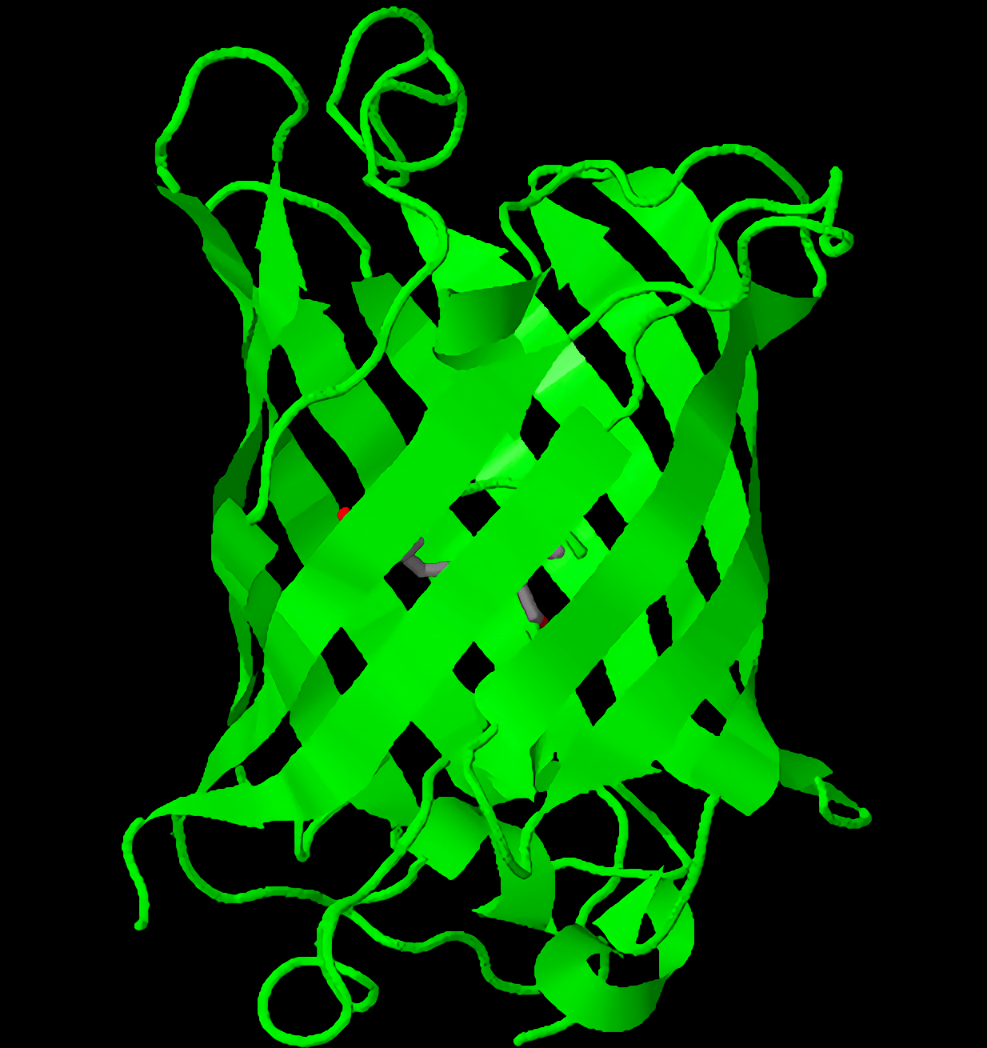
GFP is a protein that causes cells to glow under UV light.
If added as a marker gene, GFP allows scientists to quickly identify colonies of transformed bacteria.

Slide 16
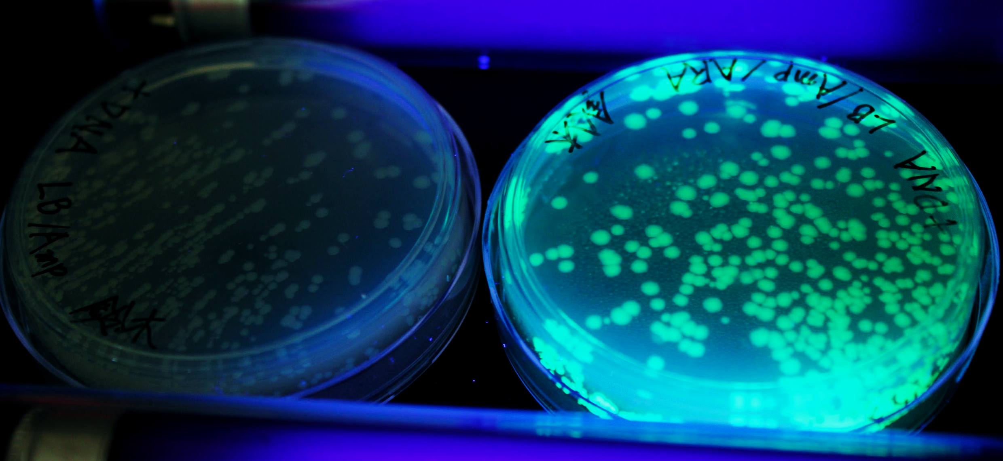
GFP is a protein that causes cells to glow under UV light. If added as a marker gene, GFP allows scientists to quickly identify colonies of transformed bacteria.

Slide 17
Promoters and Terminators
The most common aim of creating a transformed cell is to produce a protein.
  This protein may have some useful application.
In order to produce a protein, the vector must contain promoter and terminator regions.
  A promoter region encourages RNA polymerase to bind and initiate transcription of the gene.
  A terminator region halts transcription of the gene by forcing RNA polymerase to unbind.
Promoter and terminator regions are sometimes present in the vector DNA.
Other times, promoter and terminator regions have to be added alongside the the gene of interest.
PROMOTER REGION
GENE OF INTEREST
TERMINATOR REGION

Slide 18
In Vitro Cloning
In vitro cloning is more commonly referred to as the polymerase chain reaction (PCR).
  PCR is used to make many copies of a particular DNA fragment.
The PCR reaction mixture has a number of key ingredients:
  The DNA fragment to be copied.
  Free DNA nucleotides.
  Taq polymerase - this is a type of DNA polymerase that is able to withstand high temperatures.
  Primers - these are short sequences of single-stranded DNA that bind to the start of the DNA fragment. They allow Taq polymerase to initiate DNA replication.
The reaction mixture is heated to 95°C.
  This causes the hydrogen bonds holding the strands of DNA together to separate.
The reaction mixture is cooled to 55°C.
  This allows primers to bind to their complementary sequences on the single-stranded DNA in the process of annealing.

Slide 19
In Vitro Cloning
The reaction mixture is heated to 72°C.
  This is the optimum temperature for Taq polymerase.
  The Taq polymerase attaches to the primers and attaches free DNA nucleotides to each strand.
  This occurs through complementary base pairing.
2 copies of the DNA fragment are formed.
  The PCR cycle is now complete and may be repeated as many times as necessary.
  Each PCR cycle doubles the amount of DNA present in the reaction mixture.
PCR is a mechanism that allows for the creation of a large number of fragments in a relatively short period of time.
  After a standard protocol of 40 cycles, there will be over 500 billion copies of the DNA fragment present in the reaction mixture.
  PCR video.

Slide 20
The stages of PCR. Taq polymerase is a thermostable polymerase, sourced from extremophilic bacteria. After the strands have been separated and the primers have annealed, Taq polymerase adds free nucleotides to the exposed DNA strands. Each PCR cycle results in double the number of DNA fragments.
ORIGINAL DNA FRAGMENT
1.
2.
3.
DNA PRIMER
NUCLEOTIDE
BREAKING OF HYDROGEN BONDS AT 95°C LEADS TO SEPARATION OF STRANDS
ANNEALING OF PRIMERS AT 55°C
CREATION OF NEW STRAND AT 72°C

Slide 21
Transgenic Organisms
The creation of transgenic organisms is referred to as genetic engineering.
  E. coli bacteria can be genetically engineered to produce human insulin protein.
  Corn plants can be genetically engineered to create toxins that are insecticidal.
  Goats can be genetically engineered to excrete silk protein in their milk.
There are many potential humanitarian benefits to using transgenic organisms.
  It is likely that transgenic organisms will benefit humanity in a number of different ways.
These have to be balanced against the ethical, monetary and social concerns many people have about using transgenic organisms.
  Environmentalists and anti-globalisation activists are often in staunch opposition to the use of transgenic organisms.

Slide 22
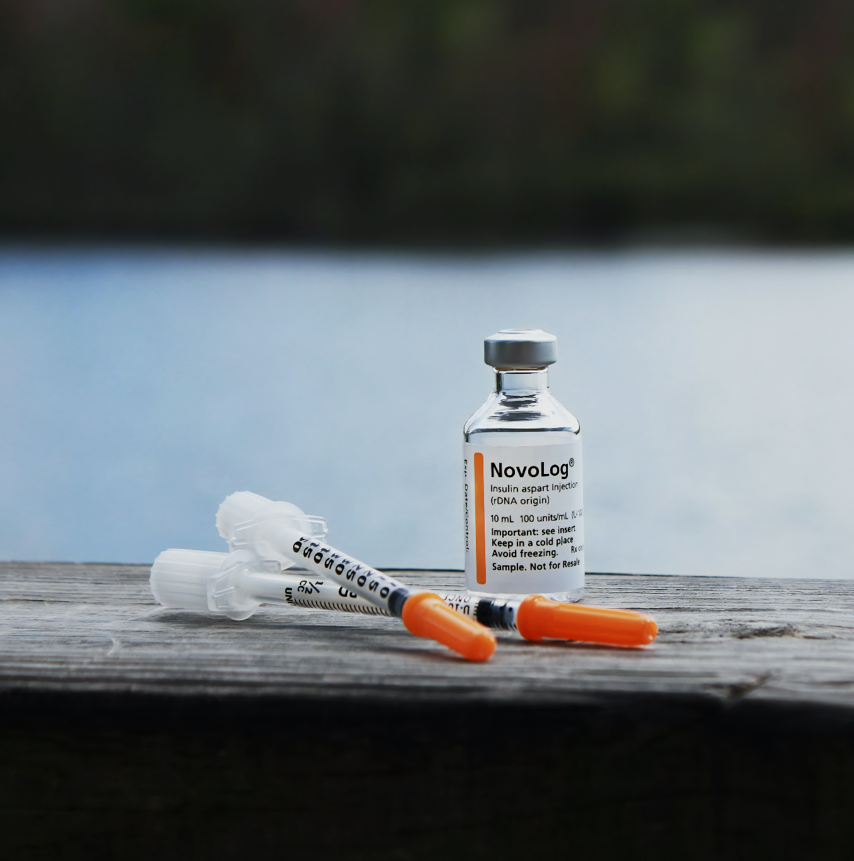
The use of transgenic E. coli bacteria to create human insulin remains the most famous medical application of genetic engineering.
Insulin was originally sourced from the pancreases of pigs or horses. This led to many cases of allergic reactions.
The creation of a human insulin analogue has revolutionised therapy for Type I diabetics.

Slide 23
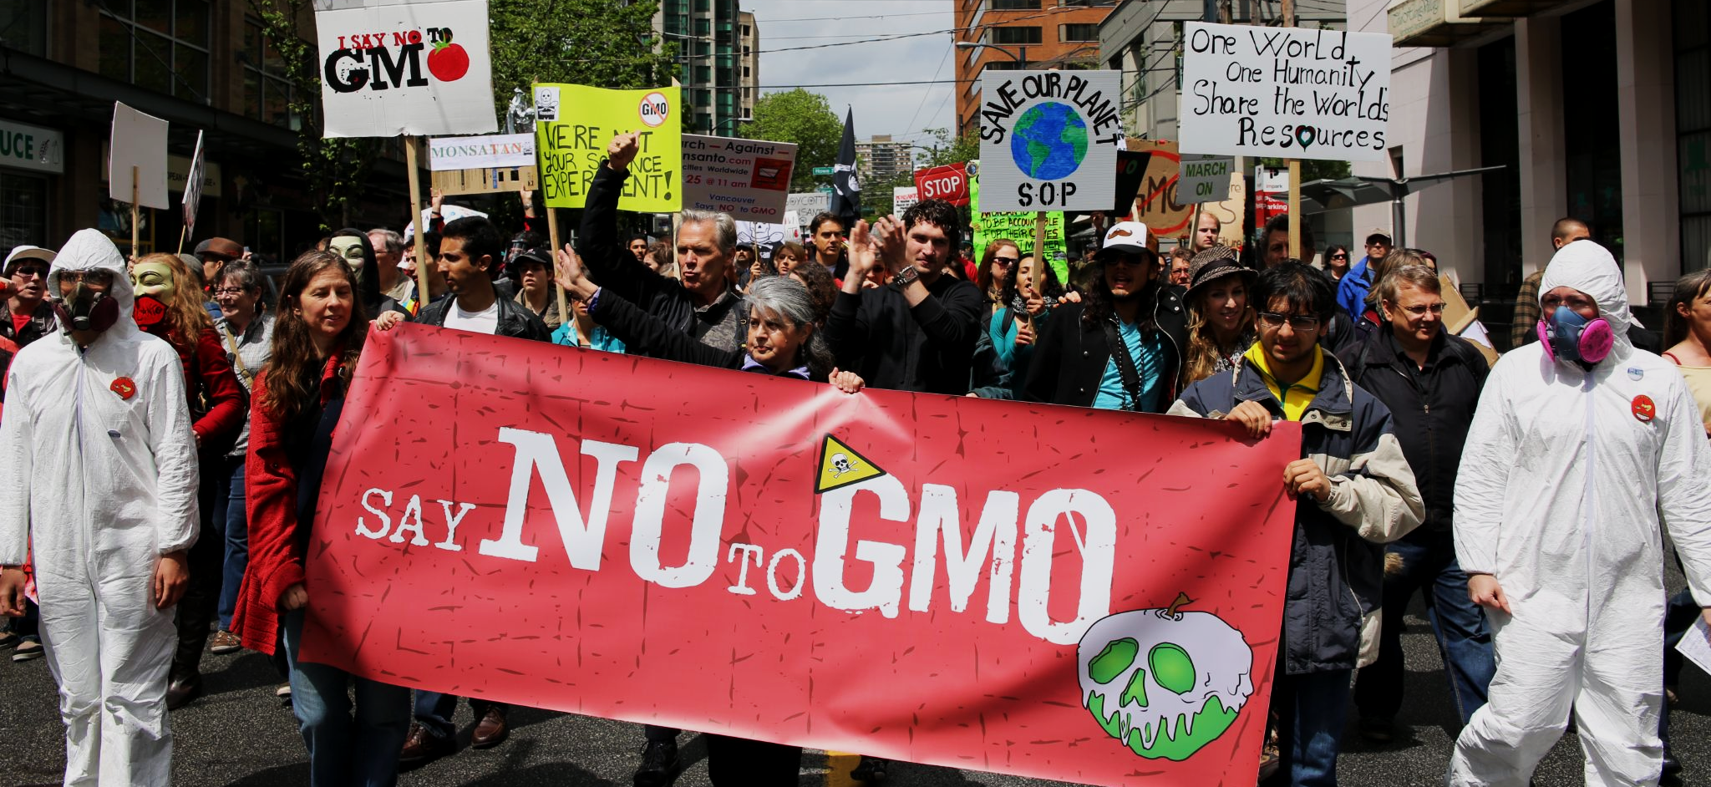
A march against the agrochemical company Monsanto. Environmentalists and anti-globalisation activists are often in staunch opposition to the use of transgenic organisms.

Slide 24
Evaluating Transgenic Organisms
Regulators have to balance the humanitarian benefits of transgenic organisms with legitimate concerns over their ethics and applications:
Field | Benefits | Concerns
Medicine | Creation of large quantities of vaccines quickly and cheaply (the hepatitis B vaccine is created using transgenic yeast). Creation of drugs with improved efficacy and safety (insulin from transgenic E. coli). | Potential issues over patent ownership. Companies may limit use of life-saving technologies.
Agriculture | Creation of crops with higher yields or more resistance to drought. Could significantly reduce malnutrition or famine. Golden rice is an example of a transgenic crop with increased levels of beta-carotene (this can help with blindness caused by vitamin A deficiency). | Transgenic crops could interbreed with wild plants, creating transgenic ‘superweeds’. This might have unknown consequences to the environment. Agrochemical companies charge high prices for transgenic seeds and often require farmers to repurchase seeds each year.
Industry | Industrial biology often requires the use of enzymes (chymosin in cheese-making, for example). Large quantities of these enzymes are often produced quickly and cheaply by transgenic organisms. | A few large biotechnology companies have near-total control of the market. Anti-globalists are against this as a point of principle. Some believe that biotechnology will introduce unwanted toxins into the food supply.

