Slide 1
AQA A Level Biology
5 - Enzymes
Biological Catalysts

Slide 2
Enzymes
Specification Point 3.1.4.2 - Many proteins are enzymes.
Enzymes are proteins that speed up the rate of chemical reactions.
  Enzymes are often referred to as biological catalysts.
Enzymes catalyse metabolic reactions.
  This can happen at a cellular level, for example during respiration.
  Enzymes can also affect the organism as a whole, for example during digestion.
Enzymes contain one or more active sites.
  The active site is the part of the enzyme where a substrate will bind.
  The substrate is the molecules the enzyme interacts with.
The active site of the enzyme is highly specific.
  This is due to the tertiary structure of the enzyme.

Slide 3
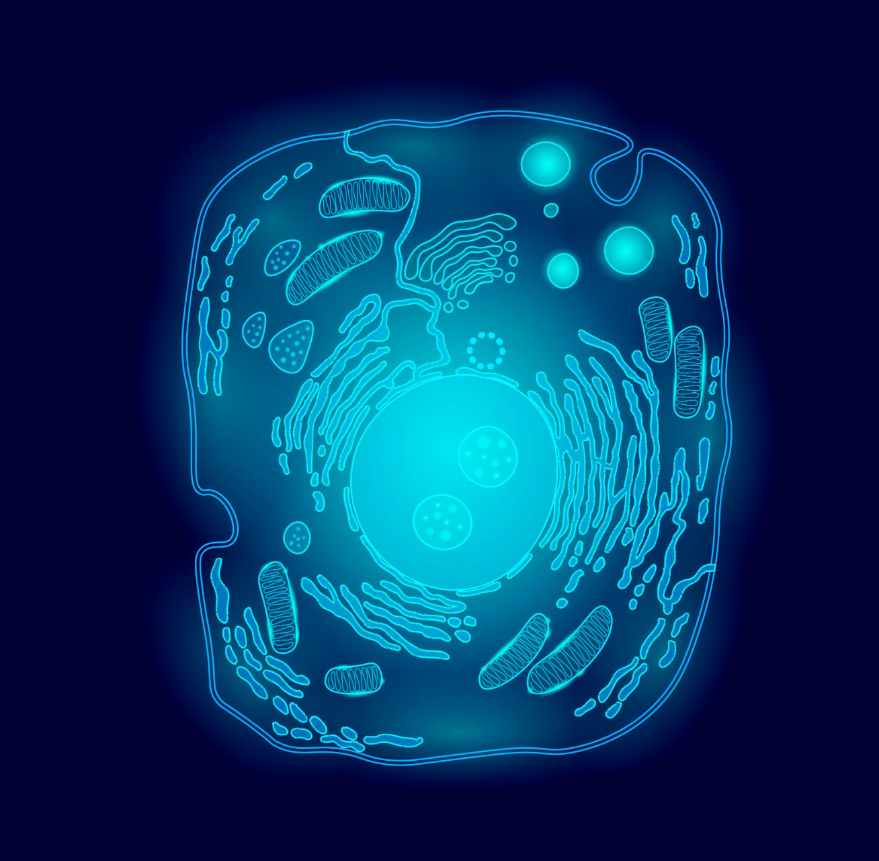
Enzymes are vital for a number of metabolic processes taking place on the cellular level.

Slide 4
DUODENUM
Enzymes are also important during digestion.
Lots of different enzymes are secreted into the small intestine during this process.
ILEUM

Slide 5
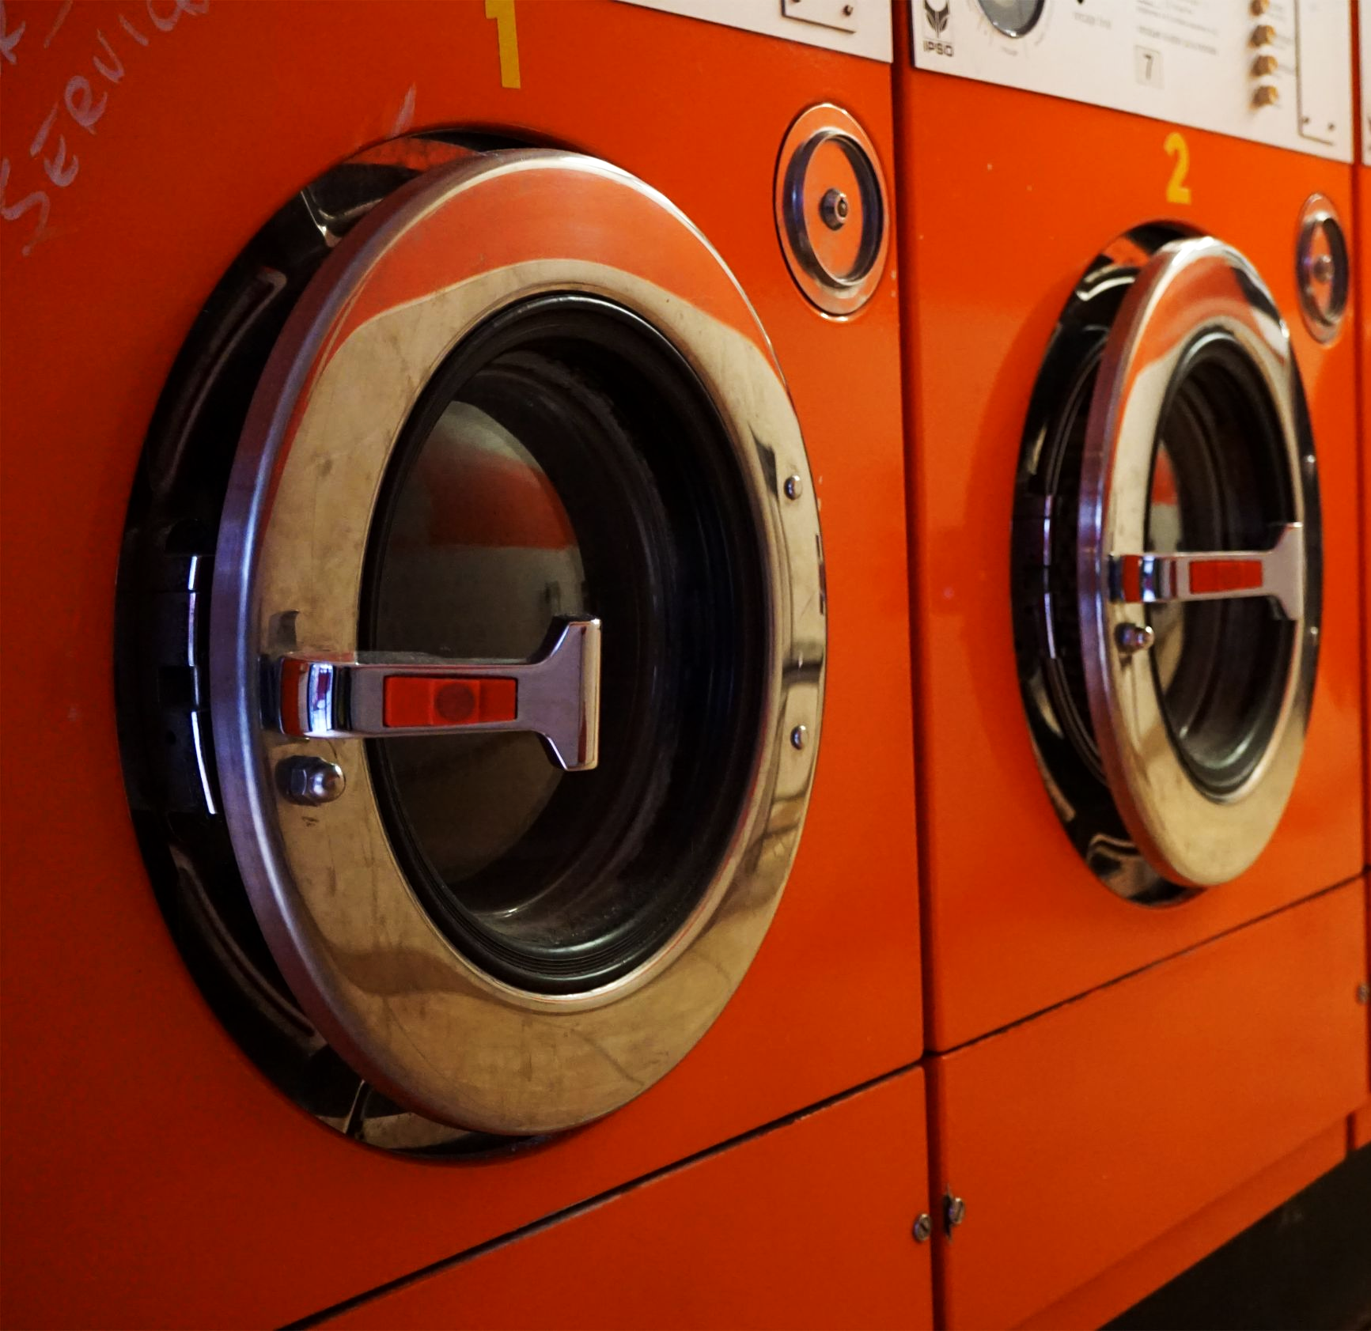
Enzymes also have a variety of industrial and domestic applications, perhaps most famously in washing detergent.

Slide 6
The model of enzyme action. The active site of the enzyme will form an enzyme-substrate complex with the substrate. Metabolic reactions then take place which yield one or more products.
PRODUCTS
SUBSTRATE
ACTIVE SITE
SUBSTRATE ENTERS THE ACTIVE SITE OF THE ENZYME
ENZYME-SUBSTRATE COMPLEX IS FORMED
ENZYME-PRODUCT COMPLEX IS NOW FORMED
PRODUCTS LEAVE THE ACTIVE SITE OF ENZYME

Slide 7
Activation Energy
In order for a chemical reaction to take place, a certain amount of energy is required.
This is referred to as the activation energy (E_{a}) of a reaction.
  E_{a} is often provided as heat.
Enzymes lower the amount of activation energy required for a reaction to proceed.
  This allows reactions to occur at a much lower temperature than they could without an enzyme.
  This is one of the reasons that enzymes are vital in biological systems.

Slide 8
E_{a} WITH AND WITHOUT ENZYME PRESENT
Enzymes significantly reduce the E_{a} of a reaction.
This allows chemical reactions to take place at temperatures found inside biological systems.
ENERGY →
REACTION TIME →

Slide 9
Enzyme-Substrate Complexes
When a substrate binds to the active site of an enzyme, it forms an enzyme-substrate (E-S) complex.
  The formation of an E-S complex is what lowers the E_{a} of the reaction.
There are two reasons for the lowering of the activation energy:
If substrate molecules need to be joined together, their proximity in an E-S complex reduces the repulsion that may be present between the molecules.
  This helps the substrate molecules to bond more easily.
If the enzyme is catalysing the breakdown of single molecule into two smaller molecules, the E-S complex puts strain on the bonds in the substrate.
  This helps bonds to break more easily.

Slide 10
Models of Enzyme Action
One theory of how enzymes work is called the lock and key model.
  Here the shape of the substrate (the key) fits perfectly in the active site (the lock).
  These shapes are perfectly complementary to one another.
  The lock and key model was first proposed by German chemist Emil Fischer in 1894.
A more modern theory is called the induced fit model.
  The enzyme and the substrate are not perfectly complementary to one another.
  The substrate induces a slight change in the shape of the active site to create a perfect fit.
  The induced fit model was popularised by American biochemist Daniel Koshland in the 1950s.
The induced fit model explained why enzymes are so specific.
  It is also an example of how scientific thinking can change over time.

Slide 11
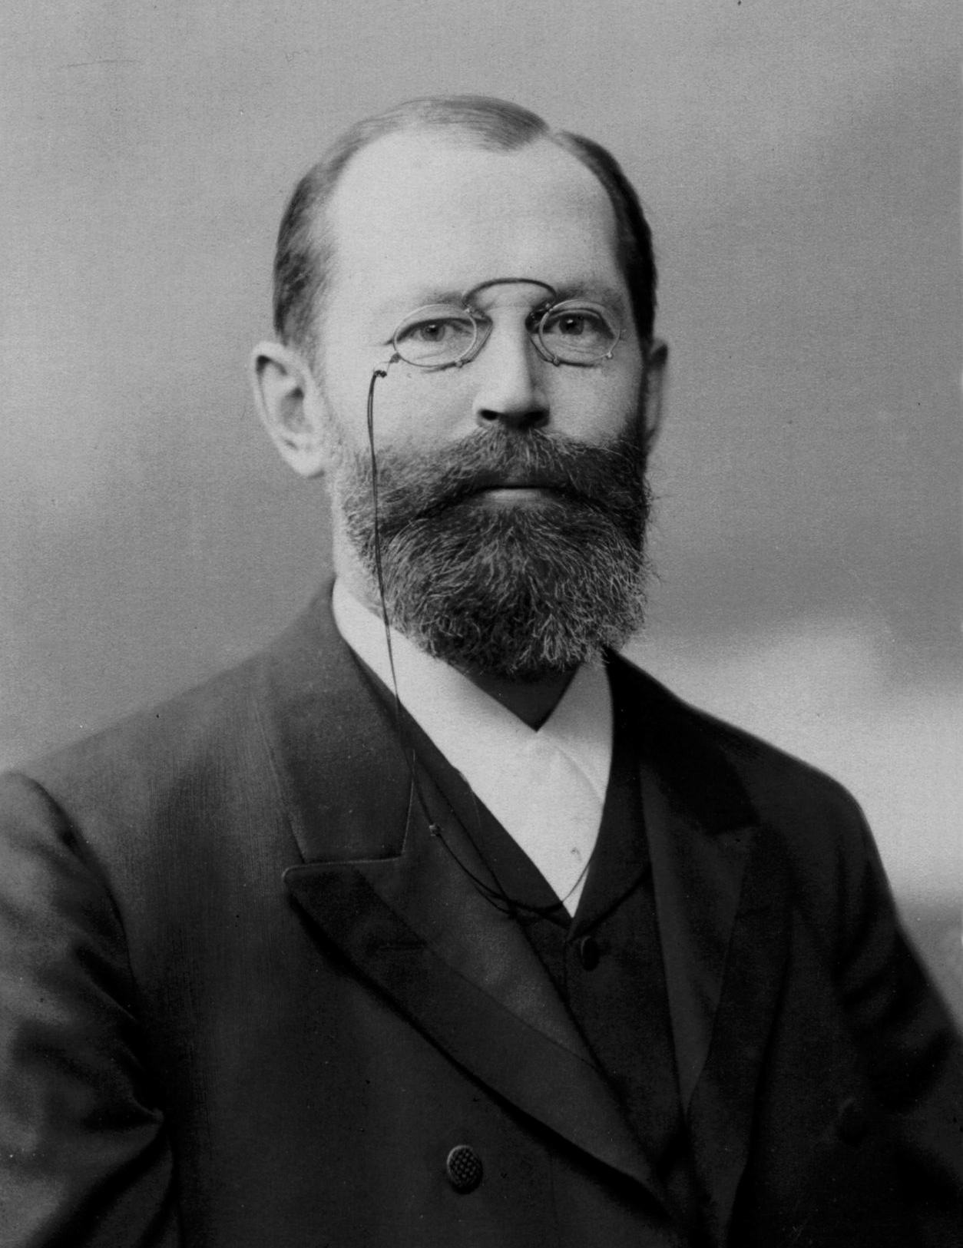
The lock and key analogy for enzymes was first proposed by the German chemist Emil Fischer in 1894.

Slide 12
The lock and key model summarizes the basic mechanism of enzyme action.
In this model, the substrate (the key) fits perfectly inside the active site of the enzyme (the lock).

Slide 13
SUBSTRATE
ACTIVE SITE
1. SUBSTRATE ATTACHES TO THE ENZYME
REACTION
2. ENZYME CHANGES SHAPE SLIGHTLY TO FIT SUBSTRATE
The induced fit model is a more accurate representation of enzyme action.
PRODUCTS
3. ENZYME CHANGES BACK TO ORIGINAL FORM, READY FOR NEW SUBSTRATES

Slide 14
Enzyme Properties
Enzymes have a tertiary structure.
Enzymes are very specific, they usually only catalyse one reaction.
  Maltase for example only catalyses the reaction of maltose into two glucose molecules.
The enzyme and substrate must be complementary to one another.
  If the shape of the substrate does not match the active site, an E-S complex will not be formed.
If the tertiary structure is altered the shape of the active site will change.
  This means E-S complexes can’t form and a metabolic reaction will not take place.
When the tertiary structure of the active site is altered, the enzymes is said to have been denatured.
  Denatured enzymes are not functional.

Slide 15
If the active site changes shape, it will no longer be complementary to the substrate and is said to have been denatured.

