Slide 1
AQA A Level Biology
59 - Gene Expression
Transcription Factors, RNAi and Epigenetics

Slide 2
Transcription Factors
Specification Point 3.8.2.2 - Regulation of transcription and translation.
During transcription, a section of DNA is copied into mRNA.
  A section of DNA that codes for a protein is called a gene.
  Genes are transcribed with the help of an enzyme called RNA polymerase.
Not all of the genes in a cell are expressed.
  Gene expression involves both transcription and translation (the formation of protein from a sequence of mRNA).
  As only certain genes in a cell are expressed, only certain proteins are made.
  These proteins determine the structure and function of the cell.
The transcription of a gene is determined by a transcription factor.
  A transcription factor is a protein that binds to specific sites on the DNA sequence.

Slide 3
Activators and Repressors
Transcription factors bind to promoter regions.
  A promoter is a sequence of DNA located near the start of a gene.
Transcription factors control the rate of transcription.
  As they determine whether the mRNA for a particular gene is synthesised, transcription factors directly control the level of gene expression.
Activators increase the rate of transcription.
  An activator is a transcription factor that helps RNA polymerase to bind to the promoter.
  This helps to initiate transcription.
Repressors reduce the rate of transcription.
  A repressor is a transcription factor that blocks the binding of RNA polymerase to the promoter.
  This helps to slow or stop transcription.

Slide 4
PROMOTER
GENE A
GENE B
ACTIVATOR
RNA POLYMERASE
PROMOTER
GENE A
GENE B
GENES A AND B ARE TRANSCRIBED AND TRANSLATED
In this instance, an activator increases the likelihood of RNA polymerase binding to the promoter. The rate of transcription increases.

Slide 5
PROMOTER
GENE A
GENE B
REPRESSOR
RNA POLYMERASE
PROMOTER
GENE A
GENE B
GENES A AND B ARE NOT TRANSCRIBED OR TRANSLATED
In this instance, a repressor reduces the likelihood of RNA polymerase binding to the promoter. The rate of transcription decreases.

Slide 6
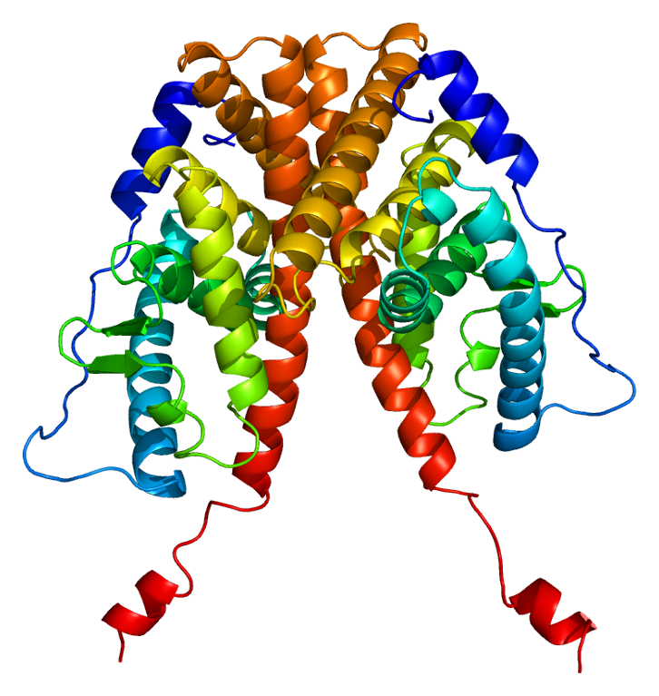
Oestrogen
Transcription factors can be affected by molecules in the cell.
  A wide array of molecules can influence transcription factors.
Oestrogen is a steroid hormone that binds to a transcription factor called an oestrogen receptor.
  This forms an oestrogen-oestrogen receptor complex.
The complex binds to specific promoter regions and initiates transcription.
  The complex is thus acting like an activator.
Targeted mRNA sequences are translated into protein.
Oestrogen binds to a transcription factor called an oestrogen receptor, pictured above.

Slide 7
OESTROGEN
1. Oestrogen diffuses into the cell through the cell membrane.
2. Oestrogen binds to the oestrogen receptor, forming an oestrogen-oestrogen receptor complex.
3. The complex enters the nucleus, where it binds to specific sites on the DNA.
4. Genes are transcribed and translated into proteins, which alter the structure and function of the cell.
OESTROGEN RECEPTOR
OESTROGEN-OESTROGEN RECEPTOR COMPLEX
NUCLEUS
DNA
PROTEIN
mRNA

Slide 8
RNAi
Gene expression can also be inhibited by RNA interference (RNAi).
  RNAi is only present in eukaryotic cells.
RNAi molecules are short, double stranded sequences of RNA.
  RNAi molecules prevent mRNA from being translated into protein.
There are 2 types of RNAi molecule.
  Small interfering RNA (siRNA).
  MicroRNA (miRNA).
siRNA is fully complementary to its mRNA target.
  This mRNA sequence may code for a particular protein.
  siRNA molecules will only bind to a specific mRNA sequence.
miRNA is partially complementary to its mRNA target.
  miRNA molecules can binds to lots of different mRNA sequences.
RNAi is a short, double stranded section of RNA which interferes with the translation of proteins.

Slide 9
siRNA
siRNA interferes with the expression of genes:
A gene is transcribed into mRNA.
  This mRNA leaves the nucleus and enters the cytoplasm.
At the same time a double stranded sequence of siRNA will unwind into 2 separate strands.
  1 of these strands will degrade, leaving single stranded siRNA.
The remaining strand of siRNA will bind to the complementary sequence of mRNA.
  This is referred to as hybridisation.
The siRNA/mRNA hybrid recruits a protein called RNA inducing silencing complex (RISC).
  RISC destroys the mRNA, preventing the translation of the associated gene.

Slide 10
GENE
siRNA
TRANSCRIPTION
The mechanism of RNA interference involving a molecule of siRNA.
mRNA
GENE IS NOT TRANSLATED
RISC

Slide 11
miRNA
miRNA also interferes with the expression of genes using a similar mechanism:
A gene is transcribed into mRNA.
  This mRNA leaves the nucleus and enters the cytoplasm.
At the same time a double stranded sequence of miRNA will unwind into 2 separate strands.
  1 of these strands will degrade, leaving single stranded miRNA.
miRNA will bind to a complementary region on the mRNA strand.
  The miRNA and the mRNA are only partially complementary to each other.
The miRNA/mRNA hybrid associates with a protein complex.
  The hybrid is then moved to a processing body.
  Here it may be destroyed or stored so the mRNA may be translated at a later time.
RNAi video.

Slide 12
Epigenetics
Epigenetics is the study of changes to the phenotype that do not involve changes to the DNA base sequence.
  The phenotype can be defined as the displayed characteristics of an organism.
  Epigenetic control is determined by the presence or absence of chemical compounds, referred to as epigenetic marks.
Gene expression may be influenced by epigenetics.
  The epigenome has some control over which genes are expressed and at what time.
The epigenome may be influenced by the environment.
  Food, stress and the presence of toxins can all influence epigenetic control.
The epigenome is somewhat heritable.
  The DNA base sequence is inherited through generations.
  It was initially thought that epigenetic marks were completely removed between generations.
  New research suggests that epigenetic marks may persist through generations.

Slide 13
DNA Methylation
The methylation of DNA is an example of epigenetic control.
  Methylation occurs when a methyl group (CH₃) is added to the DNA base sequence.
Methyl groups attach to CpG sites.
  CpG sites are found between the bases cytosine (C) and guanine (G) on the same strand of DNA.
  These bases are joined together by a phosphodiester bond.
Methylation at CpG sites makes it harder for RNA polymerase to bind to the DNA.
  If RNA polymerase is unable to bind to the DNA, transcription will not take place.
  Increased methylation therefore leads to reduced gene expression.
  The gene is said to have been switched off.
NH₂
CH₃
N
CYTOSINE
N
O
R’5
O
H
O
H
H
N
NH
O
H
GUANINE
N
N
NH₂
O
P
O⁻
O
O
H
H
H
3’R
H
The addition of a CH₃ group at a CpG site.

Slide 14
Histone Acetylation
The acetylation of histones is another example of epigenetic control.
  Acetylation occurs when an acetyl group (COCH₃) is added to a histone.
  A histone is a protein that provides structural support to a chromosome.
    DNA wraps around histones to form chromatin.
The acetylation of histones forces the chromatin to decondense.
  This allows enzymes like RNA polymerase to bind to the DNA more easily.
  Increased acetylation therefore leads to increased transcription of a gene.
  The gene is said to be switched on.
Acetyl groups are removed by histone deacetylases (HDACs).
  HDACs are enzymes that cause chromatin to recondense.
  This makes it harder for transcriptional enzymes to access the DNA.
  The gene is said to be switched off.

Slide 15
The addition of acetyl groups onto histones forces chromatin to unwind, exposing the DNA bases. This makes it easier for RNA polymerase to bind to the DNA and transcribe genes into mRNA.

Slide 16
Epigenetics and Health
Epigenetic controls can increase the risk of developing cancer.
  Increased methylation of tumour suppressor genes can reduce their expression.
  This can lead to the growth of a cancerous tumour.
The epigenome also has an influence on the development of other diseases.
A duplication mutation in a gene called FMR1 on the X chromosome leads to a disease called Fragile X syndrome (FXS).
  Sufferers of FXS have many more copies of the DNA sequence CGG than normal.
  CGG is a sequence containing a CpG site.
  An increased number of CpG sites leads to increased methylation of the DNA.
  This switches the FMR1 gene off - the FMR protein is not produced.
  Lack of the FMR protein leads to a wide range of learning and behavioural difficulties.

Slide 17
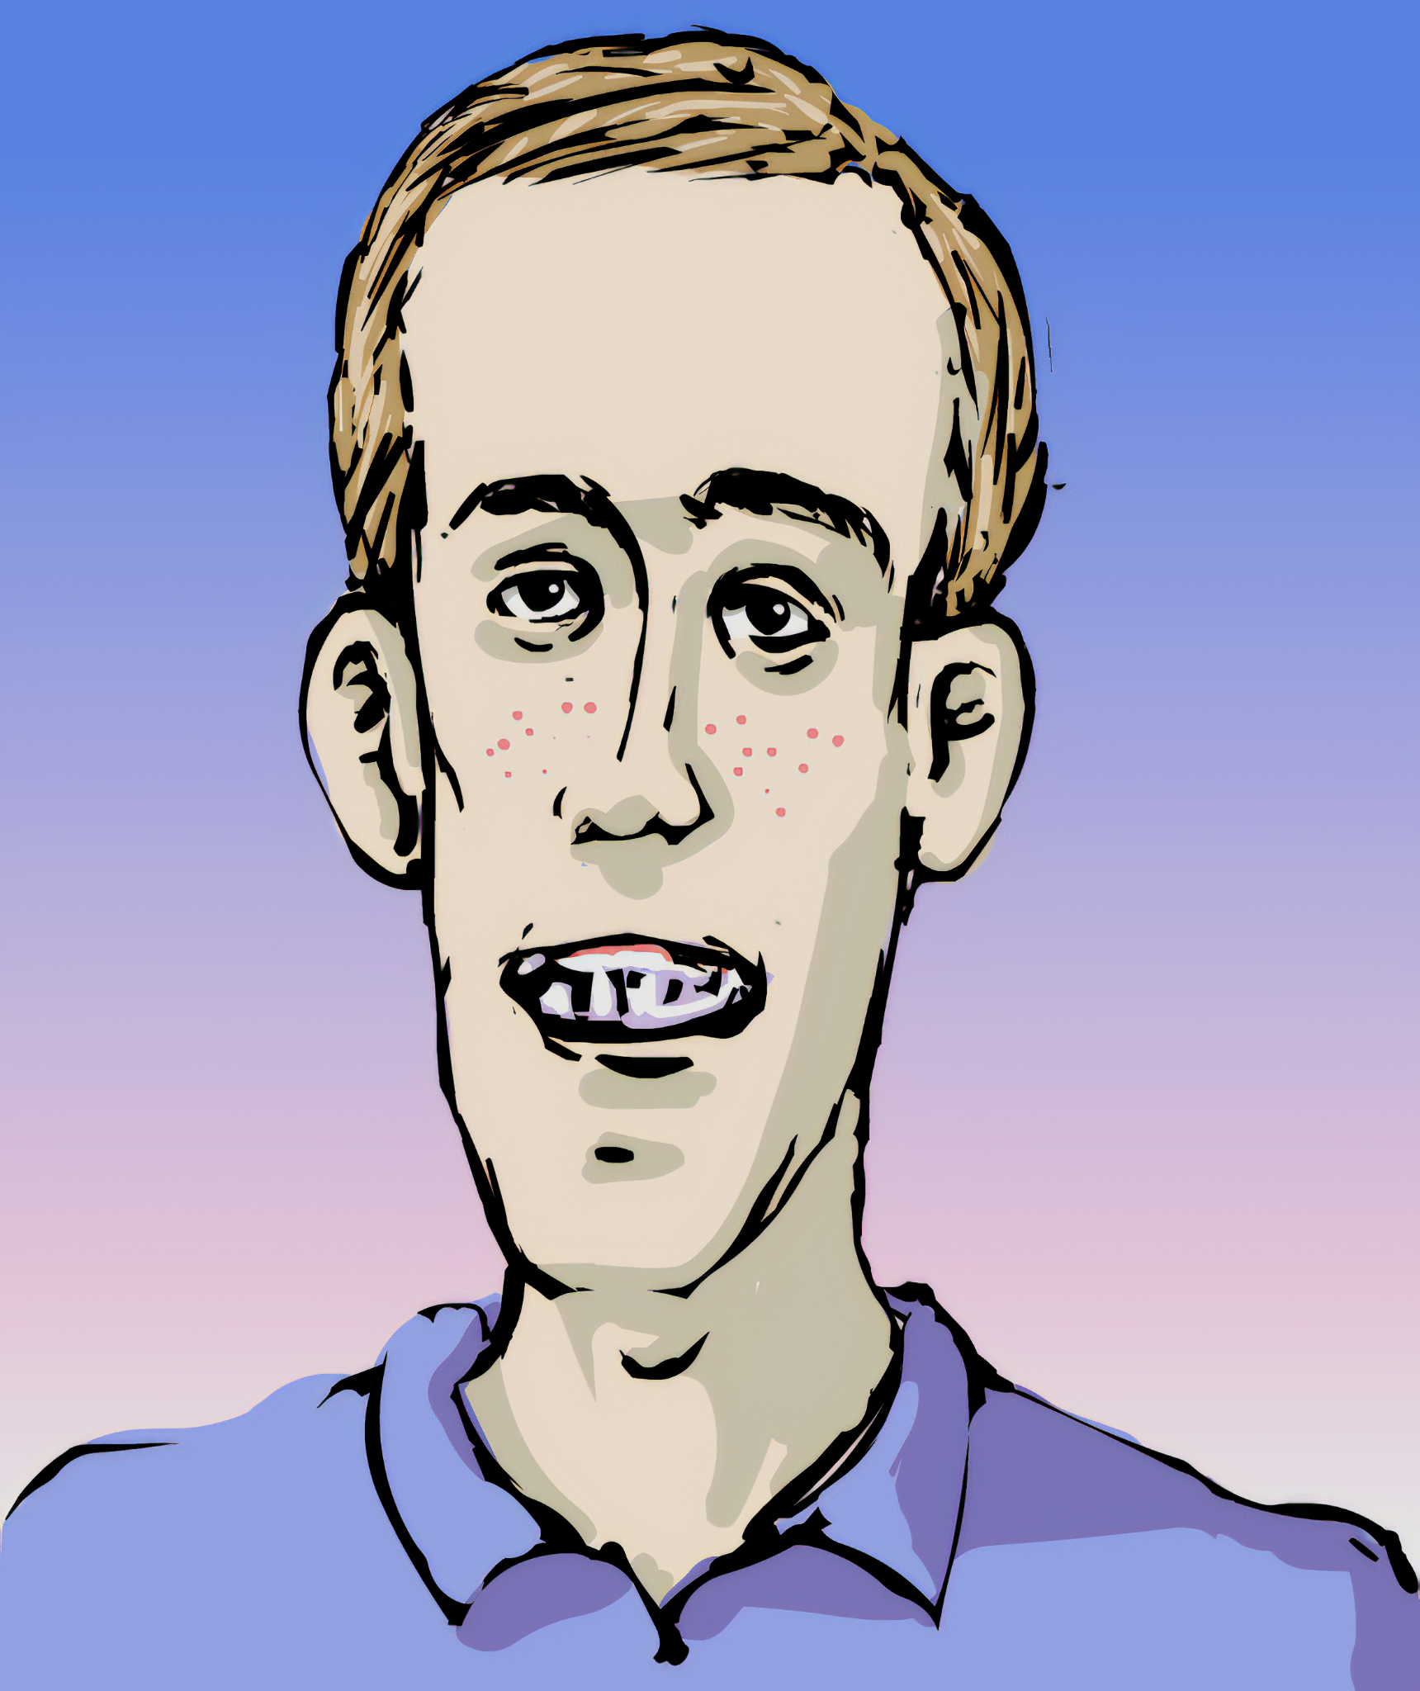
The epigenome can have a profound impact on the health of an individual.
Individuals with Fragile X syndrome suffer from a lack of FMR protein.
This leads to a wide range of learning and behavioural difficulties.

Slide 18
Epigenetics and Health
Medical conditions that are caused by epigenetics are reversible.
  Chemical compounds can be added or removed to counteract epigenetic influences.
The rate of methylation at CpG sites can be prevented or slowed.
  Azacitidine is a chemotherapy drug that prevents the methylation of tumour suppressor genes.
  This reactivates the tumour suppressor genes, slowing the rate of tumour growth.
The deacetylation of histones can also be prevented or slowed.
  HDAC inhibitors are drugs that prevent HDACs from removing acetyl groups from histones.
  Vorinostat is a HDAC inhibitor that ensures genes remain acetylated and are transcribed and translated into protein.
O
N
OH
The HDAC inhibitor vorinostat.
N
O

Slide 19
Genotype and Environment
The phenotype of an organism is determined by a combination of genotype and environment.
  The phenotype can be seen as an interaction between genetic and environmental factors.
There are a number of examples of diseases whose origins have both genetic and environmental contributors.
  Autism - research has suggested that exposure to air pollution or pesticides contribute to an increased risk of autism in those who are already genetically susceptible.
  Breast cancer - research has shown that breast cancer is caused by a combination of genetic and environmental risk factors. Exposure to hormone therapies and increased alcohol intake have both been shown to increase the risk of breast cancer.
  Parkinson’s disease - poor nutrition and nicotine consumption both have a stronger impact in those who are genetically susceptible.
Research on the effects of genotype and environment are often undertaken on groups of identical twins.
  This is because identical twins have identical genotypes.
  Any changes to the phenotype must therefore be as a result of the environment.

Slide 20

Studies are often conducted on identical twins due to their identical genetics.
This means that any observable differences must be entirely due to variation in the environment.

Slide 21
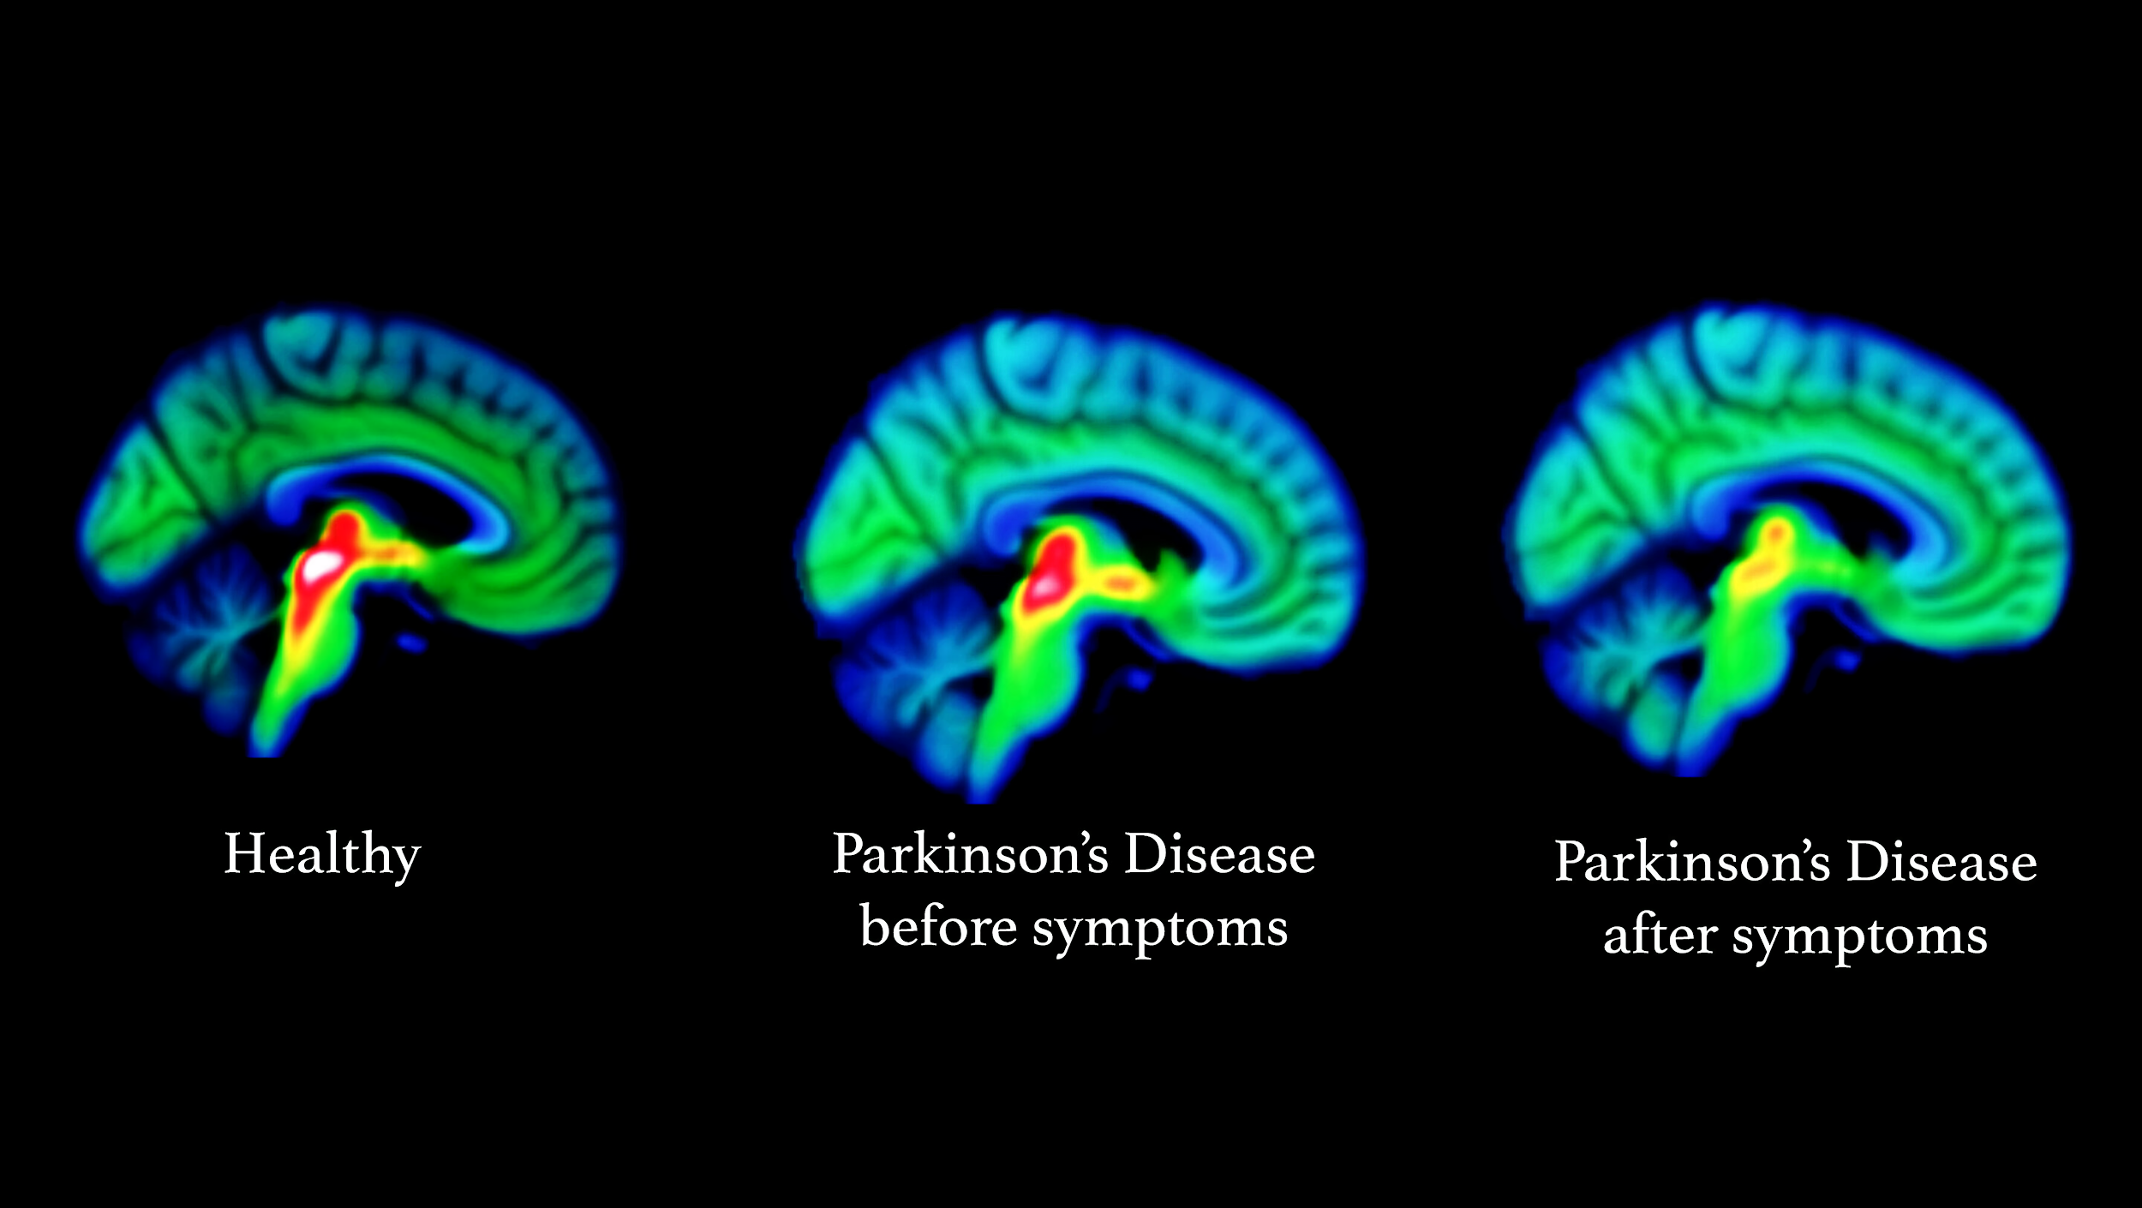
HEALTHY BRAIN
Brain scans showing the decrease of serotonin secretion as Parkinson’s progresses.
Both genotype and environment have been found to contribute to an individual’s susceptibility to Parkinson’s.
EARLY-STAGE PARKINSON’S
LATE-STAGE PARKINSON’S

