Slide 1
AQA A Level Biology
58 - Stem Cells
Potency, Therapies and Ethics

Slide 2
Stem Cells
Specification Point 3.8.2.1 - Most of a cell’s DNA is not translated.
A stem cell is an undifferentiated cell.
  This means that it has not specialised to perform a particular function.
All the cells in the body are derived from stem cells.
  During differentiation, stem cells will divide into specialised cells.
  There are 200 types of specialised cell in the human body (blood cells, muscle cells and so on).
Stem cells are found in embryos and some adult tissues.
  Early-stage embryos are home to embryonic stem cells.
  Adult stem cells are found in tissues whose cells need constant regeneration.
    Hematopoietic stem cells (HSCs) are found in the bone marrow where they differentiate into all blood cells.
Early-stage embryos, called blastocysts, are a good source of stem cells.

Slide 3
HEMATOPOIETIC STEM CELL
MYELOID PROGENITOR
LYMPHOID PROGENITOR
ERYTHROCYTE
MAST CELL
NATURAL KILLER CELL
SMALL LYMPHOCYTE
MYELOBLAST
T LYMPHOCYTE
B LYMPHOCYTE
MEGAKARYOCYTE
BASOPHIL
NEUTROPHIL
EOSINOPHIL
MONOCYTE
PLASMA CELL
PLATELETS
MACROPHAGE
A hematopoietic stem cell (HSC) is an adult stem cell that has the ability to differentiate into any cell found the the bloodstream.

Slide 4
Cell Potency
A totipotent stem cell can differentiate into any cell in the body.
  Totipotent stem cells are found during the first 4 divisions of a zygote.
A pluripotent stem cell can differentiate into any cell apart from cells in the placenta.
  Pluripotent stem cells are present once the zygote has differentiated into a blastocyst.
A multipotent stem cell can differentiate into a few different types of cell.
  HSCs can only differentiate into cells found in the bloodstream.
  HSCs cannot differentiate into muscle or nerve cells, for example.
A unipotent stem cell can only differentiate into a single type of cell.
  Hepatoblasts are stem cells that can only differentiate into hepatocytes (liver cells).

Slide 5
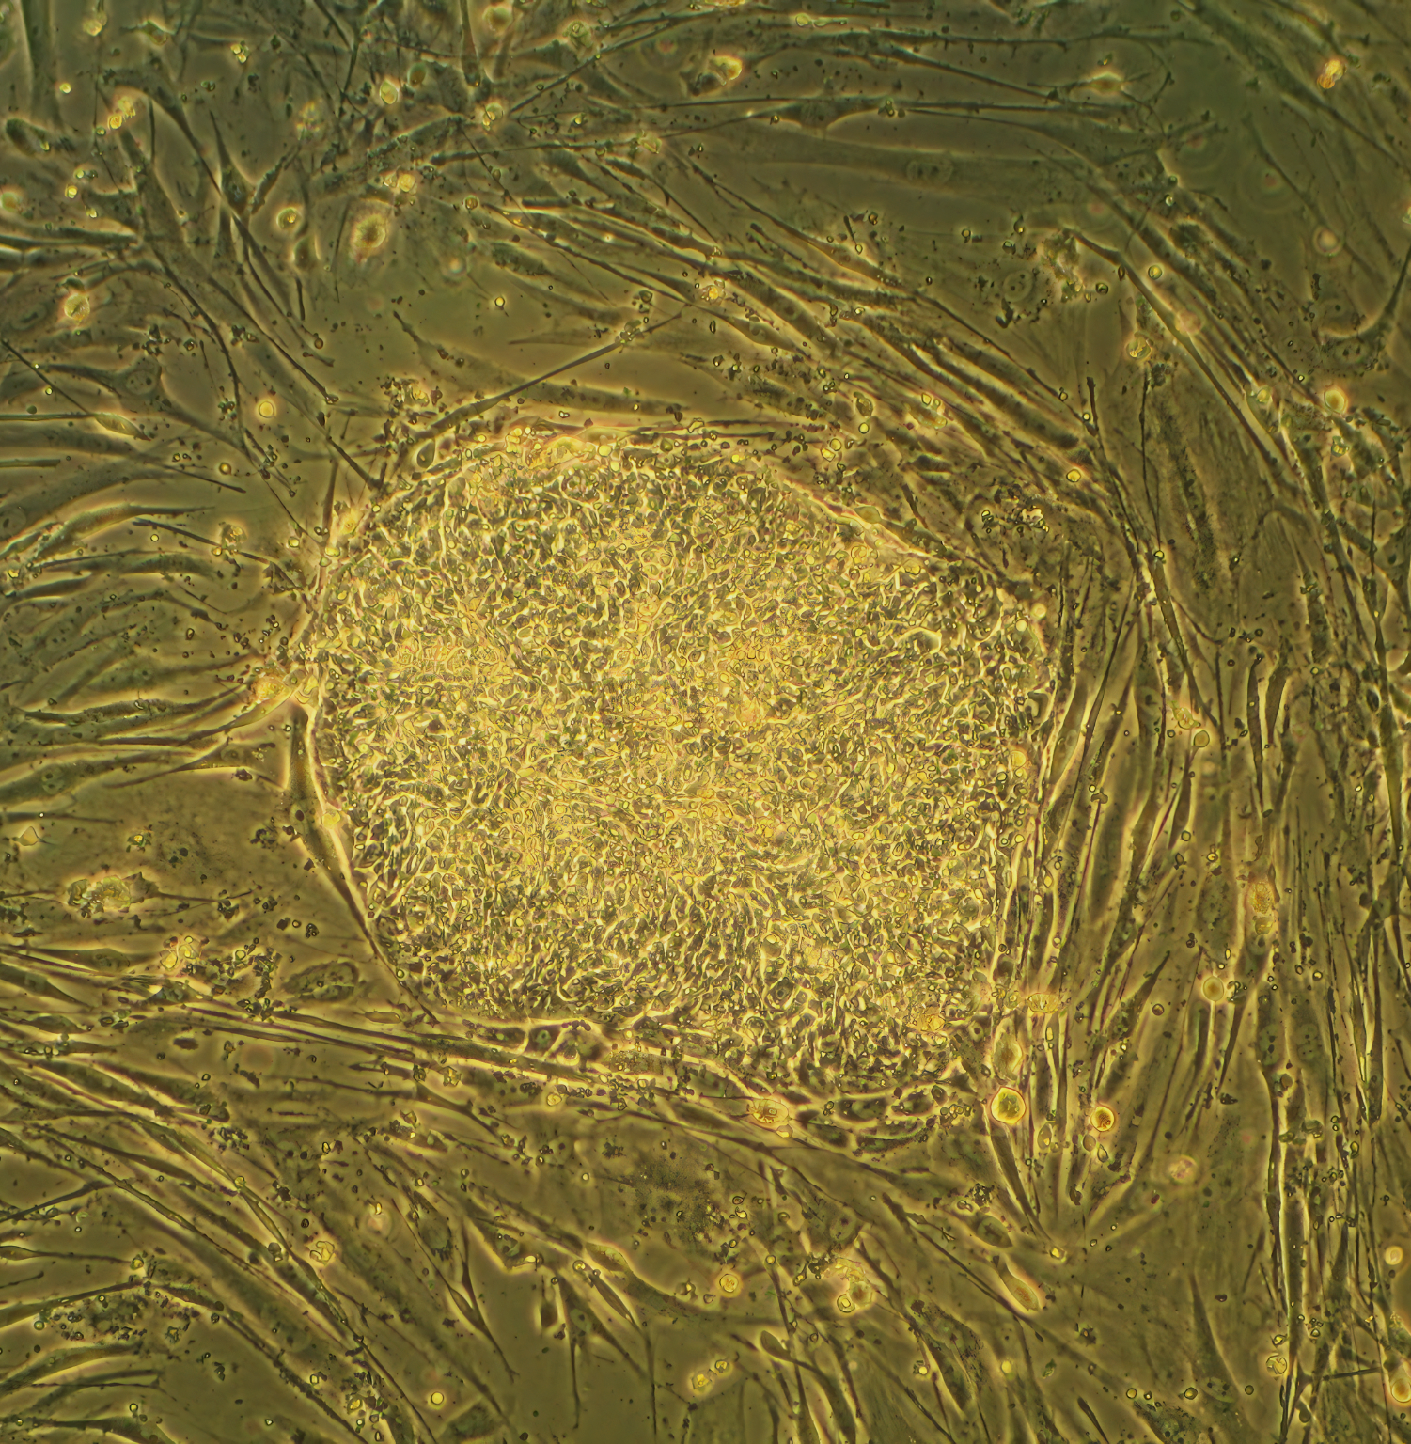
Embryonic stem cells are either totipotent or pluripotent.
As a foetus develops, stem cells begin to become more specialised and less flexible in their ability to differentiate.

Slide 6
Cell Differentiation
Cells become specialised through cell differentiation.
During differentiation, only certain genes are expressed.
  All stem cells contain the same genes.
  Depending on the conditions in or surrounding the cell, some of these genes will be switched on and some will be switched off.
Only genes that are expressed are transcribed into mRNA.
  The mRNA is then translated into protein.
  These proteins determine the structure and function of the cell.
  The cell is now said to be specialised - once the cell has been altered the change is difficult to reverse.
GENES SWITCHED ON
mRNA TRANSCRIBED, PROTEINS TRANSLATED
PROTEINS MODIFY CELL
CELL IS NOW SPECIALISED
GENES SWITCHED OFF
mRNA NOT TRANSCRIBED, PROTEINS NOT TRANSLATED

Slide 7
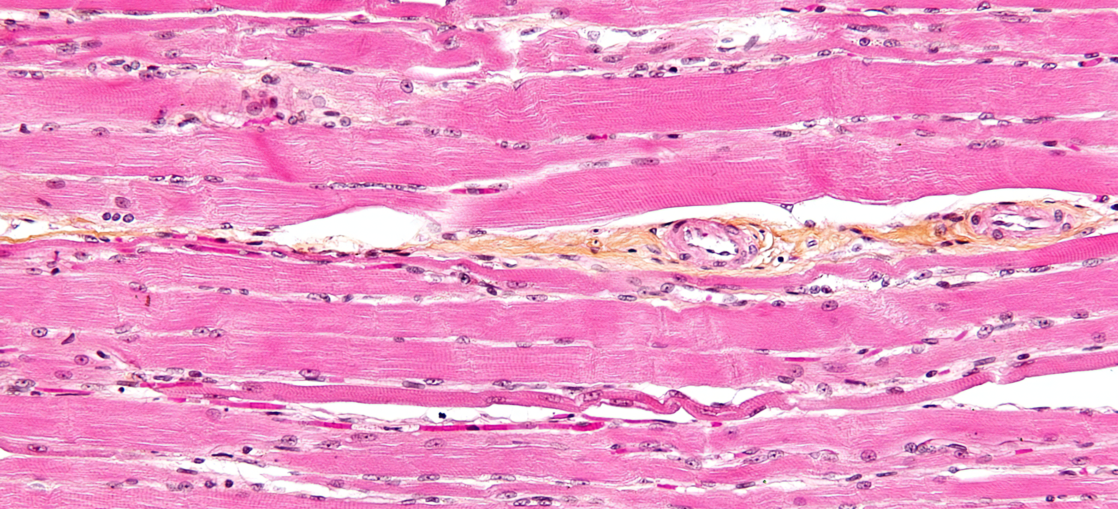
All muscle cells contain the proteins actin and myosin for muscle contraction. The production of these proteins requires the expression of genes that are only switched on in muscle cells.

Slide 8
Cardiomyocytes
Cardiomyocytes are cells that make up the heart tissue.
  Cardiomyocytes are a type of muscle cell that are highly resistant to fatigue.
Historically, scientists believed that cardiomyocytes were unable to divide.
  This would mean that the heart would be unable to repair itself if it were damaged, either through old age or through a heart attack.
New research suggests that the heart has some regenerative abilities.
  Some scientists believe that damaged cardiomyocytes can be replaced over time.
This would imply that the heart has its own supply of stem cells.
  These stem cells would be unipotent; they would only be able to differentiate into a single type of cell (a cardiomyocyte).

Slide 9
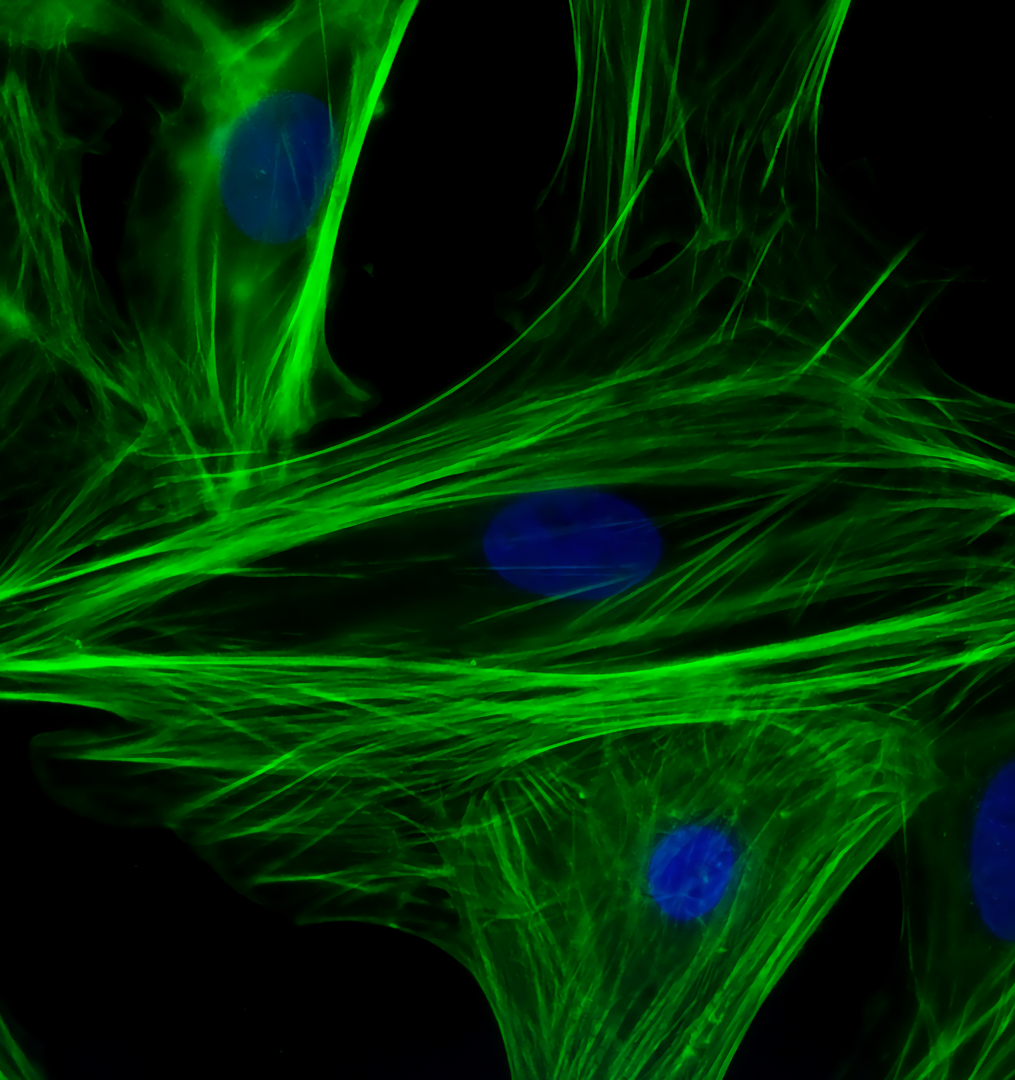
New research suggests that cardiomyocytes are able to regenerate over time.
This may be due to a store of unipotent stem cells found somewhere in the heart.

Slide 10
Stem Cell Therapy
As stem cells have the ability to differentiate into a range of different cell types, they may have therapeutic uses.
  The use of stem cells to treat disease is referred to as stem cell therapy.
Bone marrow transplants are currently the only widely-practiced form of stem cell therapy.
  Bone marrow transplants are used to replace faulty bone marrow.
    Faulty bone marrow may lead the production of abnormal blood cells.
  Bone marrow transplants can be used to treat leukaemia, a cancer of the white blood cells.
In the future, stem cell therapies may be able to treat a wide array of conditions:
  Spinal cord injuries.
  Heart disease.
  Respiratory diseases.
  Organ transplants.

Slide 11
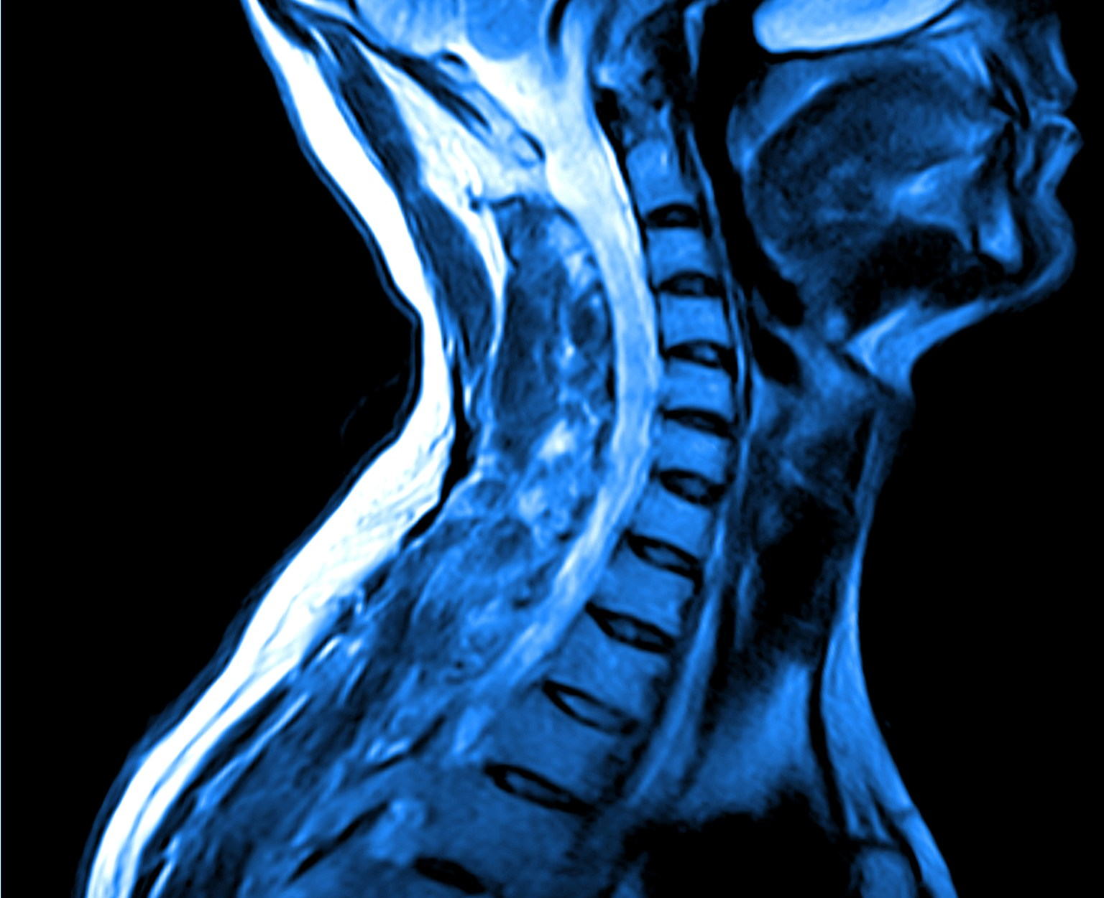
As the spinal cord has a very limited ability to repair itself, injuries can have devastating effects. Stem cell therapies could replace the damaged nerve tissue with healthy cells.

Slide 12
Sources of Stem Cells
There are currently 3 sources of stem cells:
  Adult stem cells.
  Embryonic stem cells.
  Induced pluripotent stem cells (iPSCs).
Type | Source and Ability
Adult stem cells | Found in small numbers in most adult tissue. Most commonly sourced from the bone marrow of a donor. Multipotent so can only give rise to a limited number of cell types.
Embryonic stem cells | Found in embryos between 3-5 days old. These embryos are created in laboratory settings using in vitro fertilization (IVF). Pluripotent so can develop into all cell types in the body.
iPSCs | Created by reprogramming body cells into pluripotent stem cells using transcription factors in laboratory settings.

Slide 13
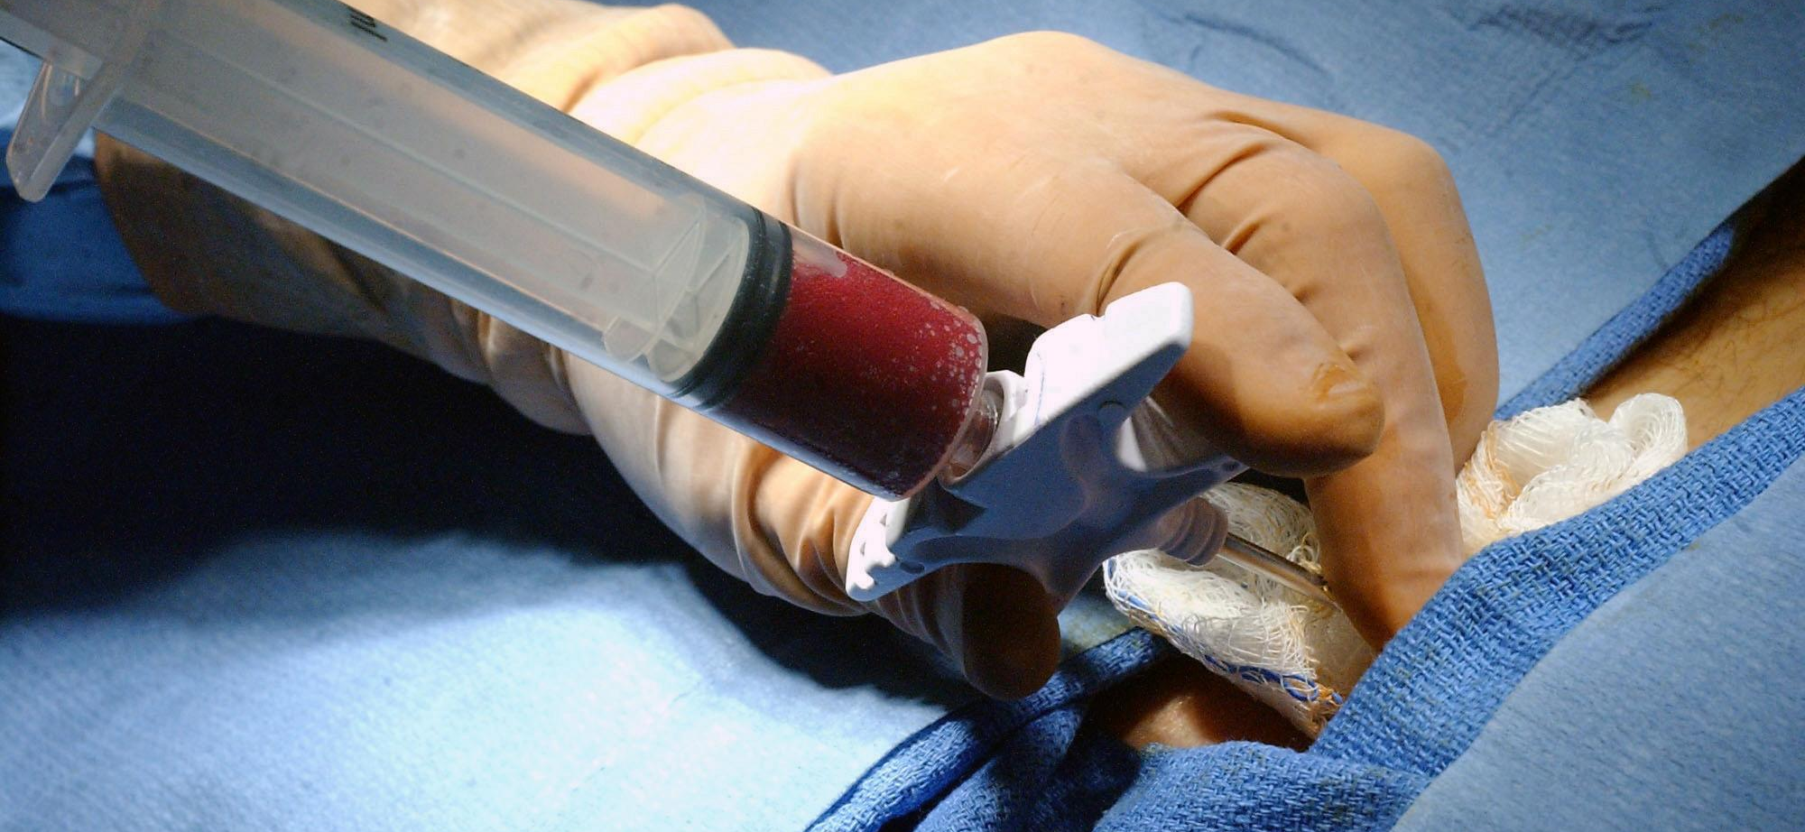
Adult stem cells are most commonly harvested from bone marrow. In this example, stem cells are being extracted from the pelvis.

Slide 14
Ethics of Stem Cells
The use of stem cells raises ethical concerns.
People are most concerned about the use of embryonic stem cells.
  Embryos used in stem cell research are destroyed after 14 days.
    These embryos had the potential to become a foetus if implanted into a uterus.
  Others believe that life begins at the point of fertilisation. They argue it is morally wrong to destroy embryos.
There are few objections to the use of adult stem cells.
  Individuals can give informed consent to have their stem cells harvested.
  However, as adult stem cells are multipotent, they have more limited potential than embryonic stem cells.
iPSCs may have tremendous therapeutic potential.
  As iPSCs are formed from adult tissue, the ethical concerns surrounding embryonic stem cells are not present.
  iPSCs have the same ability to differentiate as embryonic stem cells.
  iPSCs could be used to grow replacement organs; these would be genetically identical to the donor, so the risks of organ rejection would be eliminated.

Slide 15
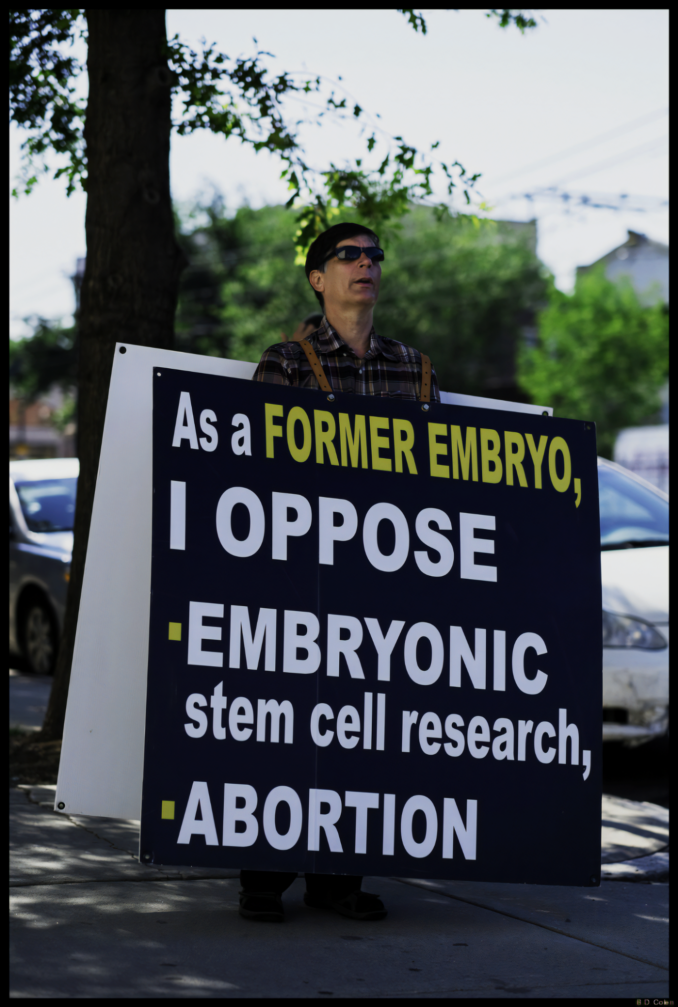
There are ethical concerns with the use of embryos. Some do not believe in their destruction on the basis of their potential to develop into a human baby.

Slide 16
Evaluating Stem Cell Therapy
Decision makers have to consider society’s views when legislating for stem cell research.
  Decision makers may include individuals in government and medical professionals.
Stem cell therapies have the potential to save lives.
  In the UK, there are over 7,000 people waiting for an organ transplant. Many of these individuals will die before an organ becomes available.
  As organs can be grown using stem cell therapy, shortages could be eliminated.
  As the transplanted organ would be genetically identical to the original organ, the chance of organ rejection would also be eliminated.
Stem cell therapies also have the potential to improve an individual’s quality of life.
  Stem cells could replace damaged tissue, such as those found in the eyes or the spinal cord.
  These could potentially restore a person’s sight, or their ability to walk again.

Slide 17
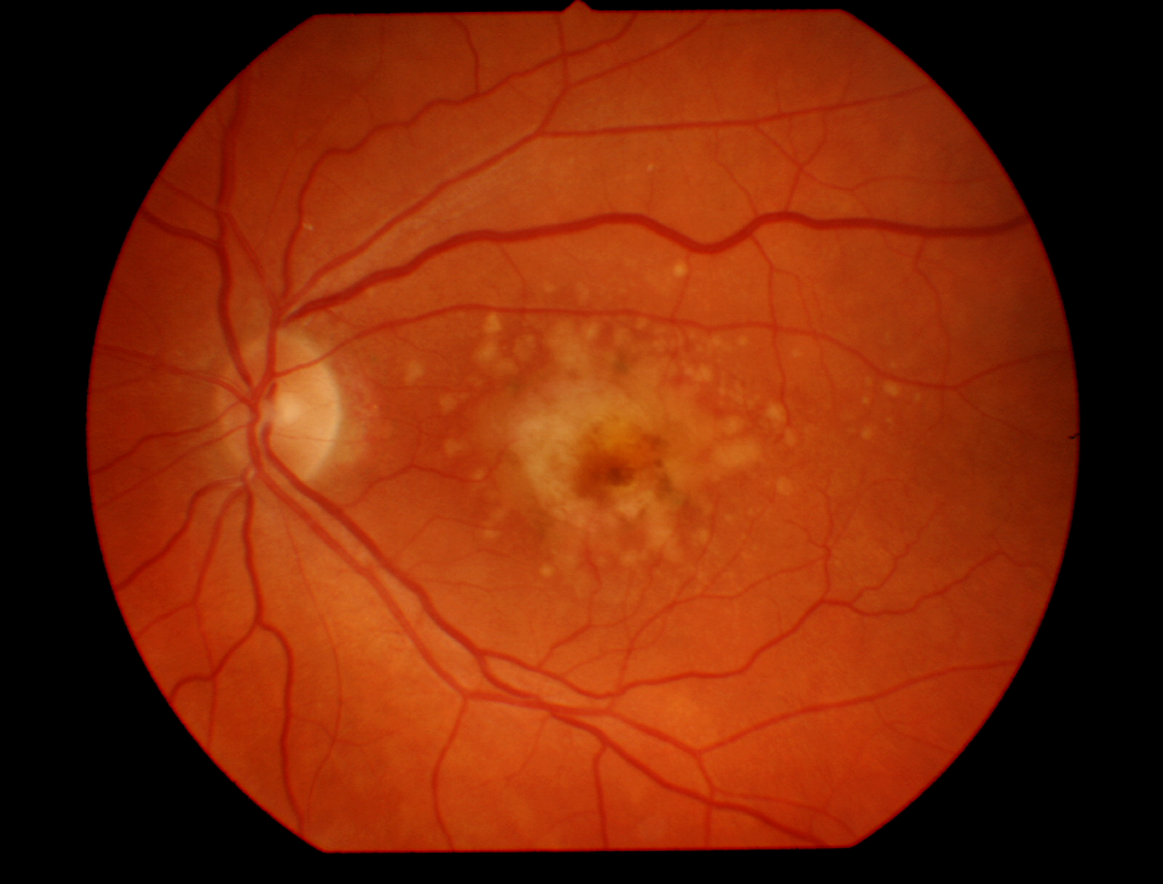
Age-related macular degeneration is the leading cause of blindness.
Clinical trials involving stem cell therapy have shown great promise in restoring sight.

