Slide 1
AQA A Level Biology
57 - Mutations and Cancer
Mutagens, Tumours and Treatments

Slide 2
Mutations
Specification Point 3.8.1 - Alteration of the sequence of bases in DNA can alter the structure of proteins.
A mutation can be defined as an change in the base sequence of DNA.
There are several types of mutation:
  Substitutions - 1 or more nucleotides are swapped for alternative nucleotides (ATC|GTC → ATA|GTC).
  Deletions - 1 or more nucleotides are removed (ATC|GTC → ATG|TC).
  Additions - 1 or more nucleotides are added (ATC|GTC → ATC|GTC|A).
  Duplications - 1 or more nucleotides are repeated (ATC|GTC → ATC|CCC|GTC).
  Inversions - a sequence of nucleotides are separated and then reattached in the reverse order (ATC|GTC → ATC|CTG).
  Translocations - A sequence of nucleotides break off and are then reattached at a different position on the chromosome or on a different chromosome altogether.

Slide 3
Consequences of Mutations
Mutations may lead to changes in the shape of a protein.
  As the nucleotide sequence determines the sequence of amino acids, a different polypeptide may be coded for.
  This may mean the protein no longer functions correctly.
Mutations may increase the likelihood of certain cancers.
  BRCA1 is a gene that, if altered, significantly increases the risk of developing breast cancer.
Mutations may directly cause genetic disorders.
  These are often referred to as hereditary diseases.
  Huntington’s and cystic fibrosis are 2 such examples.
Mutations in the DNA sequence may change the sequence of amino acids. This can have lethal consequences.

Slide 4
CHROMOSOME 7
Mutations in the CFTR gene on the long arm of chromosome 7 can lead to the production of a non-functional version of the CFTR protein.
This causes the symptoms of cystic fibrosis - a chronic and incurable disease that affects the lungs and other organs. Cystic fibrosis is an example of a disease that is inherited through generations.
CFTR GENE

Slide 5
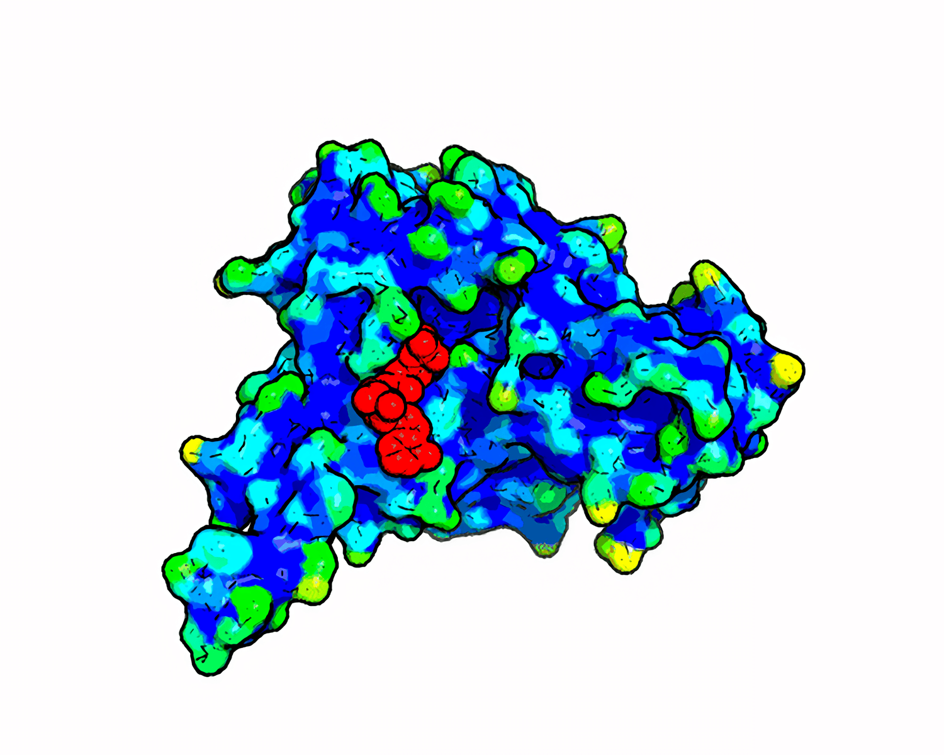
Mutations in the CFTR gene on the long arm of chromosome 7 can lead to the production of a non-functional version of the CFTR protein.
This causes the symptoms of cystic fibrosis - a chronic and incurable disease that affects the lungs and other organs. Cystic fibrosis is an example of a disease that is inherited through generations.

Slide 6
Degeneracy and Frameshift
Some mutations will not affect the sequence of amino acids.
  This is due to the degenerate nature of DNA.
  More than 1 codon codes for the same amino acid.
  Substitutions and inversions are examples of mutations that often result in the same amino acid sequence.
Some mutations will have a profound effect on the sequence of amino acids.
  If a mutation changes the number of bases in a gene, the codons will shift to the left or right.
  This is because DNA is a non-overlapping code. Codons are always read in groups of 3.
  This is referred to as frameshift - any codons that are read after the mutation are likely to be different to the original code.
  Additions, deletions and duplications are examples of mutations that lead to frameshift.

Slide 7
In this example, a substitution mutation has not altered the sequence of amino acids. These types of mutations are sometimes referred to as silent mutations.
AAA | CTT | GTC → AAG | CTT | GTC
LYSINE | LEUCINE | VALINE → LYSINE | LEUCINE | VALINE
In this example, a deletion mutation has resulted in the loss of an A base at position 3 on the first codon. This has shifted the entire sequence left, resulting in an entirely new sequence of amino acids.
AAA | CAC | GTC → AAC | ACG | TCA
LYSINE | LEUCINE | VALINE → ASPARAGINE | THREONINE | SERINE

Slide 8
Mutagens
A mutagen is a physical or chemical agent that increases the rate of mutation in DNA.
Examples of physical mutagens include UV radiation and ionising radiation.
  UV radiation can cause errors in DNA replication.
  Ionising radiation (X-rays, gamma rays and alpha particles) can cause DNA to break. Errors may be introduced when cells attempt to repair the DNA.
Examples of chemical mutagens include deaminating agents and alkylating agents.
  Deaminating agents (nitrous acid, for example) remove amine groups (NH₂) from bases. This most notably leads to the conversion of cytosine (C) into uracil (U).
  Alkylating agents (ethylnitrosourea, for example) add methyl groups (CH₃) to the phosphodiester backbone of DNA. When alkylated, guanine (G) pairs with thymine (T) rather than cytosine (C).

Slide 9
UV LIGHT
Radiation from UV light can cause DNA breakages. Errors can occur in the subsequent repairing, leading to mutations in the base sequence.

Slide 10
Cancer
Specification Point 3.8.2.3 - Gene expression and cancer.
Mutations that occur in adulthood are referred to as acquired mutations.
  Mutations may occur in genes that are responsible for cell division.
  This may lead to uncontrolled cell division.
Cells that divide out of control may form a tumour.
  A tumour may be defined as a group of abnormal cells that form lumps or growths.
Some tumours are benign.
  These tumours are slow-growing and lack the ability to invade surrounding tissue.
Some tumours are cancerous.
  These tumours grow much more quickly and are able to invade surrounding tissue.
  In certain circumstances, cells may break off the main tumour and spread throughout the body.
    This is referred to as metastasis.

Slide 12
Tumour Suppressor Genes and Proto-Oncogenes
There are 2 main types of gene that regulate cell division:
  Tumour suppressor genes.
  Proto-oncogenes.
Tumour suppressor genes slow down cell division.
  Tumour suppressor genes create proteins that limit the rate of cell division.
  They also tell cells when to die - this is referred to as apoptosis.
Proto-oncogenes speed up cell division.
  Proto-oncogenes create proteins that increase the rate of cell division.
If a mutation occurs in a tumour suppressor gene or a proto-oncogene, cells will divide uncontrollably.
  This may result in the growth of a cancerous tumour.
Tumour suppressor genes and proto-oncogenes both change the speed of the cell cycle.

Slide 13
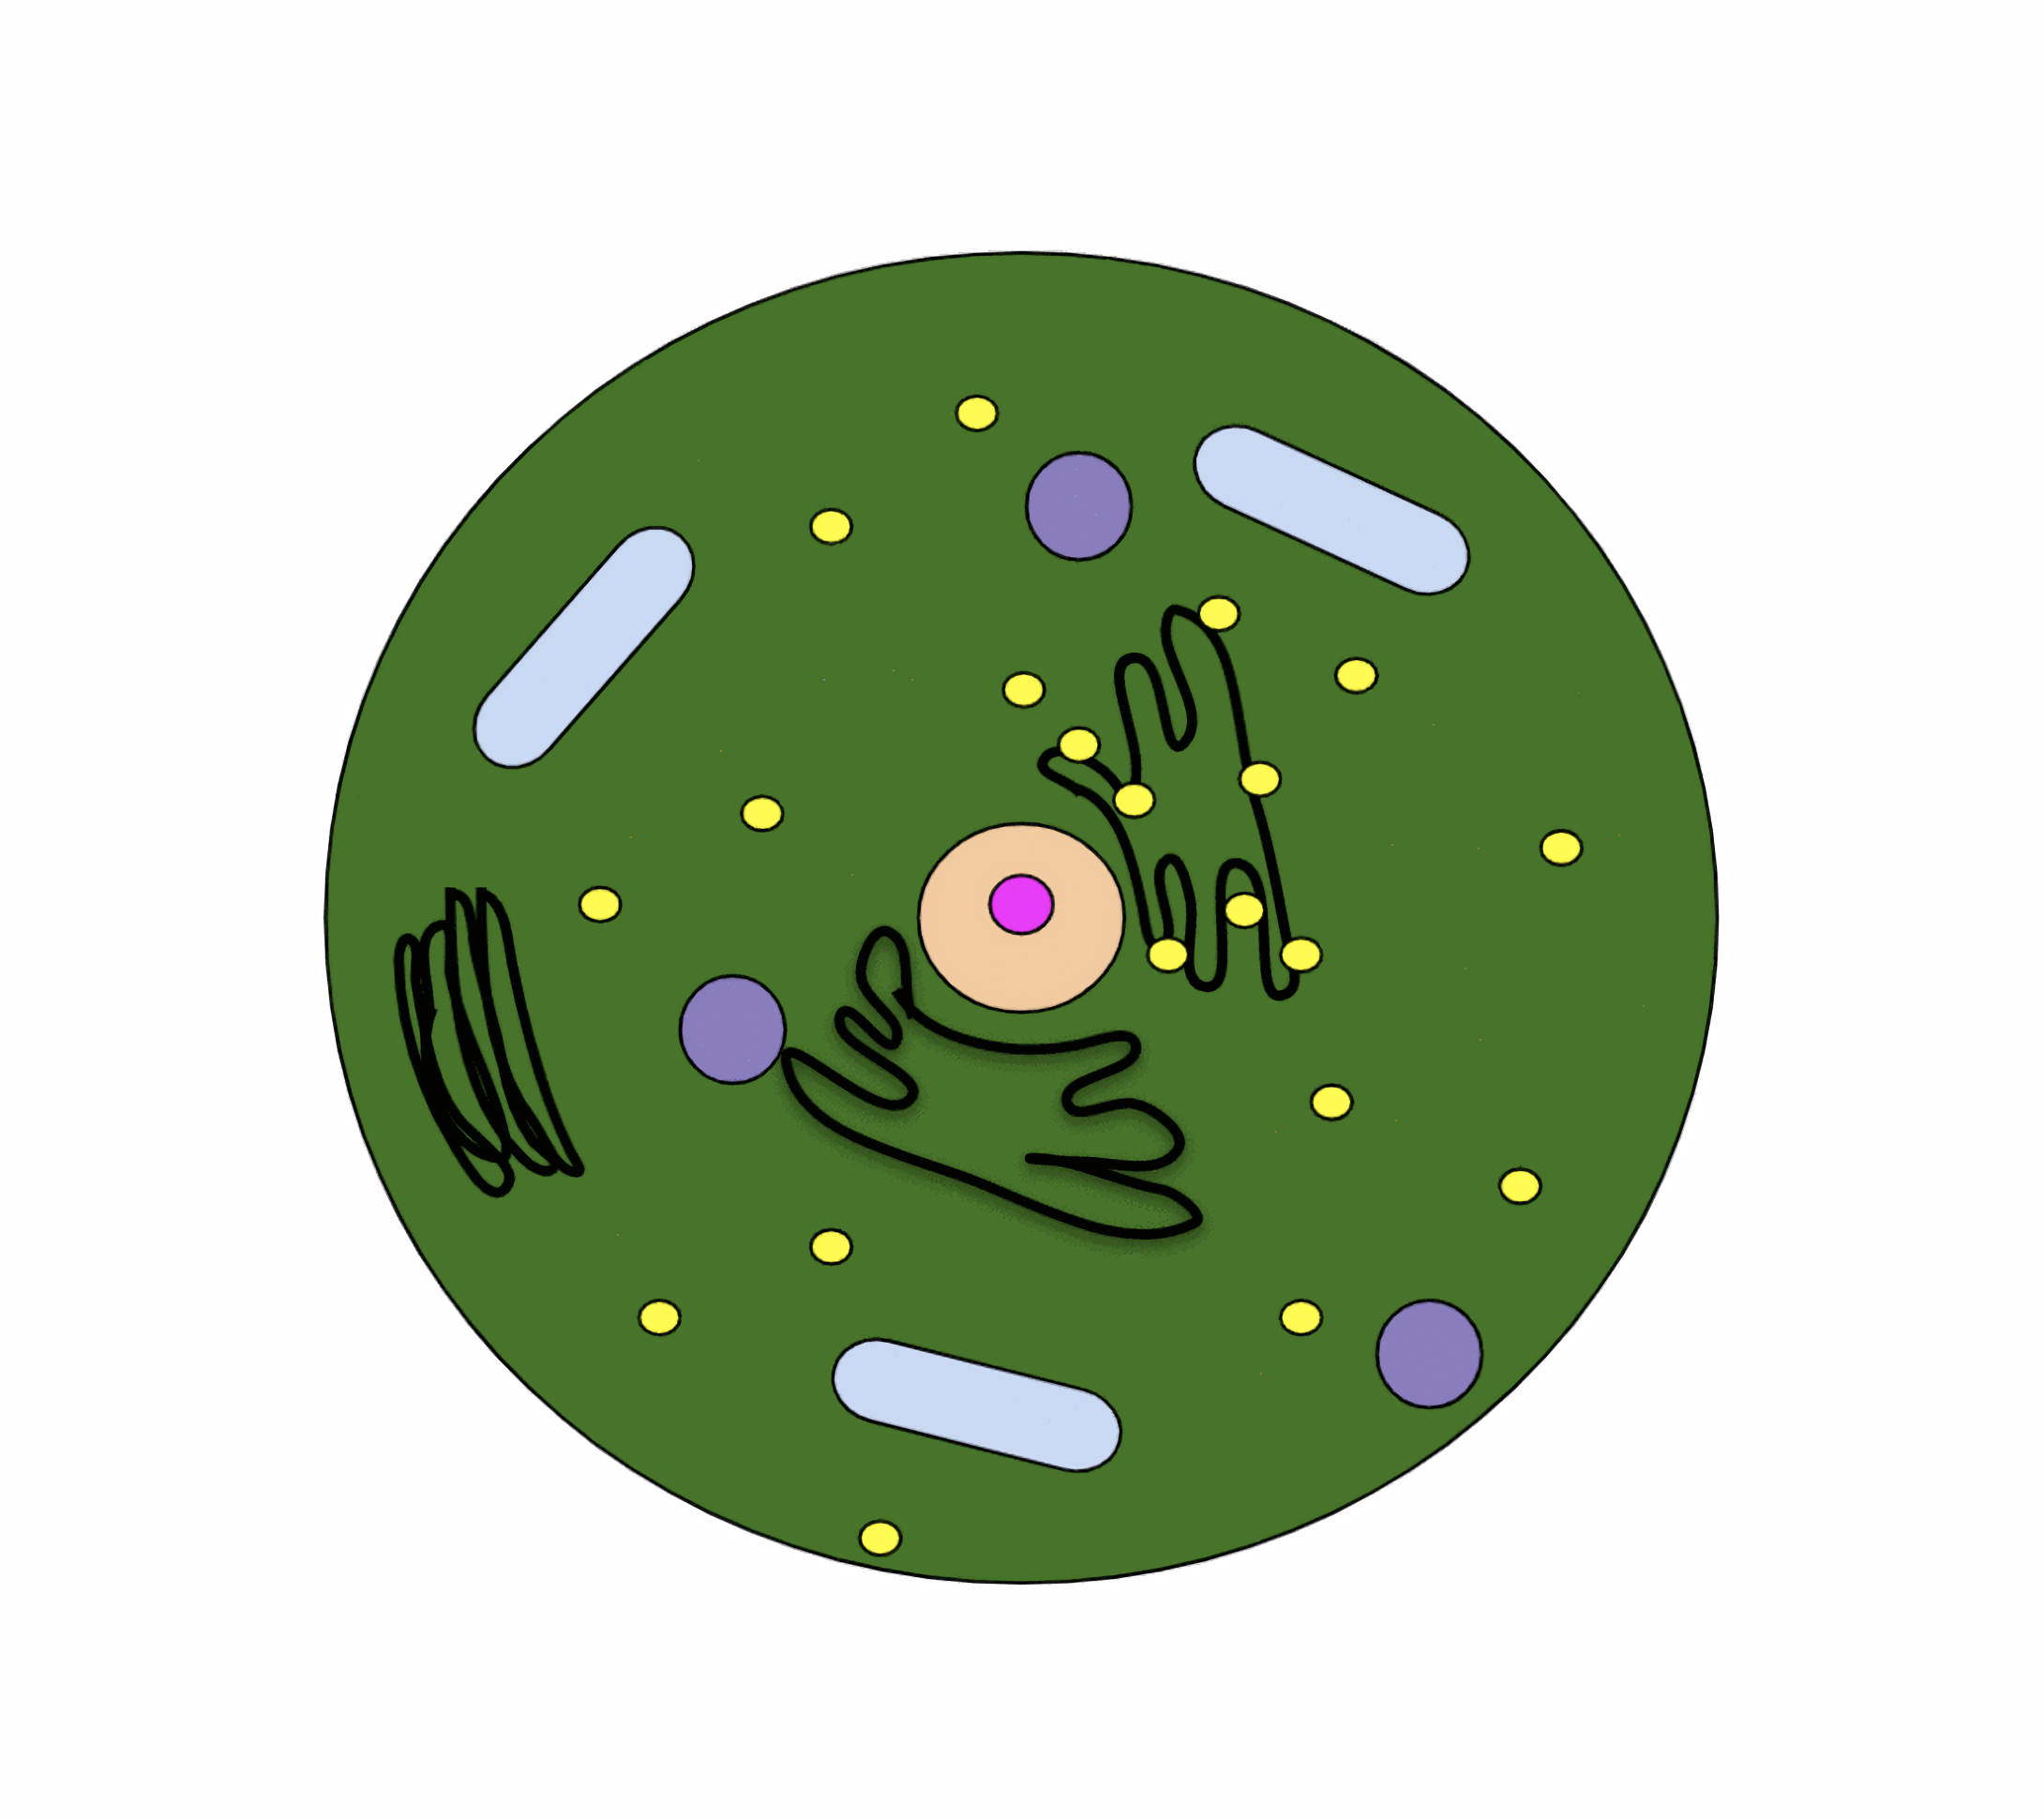
If they detect a harmful mutation, tumour suppressor genes can trigger apoptosis.
This may not occur if the tumour suppressor gene is itself subjected to a mutation.

Slide 14
Causes of Tumour Growth
There are several factors that are thought to contribute to the growth of tumours.
Abnormal methylation of DNA may lead to the growth of a tumour.
  Methyl groups (CH₃) are added to DNA in the process of methylation.
  Methylation is important in the regulation of gene expression.
  Too much methylation (hypermethylation) or too little methylation (hypomethylation) of cancer-related genes may lead to the growth of a tumour.
Increased exposure to oestrogen is thought to increase the risk of developing breast cancer.
  Oestrogen increases the rate of cell division in breast tissue.
    This increases the risk of acquired mutations.
  Oestrogen may also introduce mutations into the DNA of cells in breast tissue.

Slide 15
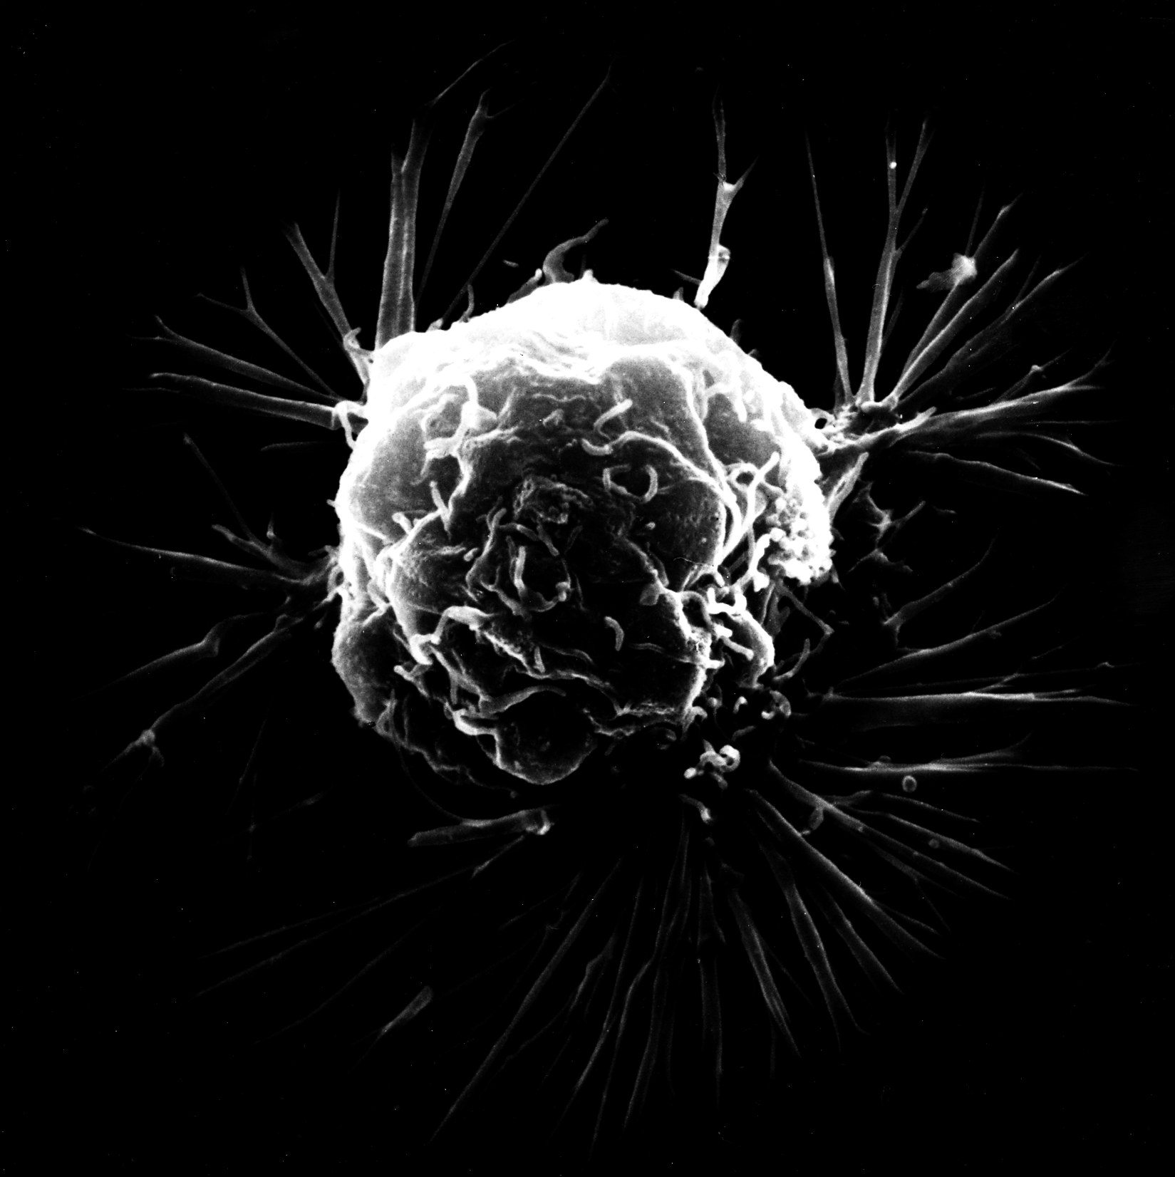
A cancerous cell in breast tissue. Exposure to high levels of oestrogen over an extended period of time is thought to increase a woman’s risk of developing breast cancer.

Slide 16
Risk Factors for Cancer
A cancer risk factor is anything that increases a person’s chance of getting cancer.
  Risk factors may have either a genetic or environmental basis.
The risk of developing certain types of cancer can be strongly influenced by genetics.
  Certain cancers (for example, breast, ovarian and prostate) are linked to specific alleles.
  Inheriting this allele will increase the likelihood of getting cancer.
  Women with a faulty allele for the BRCA1 gene have up to a 90% chance of developing breast cancer in their lifetime.
The risk of developing cancer may also be influenced by the environment.
  Lifestyle choices like smoking and alcohol consumption are strongly linked to cancer risk.
  Occupational hazards like exposure to radiation can also contribute to cancer risk.

Slide 17
There is a strong positive correlation between the risk of lung cancer and smoking.

Slide 18
Prevention and Treatment of Cancer
It is possible to screen for certain cancer-causing mutations.
  Many women are routinely screened for the faulty BRCA1 allele.
  If the faulty allele is detective, preventive steps such as a mastectomy may be performed to significantly reduce the risk of breast cancer developing.
Cancer that has been caused by a particular mutation may be targeted more specifically than with traditional chemotherapy or radiotherapy.
  Breast cancer that is caused by a mutation in a proto-oncogene called HER2 can be treated with a drug called Trastuzumab.
  Trastuzumab binds to a receptor on the mutated HER2 protein and slows the rate of cell division.
In the future, cancer may be treated using gene therapy.
  Gene therapy seeks to replace defective alleles for a gene with working versions.
  Gene therapy may be able to treat certain cancers that are caused by these defective alleles.

Slide 19
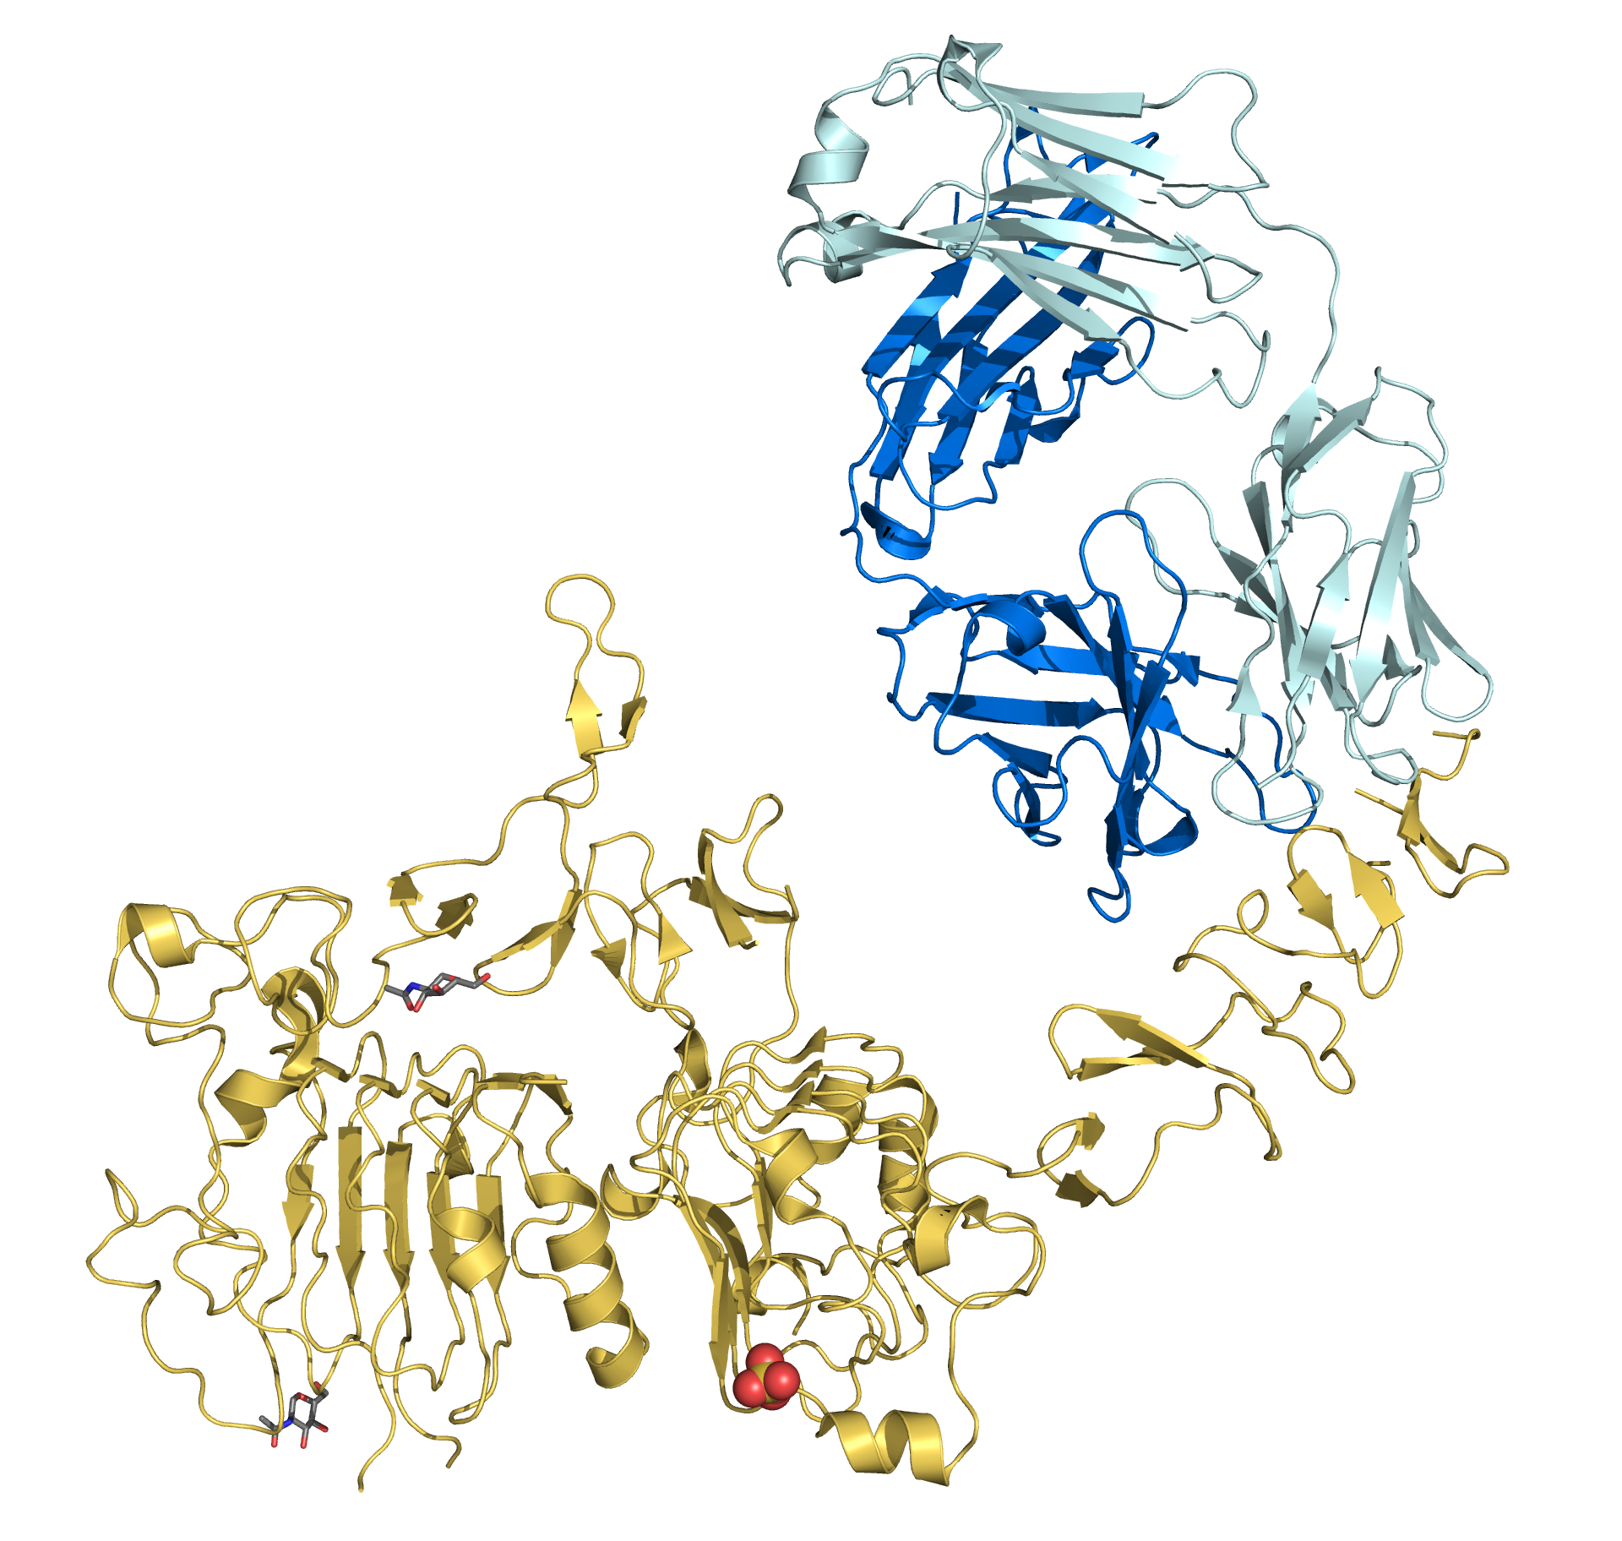
Trastuzumab binding to the HER2 receptor protein.
This inhibits the protein and slows the rate of cell division. When used in conjunction with chemotherapy, cancer survival rates increase significantly.

