Slide 1
AQA A Level Biology
56 - Conservation
Strategies and Conflicts

Slide 2
Conservation
Specification Point 3.7.4 - Populations in ecosystems.
Conservation biology is the discipline of protecting and managing global biodiversity.
  Conservation biologists are concerned with the destruction and loss of species and habitats.
Conservation aims to protect and manage ecosystems in a sustainable manner.
  Sustainable development can be defined as the need to meet the demands of the current human population without degrading the environment for future generations.
Conservation is a dynamic process.
  This means that it needs to constantly adapt to changing environmental, social and political pressures.
Conservation sometimes lead to conflicts.
  There is often a delicate balance that needs to be maintained between conservation and human needs.

Slide 3
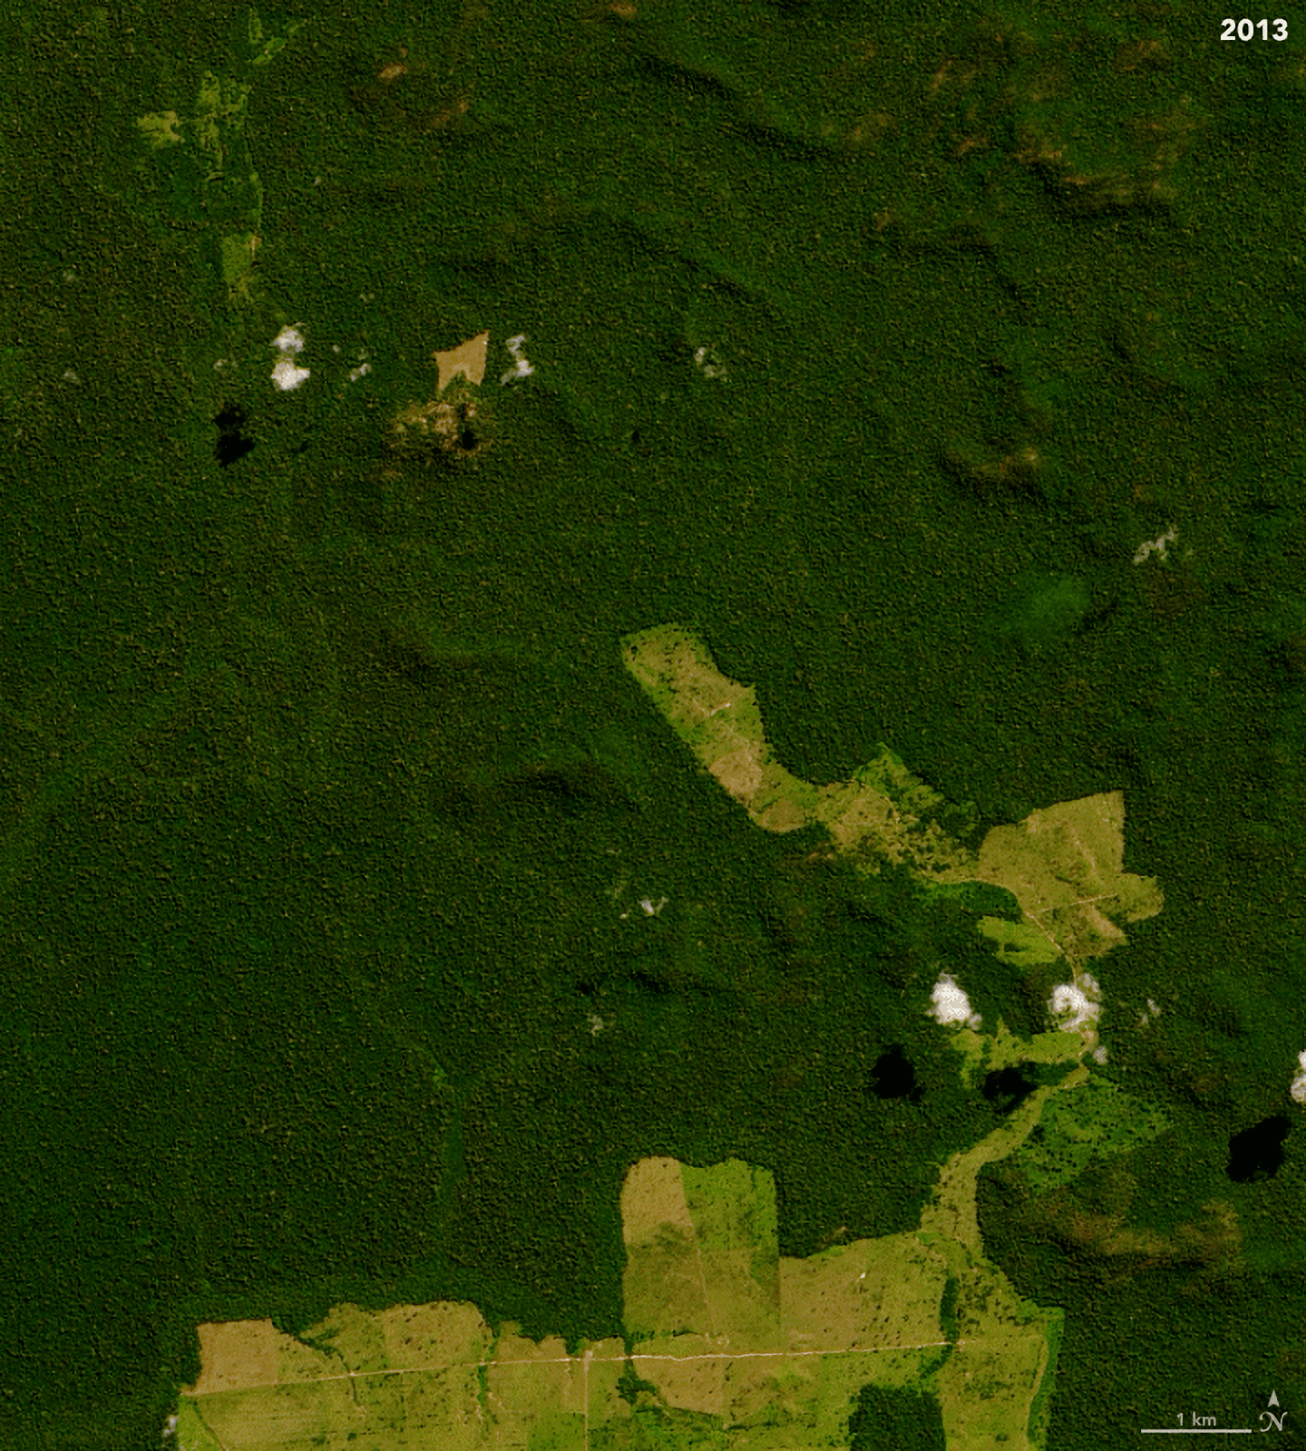
The Brazilian Amazon, one of the most naturally biodiverse regions on Earth, is losing upwards of 10,000 km² of forest per year.
A desire to conserve the rainforest ecosystem has come into direct conflict with the need for increased agricultural output and housing.

Slide 4
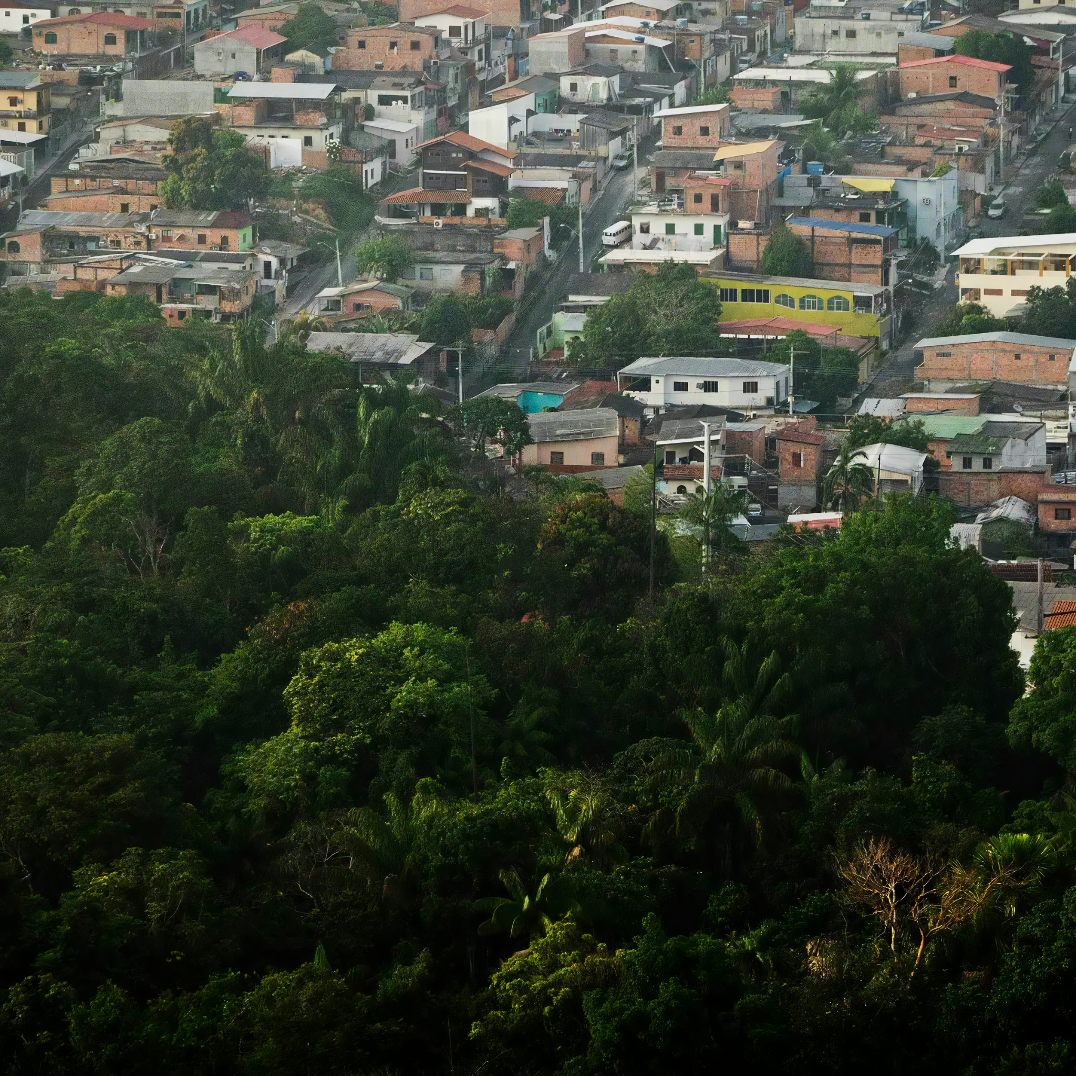
A desire to conserve the rainforest ecosystem has come into direct conflict with the need for increased agricultural output and housing.
Pictured is the Brazilian city of Manaus, one that is directly expanding into Amazon rainforest.

Slide 5
THE NUMBER OF THREATENED SPECIES IS INCREASING RAPIDLY
30,000
As more areas lose their trees, increasing numbers of species are threatened with extinction.
This is a grave concern to conservation biologists.
20,000
NUMBER OF THREATENED SPECIES →
10,000
0
2000
2010
2020

Slide 6
Conservation Strategies
There are a number of ways to conserve different habitats and species.
  These are referred to as conservation strategies.
Habitats and species can be given legal protections.
  In the UK, habitats are preserved through legal designations. Sites of Special Scientific Interest (SSRIs) and Areas of Outstanding Natural Beauty (AONBs) are 2 such examples.
  Globally, endangered species are protected through the CITES (Convention on International Trade in Endangered Species of Wild Fauna and Flora) agreement.
The populations of endangered species can be increased through captive breeding programmes.
  Species can be bred in captivity to help boost their numbers. This often takes place in zoos.
  Animals that have been bred in captivity can then be released into the wild.

Slide 7
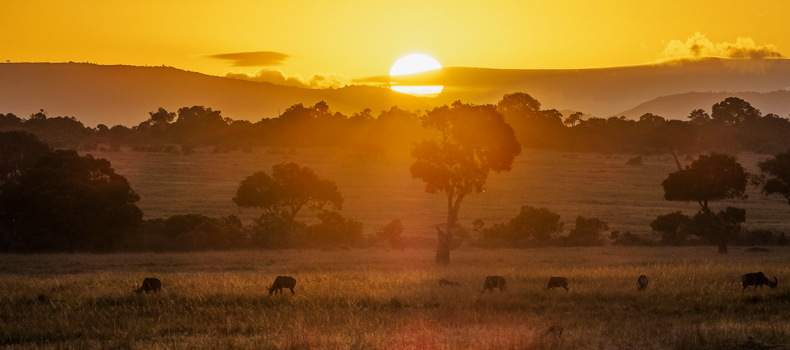
The Maasai Mara is a large national reserve in Kenya. It has become a popular destination for tourists. There is an ongoing and complicated conflict between the desire to conserve the habitat with the wish of its occupants to earn revenue from tourists.

Slide 8
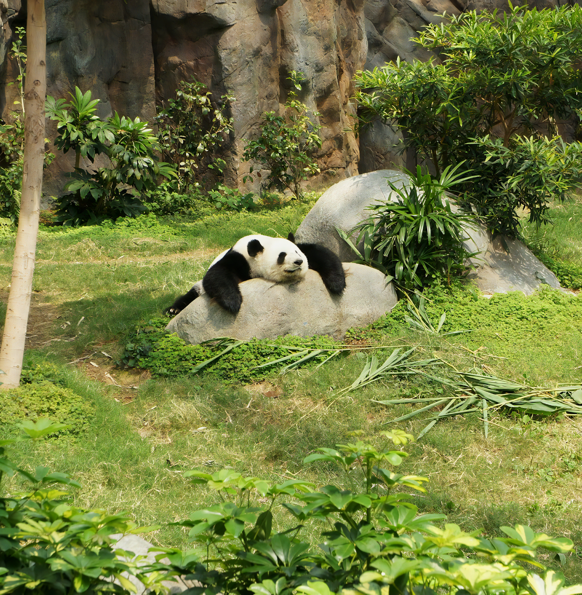
One of the most famous captive breeding programmes involves the giant panda.
Various measures have been implemented to try and encourage pandas to mate with each other in the wild and there are concerns that money could be better spent on other forms of conservation.

Slide 9
Conservation Strategies
The succession of ecologically rich areas can be managed.
  The process of succession often involves the disruption of ecosystems.
  Humans can intervene to ensure that a habitat will continue to exist in its current state of succession.
The genetic diversity of plants can be preserved using seed banks.
  A seed bank stores seeds in a safe location where it is both cool and dry.
  The genetic template more many different species of plant can be stored in a relatively small location. The seeds can also be stored for a long period of time.
  Seed banks can be used to reseed a plant population if it were to go extinct in the wild.
Fishing stocks can be managed using fishing quotas.
  Fishing quotas are a means of regulating how many fish of a particular species can be caught in a particular area.
  Quotas aim to prevent overfishing, which can lead to the extinction of particularly popular species of fish, such as salmon and tuna.

Slide 10
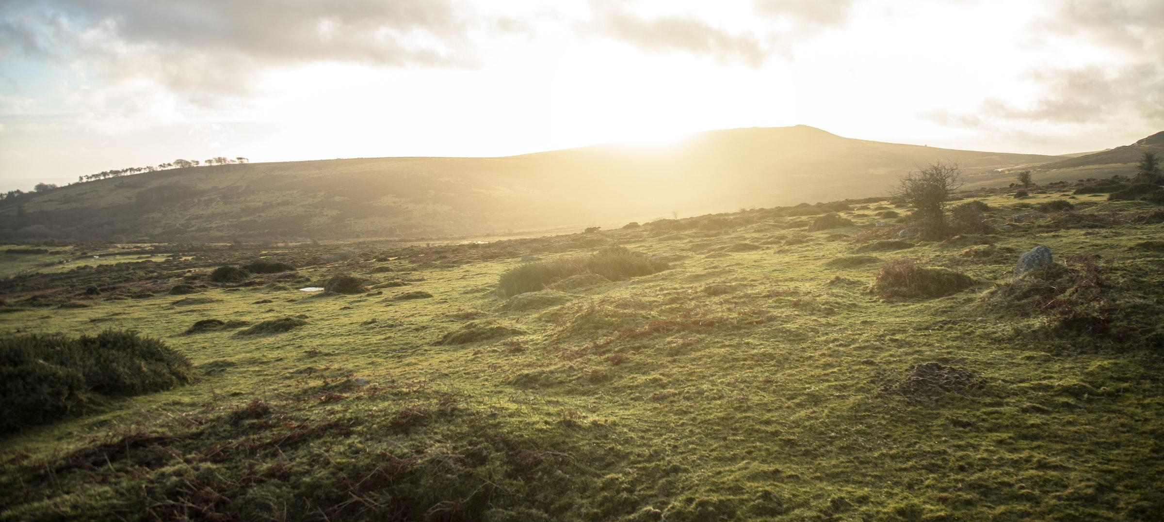
The Scottish moorlands are a good example of where succession is actively managed. Without human intervention, the moorlands would succeed into mixed forest. This would lead to the loss of a number of rare plant and animal species. Areas of land are routinely burned to prevent succession.

Slide 11
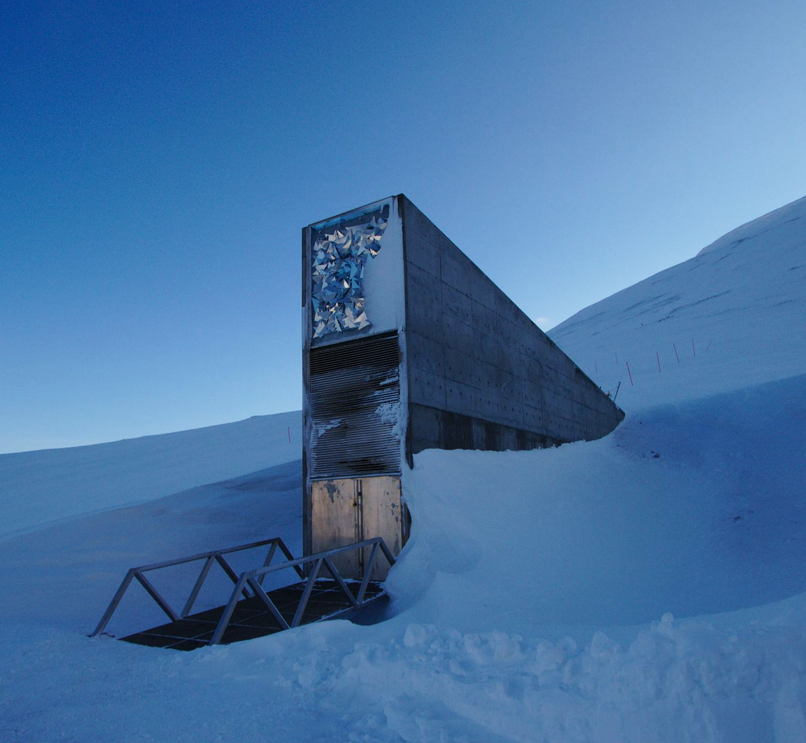
The Svalbard Global Seed Vault in Norway has a storage capacity of 4.5 million seed samples and is home to over 4,000 different species of seed.
Seed banks can store a tremendous amount of genetic diversity in a relatively small area.

Slide 12
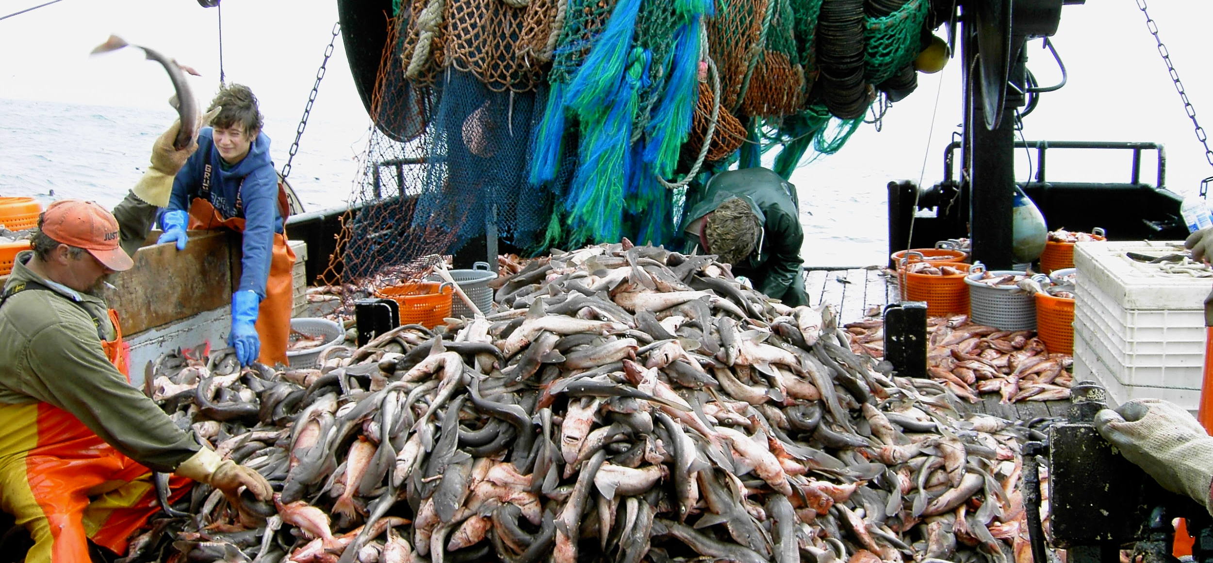
Many species of fish have seen alarming declines in their numbers. Current estimates predict the oceans will be entirely depleted of edible fish by 2048. Stringent legal quotas have been brought in to try and arrest this decline.

Slide 13
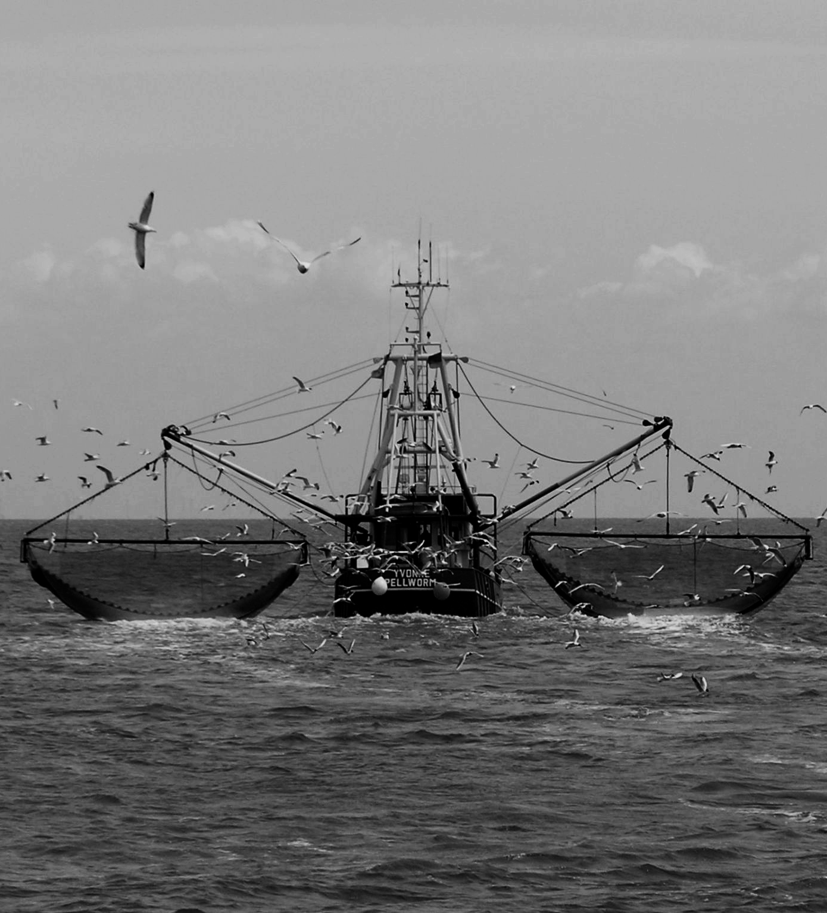
Globally, the proportion of stocks that are fished unsustainably are increasing.
Aquaculture provides a sustainable alternative to open water fishing.
SUSTAINABLE
% OF FISH STOCKS →
UNSUSTAINABLE
TIME →

Slide 14
Limitations of Conservation Strategies
Strategy | Limitations
Protected areas | There is often direct conflict between stakeholders. Conservationists wish to preserve the area whilst local inhabitants will often wish to make a living from it, either through agriculture or tourism.
Captive breeding programmes | Some animal species (pandas, for example) have difficulty mating in artificial surroundings, such as zoos. Releasing animals back into the wild may be unsuccessful, or could introduce a new disease to the native population.
Seed banks | Seeds need to be constantly tested for viability. This is both expensive and time-consuming.
Fishing quotas | Quotas are generally unpopular with fishermen, as they directly limit potential revenue. Maritime boundaries are often disputed and international cooperation is required for quotas to be truly effective.

