Slide 1
AQA A Level Biology
55 - Succession
Primary and Secondary Succession

Slide 2
Ecological Succession
Specification Point 3.7.4 - Populations in ecosystems.
Ecological succession explains how an ecosystem changes over time.
  Ecosystems exists as a dynamic systems; they are in a constant state of flux.
Succession happens in a series of stages.
  The biotic and abiotic factors in an ecosystem will change over time.
  As they change, 1 community of organisms is succeeded by another.
Primary succession occurs on newly-formed land.
  This land initially lacks soil, and may have formed after a land-forming event such as a glacial melt or a lava flow.
Secondary succession occurs on land that has been cleared of plantlife.
  This land contains soil, and may have formed after a forest fire or through man-made deforestation.

Slide 3
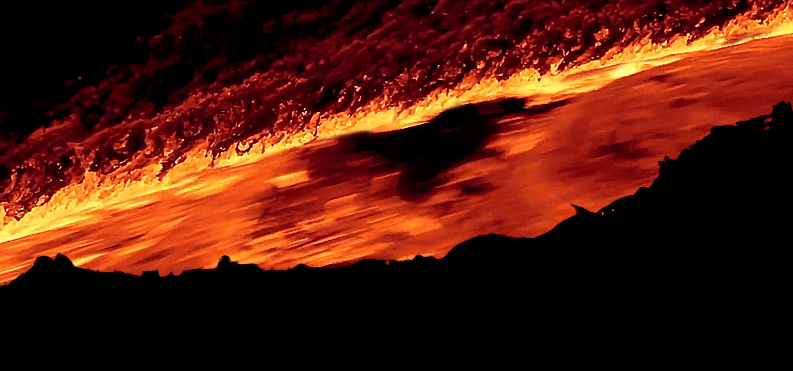
When the lava flows from volcanic eruptions cool, bare rock will remain. This forms a good substrate for primary succession to begin.

Slide 4
Primary Succession
The newly-formed land is first colonised by a pioneer species.
  It is likely that the abiotic conditions are harsh. There will be limited water and nutrients for colonising plants.
  The pioneer species that grow on this land are extremophilic, they are able to tolerate such abiotic conditions.
  During primary succession after lava flows, lichens are the most common pioneer species.
The pioneer species then modify the abiotic conditions of the habitat.
  As pioneer species die, their organic matter is decomposed by microorganisms.
  This forms a basic layer of soil, referred to as humus.
The abiotic conditions are now more supportive of a wider variety of species.
  Small shrub-like plants can now colonise the soil.
  They in turn will die and their organic matter is added to the soil.
  Nitrogen-fixing bacteria will often accompany these new species of plants. This will allow ammonia to be added to the soil.

Slide 5
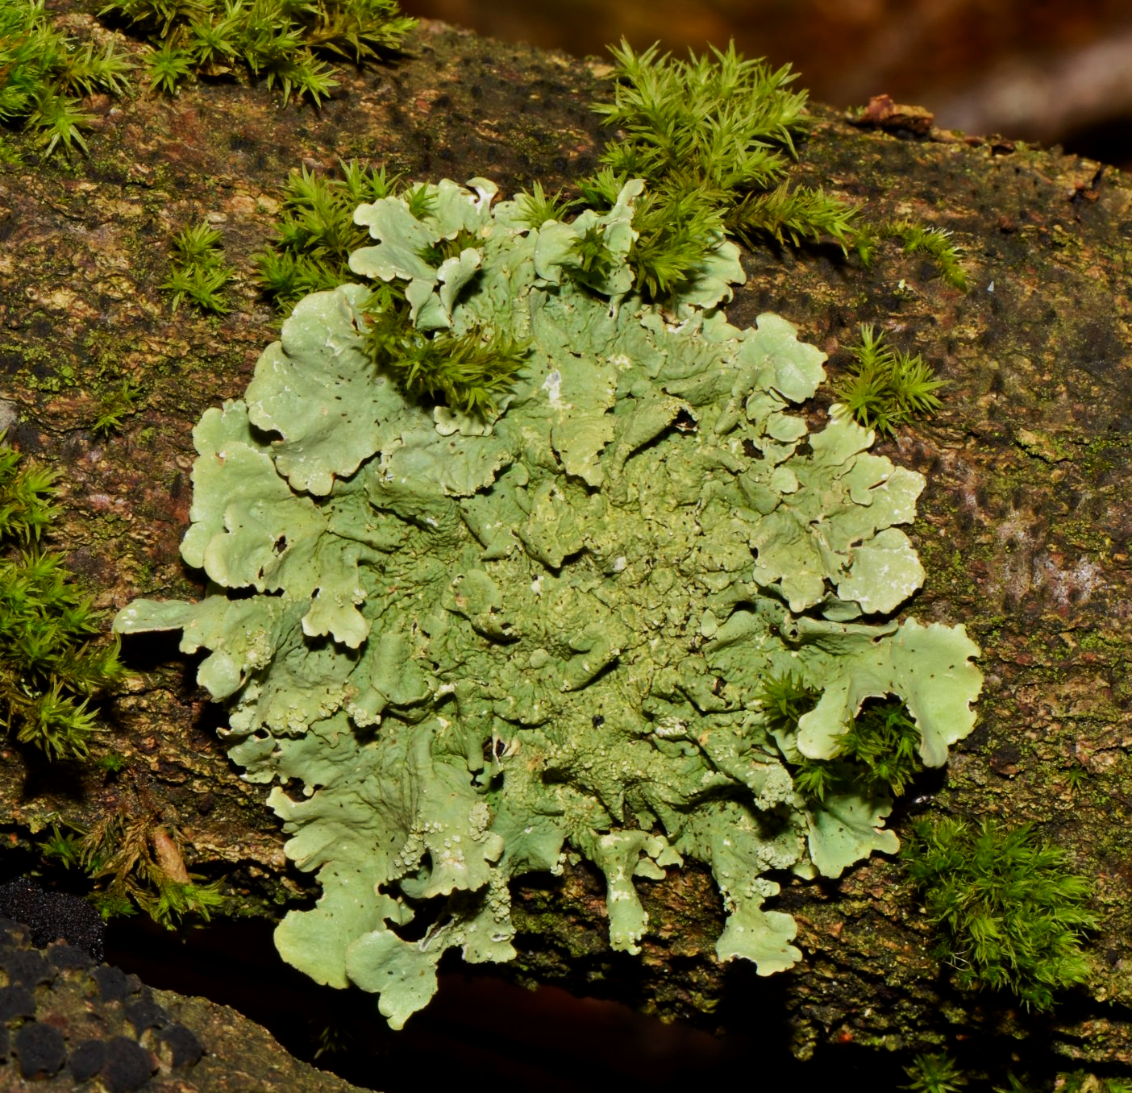
Newly-formed land is colonised by extremophilic pioneer species.
Lichens are very tolerant to harsh conditions, so are often the first to colonise ground that has been stripped by a lava flow.

Slide 6
Primary Succession
As new plants and animals are attracted to the habitat, they outcompete plants and animals that are already established.
  This is because the established plants and animals change the conditions of the ecosystem so as to make it more suitable for the newly-arriving species.
Over time, the ecosystem will stabilise, and eventually result in a climax community.
  A climax community is the final stage of succession.
  A climax community represents the most complex collection of plants and animals that the ecosystem can support.
  If undisturbed, the climax community is unlikely to change in any profound way.

Slide 7
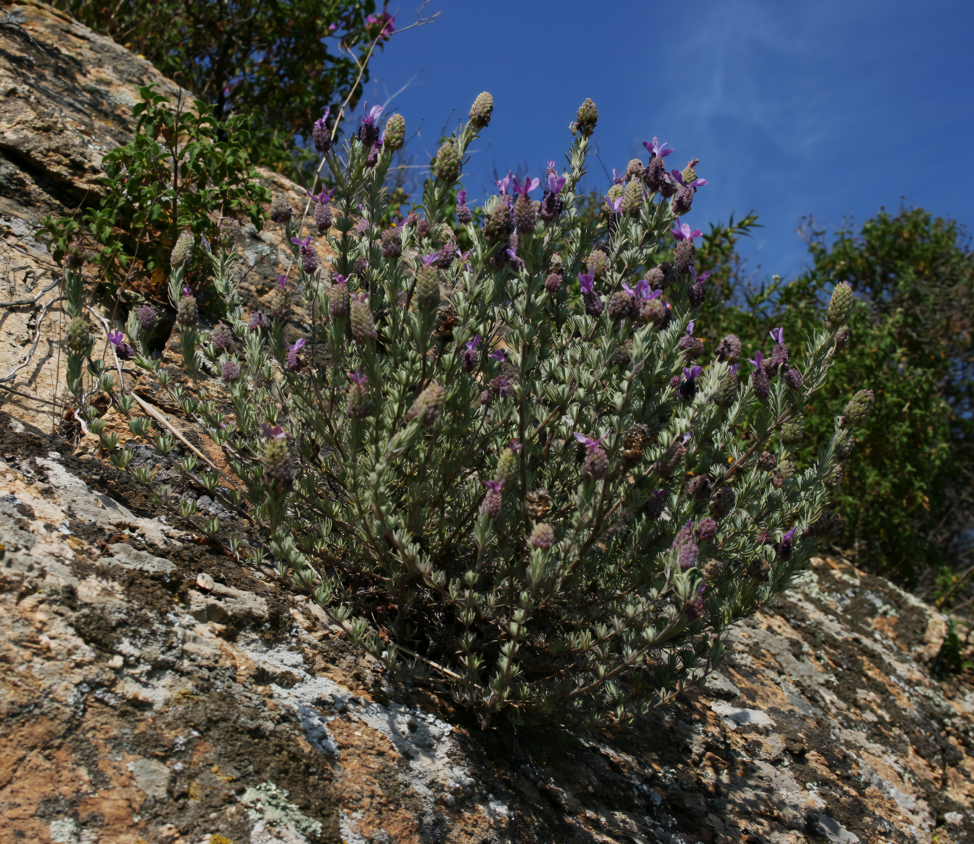
After the pioneer species have made the ground more supportive of other species, larger plants and shrubs will come in and outcompete them.
This will, in turn, allow for a more diverse selection of animals as more niches are created.

Slide 8
The mechanism of primary succession. Over time, the depth and richness of the soil will increase, supporting an ever-more diverse selection of species. Eventually the ecosystem will stabilise, resulting in a climax community.
1. BARE ROCK
2. PIONEER SPECIES SUCH AS MOSSES AND LICHENS
3. HERBACEOUS PLANTS, GRASSES AND SOME SHRUBS
4. LARGER TREES
5. CLIMAX COMMUNITY

Slide 9
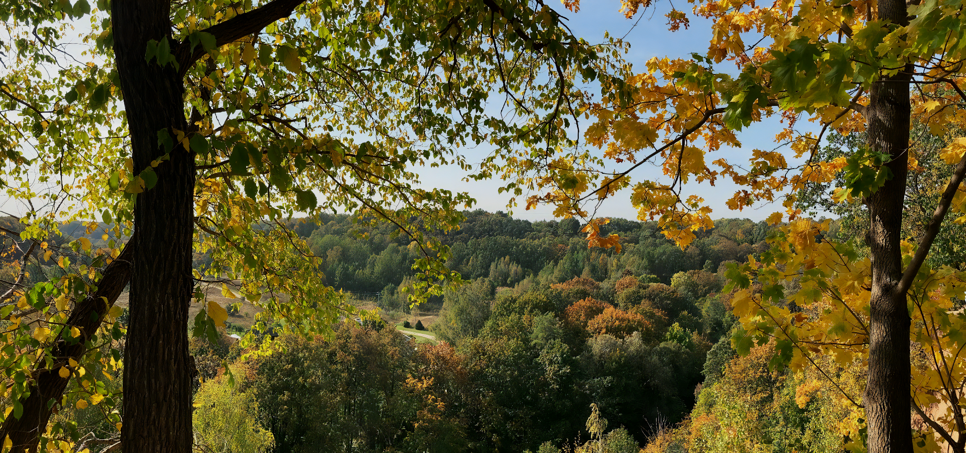
The most common climax community in the UK is a mixed-oak forest. This climax community has formed because of the climate that is present in an ecosystem and is often referred to as a climatic climax community.

Slide 10
Secondary Succession
Secondary succession occurs after the original community has been destroyed.
  The area will be free of plant-life, but the original soil will remain.
The pioneer species found in secondary succession will be different to those found in primary succession.
  In secondary succession, pioneer species are usually larger shrubs.
Humans can have an impact on succession.
  Artificial activities such as agricultural cropping can halt the development of a natural climax community.
When human influences have prevented the ecosystem developing further, a plagioclimax community is said to have formed.
  The most common plagioclimax communities are formed through agriculture.

Slide 11
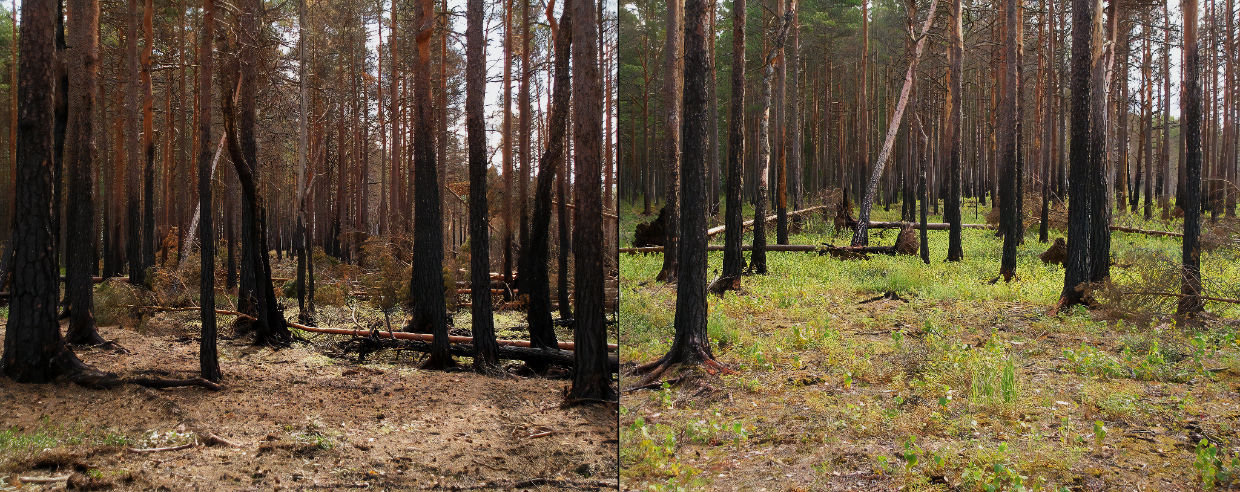
BEFORE SUCCESSION
AFTER SUCCESSION
A forest fire has removed most of the floor-dwelling species, but the soil remains intact.
Secondary succession allows for new pioneer species to quickly colonise the forest floor.

Slide 12
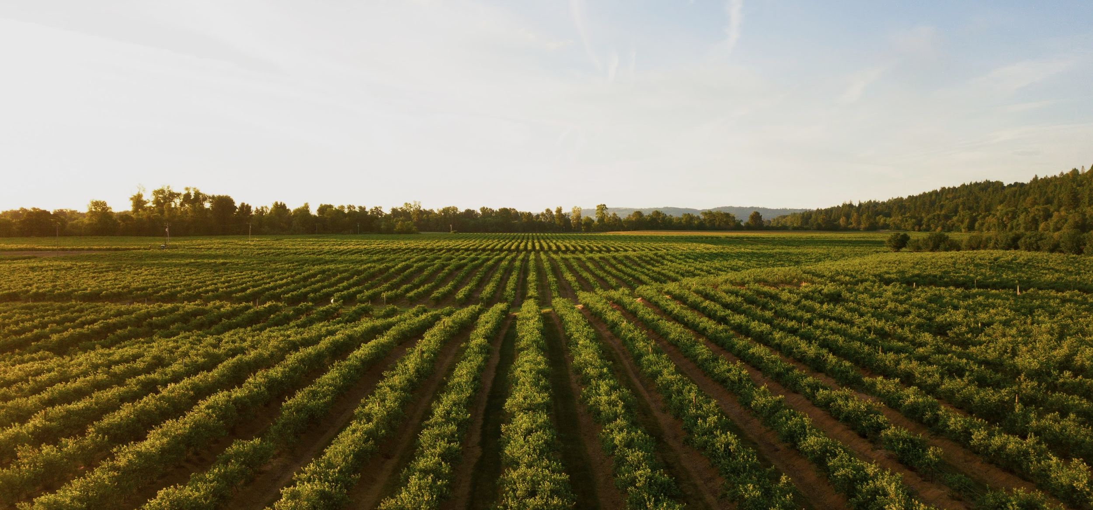
Human activities can prevent the formation of a natural climax community. When the development of an ecosystem is altered by human intervention, a plagioclimax may form.

