Slide 1
AQA A Level Biology
54 - Ecological Sampling
Quadrats, Transects and Mark-Release-Recapture

Slide 2
Sampling
Specification Point 3.7.4 - Populations in ecosystems.
Ecological sampling may measure abundance or distribution.
  Abundance can be defined as the number of individuals of a particular species in a given area.
  Distribution can be defined as the location of a particular species in a given area.
Most ecological research uses random sampling.
  This is because it would be too laborious and time-consuming to investigate all the individuals in a given population.
  Random sampling looks at a proportion (for example 10%) of the total population and then applies the findings to the entire population.
Random sampling also helps to avoid bias.
  Bias occurs when the sample is not an accurate reflection of the entire population.
  If done correctly, random sampling provides an accurate snapshot of the entire population.
  Random sampling often involves dividing a site into grid squares, and using a random number generator to allocate sites to sample.

Slide 3
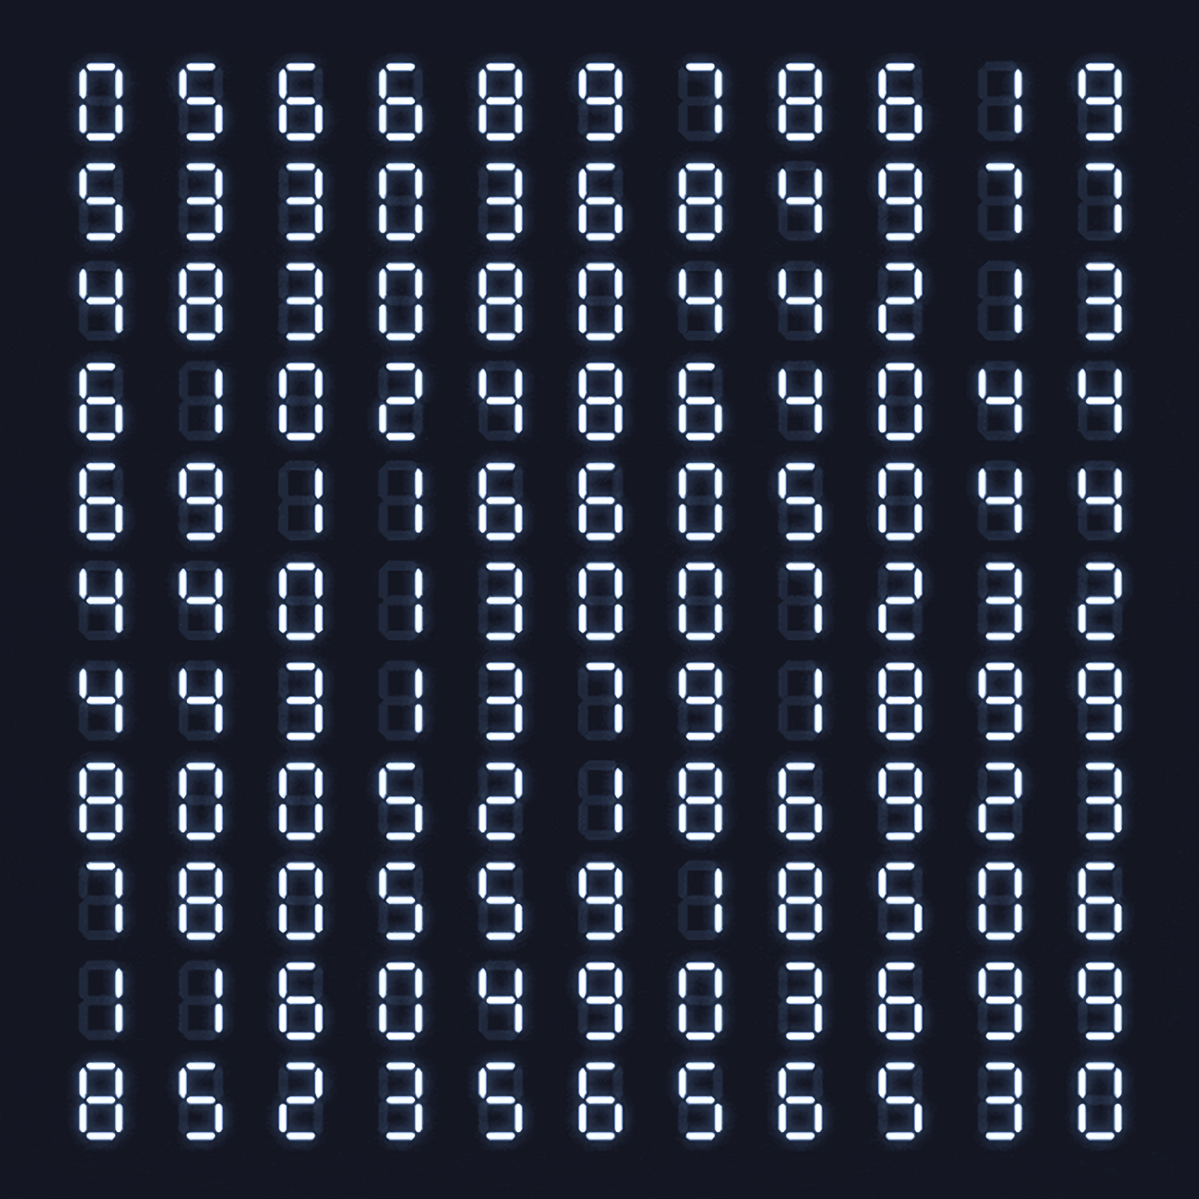
Random number generators are often used to create grid coordinates which allow ecologists to allocate sampling sites in a non-biased way.

Slide 4
Random sampling attempts to offer as representative a measure as possible of the total population. This helps to avoid bias which would skew the data in one direction.
NON-RANDOM SAMPLING
RANDOM SAMPLING

Slide 5
Quadrats and Transects
When looking at non-motile organisms, the most commonly used pieces of sampling equipment are quadrats and transects.
  Non-motile organisms include plants and slow-moving creatures (limpets, for example).
A quadrat is a square frame of a defined size.
  Some quadrats are further divided into a number of smaller squares (100, for example).
Quadrats are placed on the ground at sampling sites.
  Species frequency (how often the species appears in a quadrat) may be recorded.
  Percentage cover (how much of the quadrat is occupied by a species) may also be recorded.
A transect is a line that crosses a habitat.
  Transects are used to investigate the distribution of species throughout this particular habitat.
2 of the most common forms of transects are belt transects and interrupted belt transects.
  When using a belt transect, quadrats are placed alongside each other to calculate species frequency or percentage cover.
  When using an interrupted belt transect, quadrats are placed at regular intervals (every 5 m, for example) along the transect.
1 m
1 m
A quadrat is a square frame with a known size that is used to estimate the size of populations.

Slide 6
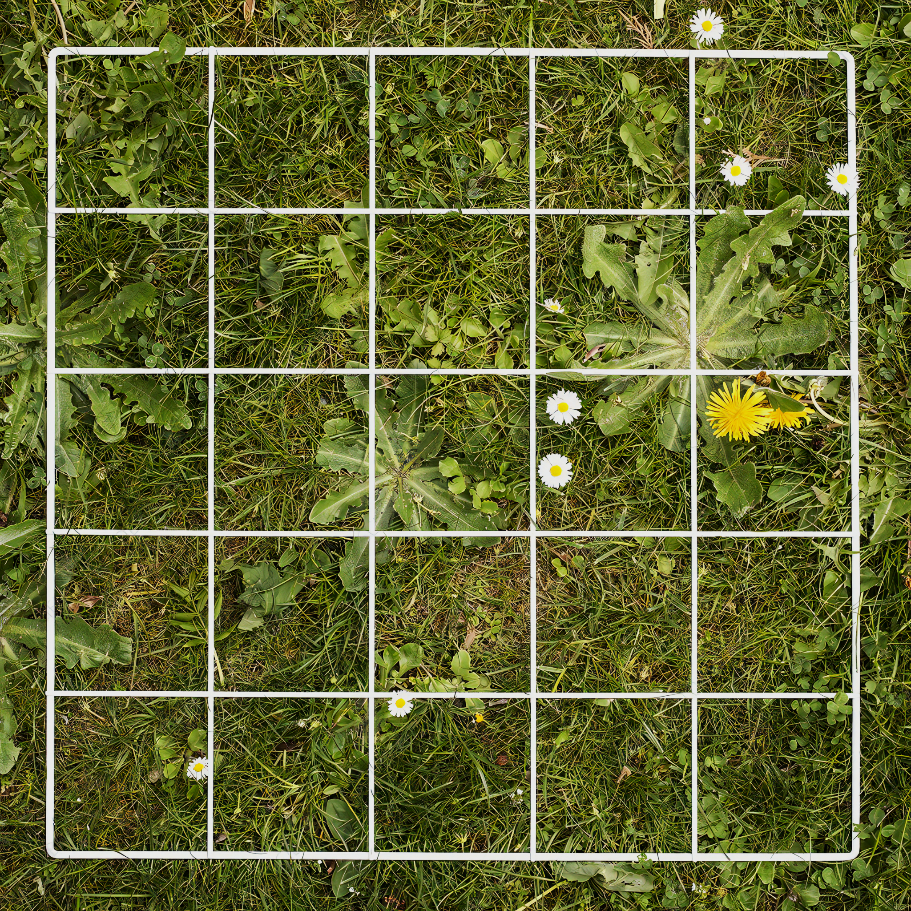
Square frames called quadrats are often used for ecological sampling.
They are able to measure both species frequency and percentage cover.

Slide 7
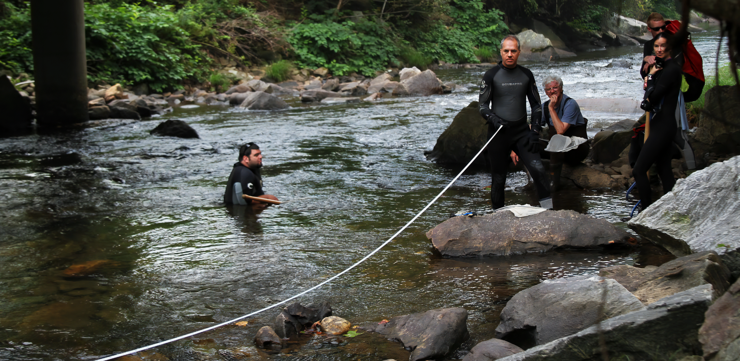
Lines called transects are often used to measure the distribution of a particular species in a habitat.

Slide 8
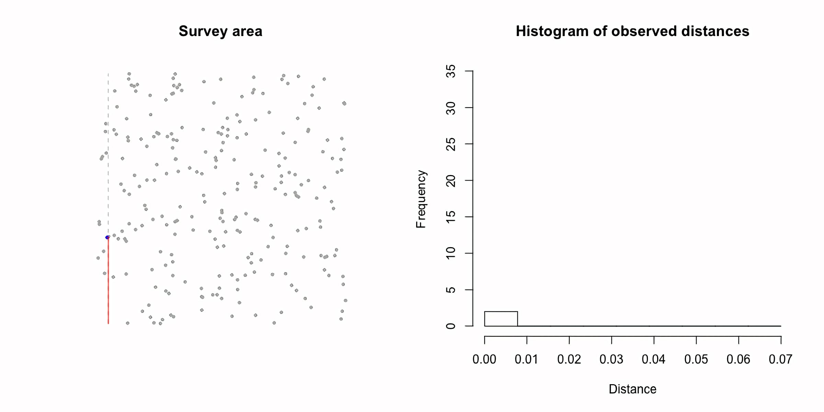
SURVEY AREA
This transect illustrates how the distribution of a particular species of plant is more commonly found in 1 area of a habitat than another.
FREQUENCY
DISTANCE FROM START POINT

Slide 9
Nets and Pitfall Traps
More motile animals (such as insects) may require the use of specialised equipment in order to be captured.
Flying insects may be captured using a sweep net.
  A sweep net is a net on an extendable pole.
Aquatic organisms may be captured using a traditional fishing net.
Terrestrial insects may be captured using a pitfall trap.
  This usually includes a container that is buried into the ground.
  Insects will fall into the container as they walk over the trap.
Insects may be captured using a sweep net.

Slide 10
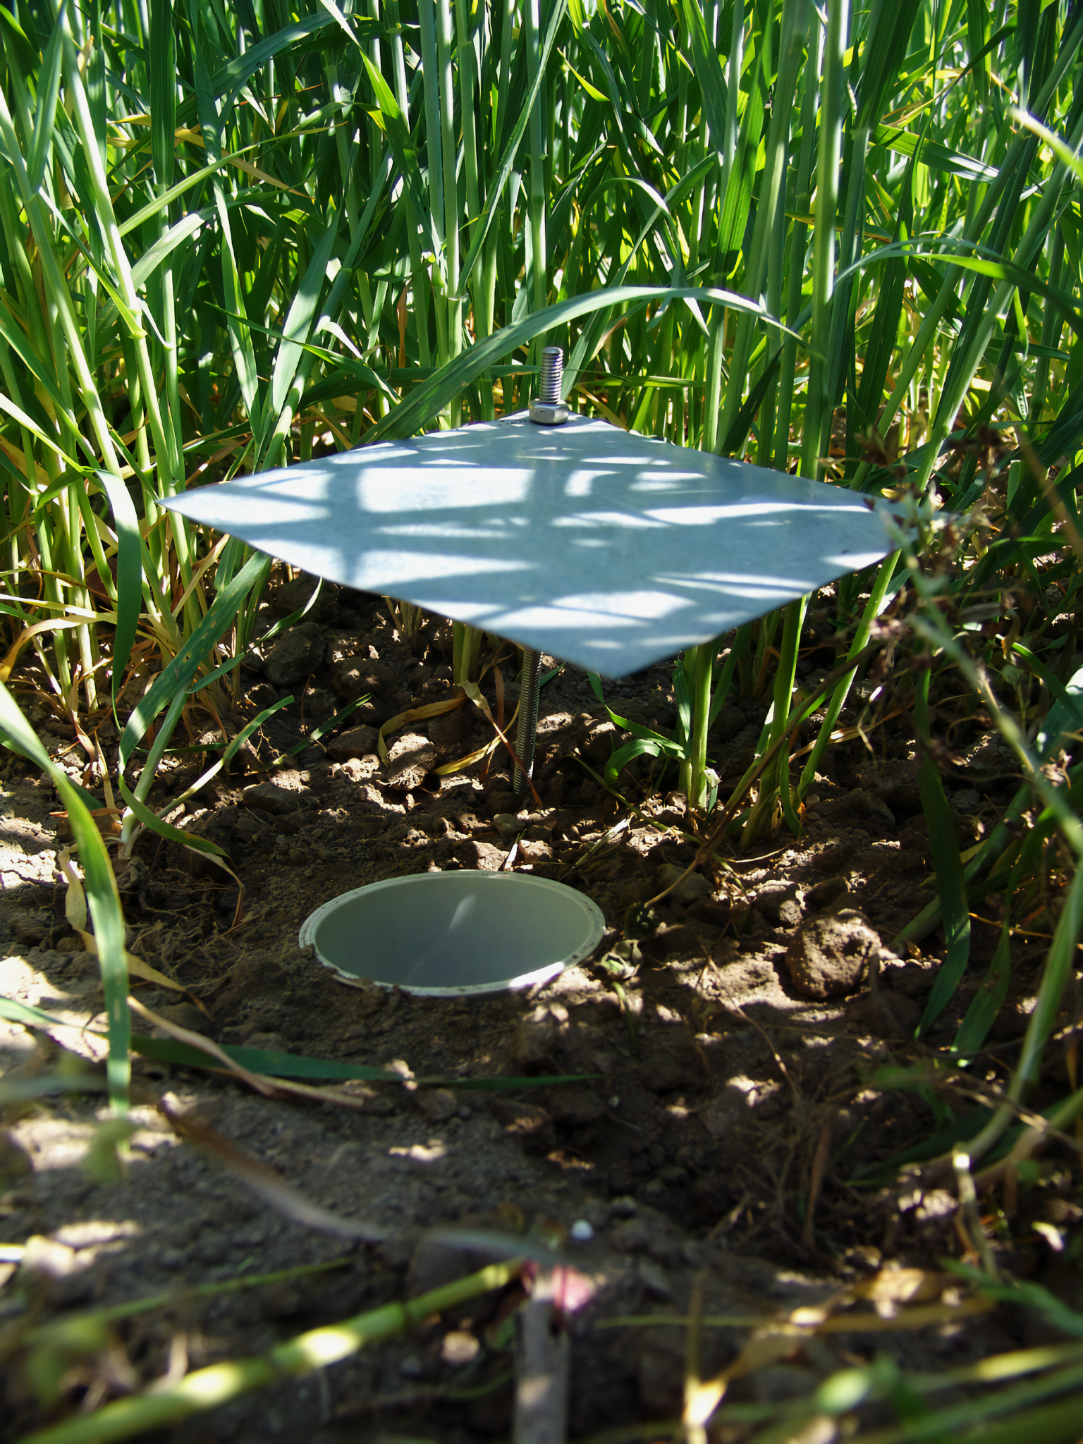
A pitfall trap is designed to capture ground-dwelling insects.
Insects will drop into the trap, which is often coated with detergent to prevent escape.

Slide 11
Mark-Release-Recapture
The size of a particular population can be estimated using a technique referred to as mark-release-recapture:
During mark-release-recapture, a sample of a particular species are caught.
  The number of individuals captured is then counted.
These individuals are marked so that they can be readily identified.
  The method of marking must be harmless to the organism. It should not reduce their capability or make them more vulnerable to predators.
The organisms are released back into their habitat.
  A period of time must now be allowed to pass.
  This is to ensure that the marked individuals will successfully reintegrate with the main population.
A second sampling of the population is undertaken.
Both the total number of individuals in the second sample, as well as the number of individuals in the second sample that were marked are counted.

Slide 12
Mark-Release-Recapture
The population size can be estimated using the following equation:
There are a number of assumptions when using mark-release-recapture:
  During the time of the study, there are no births, deaths or migratory factors that could affect the size of the population.
  The marked sample successfully reintegrated with the main population.
  The survivability of the marked sample was not affected in any way.
P = size of population
N₁ = number of individuals caught in the first sample
N₂ = number of individuals caught in the second sample
M₂ = number of individuals in the second sample that were marked

Slide 13
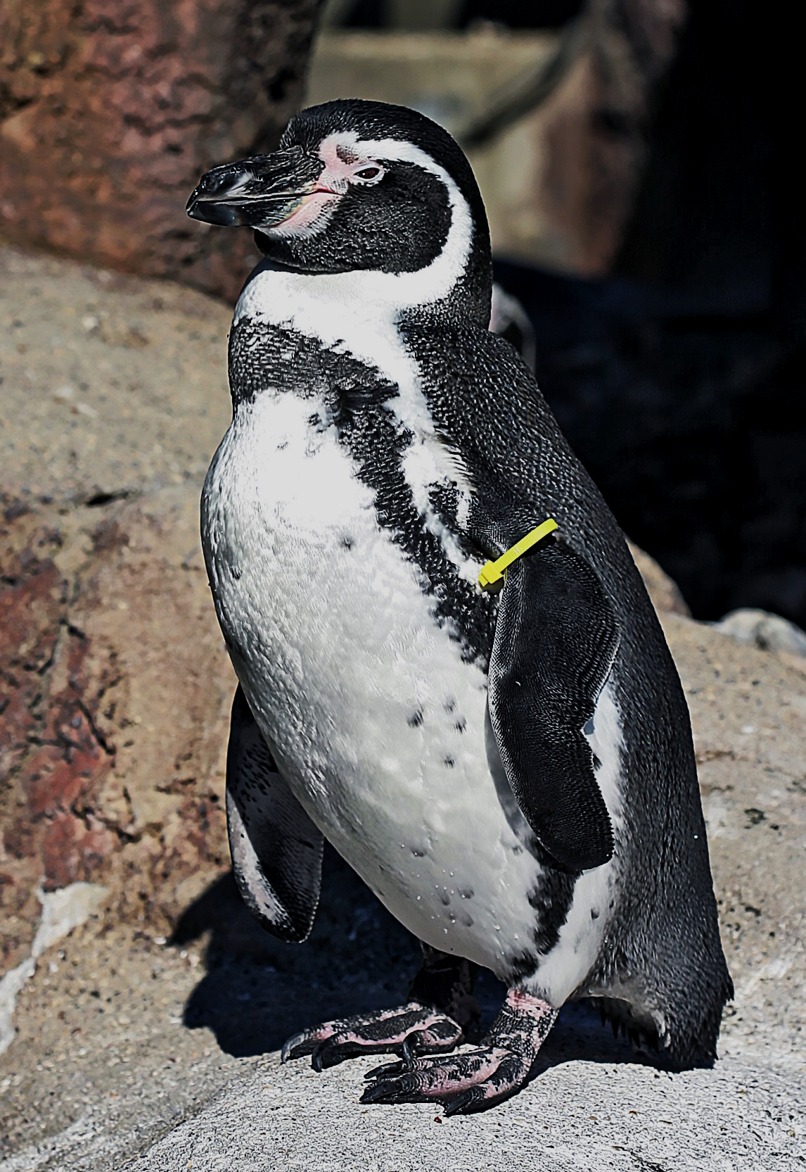
A tagged Humboldt penguin as part of a mark-release-recapture population study.
Some people believe that the capturing of animals is unethical as it puts them under unnecessary stress.
If the population captured and marked in the first sample (N₁) is 42, the population captured in the second sample (N₂) is 60 and the number of marked individuals in the second sample (M₂) is 17:
42 × 60 = 2520
2520 ÷ 17 = 148

Slide 14
Investigating Species Distribution
Practical 12: Investigating the effect of a named environmental factor on the distribution of a given species.
It is likely that the distribution of a particular species will vary in a given area.
  This is often due to an environmental factor, such as temperature or pH.
  The effect of this factor can be measured using an investigation:
Consider an area that is likely to exhibit a range of environmental conditions.
  A shoreline is a good habitat to sample.
Place a 100 m long transect at the shoreline, facing directly inland.
  Every 10 m, place a 1 m² quadrat next to the transect.
Count the percentage cover of grass in each quadrat.
At the same time, use a pH meter to measure the soil pH in each quadrat.

Slide 15
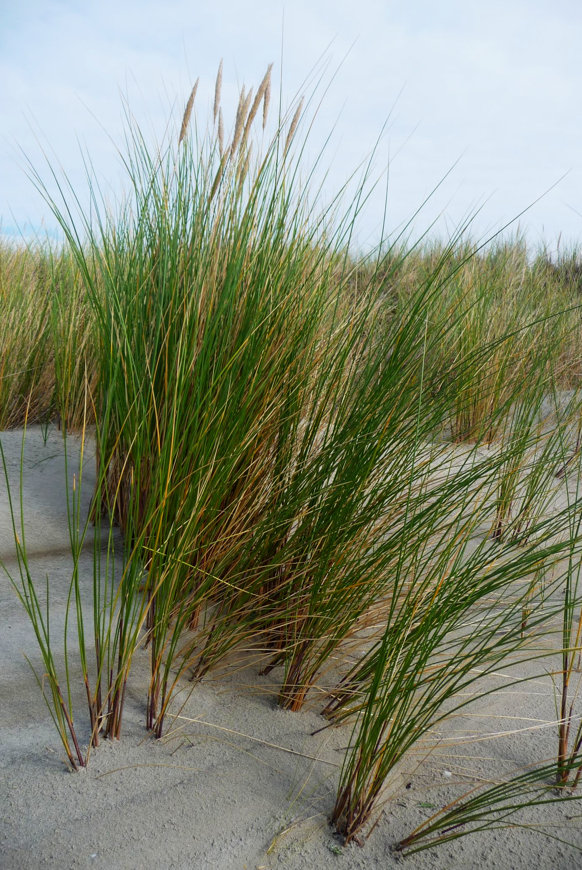
Marram grass is found on many shorelines.
An ecological investigation using a combination of transects and quadrats can show how coastal grasses have an optimum pH for growth.
PERCENTAGE COVER OF GRASS →
SOIL pH →

