Slide 1
AQA A Level Biology
53 - Populations and Ecosystems
The Niche, Adaptations and Predator-Prey Interactions

Slide 2
Ecosystems, Habitats and Niches
Specification Point 3.7.4 - Populations in ecosystems.
An ecosystem can be defined as a community of living organisms in conjunction with the non-living components of their environment.
  The non-living components of an ecosystem are referred to as abiotic components.
  The living components of an ecosystem are referred to as biotic components.
  Ecosystems show interactions between biotic and abiotic components.
A habitat can be defined as the place where an organism in a particular ecosystem lives.
  For example, a forest may be a habitat for several tree-dwelling species.
A niche can be defined as the role of a species in its habitat.
  For example, a species’ niche might be defined by the organisms it consumes, and what consumes it.
  A niche can only be occupied by a single species.
  This is referred to as the competitive exclusion principle.

Slide 3
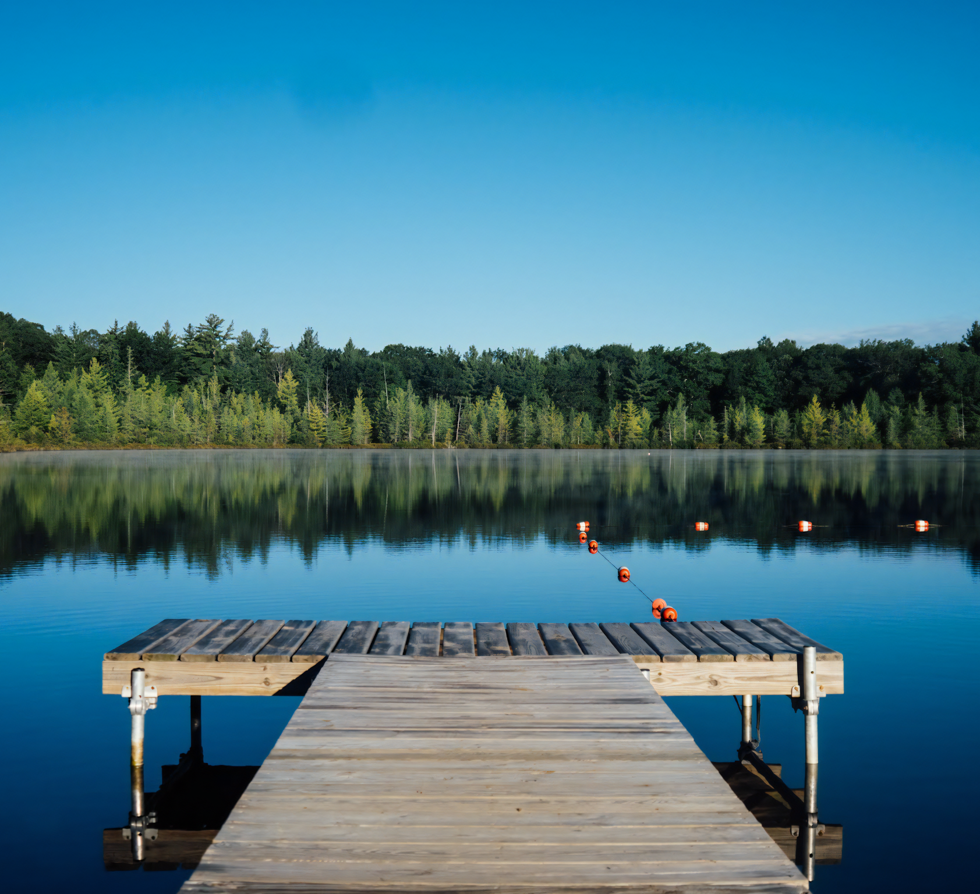
Lakes are habitats for a variety of aquatic species. Freshwater ecosystems will include living (biotic) components, as well as non-living (abiotic) components such as the temperature and pH of the water.

Slide 4
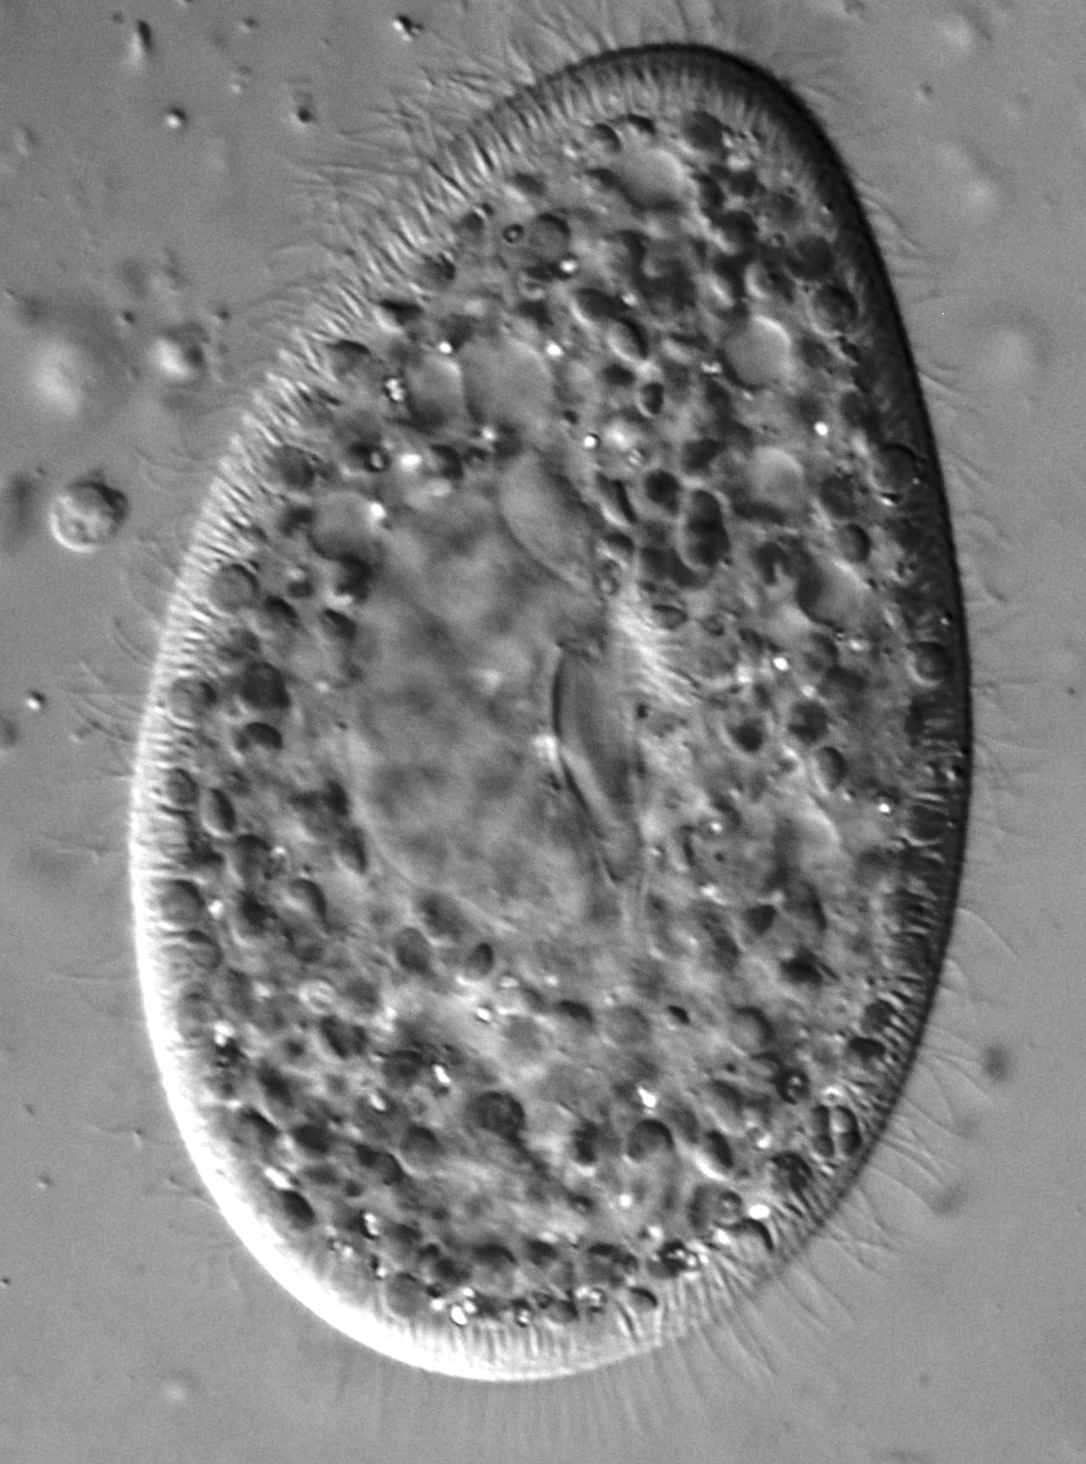
Paramecium is a genus of single-celled aquatic organisms that are often used to illustrate the competitive-exclusion principle.
P. aurelia grown alone
When grown on its own in a petri dish, P. aurelia grows well in its growth medium.
POPULATION SIZE
TIME (HOURS)
P. caudatum grown alone
Likewise, P. caudatum grows well without any competition.
Both P. aurelia and P. caudatum grown together
When grown together, the 2 species of Paramecium are trying to occupy the same niche. P. caudatum is outcompeted by P. aurelia and is eliminated.

Slide 5
Adaptations
An adaptation can be defined as any feature belonging to a species that increases its chance of survival.
  Adaptations may be behavioural, physiological or anatomical.
Those organisms that are better adapted to a particular environment will live to reproduce.
Organisms that are better adapted to an environment will pass on their beneficial alleles are passed to the next generation.
  This is the mechanism of natural selection.
Every species has adapted to reside in its own unique niche.
  For example, the West African giraffe has a long neck to be able to graze on very tall trees.
  This food source has thus become unique to the West African giraffe.

Slide 6
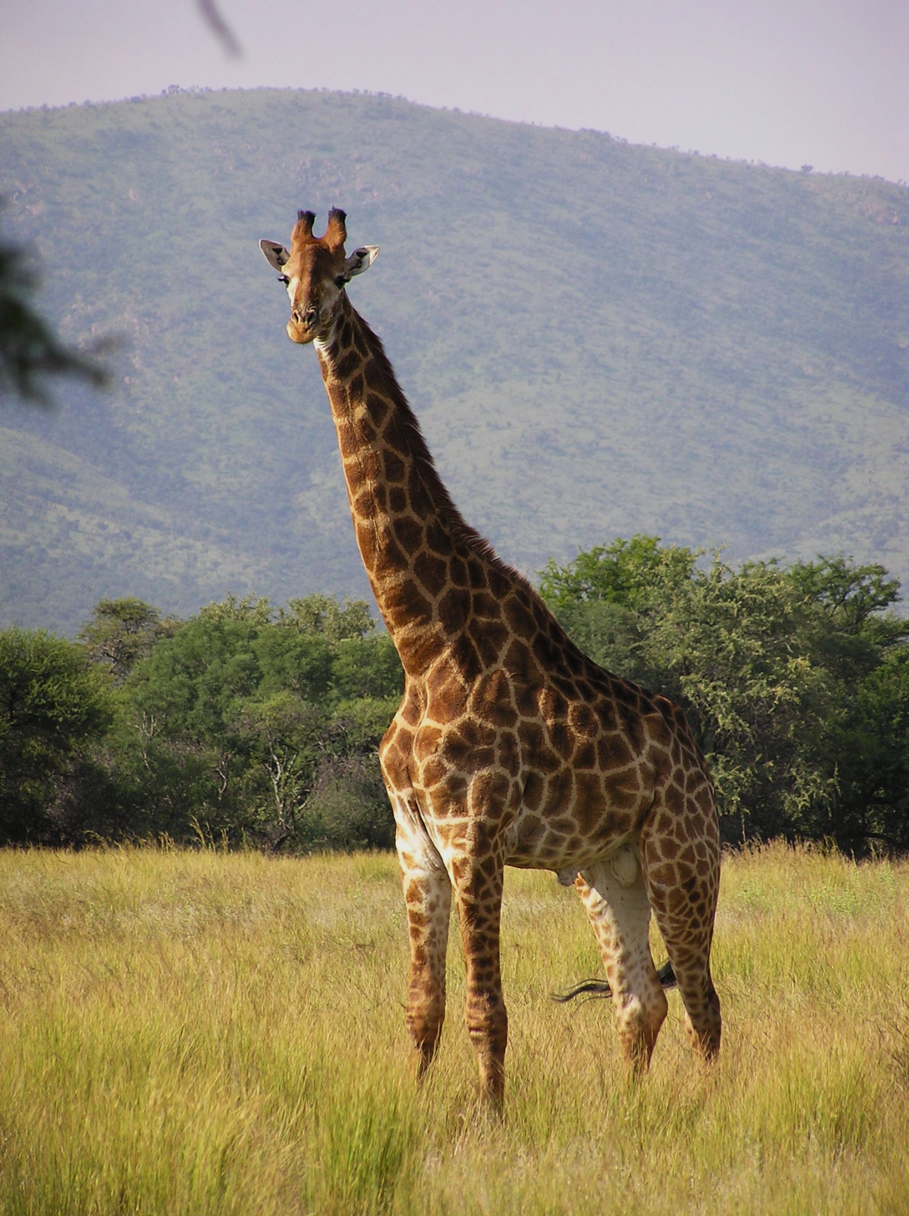
The South African giraffe has a long neck to reach food sources other herbivores cannot.
This is an example of an anatomical adaptation.

Slide 7
Populations and Carrying Capacities
A population can be defined as a group of individuals of the same species living and interbreeding within a given area.
  A population resides in a particular habitat.
A community can be defined as a group of populations of different species in a habitat.
Each ecosystem can support a maximum stable population size.
  This is referred to as the carrying capacity of the ecosystem.
  The carrying capacity of an ecosystem depends on a variety of biotic and abiotic factors.
All populations have a certain carrying capacity, which depends on a number of biotic and abiotic factors.
POPULATION SIZE →
TIME →

Slide 8
Abiotic Factors
Abiotic factors will have an impact on the population size of a particular species.
Abiotic factors include:
  Water availability.
  Light intensity.
  Temperature.
  Soil composition.
If the abiotic conditions are harsh, it is unlikely that the ecosystem will be able to support a wide variety of life.
  In areas with extreme temperatures (deserts and tundra), organisms will have to expend large amounts of energy to maintain their internal body temperature.
  This will leave little energy for growth and reproduction of the species, so the carrying capacity of the population is likely to be low.

Slide 9
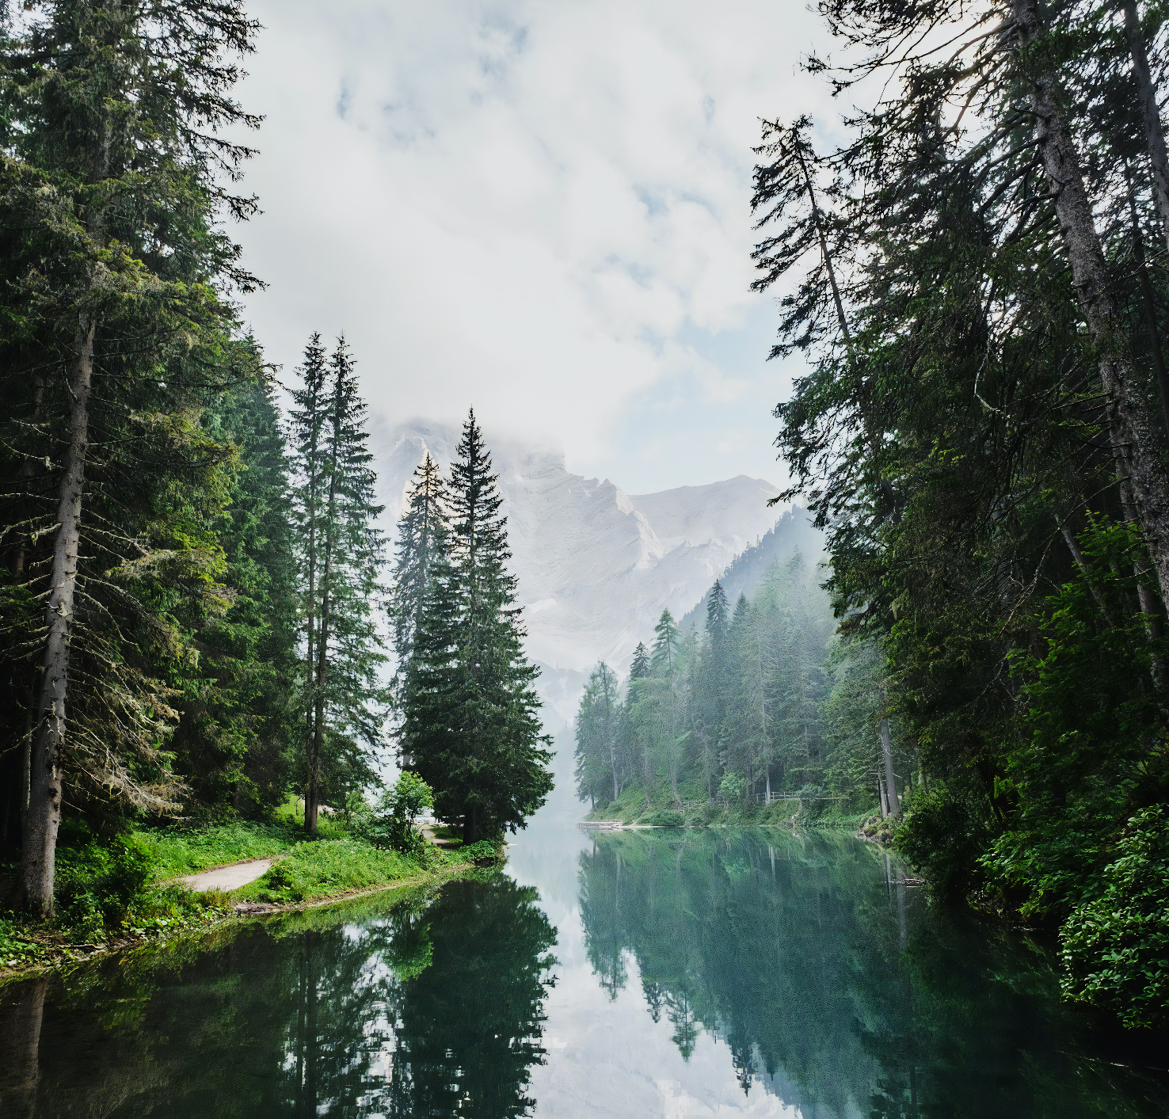
Temperate climates that are close to the optimum temperature for metabolic reactions will ensure that animals do not have to expend so much energy to maintain their internal temperature.
More energy will be available for growth and reproduction and the ecosystem will be able to support a larger carrying capacity.

Slide 10
Biotic Factors
Biotic factors will also impact the size of the population.
Biotic factors include:
  Interspecific competition.
  Intraspecific competition.
  Predation.
Interspecific competition is competition between individuals of different species.
  This occurs when individuals from different species compete for the same resources.
    For example, 2 different species of squirrel may compete for the same food source.
  Interspecific competition may reduce the population sizes of both species.
  It may also result in the elimination of a species, if the other species is a markedly better competitor.
Intraspecific competition is competition between individuals of the same species.
  Individuals of the same species are likely to compete for the same resources.
    For example, a species of bird may compete for the same food source.
  This competition will reduce the population size of the species in question.
  The population may then rebound as the resource becomes more plentiful again (due to the reduction in population).
Predation occurs when a predator eats one or more of its prey.

Slide 11
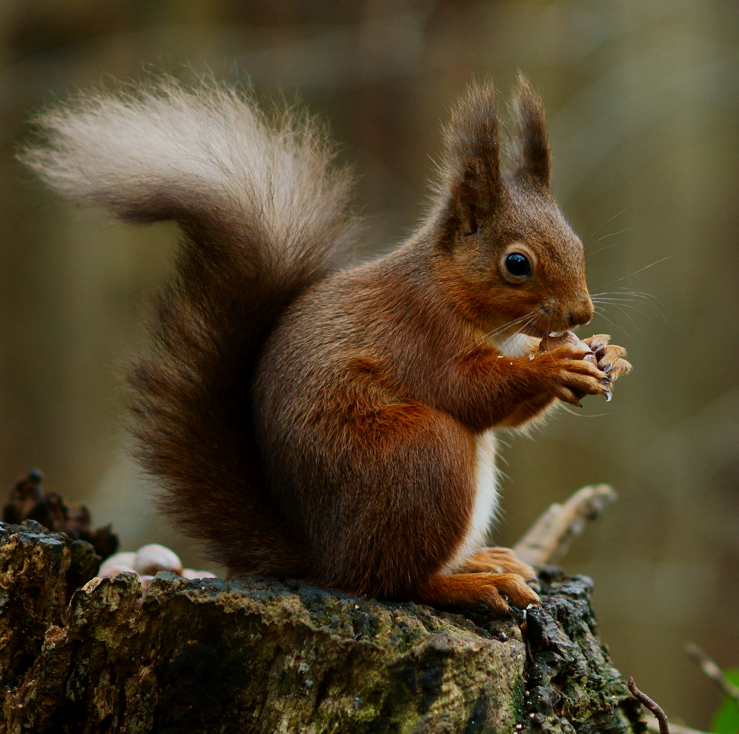
In the United Kingdom, the red squirrel has been almost entirely outcompeted by the larger and stronger grey squirrel.

Slide 12
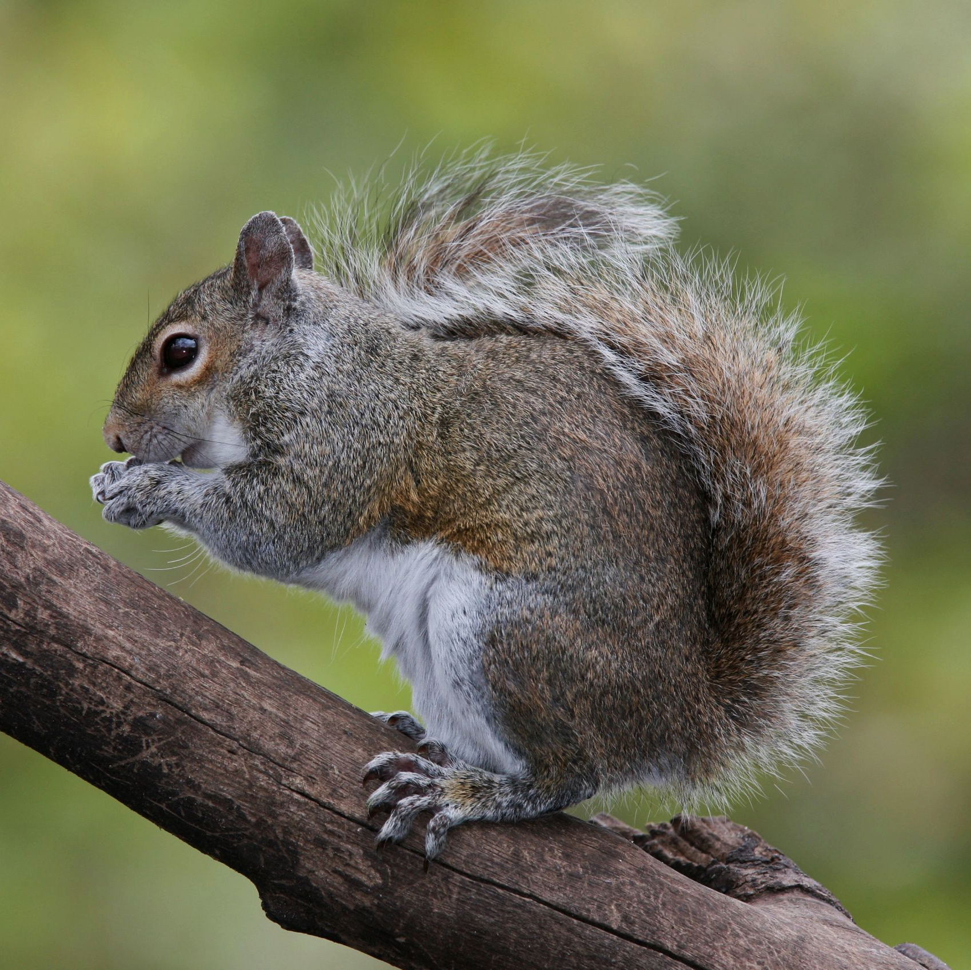
In the United Kingdom, the red squirrel has been almost entirely outcompeted by the larger and stronger grey squirrel.

Slide 13
POPULATION OF SQUIRRELS OVER TIME ON ANGLESEY
RED SQUIRREL
GREY SQUIRREL
In parts of the United Kingdom, the grey squirrel has forced the red squirrel into extinction.
POPULATION SIZE →
TIME →

Slide 14
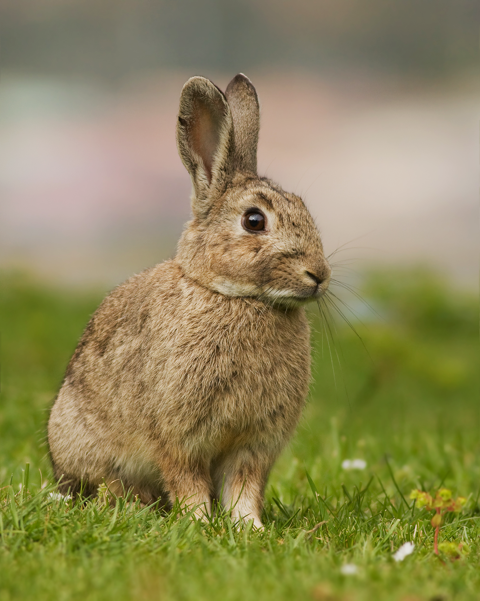
Rabbits are famous for their ability to produce large numbers of offspring very quickly. As the rabbit population all belong to the same species, this is an example of intraspecific competition.
2. BECAUSE THE RABBIT POPULATION INCREASES SO RAPIDLY, IT OVERSHOOTS THE CARRYING CAPACITY OF THE ECOSYSTEM. THERE IS NOT ENOUGH FOOD TO SUPPORT THIS SIZE OF POPULATION
CARRYING CAPACITY
POPULATION SIZE →
3. THE RABBIT POPULATION BEGINS TO EQUILIBRATE AND REACH A STABLE POPULATION SIZE
1. WHEN THE RABBIT POPULATION IS SMALL, FOOD IS PLENTIFUL. THE RABBIT POPULATION GROWS QUICKLY
TIME →

Slide 15
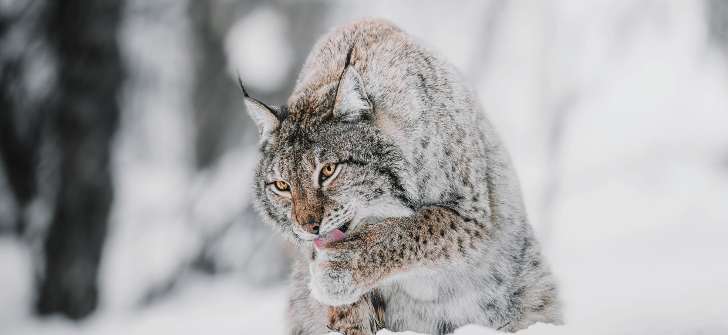
The predation of the snowshoe hare by the Canada lynx is a famous case study illustrating how predation can affect the sizes of both populations. This is referred to as a predator-prey cycle.

Slide 16
The predation of the snowshoe hare by the Canada lynx is a famous case study illustrating how predation can affect the sizes of both populations. This is referred to as a predator-prey cycle.
1. WHEN THE LYNX POPULATION IS LOW, THE POPULATION OF THE HARE CAN INCREASE. THIS IS BECAUSE THERE IS LITTLE PREDATION
3. THE REDUCED NUMBER OF HARES NOW DRIVES THE NUMBER OF LYNX DOWN DUE TO THE SCARCITY OF FOOD
POPULATION SIZE →
HARE POPULATION
LYNX POPULATION
2. THE LYNX POPULATION NOW INCREASES AS PREY BECOME MORE PLENTIFUL, THIS SUPPRESSES THE NUMBER OF HARES
4. THIS CYCLE CONTINUES TO REPEAT UNLESS DISTRUBED BY ANOTHER EXTERNAL FACTOR, SUCH AS A NEW SOURCE OF PREY
TIME →

Slide 17
The Growth of Bacterial Populations
When supplied with enough nutrients, bacterial populations will grow very rapidly.
  E.coli is a bacterium that can double its population size every 20 minutes.
The growth of bacteria in a broth culture can be investigated using spectrophotometry.
  Light is passed through a nutrient broth containing a population of bacteria.
  The bacterial population reduces the amount of light that can pass through the broth.
  The amount of light absorbed by the broth can be measured using a device called a spectrophotometer.
    The spectrophotometer will yield an absorbance value.
The higher the absorbance value, the larger the bacterial population.

Slide 18
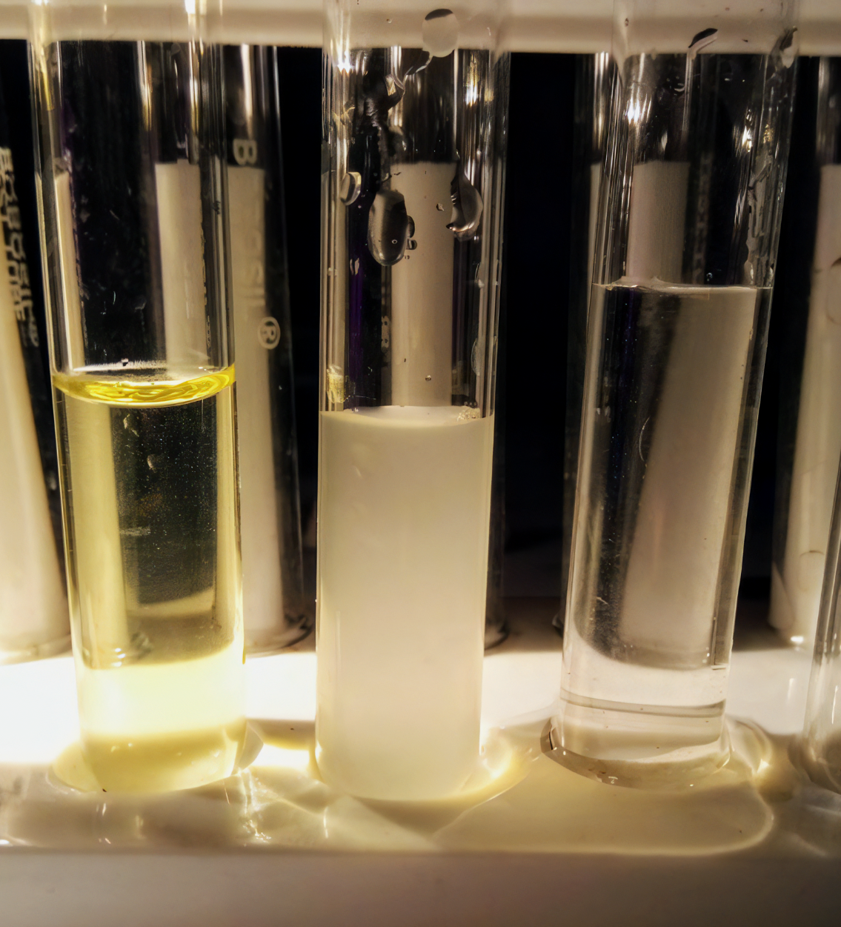
Broth culture without bacteria (left), with a growing population of bacteria (centre) and a negative control (right).
Absorbance values can be measured quantitatively using a spectrophotometer.

Slide 19
ABSORBANCE VALUE →
As bacterial populations increase so rapidly, the absorbance value is often measured using a logarithmic scale (log₁₀).
Every value on the y-axis is 10 times larger than the preceding value. This allows large increases in bacterial populations to be plotted on a single graph.
TIME →
ABSORBANCE VALUE (LOG₁₀) →
TIME →

