Slide 1
AQA A Level Biology
52 - Variation and Speciation
Hardy-Weinberg, Adaptations and Reproductive Isolation

Slide 2
Genetic Terms
Specification Point 3.7.2 - Populations.
A species can be defined as a group of similar organisms that are able to reproduce to yield fertile offspring.
  2 different species may interbreed to yield offspring, but these will be sterile hybrids.
A population can be defined as a group of organisms that live in the same habitat at the same time.
  As a result, different populations of the same species have the ability to interbreed.
The gene pool can be defined as the complete set of alleles in a particular population.
  The commonness of an allele in a particular population is called the allele frequency.
  The allele frequency is usually given as a percentage of the total population.

Slide 3
The Hardy-Weinberg Principle
The Hardy-Weinberg principle is a mathematical model that states that the allele frequencies observed in a population will not change from one generation to the next.
  The Hardy-Weinberg principle was developed independently by two scientists in the early 20th century to predict how genetic diseases are inherited through generations.
The Hardy-Weinberg principle only holds true under certain conditions:
  The population is large and regularly mates with each other.
  Mating between individuals is completely random.
  There is no migration (either immigration or emigration) seen in the population.
  Mutations and natural selection do not occur in the population.
If allele frequencies change between generations, it is assumed that an external factor is at work.
  Any of the above factors are considered to be external.

Slide 4
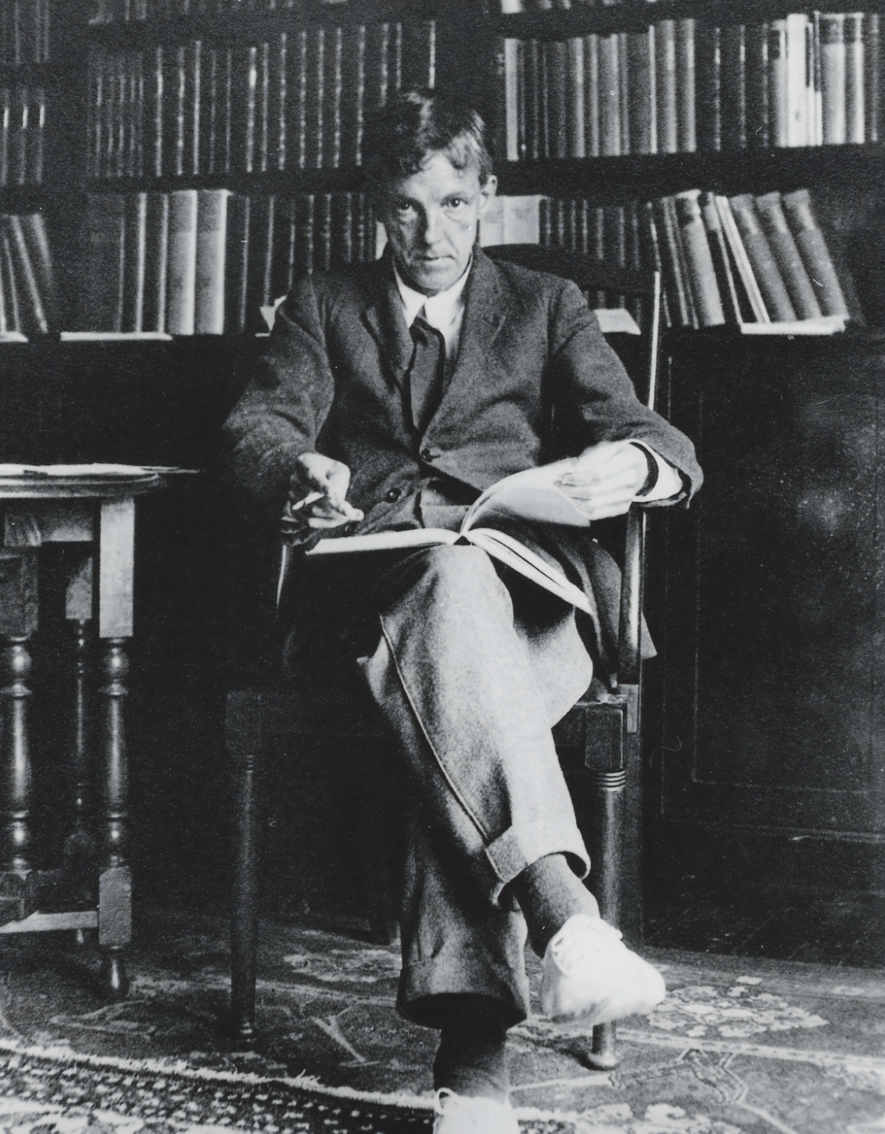
The Hardy-Weinberg principle is a mathematical model expressed in literature firstly by British mathematician G. H. Hardy and later by the German doctor Wilhelm Weinberg.
The Hardy-Weinberg principle states that the allele frequencies observed in a population will not change from one generation to the next.

Slide 5
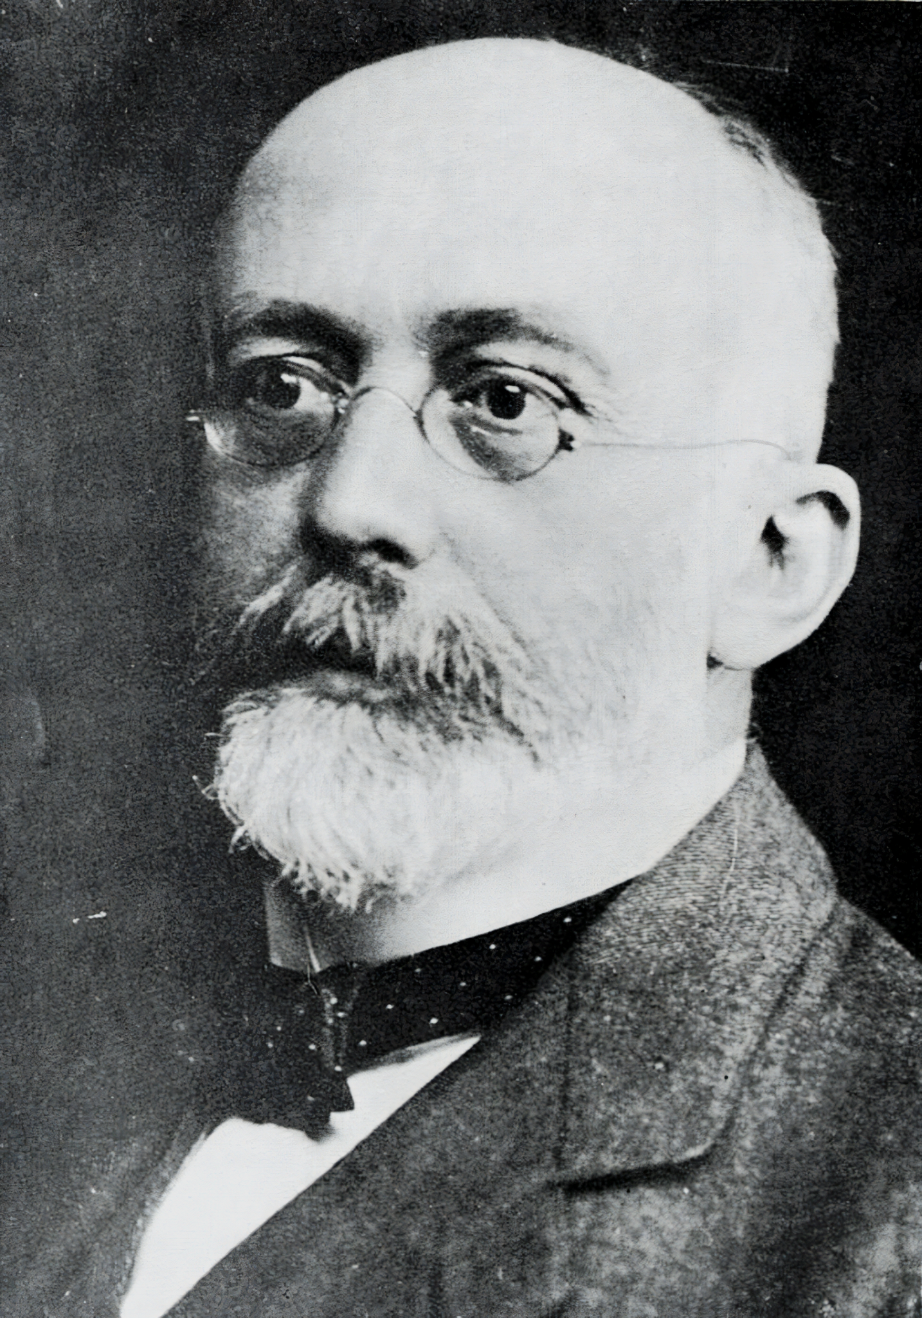
The Hardy-Weinberg principle is a mathematical model expressed in literature firstly by British mathematician G. H. Hardy and later by the German doctor Wilhelm Weinberg.
The Hardy-Weinberg principle states that the allele frequencies observed in a population will not change from one generation to the next.

Slide 6
The Hardy-Weinberg Equation
The Hardy-Weinberg principle can be used to calculate the allele frequency in a population.
  The total frequency of all the alleles of a particular gene must equal 1 (or 100%).
  As a result, the combined frequency of the dominant and recessive alleles must also equal 1.
It can also be used to calculate the frequency of individual genotypes.
  The total frequency of all the possible genotypes in a population must equal 1.
  In a gene with 2 alleles, there are 3 genotypes - homozygous dominant, heterozygous and homozygous recessive.
p = frequency of the dominant allele.
q = frequency of the recessive allele.
p² = frequency of the homozygous dominant genotype.
2pq = frequency of the heterozygous genotype.
q² = frequency of the homozygous recessive genotype.

Slide 7
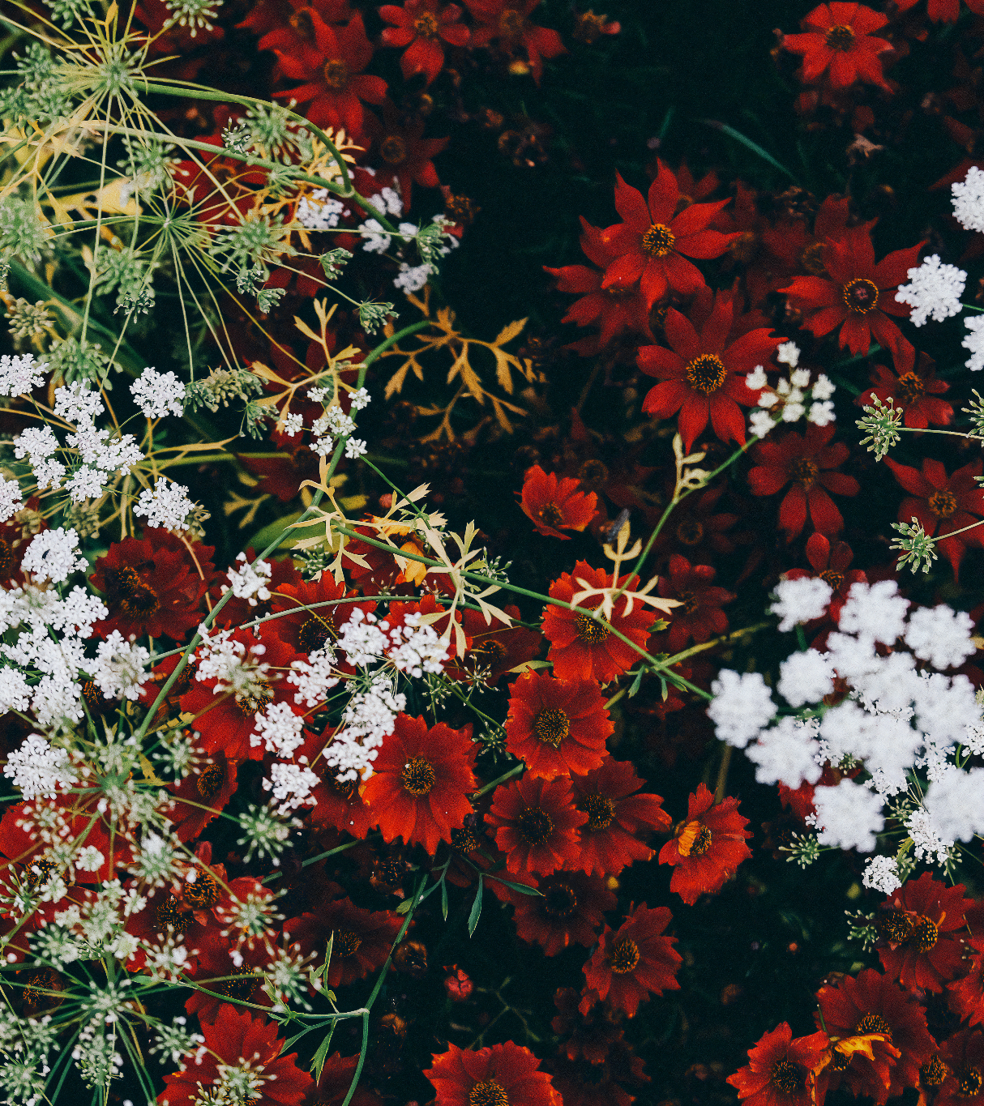
In this scenario, there are 2 alleles for flower colour; red (R) and white (r) - the R allele is dominant to the red allele. There are 80 red flowers and 20 white flowers.
The red flowers can have the genotypes RR or Rr whilst the white flowers must have the genotype rr. Say we were asked to calculate the frequency of the dominant (p) and the recessive (q) alleles in the population:
p + q = 1 and p² + 2pq + q² = 1
p² + 2pq = 0.8 and q² = 0.2
q = 0.45 (45%) so p = 0.55 (55%)
Other examples can be found here.

Slide 8
Variation
Specification Point 3.7.3 - Evolution may lead to speciation.
Variation can be defined as the differences that exist between individuals of the same species or differences that exist between species.
  Differences in individuals that belong to the same species is called intraspecific variation.
  Differences between different species is called interspecific variation.
Variation can be due to genetic factors.
  Genetic variation in members of the same species is due to the number of different alleles that are present for a particular gene.
  New alleles are created by mutations, as well as the exchange of genetic material during crossing over in meiosis.
Variation can also be due to environmental factors.
  Differences in the climate, food sources and lifestyle can also lead to variation.
Most variation is caused by a combination of genetic and environmental factors.

Slide 9
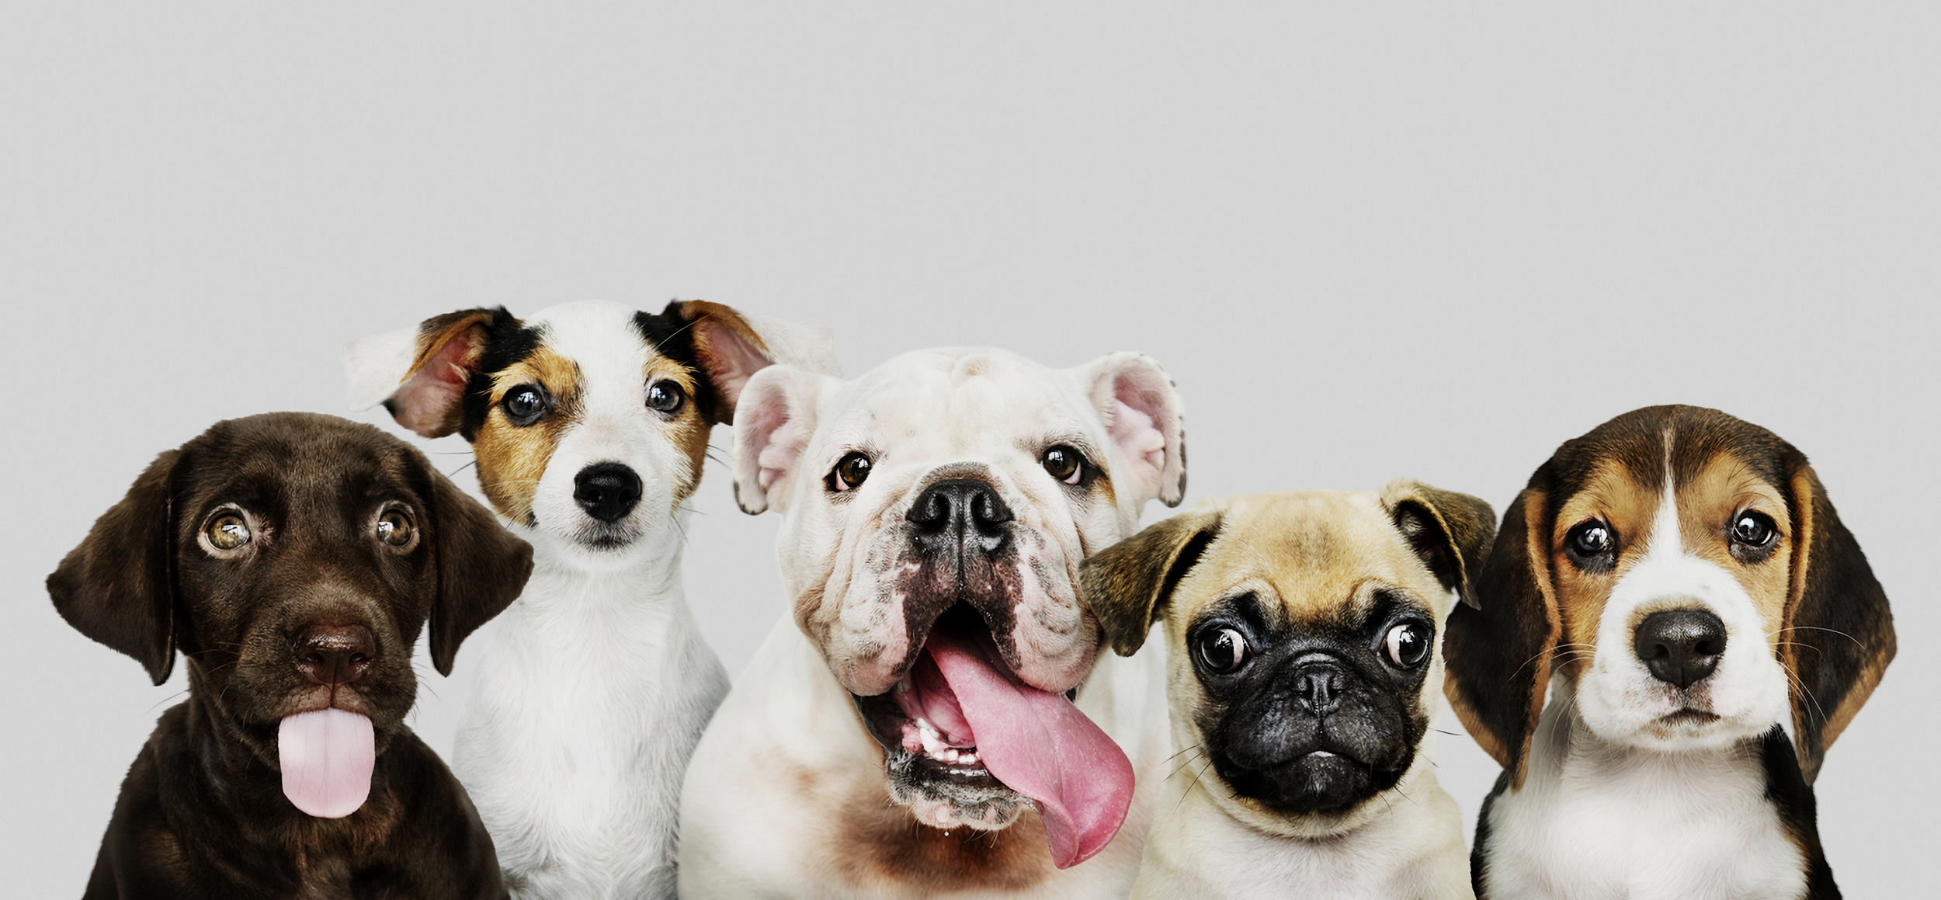
All domesticated dogs belong to the same species (Canis familiaris). There is, however, tremendous variation in size, colouring and body-shape. This is primarily down to a high level of genetic variability - there are lots of different alleles present in the population.

Slide 10
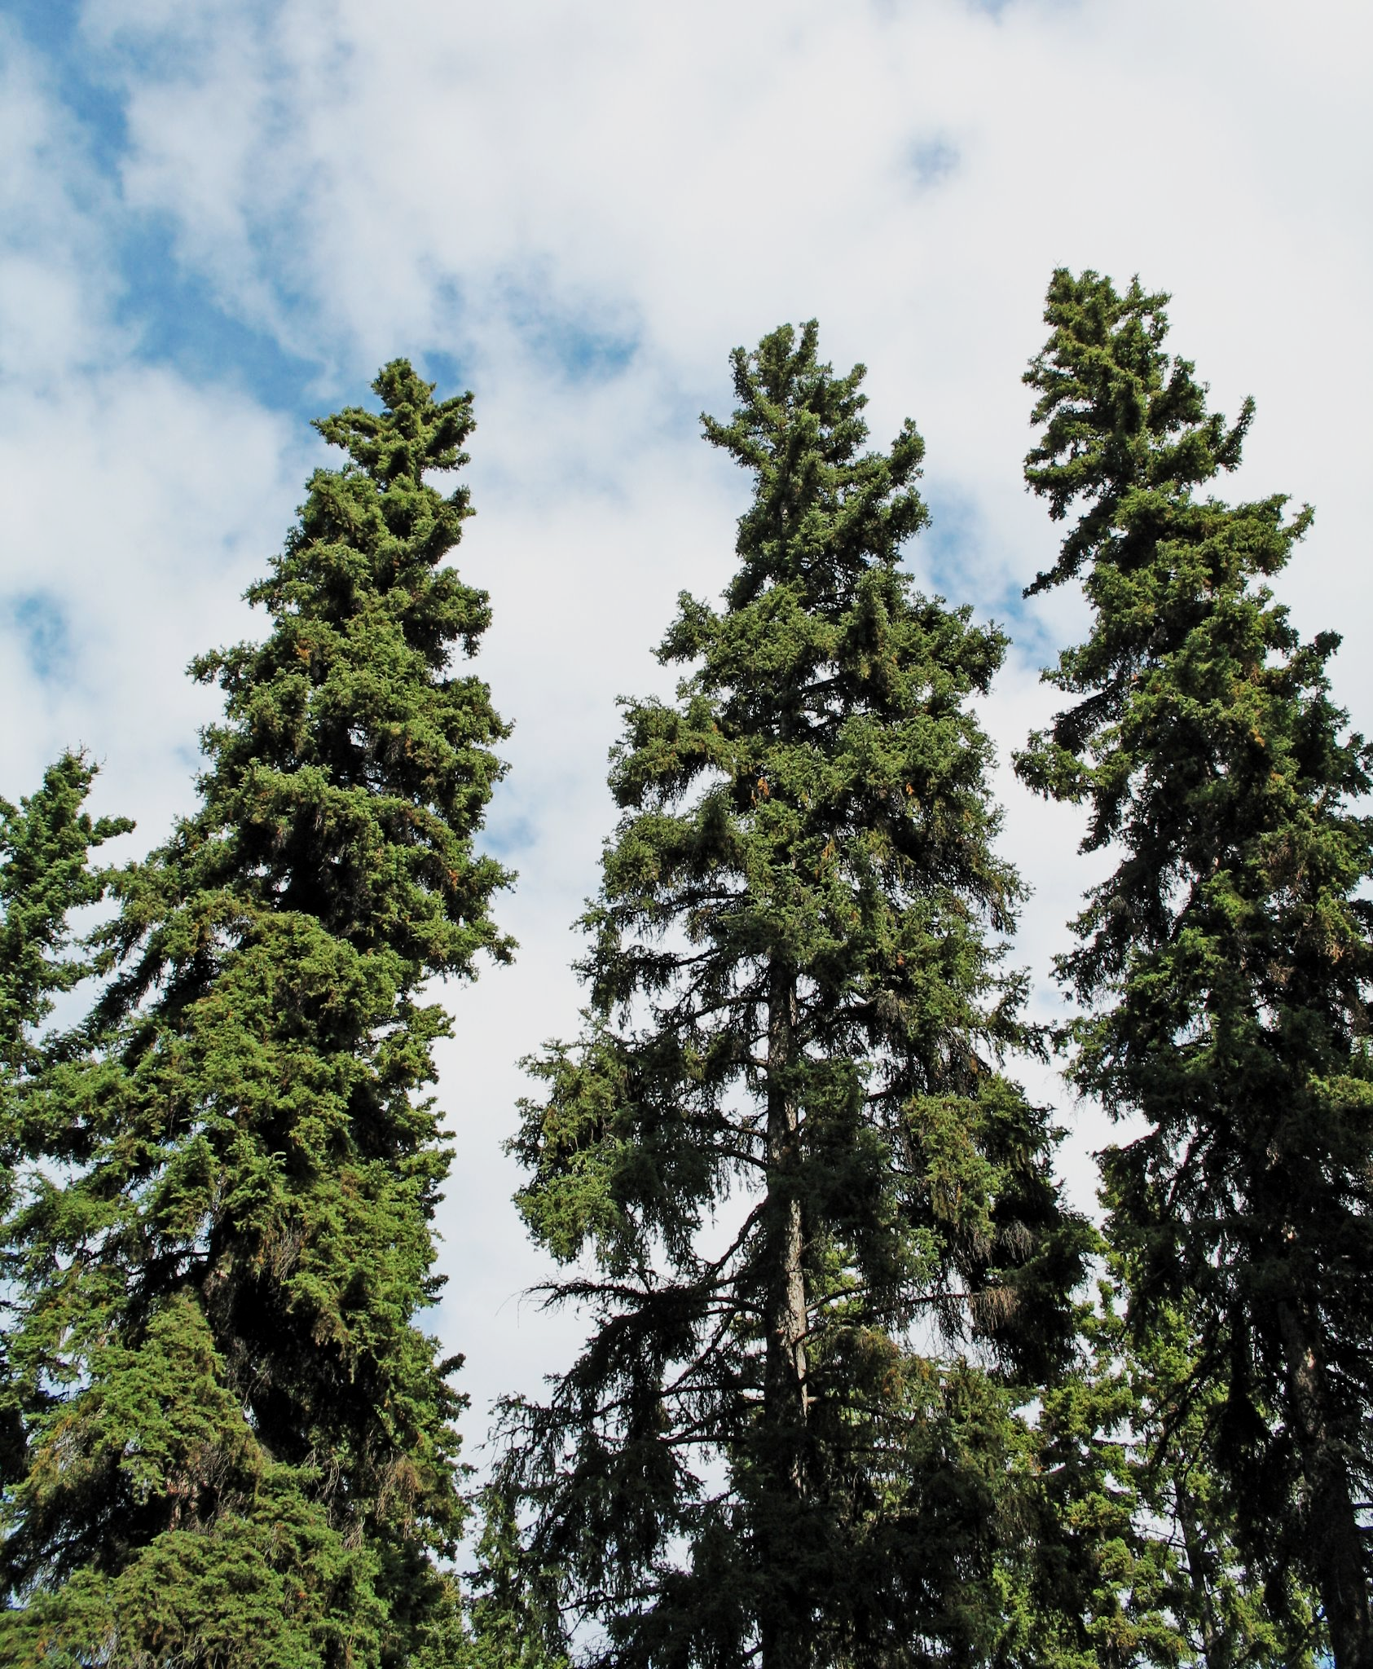
The height of trees can be affected by environmental factors such as the availability of light or nutrients.
VARIATION IN THE HEIGHT OF SPRUCE TREES
FREQUENCY →
HEIGHT →

Slide 11
Evolution by Natural Selection
Evolution relies on changes in the allele frequencies in a population over time.
  The main mechanism that allows this to happen is called natural selection.
In the wild, organisms are constantly subjected to selection pressures.
  Selection pressures affect the survivability of the organism in question.
  Examples of selection pressures include: scarcity of food, lack of shelter or the presence of disease.
Due to genetic variation, different individuals have different alleles.
  Some alleles provide their respective organisms with a greater chance of survival.
  This organism is said to be better adapted to their environment.
Organisms that are well-adapted to their environment are more likely to survive than those that are less well-adapted.
  These individuals are also more likely to reproduce and pass their alleles on to the next generation.
  Over several generations, the frequency of this beneficial allele increases.

Slide 12
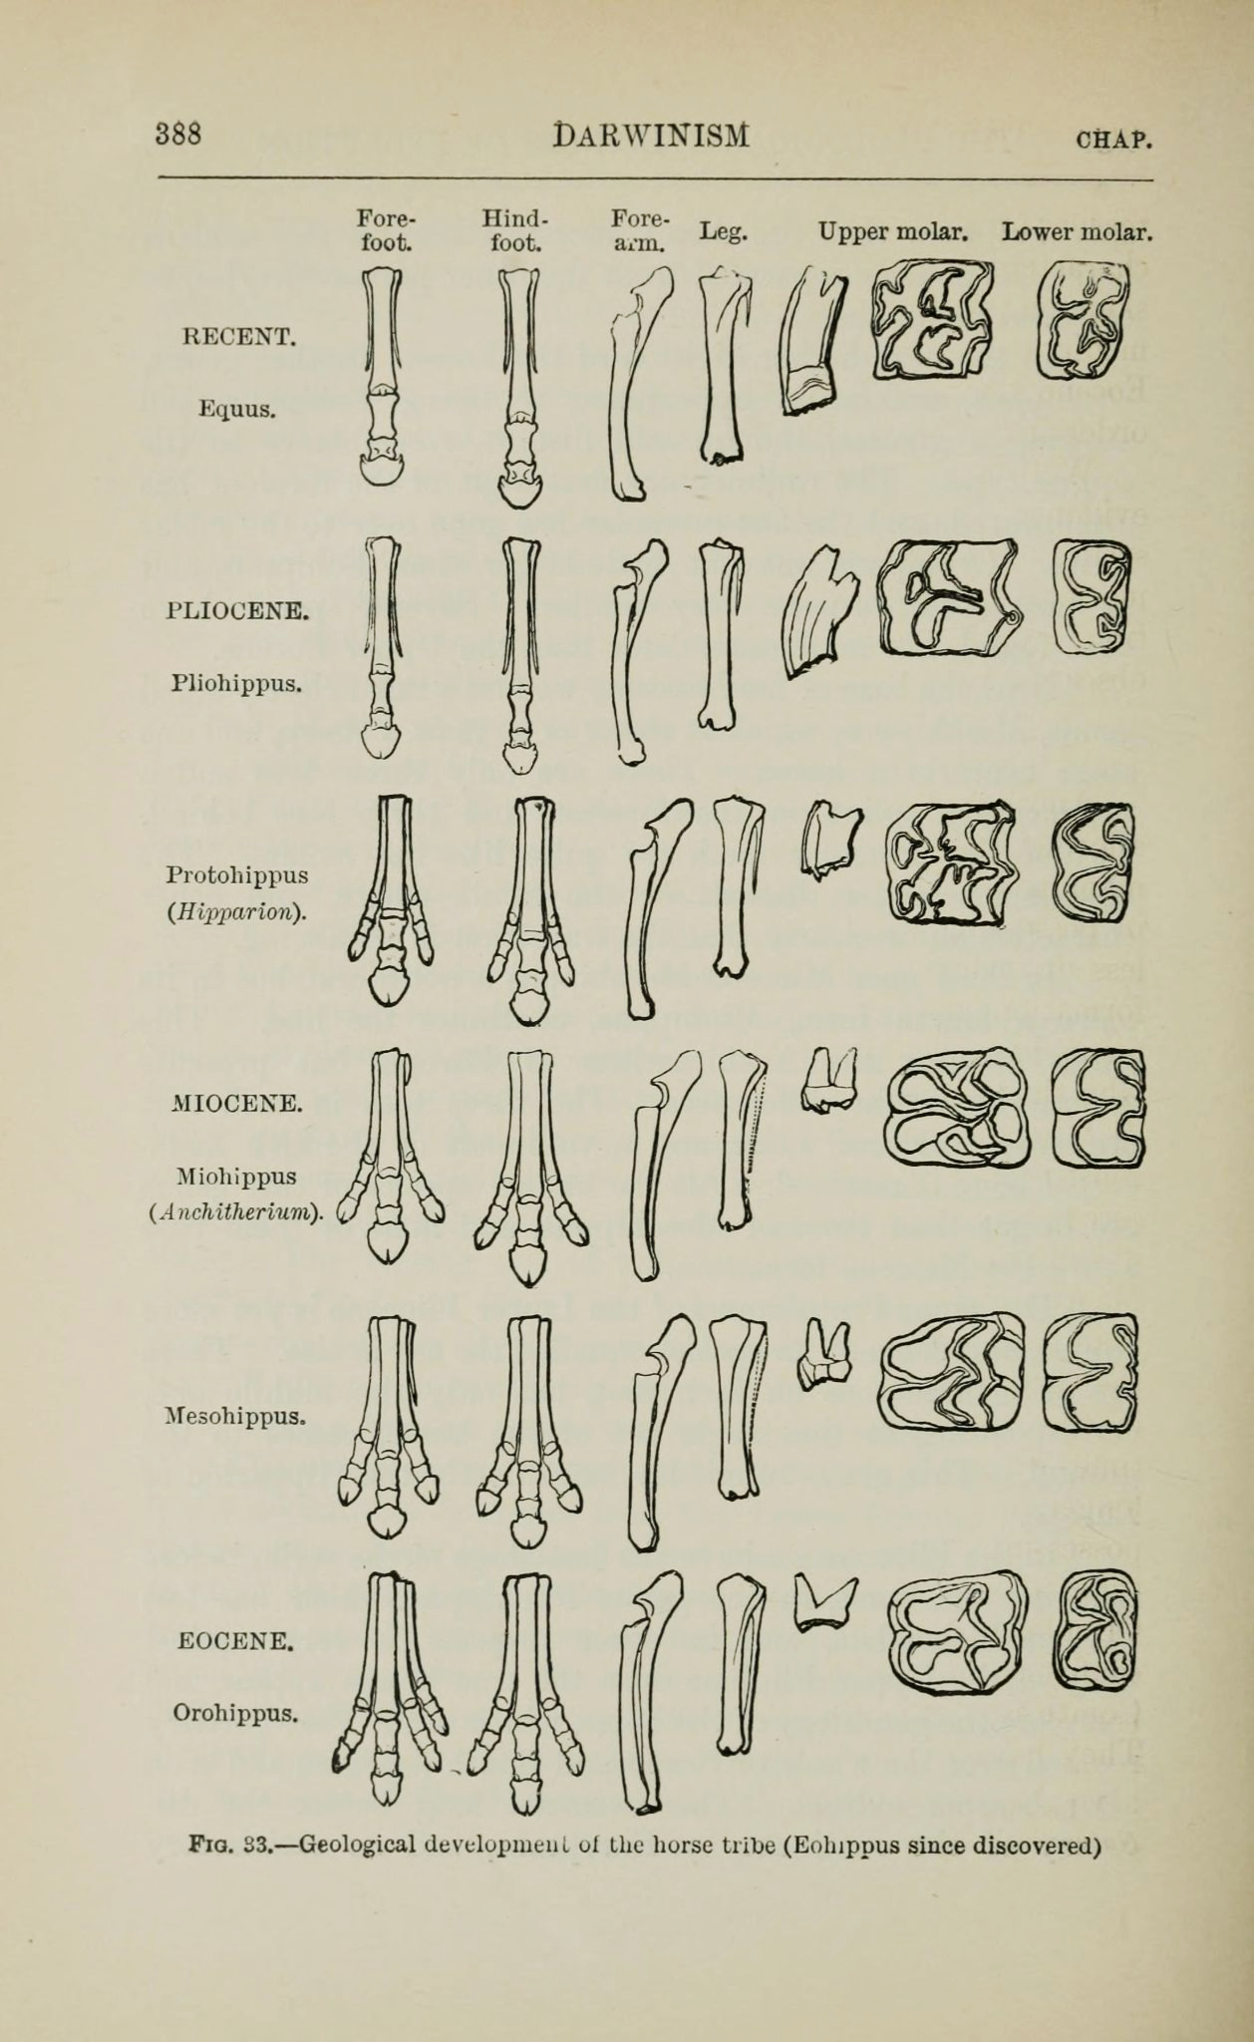
The evolution of horses’ hooves is one key example of natural selection.
The removal of some toes allowed for horses to cover greater distances at greater speeds.

Slide 13
Forms of Natural Selection
There are 3 main forms of natural selection:
  Stabilising selection.
  Directional selection.
  Disruptive selection.
Stabilising selection occurs when selection pressures favour a middling characteristic.
  Stabilising selection reduces the number of extreme phenotypes in the population and is associated with a loss of genetic diversity.
  Stabilising selection occurs when the environment is constant.
Directional selection occurs when selection pressures favour an extreme characteristic.
  Directional selection occurs when the environment is changing.
Disruptive selection occurs when selection pressures select against middling characteristics.
  Disruptive selection is the opposite of stabilising selection.
  Disruptive selection occurs when the environment favours 2 or more extreme phenotypes.

Slide 14
DIRECTIONAL SELECTION
STABILISING SELECTION
DISRUPTIVE SELECTION
FREQUENCY OF ALLELE
FREQUENCY OF ALLELE
FREQUENCY OF ALLELE
BEFORE
AFTER
BEFORE
AFTER
BEFORE
AFTER
PHENOTYPE
PHENOTYPE
PHENOTYPE
The 3 main forms of selection. In extreme cases the changes in phenotype can be so large as to produce an entirely new species. This is most often seen in disruptive selection, where 2 new populations form with largely different phenotypes from each other.

Slide 15
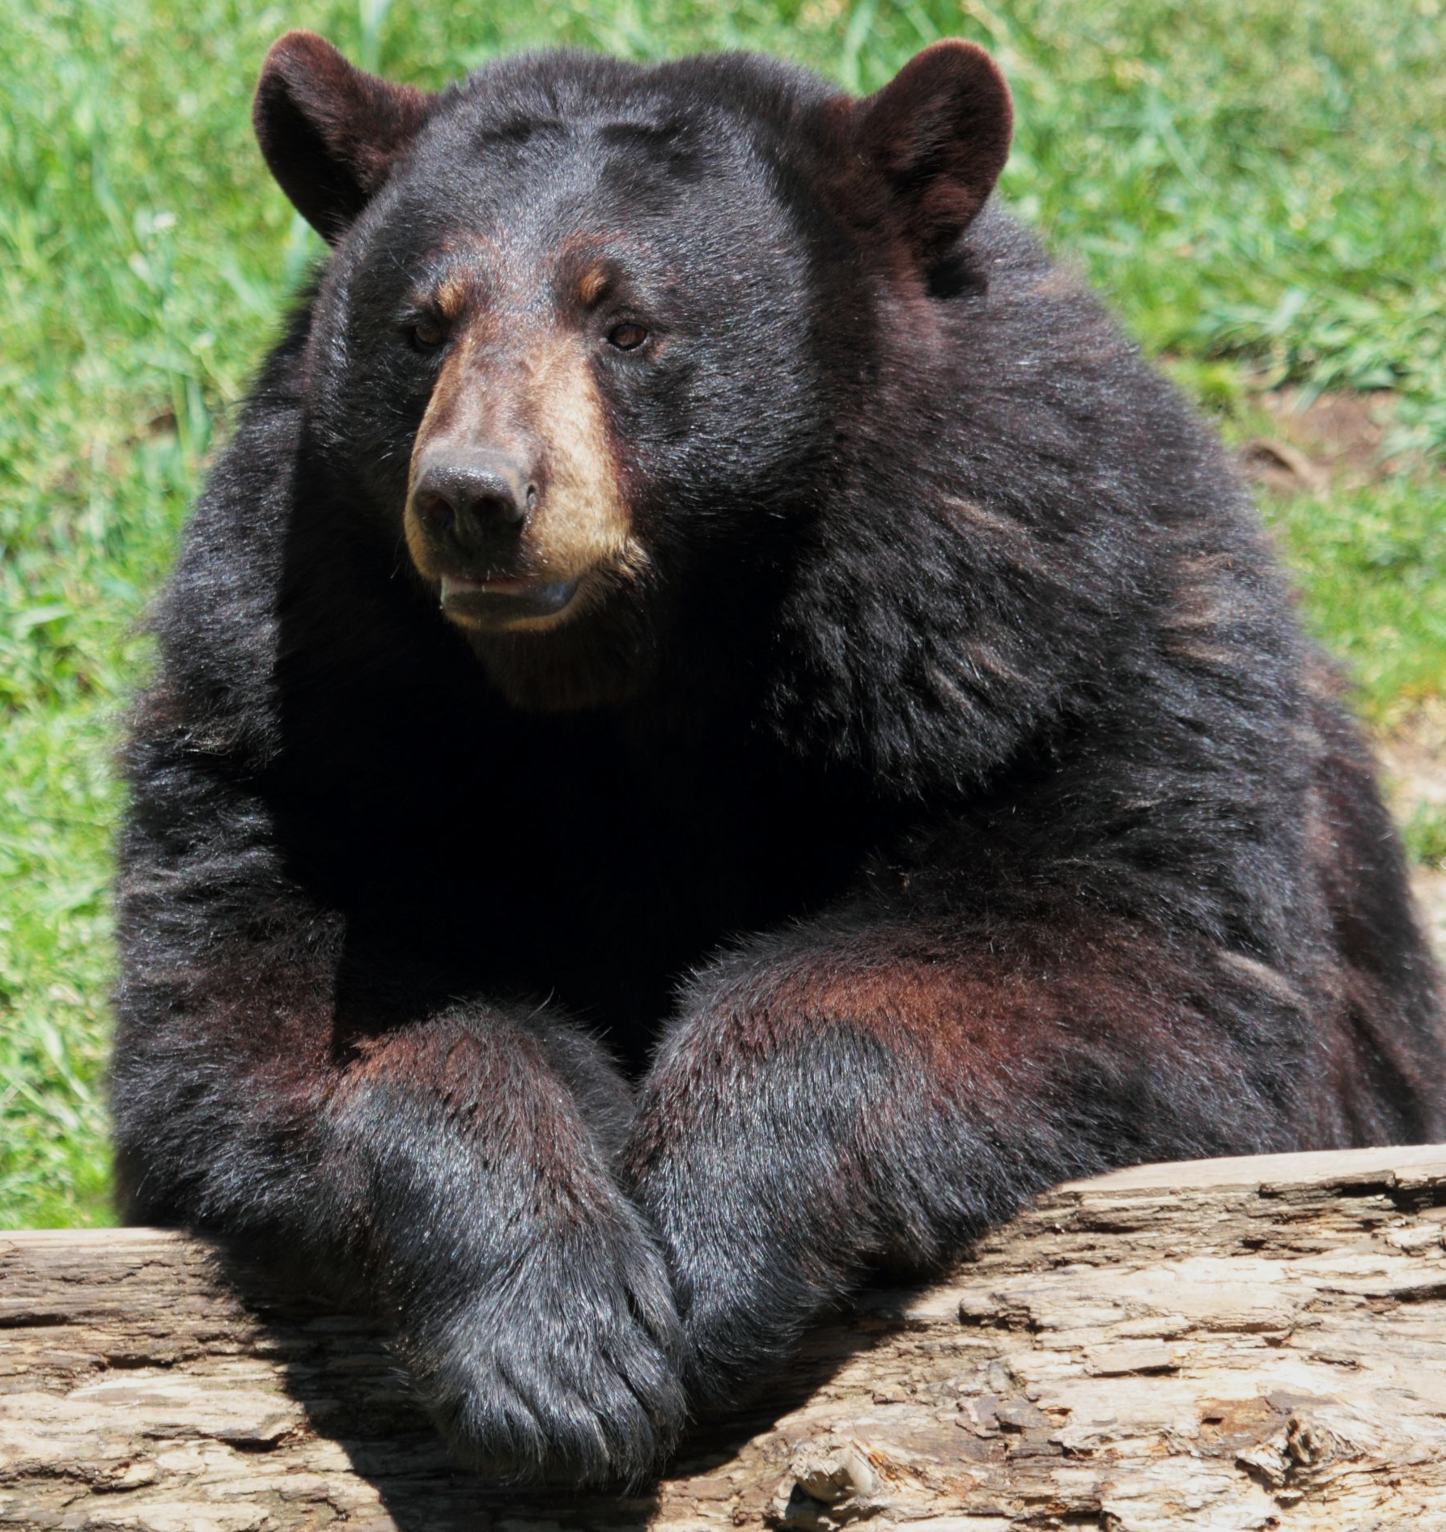
The fossil record shows a general increase in size of American black bears.
This is because, due to an increasing scarcity of food, larger bears (with the ability to store more fat) were more likely to survive than smaller bears. This is an example of directional selection.

Slide 16
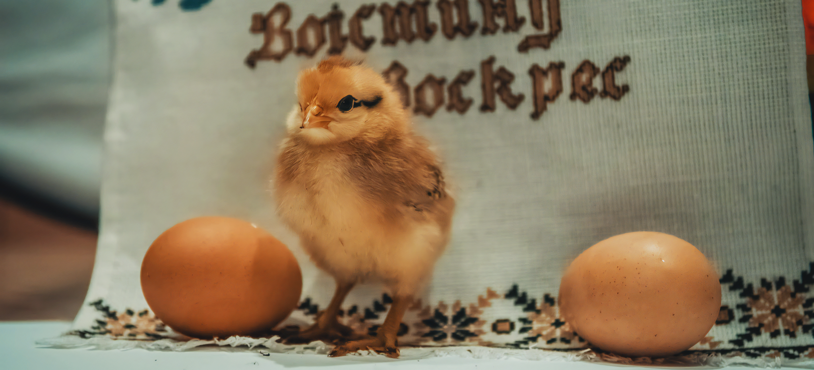
The number of eggs laid by birds is an example of stabilising selection. If the mother lays too few eggs, there is a fair chance none of the chicks will survive to maturity. If she lays too many eggs, she will be unable to provide enough food for the nest and many will starve. There is a selection pressure favouring a median number of eggs.

Slide 17
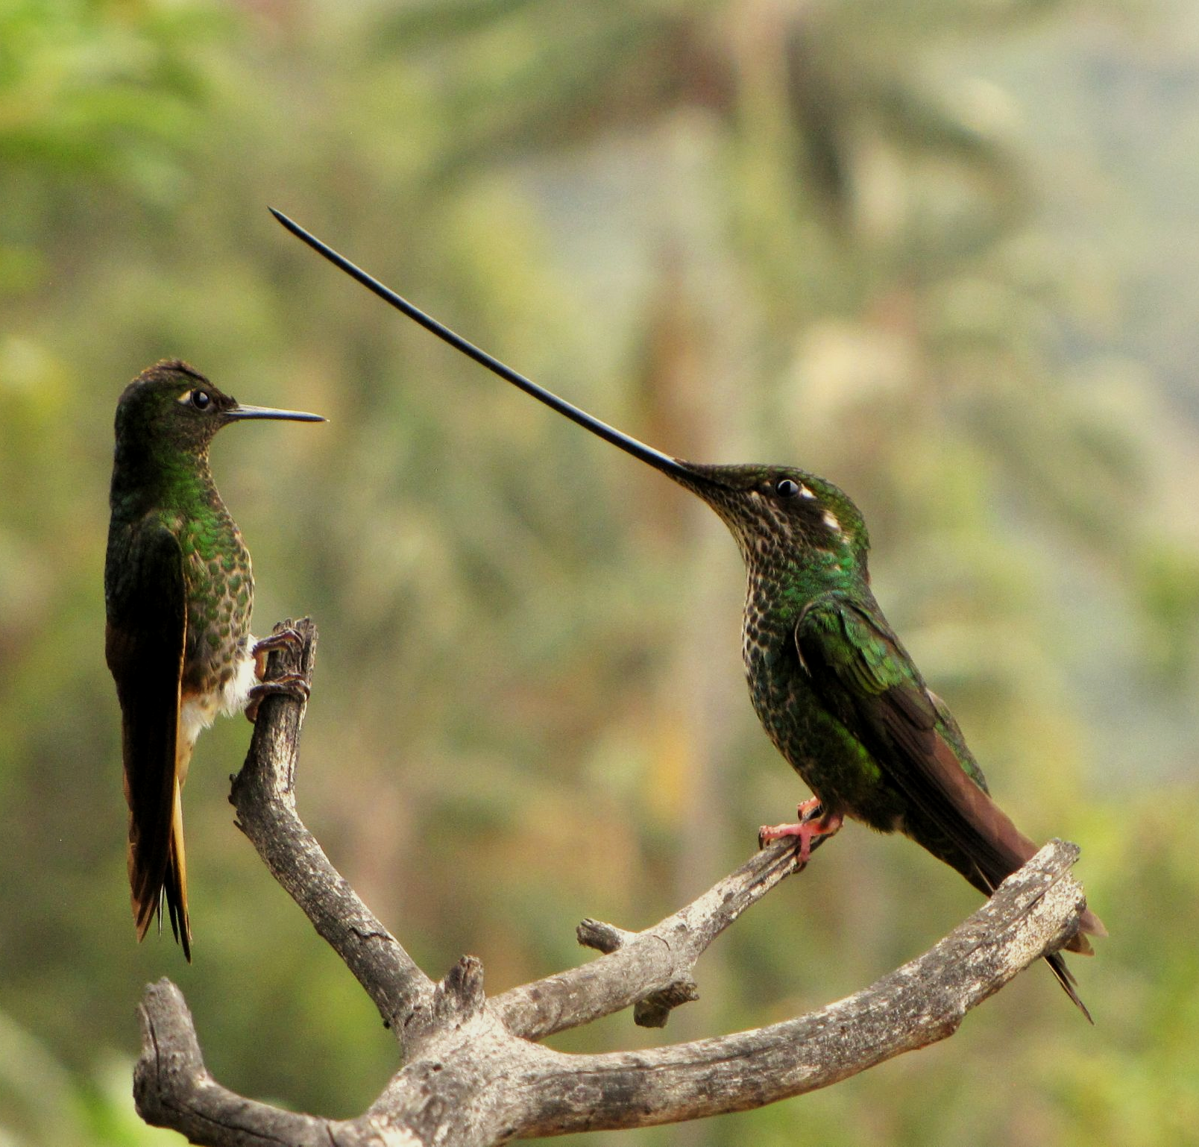
The sword-billed hummingbird exhibits 2 extreme phenotypes - a short bill and an extremely long bill.
The median-lengthed bill was selected against as it is unable to reach the nectar of the plant it uses as a food source. This is an example of disruptive selection.

Slide 18
Speciation
Speciation can be defined as the formation of new and distinct species.
  A new species will evolve from an existing species.
Speciation occurs when populations of the same species are reproductively isolated from each other.
  Reproductive isolation occurs when individuals from the same species do not interbreed.
If populations become physically isolated from each other, they may be unable to interbreed.
  This may lead to allopatric speciation.
Populations may also choose not to interbreed, despite their physical proximity.
  This may lead to sympatric speciation.

Slide 19
Allopatric Speciation
If populations are geographically separated from each other, it is unlikely they will be able to interbreed.
  This geographical separation may come about due to a flood, or the formation of a new land mass, such as a range of mountains.
The 2 populations are likely to be subjected to different environmental conditions.
  For example, there may be different climates in the 2 locations.
Over time, these 2 populations will become better adapted to their respective locations.
  This is due to the process of natural selection.
Eventually, the phenotypes of the 2 populations will have changed sufficiently to prevent successful interbreeding.
  Fertile offspring will no longer be produced.
  As a result, these 2 populations would now be considered to belong to different species.

Slide 20
During allopatric speciation, 2 populations from the same species are geographically isolated from each other. As there is likely to be environmental variation in the 2 isolated areas, directional selection will ensure the phenotypes of the populations become more distinct. Eventually the 2 populations will be so different from each other that successful interbreeding will be impossible.
PEAK A
PEAK B
1. The population occupies both peaks and is free to interbreed.
2. An event (such as a flood) occurs that isolates the population into 2 groups. They can no longer interbreed with each other.
3. Over time, changes in the phenotypes of the 2 groups renders successful interbreeding impossible. Population A and population B are now reproductively incompatible and are considered to be distinct species.

Slide 21
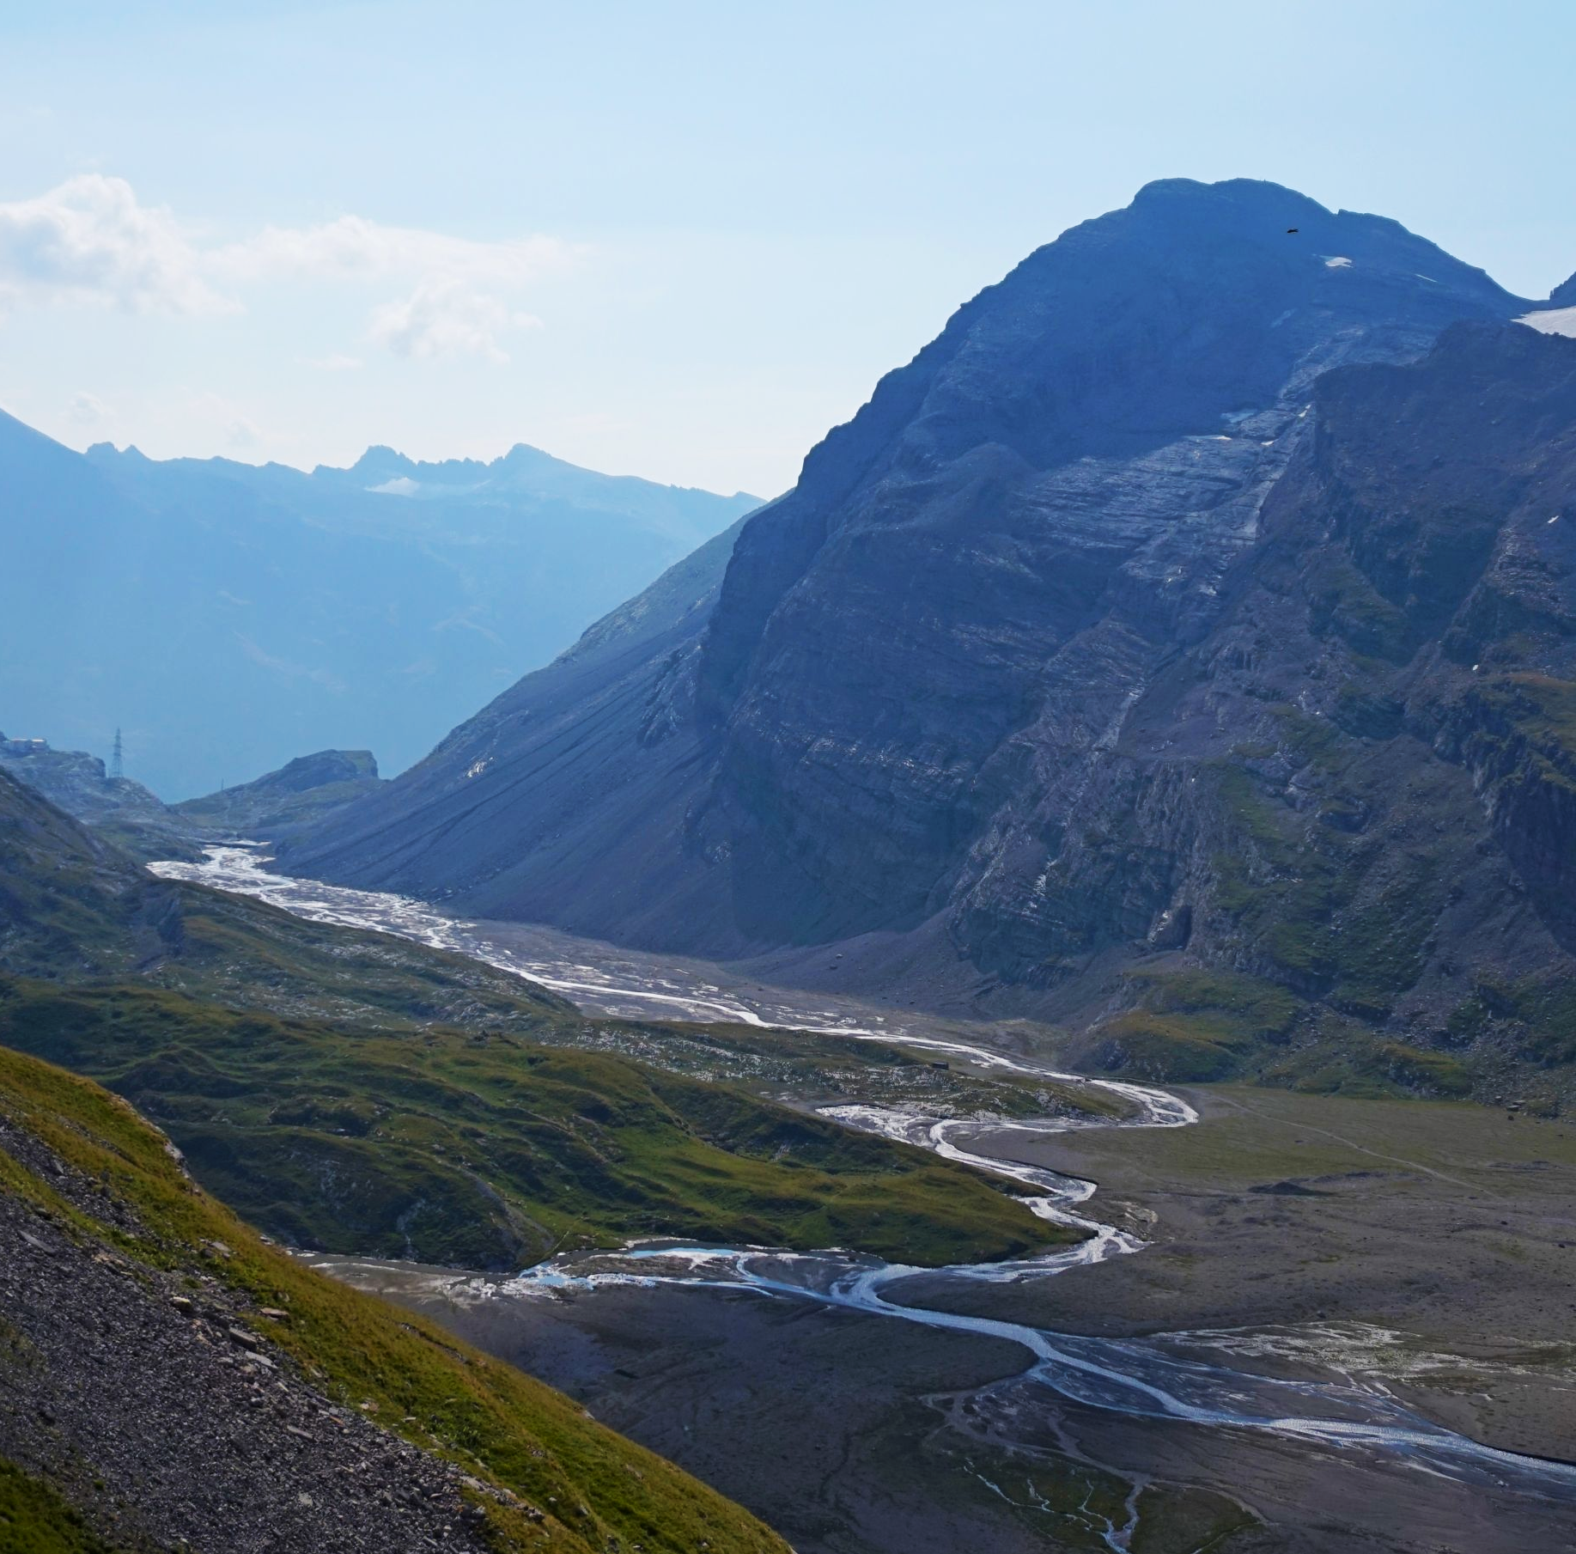
In this example of allopatric speciation, a river has separated two populations of the same species from one another.
Over time, changes in the phenotype will render these two populations reproductively incompatible.
This separation has led to the formation of two species.

Slide 22
Sympatric Speciation
Sympatric speciation occurs when 2 populations of the same species live in the same location, but do not interbreed with each other.
  Sympatric speciation is much rarer than allopatric speciation.
Sympatric speciation is thought to come about by mutations, which prevent reproductive success.
There are several theories that explain sympatric speciation:
  Individuals may develop different mating seasons, which ensure that they are not reproductively active at the same time of the year.
  Individuals may develop different genitalia, which can prevent successful breeding.
  Individuals may develop different courtship rituals, which prevents breeding altogether.

Slide 23
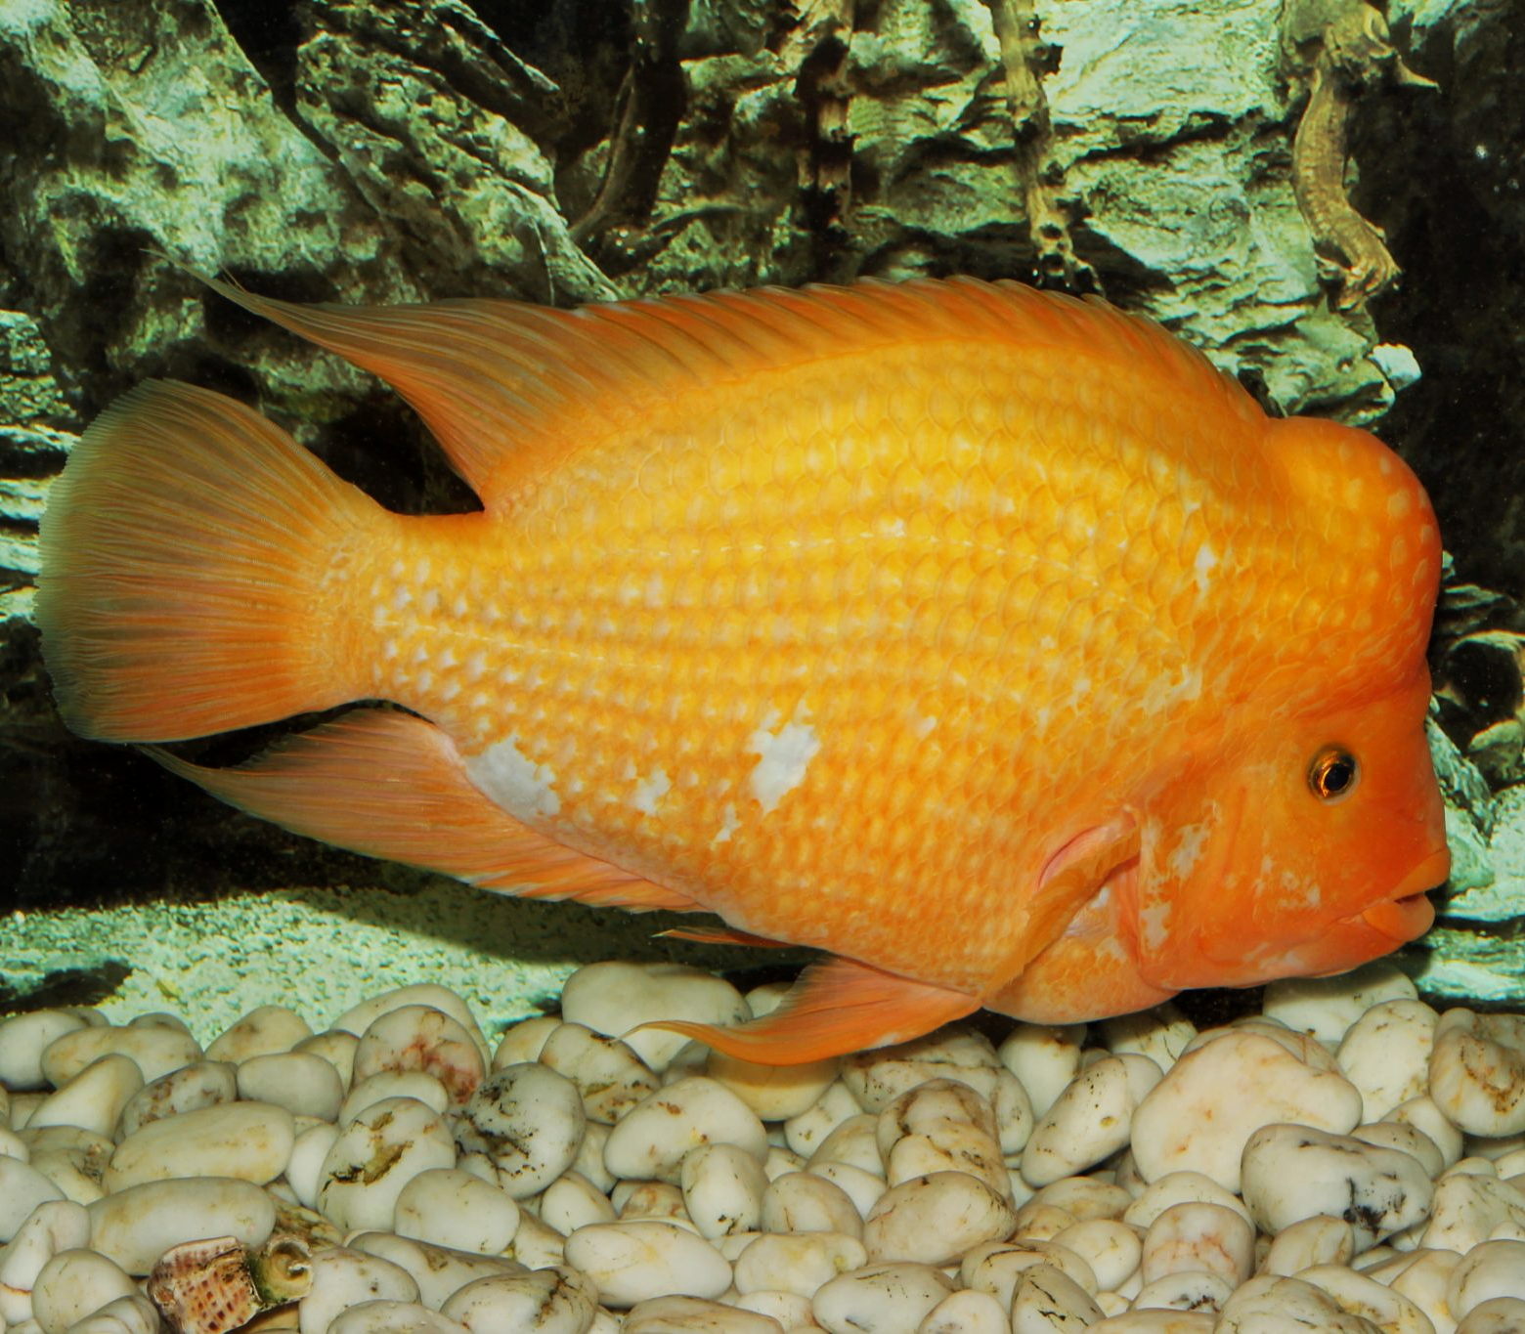
Sympatric speciation is rarely observed in nature. 1 example is the Midas cichlid, a fish that lives in Lake Apoyo in Nicaragua.
Recent DNA analysis has identified 2 distinct species of the cichlid in the same lake. The newer species is thought to have evolved less that 10,000 years ago.

Slide 24
Genetic Drift
The primary mechanism of evolution is natural selection.
Evolution may also occur through genetic drift.
  Genetic drift occurs when the frequency of a particular allele in the population changes from generation to generation due to chance.
  Genetic drift is also referred to as random drift.
Genetic drift occurs more frequently in small populations.
  This is because chance will have a greater impact when there are fewer alleles.
Consider a population with 2 alleles - B and b.
  Initially, the frequency of the alleles are equal (p = 0.5 and q = 0.5).
By random chance, the frequency of the alleles changes in the next generation.
  Now the frequency of the B allele is significantly greater than the frequency of the b allele (p - 0.7 and q = 0.3).
  This may be due to certain individuals with particular alleles mating unsuccessfully.
Over time, 1 of the alleles may disappear from the population.
  In events unrelated to natural selection, only the B allele remains (p = 1 and q = 0).
In small populations, genetic drift can cause alleles to disappear from the gene pool.

Slide 25
The Diversity of Life
There are approximately 8.7 million different species on Earth.
This biodiversity is due to the process of speciation.
  Some 3.5 billion years ago, life began on Earth.
  There was a single species that evolved into a 2 different species.
  These 2 species then evolved again into 4 different species.
This process has been repeated again and again to create all the different species on Earth.
Beginning with the Cambrian Explosion some 540 million years ago, there was a massive biodiversification of multicellular organisms.
NUMBER OF GENERA →
TIME →

