Slide 1
AQA A Level Biology
51 - Linkage and Epistasis
Autosomal and Sex Linkage, Gene Silencing and Chi-Squared

Slide 2
Sex Linkage
Specification Point 3.7.1 - Inheritance.
In mammals, the genetic information for biological sex is carried on the sex chromosomes.
  Males have a single copy of the X chromosome and a single copy of the Y chromosome (XY).
  Females have 2 copies of the X chromosome (XX).
A number of characteristics are sex-linked.
  This means that the alleles for a sex-linked gene are found on the sex chromosomes.
The Y chromosome is much smaller than the X chromosome.
  This means that most of the genes for sex-linked characteristics are carried on the X chromosome.
Males are more likely to suffer from diseases associated with sex linkage.
  This is because males only carry a single copy of the X chromosome.
  Males will express the phenotype associated with the sex-linked allele even if the condition is recessive.
  As a result, it is impossible for a male individual to be a carrier of the disease.

Slide 3
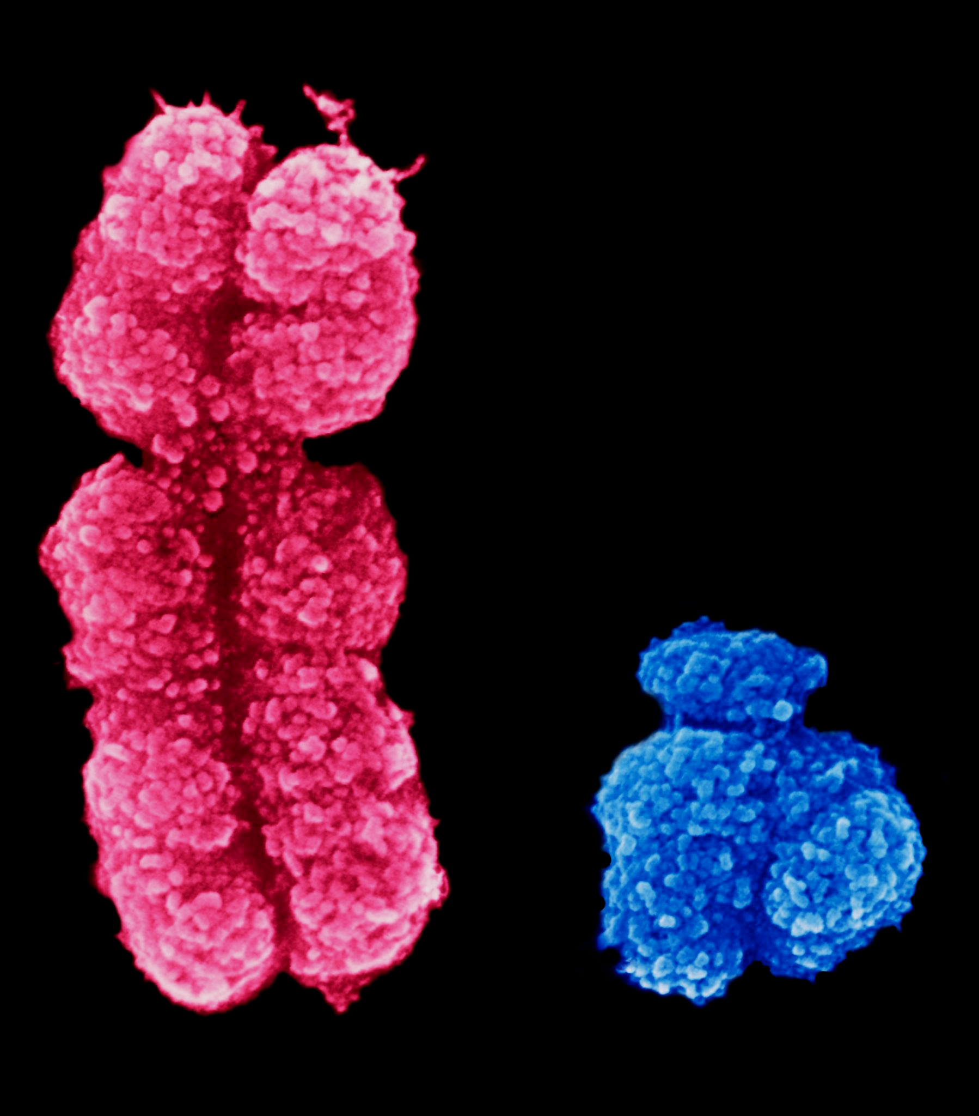
In humans, the Y chromosome is much smaller than the X chromosome.
This means that males are much more likely to suffer from sex linked diseases, due to the inability of the Y chromosome to carry many genes.

Slide 4
A Punnett square displaying the possible outcomes of sexual reproduction. Any offspring with the genotype XY will be biologically male, any offspring with the genotype XX will be biologically female. The probability of giving birth to either a boy or a girl is 50%.
MALE’S ALLELES
 | X | Y
X | XX | XY
X | XX | XY
FEMALE’S ALLELES
POSSIBLE F₁ GENOTYPES

Slide 5
The case of hereditary colour blindness is the most famous example of a sex-linked condition. The N allele is dominant to the n allele. In this scenario, a carrier female (X^{N}X^{n}) reproduces with an unaffected male (X^{N}Y). Both have normal vision. Both female offspring (X^{N}X^{N} and X^{N}X^{n}) have normal vision. 1 of the males has normal vision (X^{N}Y). The other male, unprotected by a second X chromosome, is afflicted with colour blindness (X^{n}Y).
GAMETES’ ALLELES
 | X^{N} | Y
X^{N} | X^{N}X^{N} | X^{N}Y
X^{n} | X^{N}X^{n} | X^{n}Y
N = ALLELE FOR NORMAL VISION
n = ALLELE FOR COLOUR BLINDNESS
PARENTAL GENOTYPES = X^{N}X^{n} AND X^{N}Y
PARENTAL PHENOTYPES = BOTH HAVE NORMAL VISION
F₁ GENERATION = 1x X^{N}X^{N}, 1x X^{N}X^{n}, 1x X^{N}Y, 1x X^{n}Y
PHENOTYPIC RATIO = 3 : 1 NORMAL VISION TO COLOUR BLIND
OR 2 : 1 : 1 NORMAL FEMALE TO NORMAL MALE TO COLOUR BLIND MALE
GAMETES’ ALLELES
POSSIBLE F₁ GENOTYPES

Slide 6
An Ishihara colour test plate. People with normal vision should see the number 74. Viewers with red–green color blindness may read it as 21. Those with total color blindness may not see any numbers.
Approximately 1 in 12 men suffer with some form of colour blindness. This is compared to about 1 in 200 women.

Slide 7
Autosomal Gene Linkage
An autosome is any chromosome that is not a sex chromosome.
  In humans, chromosomes 1-22 are defined as autosomal.
  An autosomal gene is a gene found on any of these 22 autosomes.
Genes that are in close proximity to each other on the same autosome are said to be linked.
  During meiosis I, genetic material is swapped between chromosomes in the process of crossing over.
  2 genes that are physically near to each other are unlikely to be separated onto different chromatids.
  During independent segregation, these genes will remain together as a pair and will find themselves in the same gamete.
The closer the proximity, the greater the chance that the 2 genes will be inherited together.
  Autosomal gene linkage creates odd phenotypic ratios. A classical dihybrid cross of 2 heterozygotes carrying unlinked genes should yield a 9:3:3:1 ratio.
  Genes that are autosomally-linked will yield a phenotypic ratio closer to 3:1. This appears much more like a monohybrid cross because the 2 linked genes have been inherited together.

Slide 8
Gene A and gene B are located next to each other on the same chromosome. During crossing over, they are likely to be inherited as a pair. They are said to be linked to each other.
Gene A and gene C are located on different chromosomes. They will not be inherited as a pair and are said to be unlinked.
Whilst gene A and gene D are located on the same chromosome, they are far away from each other. They are unlikely to be inherited as a pair and are said to be unlinked.
GENE D
GENE C
GENE B
GENE A
GENE A
GENE A
LINKED
UNLINKED
UNLINKED

Slide 9
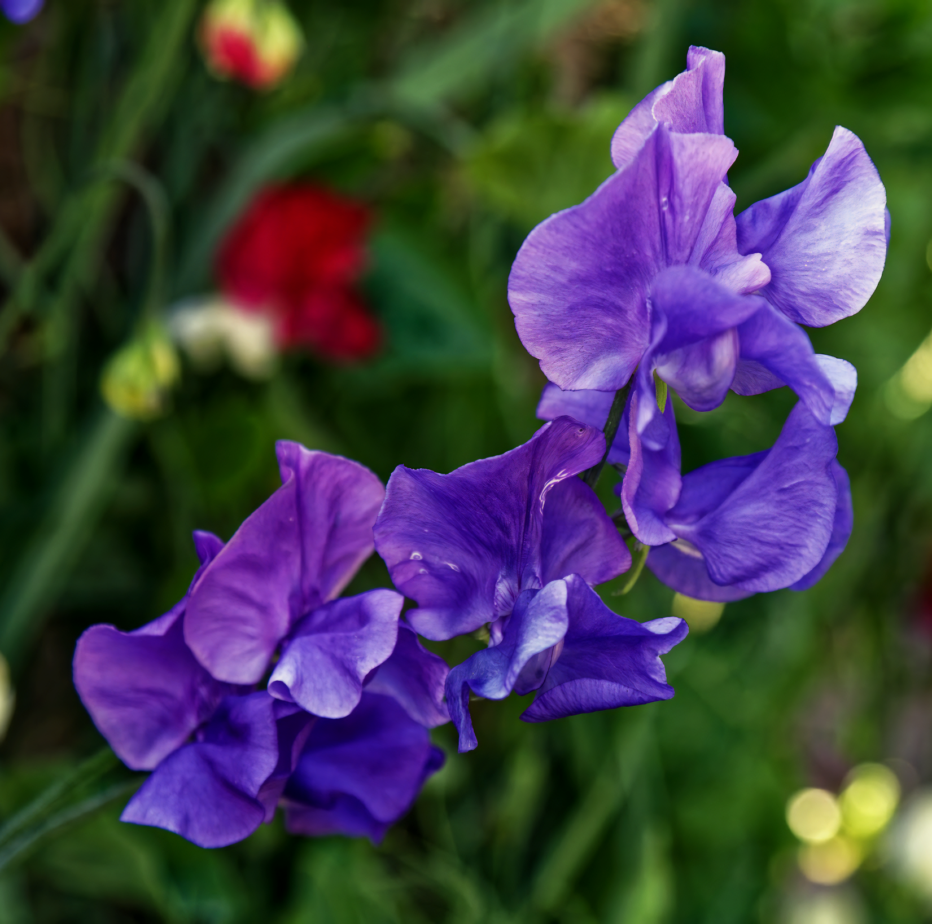
The sweet pea is a plant that displays autosomal gene linkage. The gene for flower colour (with F and f alleles) is linked to the gene for pollen grain shape (with L and l alleles).
A dihybrid cross should yield the classical 9:3:3:1 ratio. Instead a 3:1 ratio is observed; almost as if the 2 genes were behaving as a single characteristic.

Slide 10
Epistasis
In some cases, 1 gene may mask the expression of another gene.
  This is referred to as epistasis or gene silencing.
Epistasis is often seen in flower colour.
  The colour of a flower is often governed by 2 genes.
Gene 1 may code for a blue pigment whilst gene 2 codes for an enzyme that converts the blue colour to a green colour.
  Gene 1 contains the dominant B allele.
  Gene 2 contains the dominant G allele.
If the B allele is not present in the genotype, a white flower will be produced regardless of whether the G allele is present or not.
  In this scenario, gene 1 is epistatic to gene 2.
  This is because gene 1 is masking the expression of gene 2.
GENE 1
(BB OR Bb)
GENE 2
(GG OR Gg)
WHITE MOLECULE
BLUE PIGMENT
GREEN PIGMENT

Slide 11
Dominant and Recessive Epistasis
Dihybrid crosses that involve epistatic genes do not follow expected ratios.
  A classical dihybrid cross involving 2 heterozygotes (with the genotype BbGg) should yield a 9:3:3:1 ratio.
If the recessive allele is epistatic, 2 copies of the allele are required to mask the expression of the other gene.
  Crossing a 2 heterozygotes will yield a 9:3:4 ratio.
If the dominant allele is epistatic, only 1 copy of the allele is required to mask the expression of the other gene.
  Crossing 2 heterozygotes will yield a 12:3:1 ratio.
Epistasis video.

Slide 12
The coat colour of Labrador Retrievers is controlled by a recessive epistatic allele. If the dog is homozygous recessive for the gene for melanin production (mm), the effects of the gene for coat colour is masked. All Retrievers that lack melanin are golden in colour, regardless of the genotype of the masked gene.
GAMETES’ ALLELES
M = ALLELE FOR MELANIN
m = ALLELE FOR NO MELANIN
B = ALLELE FOR BLACK COAT COLOUR
b = ALLELE FOR BROWN COAT COLOUR
PARENTAL GENOTYPES = BOTH MmBb
PARENTAL GAMETES = MB, Mb, mB AND mb
F₁ GENERATION = 9x BLACK COATS (MMBB, MmBB, MmBb), 3x BROWN COATS (MMbb, Mmbb), 4X GOLDEN COATS (mmBB, mmBb, mmbb)
PHENOTYPIC RATIO = 9 : 3 : 4
 | MB | Mb | mB | mb
MB | MMBB | MMBb | MmBB | MmBb
Mb | MMBb | MMbb | MmBb | Mmbb
mB | MmBB | MmBb | mmBB | mmBb
mb | MmBb | Mmbb | mmBb | mmbb
GAMETES’ ALLELES
POSSIBLE F₁ GENOTYPES

Slide 13
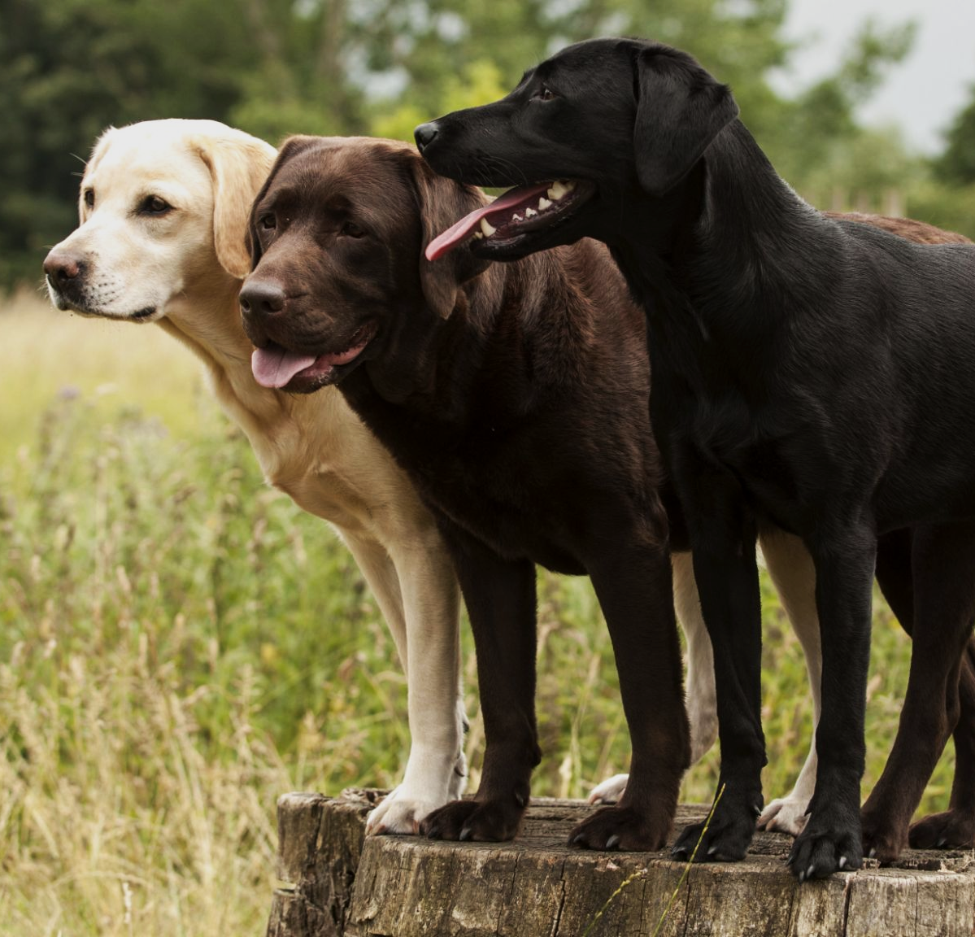
Coat colour in Labrador Retrievers is an example of recessive epistasis.
If both alleles for melanin production are recessive (mm), the coat of the Labrador is golden, regardless of the alleles that are present in the masked gene.

Slide 14
The fruit colour in certain species of squash is controlled by a dominant epistatic allele. If the squash contains at least 1 copy of the allele for a white colour (WW or Ww), the effects of the gene for a yellow (YY or Yy) or green (yy) coloured squash are masked.
GAMETES’ ALLELES
W = ALLELE FOR WHITE COLOUR
w = ALLELE FOR OTHER COLOURS
Y = ALLELE FOR YELLOW COLOUR
y = ALLELE FOR GREEN COAT COLOUR
PARENTAL GENOTYPES = BOTH WwYy
PARENTAL GAMETES = WY, Wy, wY AND wy
F₁ GENERATION = 12x WHITE SQUASH (WWYY, WWYy, WWyy, WwYY, WwYy, Wwyy), 3x YELLOW SQUASH (wwYY, wwYy), 1X GREEN SQUASH (wwyy)
PHENOTYPIC RATIO = 12 : 3 : 1
 | WY | Wy | wY | wy
WY | WWYY | WWYy | WwYy | WwYy
Wy | WWYy | WWyy | WwYy | Wwyy
wY | WwYY | WwYy | wwYY | wwYy
wy | WwYy | Wwyy | wwYy | wwyy
GAMETES’ ALLELES
POSSIBLE F₁ GENOTYPES

Slide 15
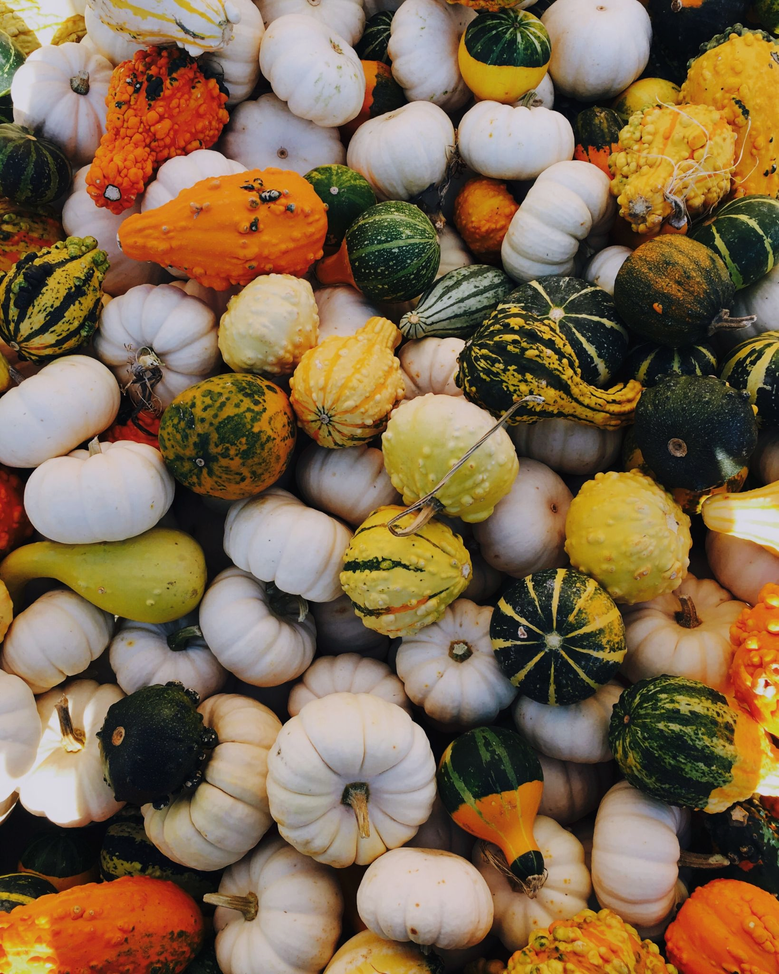
The colour of squash plants is an example of dominant epistasis. If an allele for white squash is present (WW or Ww), the presence of a second gene for colour is inconsequential.

Slide 16
The Chi-Squared Test
The chi-squared (χ²) test is designed to test how likely it is that an observed set of values is due to chance.
The χ² test is a ‘goodness of fit’ statistic.
  This means that is measures how well an observed set of data fits with an expected set of data.
The χ² test is often used in to test established theories in genetics.
  In monohybrid inheritance, it is well-understood that when crossing 2 heterozygotes for a particular gene, a 3:1 ratio is expected in the F₁ generation.
  In dihybrid inheritance, it well-understood that when crossing 2 heterozygotes for a both genes, a 9:3:3:1 ratio is expected in the F₁ generation.
Σ = Sum of equation.
O = Observed result.
E = Expected result.

Slide 17
PHENOTYPE | RATIO | EXPECTED RESULT (E) | OBSERVED RESULT (O)
BROWN EYES | 3 | 120 | 113
BLUE EYES | 1 | 40 | 47
An exemplar χ² for a monohybrid cross involving eye colour. Heterozygotes (Bb) were crossed with each other to create an F₁ generation containing 160 individuals. As the expected ratio of blue eyes to brown eyes is 3:1, we should expect 120 individuals with brown eyes and 40 with blue eyes.
Our observed numbers showed a slight variance in this (113 brown eyed individuals against 47 blue eyed individuals). Using the χ² equation, we yield a value of 1.64. This is a measure of variance between our observed and expected values.
PHENOTYPE | RATIO | EXPECTED RESULT (E) | OBSERVED RESULT (O) | O - E | (O - E)² | (O - E)²/E
BROWN EYES | 3 | 120 | 113 | -7 | 49 | 0.41
BLUE EYES | 1 | 40 | 47 | 7 | 49 | 1.23
 |  |  |  | SUM OF (O-E)²/E = |  | 1.64

Slide 18
In order to calculate whether our observed and expected values are statistically similar to each other, we must compare our χ² value (1.64) with an established critical value found in a χ² table. In this instance, as we had 2 phenotypes (brown eyes and blue eyes), there are 2 classes. Biologists generally accept a P value of 0.05 for statistical certainty.
If our χ² value exceeds the critical value, the 2 sets of data are significantly different from each other and we reject the null hypothesis (that the gene for eye colour follows a traditional 3:1 ratio). In this instance, our χ² value is smaller than the critical value (3.84). We can now accept the null hypothesis and assume that our observed values is significantly similar to the expected values.
DEGREES OF FREEDOM | NUMBER OF CLASSES | CRITICAL VALUE
1 | 2 | 2.71 | 3.84 | 6.64
2 | 3 | 4.61 | 5.99 | 9.21
3 | 4 | 6.25 | 7.82 | 16.27
PROBABILITY RESULT CAME ABOUT BY CHANCE (P VALUE) |  | 0.1 (10%) | 0.05 (5%) | 0.01 (1%)

