Slide 1
AQA A Level Biology
50 - Genetics
Monohybrid and Dihybrid Inheritance

Slide 2
Genes and Alleles
Specification Point 3.7.1 - Inheritance.
A gene is a region of DNA that codes for a protein.
  The order of bases in a gene determines the order of amino acids in a protein.
A gene can exist in multiple forms.
  These forms are called alleles.
Alleles are usually represented using letters.
  The allele for brown eyes is usually allocated the letter B.
  The allele for blue eyes is usually allocated the letter b.
The base sequence of 2 alleles of the same gene may be slightly different to one another.
  This may lead to slightly different proteins being made.
  For example, different alleles for eye colour may produce differently coloured proteins.

Slide 3
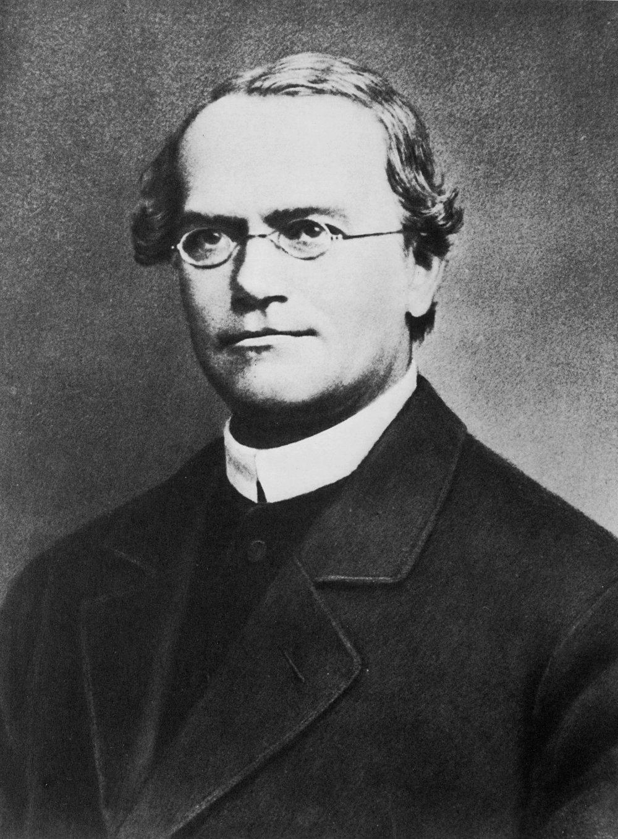
Gregor Mendel is considered the father of modern genetics. His experiments on pea plants established many of the rules on heredity which are still used today.

Slide 4
Gene Loci, Genotypes and Phenotypes
Most human cells are diploid.
  This means that there are 2 copies of each chromosome.
  A matching pair of chromosomes are said to be homologous to each other.
Different alleles of a gene are found at the same location on each chromosome.
  This is called a gene locus.
The combination of alleles that an individual possesses for a specific gene is called a genotype.
  One individual may have the genotype BB for eye colour.
  An individual may also have the genotypes Bb or bb.
The sum of an organism’s observable characteristics is called a phenotype.
  As well as the genotype, an organism’s phenotype may be influenced by a variety of environmental and lifestyle factors.

Slide 5
CHROMOSOME 15
1 specific region (a gene locus) on chromosome 15 plays an important role in the development of eye colour in humans. 2 of the most common alleles are the brown (B) allele and the blue (b) allele.
The combination of these alleles is referred to as an individual's genotype. In this instance, the genotype is directly responsible for the expressed characteristic, an individual’s phenotype.
GENE LOCUS

Slide 6
Dominance and Codominance
A diploid organism can be either homozygous or heterozygous for a particular gene.
  If both of the alleles are identical (for example BB or bb), an individual is said to be homozygous.
  If the alleles are different to one another (for example Bb), an individual is said to be heterozygous.
A dominant allele is always expressed in the phenotype.
  Dominant alleles are represented by a capital letter (B).
  Only 1 copy of the allele is required for it to be displayed in the phenotype.
  For example, the genotypes BB and Bb will both lead to an individual with brown eyes.
A recessive allele is only expressed under certain conditions.
  Recessive alleles are represented by a lowercase letter (b).
  2 copies of the allele are required for them do be displayed in the phenotype.
  The genotype bb is the only combination of alleles that will lead to an individual with blue eyes.
In some instances, neither allele is recessive - these alleles are said to be codominant.
  In this scenario, both alleles will be expressed in the phenotype.

Slide 7
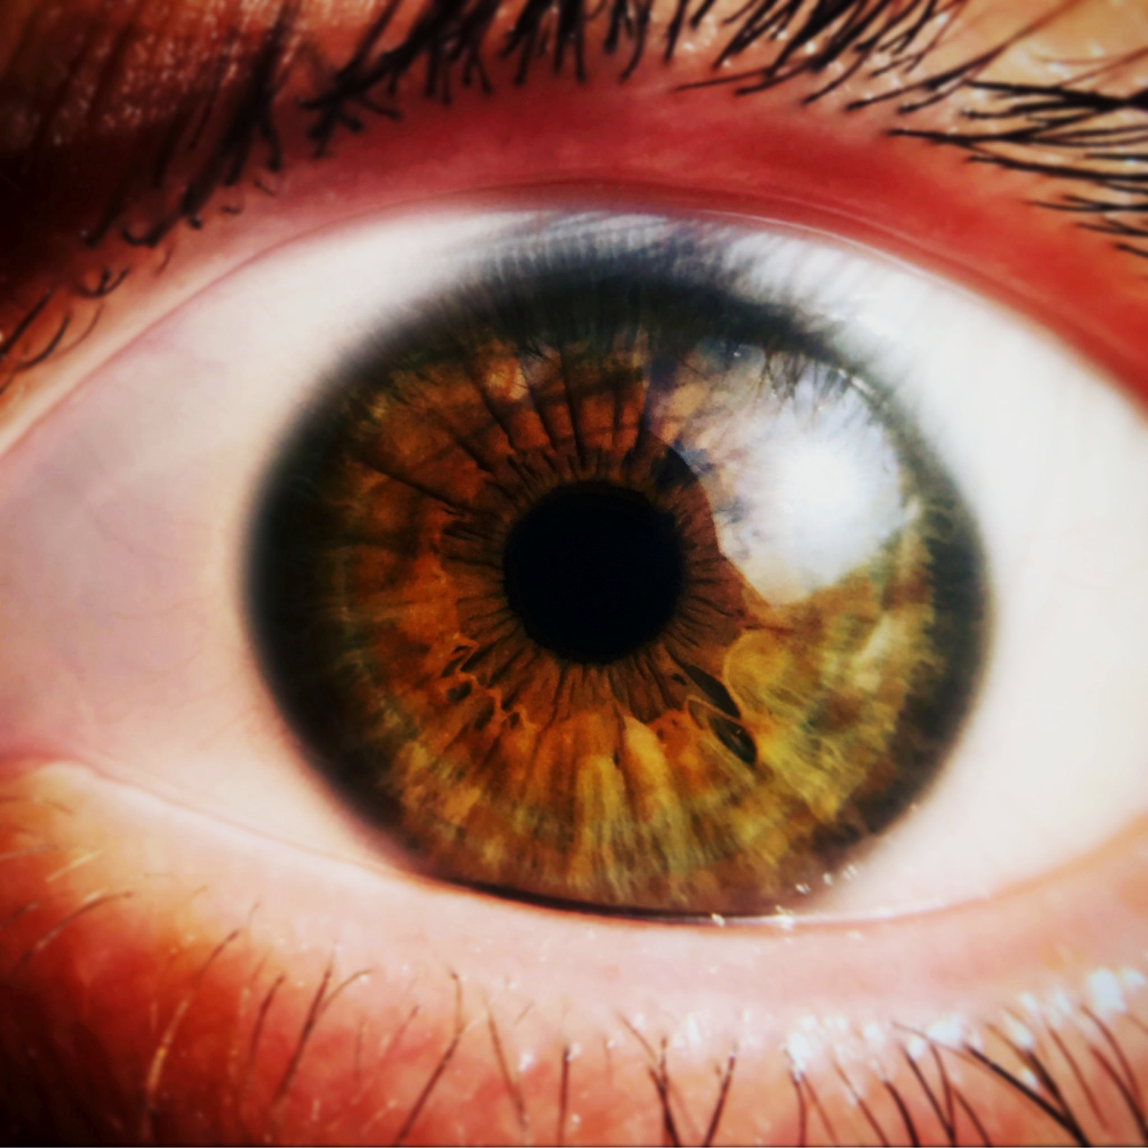
An individual with brown eyes can be homozygous dominant (BB) or heterozygous (Bb) for the gene for eye colour.

Slide 8
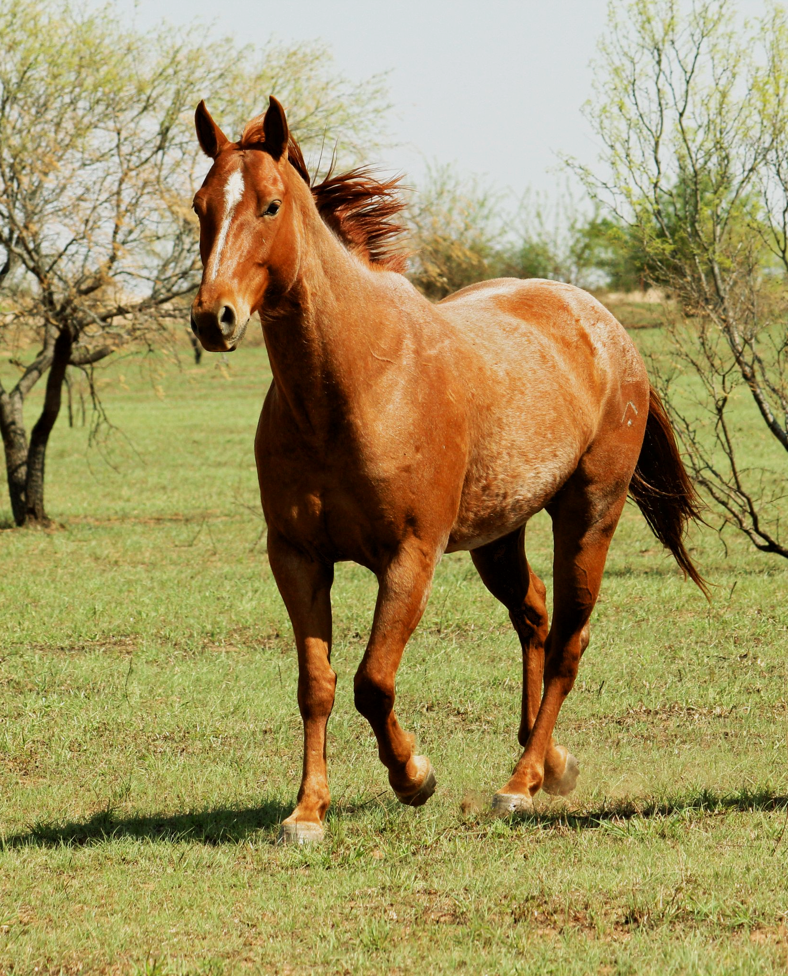
Roan horses have coats that express a red allele (R) and a white allele (W). The genotype of horse individual is a heterozygous RW. These alleles are said to be codominant to one another.

Slide 9
Monohybrid Inheritance
Monohybrid inheritance is the inheritance of characteristics controlled by a single gene.
  Monohybrid inheritance can be illustrated through the use of a Punnett square.
The results from monohybrid crosses show the likelihood of particular alleles being inherited.
  Individuals that inherit at least 1 copy of a dominant allele will express this allele in the phenotype.
  Individuals that inherit both copies of a recessive allele will express this allele in the phenotype.
The likelihood of a particular phenotype being inherited is referred to as a phenotypic ratio.
  Individuals may be homozygous dominant (both alleles in the genotype are dominant).
  Individuals may be heterozygous (1 allele in the genotype is dominant and the other allele is recessive).
  Individuals may be homozygous recessive (both alleles in the genotype are recessive).

Slide 10
An example monohybrid cross using a Punnett square. In this example 2 heterozygotic individuals for seed rotundity are crossed with each other. As the R allele is dominant to the r allele, both homozygous dominant and heterozygous offspring will exhibit round seeds in the phenotype. The homozygous recessive individuals will exhibit wrinkled seeds in the phenotype. The first generation (F₁) of offspring will exhibit these phenotypes in a 3:1 ratio.
GAMETES’ ALLELES
 | R | r
R | RR | Rr
r | Rr | rr
R = ALLELE FOR ROUND SEEDS
r = ALLELE FOR WRINKLED SEEDS
PARENTAL GENOTYPES = BOTH Rr
PARENTAL GAMETES = R AND r
PARENTAL PHENOTYPES = BOTH ROUND SEEDS
F₁ GENERATION = 1x RR, 2x Rr, 1x rr
PHENOTYPIC RATIO = 3 : 1 ROUND SEEDS TO WRINKLED SEEDS
GAMETES’ ALLELES
POSSIBLE F₁ GENOTYPES

Slide 11
Monohybrid crosses can also be used to illustrate codominance. Sickle-cell anemia is a disease that affects the red blood cells. Individuals may possess either H^{N} or H^{S} alleles. As these alleles are both expressed in the phenotype; there are now 3 potential phenotypes: those with normal haemoglobin (H^{N}H^{N}), those with sickle-cell trait (H^{N}H^{S}), or those with sickle-cell anemia (H^{S}H^{S}).
GAMETES’ ALLELES
 | H^{N} | H^{S}
H^{N} | H^{N}H^{N} | H^{N}H^{S}
H^{S} | H^{N}H^{S} | H^{S}H^{S}
H^{N} = ALLELE FOR NORMAL HAEMOGLOBIN
H^{S}= ALLELE FOR SICKLE HAEMOGLOBIN
PARENTAL GENOTYPES = H^{N}H^{S} AND H^{N}H^{S}
PARENTAL GAMETES = H^{N} AND H^{S}
PARENTAL PHENOTYPES = BOTH SICKLE-CELL TRAIT
F₁ GENERATION = 1x H^{N}H^{N}, 2x H^{N}H^{S}, 1x H^{S}H^{S}
PHENOTYPIC RATIO = 1 : 2 : 1 NORMAL HAEMOGLOBIN TO SICKLE-CELL TRAIT TO SICKLE-CELL ANEMIA
GAMETES’ ALLELES
POSSIBLE F₁ GENOTYPES

Slide 12
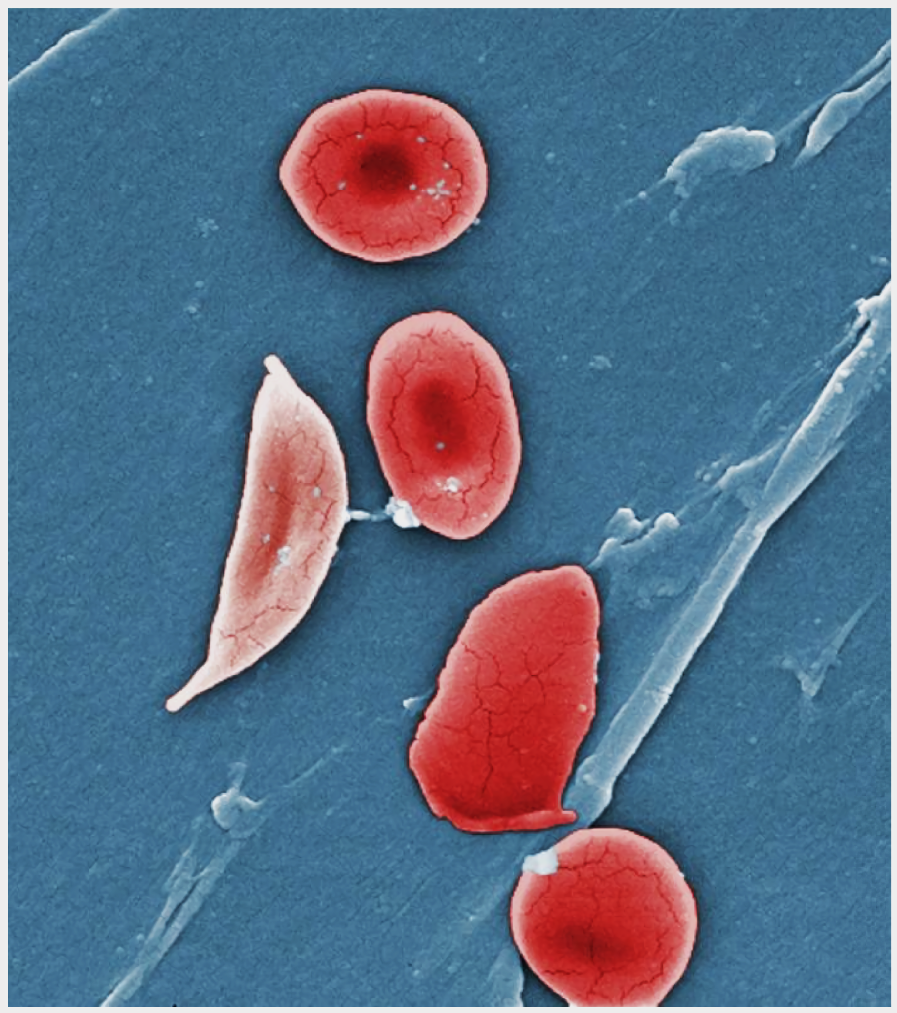
Sickle-cell anemia is a genetic disease characterised by the creation of sickle-shaped red blood cells. These are inefficient at carrying oxygen around the body and result in a number of health conditions.

Slide 13
It is common for a gene to have more than 2 alleles. The ABO blood type system in humans is 1 such example. The gene for blood type has 3 allelic variants (I^{A}, I^{B} and I^{O}). I^{A} and I^{B} are codominant to each other. I^{O} is recessive to both I^{A} and I^{B}. This allows for 4 potential phenotypes: those with type A blood (I^{A}I^{A} or I^{A}I^{O}), those with type B blood (I^{B}I^{B} or I^{B}I^{O} ), those with type AB blood (I^{A}I^{B}), or those with type O blood (I^{O}I^{O}).
GAMETES’ ALLELES
 | I^{B} | I^{O}
I^{A} | I^{A}I^{B} | I^{A}I^{O}
I^{O} | I^{B}I^{O} | I^{O}I^{O}
I^{A} = ALLELE FOR TYPE A BLOOD
I^{B} = ALLELE FOR TYPE B BLOOD
I^{O} = ALLELE FOR TYPE O BLOOD
PARENTAL GENOTYPES = I^{A}I^{O} AND I^{B}I^{O}
PARENTAL GAMETES = I^{A} AND I^{O} (MOTHER), I^{B} AND Iº (FATHER)
PARENTAL PHENOTYPES = MOTHER IS TYPE A, FATHER IS TYPE B
F₁ GENERATION = 1x I^{A}I^{B}, 1x I^{A}I^{O}, 1x I^{B}I^{O}, 1x I^{O}I^{O}
PHENOTYPIC RATIO = 1 : 1 : 1 : 1 TYPE A BLOOD TO TYPE B BLOOD TO TYPE AB BLOOD TO TYPE O BLOOD
GAMETES’ ALLELES
POSSIBLE F₁ GENOTYPES

Slide 14
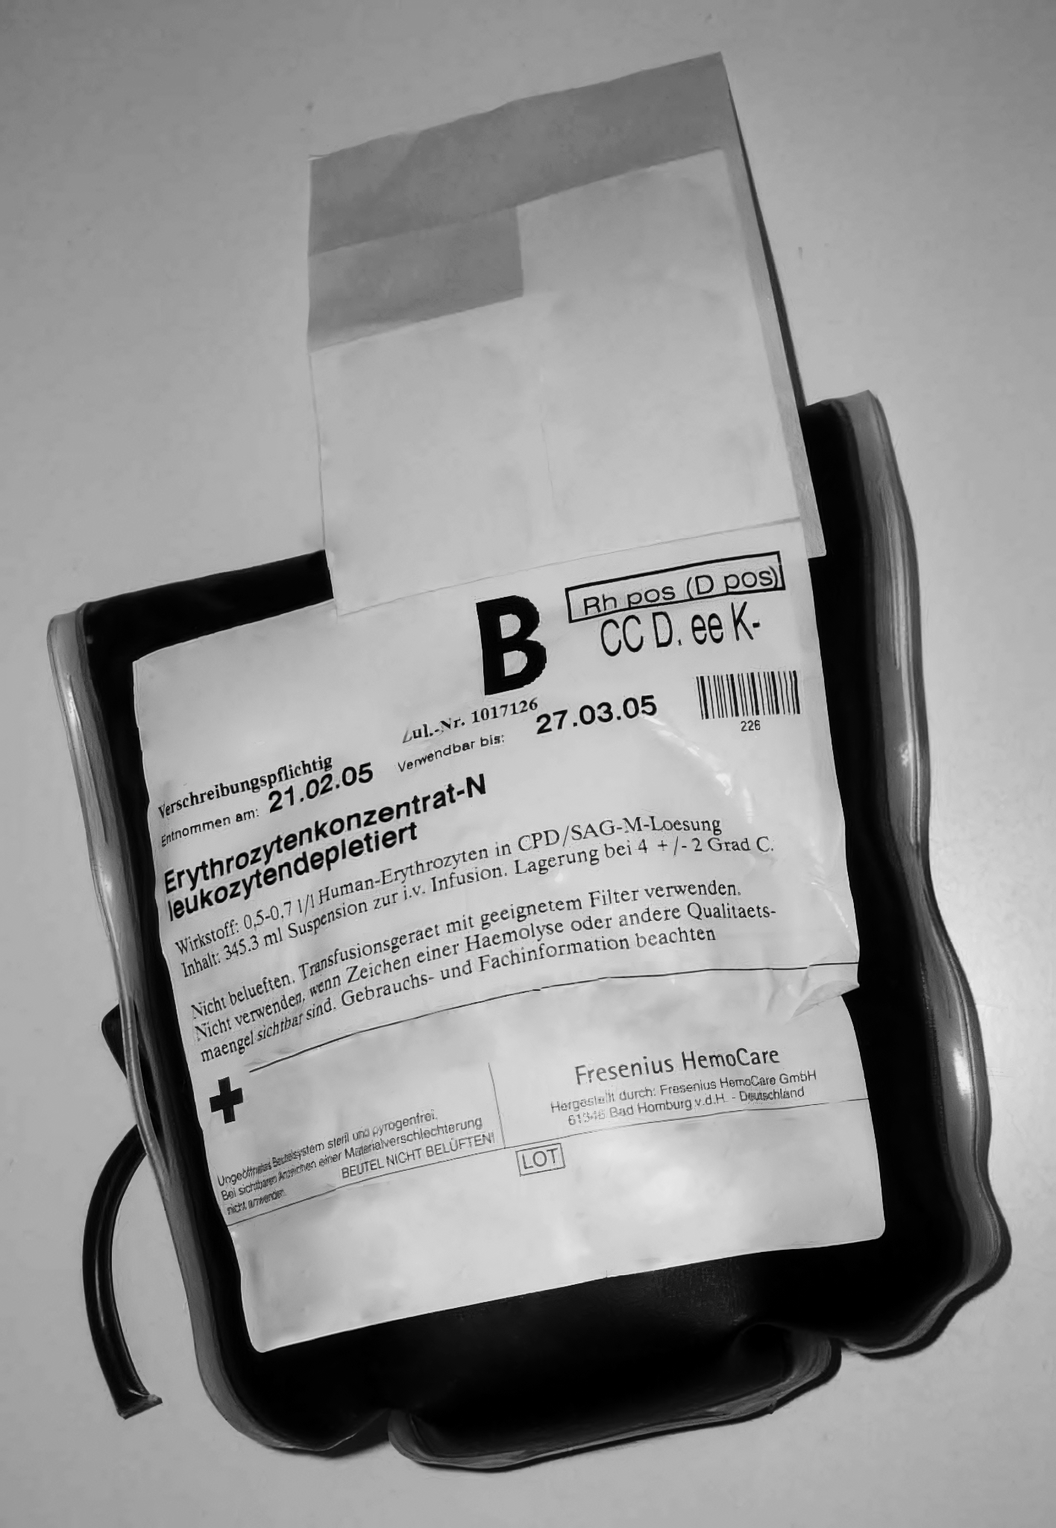
A
B
Red blood cells have 4 major types. Type A, type B and type AB have different combinations of antigens whereas type O has no antigens at all.
AB
O

Slide 15
Dihybrid Inheritance
Dihybrid inheritance is the inheritance of 2 characteristics which are controlled by different genes.
  Each of the genes will contain different alleles.
These 2 genes are unlinked to each other.
  This means that the inheritance of the first gene does not affect the chances of inheriting the second gene.
The independent segregation of unlinked genes results in a greater number of potential gamete combinations.
  There are also a greater number of possible phenotypes.

Slide 16
An example dihybrid cross using a Punnett square. In this example 2 heterozygotic individuals for both seed rotundity and seed colour are crossed with each other. As such, both individuals have the genotype RrYy. As the gametes will contain both genes, there are 4 possible gametic combinations (RY, Ry, rY and ry), leading to 16 potential F₁ genotypes.
GAMETES’ ALLELES
R = ALLELE FOR ROUND SEEDS
r = ALLELE FOR WRINKLED SEEDS
Y = ALLELE FOR YELLOW SEEDS
y = ALLELE FOR GREEN SEEDS
PARENTAL GENOTYPES = BOTH RrYy
PARENTAL GAMETES = RY, Ry, rY AND ry
PARENTAL PHENOTYPES = BOTH ROUND AND YELLOW SEEDS
F₁ GENERATION = 9x ROUND AND YELLOW SEEDS (RRYY, RrYY, RrYy, RRYy), 3x ROUND AND GREEN SEEDS (RRyy, Rryy), 3x WRINKLED AND YELLOW SEEDS (rrYY, rrYy), 1x WRINKLED AND GREEN SEEDS (rryy)
PHENOTYPIC RATIO = 9 : 3 : 3 : 1
 | RY | Ry | rY | ry
RY | RRYY | RRYy | RrYY | RrYy
Ry | RRYy | RRyy | RrYy | Rryy
rY | RrYY | RrYy | rrYY | rrYy
ry | RrYy | Rryy | rrYy | rryy
GAMETES’ ALLELES
POSSIBLE F₁ GENOTYPES

Slide 17
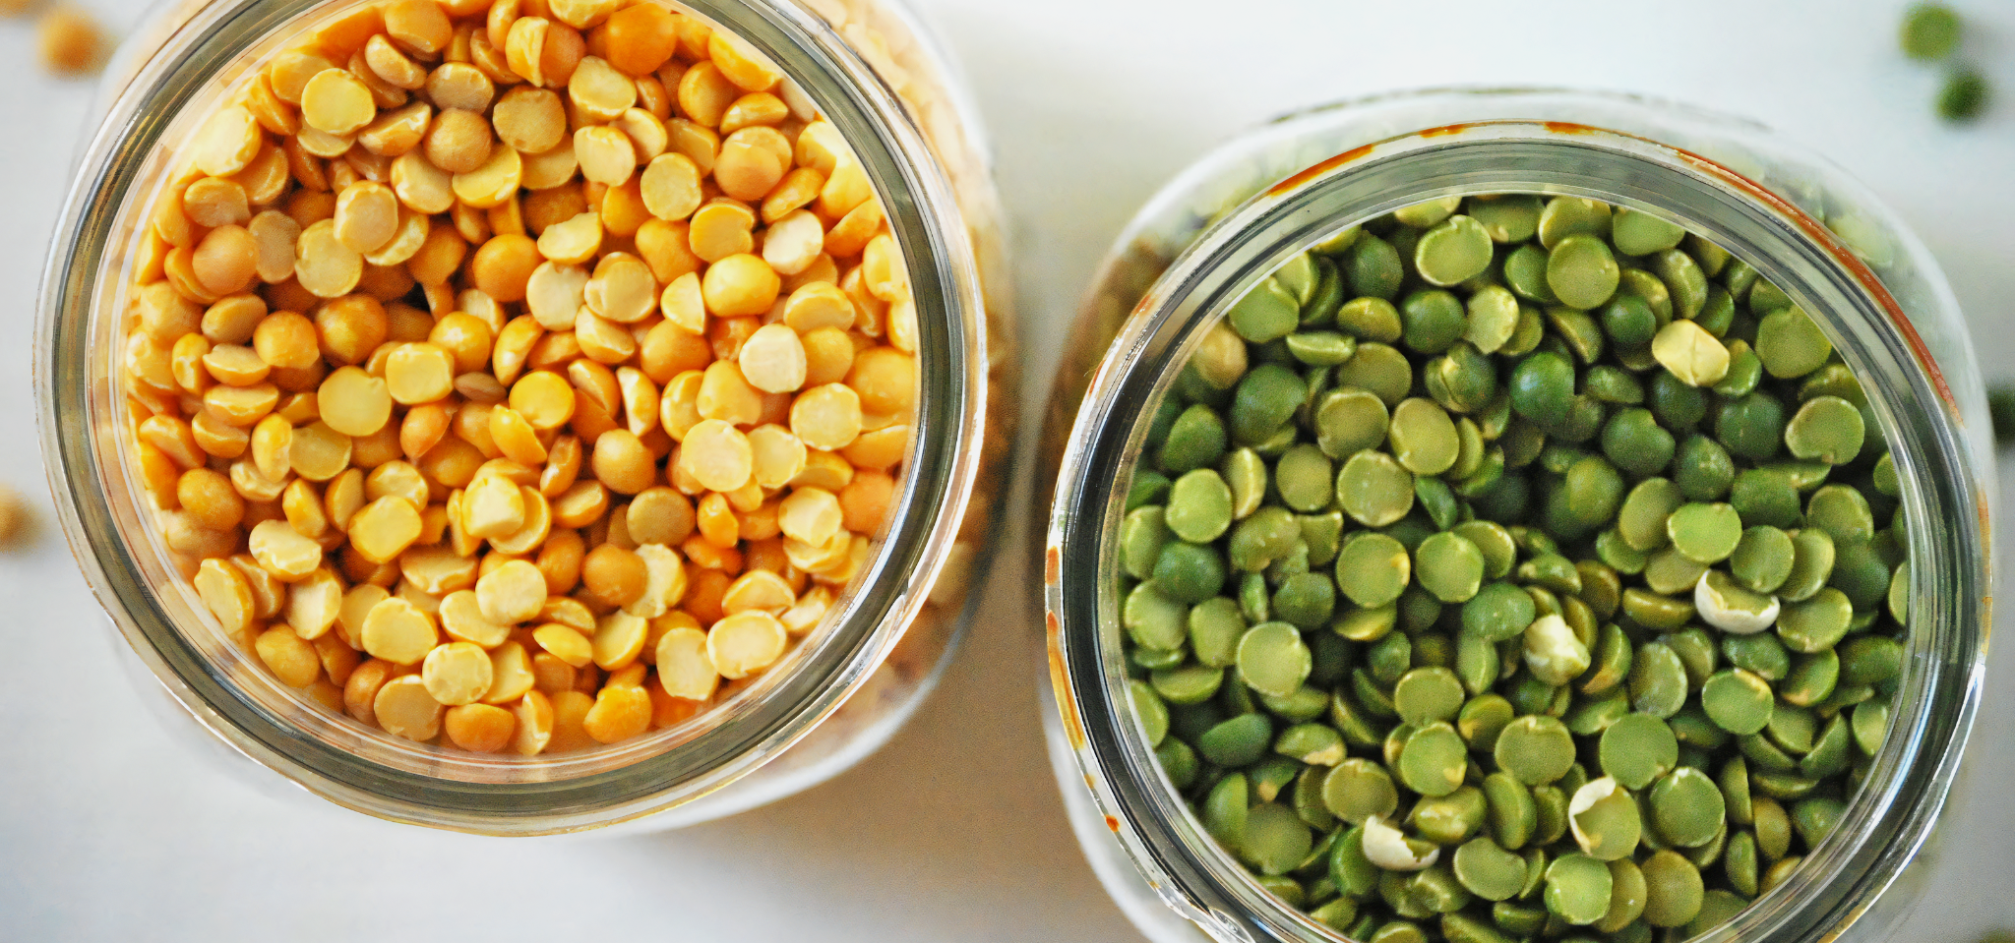
Pea seeds may be yellow or green in colour. They may also be round or wrinkled. These characteristics are determined by the alleles of 2 separate genes.

