Slide 1
AQA A Level Biology
4 - Proteins
Amino Acids and Polypeptides

Slide 2
Proteins
Specification Point 3.1.4.1 - General properties of proteins.
Proteins are made of amino acids.
Two amino acids join together to make a dipeptide.
Several amino acids join together to form a polypeptide.
When two amino acids are joined together, a dipeptide is formed.
When lots of amino acids are joined together, a polypeptide is said to be formed.
AMINO ACID 1
AMINO ACID 2
AMINO ACID 1
AMINO ACID 2
AMINO ACID 3

Slide 3
Amino Acids
Amino acids have the same general formula:
A carboxylic acid (COOH) at one end.
An amine (NH₂) at the other end.
An R group which varies depending on the amino acid.
All living things share the same 20 amino acids.
  Amino acids are found universally in nature.
The basic structure of an amino acid. Every amino acid has a different R group.

Slide 4
The R group of each amino acid is widely variable.

Slide 5
Forming Dipeptides and Polypeptides
Amino acids are linked together in condensation reactions to form peptide bonds.
  During a condensation reaction, a molecule of water (H₂O) is released.
The formation of the simplest dipeptide glycylglycine from two glycine amino acids.

Slide 6
Protein Structure
Proteins exist as large and complex molecules.
Proteins exist in four levels:
  Primary structure.
  Secondary structure.
  Tertiary structure.
  Quaternary structure.
The primary structure of proteins is the sequence of amino acids.
  For example a pentapeptide with the sequence met–phe–pro–lys–gly.
The secondary structure of proteins involves hydrogen bonds.
  Hydrogen bonds between amino acids can cause coiling or folding.
  Proteins can coil into an alpha helix.
  Proteins can fold into a beta pleated sheet.

Slide 7
PRIMARY STRUCTURE
AMINO ACID SEQUENCE
The primary structure of proteins is the sequence of amino acids.
Some simple polypeptides exhibit secondary structures due to hydrogen bond interactions.
Two examples of secondary formations are alpha helices and beta pleated sheets.
BETA SHEET
ALPHA HELIX
SECONDARY STRUCTURE
REGULAR FORMATIONS

Slide 8
Protein Structure
Tertiary structures include more complicated arrangements.
  More bonds can form between different parts of the polypeptide chain.
  These include more hydrogen bonds and ionic bonds.
  Whenever two cysteine molecules are near to each other, disulphide bridges may form.
Quaternary structures involve multiple polypeptide chains.
  Many proteins include more than one polypeptide chain.
  The quaternary structure is often the proteins final, 3D structure.
  Examples include haemoglobin, insulin and collagen.

Slide 9
TERTIARY STRUCTURE
COMPLEX 3D FORMATIONS
Tertiary structures include more complicated arrangements involving more hydrogen bonding, ionic bonding and disulphide bridges.
Shown is a tertiary protein called p13 which is found in the mitochondria.

Slide 10
QUATERNARY STRUCTURE
MULTIPLE POLYPEPTIDE CHAINS
Quaternary proteins consist of multiple polypeptide chains.
Haemoglobin is a vital quaternary protein found in red blood cells.
Haemoglobin in possession of four different polypeptide chains.

Slide 11
Functional Proteins
Many proteins carry out a specific function.
  Enzymes, antibodies and transport proteins are all functional.
Enzymes catalyse reactions.
  Enzymes are mostly spherical and soluble.
  Enzymes are vital for the digestion of larger molecules into smaller ones.
Antibodies are involved in the immune response.
  Antibodies are transported in the blood.
  Antibodies consist of 4 chains, 2 light and 2 heavy.
Transport proteins are found in cell membranes.
  Transport proteins transport molecules and ions across otherwise impermeable membranes.

Slide 12
SUBSTRATE
Enzymes fold in specific ways to create metabolically volatile active sites.
The enzyme amylase is used to break down the polysaccharide starch into maltose.
ENZYME

Slide 13
Antibodies are vital for the immune response.

Slide 14
Structural Proteins
Some proteins are physically strong.
  They provide structure to organs or organ systems.
Structural proteins include keratin and collagen.
Keratin is found in hair and nails.
Collagen is an important component of connective tissue.
  Collagen has 3 polypeptide chains coiled tightly together.
Keratin is a structural protein that is integral to the structure of hair.

Slide 15
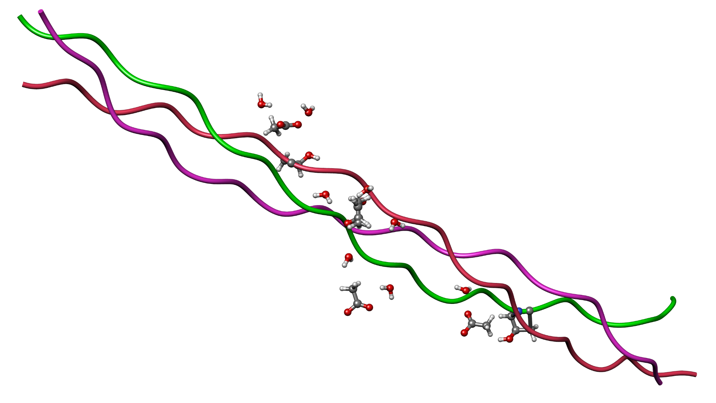
Collagen is comprised of three polypeptide chains which makes it physically strong.
Collagen is a ubiquitous supportive tissue in mammals.

Slide 16
The Biuret Test for Proteins
The test for proteins is called the Biuret test.
The test solution needs to be alkaline.
  This can be achieved with a few drops of sodium hydroxide (NaOH).
A few drops of copper sulphate (CuSO₄) are added.
If a protein is present, a purple colour will form in solution.
If protein is absent, the solution will remain blue.
Biuret test video.
A positive test for proteins sees Biuret reagent change colour from blue to purple.

Slide 17
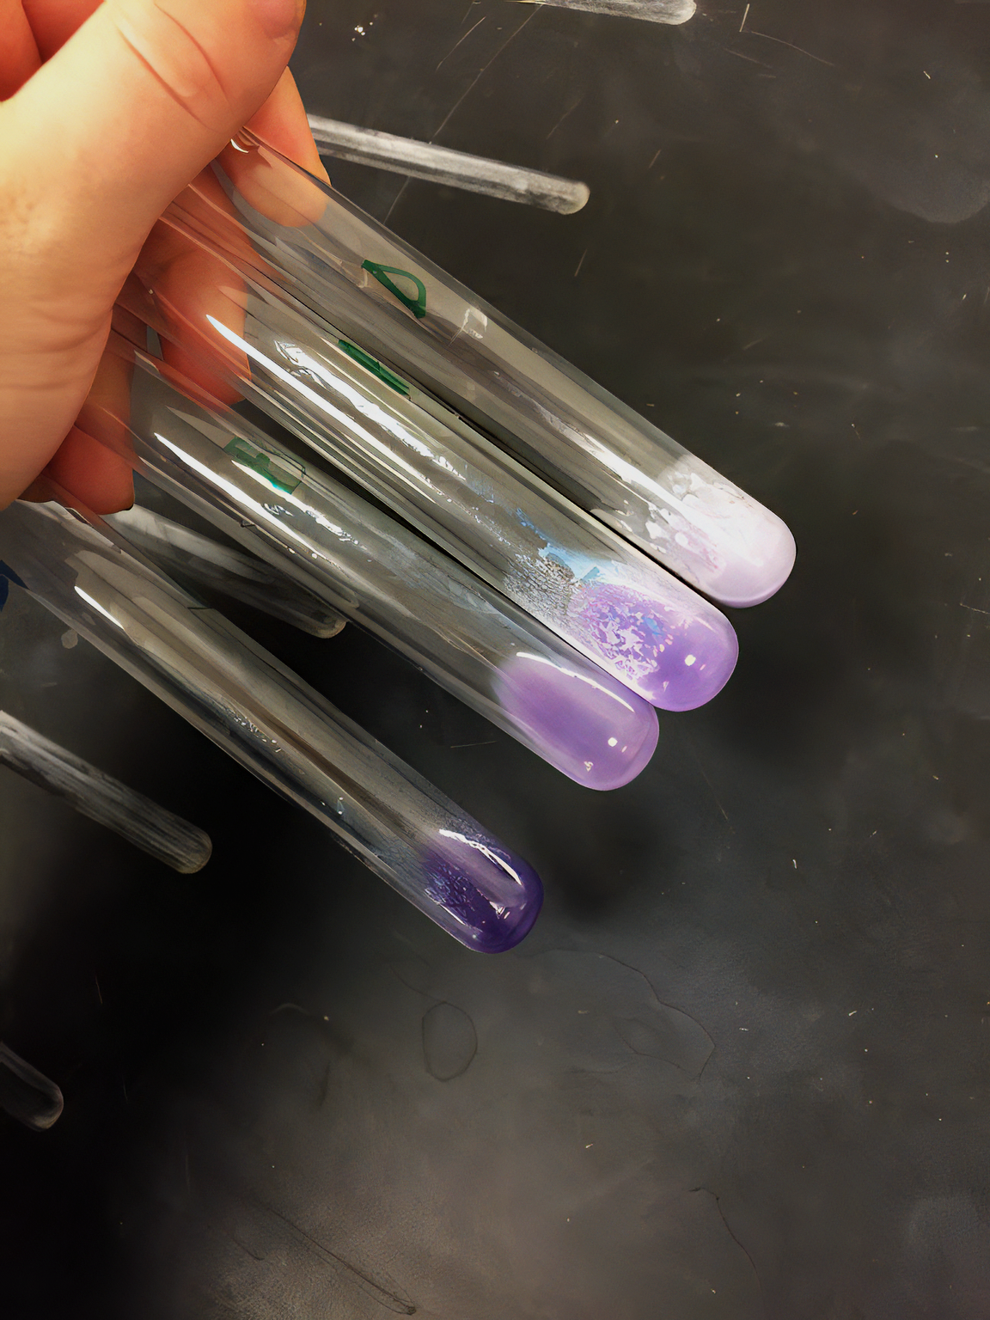
Biuret reagent can be used to estimate the concentration of protein. The higher the concentration, the deeper the purple colour.

