Slide 1
AQA A Level Biology
49 - The Kidneys
Ultrafiltration, Selective Reabsorption and Osmoregulation

Slide 2
The Kidneys
Specification Point 3.6.4.3 - Control of blood water potential.
The kidneys are a pair of excretory organs found in all mammals.
  Blood enters the kidney through the renal artery.
  Blood exits the kidney through the renal vein.
The functional unit of a kidney is called a nephron.
  A nephron is a series of tubules and associated capillaries.
  Each kidney contains in the region of 1 million nephrons.
Blood is filtered by the kidneys.
  Substances are filtered into the nephron through ultrafiltration.
  Useful substances (such as glucose) are reabsorbed into the bloodstream through selective reabsorption.
Waste products are excreted from the body during urination.
  Urea, excess water and excess salts are all removed from the body.
KIDNEY
URETERS
BLADDER

Slide 3
RENAL ARTERY
The kidneys are supplied with unfiltered blood by the renal artery. Substances are filtered out of the blood into the nephron during ultrafiltration.
Some useful substances are absorbed back into the blood by selective reabsorption. The filtered blood is returned back to the body through the renal vein. Waste substances pass from the nephron to the ureter; a tube that leads to the bladder.
RENAL VEIN
URETER
NEPHRON

Slide 4
Ultrafiltration
The renal artery branches into a number of smaller arterioles.
  The afferent arteriole brings blood into the glomerulus.
  The efferent arteriole takes blood away from the glomerulus.
Each arteriole branches further into a ball of capillaries called a glomerulus.
The glomerulus is located inside a cup-like sac called the Bowman’s capsule.
The diameter of the afferent arteriole is larger than the diameter of the efferent arteriole.
  This creates a region of high pressure inside the glomerulus.
Molecules are forced into the Bowman’s capsule due to this high pressure during ultrafiltration.
  Molecules are forced through the capillary endothelium, a basement membrane, and finally the epithelium of the Bowman’s capsule.
EFFERENT
ARTERIOLE
AFFERENT
ARTERIOLE
GLOMERULUS
BOWMAN’S CAPSULE

Slide 5
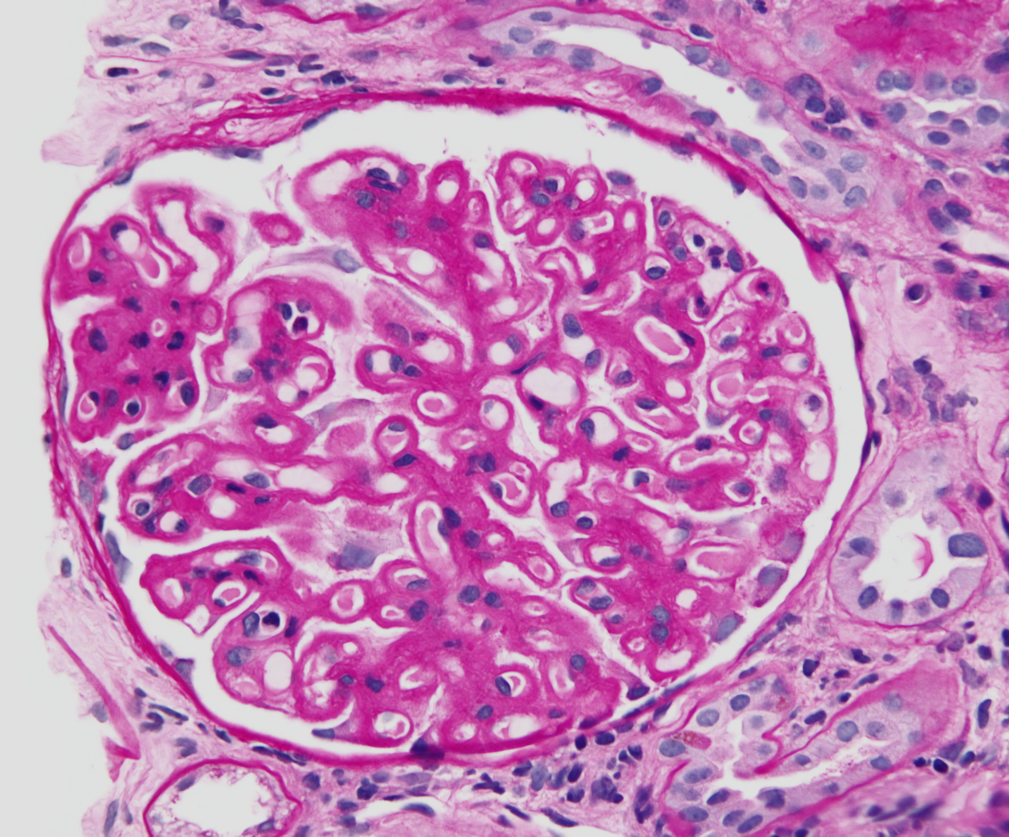
Molecules are forced, due to the high pressure in the glomerulus, to pass into the Bowman’s capsule through the basement membrane.

Slide 6
Selective Reabsorption
Once inside the nephron, molecules flow through a series of folded tubules.
  Molecules initially flow through the proximal convoluted tubule (PCT).
  They then pass through the loop of Henle.
  Finally, molecules travel through the distal convoluted tubule (DCT).
As useful molecules pass through the tubules, they are selectively reabsorbed by a mixture of facilitated diffusion and active transport.
  Glucose is reabsorbed through active transport.
  Salts are reabsorbed through facilitated diffusion.
Water is reabsorbed into the blood capillaries by osmosis.
Waste products are passed to the bladder through the ureter.
A mixture of water, salts and urea makes up urine.
  Urine is stored in the bladder until it is excreted during from the body during urination.

Slide 7
DISTAL CONVOLUTED TUBULE
PROXIMAL CONVOLUTED TUBULE
GLOMERULUS
BOWMAN’S CAPSULE
EFFERENT ARTERIOLE
AFFERENT ARTERIOLE
The structure of a nephron.
DL
COLLECTING DUCT
LOOP OF HENLE
AL

Slide 8
Osmoregulation
Water is essential for a variety of metabolic processes.
  It is therefore important that the water potential (ψ) of the blood is maintained.
The maintenance of blood ψ is referred to as osmoregulation.
Osmoregulation is an example of negative feedback:
  If the ψ of the blood is too low (dehydration), the amount of water reabsorbed by the nephron increases.
    This means that less water will be excreted from the bladder, so the urine will appear more concentrated.
  If the ψ of the blood is too high (overhydration), the amount of water reabsorbed by the nephron decreases.
    This means that more water will be excreted from the bladder, so the urine will appear more dilute.
Water is primarily reabsorbed at the DCT, the loop of Henle and the collecting duct.

Slide 9
The Loop of Henle
The loop of Henle is located in the middle of the kidney.
  The middle of the kidney is referred to as the medulla.
The loop of Henle is made up of 2 sections, called limbs.
  The ascending limb (AL).
  The descending limb (DL).
The loop of Henle uses countercurrent multiplication to regulate the ψ of the blood.
  This is a mechanism that uses energy to create a concentration gradient.
At the top of the AL, sodium ions (Na⁺) are actively transported out of the nephron, into the medulla.
  The AL is permeable to Na⁺, but impermeable to water.
  This means that water will remain inside the AL.
  A low ψ is now present in the medulla.

Slide 10
The Loop of Henle
The ψ of the medulla falls below the ψ of the DL of the loop of Henle.
  The DL is permeable to water but impermeable to Na⁺.
Water moves out of the DL into the medulla by osmosis.
  This water is reabsorbed back into the bloodstream through capillaries.
At the bottom of the AL, Na⁺ moves out into the medulla by facilitated diffusion.
  This further lowers the ψ in the medulla.
Water may also leave the DCT by osmosis.
  This water is also reabsorbed back into the bloodstream.
The low ψ of the medulla may also impact the collecting duct.
  The collecting duct is the final section of the nephron.
  Water may leave the collecting duct by osmosis.

Slide 11
1.
Na⁺
Na⁺
DESCENDING LIMB
Na⁺
ASCENDING LIMB
2.
H₂O
H₂O
H₂O
Na⁺
Na⁺
1. Na⁺ is actively transported out of the top of the AL, into the medulla. This creates a low ψ in the medulla.
2. Water leaves the DL by osmosis.
3. At the bottom of the AL, Na⁺ leaves by facilitated diffusion.
Na⁺
3.

Slide 12
ADH
Blood ψ is measured by cells called osmoreceptors.
  Osmoreceptors are found in a region of the brain called the hypothalamus.
If the ψ of the blood decreases, water will leave osmoreceptors by osmosis.
  The osmoreceptor will shrink as a consequence.
The shrinking of the osmoreceptor will signal the pituitary gland to secrete a hormone called antidiuretic hormone (ADH).
  The pituitary gland is a bean-shaped gland found at the base of the brain.
  ADH travels to the kidneys and binds to cells in the collecting duct.
The binding of ADH signals a group of channel proteins, called aquaporins, to fuse with the membrane of the collecting duct.
  Aquaporins allow water to be absorbed from the collecting duct, into the bloodstream, by osmosis.
  The collecting duct is now said to be more permeable to water.
Increased levels of ADH in the bloodstream lead to increased reabsorption of water.
  High concentrations of ADH lead to a small volume of concentrated urine.
  Lower concentrations of ADH lead to a larger volume of more diluted urine.

Slide 13
The pituitary gland is found at the base of the brain.
The pituitary gland is responsible for secreting ADH, a hormone that controls the water potential of the blood.
This control mechanism is called osmoregulation.

Slide 14
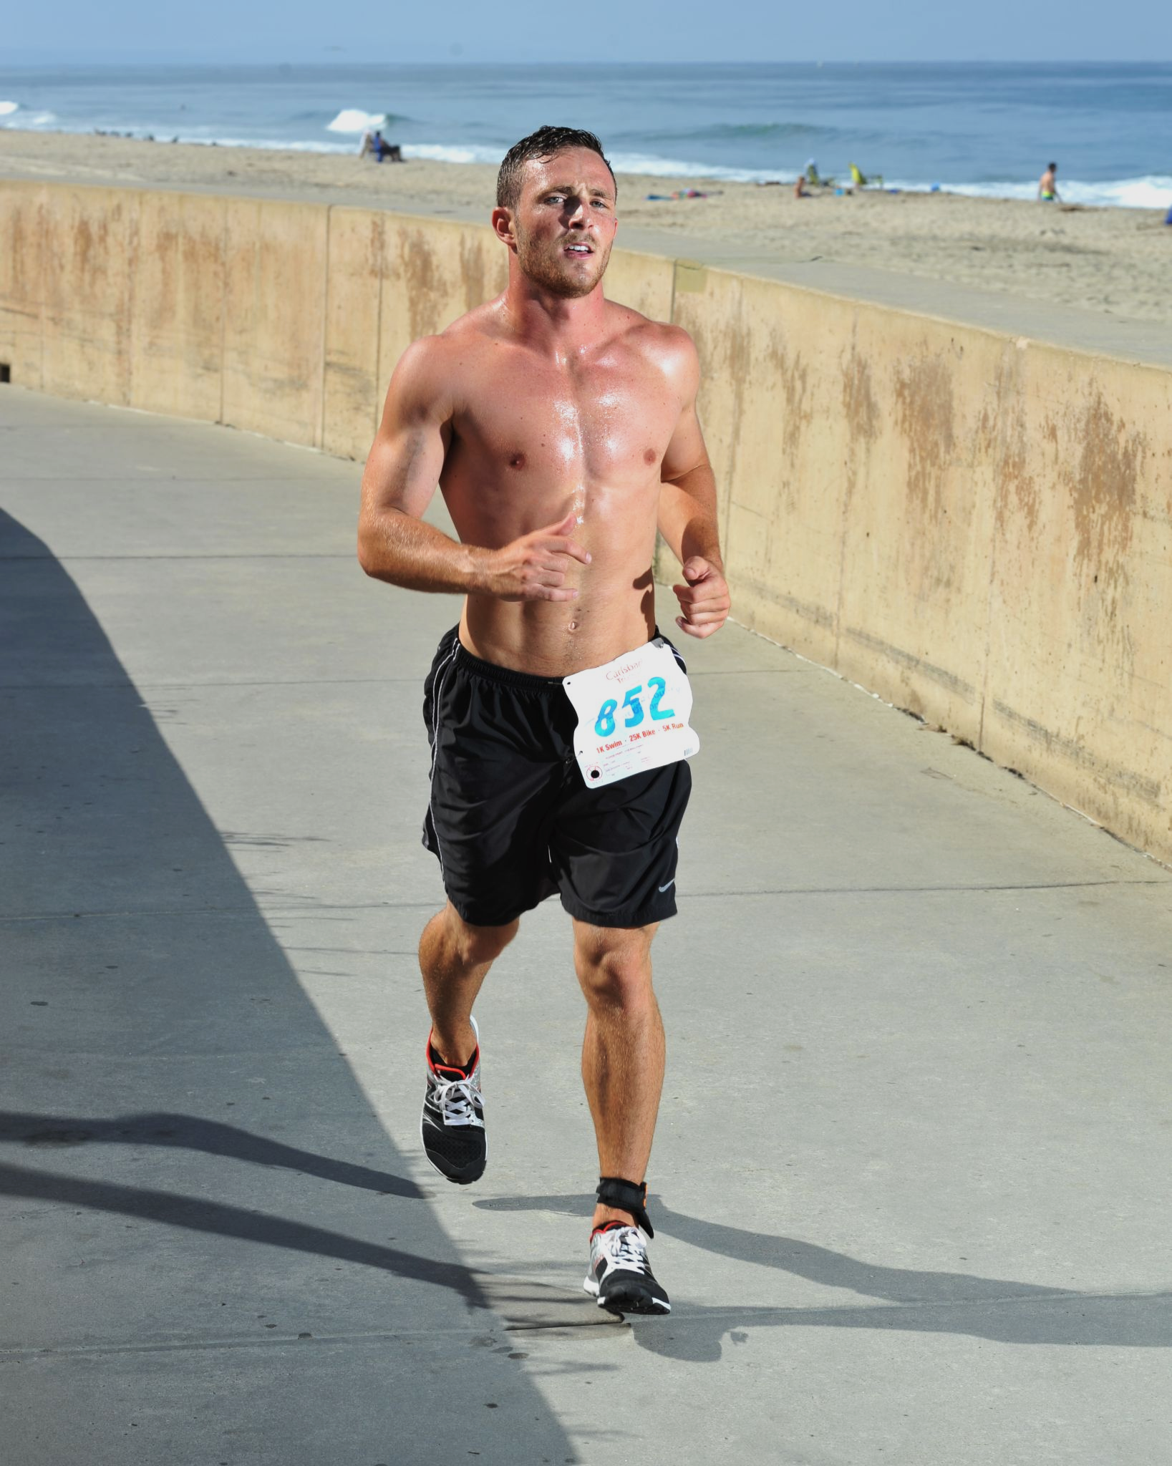
Exercise will result in water loss from sweating.
More ADH will be released to ensure more water is reabsorbed back into the body.
The volume of urine will decrease and the concentration of urine will increase.

Slide 15
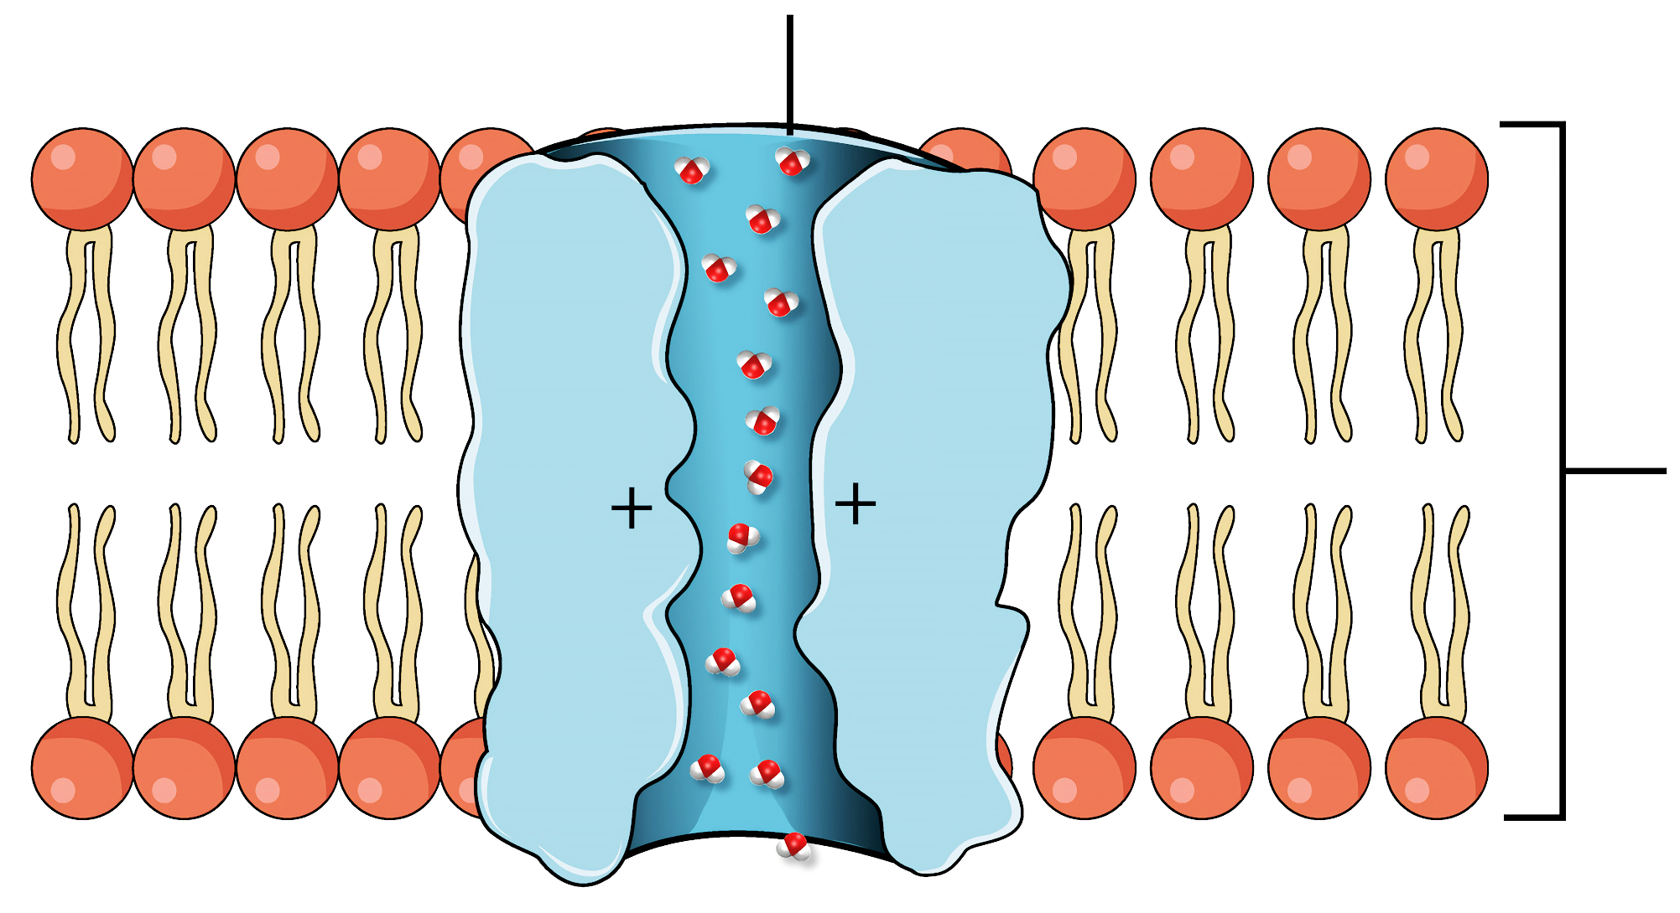
Aquaporins are channel proteins that can fuse with the cell membrane of the collecting duct when signalled to by ADH. Higher concentrations of ADH will lead to more aquaporins migrating to the cell membrane, and thus more reabsorption of water into the bloodstream.
AQUAPORIN
CELL MEMBRANE OF COLLECTING DUCT

Slide 16
Osmoregulation is one of many mechanisms that is achieved through negative feedback.
DEHYDRATION
OVERHYDRATION
OSMORECEPTORS IN BRAIN DETECT CHANGE
OSMORECEPTORS IN BRAIN DETECT CHANGE
CONDITIONS RETURNED TO NORMAL THROUGH NEGATIVE FEEDBACK
MORE ADH SECRETED BY THE PITUITARY GLAND
LESS ADH SECRETED BY THE PITUITARY GLAND
MORE WATER REABSORBED BY OSMOSIS IN COLLECTING DUCT
LESS WATER REABSORBED BY OSMOSIS IN COLLECTING DUCT

