Slide 1
AQA A Level Biology
48 - Controlling Blood Glucose
Insulin, Glucagon and Diabetes

Slide 2
Blood Glucose
Specification Point 3.6.4.2 - Control of blood glucose concentration.
Glucose is a substrate that is required for respiration.
  The concentration of glucose in cells must be kept relatively constant.
  A blood glucose concentration between 4.0 and 5.9 mmol/L is considered normal.
The concentration of glucose in the bloodstream rises after eating carbohydrates.
  Carbohydrates are broken down into simpler sugars during digestion.
The concentration of glucose in the bloodstream falls after exercise.
  This is because glucose is respired to release energy.
  Glucose is broken down to generate ATP for muscular contractions.

Slide 3

After eating a meal, blood glucose levels will rise.
This is most obvious when eating carbohydrate-rich foods, such as bread.

Slide 4
MEAL 1
MEAL 3
MEAL 2
After eating a meal, blood glucose levels will rise.
This is most obvious when eating carbohydrate-rich foods, such as bread.
BLOOD GLUCOSE CONCENTRATION →
TIME OF DAY →

Slide 5

After exercise, blood glucose levels will fall.
Glucose is respired to regenerate ATP.

Slide 6
Insulin and Glucagon
Blood glucose is controlled by a pair of antagonistic hormones, insulin and glucagon.
  Antagonistic hormones have opposite actions on the body.
  Both hormones are secreted by groups of cells in the pancreas, called islets of Langerhans.
When blood glucose is too high, insulin is secreted.
  Insulin is secreted by beta (β) cells in the islets of Langerhans.
  Insulin acts on muscle and liver cells.
  Glucose is taken up by these cells, and the concentration of glucose in the blood falls.
When blood glucose is too low, glucagon is secreted.
  Glucagon is secreted by alpha (α) cells in the islets of Langerhans.
  Glucagon acts on liver cells.
  Glucose is released from these cells, and the concentration of glucose in the blood rises.

Slide 7
STOMACH
LIVER
The pancreas is responsible for the production of both insulin and glucagon. These hormones are produced in cell clusters called islets of Langerhans. Insulin is produced by β cells and glucagon is produced by α cells.
GALLBLADDER
SMALL INTESTINE
PANCREAS

Slide 8
Insulin
Insulin binds to receptors on the surface of muscle and liver cells.
Insulin increases the permeability of muscle cells to glucose.
  This means that the cell will take up more glucose than usual.
Insulin also activates a series of enzymes in both muscle and liver cells that convert glucose into glycogen.
  This process is referred to as glycogenesis.
Insulin also increases the rate of respiration in muscle cells.
  This means that glucose is broken down more quickly.
These actions combine to significantly reduce the concentration of glucose in the bloodstream.
GLYCOGENESIS
GLUCOSE
GLYCOGEN

Slide 9
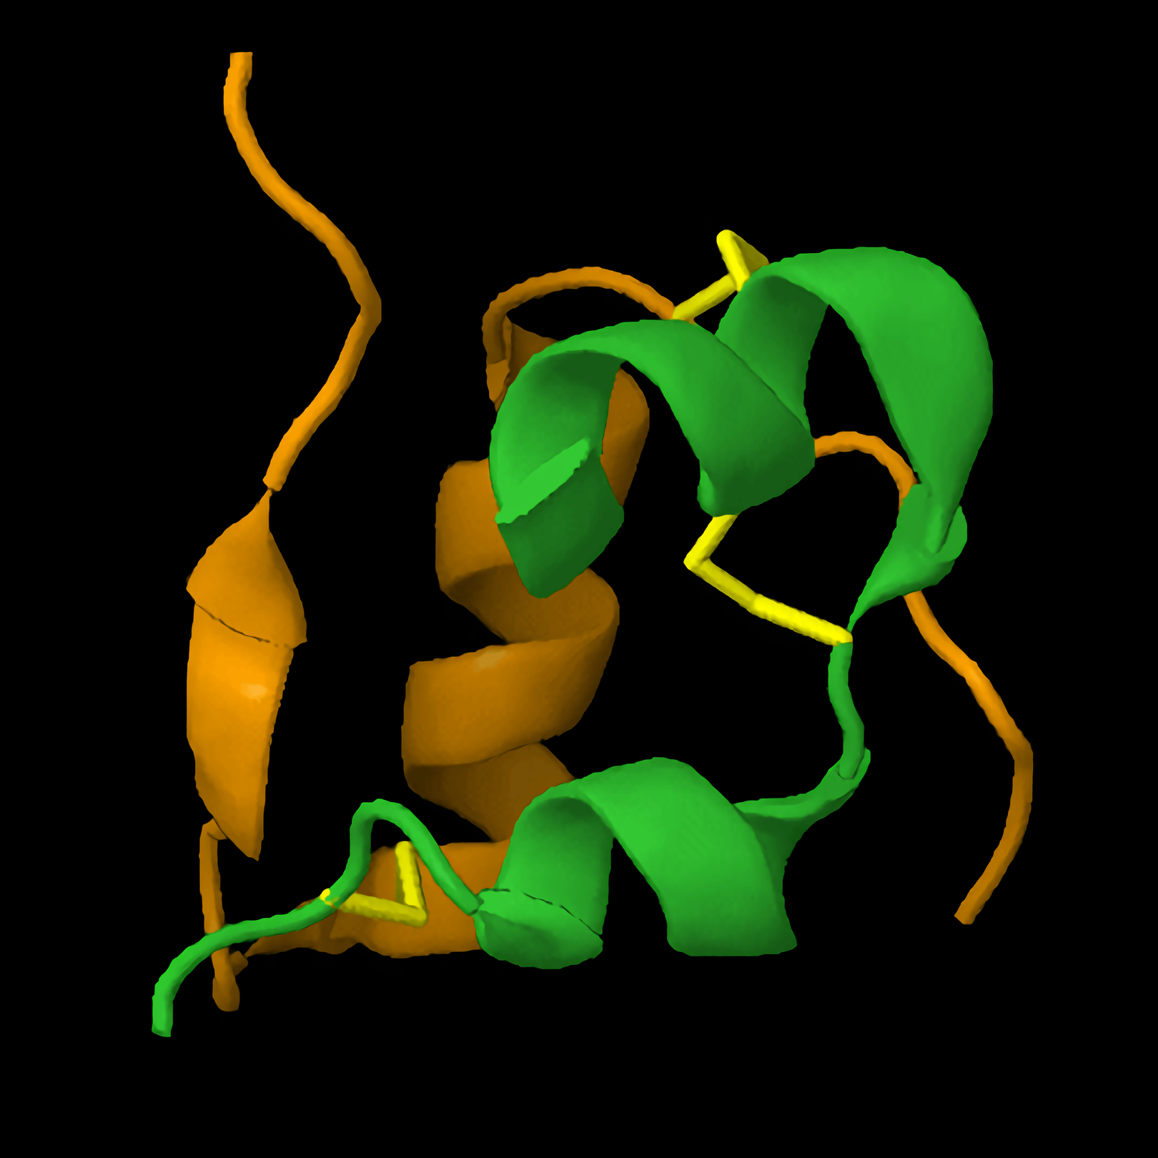
Insulin is a protein-based hormone responsible for the the conversion of glucose into the polysaccharide glycogen.
This process is referred to as glycogenesis.

Slide 10
Glucagon
Glucagon binds to receptors on the surface of liver cells.
  This activates a series of enzymes that break down glycogen into glucose.
  This process is referred to as glycogenolysis.
Glucagon is also responsible for the generation of glucose from non-carbohydrate substrates.
  Glycerol and amino acids can be combined to form glucose in the liver.
  This process is referred to as gluconeogenesis.
These actions combine to significantly increase the concentration of glucose in the bloodstream.
As hormones, both insulin and glucagon have widespread effects over cells in the body.
  This is in contrast to electrical impulses, which offer far more localised effects.
GLYCOGENOLYSIS
GLUCONEOGENESIS
GLYCOGEN
GLUCOSE
GLYCEROL + AA
GLUCOSE

Slide 11
Blood Glucose and Negative Feedback
The control of blood glucose is an example of negative feedback.
If blood glucose is too high:
  Receptors in the pancreas detect this increase in blood glucose.
  β cells begin secreting insulin and α cells stop secreting glucagon.
  Insulin binds to receptors on liver and muscle cells.
  Glycogenesis is activated and glucose is converted to glycogen - blood glucose levels fall.
If blood glucose is too low:
  Receptors in the pancreas detect this decrease in blood glucose.
  β cells stop secreting insulin and α cells begin secreting glucagon.
  Glucagon binds to receptors on liver cells.
  Glycogenolysis and gluconeogenesis are both activated and more glucose is produced - blood glucose levels rise.

Slide 12
The regulation of blood glucose is achieved through negative feedback.
BLOOD GLUCOSE RISES
BLOOD GLUCOSE FALLS
CELLS IN PANCREAS DETECT CHANGE
CELLS IN PANCREAS DETECT CHANGE
CONDITIONS RETURNED TO NORMAL THROUGH NEGATIVE FEEDBACK
INSULIN SECRETED FROM PANCREAS
GLUCAGON SECRETED FROM PANCREAS
BLOOD GLUCOSE FALLS
BLOOD GLUCOSE RISES

Slide 13
GLUT4
Glucose is transported into cells using channel proteins.
  Channel proteins allow glucose to cross the cell membrane.
GLUT4 is a channel protein found in skeletal and cardiac tissue.
  At low concentrations of insulin, GLUT4 is packaged inside vesicles in the cytoplasm.
When insulin binds to receptors on the cell membrane, GLUT4 is activated.
  GLUT4 migrates to and fuses with the cell membrane.
  Glucose can then be transported into the cell through the GLUT4 protein.
INSULIN
GLUCOSE
GLUT4
INSULIN RECEPTOR

Slide 14
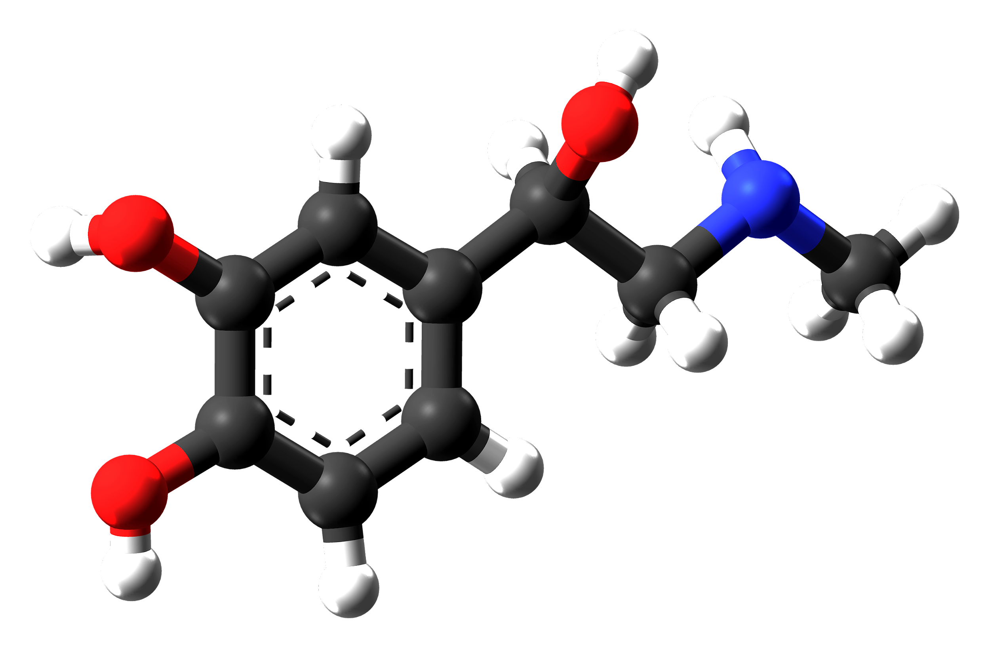
Adrenaline
Adrenaline is a hormone that is secreted by the adrenal glands.
  The adrenal glands are located just above the kidneys.
Adrenaline is secreted when blood glucose is low.
  Adrenaline activates glycogenolysis and inhibits glycogenesis.
  It also stimulates the secretion of glucagon.
  These processes increase the amount of glucose available to muscles for respiration.
Adrenaline is also secreted during times of stress.
  Adrenaline is primarily responsible for the ‘fight or flight’ response in mammals.
The molecular structure of the protein hormone adrenaline.

Slide 15
The Second Messenger System
Adrenaline and glucagon cannot enter the cell.
  They instead bind to receptors on the outside of the cell membrane.
The binding of these hormones activates an enzyme on the inside of the cell membrane.
  This enzyme is called adenyl cyclase.
Adenyl cyclase produces a chemical, referred to as a second messenger.
  Adenyl cyclase converts ATP into the chemical cyclic AMP (cAMP).
The second messenger (cAMP) then activates a series of other enzymes that break down glycogen into glucose.
  This is referred to as an enzyme cascade.
  In this instance, cAMP activates an enzyme called protein kinase A which drives the cascade.

Slide 16
ADRENALINE
The second messenger system, illustrated using the hormone adrenaline.
The activation of adenyl cyclase leads to the formation of the second messenger cAMP. This drives a series of cascade reactions and will eventually lead to glycogenolysis.
ADENYL CYCLASE
RECEPTOR
ATP → cAMP
PROTEIN KINASE A
ENZYME CASCADE

Slide 17
Diabetes
Diabetes is a disease characterised by an inability to control blood glucose.
  Blood glucose levels may rise to dangerous levels as a result.
Type I diabetes is an autoimmune disease that usually manifests itself during childhood.
  Type I diabetes is sometimes referred to as early-onset diabetes.
  During Type I diabetes, the immune system attacks β cells in the pancreas.
  β cells are destroyed and little or no insulin is produced by the body.
  Type I diabetes is usually treated with regular injections of insulin.
  Insulin therapy ensures that blood glucose levels remain relatively constant.
Type II diabetes is primarily a disease of lifestyle that manifests itself much later in life.
  Type II diabetes is sometimes referred to as late-onset diabetes.
  Type II diabetes is associated with a diet high in sugar and saturated fats, as well as a lack of exercise.
  Type II diabetes occurs when cells in the liver do not respond to insulin.
  As a result, blood glucose levels rise above normal.
  Type II diabetes can usually be controlled by adopting a balanced diet and regular aerobic exercise.
  If these interventions are unsuccessful, insulin injections may be required.

Slide 18
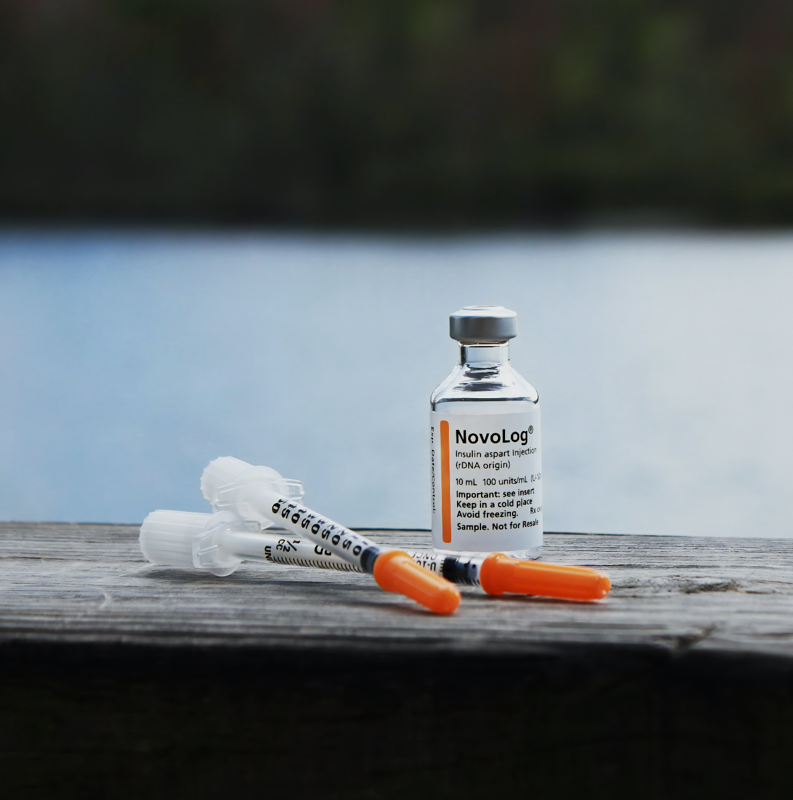
Type I diabetes can usually be controlled using regular injections of insulin.

Slide 19
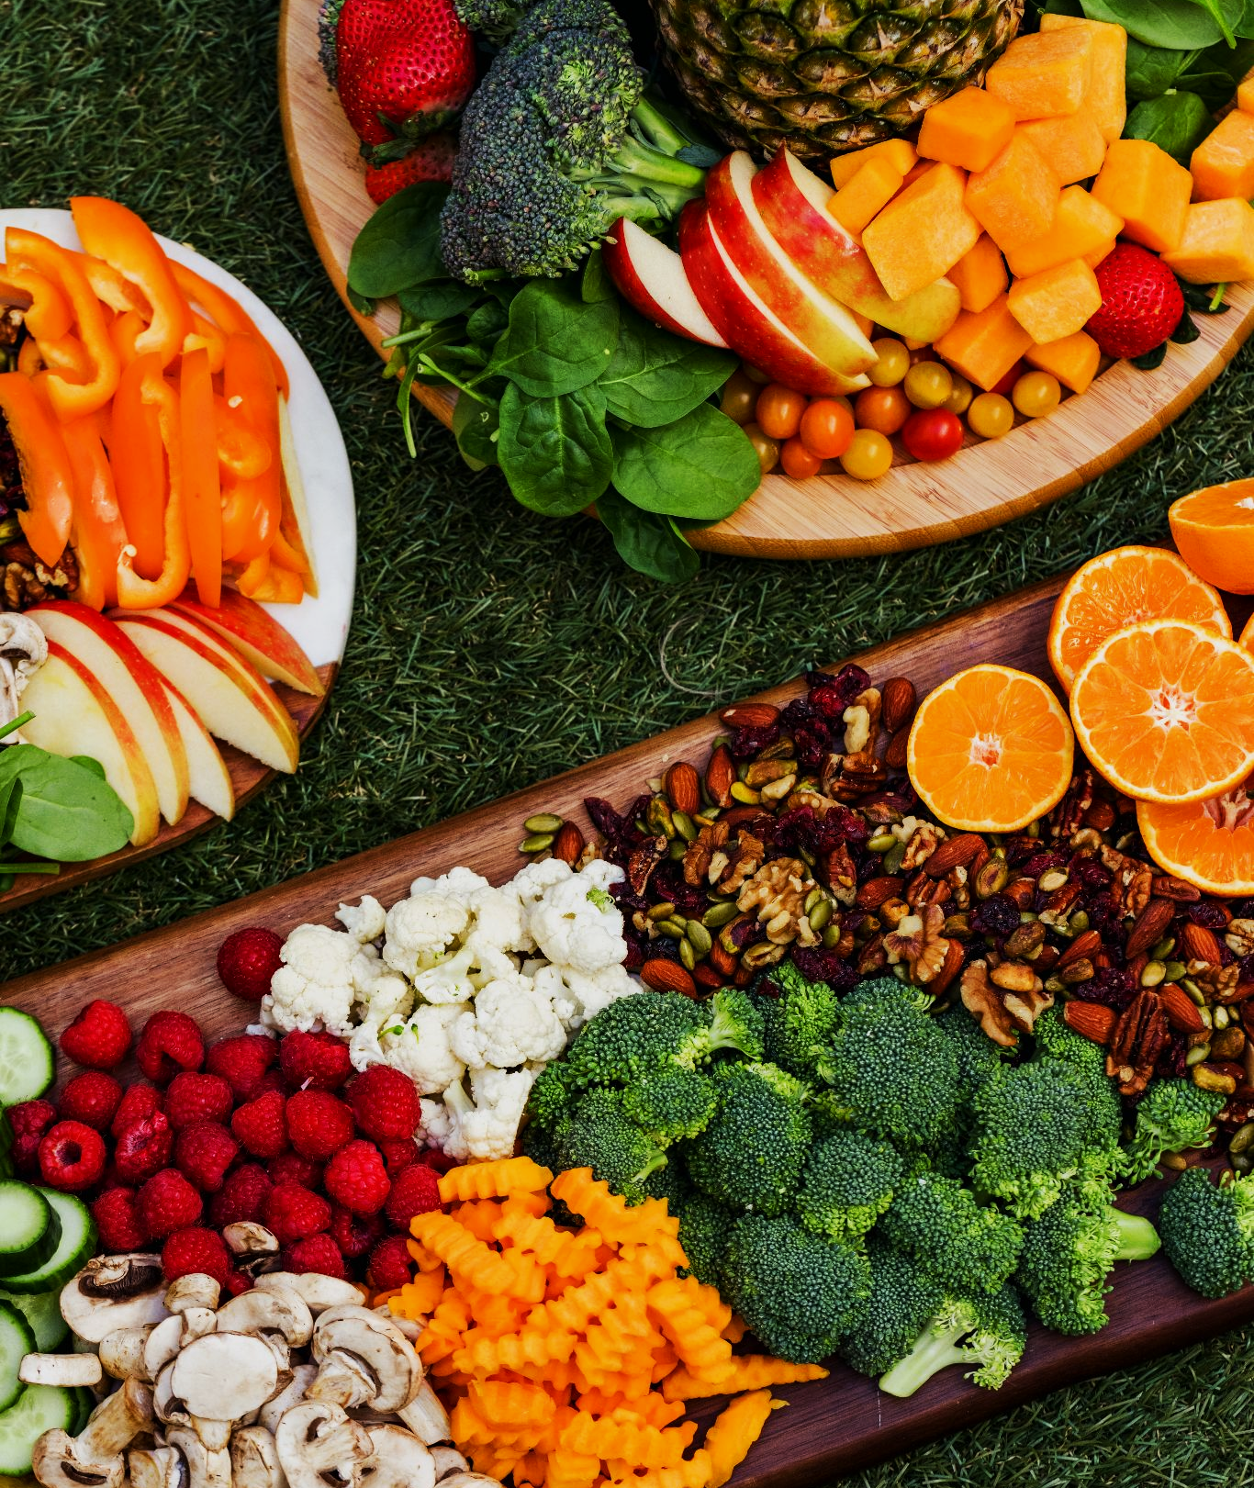
Adopting a balanced diet, rich in fruit and vegetables, is encouraged for those suffering with Type II diabetes.

Slide 20
Responding to Type II Diabetes
In the UK, Type II diabetes is becoming increasingly common.
  It is currently estimated that there are 4.7 million people in the UK living with Type II diabetes.
  That number is expected to rise to 5.5 million by 2030.
The rise in Type II diabetes has been linked to an increasingly unhealthy diet and sedentary lifestyle.
  Type II diabetes is associated with a number of additional health problems, such as cardiovascular disease, kidney failure and blindness.
Health advisors suggest individuals eat a diet low in sugar, salt and saturated fats.
  They also suggest sufferers undertake regular exercise and lose weight if necessary.
The food industry has faced much criticism for advertising unhealthy food.
  Some food companies have attempted to make their food healthier by reducing the sugar and salt contents of their products.
  Food companies are likely to continue marketing ‘junk’ products as long as it is financially viable to do so.

Slide 21
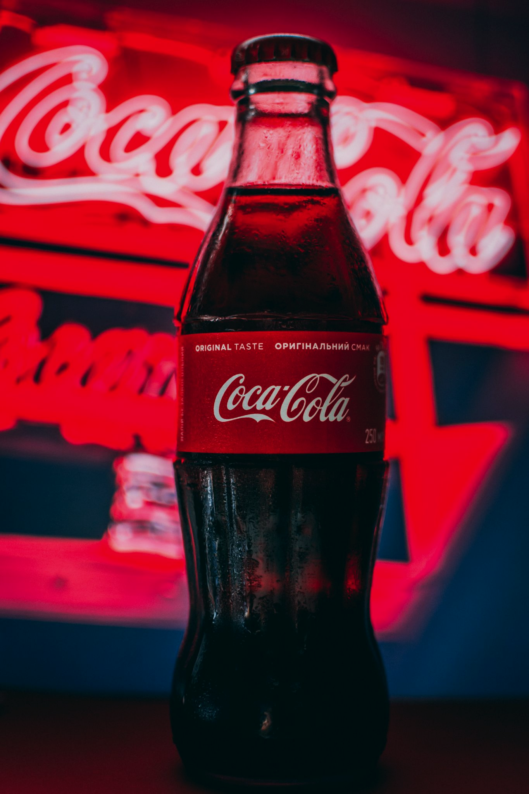
Carbonated sweet beverages such as Coca Cola are very high in sugar.
This 250 ml bottle contains 27 g (over 7 teaspoons) of sugar.

Slide 22
30
25
In the Western world, including the US and the UK, diabetes is becoming increasingly common and a major health concern.
Governments and food manufacturers are under pressure to ensure food is healthier, as well as encouraging people to exercise regularly.
20
% OF AMERICANS WITH DIABETES →
15
10
5
0
1960
1970
1980
1990
2000
2010
2020

Slide 23
Testing Urine for Glucose
Practical 11: Production of a dilution series of a glucose solution and use of colorimetric techniques to produce a calibration curve with which to identify the concentration of glucose in an unknown ‘urine’ sample.
A high concentration of glucose in the urine is a key indicator for diabetes.
  Generally, the concentration of glucose in the urine of non-diabetics is negligible.
Create a dilution series of glucose using distilled water.
  5 test tubes with concentrations ranging from 0 to 10 mM/L would be appropriate.
Add 2 cm³ of Benedict’s reagent to these test tubes and place in a water bath for 5 minutes at 85°C.
  As the Benedict’s reagent is reduced, it will change from a blue solution to a brick-red precipitate.
Zero a colorimeter using a cuvette with distilled water.
  The colorimeter should be set to the red filter.
  Place each of the samples into a cuvette and measure the absorbance using the colorimeter.

Slide 24
Testing Urine for Glucose
Create a calibration curve, plotting the absorbance against the known glucose concentrations.
Repeat the experiment using a test tube with an unknown concentration of glucose.
  Use the calibration curve to ascertain the concentration of this sample.
  Glucose calibration curve practical video.
An exemplar calibration curve. As glucose concentration increases, the amount of colour absorbed by the Benedict’s reagent also increases.
COLOUR ABSORBANCE (AU) →
GLUCOSE CONCENTRATION (mM/L) →

