Slide 1
AQA A Level Biology
46 - Muscles
Myofibrils, Sliding Filament Theory, Phosphocreatine

Slide 2
Types of Muscle
Specification Point 3.6.2.3 - Skeletal muscles are stimulated to contract by nerves and act as effectors.
There are 3 main types of muscle in the human body:
  Skeletal muscle moves bones by contracting and relaxing in response to impulses from the nervous system.
  Smooth muscle contract and relax the walls of internal organs automatically, without nervous control.
  Cardiac muscle is a specific form of smooth muscle found only in the walls of the heart.
Skeletal muscle is attached to bones by tendons.
  Bones are attached to each other by ligaments.
Skeletal muscles work in antagonistic pairs.
  As one muscle contracts (the agonist), the other muscle relaxes (the antagonist).
  This is most obvious in the arm, where the biceps and triceps will combine to move bones at the elbow joint.

Slide 3
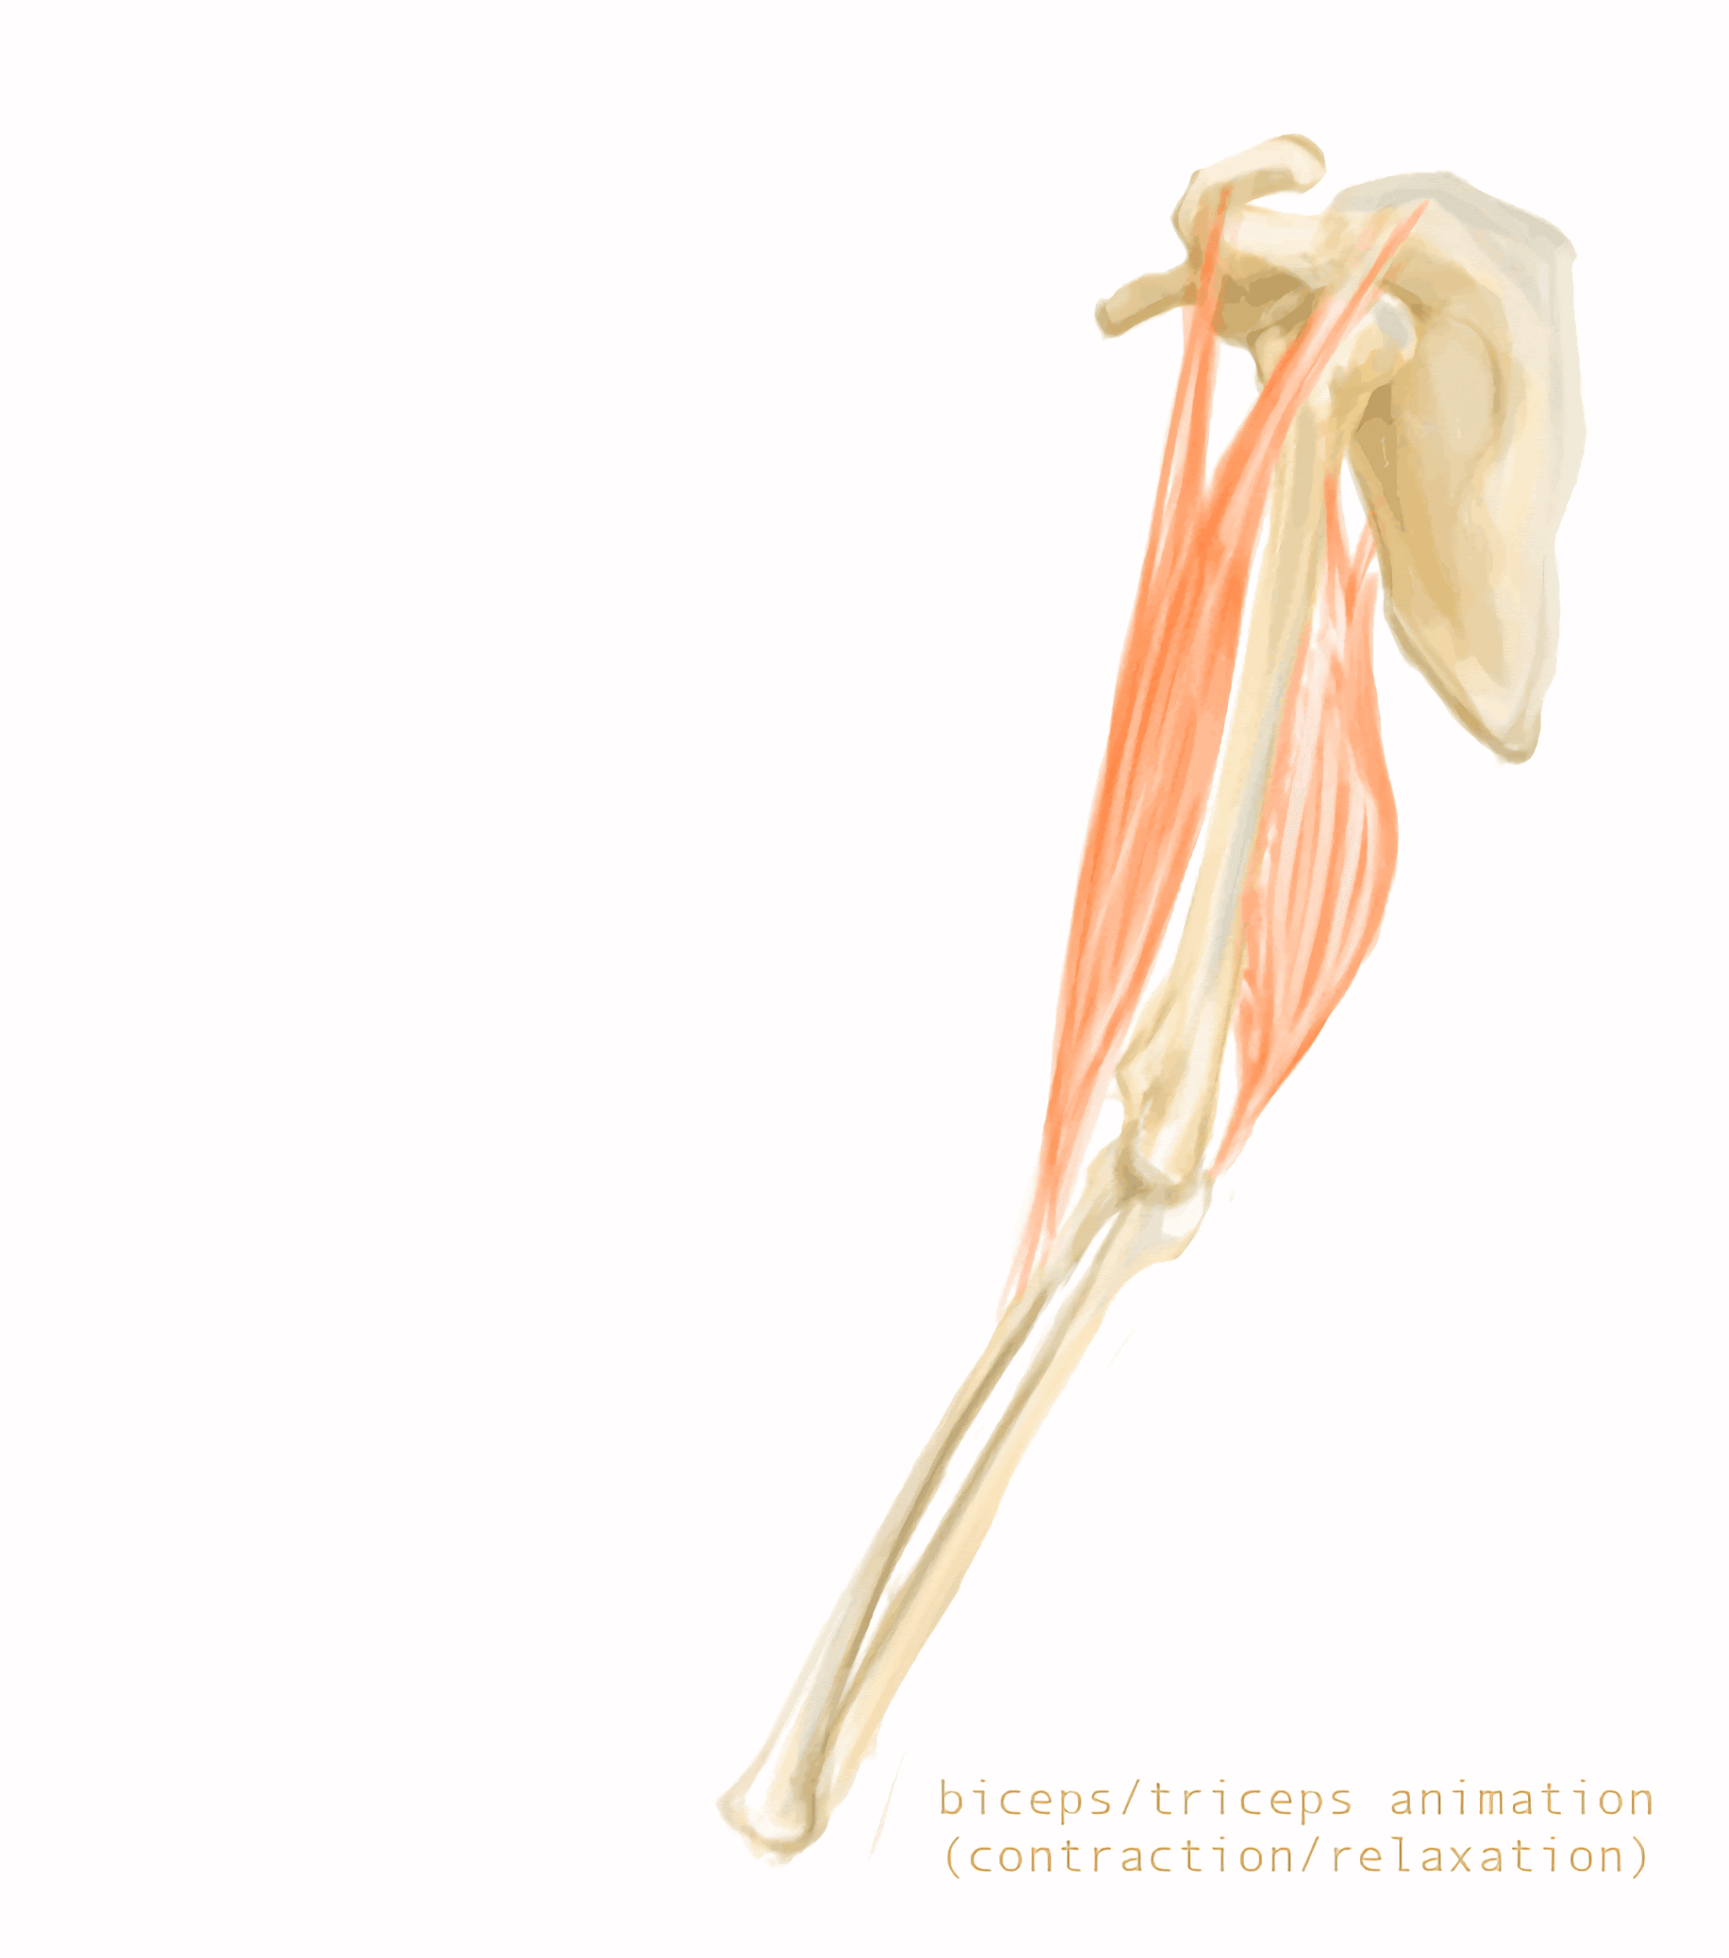
The biceps and the triceps work in an antagonistic pair. As the biceps (top) contract, the triceps (bottom) relax and vice versa.
This allows bones in the arm to be levered into position using the elbow joint.

Slide 4
Skeletal Muscle
Skeletal muscles are made up of muscle fibres.
  The cell membrane of these muscle fibres is referred to as the sarcolemma.
  The cytoplasm of muscle fibres is referred to as the sarcoplasm.
The sarcolemma of muscle fibres will fold inwards to form transverse (T) tubules.
  T-tubules are conductive. They help to carry electrical impulses throughout the sarcoplasm.
Every skeletal muscle cell contains a sarcoplasmic reticulum.
  The sarcoplasmic reticulum is a network of sac-like membranes that is found in the sarcoplasm.
  Its structure is very similar to the endoplasmic reticulum.
  The sarcoplasmic reticulum stores calcium ions (Ca²⁺); these are important for muscle contraction.
Skeletal muscle fibres are multinucleate.
  This means each cell may contain several nuclei.
  They are also rich in mitochondria for ATP production.
Muscle fibres are arranged in a myofibril.
  A myofibril is a rod-shaped structure that is dense in several different proteins.

Slide 5
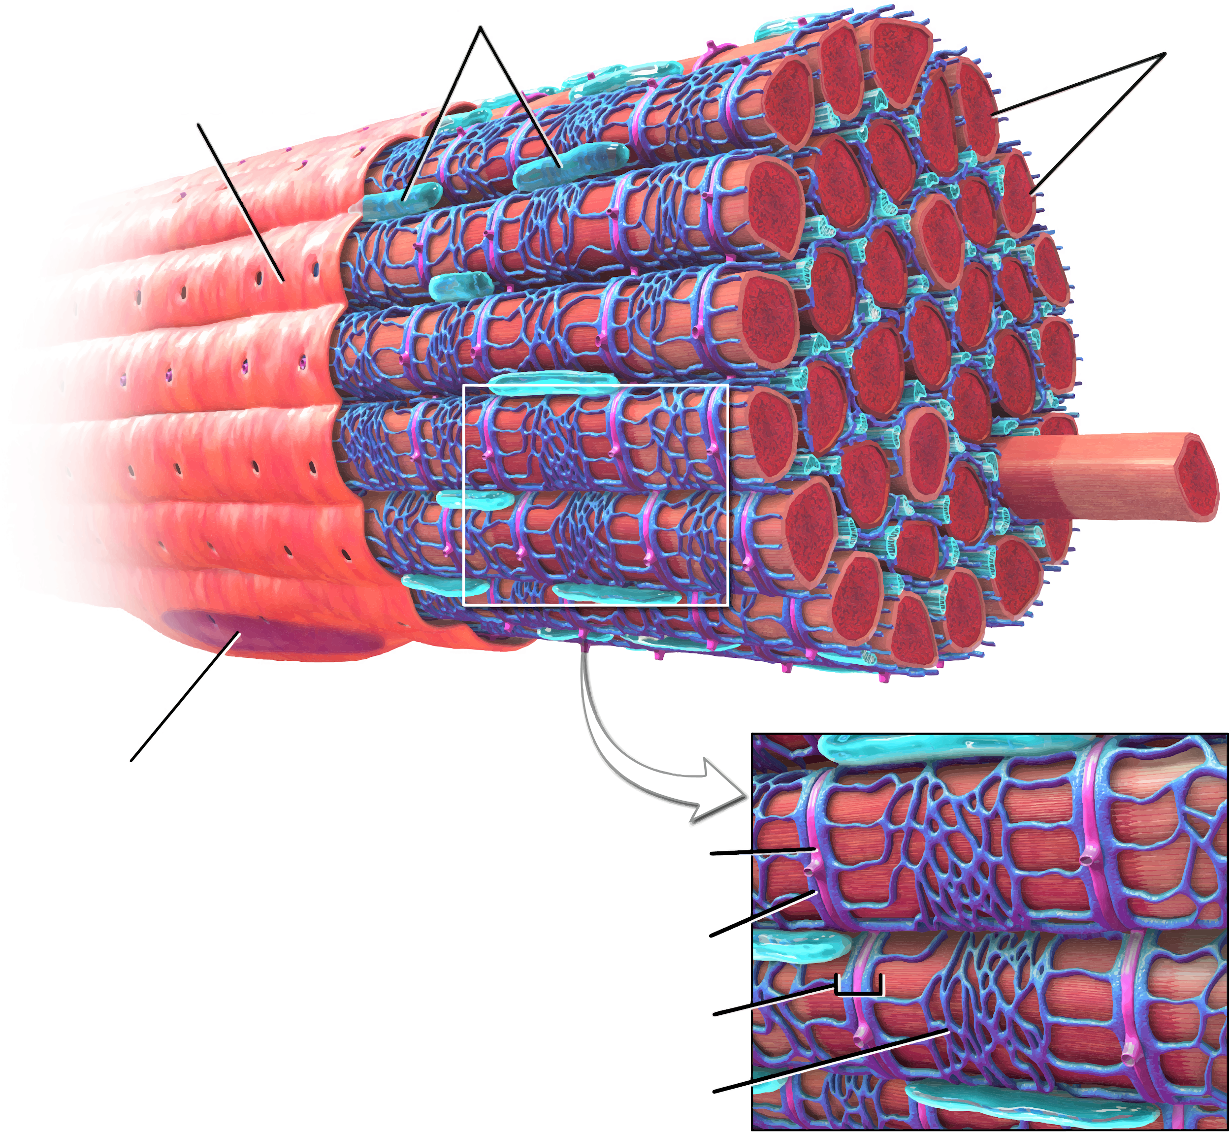
MITOCHONDRIA
MYOFIBRILS
SARCOLEMMA
Skeletal muscle fibres are striated. Each myofibril is surrounded by the sarcolemma.
T-tubules help to conduct electrical impulses throughout the muscle fibre.
NUCLEUS
T-TUBULE
TERMINAL CISTERNA
TRIAD
SARCOPLASMIC RETICULUM

Slide 6
Myofibrils
Myofibrils are composed of protein.
  These proteins are arranged into myofilaments.
Thick myofilaments are made up of the protein myosin.
  Myosin appears as a dark band under an electron microscope.
    The dark band is referred to as the A-band.
Thin myofilaments are made up of the protein actin.
  Actin appears as a light band under an electron microscope.
    The light band is referred to as the I-band.
A myofibril is made up of sarcomeres.
  A sarcomere is considered the smallest functional unit of skeletal muscle.
  The end of a sarcomere is referred to as the Z-line.
  The middle of a sarcomere is referred to as the M-line.

Slide 7
Myofibrils are made up of short units called sarcomeres. Each sarcomere is divided into a number of zones. The I-band contains only actin, the A-band contains a mixture of actin and myosin and the H-zone contains only myosin.
Z-LINE
Z-LINE
A-BAND
H-ZONE
M-LINE
I-BAND
I-BAND

Slide 8
Sliding Filament Theory
Muscle contraction is explained by sliding filament theory.
  Actin and myosin filament slide over one another to contract and shorten the sarcomere.
During a muscle contraction:
  The I-band (composed of actin) gets shorter.
  The H-zone (composed of myosin) gets shorter.
  The A-band (a mixture of actin and myosin) stays the same length.
ACTIN
MYOSIN
RELAXED SARCOMERE
CONTRACTED SARCOMERE

Slide 9
The Actin-Myosin Binding Site
The mechanism of muscle contraction requires actin and myosin to slide over one another.
  Each myosin filament contains a globular head.
  The myosin head attaches to a binding site on the actin filament.
    This is referred to as an actin-myosin binding site.
At rest, the actin-myosin binding site is blocked by another protein called tropomyosin.
  Tropomyosin is a similar shape to myosin, so can fit into the actin-myosin binding site.
  This means that the muscle cannot contract without the tropomyosin first being removed from the actin-myosin binding site.
Tropomyosin is itself associated with another protein called troponin.

Slide 10
ACTIN FILAMENT
TROPONIN
TROPOMYOSIN
At rest, the protein tropomyosin blocks the actin-myosin binding site. This prevents the myosin head from binding to the actin, and consequently prevents muscle contraction.
MYOSIN HEAD
MYOSIN FILAMENT

Slide 11
Muscle Contraction
An action potential arrives from a motor neurone.
  The neurotransmitter acetylcholine is released at the neuromuscular junction.
Acetylcholine binds to receptors on the sarcolemma.
  This leads to its depolarisation as sodium ions (Na⁺) diffuse down T-tubules.
The wave of depolarisation reaches the sarcoplasmic reticulum.
  In response, the sarcoplasmic reticulum releases calcium ions (Ca²⁺) into the sarcoplasm.
Ca²⁺ ions bind to troponin.
  This causes a change in the shape of the troponin molecule.
The troponin pulls on tropomyosin.
  This releases it from the actin-myosin binding site.
The myosin head is now free to bind to the actin-myosin binding site.
  This forms an actin-myosin cross bridge.

Slide 12
Muscle Contraction
A molecule of ATP is hydrolysed during the power stroke.
  Ca²⁺ activates an enzyme called ATP hydrolase which breaks down ATP into ADP and P_{i}.
  The energy released from this reaction is used to rotate the myosin head during the power stroke.
  This pulls the actin filament over the myosin filament, leading to a muscle contraction.
Another molecule of ATP is hydrolysed to break the cross bridge.
  The myosin head detaches from the actin-myosin binding site.
  The myosin head returns to its default position and may bind to another binding site further up the filament.
Muscle contraction stops when Ca²⁺ leaves the sarcoplasm.
  When the motor neurone ceases to depolarise the muscle, Ca²⁺ is actively transported back into the sarcoplasmic reticulum.
  Tropomyosin returns to block the actin-myosin binding site and the muscle returns to its resting state.
  Muscle contraction video.

Slide 13
The sliding filament theory of muscle contraction.
ATP → ADP + P_{i}
ATP → ADP + P_{i}
AT REST, THE ACTIN-MYOSIN BINDING SITE IS BLOCKED BY A COMPLEX CONTAINING TROPOMYOSIN AND TROPONIN
Ca²⁺ IS RELEASED FROM THE SARCOPLASMIC RETICULUM AND BINDS THE COMPLEX. THIS RELEASES THE COMPLEX FROM THE BINDING SITE
THE MYOSIN HEAD BINDS TO THE BINDING SITE ON THE ACTIN
THE MYOSIN HEAD ROTATES DURING THE POWER STROKE, PULLING THE ACTIN FILAMENT OVER THE MYOSIN. THIS REQUIRES THE HYDROLYSIS OF A MOLECULE OF ATP
ANOTHER MOLECULE OF ATP IS HYDROLYSED TO ALLOW THE MYOSIN HEAD TO DETACH FROM THE BINDING SITE

Slide 14
Generating ATP for Muscles
Lots of ATP is required for muscle contraction.
There are 3 main ways to generate ATP:
  Aerobic respiration.
  Anaerobic respiration.
  The ATP-phosphocreatine system.
During aerobic respiration, lots of ATP is generated.
  There are several stages to aerobic respiration, culminating with oxidative phosphorylation.
  Aerobic respiration requires oxygen (O₂) and is slow to deliver ATP.
  It is most suitable for long periods of low-intensity exercise, such as walking.
Anaerobic respiration produces ATP more quickly and does not require O₂.
  It does however lead to the production of lactic acid, which builds up in the muscle and can lead to cramping.
  It is most suitable for short bursts of high-intensity exercise, such as sprinting.
The ATP-phosphocreatine system produces ATP almost instantaneously.
  ADP can be phosphorylated using a phosphate group provided by phosphocreatine (PCr).
  This is a single-step reaction, so ATP is produced very quickly.
  The cell’s supply of PCr runs out after a few seconds, so the system is most useful for very short bursts of very intense exercise, such as a tennis serve.

Slide 15

Jogging, a low-intensity exercise, primarily uses aerobic respiration to generate lots of ATP.

Slide 16
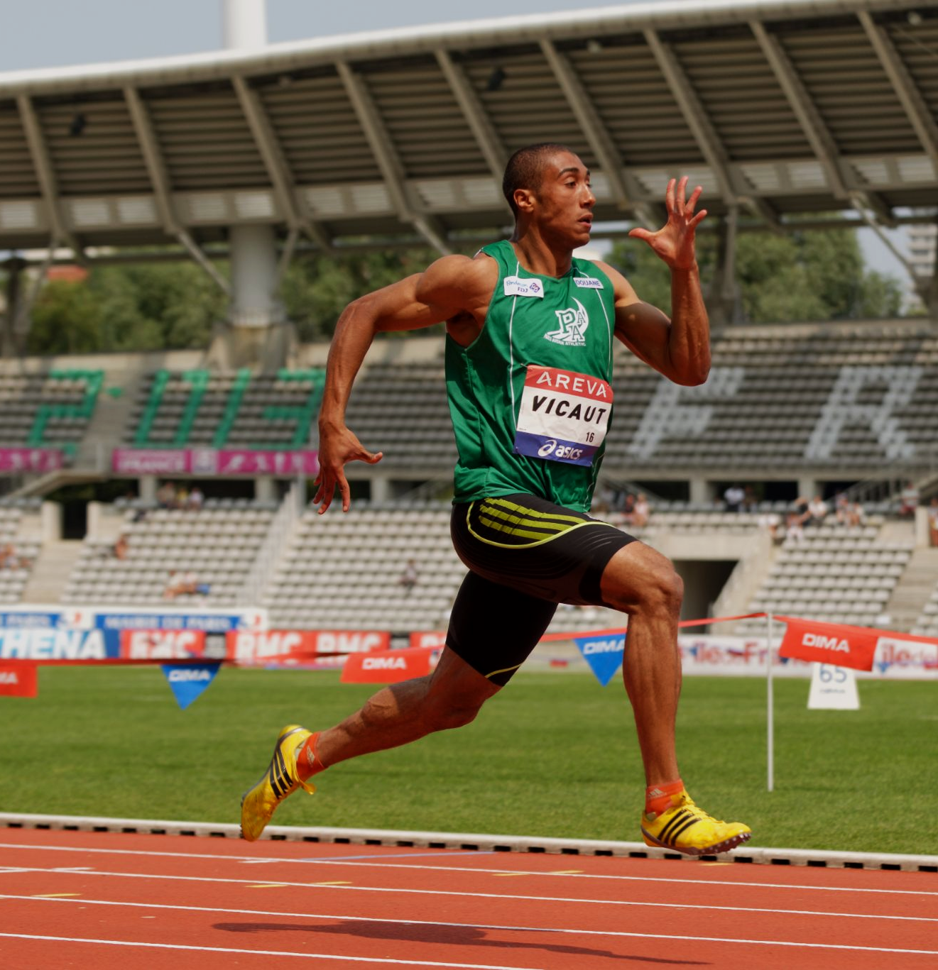
Sprinting, a high-intensity exercise, primarily uses anaerobic respiration to generate much smaller amounts of ATP.
Sprinting can only be maintained for a short period due to the buildup of lactic acid in the muscles.

Slide 17
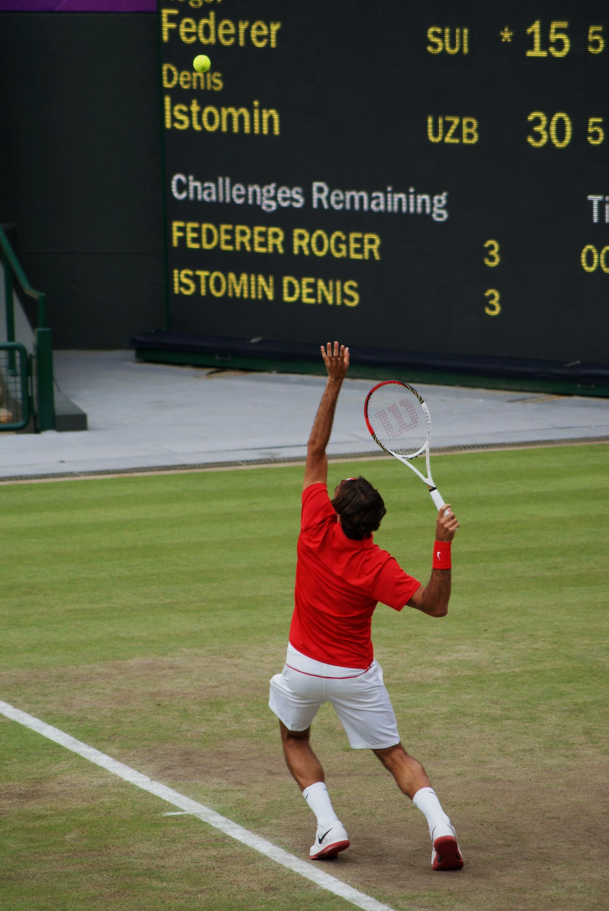
A tennis serve is an activity that requires a very short burst of energy. As such, ATP is mainly provided through the ATP-phosphocreatine system:
ADP + PHOSPHOCREATINE (PCr) → ATP + CREATINE (Cr)

Slide 18
Slow and Fast Twitch Muscles
Slow twitch muscle fibres are used for endurance.
  Slow twitch muscles are used for walking and maintaining posture.
  These muscles primarily use aerobic respiration to generate ATP.
Slow twitch muscles are well-supplied with blood and mitochondria.
  A good blood supply provides O₂ for aerobic respiration.
  Mitochondria are used to generate ATP.
Slow twitch muscles contain lots of myoglobin.
  Myoglobin is a protein found in muscles that helps to store O₂.
Fast twitch muscle fibres are used for speed and power.
  Fast twitch muscles are used for sprints.
  These muscles primarily use anaerobic respiration to generate ATP.
Fast twitch muscles contain fewer blood vessels and mitochondria.
  They also contain much less myoglobin.

Slide 19
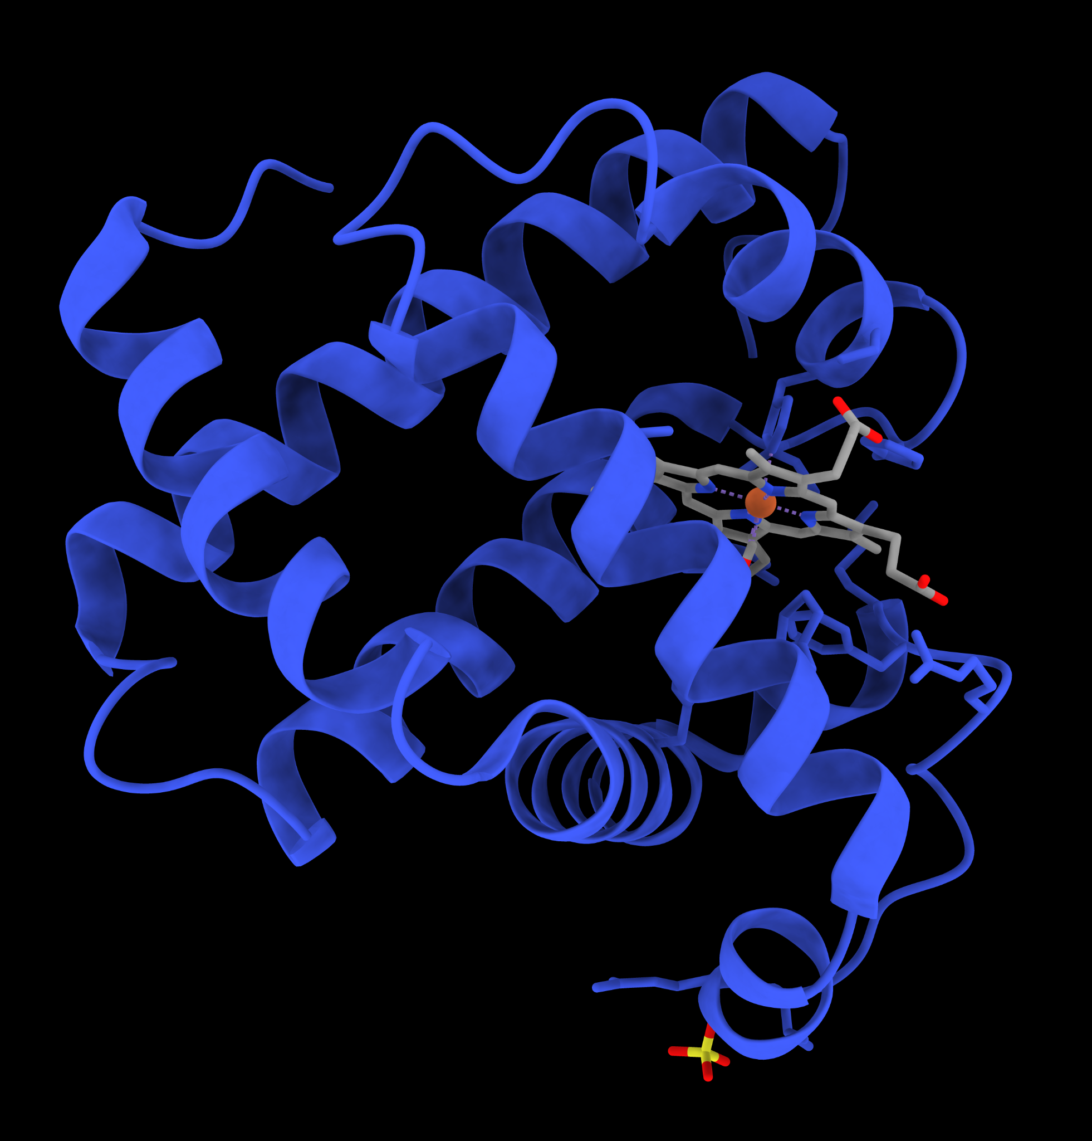
Myoglobin is a quaternary protein that closely resembles haemoglobin.
Myoglobin is found in muscles and helps to store O₂ for respiration.

Slide 20
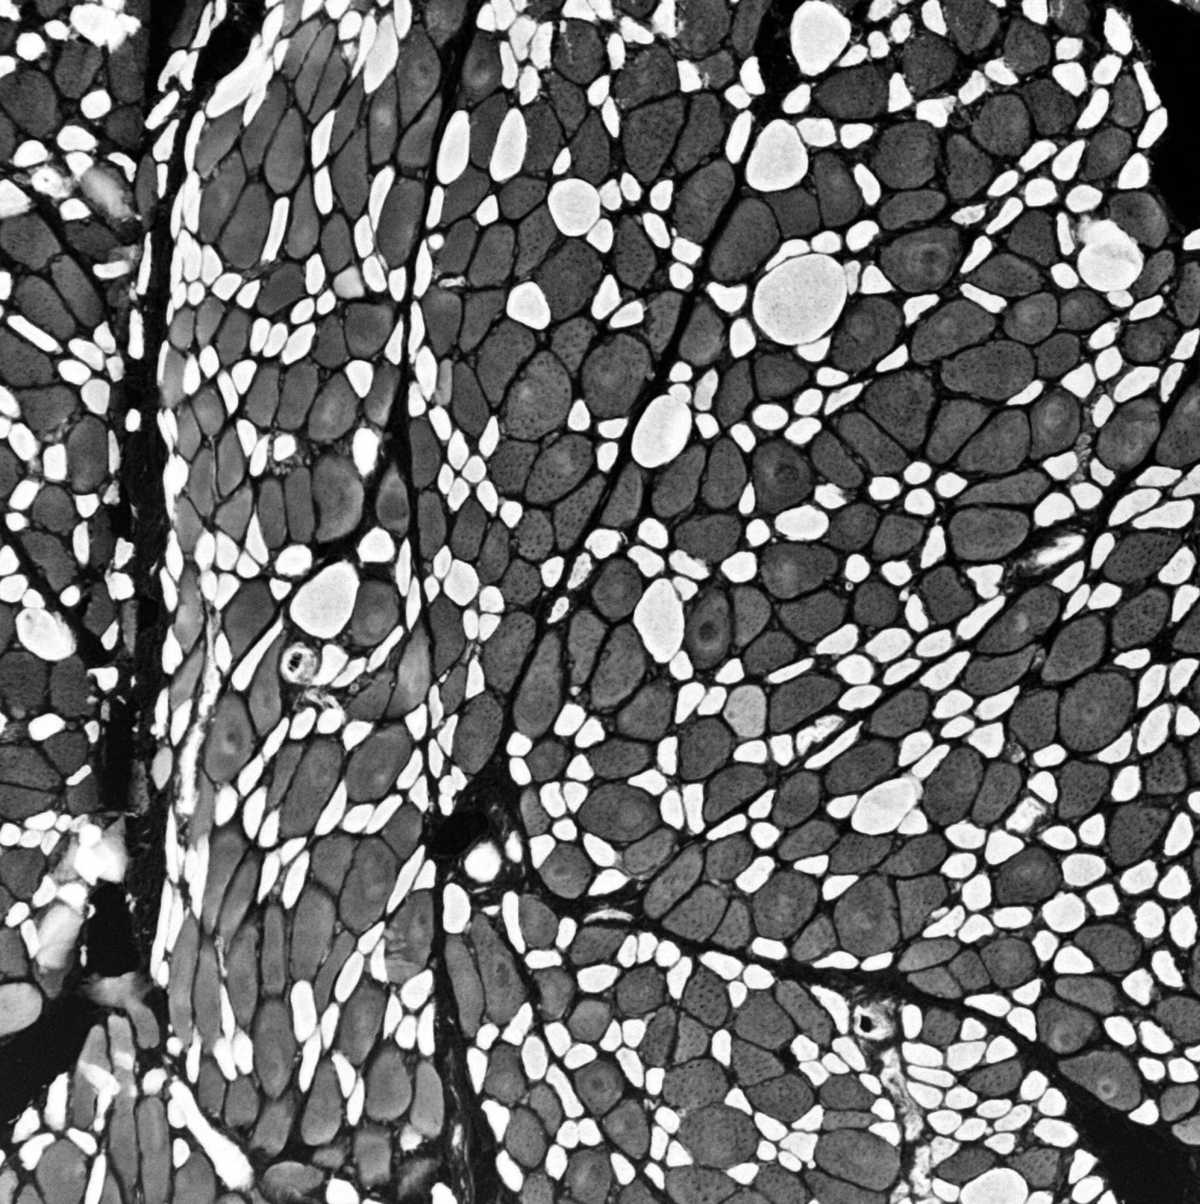
A cross-sectional micrograph of a muscle. The dark fibres, full of myoglobin are slow twitch fibres. The light fibres are fast twitch fibres.

