Slide 1
AQA A Level Biology
45 - Nerves and Synapses
Action Potentials and Neurotransmitters

Slide 2
The Resting Potential
Specification Point 3.6.2.1 - Nerve impulses.
When at rest, fluid on the inside of a neurone’s membrane is significantly more negative than fluid outside the membrane.
  This is referred to as the resting potential.
  In most neurones the resting potential across the membrane is around -70 mV.
The resting potential is established by the sodium-potassium pump.
  The sodium-potassium pump uses active transport to move 3 sodium ions (Na⁺) out of the neurone.
  At the same time, the pump moves 2 potassium ions (K⁺) into the neurone.
  Energy is required for this process in the form of ATP.
  As there are more positively charged ions outside of the neurone than inside, an electrochemical gradient is created.

Slide 3
OUTSIDE OF NEURONE
NET POSITIVE CHARGE
3X Na⁺
The sodium-potassium pump establishes a resting potential between the inside and outside of the neurone.
3 Na⁺ ions are pumped out for every 2 K⁺ ions pumped in.
The resting potential for most neurones is around -70 mV.
ATP → ADP
2X K⁺
INSIDE OF NEURONE
NET NEGATIVE CHARGE

Slide 4
The Action Potential
During an action potential, a neurone is excited.
  The neurone carries an electrical impulse down a section of conductive fibre called an axon.
A stimulus excites the neurone.
  This causes voltage-gated sodium ion channels on the axon to open.
  Na⁺ moves into the axon by facilitated diffusion.
  This causes the inside of the neurone to become less negatively charged.
The neurone is depolarised.
  If the influx of Na⁺ is sufficient to exceed the threshold potential (around -55 mV in most neurones), an action potential is triggered.
  More sodium ion channels open and more Na⁺ floods into the neurone.
  This causes the inside of the neurone to become positively charged (up to around 40 mV).
The neurone is repolarised.
  Sodium ion channels close and voltage-gated potassium ion channels open.
  K⁺ moves out of the neurone by facilitated diffusion (efflux).
  The neurone becomes negatively charged again.

Slide 5
The Action Potential
The neurone undergoes hyperpolarisation.
  Potassium ion channels close slowly.
  This leads to an overshoot, where slightly too many K⁺ ions leave the neurone.
  The axon becomes slightly more negative than its default resting potential.
The neurone is returned to its resting potential.
  The sodium-potassium pump corrects the ion imbalance.
  Na⁺ is pumped out of and K⁺ is pumped into the axon.
  The resting potential is maintained until the neurone is triggered by another stimulus.
Action potentials cannot be triggered during the refractory period.
  During this time, the axon is incapable of repeating the action potential.
  Both sodium and potassium ion channels take time to recover from the action potential.
    During this recovery, these ion channels are closed.
  The refractory period limits the number of times the neurone can be stimulated in a set period of time.
  It also ensures that impulses are unidirectional.
    This means they only travel in 1 direction.

Slide 6
40
20
0
1. DEPOLARISATION - SODIUM ION CHANNELS OPEN AND Na⁺ IONS ENTER THE NEURONE
2. REPOLARISATION - SODIUM ION CHANNELS CLOSE. POTASSIUM ION CHANNELS OPEN AND K⁺ LEAVES THE NEURONE
-20
VOLTAGE ACROSS MEMBRANE (mV) →
The action potential can be broken down into three key stages: depolarisation, repolarisation and hyperpolarisation.
-40
THRESHOLD POTENTIAL
-60
REFRACTORY PERIOD
-80
3. HYPERPOLARISATION - POTASSIUM ION CHANNELS ARE SLOW TO CLOSE. SLIGHT OVERSHOOT OF K⁺
-100
STIMULUS
-120
0
0.5
1.0
1.5
2.0
2.5
3.0
TIME (ms) →

Slide 7
Waves of Depolarisation
When Na⁺ ions diffuse into the neurone some Na⁺ moves sideways.
  This is referred to as a wave of depolarisation.
The sideways movement of Na⁺ opens adjacent sodium ion channels.
  This ensures a unidirectional impulse as the region behind the wave is still vulnerable to the refractory period.
LATERAL DIFFUSION OF Na⁺
SODIUM ION CHANNEL OPENS AND MORE Na⁺ ENTERS THE NEURONE, PROPAGATING THE IMPULSE

Slide 8
The All-Or-Nothing Principle
When the threshold potential is exceeded, an action potential will be triggered.
The action potential will fire with the same ferocity, regardless of the size of the stimulus.
  A larger stimulus will not result in a larger action potential.
This is referred to as the all-or-nothing principle.
Larger stimuli will however produce more frequent action potentials.
  Larger stimuli reduce the duration of the refractory period.
  This allows another action potential to be generated more quickly.

Slide 9
Regardless of the strength of the stimulus, the all-or-nothing principle ensures the strength of action potential will remain the same.
STRENGTH OF STIMULUS →
THRESHOLD
POTENTIAL

Slide 10
The Speed of Conduction
Various factors affect how quickly an impulse travels down a neurone.
Mammalian nerves are covered in a myelin sheath.
  Myelin is a fatty substance that insulates the axon of the neurone.
  Myelin is made by specialised cells called Schwann cells.
  There are small gaps between Schwann cells called nodes of Ranvier.
Nodes of Ranvier allow for a process called saltatory conduction.
  Na⁺ ions may only diffuse through the axon at nodes of Ranvier.
  As the Na⁺ diffuses across the axon, it depolarises the adjacent node.
  This ‘jumping’ from 1 node to the next is referred to as saltatory conduction.
Impulses are faster through axons with a larger diameter.
  A diameter with a larger diameter has more internal volume relative to its surface area.
  This means there is less resistance to the flow of Na⁺ ions.
Impulses are faster at higher temperatures.
  Ions diffuse more quickly at higher temperatures.
  This only holds true to around 40°C; at higher temperatures protein channels will begin to denature.

Slide 11
A mammalian motor neurone. Impulses travel from the start of the axon to the axon terminal.
DENDRITES (PROJECTIONS THAT CONNECT TO OTHER NEURONES)
AXON TERMINAL
NODE OF RANVIER
CELL BODY
DIRECTION OF IMPULSE
SCHWANN CELL
AXON
MYELIN SHEATH
NUCLEUS

Slide 12
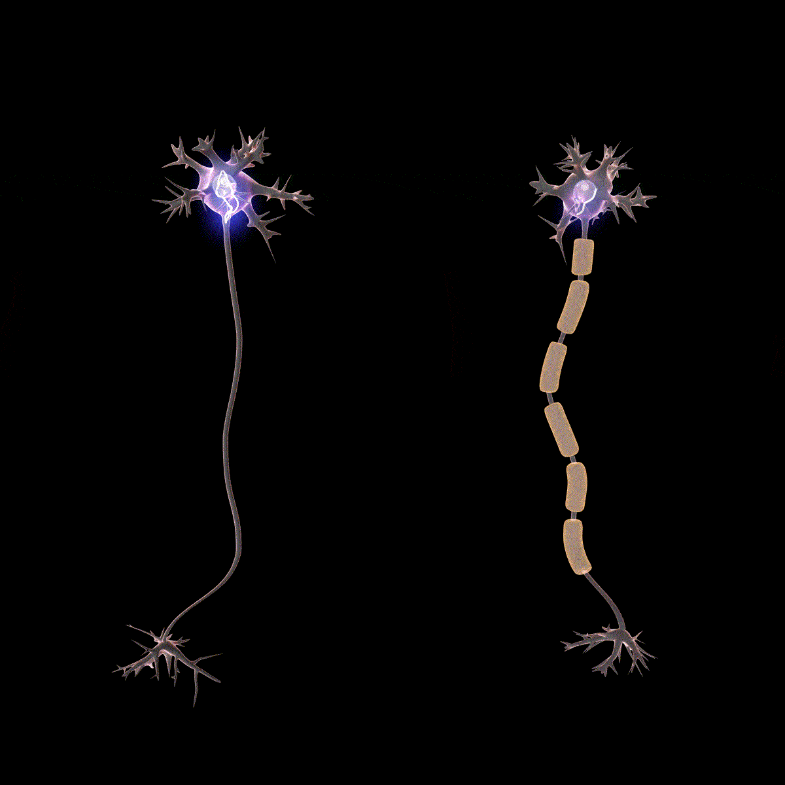
A fatty substance called myelin speeds up the rate of electrical transmission in neurones.
Myelin helps to insulate the neurone and is found in all mammals

Slide 13
Synapses
Specification Point 3.6.2.2 - Synaptic transmission.
The junction between 1 neurone and an adjacent neurone is called a synapse.
  Synapses may also be found at the junction between motor neurones and effectors.
The gap between 2 neurones is referred to as the synaptic cleft.
  Mammalian synaptic clefts are about 20 nm wide.
The synapse has 2 parts.
  The presynaptic knob appears before the synaptic cleft.
  The postsynaptic knob appear after the synaptic cleft.
Electrical information is converted into chemical information at synapses.
  When the action potential reaches the end of the neurone, it stimulates the release of chemicals called neurotransmitters into the synaptic cleft.
  Neurotransmitters then bind to receptors on the postsynaptic neurone, triggering an action potential in this neurone.

Slide 14
Acetylcholine
Synapses allow for the unidirectional transmission of impulses.
  As the receptors for neurotransmitters are only found on the postsynaptic neurone, impulses can only travel in 1 direction.
Acetylcholine is an example of a neurotransmitter.
  Acetylcholine is involved in both the CNS and PNS.
  Synapses that use acetylcholine are referred to as cholinergic synapses.
Acetylcholine is a neurotransmitter found in the brain and body of many different types of animal.

Slide 15
PRESYNAPTIC KNOB
ACETYLCHOLINE
1. An action potential arrives at the end of the presynaptic neurone.
2. This change in voltage opens calcium ion (Ca²⁺) channels.
3. Ca²⁺ enters the presynaptic knob, signalling vesicles containing acetylcholine to migrate and fuse with the presynaptic membrane.
4. Acetylcholine is released into the synaptic cleft through exocytosis. It diffuses across the cleft and binds to receptors on the postsynaptic knob.
5. These receptors open sodium ion channels (Na⁺), also on the postsynaptic knob.
6. Na⁺ enters the postsynaptic knob, leading to its depolarisation. The action potential is thus propagated from one neurone to the next.
7. Acetylcholine is reabsorbed back into the presynaptic knob through channel proteins. It is then broken down by the enzyme acetylcholinesterase.
CHANNEL PROTEIN FOR REABSORBING ACETYLCHOLINE
SECRETORY
VESICLE
VOLTAGE-GATED CALCIUM ION CHANNEL
CHEMICALLY-GATED SODIUM ION CHANNEL
RECEPTOR FOR ACETYLCHOLINE
POSTSYNAPTIC KNOB

Slide 16
Excitation and Inhibition
Excitatory neurotransmitters lead to depolarisation of the postsynaptic knob.
  If the threshold potential is reached, an action potential will be created in the postsynaptic neurone.
  Acetylcholine is an example of an excitatory neurotransmitter.
  Acetylcholine leads to depolarisation at cholinergic synapses.
Inhibitory neurotransmitters lead to hyperpolarisation of the postsynaptic knob.
  This prevents the postsynaptic neurone from creating an action potential.
  Gamma aminobutyric acid (GABA) is an example of an inhibitory neurotransmitter.
  GABA opens potassium ion channels, leading to hyperpolarisation.

Slide 17
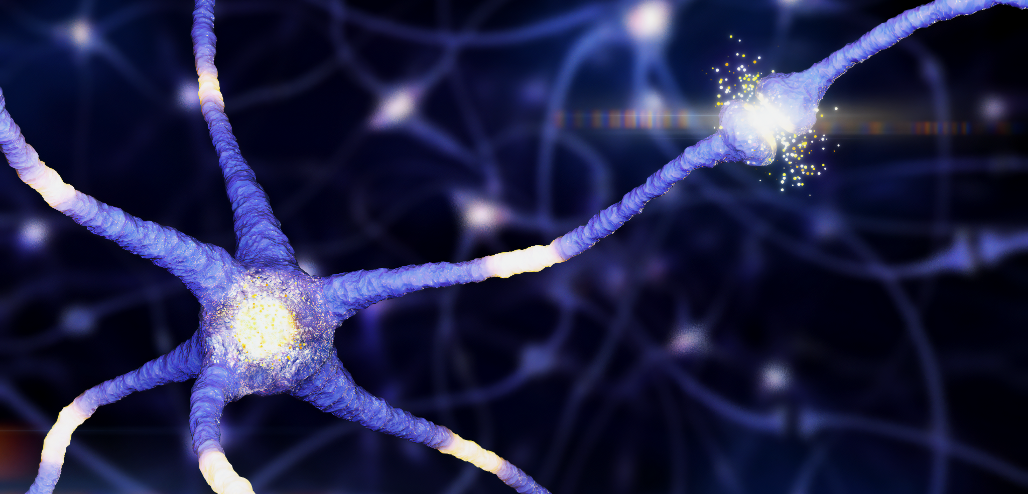
Synapses in the brain are often calmed through the impact of GABA - an inhibitory neurotransmitter.

Slide 18
Summation
Weak stimuli are unlikely to trigger action potentials.
  This is because they will only lead to the release of small quantities of neurotransmitter into the synaptic cleft.
  The resulting influx of Na⁺ is unlikely to exceed the threshold potential.
The neurotransmitters from 2 or more neurones are combined during spatial summation.
  The cumulative effect of both neurones may offer a depolarising effect that is sufficient to depolarise the postsynaptic neurone.
Temporal summation occurs when 1 neurone fires several impulses in quick succession.
  This will lead to the release of more neurotransmitter than usual.
  The increased volume of neurotransmitter may be sufficient to depolarise the postsynaptic neurone.
SPATIAL SUMMATION
TEMPORAL SUMMATION

Slide 19
Neuromuscular Junctions
A neuromuscular junction is a synapse between a motor neurone and a muscle cell.
  A neuromuscular junction is a specialised type of cholinergic synapse.
  Acetylcholine binds to receptors on the postsynaptic knob called nicotinic cholinergic receptors.
There are a number of differences between neuromuscular junctions and traditional cholinergic synapses:
  Neuromuscular junctions have more receptors on their postsynaptic membranes.
  Acetylcholine always has an excitatory effect on effectors; this is not true for all cholinergic synapses.
  Neuromuscular junctions contain junctional folds. These folds store acetylcholine and increase the likelihood of a depolarisation leading to a muscular response.

Slide 20
AXON
VESICLE
A neuromuscular junction.
Junctional folds are visible on the postsynaptic membrane.
ACETYLCHOLINE
RECEPTOR

Slide 21
The Effects of Drugs on Synapses
Many drugs have an impact on synaptic transmission:
Drug Family | Mechanism | Examples
Agonists. | Agonists are similar shapes as the genuine neurotransmitter. As such, they mimic the action of the neurotransmitter when they bind to receptors. This leads to more frequent depolarisations. | Nicotine, morphine, heroin.
Antagonists. | Antagonists block receptors by binding to them. This means that the receptor cannot be activated. The leads to more infrequent depolarisations. | Curare, naltrexone.
Nerve gases. | Nerve gases usually work by inhibiting enzymes, such as acetylcholinesterase. This means acetylcholine remains in the cleft for much longer than normal, leading to repeated depolarisations. | Sarin, VX.
Stimulants. | Stimulants encourage the release of neurotransmitter. This leads to more frequent depolarisations. | Caffeine, amphetamines.
Sedatives. | Sedatives inhibit the release of neurotransmitter. This leads to more infrequent depolarisations. | Alcohol.

Slide 22

Caffeine is a well-known component of most coffees.
Caffeine acts as an stimulant, increasing the likelihood of depolarisations in brain tissue, famously leading to increased alertness.

