Slide 1
AQA A Level Biology
44 - The Control of Heart Rate
Communication Between Heart and Brain

Slide 2
The Nervous System
Specification Point 3.6.1.3 - Control of heart rate.
The nervous system can be divided into 2 subsystems:
  The central nervous system (CNS) consists of the brain and the spinal cord.
  The peripheral nervous system (PNS) consists of all the other neurones that are connected to the CNS.
The PNS can be further subdivided:
  The somatic nervous system is consciously controlled by the brain (tasks such as exercise, writing etc.).
  The autonomic nervous system involves unconscious processes such as digestion.
The autonomic nervous system is also split into 2 subsystems.
  The sympathetic nervous system readies the body for action by increasing the activity of biological systems.
    It is often referred to as the ‘fight or flight’ system.
  The parasympathetic nervous system calms the body by decreasing the activity of biological systems.
    It is often referred to as the ‘rest and digest’ system.

Slide 3
The nervous system is divided into 2 subsystems. The central nervous system (CNS) and and the peripheral nervous system (PNS).
The CNS includes the brain and the spinal cord.
The PNS consists of all the other interconnected neurones.

Slide 4

The PNS can be divided into the somatic and the autonomic nervous systems.
The somatic nervous system controls conscious tasks, such as writing.

Slide 5

The PNS can be divided into the somatic and the autonomic nervous systems.
The autonomic nervous system controls unconscious tasks, such as digestion.

Slide 6
The Heartbeat
The heart is referred to as myogenic.
  This means it can contract and relax without receiving signals from the nervous system.
  This pattern of contraction and relaxation determines the heartbeat.
The heartbeat originates at the sinoatrial node (SAN).
  The SAN is a ball of tissue located in the wall of the right atrium of the heart.
  The SAN has the ability to spontaneously produce an electrical impulse.
  The SAN is often referred to as the pacemaker of the heart.
The SAN causes a contraction in both atria.
  A band of collagen (a non-conductive material) prevents impulses directly passing to the ventricles.
Impulses travel to the atrioventricular node (AVN).
  The AVN passes impulses to a collection of conductive fibres called the bundle of His.
  There is a short delay before the AVN continues the impulse - this allows the atria to completely empty of blood.
The bundle of His carries the impulse to the Purkinje fibres.
  The conductive Purkinje fibres carry the impulse from the bottom of the heart, up both of the ventricles, simultaneously.
  Both ventricles now contract, from the bottom upwards.

Slide 7
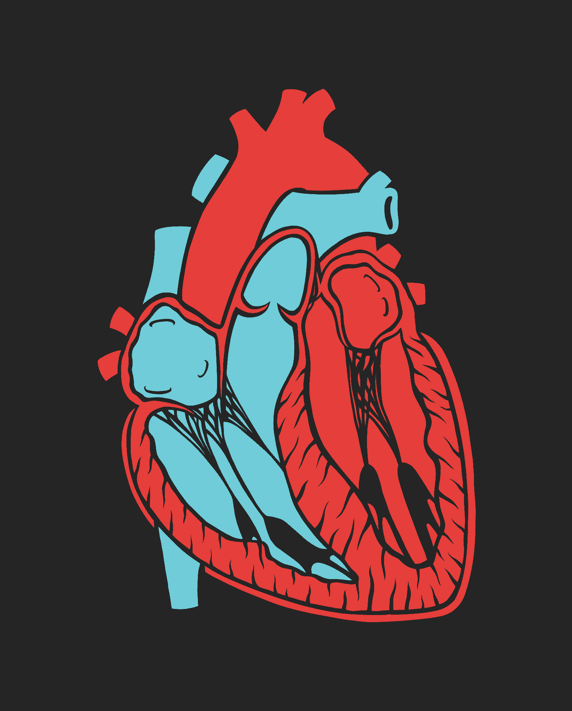
The heart is described as a myogenic organ. This means that it can contract and relax without receiving signals from the brain.
In other words, the signal for a heartbeat is initiated by the heart muscle cells themselves and originate in a ball of tissue called the SAN.

Slide 8
1. SINOATRIAL NODE (SAN)
2. ATRIOVENTRICULAR NODE (AVN)
1. The impulse is initiated at the SAN. The atria contract.
2. The impulse travels to the AVN.
3. There is a short delay before the AVN carries the impulse to the bundle of His.
4. The impulse is carried to Purkinje fibres. Ventricles contract from bottom up.
3. BUNDLE OF HIS (LEFT)
3. BUNDLE OF HIS (RIGHT)
4. PURKINJE FIBRES

Slide 9
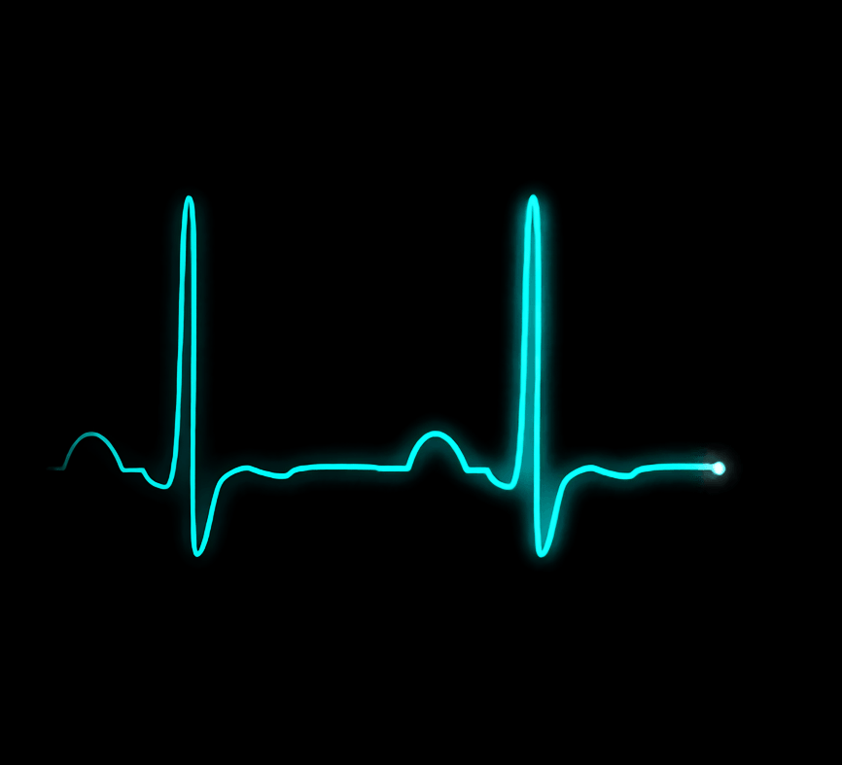
Electrical impulses in the heart can be measured using an electrocardiogram (ECG).
The results yield a distinctive pattern, known as an ECG trace.

Slide 10
Baroreceptors and Chemoreceptors
Whilst the SAN controls the heartbeat from within the heart muscle, the rate of contraction is controlled by the brain.
  A region of the brain called the medulla oblongata controls the heart rate.
Changes inside the body are referred to as internal stimuli.
  There may be changes in blood pressure.
  There may also be changes in blood pH.
Changes in blood pressure are detected by baroreceptors.
  Baroreceptors are found in the aorta and the carotid arteries.
Changes in blood pH are detected by chemoreceptors.
  Chemoreceptors detect changes in the concentration of carbon dioxide [CO₂].
  High [CO₂] is acidic and indicative of an inadequate rate of respiration.
Electrical impulses from these receptors are carried to the medulla by sensory neurones.
The medulla coordinates a response and sends impulses to the SAN via the sympathetic or parasympathetic neurones.

Slide 11
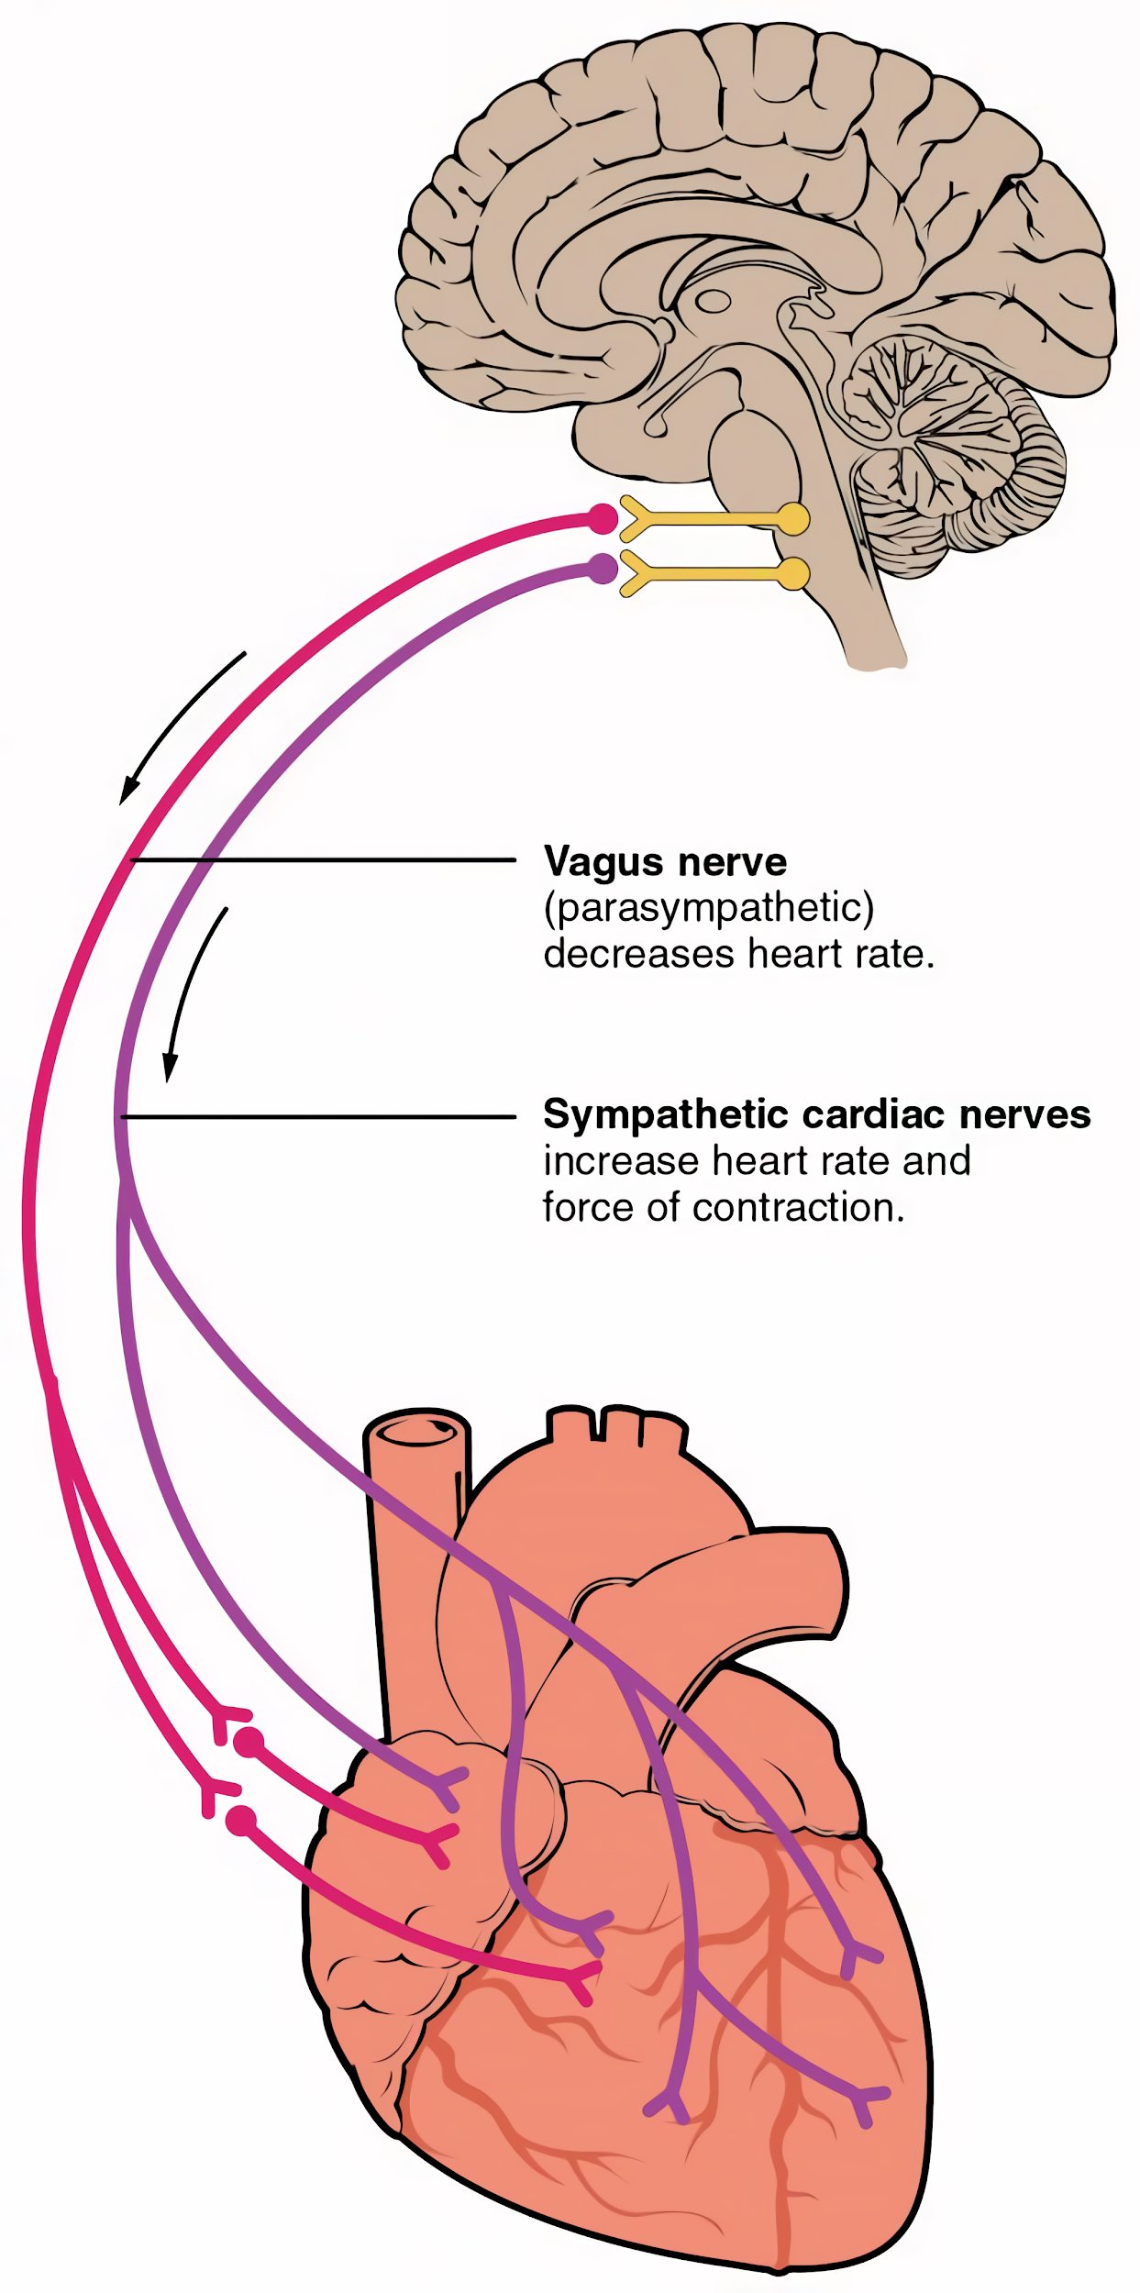
PARASYMPATHETIC NEURONE
Impulses are coordinated in a region of the brain called the medulla oblongata.
Stimulation of the sympathetic neurone will increase the heart rate. Stimulation of the parasympathetic neurone will decrease the heart rate.
SYMPATHETIC NEURONE

Slide 12
Controlling Heart Rate
A number of changes to the body’s internal conditions may occur.
Each time the body will respond to return conditions to normal.
  This is referred to as negative feedback.
Condition | Receptor Involved | Response
High blood pressure. | Baroreceptor | Impulse coordinated through parasympathetic neurone. Heart rate slows down. Blood pressure decreases.
Low blood pressure | Baroreceptor | Impulse coordinated through sympathetic neurone. Heart rate speeds up. Blood pressure increases.
High blood pH | Chemoreceptor | Impulse coordinated through parasympathetic neurone. Heart rate slows down. Blood pH decreases.
Low blood pH | Chemoreceptor | Impulse coordinated through sympathetic neurone. Heart rate speeds up. Blood pH increases.

