Slide 1
AQA A Level Biology
43 - Receptors and Effectors
Reflex Arcs, the Pacinian Corpuscle and Photoreceptors

Slide 2
Receptors and Effectors
Specification Point 3.6.1.2 - Receptors.
Receptors have the ability to detect a stimulus.
Receptors are usually cells.
  Rods and cones are examples of photoreceptors in the eyes.
Receptors may also be proteins on the surface of cell membranes.
  CD8 receptors are proteins on the surface of white blood cells that are involved in cell signalling.
Effectors have the ability to respond to a stimulus.
  Effectors include both muscles and glands.
Receptors and effectors communicate with one another.
  Receptors and effectors communicate via electrical signals (the nervous system).
  They may also communicate via chemical signals (the hormonal systems).
  Sometimes these 2 systems will interact with each other.

Slide 3
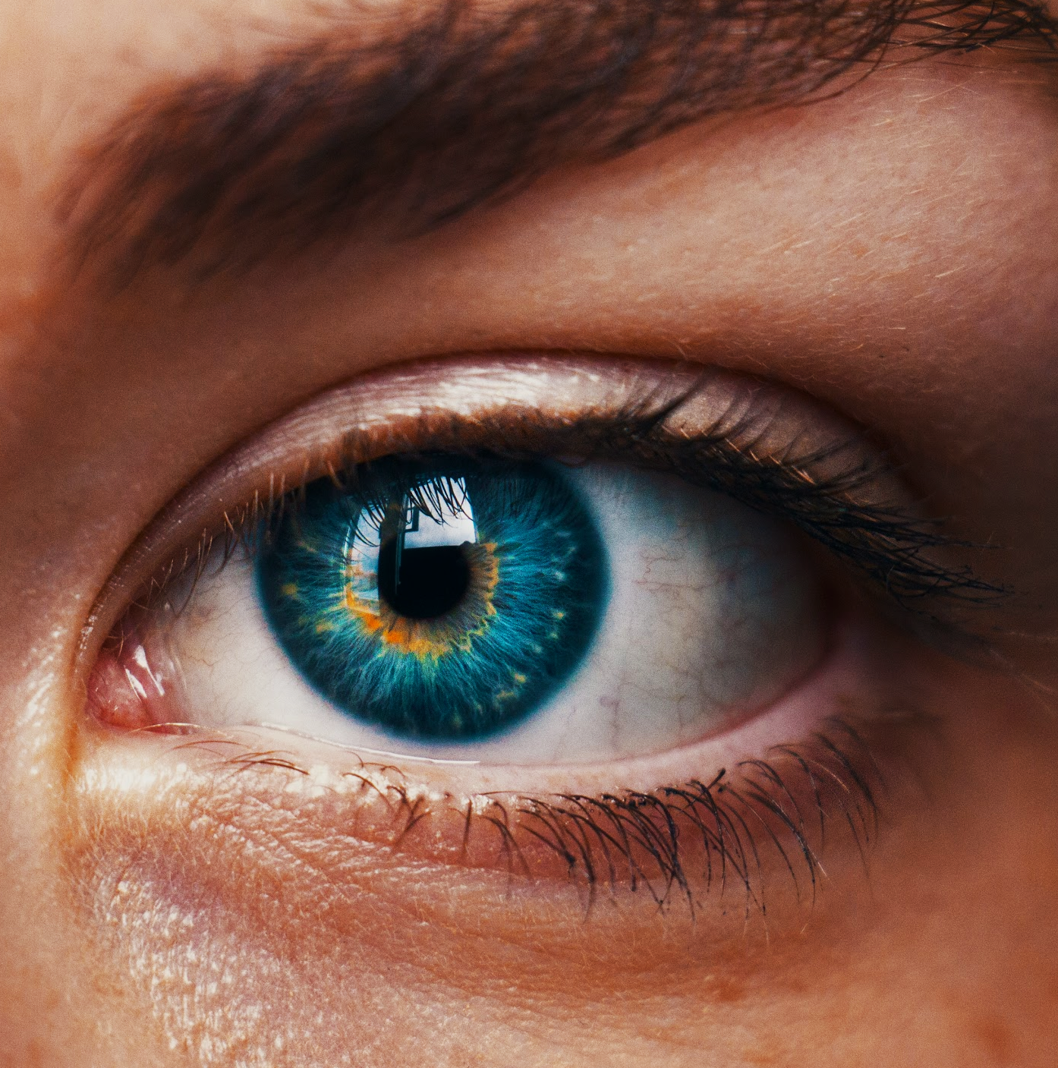
Photoreceptors (rod cells and cone cells) in the eyes allow for the detection of light.

Slide 4
The Nervous System
The nervous system is made up of a network of neurones.
  Neurones are often referred to as nerve cells.
Sensory neurones carry electrical signals from receptors to the central nervous system (CNS).
  The CNS includes the brain and the spinal cord.
Motor neurones carry electrical signals from the CNS to effectors.
Relay neurones carry electrical signals between sensory and motor neurones.
Electrical information is converted into chemical information at a synapse.
  Synapses are found at the end of neurones.
  Electrical impulses are converted into chemicals called neurotransmitters.
  Neurotransmitters diffuse across the gap between neurones.
  A new electrical impulse is then generated at the next neurone.

Slide 5
The central nervous system (CNS) and the peripheral nervous system (PNS) show a complex network of interlocking neurones.
The CNS consists of the brain and the spinal cord. The PNS consists of all other associated neurones.

Slide 6
Reflex Arcs
A reflex action is an automatic and near-instant response to a stimulus.
Reflex actions do not require conscious thought.
  The impulses associated with reflex actions do not involve conscious regions of the brain.
  This makes the response much faster than one that would require active thought.
Reflex actions are evolutionary mechanisms designed to protect the body against harm.
  As the response happens so quickly, any potential risk of damage to the body is minimised.
Reflex actions can be summarised by a reflex arc.
  Reflex arcs illustrate the pathways impulses take during a reflex action.
STIMULUS
RECEPTOR
CNS
EFFECTOR
RESPONSE
SENSORY
NEURONE
MOTOR
NEURONE

Slide 7

Reflex actions are evolved mechanisms designed to help the body avoid unnecessary damage.

Slide 8
Stimulating Receptors
Receptors detect a single type of stimulus.
  Changes in light, pressure and temperature are all detected by different receptors.
When the receptor is resting, there is a difference in electrical charge between the inside and the outside of the cell.
  The imbalance in charges is due to differing concentrations of ions on the inside and the outside of the cell membrane.
  This is referred to as the resting potential.
  At rest, the inside of the cell is more negatively charged than the outside of the cell.
  The resting potential is established by an enzyme called the sodium-potassium pump.
Changes in electrical charge create voltage.
  Because the disruption of charges in cells are small, they are measured in millivolts (mV).

Slide 9
Stimulating Receptors
Small changes in the voltage across the cell membrane are called generator potentials.
  When the receptor detects a stimulus, the membrane becomes excited.
  This means that ions can move into the cell more easily.
  The influx of ions causes a change in the voltage across the membrane.
When the generator potential is large enough, an action potential is triggered.
  An action potential is an electrical impulse that travels down the neurone.
  In order for an action potential to be triggered, a certain voltage must be reached.
  This is referred to as the threshold potential.
Action potentials are all of equal size.
  If the threshold potential is exceeded, even by a small number of ions, an action potential will occur.
  This is referred to as the all or nothing principle.

Slide 10
IF THE STIMULUS EXCEEDS THE THRESHOLD POTENTIAL, AN ACTION POTENTIAL WILL BE TRIGGERED
The stimulation of receptors relies on the influx of positively charged ions.
If the change in voltage is sufficient, an action potential will be generated and an electrical impulse will be transmitted to a neurone.
VOLTAGE ACROSS MEMBRANE (mV) →
THRESHOLD POTENTIAL
SMALL GENERATOR POTENTIALS
STIMULUS
TIME →

Slide 11
The Pacinian Corpuscle
Pacinian corpuscles are mechanoreceptors found on the surface of the skin.
  Mechanoreceptor detects small vibrations or changes in pressure.
  Pacinian corpuscles contribute to the sensation of touch.
Pacinian corpuscles contain sensory nerve endings.
  These nerve endings are surrounded by layers of tissue called lamellae.
When the Pacinian corpuscle is stimulated, lamellae are deformed.
  The lamellae then press on the nerve ending, opening stretch-mediated sodium ion channels.
Sodium diffuses into the cell through these ion channels.
  This creates a generator potential.
If the generator potential exceeds the threshold potential, an action potential is triggered.

Slide 12
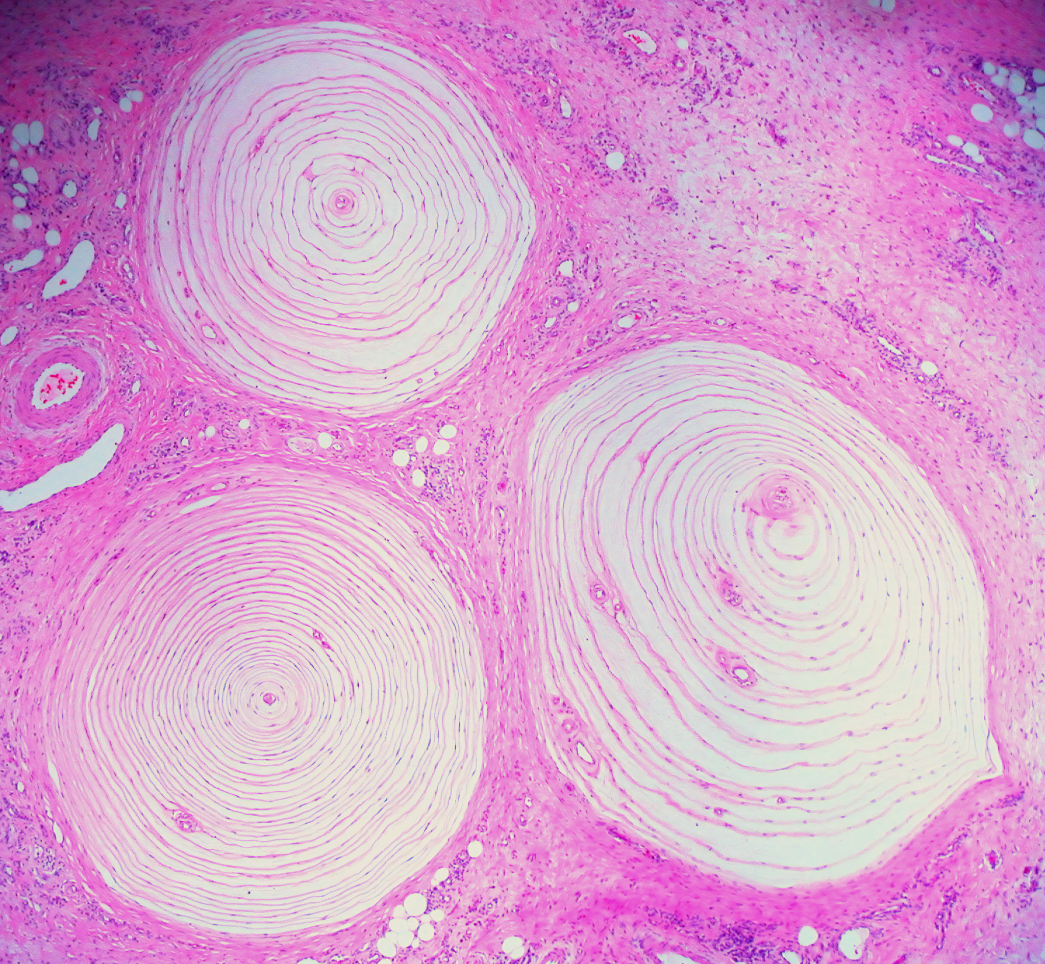
Three Pacinian corpuscles.
As the lamellae are deformed, stretch-mediated sodium ion channels open. This causes an influx of sodium ions into the mechanoreceptor, potentially triggering an impulse.

Slide 13
Photoreceptors
Photoreceptors are found in the eye.
  Photoreceptors are sensitive to changes in light.
As light enters the eye, photoreceptors are stimulated.
  Light enters the eye through the pupil.
  Light is then focused onto the back of the eye - the retina.
The retina contains 2 types of photoreceptor - rod cells and cone cells.
  Rod cells are found at the edges of the retina.
  Cone cells are found in the centre of the retina - the fovea.
Rod cells are very sensitive to changes in light.
  They do however mostly offer images in black and white.
Cone cells are less sensitive than rod cells but offer images in colour.
  There are 3 types of cone cell, each containing different optical pigments.
  Each pigment (blue, red and green) is sensitive to different spectra of light.

Slide 14
CORNEA
PUPIL
Light passes through the eye and is focused onto the retina. The retina contains the photoreceptor cells known as rods and cones.
RETINA
FOVEA
OPTIC NERVE

Slide 15
Rod Cells
Rod cells are sensitive to light.
  Several rod cells join to 1 sensory neurone.
  This means that generator potentials can be combined to exceed the threshold potential, thus triggering an impulse.
  Rod cells are important for vision in low light situations (for example, at night.)
Rod cells have low visual acuity.
  Visual acuity is the ability to tell 2 objects apart from one another when these objects are close together.
  Many rod cells join to to the same sensory neurone.
    This means that the brain interprets these separate points as a single point.
ACTION POTENTIAL
ROD CELLS
SENSORY NEURONE
GANGLION
(TO OPTIC NERVE)

Slide 16
Cone Cells
Cone cells are much less sensitive to light than rod cells.
  Each cone cell is joined to a single sensory neurone.
  More light is required to reach the threshold potential, making it harder to trigger an impulse.
Cone cells have high visual acuity.
  As each cone cell is joined to its own sensory neurone, the brain interprets impulses from each cone cell as separate signals.
  This means that cone cells can tell offer much more visual detail than rod cells.
ACTION POTENTIAL
CONE CELL
SENSORY NEURONE
GANGLION
(TO OPTIC NERVE)

