Slide 1
AQA A Level Biology
42 - Survival and Response
Taxis, Kinesis and Tropisms

Slide 2
Plant and Animal Responses
Specification Point 3.6.1.1 - Survival and response.
Any change to external or internal environment is called a stimulus.
  Light intensity, temperature and water availability are all examples of stimuli.
Organisms have the ability to respond to external stimuli.
  Animals move away from areas that are too hot or too cold.
  Plants may grow in the direction of light.
Organisms also have the ability to respond to internal stimuli.
  This ensures that the conditions are optimal for metabolic processes.
  For example, mammals can respond to changes in internal temperature, water potential and glucose concentration through physiological adaptations.

Slide 3
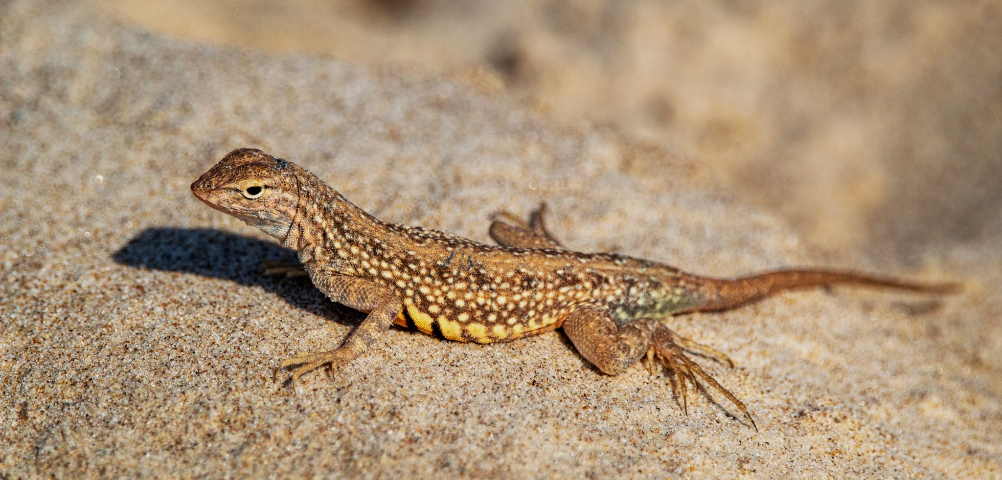
Ectotherms like lizards may bask in the sun or shade, depending on the ambient temperature.

Slide 4
Taxis and Kinesis
Simple organisms such as invertebrates will attempt to remain in a favourable environment.
  Woodlice are examples of such organisms.
  Woodlice prefer environments that are both dark and damp.
A taxis is a directional response to a stimulus.
  For example, woodlice may move away from a light source.
  This increases the likelihood of the woodlice surviving predation.
A kinesis is a non-directional response to a stimulus.
  For example, woodlice move more slowly in humid conditions.
  This ensures the woodlice stay in the humid conditions for longer - reducing water loss and increasing survivability.

Slide 5
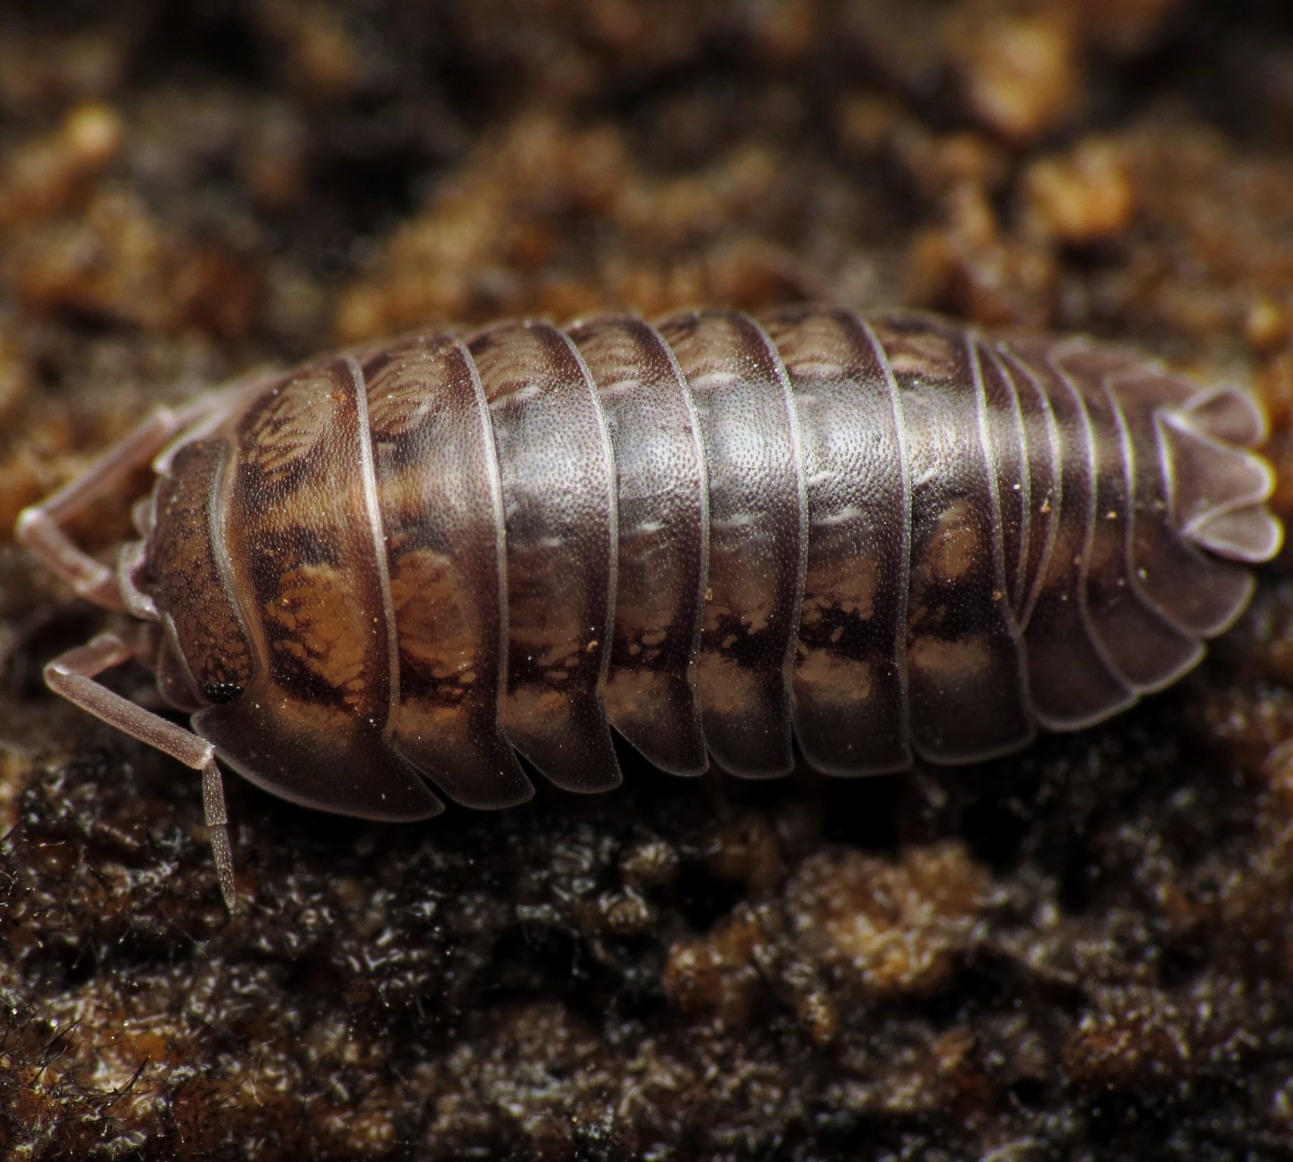
Woodlice exhibit both taxis and kinesis. Woodlice move away from bright light (taxis).
Woodlice also move more slowly and turn less often (kinesis) in damp conditions.

Slide 6
Woodlice and the Choice Chamber
Practical 10: Investigating the effect of an environmental variable on the movement of an animal using either a choice chamber or a maze.
Set up choice chamber to have 4 quadrants.
  A choice chamber can be constructed using a petri dish and plastic dividers.
  The conditions should be as follows:
    Dark and dry, dark and damp, light and dry, light and damp.
  Use a piece of cardboard to block out the light on one half.
  Use wet filter paper to create damp areas.
Place 10 woodlice in the centre of the choice chamber and leave for 10 minutes.
  This will allow the woodlice to acclimate to the environmental conditions.
  Ensure that the woodlice are handled as carefully as possible.
Record how many woodlice are in each quadrant.
  Repeat the experiment by moving woodlice back to the centre of the choice chamber.
  Woodlice practical video.

Slide 7
DARK + DRY
LIGHT + DRY
A petri dish can function as a makeshift choice chamber.
Woodlice will tend to gravitate towards conditions that are both dark and damp. The woodlice achieve this through a combination of taxis and kinesis.
DARK + DAMP
LIGHT + DAMP

Slide 8
Tropisms
Plants are also able to respond to their environment.
A directional response to a stimulus in a plant is called a tropism.
  Tropisms increase a plant’s likelihood of survival.
A directional response to light is called a phototropism.
  The shoots of a plant are positively phototropic - this means they grow towards light.
  The roots of a plant are negatively phototropic - this means they grow away from light.
A directional response to gravity is called a gravitropism.
  The shoots of a plant are negatively gravitropic - this means they grow upwards, against gravity.
  The roots of a plant are positively gravitropic - this means they grow downwards, with gravity.
The growth of plants are affected by chemicals called auxins.
  Auxins are hormone-like compounds that affect the rate of plant growth.
  Auxins are produced in the shoots of the plant and then travel around the plant via mass transport.

Slide 9
SHOOTS GROW UPWARDS AGAINST GRAVITY
The roots of plants are both positively gravitropic (growing towards gravity) and negatively phototropic (growing away from light).
The shoots of plants are both positively phototropic (growing towards light) and negatively gravitropic (growing against gravity).
ROOTS GROW DOWNWARDS TOWARDS GRAVITY

Slide 10
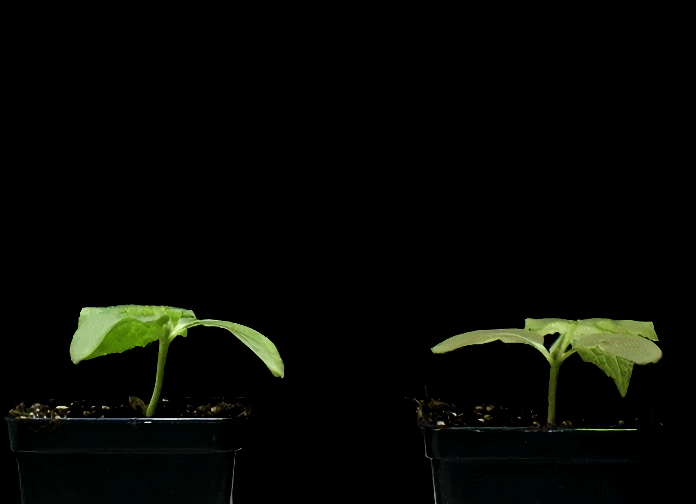
Plant shoots are negatively gravitropic - they grow upwards, away from the soil.

Slide 11
Indoleacetic Acid
Indoleacetic acid (IAA) is a type of auxin.
  IAA is produced in the shoots and roots of flowering plants.
IAA is transported around the plant.
  IAA can diffuse into nearby cells.
  It is also carried by mass transport in the phloem.
IAA is responsible for phototropism.
  When it’s sunny, IAA diffuses to the shady side of both shoots and roots.
  In shoots, a high concentration of IAA leads to cell elongation - this causes the shoot to bend towards the light.
  In roots, a high concentration of IAA leads to cell inhibition - this causes the root to bend away from the light.
IAA is also responsible to gravitropism.
  IAA diffuses to the underside of both shoots and roots.
  In shoots, a high concentration of IAA leads to cell elongation - this causes the shoot to grow upwards.
  In roots, a high concentration of IAA leads to cell inhibition - this causes the root to grow downwards.

Slide 12
3. IAA causes cells on the shady side to elongate, bending the stem towards the light in an example of positive phototropism.
2. Light from one direction causes IAA to accumulate on the shady side of the stem.
LIGHT
1. The auxin IAA is made in the tip of growing shoots.

Slide 13
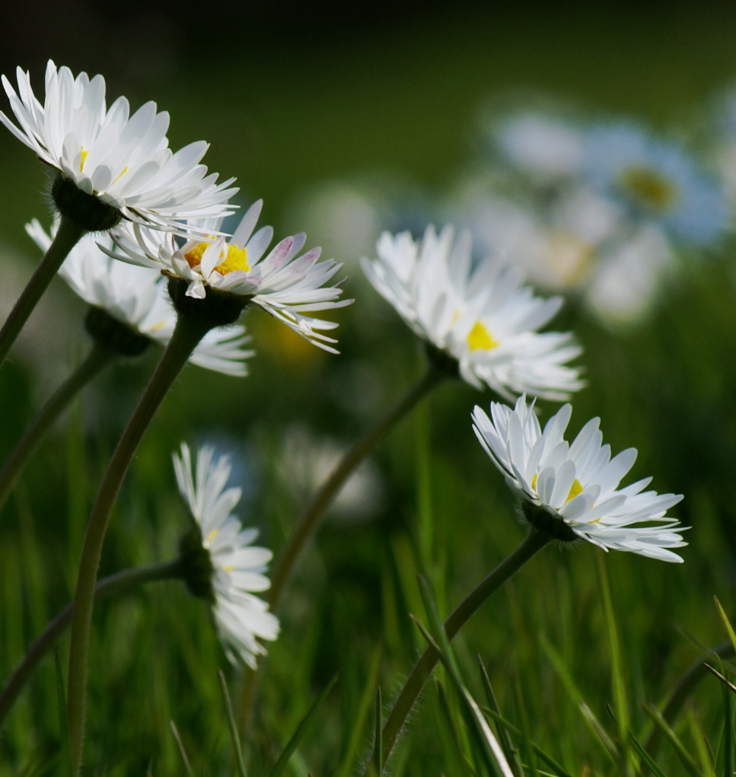
Daisies exhibit positive phototropism when exposed to directional light.
Positive phototropism allows plants to orientate themselves to where there is most sunlight, maximising their rate of photosynthesis.
The compound IAA is responsible for positive phototropism.

