Slide 1
AQA A Level Biology
41 - Nutrient Cycles
Nitrogen, Phosphorous, Fertilisers and Eutrophication

Slide 2
Saprobionts
Specification Point 3.5.4 - Nutrient cycles.
In ecosystems, nutrients are cycled through food webs.
  Nitrogen (N) and phosphorus (P) are examples of nutrients that are regularly recycled.
Nutrient cycles are often driven by saprobionts.
  Saprobionts are either bacteria or fungi that feed on dead or decaying matter through the process of saprotrophic nutrition.
During saprotrophic nutrition, extracellular enzymes are secreted by the saprobiont.
  These enzymes break down organic compounds into inorganic ions.
  For example, Aleuria aurantia (nicknamed the orange-peel fungus) breaks down organic matter from nearby decaying plants.

Slide 3
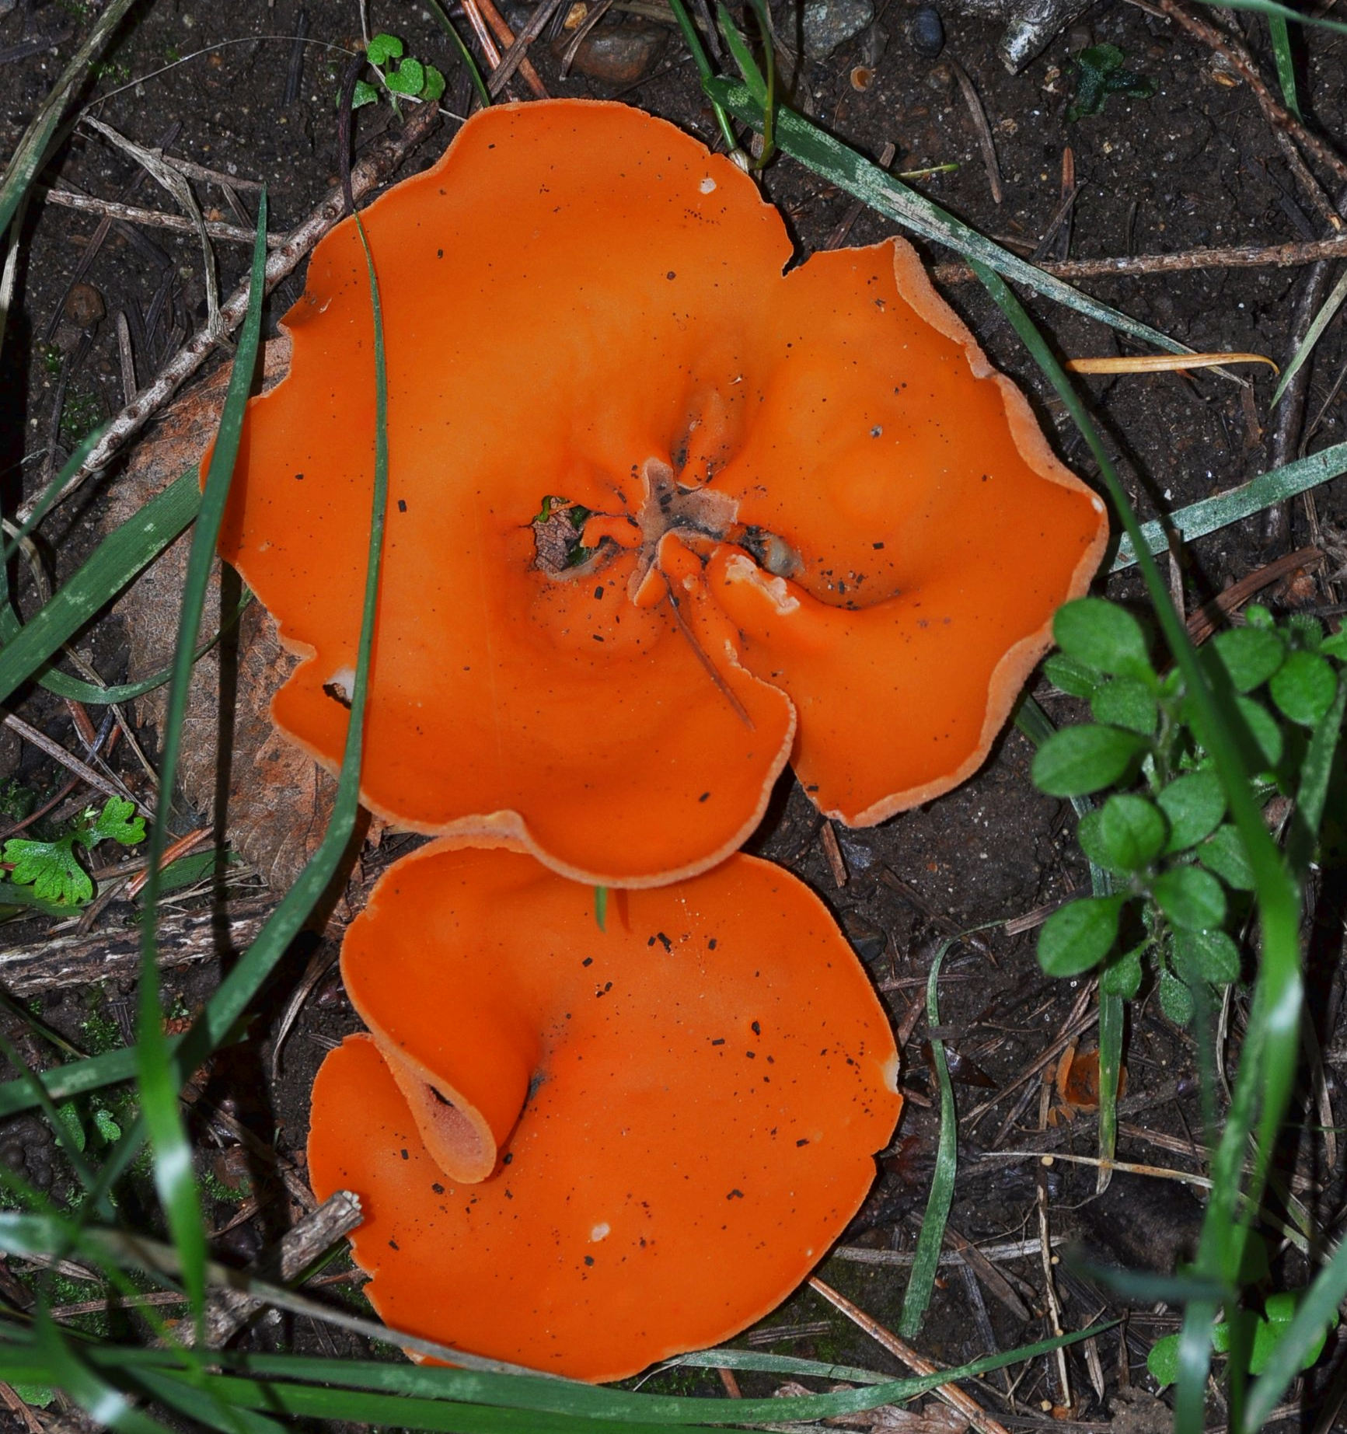
Aleuria aurantia is a saprotrophic fungus - it secretes extracellular enzymes and then absorbs the digested products.

Slide 4
Symbiosis and Mycorrhizae
A symbiotic relationship is a close biological interaction between two species.
  In many situations, each species benefits from the presence of the other.
A symbiotic relationship between a plant and a fungus is called a mycorrhiza.
Fungi have long branching filaments called hyphae.
  Hyphae increase the surface area of the plant’s root system.
  The helps the plant to absorb inorganic ions that may be quite scarce in the soil.
  They may also improve the rate of water uptake by the plant.
In return, the plant supplies sugars and other organic molecules to the fungus.
  The plant makes these organic molecules through photosynthesis.
  Farmers will often plant certain species of fungus in with crop plants to increase yields.

Slide 5
The formation of a symbiotic mycorrhiza between fungus and plant.
THE FUNGUS PENETRATES THE PLANT TO FORM A MYCORRHIZA
PLANTS SUPPLY SUGARS TO THE FUNGUS. IN RETURN THE FUNGUS PROVIDES THE PLANT WITH A SUPPLY OF INORGANIC IONS
ROOT OF PLANT
THE HYPHAE OF THE FUNGUS INCREASE SURFACE AREA OF THE ROOT NETWORK FOR FASTER ABSORPTION

Slide 6
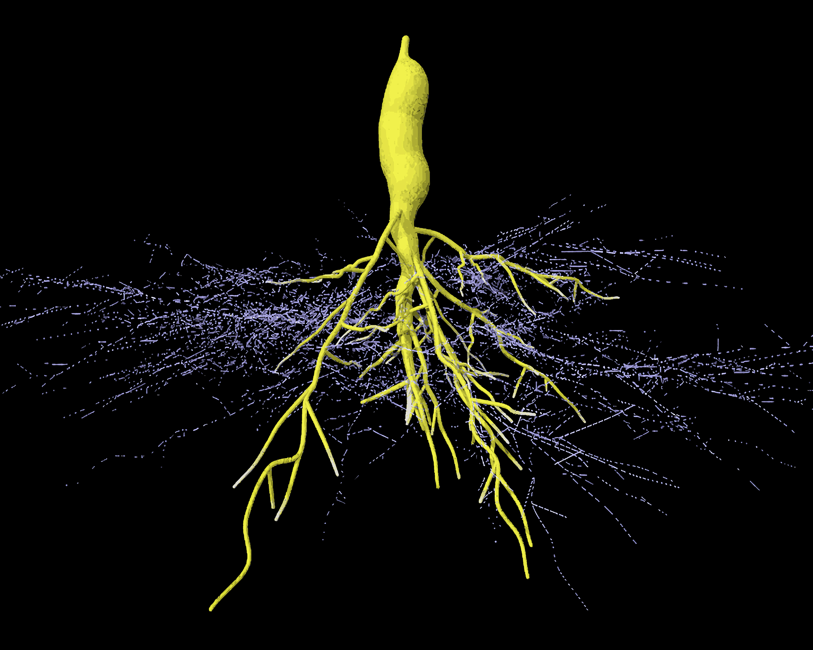
A 3D timelapse of a root tuber being colonised by a fungus.
The hyphae of the fungus increase the surface area of the root network for faster nutrient absorption.

Slide 7
Nitrogen
Nitrogen is required for a variety of biological molecules.
  Proteins and nucleic acids (DNA and RNA) both contain nitrogen.
Nitrogen gas (N₂) makes up the majority of the atmosphere.
  About 78% of the atmosphere consists of N₂.
N₂ is a very stable molecule.
  A triple bond links the 2 nitrogen atoms together (N≡N).
  This makes N₂ difficult to separate.
  Plants cannot use N₂ directly.
Bacteria convert N₂ into more usable nitrogenous compounds.
  These can then be absorbed by the plant and incorporated into biological molecules.
Nitrogen gas contains a very strong triple bond which makes it difficult for plants to incorporate directly.

Slide 8
The Nitrogen Cycle
The nitrogen cycle illustrates how atmospheric N₂ gas is converted into usable nitrogenous compounds.
Nitrogen is fixed from the atmosphere.
  Nitrogen-fixing bacteria such as Rhizobium convert N₂ gas into ammonium ions (NH₄⁺).
  Ammonia is a highly soluble compound and dissolves easily in the soil.
  Rhizobium is a symbiotic bacteria found in the root nodules of legumes.
    Legumes are plants that include the pea and bean families.
Ammonium ions may also be formed through the breakdown of dead organisms by saprotrophic nutrition.
  This is referred to as ammonification.
Ammonium ions are converted to nitrogenous compounds during nitrification.
  NH₄⁺ is converted first to a nitrite ion (NO₂⁻) by the bacteria Nitrosomonas.
  NO₂⁻ is then converted into a nitrate ion (NO₃⁻) by the bacteria Nitrobacter.

Slide 9
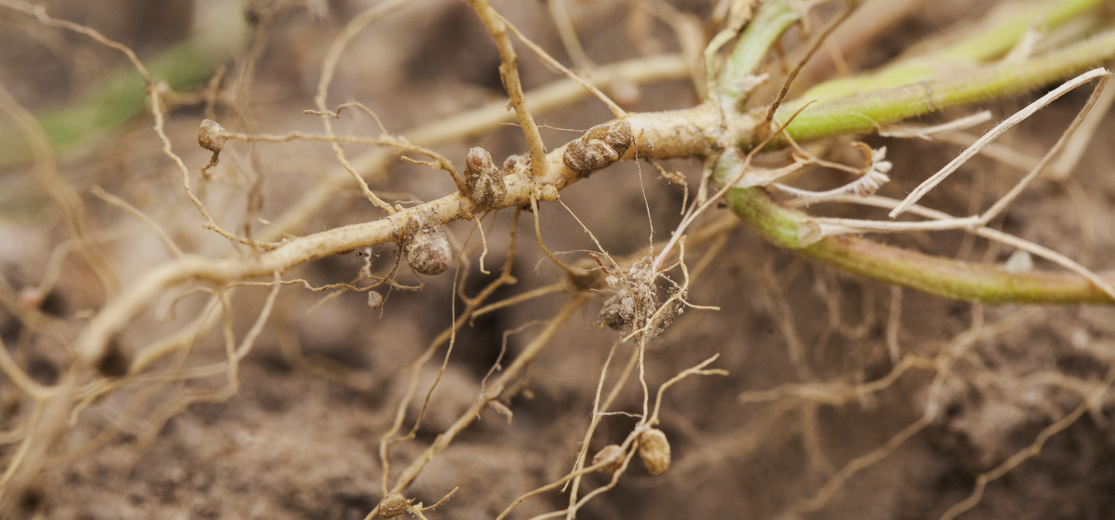
Rhizobium bacteria are found in the root nodules of leguminous plants like peas and beans. The nitrogen-fixing Rhizobium converts atmospheric N₂ into NH₄⁺ ions.

Slide 10
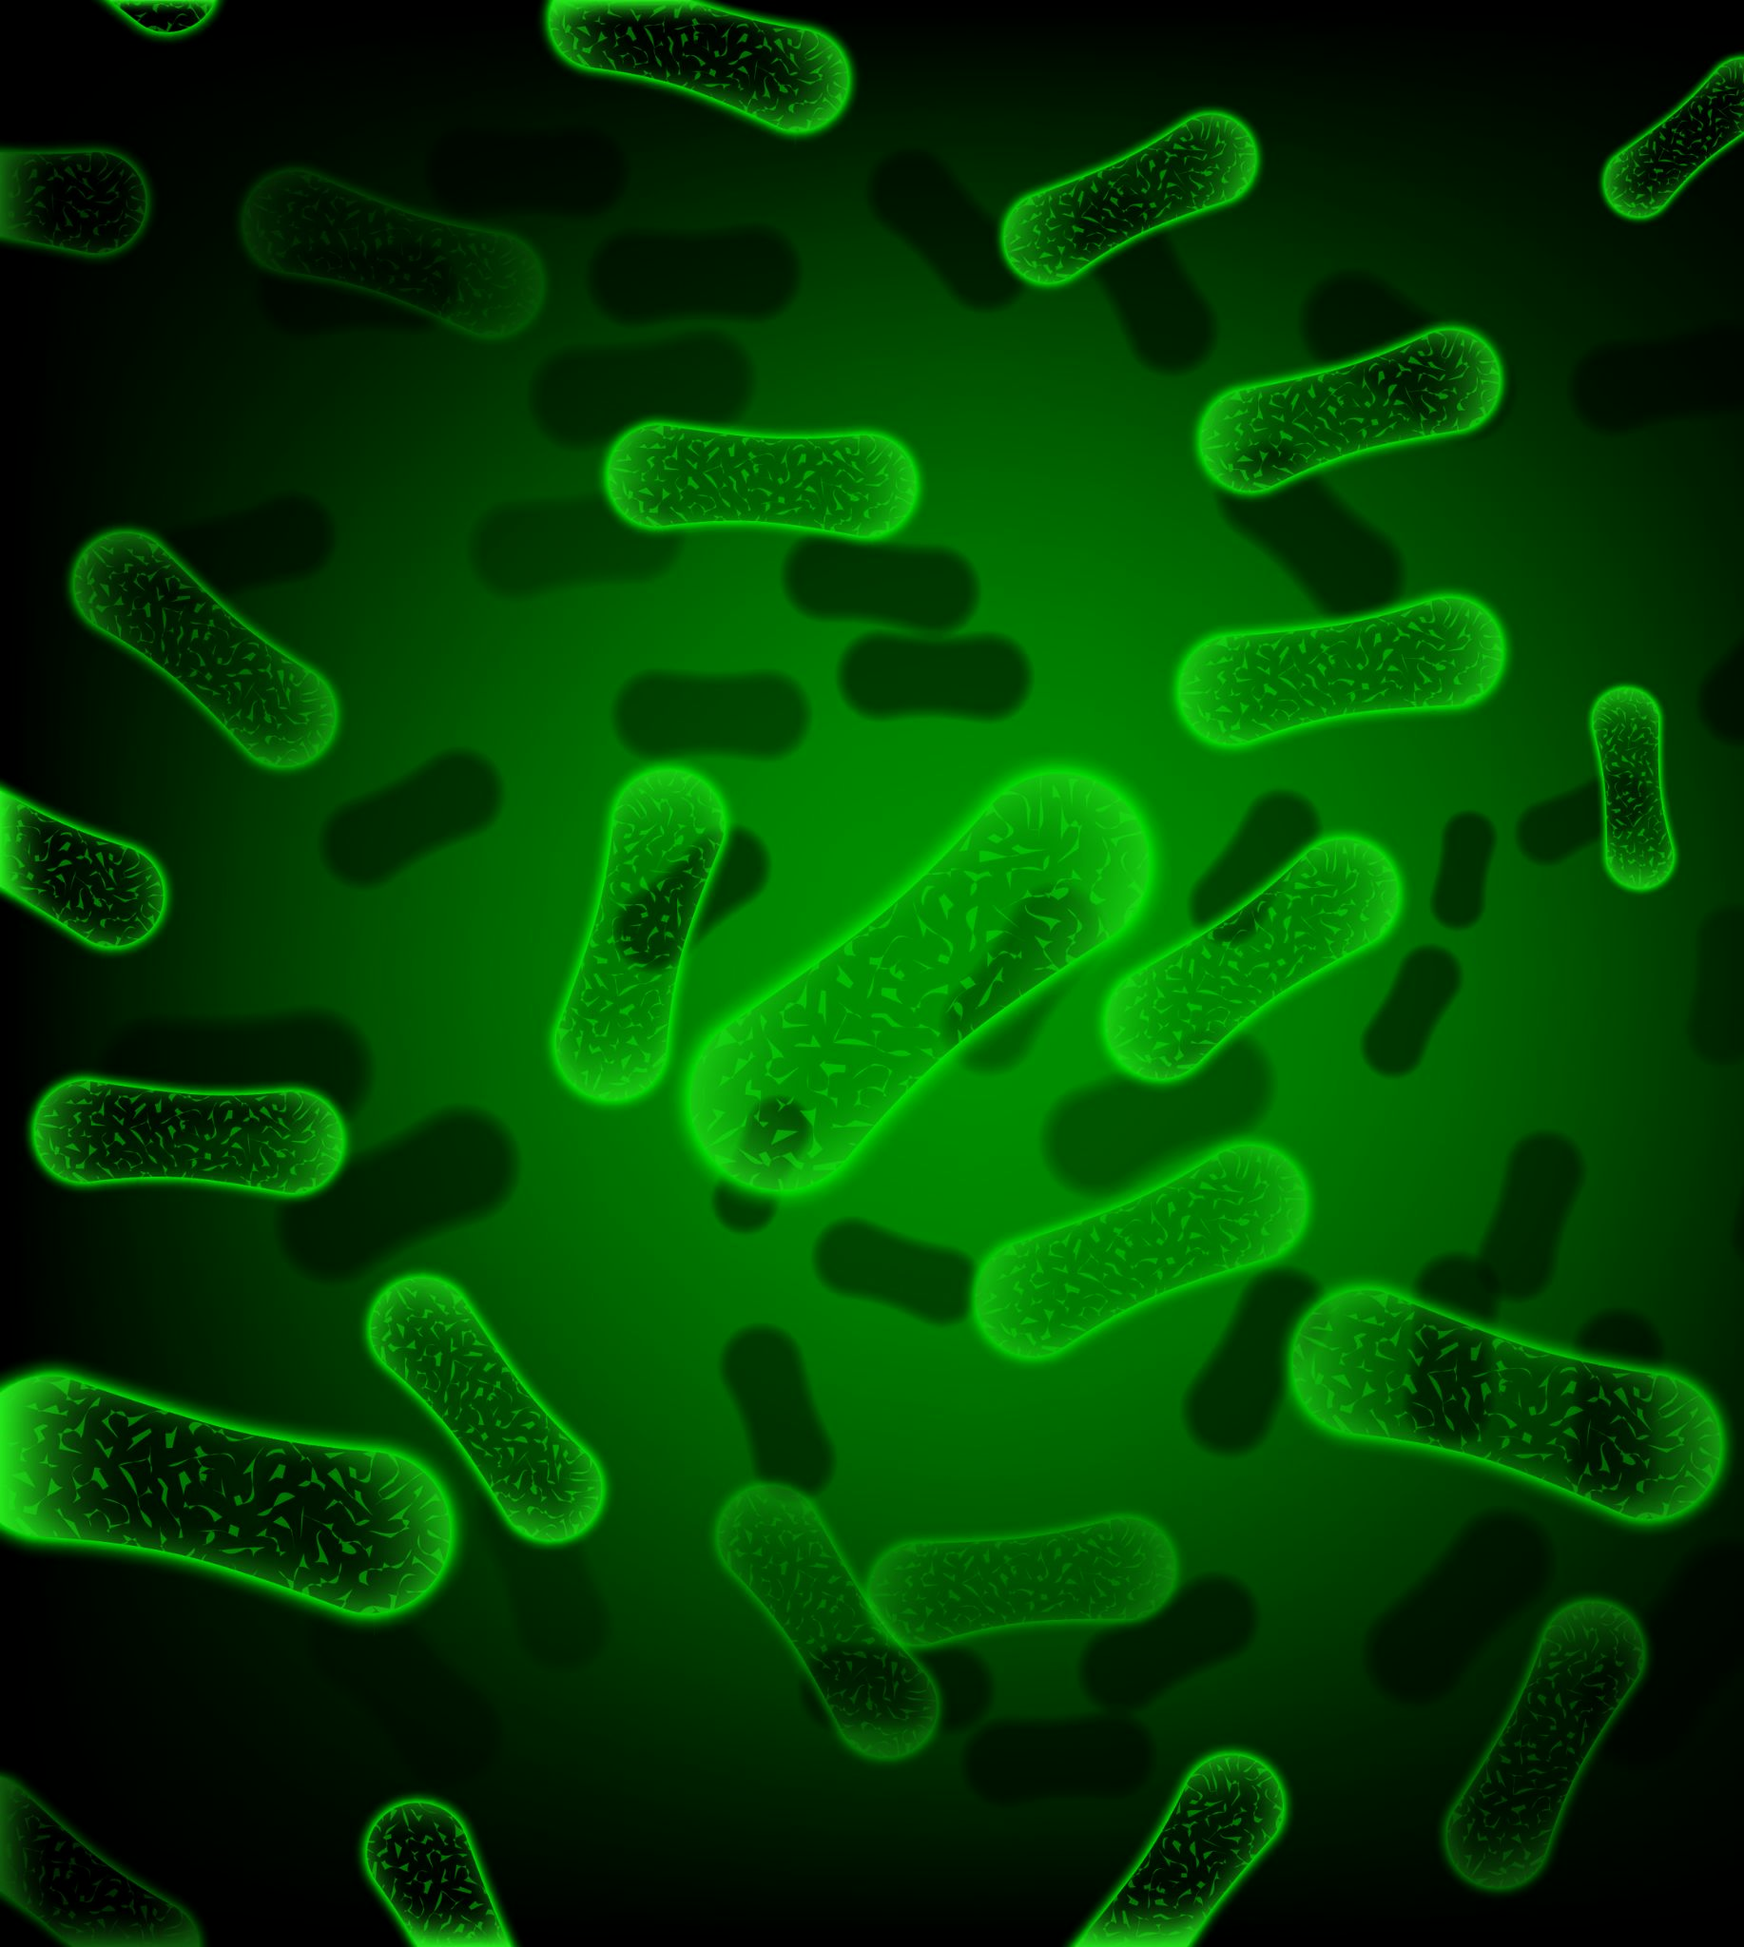
Most species of Nitrosomonas and Nitrobacter are rod-shaped.
Both are genera of nitrifying bacteria.
Nitrosomonas converts ammonium ions (NH⁴⁺) into nitrite ions (NO₂⁻).
Nitrobacter then converts nitrite ions into nitrate ions (NO₃⁻).

Slide 11
The Nitrogen Cycle
Nitrate ions may be converted back into N₂ gas during denitrification.
  This is done by denitrifying bacteria such as Thiobacillus.
Denitrification takes place in anaerobic conditions.
  This is where there is little or no oxygen (O₂) available.
  Waterlogged soil is ideal for denitrification.
Nitrogen may also be fixed by lightning strikes.
  The amount of energy released by lightning is sufficient to convert N₂ gas into various oxides of nitrogen.
Nitrogen may be delivered to the soil through fertilisers.
  Ammonium-based fertilisers are created on an industrial scale via the Haber process.

Slide 12
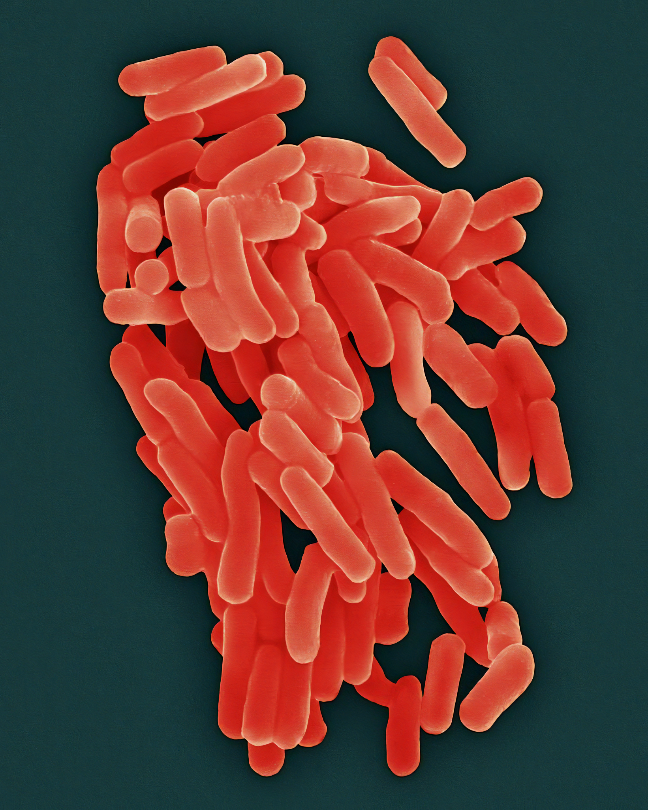
Thiobacillus is a type of denitrifying bacteria that convert nitrates back into nitrogen gas.
Denitrifying bacteria thrive in anaerobic conditions, such as waterlogged soils and are a major concern when growing crops.

Slide 13
ATMOSPHERIC NITROGEN (N₂)
LIGHTNING
STRIKE
PLANTS
DENITRIFYING
BACTERIA
NITROGEN-FIXING BACTERIA IN ROOT NODULES
NITRATES (NO₃⁻)
SAPROTROPHIC
BACTERIA AND FUNGI
NITRIFYING
BACTERIA
AMMONIFICATION
NITRIFICATION
AMMONIUM (NH₄⁺)
NITRITES (NO₂⁻)
NITROGEN-FIXING BACTERIA IN SOIL
NITRIFYING BACTERIA

Slide 14
The Phosphorus Cycle
Phosphorus is also needed to make a variety of biological molecules.
  DNA, ATP and cell membranes all require phosphorus.
Phosphorus is commonly found in rocks as a phosphate ion (PO₄³⁻).
  The PO₄³⁻ ion dissolves readily in water.
  It can then be absorbed by plants to form biological compounds.
The phosphorus cycle illustrates how phosphorus is moved through an ecosystem.
Rain and weathering cause rocks to release phosphate ions into the soil.
Plants take up these phosphate ions from the soil through their root systems.
  The plants may then be consumed by animals which distributes phosphorus throughout the food chain.
Phosphorus in soil can end up in lakes, rivers and oceans.
  Once there, it can be incorporated into sediments over time.
  It may also be incorporated into algae, which is often consumed by birds.
  Bird guano contains a very high concentration of PO₄³⁻ and is often used as a fertiliser.

Slide 15
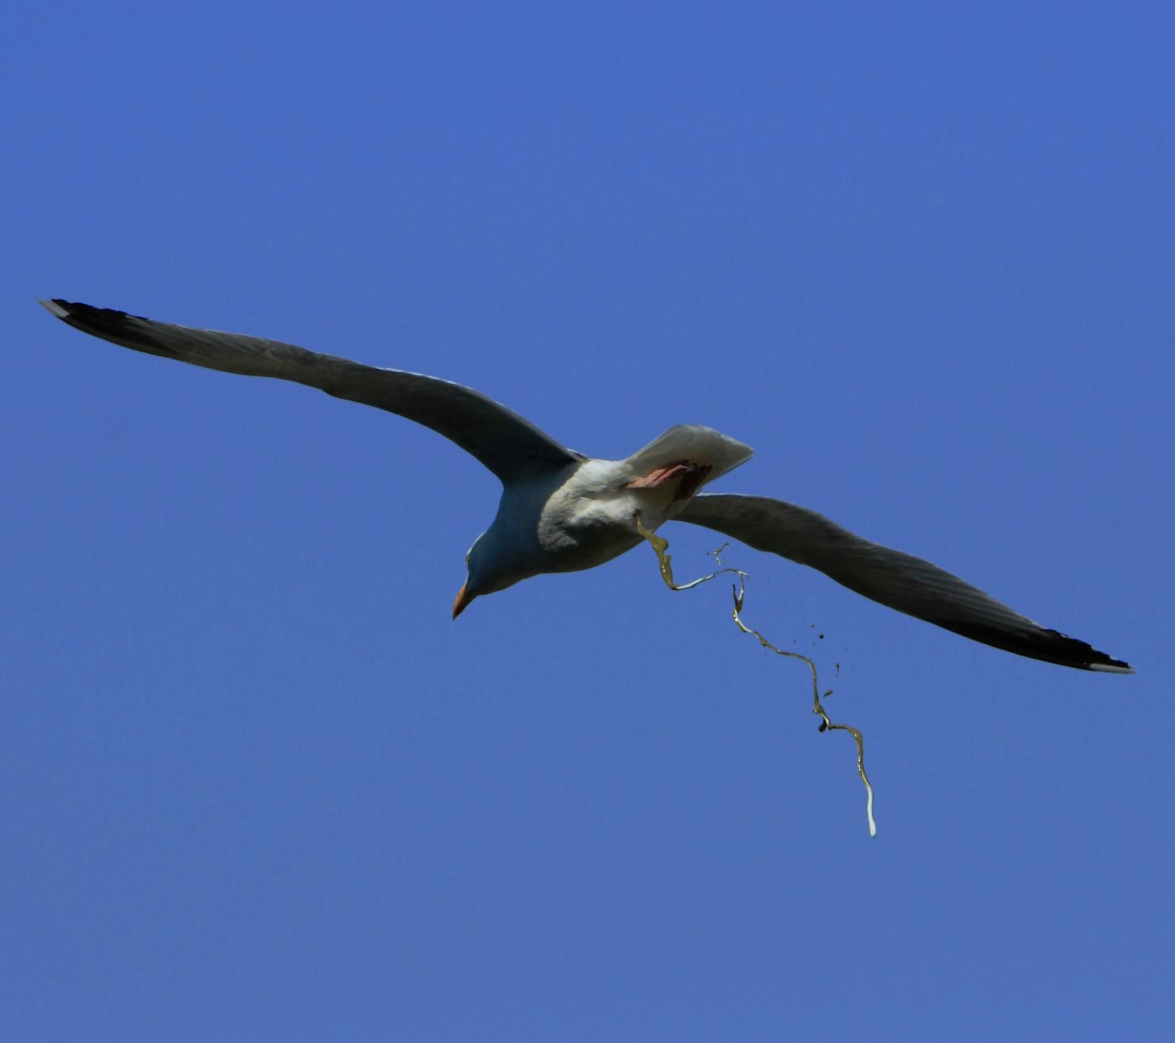
Bird guano contains a very high concentration of PO₄³⁻ ions.

Slide 16
Fertilisers
As crops grow, they deplete the soil of minerals.
  Crops take up inorganic ions like NO₃⁻ and PO₄³⁻ through their root systems.
  When the crops are harvested, nutrients are removed from the field.
Livestock may also remove nutrients from the soil when grazing.
  Most livestock animals like sheep and cows are herbivores.
Farmers often use fertiliser to replace lost minerals.
Inorganic fertiliser is artificially made using industrial processes.
  NPK fertilisers (containing nitrogen, potassium and phosphorus) are often delivered as soluble powders or pellets.
Organic fertiliser consists of natural matter.
  Manure and compost are both examples of organic fertiliser.

Slide 17
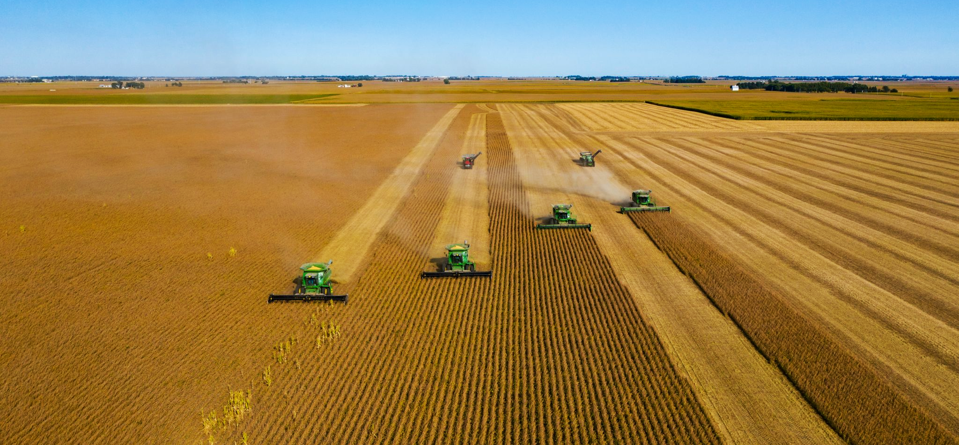
As crops grow, they deplete the soil of nutrients. When crops are harvested, these nutrients are permanently removed from the ground and must be replaced with fertilisers.

Slide 18
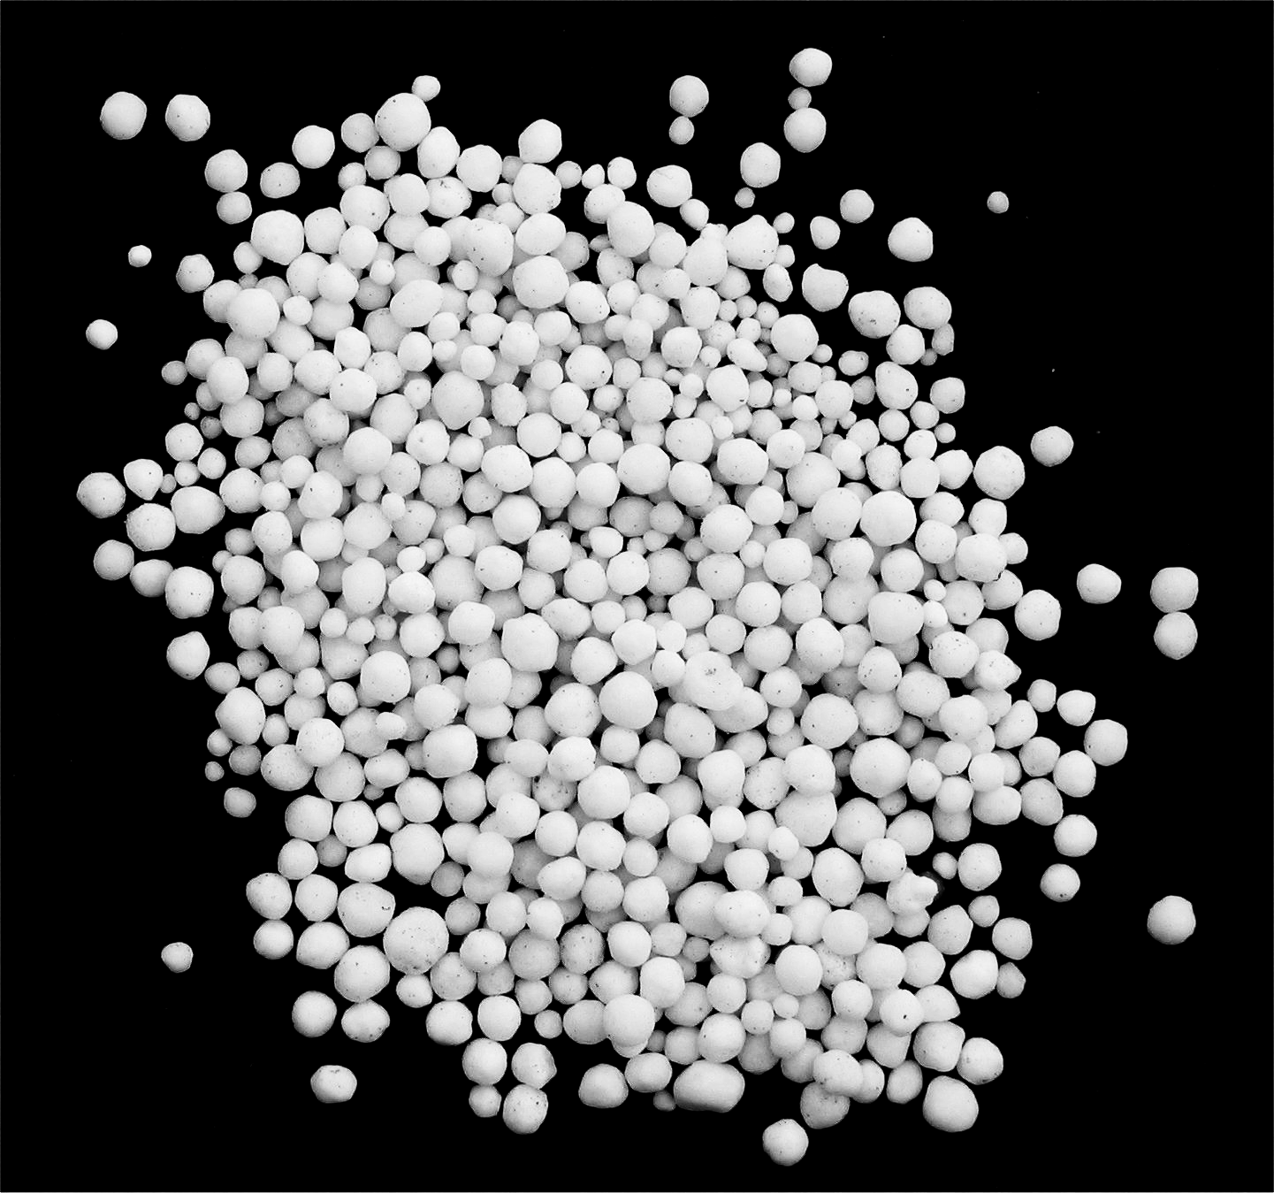
Inorganic fertiliser is often supplied in small pellets. When applied to watered soil, these pellets will quickly dissolve.

Slide 19
Leaching and Eutrophication
The use of inorganic fertilisers may have environmental consequences.
Inorganic fertilisers are highly soluble and may be leached into nearby waterways.
  As rainwater moves through the soil, it may carry dissolved fertiliser into nearby rivers or lakes.
The leaching of inorganic fertilisers may lead to eutrophication.
  The influx of nutrients into a waterway may encourage the growth of algae.
    The algae may form a bloom, covering the entire surface of the waterway.
  Owing to the lack of light, aquatic plants are unable to photosynthesise.
    This leads to the death of the plants, and a reduction in the concentration of oxygen [O₂] dissolved in the water.
  Bacteria decompose the dead plants, further reducing the [O₂] as they respire.
    This may lead to the collapse of the ecosystem, as fish and invertebrates now find it difficult to respire.
  Eutrophication video.
Organic fertilisers are far less soluble, so are unlikely to be leached from the soil.

Slide 20
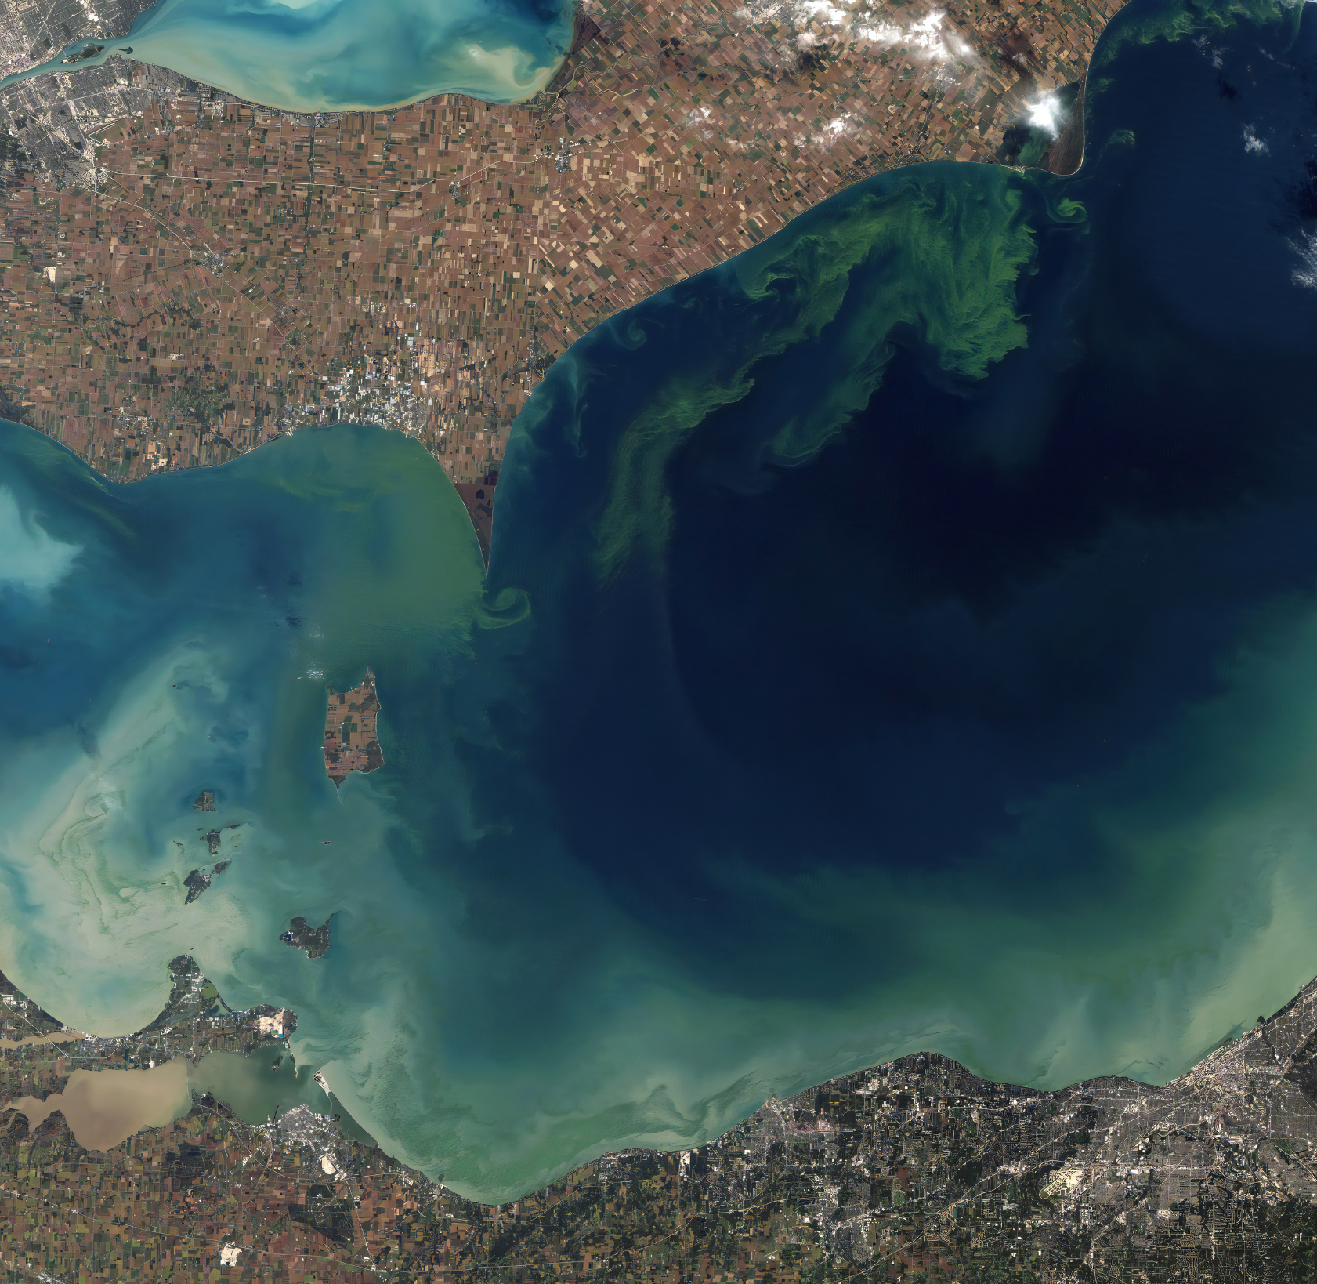
Eutrophication encourages the growth of blue-green algae which covers the surface of the waterway in an algal bloom.

Slide 21
3. SUNLIGHT IS BLOCKED BY THE ALGAL BLOOM
Eutrophication can lead to the collapse of aquatic ecosystems.
2. ALGAL BLOOM GROWS DUE TO INFLUX OF NUTRIENTS
4. AQUATIC PLANTS DIE BECAUSE THEY CANNOT PHOTOSYNTHESISE
1. DISSOLVED FERTILIZER ENTERS NEARBY WATER SOURCE
5. FISH AND OTHER ORGANISMS DIE BECAUSE OF THE LACK OF OXYGEN

