Slide 1
AQA A Level Biology
40 - Energy and Ecosystems
Biomass, Trophic Levels and Primary Productivity

Slide 2
Ecosystems and Biomass
Specification Point 3.5.3 - Energy and ecosystems.
An ecosystem can be defined as a biological community of interacting organisms and their physical environment.
  Ecosystems include both living (biotic) and non-living (abiotic) components.
All ecosystems contain producers.
Producers are organisms that make their own food.
  This type of food production is called autotrophy.
  Both terrestrial and aquatic plants are photoautotrophs; they make their own food from photosynthesis.
Some of the glucose produced by photosynthesis is used during respiration.
The rest of the glucose is incorporated into other biological molecules.
  Sucrose, cellulose and starch are all examples of such molecules.
These biological molecules are collectively referred to as the biomass of the plant.

Slide 3
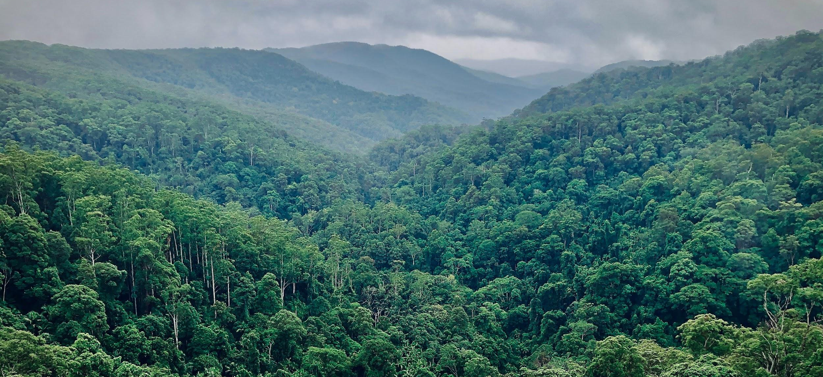
Plants and trees are considered the producers of all ecosystems. Through photoautotrophy, they convert sunlight into organic matter - biomass.

Slide 4
Biomass
Biomass has a number of different definitions.
  Biomass can be defined as the mass of living material stored in an organism.
  It can also be defined as the amount of chemical energy stored in the bonds of molecules that the organism contains.
When organisms consume other organisms, energy is transferred.
  Producers (plants) are consumed by primary consumers (herbivores).
  These primary consumers are then likely to be consumed by secondary consumers (carnivores).
One practical way to measure biomass is to calculate the dry organic mass of an organism.
  This is a measure of the amount of carbon an organism contains.
  The organism is dried and weighed at regular intervals.
  The mass of the organism will remain constant when all of the water has been removed.
  The mass of carbon is usually estimated at 50% of the total dry mass.

Slide 5
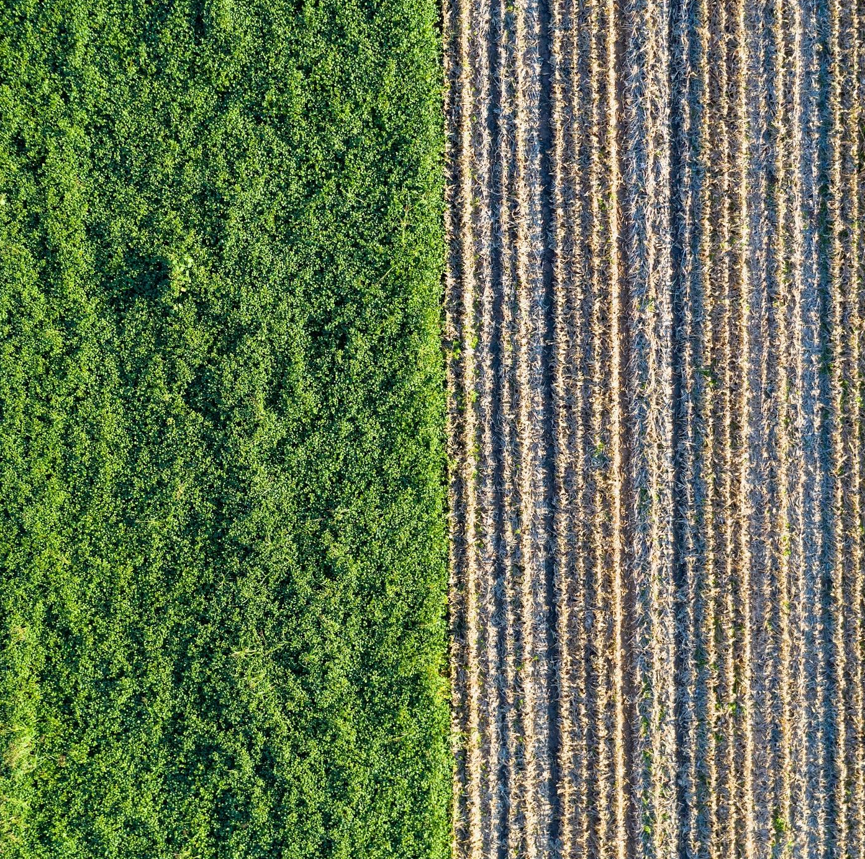
One way to estimate biomass is to dehydrate the organism in question.
Biomass is then assumed to be 50% of the total dry mass of the organism.

Slide 6
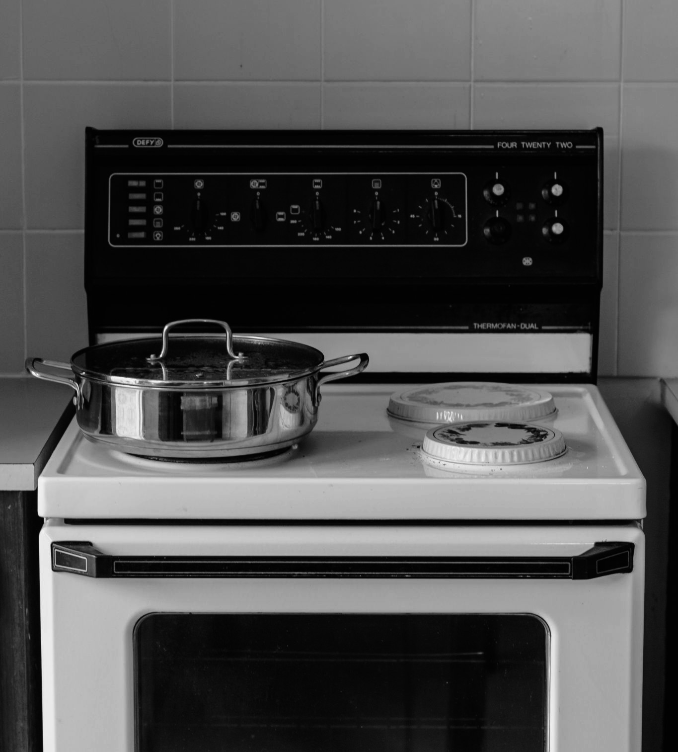
Samples are often heated in a low-temperature oven until all of the water has been removed.

Slide 7
Calorimetry
Calorimetry may be used to estimate the amount of chemical energy stored in a particular sample of biomass.
  The sample is burnt to release kinetic energy.
  The kinetic energy is used to heat a known-volume of water.
The change in temperature of the water can be used to calculate the amount of energy released.
  Energy is measured in joules (J) or kilojoules (kJ).
  The amount of energy required to heat 1 g of water by 1°C is called the specific heat capacity of water - it is approximately 4.2 J/g/°C.
Q = amount of energy released (J)
m = mass of sample (g)
C = specific heat capacity of water (4.2 J/g/°C)
∆T = change in temperature (°C)

Slide 8
STIRRER
THERMOMETER
IGNITION MECHANISM
Bomb calorimetry is often used to estimate the chemical energy present in a biomass sample. A known-volume of water is added to a sealed vessel.
The biomass is ignited and the change in temperature is used to calculate the amount of chemical energy released.
BIOMASS SAMPLE

Slide 9
Primary Productivity
Primary productivity estimates the conversion of light energy into organic compounds.
  Gross primary productivity (GPP) estimates the total amount of photosynthesis that takes place in a given area.
  Net primary productivity (NPP) estimates the total amount of organic matter that is stored in a given area.
Some of the energy produced during photosynthesis is lost as heat when the plant respires.
  This is referred to as respiratory loss (R).
  The remaining energy (NPP) is incorporated into organic molecules.
  There is thus a relationship between NPP, GPP and R:
NPP = net primary productivity
GPP = gross primary productivity
R = respiratory loss

Slide 10

Not all of the light energy that is absorbed by primary producers is converted into organic compounds.
Much of the energy is lost as heat during respiration.
If a tree takes in converts light energy into 7000 kJ of energy (GPP) and then loses 1000 kJ as heat during respiration (R), the NPP = 7000 - 1000 = 6000 kJ

Slide 11
Net Consumer Productivity
Consumers derive their energy from the ingestion of plant or animal material.
  Some of this energy is then incorporated into chemical compounds.
Only around 10% of the energy available is incorporated into the molecules of the consumer:
  Not all of the organism available to the consumer is ingested/eaten (bones, plant roots etc.)
  Some of the biological molecules are not digestible (cellulose, connective tissue etc.)
  Much of the energy taken in by the consumer is lost to the environment as respiratory losses or through the excretion of urine.
NP = Net productivity.
I = Energy available in ingested food.
F = Energy lost in faeces or urine.
R = Respiratory loss.

Slide 12
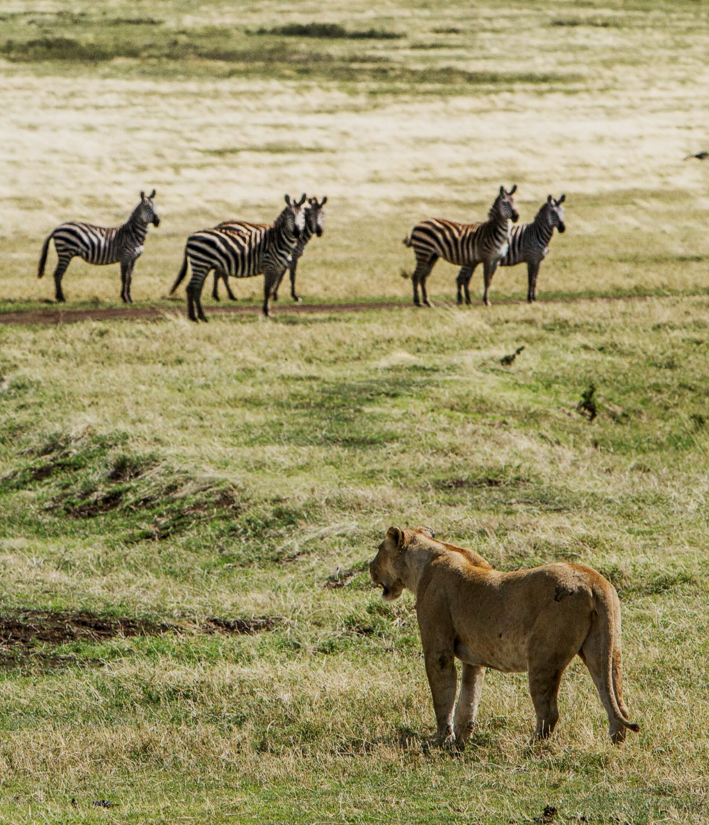
Predators such as secondary consumers will only incorporate about 10% of the total energy available to them into new organic molecules.
This is because not all of the previous trophic level will be edible and much of the energy that is ingested (I) will be lost through faeces (F) and respiration (R).

Slide 13
Food Chains and Food Webs
Food chains are simple models of energy transfer.
  A food chain is a linear sequence of organisms through which energy passes as one organism eats another.
  Each organism occupies a role in the chain, called a trophic level.
Food webs are more realistic models of energy transfer.
  Food webs consist of many interdependent food chains that may overlap between ecosystems.
  Food webs correctly depict the numerous food sources that may be available to a particular organism.
TERRESTRIAL
FOOD CHAIN
AQUATIC
FOOD CHAIN

Slide 14
A food web is a much more realistic depiction of the interconnectedness of many ecosystems.

Slide 15
Increasing Farming Efficiency
The efficiency of energy transfer is the percentage of energy that is transferred from 1 trophic level to the next:
Farmers aim to increase the amount of energy available for humans.
  Farmers try to increase both the NPP of crops and the NP of livestock.
Farmers also try to reduce energy loss to other organisms and the environment.
  Farmers simplify food webs by removing pests.
  Farmers also try to reduce the amount of heat energy lost through respiration.
%E = percentage efficiency of energy transfer
NP = net productivity of trophic level
NP₋₁ = net productivity of previous trophic level

Slide 16
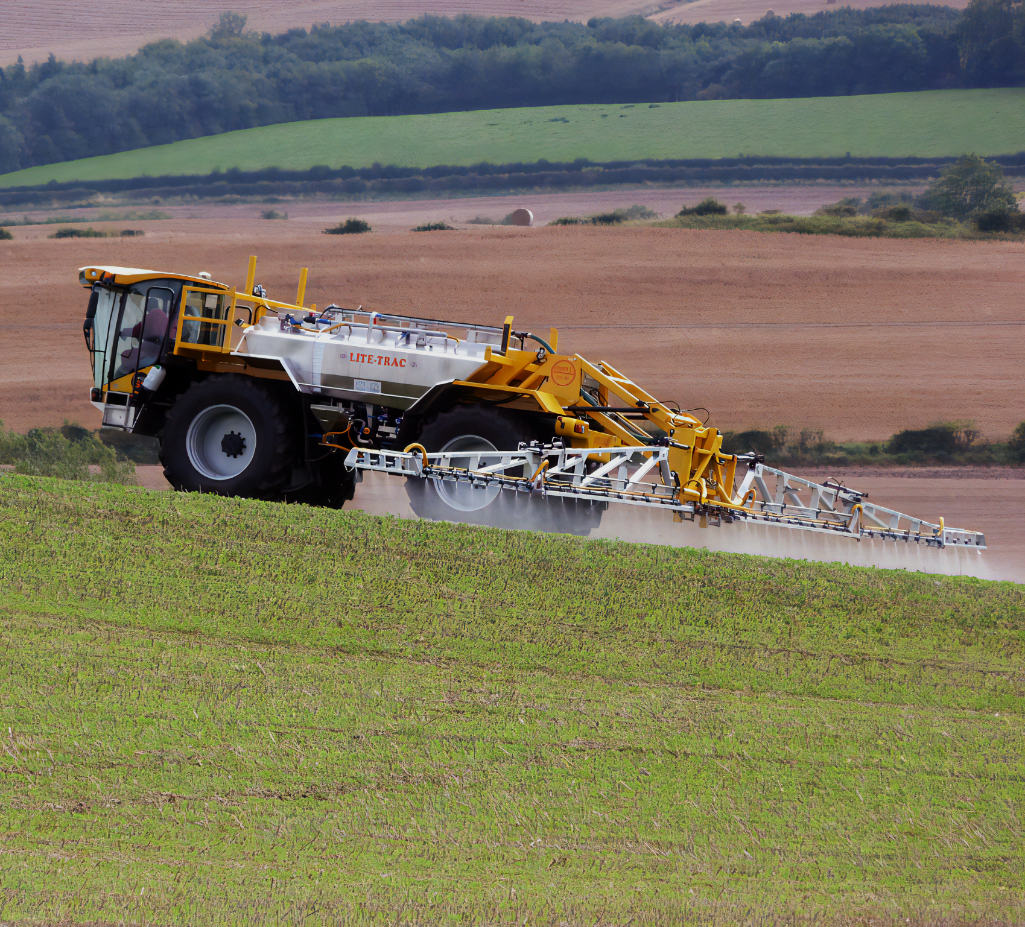
Farmers try to simplify food webs by eliminating pests.
One of the simplest and most cost-effective ways of doing this is the routine spraying of crops with pesticides.

Slide 17
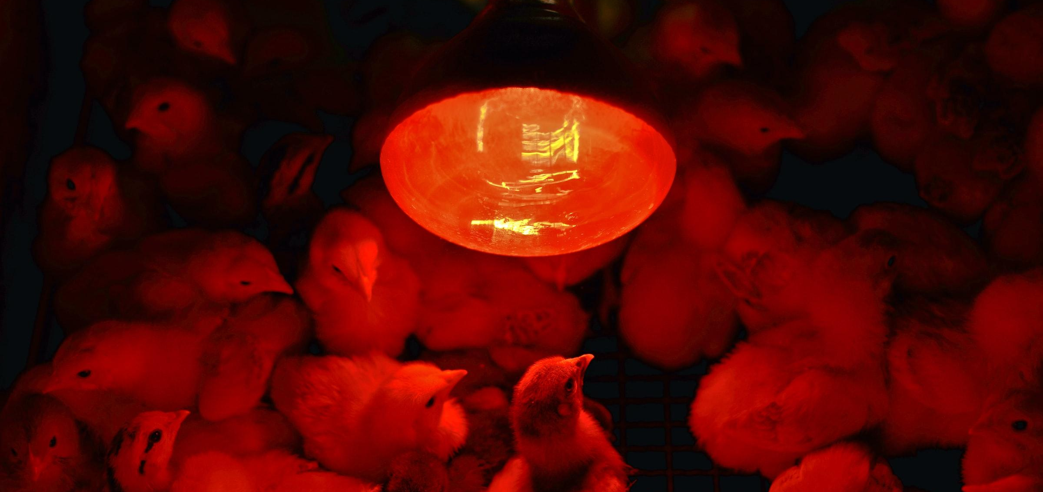
Farmers also aim to limit respiratory losses by carefully controlling the living conditions of their livestock. Chicks are kept warm to reduce the amount of energy lost as body heat.

