Slide 1
AQA A Level Biology
3 - Lipids
Triglycerides and Phospholipids

Slide 2
Triglycerides
Specification Point 3.1.3 - Lipids.
Lipids can contain a variety of elements, but all contain hydrocarbons.
  All lipids contain carbon (C), hydrogen (H) and oxygen (O).
One major group of lipids are called the triglycerides.
  Triglycerides consist of one molecule of glycerol and three molecules of fatty acids.

Slide 3
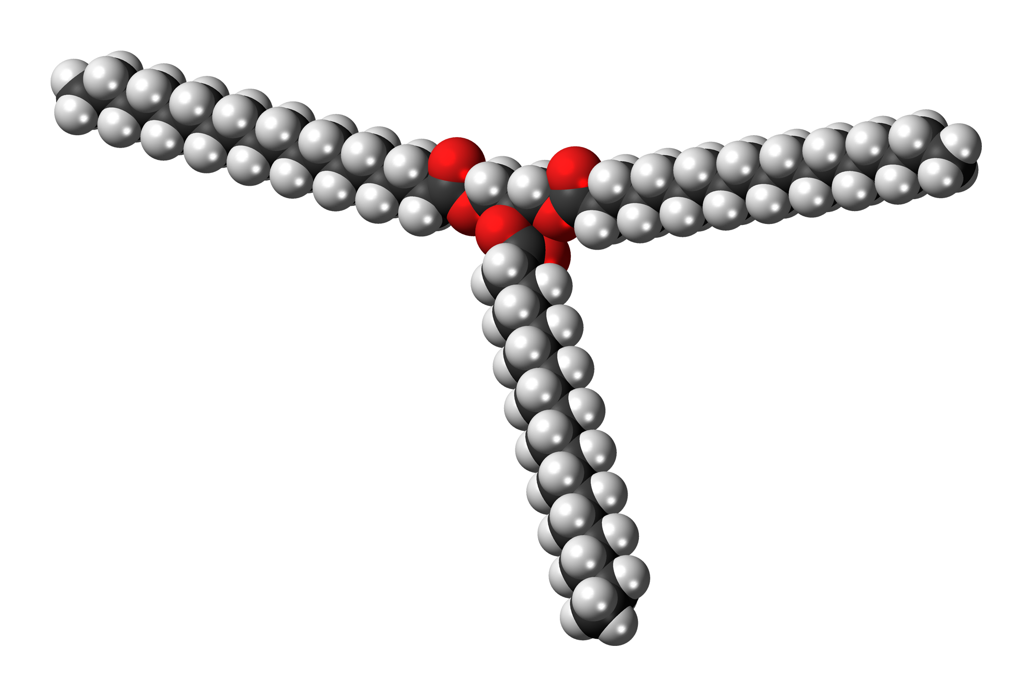
Tristearin (C₅₇H₁₁₀O₆) is an example of a triglyceride. The three fatty acids are chemically joined to a glycerol molecule.

Slide 4
Fatty Acids
All fatty acids have the same basic structure.
  The number and arrangement of the hydrocarbon ‘tail’ does differ however.
Fatty acids can be either saturated or unsaturated.
Saturated fatty acids have no double bonds between their carbon atoms.
  The fatty acid is thus ‘saturated’ with hydrogen.
    Saturated fats are more likely to be solid at room temperature.
Unsaturated fatty acids have at least one double bond between their carbon atoms.
  Monounsaturated fatty acids have a single double bond.
  Polyunsaturated fatty acids have a number of double bonds.
  Unsaturated fats are more likely to be liquid at room temperature.

Slide 5
A fatty acid. The carbon atom links the fatty acid to the glycerol whilst the R group denotes a variable hydrocarbon tail.

Slide 6
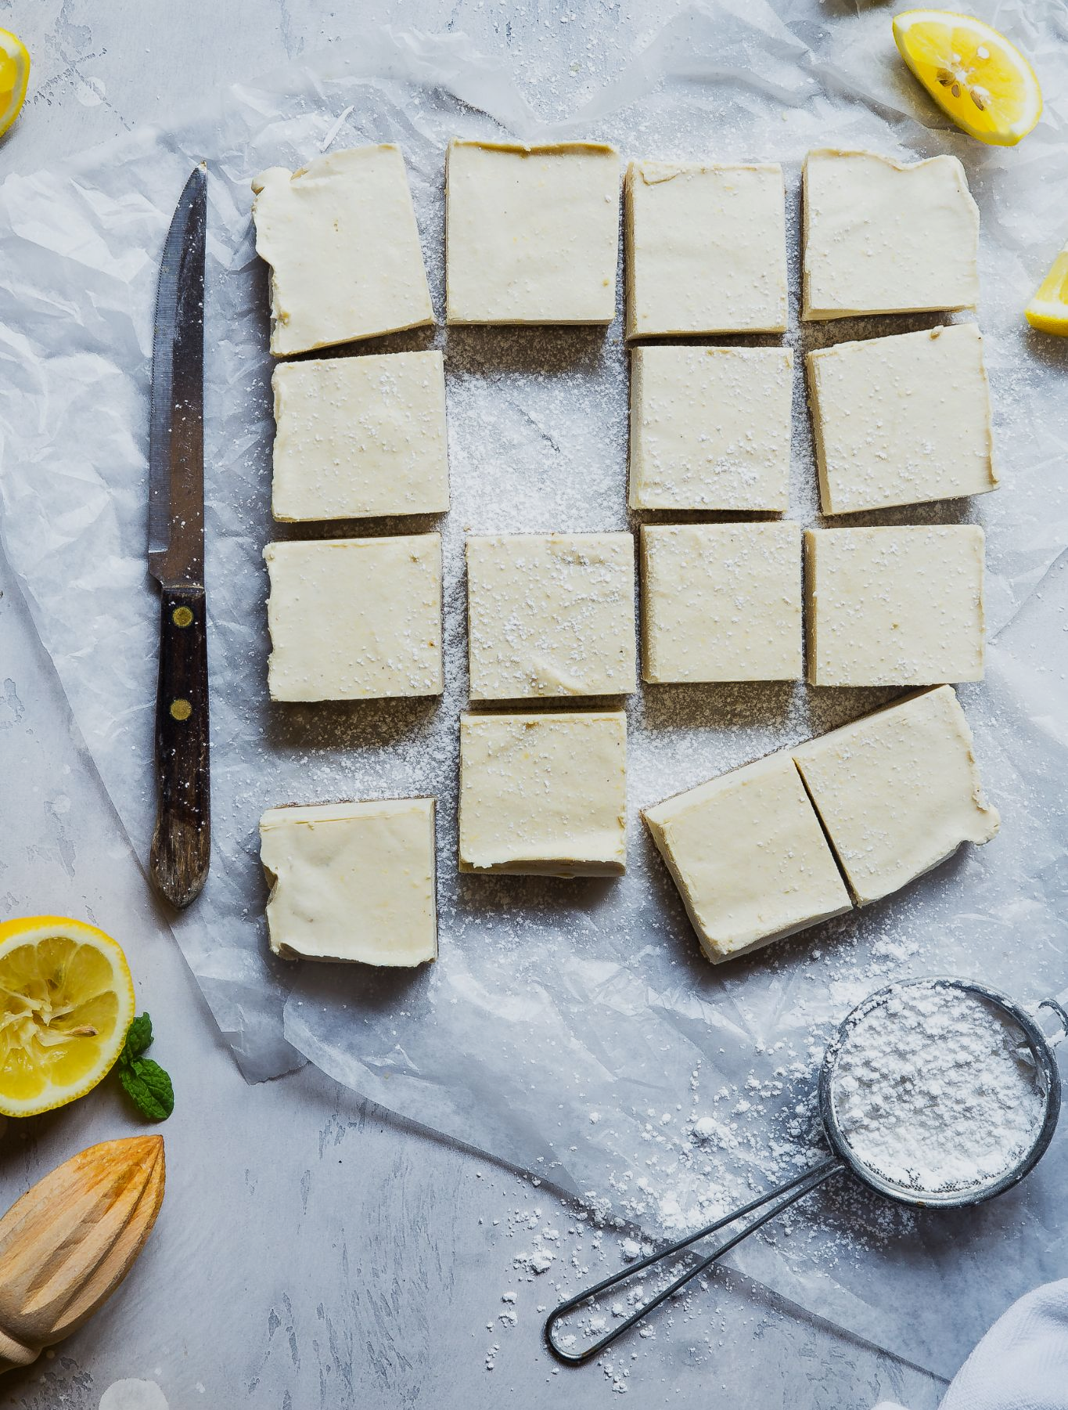
Butter is rich in saturated fatty acids.
Butter is solid at room temperature.

Slide 7

Stearic acid is saturated. There are no carbon to carbon double bonds present.
This arrangement allows them to form intermolecular bonds with neighboring fatty acids, creating a solid, tightly packed structure.
Stearic acid is uses to harden products like soap and candles.

Slide 8
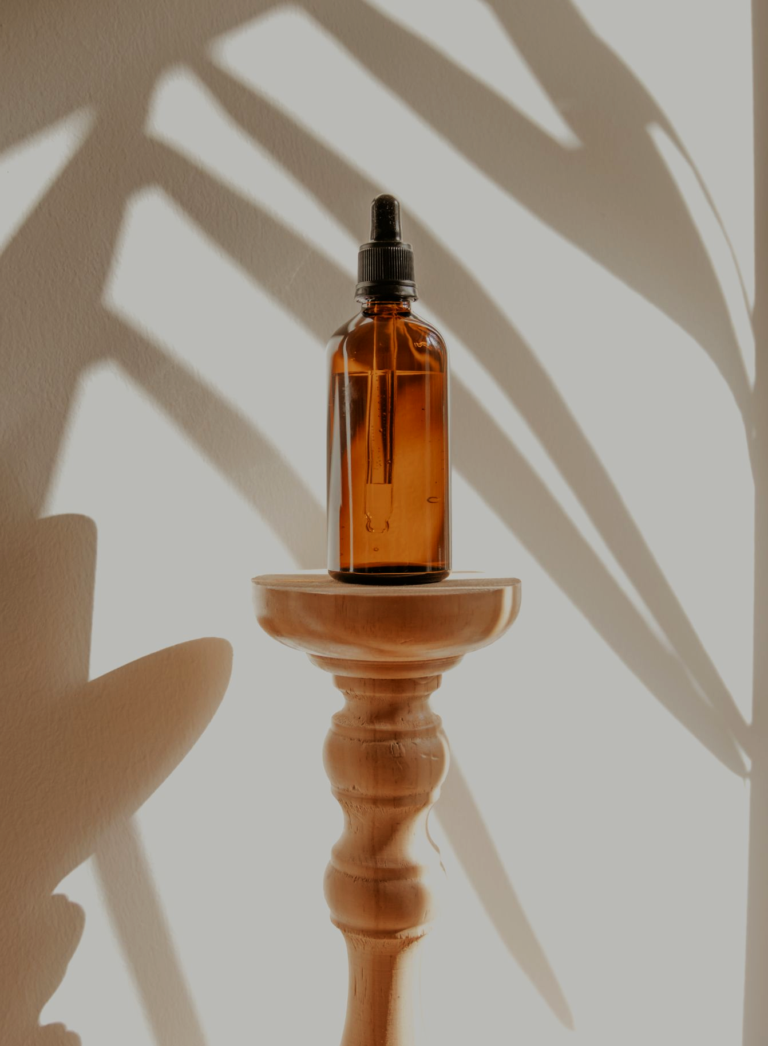
Linolenic acid is unsaturated. The presence of at least one carbon to carbon double bond causes the hydrocarbon chain to kink.
Weaker intermolecular bonds lead to much lower melting points.
As there are two double bonds, linolenic acid is a polyunsaturated fatty acid.

Slide 9
Forming Triglycerides
Triglycerides are formed by condensation reactions.
When a glycerol molecule combines with a fatty acid, an ester bond is formed.
A molecule of water is released for every ester bond formed.
  When forming a triglyceride, three molecules of water will be released.
An example triglyceride. During condensation reactions, three ester bonds will be formed between the glycerol and the three fatty acids. Three molecules of water will also be released.

Slide 10
Phospholipids
Phospholipids are found in cell membranes.
Phospholipids are structurally similar to triglycerides.
  However, 1 of the fatty acid groups is replaced by a phosphate group.
The phosphate head is hydrophilic.
  This means that it attracts water.
The fatty acid tails are hydrophobic.
  This means that they repel water.
Phospholipids make up the phospholipid bilayer, commonly referred to as the cell membrane.
PHOSPHATE
GROUP

Slide 11
Properties of Triglycerides
Triglycerides are mainly used for energy storage.
  This is because the long hydrocarbon tails contain lots of chemical energy.
  When these bonds are broken, energy is released.
  Lipids are around twice as energy-dense as carbohydrates.
Triglycerides are insoluble in water.
  This means they do not affect the water potential of cells.
  Triglycerides will bundle together as droplets due to the hydrophobic nature of the fatty acid tails.
  The tails will face inwards and the head will face outwards when immersed in water.

Slide 12
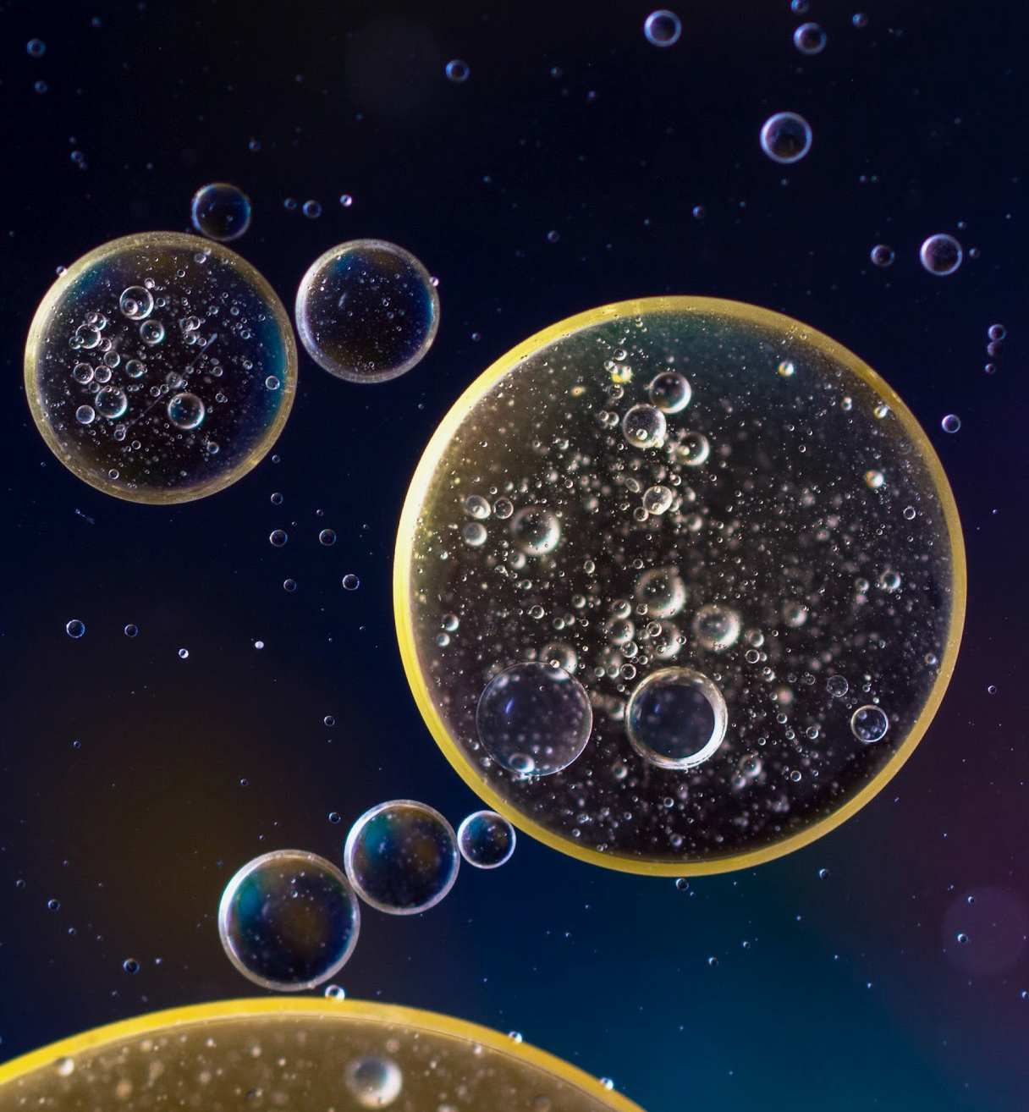
Oils will form droplets when submerged in water due to the hydrophobic nature of the fatty acid tails.

Slide 13
Properties of Phospholipids
Phospholipids make up the phospholipid bilayer.
  Phospholipids form a double layer with the phosphate heads facing outwards and the fatty acid tails facing inwards.
Phospholipids are the primary component of all cell membranes.
  Cell membranes control what enters and leaves the cell.
The bilayer acts a barrier for water-soluble substances.
  This is due to the hydrophobic core.
Phospholipids commonly orientate themselves into a bilayer. Hydrophobic phosphate heads will face inwards and hydrophilic fatty acids tails will face outwards.

Slide 14
The Emulsion Test for Lipids
The test for lipids in a food sample is called the emulsion test:
Shake the test substance with ethanol (C₂H₅OH).
  The ethanol will dissolve the lipid present.
Pour the solution into water.
  The immersion in water will cause the lipid droplets to reform.
If a lipid is present, it will show as a cloudy white emulsion.
  The greater the concentration of lipid present, the more noticeable the emulsion will be.
Emulsion test video.

Slide 15
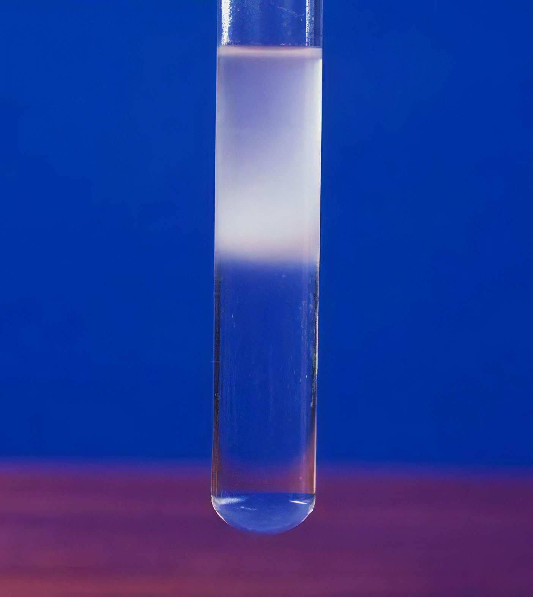
Following the emulsion test, if a lipid is present in a sample, a cloudy white emulsion will form as a layer in the upper region of the test tube.

