Slide 1
AQA A Level Biology
39 - Respiration
Aerobic and Anaerobic Respiration

Slide 2
Respiration
Specification Point 3.5.2 - Respiration.
Respiration is a biochemical process that produces ATP from glucose.
  Aerobic respiration occurs in the presence of oxygen (O₂).
  Anaerobic respiration takes place without O₂.
ATP provides energy for chemical processes.
  Active transport, DNA replication, muscle contraction, cell division and protein synthesis all use ATP as a source of energy.
6O₂ + C₆H₁₂O₆ → 6CO₂ + 6H₂O + 32ATP
Aerobic respiration produces ATP from 6 molecules of O₂ and a single molecule of glucose (C₆H₁₂O₆).

Slide 3
Respiration
Aerobic respiration occurs in the mitochondria.
  A mitochondrion is a membrane-bound organelle with a very large SA:V.
  This high SA:V increases the rate of respiration.
Anaerobic respiration occurs in the cytoplasm of the cell.
Respiration requires coenzymes.
  Coenzymes improve the functionality of enzymes.
  Nicotinamide adenine dinucleotide (NAD), flavin adenine dinucleotide (FAD) and coenzyme A (coA) are all examples of coenzymes.
Aerobic respiration takes place inside the mitochondria of a cell, whilst anaerobic respiration takes place in the cytoplasm.

Slide 4
The mitochondrion is the site of aerobic respiration.
DNA
MATRIX GRANULE
RIBOSOME
INNER MEMBRANE
MATRIX
ATP SYNTHASE
INTERMEMBRANE SPACE
OUTER MEMBRANE

Slide 5
Stages of Respiration
There are 4 stages to aerobic respiration.
Glycolysis occurs in the cytoplasm.
  Glycolysis converts a single glucose molecule into 2 molecules of the 3-carbon acid pyruvate.
The link reaction occurs in the mitochondrial matrix.
  The link reaction decarboxylates (removes a carbon from) pyruvate into the 2-carbon acetate.
  Acetate is then combined with coA to form acetyl coA.
The Krebs cycle also occurs in the mitochondrial matrix.
  Acetate is fed into the Krebs cycle and combined with the 4-carbon oxaloacetate.
  A series of redox reactions occur to create the reduced coenzymes NADH and FADH.
Oxidative phosphorylation takes place on the surface of the inner mitochondrial membrane.
  NADH and FADH are oxidised using a chain of electron carriers.
  This allows ADP to be phosphorylated into ATP.

Slide 6
Glycolysis
Glycolysis is involved in both aerobic and anaerobic respiration.
Glycolysis creates 2 molecules of pyruvate from a single glucose molecule:
Glucose is phosphorylated twice to form an unstable molecule of hexose bisphosphate.
  This requires the conversion of 2 molecules of ATP into ADP.
The hexose bisphosphate splits into 2 molecules of triose phosphate (TP).
  TP is then oxidised into pyruvate.
The oxidation of TP into pyruvate creates ATP and reduced electron carriers.
  4 ATP molecules and 2 NADH molecules are created.
  The net gain of ATP is only 2 molecules per glucose.
    This is because 2 ATP molecules were consumed earlier in glycolysis, when glucose was phosphorylated into hexose bisphosphate.

Slide 7
GLUCOSE (6C)
ATP → ADP
GLUCOSE PHOSPHATE (6C)
In glycolysis, glucose is phosphorylated into a molecule of hexose bisphosphate. After the hexose bisphosphate has split into 2 molecules of TP, it is then oxidised to pyruvate.
The net gain from glycolysis is 2 molecules of ATP and 2 molecules of NADH.
ATP → ADP
HEXOSE BISPHOSPHATE (6C)
2X TRIOSE PHOSPHATE (3C)
4X ADP → 4X ATP
2X NAD → 2X NADH
2X PYRUVATE (3C)

Slide 8
Anaerobic Respiration
There are 2 forms of anaerobic respiration.
  Lactate fermentation takes place in animal cells and some bacteria.
  Alcoholic fermentation takes place in plant cells and yeast.
Lactate fermentation converts pyruvate into lactic acid.
Alcoholic fermentation converts pyruvate first to ethanal and then to ethanol.
  This is a decarboxylation reaction with CO₂ also released as a byproduct.
Fermentation oxidises NADH back to NAD.
  This is referred to as the regeneration of NAD.
The regeneration of NAD allows glycolysis to continue.
  NAD is required to convert TP to pyruvate, thus generating a small amount of ATP.
  Anaerobic respiration generates 2 molecules of ATP per molecule of glucose.

Slide 9
LACTATE FERMENTATION
PYRUVATE (3C)
LACTIC ACID (3C)
NADH → NAD
In lactate fermentation, pyruvate is converted into lactic acid. This oxidises NADH back to NAD.
ALCOHOLIC FERMENTATION
PYRUVATE (3C)
ETHANAL (2C)
ETHANOL (2C)
↓ CO₂
NADH → NAD
In alcoholic fermentation, pyruvate is decarboxylated into ethanal and then ethanol. NADH is oxidised to NAD.

Slide 10
The Link Reaction
In the link reaction, pyruvate is oxidised to form the 2-carbon compound acetate.
  A molecule of CO₂ is released during this decarboxylation reaction.
As the pyruvate is oxidised, a molecule of NAD is reduced to form NADH.
CoA then combines with acetate to form acetyl coA.
  No ATP is formed during the link reaction.
As 2 molecules of pyruvate are created per molecule of glucose, the link reaction occurs twice for every glucose molecule.
  As a result, 2 molecules of NADH are made per glucose.
PYRUVATE (3C)
→ CO₂
ACETATE (2C)
CoA →
NAD → NADH
ACETYL CoA (2C)

Slide 11
The Krebs Cycle
During the Krebs cycle, coenzymes are reduced and ATP is synthesised.
Per glucose, the Krebs cycle forms the following:
  6 molecules of NADH from NAD.
  2 molecules of FADH from FAD.
  2 molecules of ATP from ADP and P_{i}.
The 4-carbon compound oxaloacetate combines with the 2-carbon acetyl coA.
  This forms the 6-carbon compound citrate.
Citrate is decarboxylated and dehydrogenated to the 5-carbon compound alpha-ketoglutarate.
  A molecule of CO₂ is removed during this decarboxylation.
  Dehydrogenation frees a hydrogen atom which is used to reduce a molecule of NAD to NADH.

Slide 12
The Krebs Cycle
Alpha-ketoglutarate is decarboxylated and dehydrogenated further.
  A number of 4-carbon intermediate compounds are formed.
  Again, the decarboxylation releases a molecule of CO₂ and the hydrogen released from the dehydrogenation is used to reduce a molecule of NAD to NADH.
The final 4-carbon intermediate is reformed into a molecule of oxaloacetate.
  This reaction reduces a molecule of NAD to NADH.
  It also reduces a molecule of FAD to FADH.
At the end of glycolysis, the link reaction and the Krebs cycle, the following has been made per glucose:
  10 molecules of NADH.
  2 molecules of FADH.
  4 molecules of ATP.

Slide 13
The Krebs cycle runs twice per molecule of glucose.
Its primary function is to form reduced coenzymes (NADH and FADH) that are used in oxidative phosphorylation - the final stage of aerobic respiration.

Slide 14
Oxidative Phosphorylation
During oxidative phosphorylation, NADH and FADH are oxidised to NAD and FAD.
  This allows for the synthesis of more ATP.
As NADH and FADH are oxidised, they release protons (H⁺) and electrons (e⁻).
Electrons move down proteins called electron carriers.
  As they move down the carriers, electrons lose energy.
  This energy is used to pump protons from the matrix into the intermembrane space.
An electrochemical gradient is established in the intermembrane space.
  There are now many more positively charged protons in the intermembrane space than in the matrix.
  As protons are acidic, there is now a lower pH in the intermembrane space than in the matrix.

Slide 15
Oxidative Phosphorylation
Protons use this electrochemical gradient to return to the matrix, through an enzyme called ATP synthase.
  ATP synthase is powered by the flow of protons to synthesise ATP from ADP and P_{i}.
  This process is referred to as chemiosmosis.
Electrons combine with protons and oxygen to form water.
  O₂ is referred to as the terminal electron acceptor.
At the end of aerobic respiration, 32 molecules of ATP have been formed.
  Each NADH is used to make 2.5 molecules of ATP.
  Each FADH is used to make 1.5 molecules of ATP.
Stage of Respiration | Molecules Produced | ATP Yield
Glycolysis | 2ATP, 2NADH | 7ATP
Link Reaction (2 reactions per glucose) | 2NADH | 5ATP
Krebs Cycle (2 rotations per glucose) | 2ATP, 6NADH, 2FADH | 20ATP

Slide 16
3. PROTONS MOVE THROUGH ATP SYNTHASE BY CHEMIOSMOSIS. THIS POWERS THE ENZYME SO IT MAY SYNTHESIZE ATP FROM ADP AND P_{i}
2. THE ENERGY RELEASED FROM ELECTRONS IS USED TO PUMP PROTONS FROM THE MATRIX TO THE INTERMEMBRANE SPACE. THIS CREATES AN ELECTROCHEMICAL GRADIENT
H⁺
H⁺
H⁺
H⁺
INTERMEMBRANE SPACE
I
II
III
MATRIX
NADH
½O₂
2H⁺ + 2e⁻ + ½O₂ → H₂O
NAD + H⁺ + e⁻
4. ELECTRONS, ALONGSIDE PROTONS AND THE TERMINAL ELECTRON ACCEPTOR (OXYGEN), COMBINE TO FORM WATER
ATP
1. A MOLECULE OF NADH IS OXIDISED TO RELEASE A PROTON AND AN ELECTRON. ENERGY IS RELEASED FROM THIS ELECTRON AS IT MOVES BETWEEN ELECTRON CARRIERS
ADP + P_{i}
H⁺

Slide 17
The mitochondrial genome. Mutations in this genome can lead to mitochondrial diseases. These may affect any stage of aerobic respiration, leading to reduced ATP production.
Anaerobic respiration may increase to try to counteract the reduction in ATP. This may lead to more lactate production, increasing the likelihood of muscle fatigue and weakness.

Slide 18
Alternative Substrates
Glucose is referred to as the primary respiratory substrate.
  This means it is the molecule that is most likely to be broken down into ATP.
Other molecules can also function as respiratory substrates.
  These substrates are often formed in the breakdown of larger molecules.
Fats may act as respiratory substrates during times of fasting or starvation.
  Glycerol may enter glycolysis.
  Fatty acids may enter the Krebs cycle.
Proteins may act as respiratory substrates during times of extreme starvation.
  Amino acids can be converted to molecules that may enter the Krebs cycle.
Whilst glucose is the most common respiratory substrate, other molecules like fatty acids can also be respired.

Slide 19
Respiration Experiments
Practical 9: Investigating the effect of temperature on the rate of respiration of cultures of single-celled organisms.
Yeast is a single-celled organism that can respire both aerobically and anaerobically.
  Both forms of respiration release CO₂.
  The rate of CO₂ production can be used as a measure of respiration.
Mix 10 g of dried yeast with 5 cm³ of glucose solution and pH buffer and add to 3 test tubes.
  Place test tubes in the water bath at 30°C and leave for 10 minutes to equilibrate.
Insert a holed bung into each of the test tubes and attach with a glass tube to a gas syringe.
  As the yeast respires, CO₂ will move down the tube to fill the gas syringe.
Every minute, record the volume of CO₂ produced.
  Repeat this experiment 3 times to yield a mean value.
  Repeat at different temperatures (10°C, 20°C, 40°C) to find the optimal rate for yeast respiration.
Respiration practical video.

Slide 20
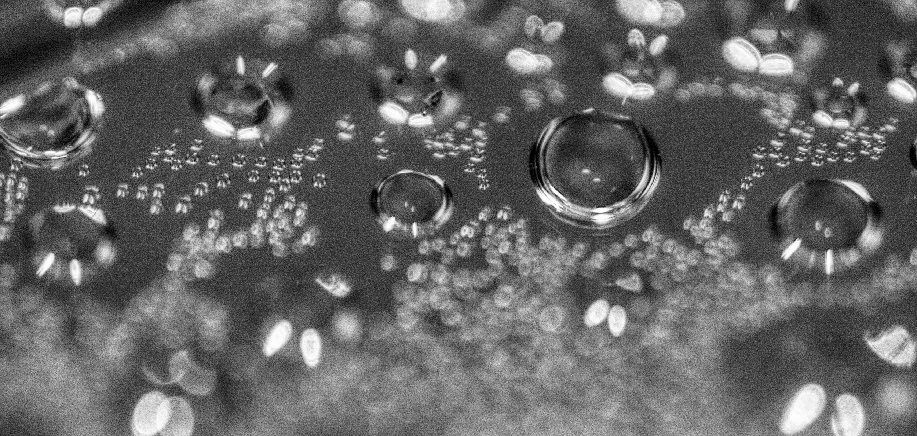
The CO₂ from yeast has a variety of industrial uses, most notably in bread-making and beer production.

