Slide 1
AQA A Level Biology
38 - The Rate of Photosynthesis
Maximising Plant Growth, Chromatography and DCPIP

Slide 2
Conditions for Photosynthesis
Specification Point 3.5.1 - Photosynthesis.
Plants require particular environmental conditions to grow.
Most plants grow well at around 25°C.
  Enzymes such as rubisco are vital for photosynthesis.
  If it is too cold, enzymes will not have the required kinetic energy to function correctly.
  If it is too hot, enzymes will denature.
  Very high temperatures will also cause the plant to rapidly dehydrate, slowing down the rate of photosynthesis.
Plants grow well at a carbon dioxide (CO₂) concentration of 0.4%.
  The CO₂ concentration in the atmosphere is currently around 0.04%.
  Increasing the concentration to 0.4% will increase the rate of photosynthesis.
  Concentrations about 0.4% will force stomata to close, limiting the rate of photosynthesis.

Slide 3
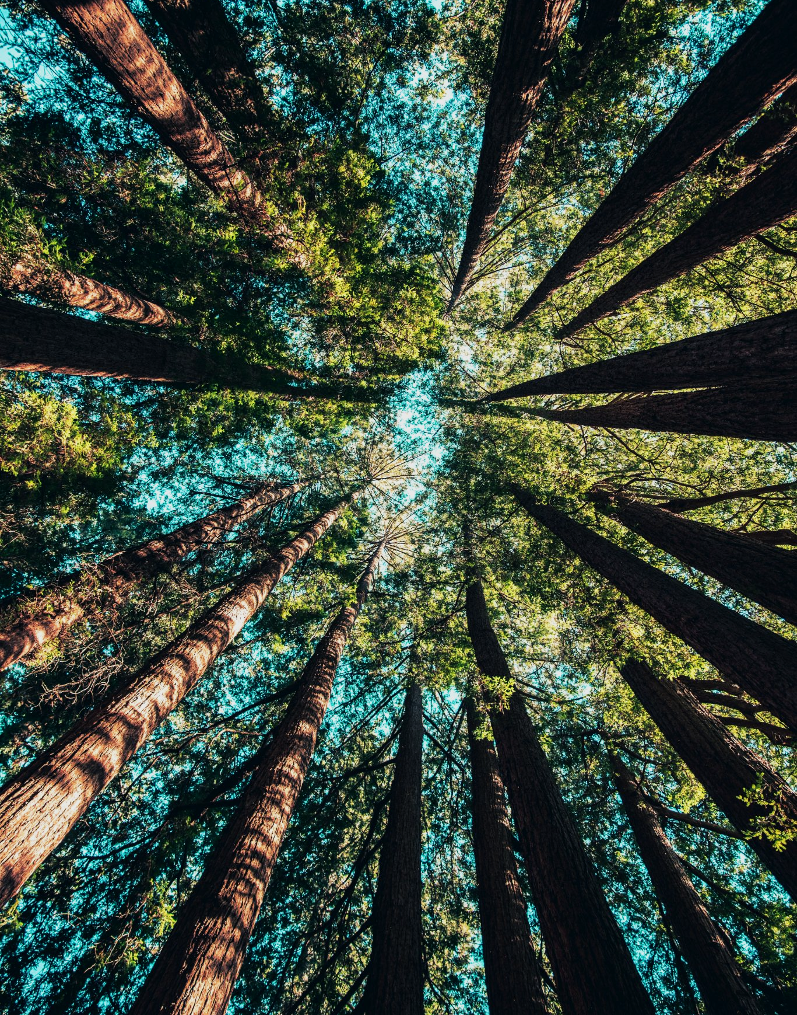
Plants and trees grow best at around 25°C.
This is the optimum temperature for photosynthesis and is commonly found in temperate areas.

Slide 4
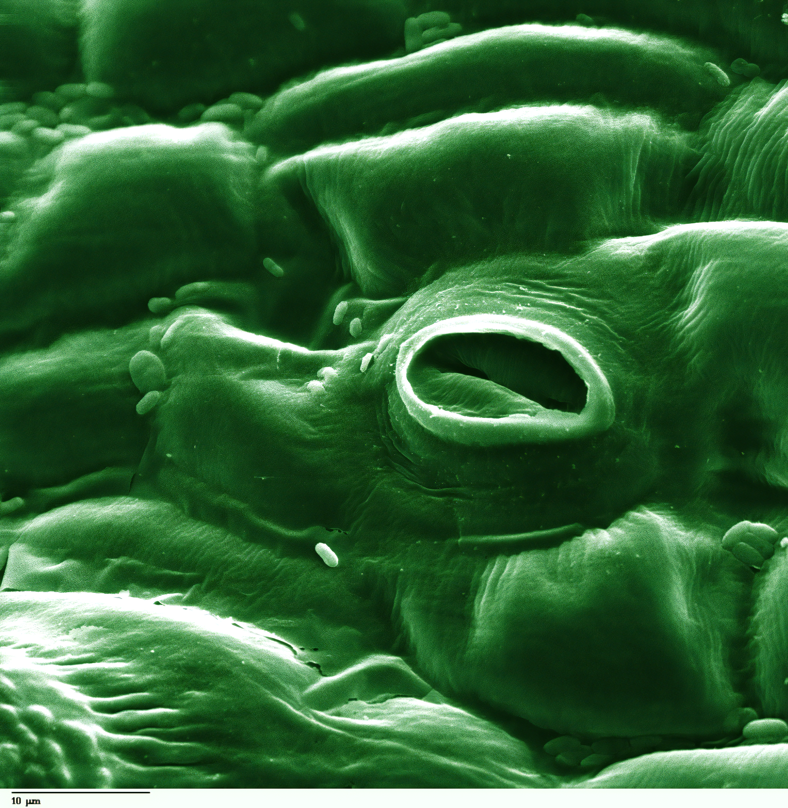
Stomata are small pores that are usually found on the underside of the leaf.
When the [CO₂] exceeds 0.4% the stomata will close, halting photosynthesis.

Slide 5
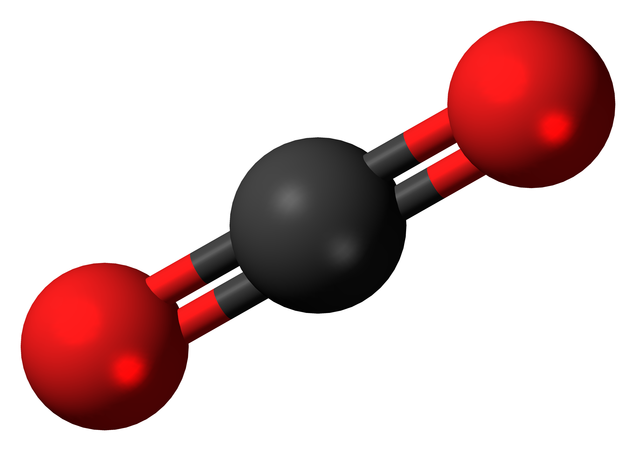
Conditions for Photosynthesis
Plants require high light intensity of particular wavelengths.
  Light energy is required for photophosphorylation.
  Only certain wavelengths of light are absorbed by photosynthetic pigments such as chlorophyll.
    Blue and red light are well-absorbed, green, yellow and orange light less so.
Plants require a constant supply of water.
  Water is required for photolysis in the light-dependent reaction.
  Too much rainfall can lead to waterlogged soil which can limit the uptake of mineral ions.
Increasing [CO₂] will increase the rate of photosynthesis up to a point.

Slide 6
CHLOROPHYLL B
CHLOROPHYLL A
Photosynthetic pigments like chlorophyll a and b only absorb certain wavelengths of light.
LIGHT ABSORBANCE →
WAVELENGTH →
VIOLET LIGHT
RED LIGHT

Slide 7
Limiting Factors and Agriculture
Light, [CO₂] and temperature can all limit the rate of photosynthesis.
  These are referred to as limiting factors.
If a particular factor is too low, compared to the other factors, the rate of photosynthesis will slow down.
  During nighttime, light intensity is the limiting factor.
Farmers can maximise the rate of crop growth by manipulating limiting factors.
  [CO₂] can be increased by burning paraffin lamps in greenhouses.
  Light can be provided throughout the night by using lamps.
  A consistent temperature can be achieving using sophisticated heating and cooling systems.

Slide 8
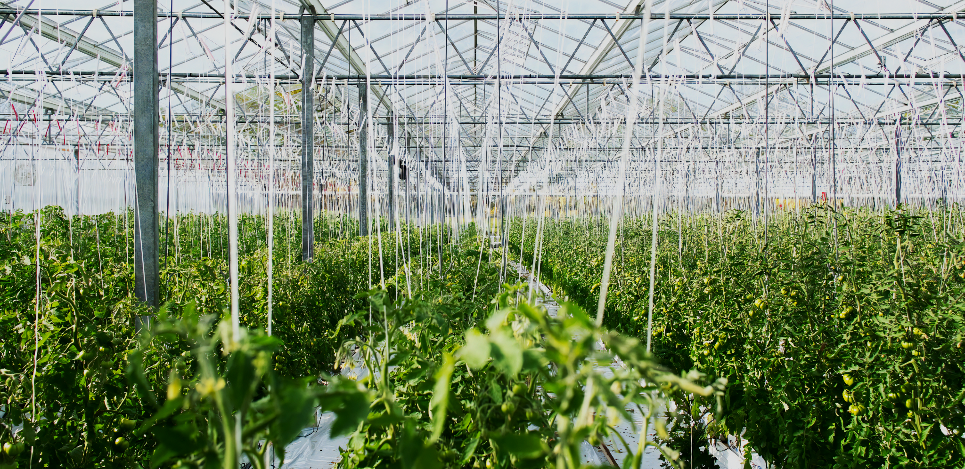
Glasshouses can be used on an industrial scale to grow crops like bananas.

Slide 9
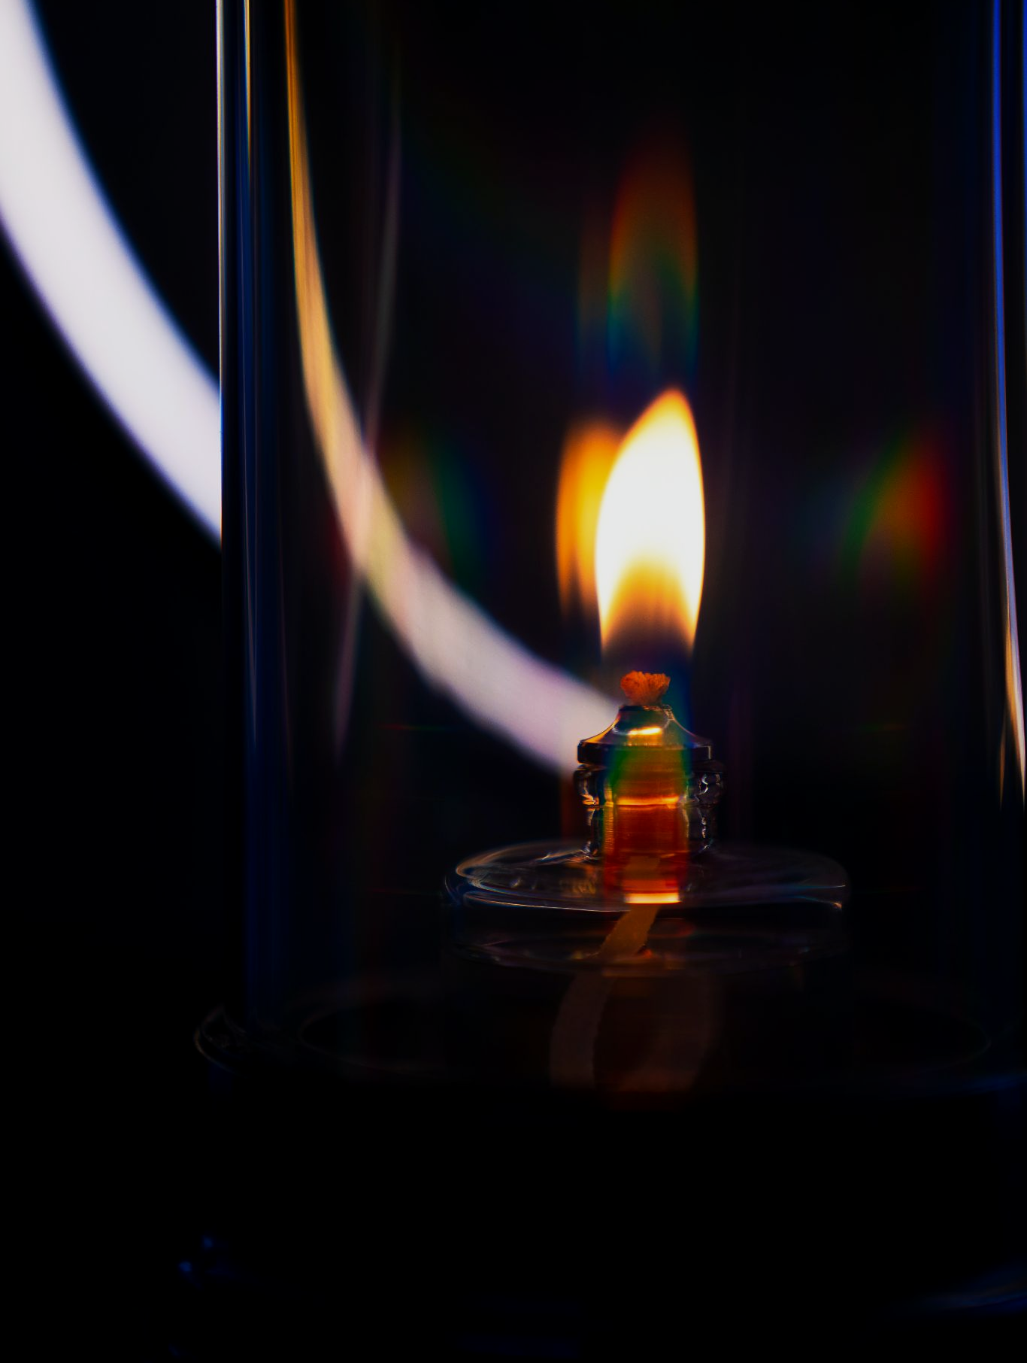
Many farmers burn paraffin lamps to increase [CO₂].

Slide 10
Chromatography
Chromatography is used to separate compounds in a mixture.
  Separation allows for easier identification of the compounds.
There are 2 popular forms of chromatography:
  Paper chromatography.
  Thin-layer chromatography (TLC).
Chromatography has 2 phases:
  Molecules move during the mobile phase.
    The mobile phase is usually a liquid-solvent.
  Molecules can’t move during the stationary phase.
    In paper chromatography the stationary phase is a section of chromatography paper.
    In TLC the stationary phase is a piece of plastic, glass or other solid substrate.

Slide 11
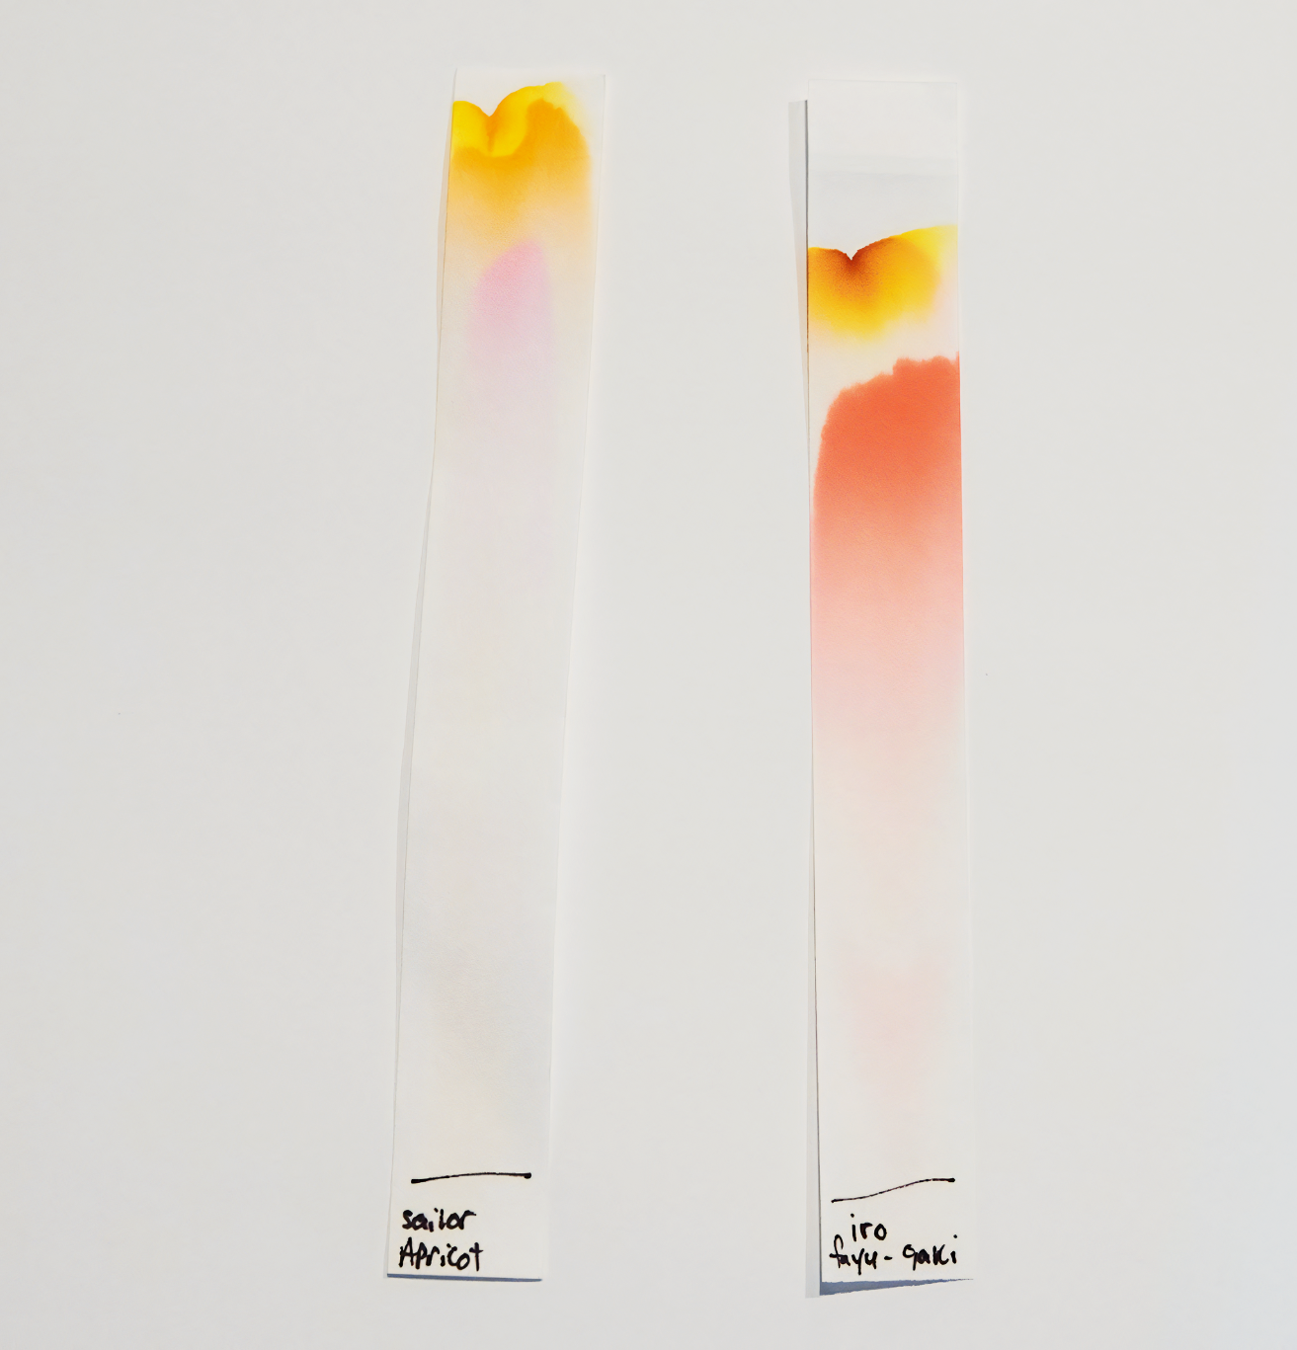
Paper chromatograms of 2 different dyes.
Due to their differing solubilities in the same solvent, different dyes will move different distances.

Slide 12
Investigating Leaf Pigments Using Chromatography
Practical 7: Use of chromatography to investigate the pigments isolated from leaves of different plants.
Draw a line in pencil about 1 cm above the bottom of the chromatography paper.
Grind up a sample of leaf and add some acetone.
  This will release the pigment from the leaves.
Use a pipette to transfer some of the pigment from a capillary tube onto the pencil line.
Lower the paper into a beaker containing an alcoholic solvent.
  Ensure that the level of the liquid does not lie above the pencil line.
  Leave the paper until the solvent has run up the entire length of the paper.
The pigment will separate out into different compounds.
  This will leave spots of color at different heights on the paper.
Calculate the retardation factor (R_{f}) for each spot.
Chromatography practical video.

Slide 13
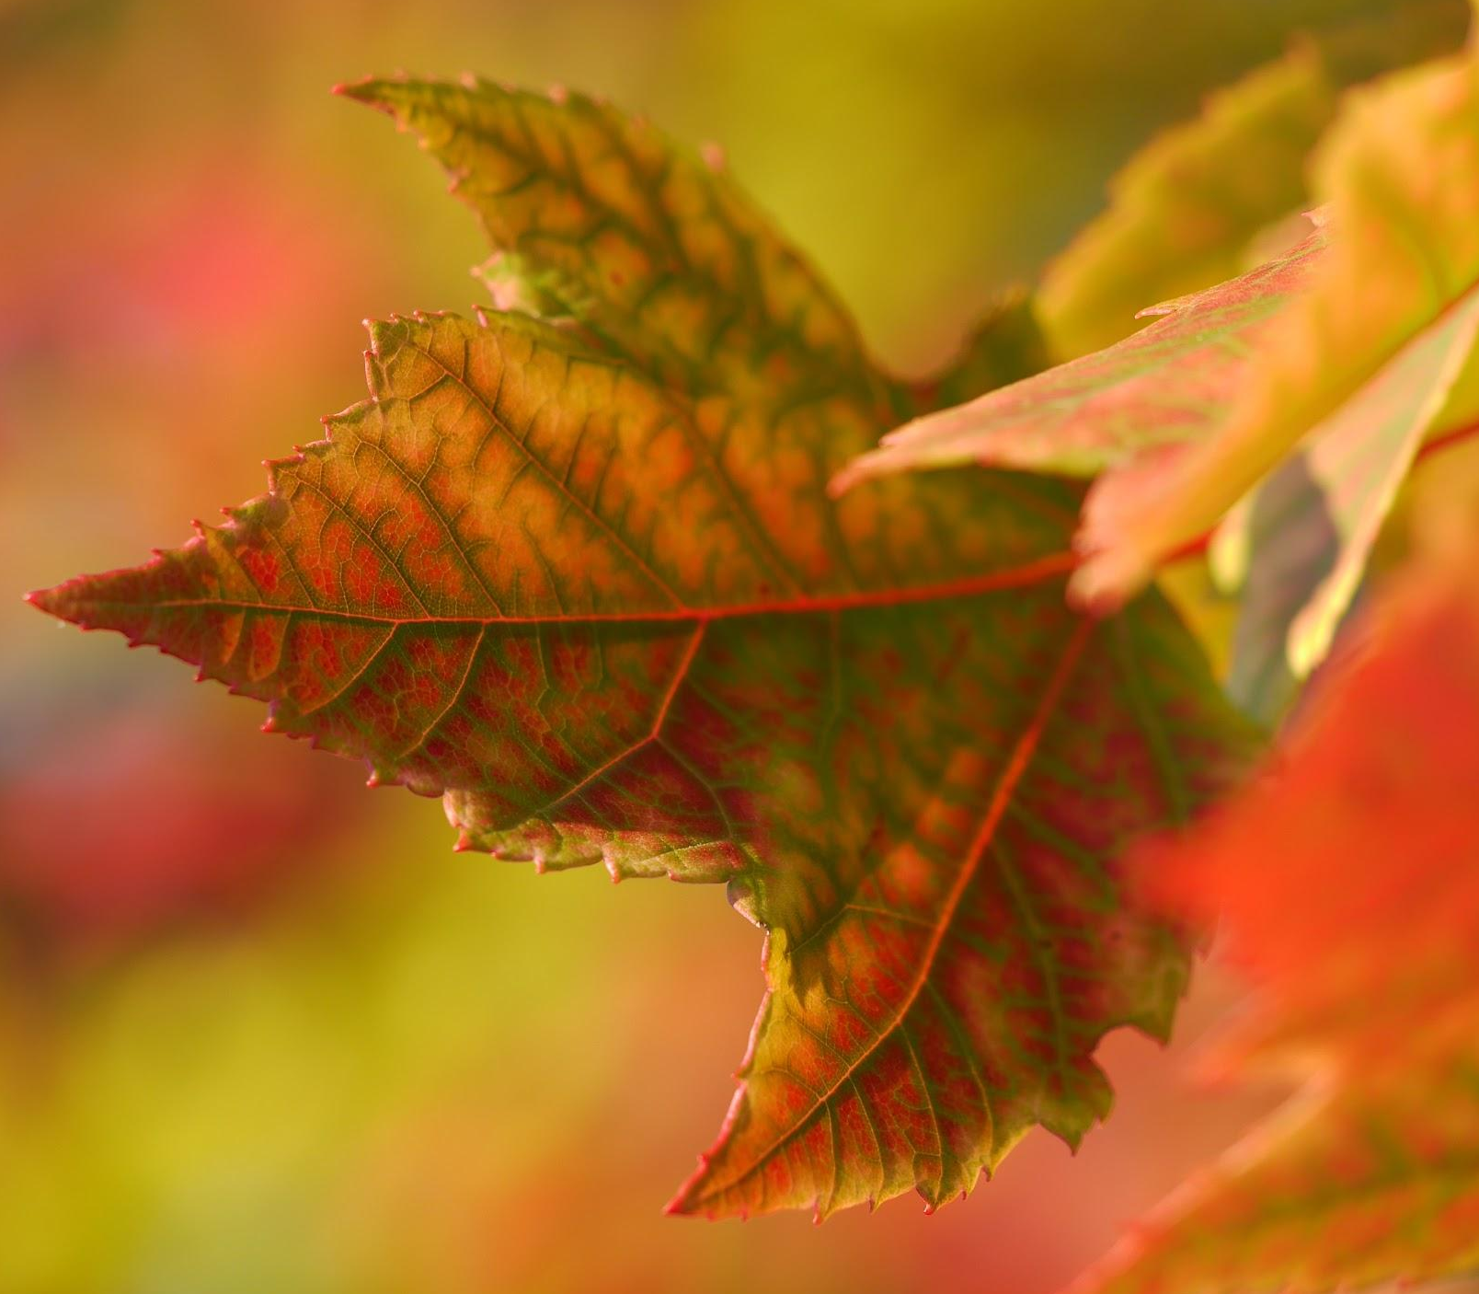
Chlorophylls, carotenoids and anthocyanins are all examples of photosynthetic pigments found in the leaf.
Each has a different colour that is easy to distinguish on a chromatogram.

Slide 14
R_{f} = retardation factor
S_{e} = distance travelled by solute (cm)
S_{v} = distance travelled by solvent (cm)
10 CM
R_{f} values are calculated by comparing the distance travelled by the solvent with the distance travelled by a particular solute.
In this case the orange solute has travelled 6 cm, relative to the 10 cm of the solvent. R_{f} = 6/10 = 0.6.
6 CM

Slide 15
NADP and Redox Reactions
During the light-dependent reaction, NADP is reduced to NADPH.
  This reaction is catalysed by a dehydrogenase enzyme.
The activity of dehydrogenases can be investigated using redox indicator dyes.
  Redox indicator dyes mimic the action of NADP by accepting electrons.
DCPIP is a redox indicator dye that changes colour when reduced.
  DCPIP loses its blue colour when it is reduced.
The rate of dehydrogenase enzyme activity can be measured using DCPIP and a colorimeter.
  As DCPIP turns colourless, more light will pass through.
  Reduced DCPIP will have a lower absorbance value than oxidised DCPIP.

Slide 16
Investigating Leaf Pigments Using Chromatography
Practical 8: Investigating the effect of light intensity on the rate of dehydrogenase activity in extracts of chloroplasts.
Grind pieces of chopped spinach using a pestle and mortar.
  Suspend the product in an ice cold, isotonic buffer.
  Filter the sample into a beaker using a muslin cloth.
Transfer to centrifuge tubes and centrifuge at high speed for 10 minutes.
  This will gather the chloroplasts in a pellet at the bottom of the tube.
Remove the supernatant and add the pellet to a fresh sample of buffer.
Set the colorimeter to the red filter.
  Zero the colorimeter using a cuvette containing chloroplast extract and distilled water.

Slide 17
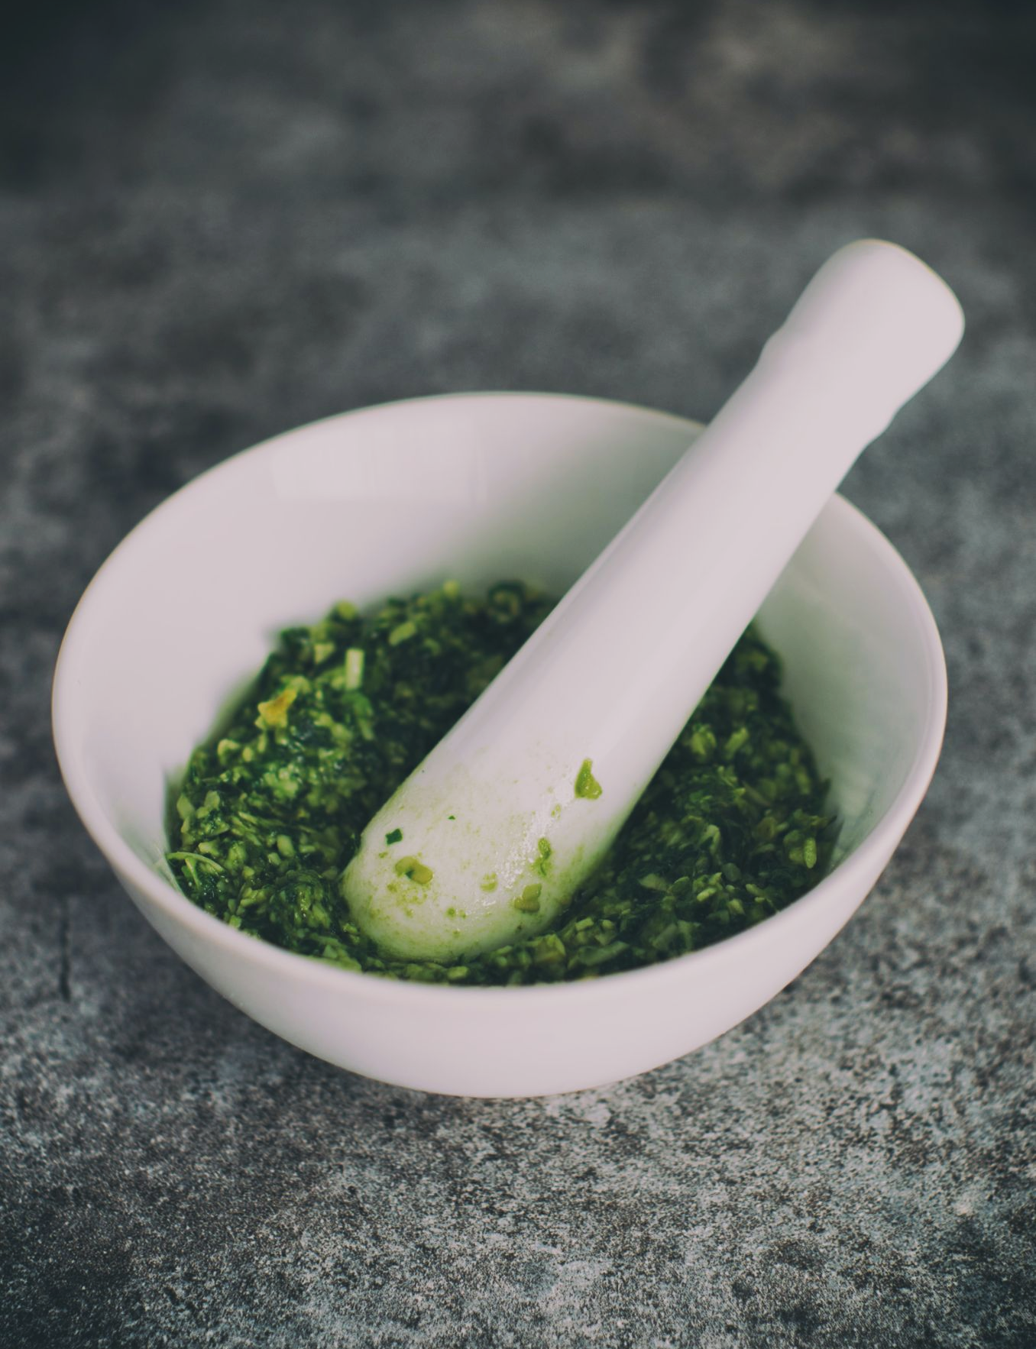
Start by grinding chopped pieces of spinach in a pestle and mortar.
Suspend the product in a solution of ice cold, isotonic buffer.

Slide 18
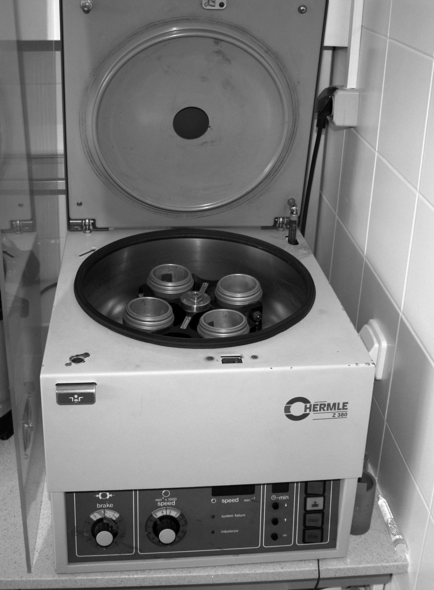
Transfer the solution to centrifuge tubes and centrifuge at high speed for 10 minutes.
This will gather the chloroplasts in a pellet at the bottom of the tube.

Slide 19
Investigating Leaf Pigments Using Chromatography
Place the test tube in a rack a set distance from a light source.
  Add DCPIP and immediately take a sample and add to a free cuvette.
Measure the absorbance of the sample using the colorimeter.
  Take a sample and measure its absorbance every 2 minutes for 10 minutes.
Repeat this for different distances from the lamp.
  This will have the effect of varying the light intensity.
DCPIP reduction practical video.
LIGHT
When light is shone at dehydrogenases, found in high concentration in chloroplasts, DCPIP will decolourise, indicating its reduction.

