Slide 1
AQA A Level Biology
37 - Photosynthesis and the Light Independent Reaction
The Calvin Cycle

Slide 2
The Stages of Photosynthesis
Specification Point 3.5.1 - Photosynthesis.
Photosynthesis has 2 distinct stages.
  The light-dependent reaction.
  The light-independent reaction.
The light-dependent reaction uses light energy to create ATP and NADPH.
  Photons of light excite electrons that are released from the hydrolysis of water.
  These electrons are used to phosphorylate ADP into ATP.
  They are also used to reduce NADP into NADPH.
The light-independent reaction uses ATP and NADPH, as well as CO₂ from the atmosphere, to create glucose.
  The ATP and NADPH created by the light dependent reaction are used to create a number of sugar-based intermediates.
  Carbon atoms from these intermediates are siphoned off to form glucose.

Slide 3
THYLAKOID
(LIGHT-DEPENDENT REACTION)
The process of photosynthesis occurs at two separate sites in a chloroplast.
The light-dependent reaction takes place on the surface of thylakoid membranes.
The light-independent reaction takes place in the fluid stroma.
STROMA
(LIGHT-INDEPENDENT REACTION)

Slide 4
The Calvin Cycle
The light-independent reaction is commonly referred to as the Calvin cycle.
  The cycle is named after the American biochemist Melvin Calvin.
The Calvin cycle takes place in the stroma of the chloroplast.
  The stroma is a gel-like fluid that contains a number of enzymes.
During the Calvin cycle, a molecule of the ribulose bisphosphate (RuBP) combines with carbon dioxide (CO₂).
  RuBP is a 5-carbon compound.
  CO₂ contains a single carbon.
These molecules are joined together using the enzyme rubisco.
  Rubisco is an abbreviation of ribulose bisphosphate carboxylase-oxygenase.

Slide 5
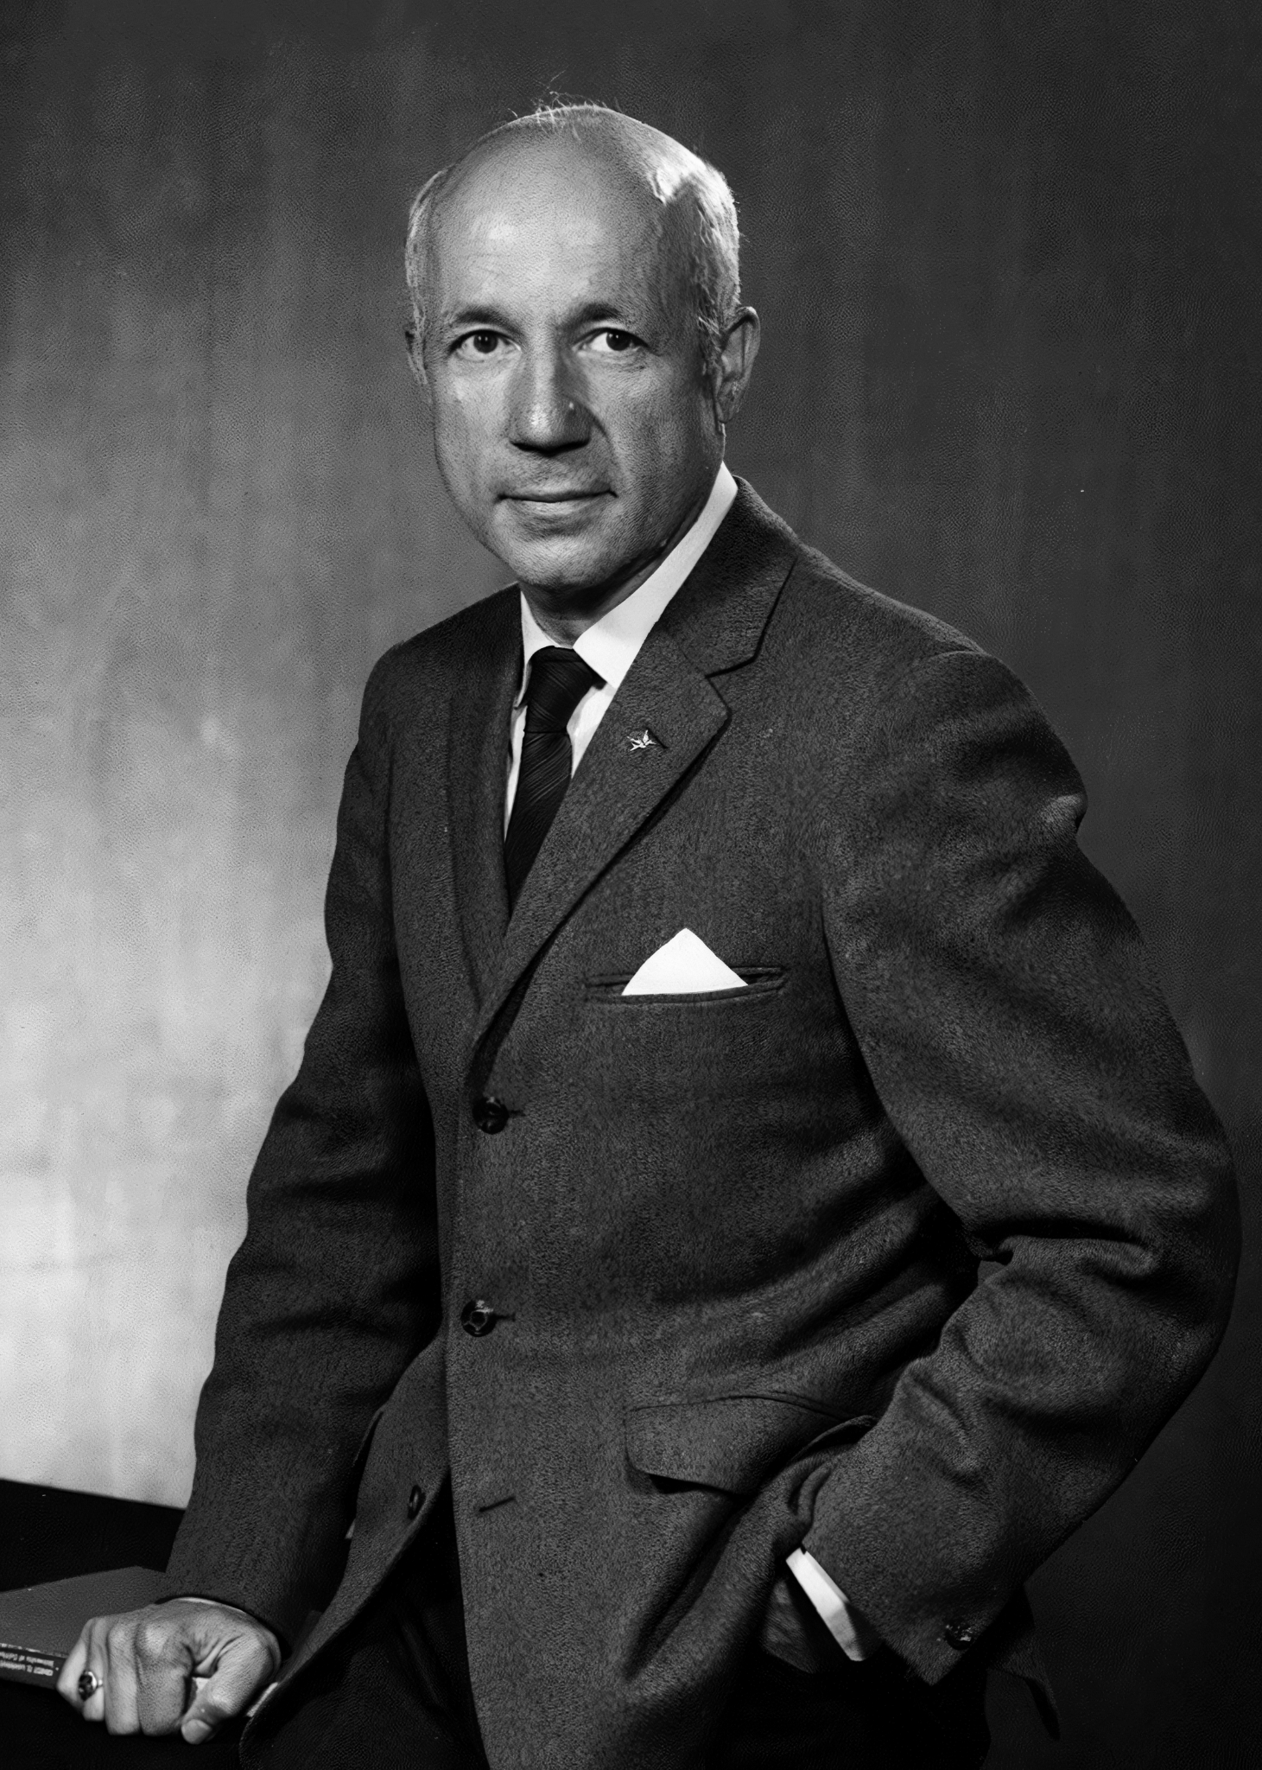
The discovery of the light-independent reaction is usually credited to the American biochemist Melvin Calvin.
Calvin received the Nobel Prize in Chemistry in 1961.

Slide 6
The gene for rubisco (rbcL) is located 55 kb into the chloroplast genome. Being present in all photosynthetic plants, rubisco is probably the most abundant enzyme on Earth.

Slide 7
The Calvin Cycle
RuBP and CO₂ combine to form an unstable 6-carbon intermediate.
  This intermediate immediately breaks down into 2 molecules of glycerate 3-phosphate (GP).
  GP is a 3-carbon compound.
GP is then reduced using NADPH and ATP to form triose phosphate (TP).
  TP is also a 3-carbon compound.
  NADPH and ATP are products of the light-dependent reaction.
Most of the TP is regenerated back into RuBP.
  5 of the 6 available carbon atoms are used to reform RuBP.
The remaining carbon atom is removed from the Calvin cycle and used to form organic compounds.
  ⅙ of the carbon in the Calvin cycle is available to form molecules such as glucose.

Slide 8
The first stage of the Calvin cycle. A molecule of 5-carbon RuBP combines with a molecule of CO₂ to form an unstable 6-carbon compound. This immediately breaks down into 2 molecules of GP.
RIBULOSE BISPHOSPHATE (RuBP)
UNSTABLE 6-CARBON INTERMEDIATE
P
P
P
P
CO₂
P
P
2 MOLECULES OF GLYCERATE 3-PHOSPHATE (GP)

Slide 9
The second stage of the Calvin cycle. 2 molecules of GP are reduced using a molecule of ATP and a molecule of NADPH. 2 molecules of TP are formed. 2 molecules of TP are regenerated into a single molecule of RuBP. A single atom of carbon is siphoned off to form organic compounds such as glucose.
GLYCERATE 3-PHOSPHATE (GP)
TRIOSE PHOSPHATE (TP)
P
ATP
NADPH
P
ADP
P
NADP
RIBULOSE BISPHOSPHATE (RuBP)
FREE CARBON ATOM
P
ORGANIC
COMPOUNDS
P
P
P
P

Slide 10
Forming Hexose Sugars
Hexose sugars contain 6 carbon atoms.
  Glucose and fructose are both examples of hexose sugars.
Hexose sugars are formed by joining 2 molecules of 3-carbon TP.
The Calvin cycle requires 6 turns to make a hexose sugar.
  Each turn of the cycle yields a single free carbon atom.
6 turns of the Calvin cycle requires significant amounts of ATP and NADPH.
  18 molecules of ATP and 12 molecules of NADPH are required for 6 rotations of the Calvin Cycle.
OH
O
OH
HO
OH
OH
Glucose can be formed from 6 turns of the Calvin cycle.

Slide 11
The Calvin cycle involves the formation of a number of carbon-based intermediates.

Slide 12
Organic Products
The Calvin cycle is responsible for the synthesis of a variety of organic products.
  Carbohydrates, lipids and amino acids are all formed directly or indirectly from the Calvin cycle.
Carbohydrates such as hexose sugars are formed from TP.
  More complex carbohydrates such as starch and cellulose are joined through the condensation reactions of hexoses.
Lipids synthesis requires glycerol and fatty acids.
  Glycerol is a byproduct of TP whilst fatty acids can be formed from GP.
Amino acids can be synthesised using GP.
The Calvin cycle is responsible for a variety of organic products, all required by the plant for sustenance.

Slide 13
The main product of the Calvin cycle is glucose, which can be packaged into polymers like starch.

