Slide 1
AQA A Level Biology
36 - Photosynthesis and the Light Dependent Reaction
Cyclic and Non-Cyclic Photophosphorylation

Slide 2
Photosynthesis
Specification Point 3.5.1 - Photosynthesis.
Plants require energy for chemical processes.
  This includes active transport, DNA replication, cell division and protein synthesis.
Plants derive this energy from glucose.
  Glucose is broken down into ATP during respiration.
Glucose is created by plants using photosynthesis.
  Plants take in water (H₂O) and carbon dioxide (CO₂) to create glucose (C₆H₁₂O₆) and oxygen (O₂).
  Light energy is required for photosynthesis to take place.
6CO₂ + 6H₂O → C₆H₁₂O₆ + 6O₂

Slide 3
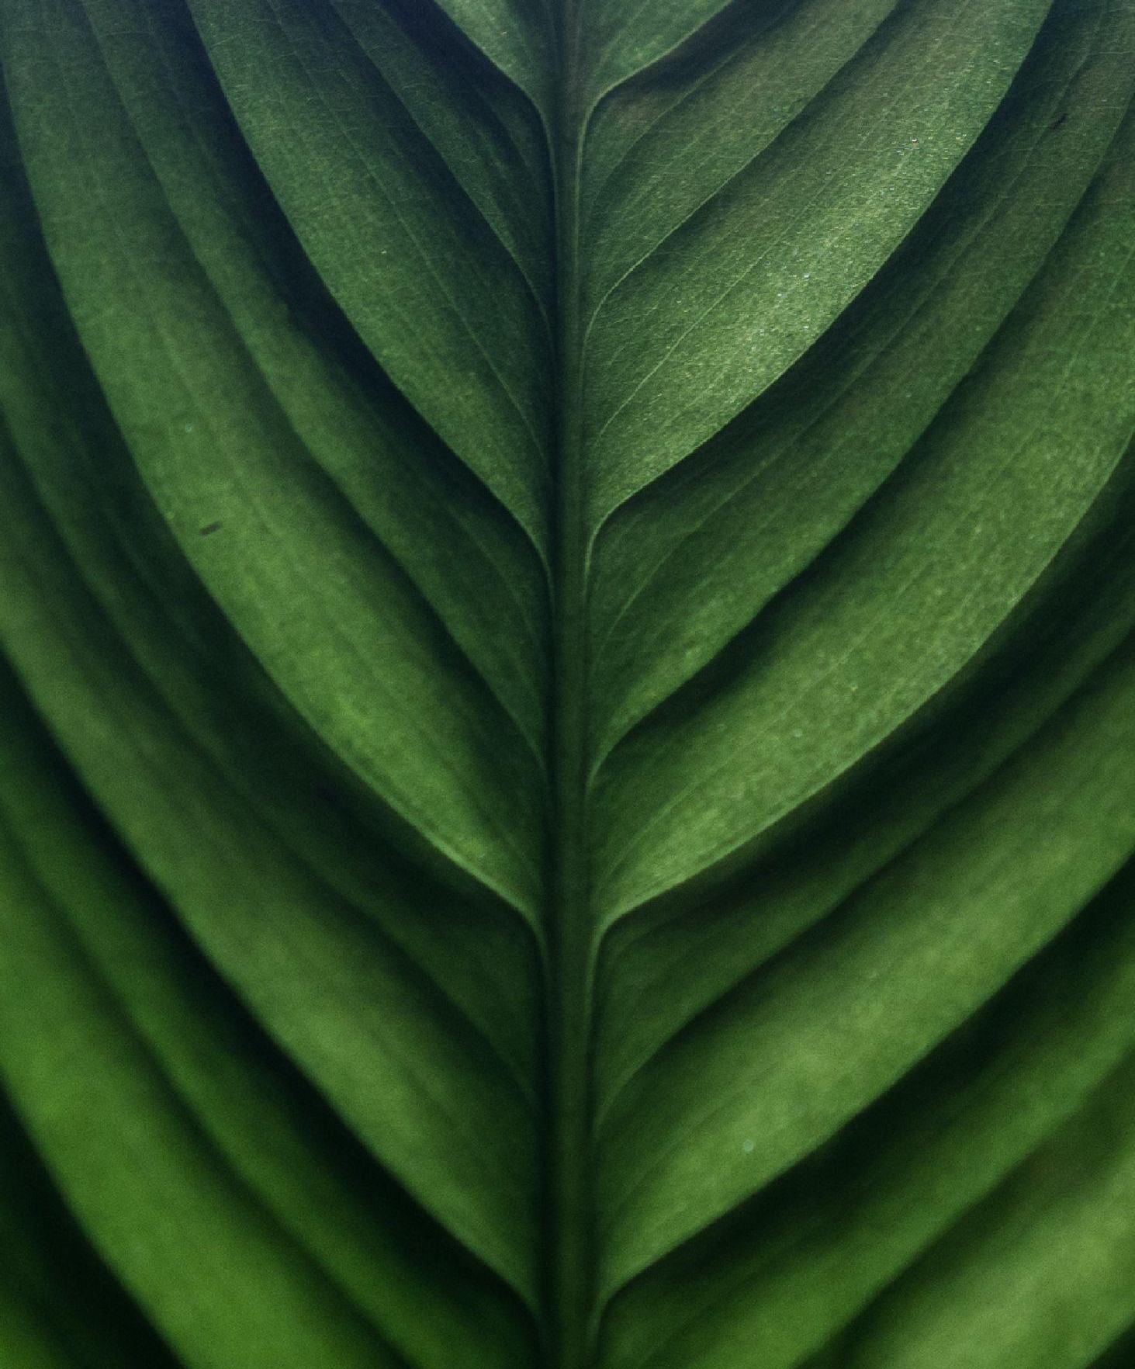
Photosynthesis mainly occurs in the leaves of plants.
Plants use the energy from photosynthesis for a variety of processes, including: active transport, DNA replication, cell division and protein synthesis.

Slide 4
ADP → ATP
Plants break down the glucose formed during photosynthesis.
  This is achieved by respiration.
Glucose is broken down into the energy molecule adenosine triphosphate (ATP).
  ATP is transported around plant cells to where it is needed.
  ATP is formed during a condensation reaction involving adenosine diphosphate (ADP).
ADP is converted to ATP by the enzyme ATP synthase.

Slide 5
ATP → ADP
ATP is hydrolysed into ADP (adenosine diphosphate) when the cell requires energy.
  A phosphate bond is broken releasing a small amount of energy (around 30 kJ/mol).
The energy from this reaction is used by plant cells for metabolic functions:
  DNA replication.
  Active transport.
  Excretion.
ATP is hydrolysed back to ADP by the enzyme ATP hydrolase.

Slide 6
The Properties of ATP
ATP has several properties which make it an ideal store of energy.
ATP releases energy in small, manageable quantities.
  Using glucose directly as an energy source would result in large quantities of wasted energy as heat.
ATP is a soluble molecule.
  This allows it to be easily transported around the cell in the cytoplasm.
ATP is easily broken down and reformed.
  Both the condensation and hydrolysis of ATP are single-step reactions.
ATP can make other compounds more reactive.
  It does this by transferring one of its phosphate groups to the target molecule through phosphorylation.
ATP will remain in the cell.
  ATP cannot pass through the cell membrane.
  This ensures the cell always has a supply of energy.

Slide 7
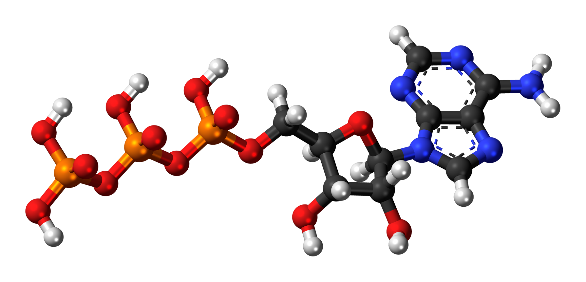
ATP has several properties which make it an ideal store of energy.
This is one of the reasons why ATP is found in many different types of life, including both animals and plants.

Slide 8
The Compensation Point
Plants carry out both photosynthesis and respiration.
  Photosynthesis and respiration can occur simultaneously.
  Photosynthesis and respiration are likely to occur at differing rates.
The rate of photosynthesis is largely dependent on the amount of light available to the plant.
  This is usually referred to as the light intensity.
At a certain light intensity, the rate of photosynthesis will be equal to the rate of respiration.
This is referred to as the compensation point.

Slide 9
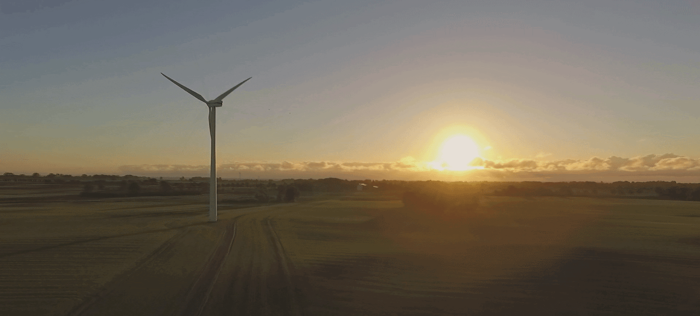
The compensation point occurs when the rate of respiration is equal to the rate of respiration. One time when this can occur is the early hours of the morning.

Slide 10
The compensation point for a particular plant can be determined by measuring the net production of O₂ at varying light intensities.
When net O₂ production is zero, O₂ is being used up as quickly as it is being created.
At this point the rate of photosynthesis is equal to the rate of respiration.
NET O₂ GENERATION →
COMPENSATION POINT
LIGHT INTENSITY →

Slide 11
Chloroplasts
Photosynthesis takes place in organelles called chloroplasts.
  Chloroplasts contain fluid-filled sacs called thylakoids.
    Thylakoids are stacked into structures called grana.
    Grana are connected by filaments called lamellae.
  Chloroplasts are surrounded by a double membrane.
Chloroplasts are filled with photosynthetic pigments.
  Chlorophyll a, chlorophyll b and carotenoids are all examples of photosynthetic pigments.
  Photosynthetic pigments absorb light energy.
  These pigments are found inside thylakoid membranes.
Photosynthetic pigments are bound to proteins to form a photosystem.
  Photosystem I (PSI) absorbs light at a wavelength of 700 nm.
  Photosystem II (PSII) absorbs light at a wavelength of 680 nm.
The chloroplast is filled with a fluid called the stroma.
  The stroma contains a mixture of enzymes, carbohydrates and amino acids.

Slide 12
The chloroplast is the site of photosynthesis.
INNER MEMBRANE
RIBOSOME
OUTER MEMBRANE
GRANUM
DNA
STROMA
THYLAKOID
THYLAKOID MEMBRANE
LAMELLA

Slide 13
NADP and Redox Reactions
Redox reactions involve both oxidation and reduction.
  Oxidation involves the loss of electrons (e⁻) or the gain of O₂.
  Reduction involves the gain of e⁻ or the loss of O₂.
Redox reactions are important in the functionality of coenzymes.
  Coenzymes transfer chemicals between molecules.
  Coenzymes offer aid to enzymes during metabolic reactions.
Nicotinamide adenine dinucleotide phosphate (NADP) is a coenzyme.
  NADP transfers hydrogen from one molecule to another.
  It can exist in an oxidised (NADP) or reduced (NADPH) form.
NADP is important in photosynthesis.
  NADP plays a vital role in the light-dependent stage of photosynthesis.
NADP is a coenzyme that is involved in the light-dependent stage of photosynthesis.

Slide 14
The Stages of Photosynthesis
Photosynthesis has 2 distinct stages.
  The light-dependent reaction.
  The light-independent reaction.
The light-dependent reaction uses light energy to create ATP and NADPH.
  Photons of light excite electrons that are released from the hydrolysis of water.
  These electrons are used to phosphorylate ADP into ATP.
  They are also used to reduce NADP into NADPH.
The light-independent reaction uses ATP and NADPH, as well as CO₂ from the atmosphere, to create glucose.
  The ATP and NADPH created by the light dependent reaction are used to create a number of sugar-based intermediates.
  Carbon atoms from these intermediates are siphoned off to form glucose.

Slide 15
THYLAKOID
(LIGHT-DEPENDENT REACTION)
The process of photosynthesis occurs at two separate sites in a chloroplast. The light-dependent reaction takes place on the surface of thylakoid membranes. The light-independent reaction takes place in the fluid stroma.
STROMA
(LIGHT-INDEPENDENT REACTION)

Slide 16
Photophosphorylation
Photophosphorylation involves the addition of a phosphate group to a molecule using light energy.
  The light-dependent reaction uses photophosphorylation in 2 situations.
Non-cyclic photophosphorylation is considered the major form of the the light-dependent reaction.
  ATP, NADPH and O₂ are all formed.
Cyclic photophosphorylation is considered the minor form of the light-dependent reaction.
  Only ATP is formed.

Slide 17
The Light-Dependent Reaction - Non-Cyclic Photophosphorylation
Photons of light are used to hydrolyse water into protons (H⁺), electrons (e⁻) and oxygen.
  This is referred to as the photolysis of water.
Light energy is then absorbed by chlorophyll at PSII.
This light energy is used to excite electrons.
  Electrons gain energy due to this excitement.
The electrons are released from chlorophyll and travel down proteins called electron carriers.
  Photosystems and electron carriers combine to form the electron transport chain.
The energy from electrons is used to pump protons from the stroma into the thylakoid space.
  This creates a difference in the concentrations of protons, referred to as an electrochemical gradient.

Slide 18
The Light-Dependent Reaction - Non-Cyclic Photophosphorylation
Protons use this electrochemical gradient to return to the stroma, through an enzyme called ATP synthase.
  ATP synthase is powered by the flow of protons to synthesise ATP from ADP and inorganic phosphate.
  This process is referred to as chemiosmosis.
Electrons travel down the electron transport chain to PSI.
They are then again excited by photons of light.
  Electrons, along with a proton, combine with a molecule of NADP.
  This reduces the NADP to form a molecule of NADPH.
Light is excited by photons of light that hit photosystems inside chloroplasts.

Slide 19
1. THE PHOTOLYSIS OF WATER RELEASES PROTONS AND ELECTRONS, AS WELL AS SOME O₂
3. PROTONS MOVE THROUGH ATP SYNTHASE BY CHEMIOSMOSIS, CREATING ATP
H₂O → 2H⁺ + 2e⁻ + ½O₂
4. ELECTRONS COMBINE WITH PROTONS TO REDUCE NADP INTO NADPH
ADP + P_{i} → ATP
H⁺
NADP + H⁺ + e⁻ → NADPH
e⁻
e⁻
H⁺
H⁺
2. ELECTRONS ARE EXCITED BY LIGHT, MOVING DOWN ELECTRON CARRIERS (EC). AS ENERGY IS LOST FROM THE ELECTRONS, PROTONS ARE PUMPED THROUGH PROTEINS FROM THE STROMA INTO THE THYLAKOID SPACE, CREATING AN ELECTROCHEMICAL GRADIENT

Slide 20
The Light-Dependent Reaction - Cyclic Photophosphorylation
Cyclic photophosphorylation only involves the use of PSI.
  ATP is the only product from cyclic photophosphorylation.
  No NADPH or O₂ is made during cyclic photophosphorylation.
Cyclic photophosphorylation uses electron carriers to recycle electrons.
  Rather than being used to reduce NADP, electrons are transferred back to PSI.
  This process only yields a small amount of ATP.
Cyclic photophosphorylation takes place when there is an excess of NADPH.
  This means that no NADP is available for non-cyclic photophosphorylation to occur.

Slide 21
3. ONLY ATP IS FORMED FROM CYCLIC PHOTOPHOSPHORYLATION
1. LIGHT ENERGY IS USED TO EXCITE AN ELECTRON RESIDING AT PSI
ADP + P_{i} → ATP
H⁺
e⁻
e⁻
e⁻
4. ELECTRONS ARE RECYCLED AND RETURNED TO PSI
H⁺
H⁺
2. PROTONS ARE ONCE MORE PUMPED INTO THE THYLAKOID SPACE, CREATING AN ELECTROCHEMICAL GRADIENT

