Slide 1
AQA A Level Biology
35 - Investigating Variation
Assessing Diversity, Sampling, Means and Standard Deviation

Slide 2
Assessing Genetic Diversity
Specification Point 3.4.7 - Investigating diversity.
Genetic diversity can be defined as the number of different alleles in a population.
Genetic diversity was originally calculated by observing the frequency of different characteristics.
  For example the number of different colours of a particular species of flower, as well as the frequency of each colour.
  A wide variety of colours indicates that there are lots of different alleles in the population and that genetic diversity is high.
Genetic diversity was originally estimated using differences in morphology, such as flower colour.

Slide 3
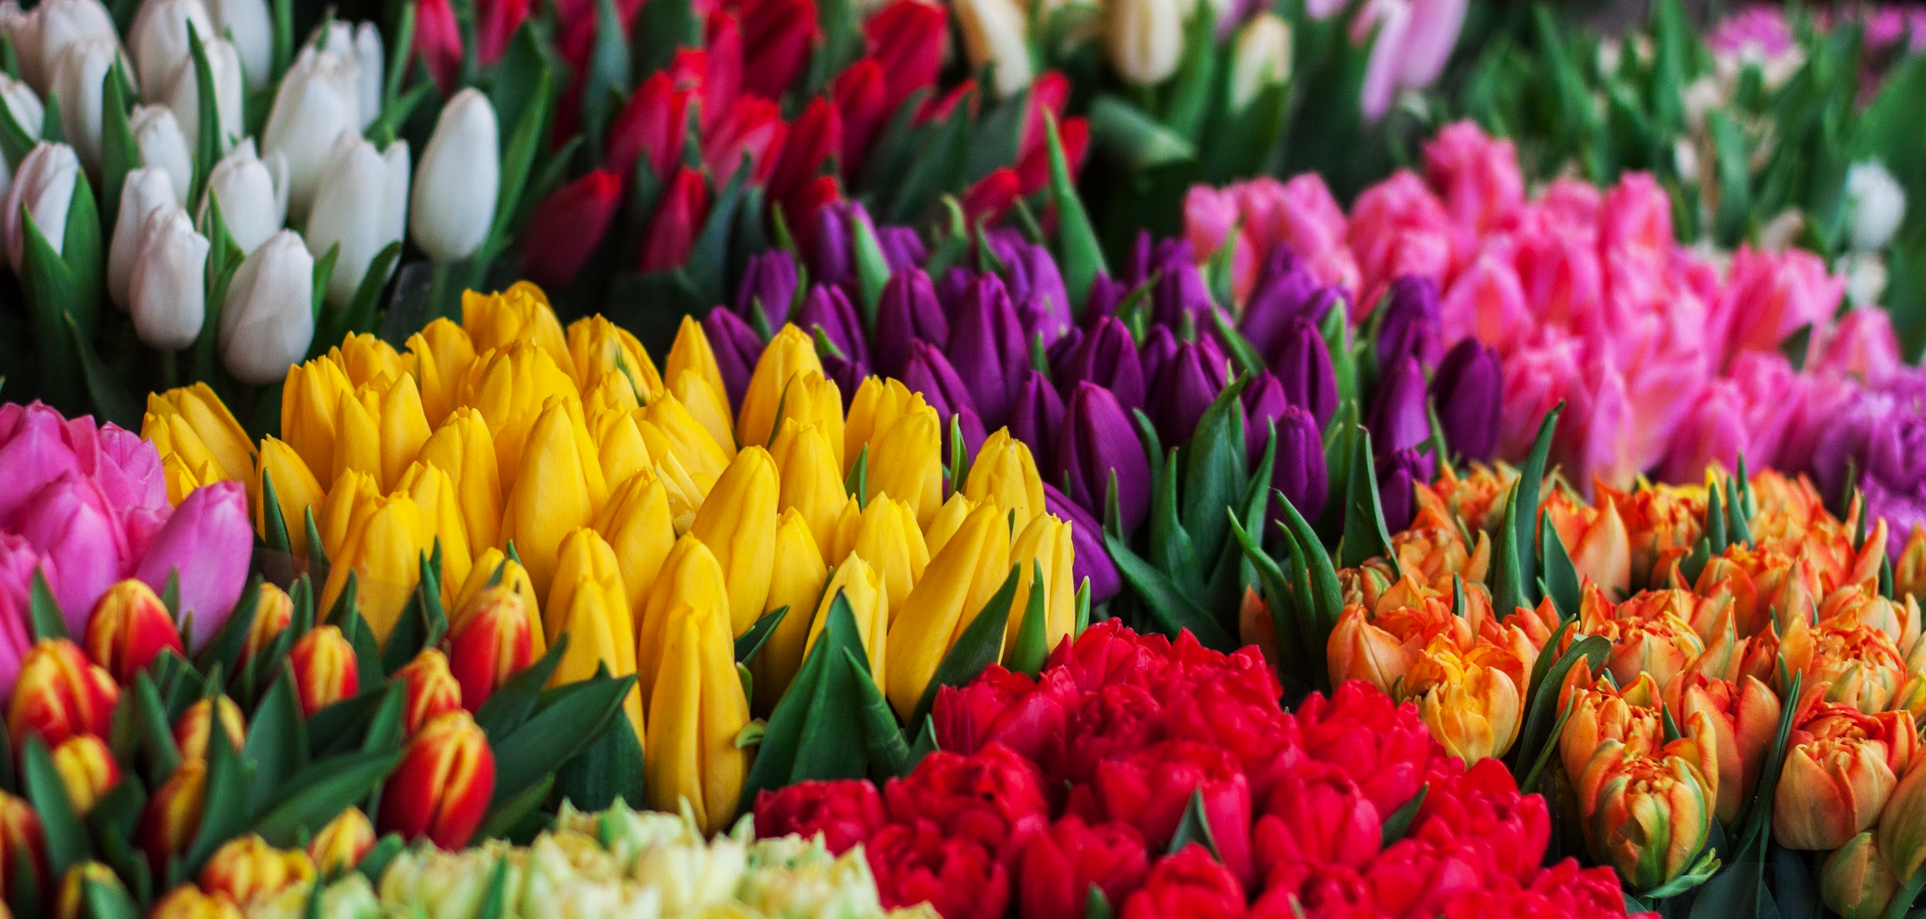
The variety of colours in tulips indicates lots of different alleles are present in the population. Genetic diversity is thus considered to be high.

Slide 4
Assessing Genetic Diversity
New technologies have been developed to measure genetic diversity more directly.
  Different alleles of the same gene (for example for flower colour) will have slightly different base sequences.
    By comparing the base sequences of different alleles throughout a population, the number of different alleles can be established.
  Different alleles will also yield different mRNA sequences and different amino acid sequences.
    These can also be compared to identify the number of different alleles in a population.
These technologies are more accurate measures of genetic diversity than using observable characteristics.
  They also allow for comparisons of genetic diversity between different species.
Differences in mRNA are now used to measure genetic diversity in and between populations.

Slide 5
Causes of Variation
Variation is defined as the differences that exist between organisms.
Variation can be caused by genetic factors.
  Different species will have different genes. This causes interspecific variation.
  Members of the same species will have different alleles for the same gene. This causes intraspecific variation.
Variation may also be caused by environmental factors.
  Climate, diet and lifestyle can all lead to intraspecific variation.
Variation is often due to a combination of genetic and environmental factors.
  The height of trees may be affected both by particular alleles, as well as the nutrients it receives.

Slide 6
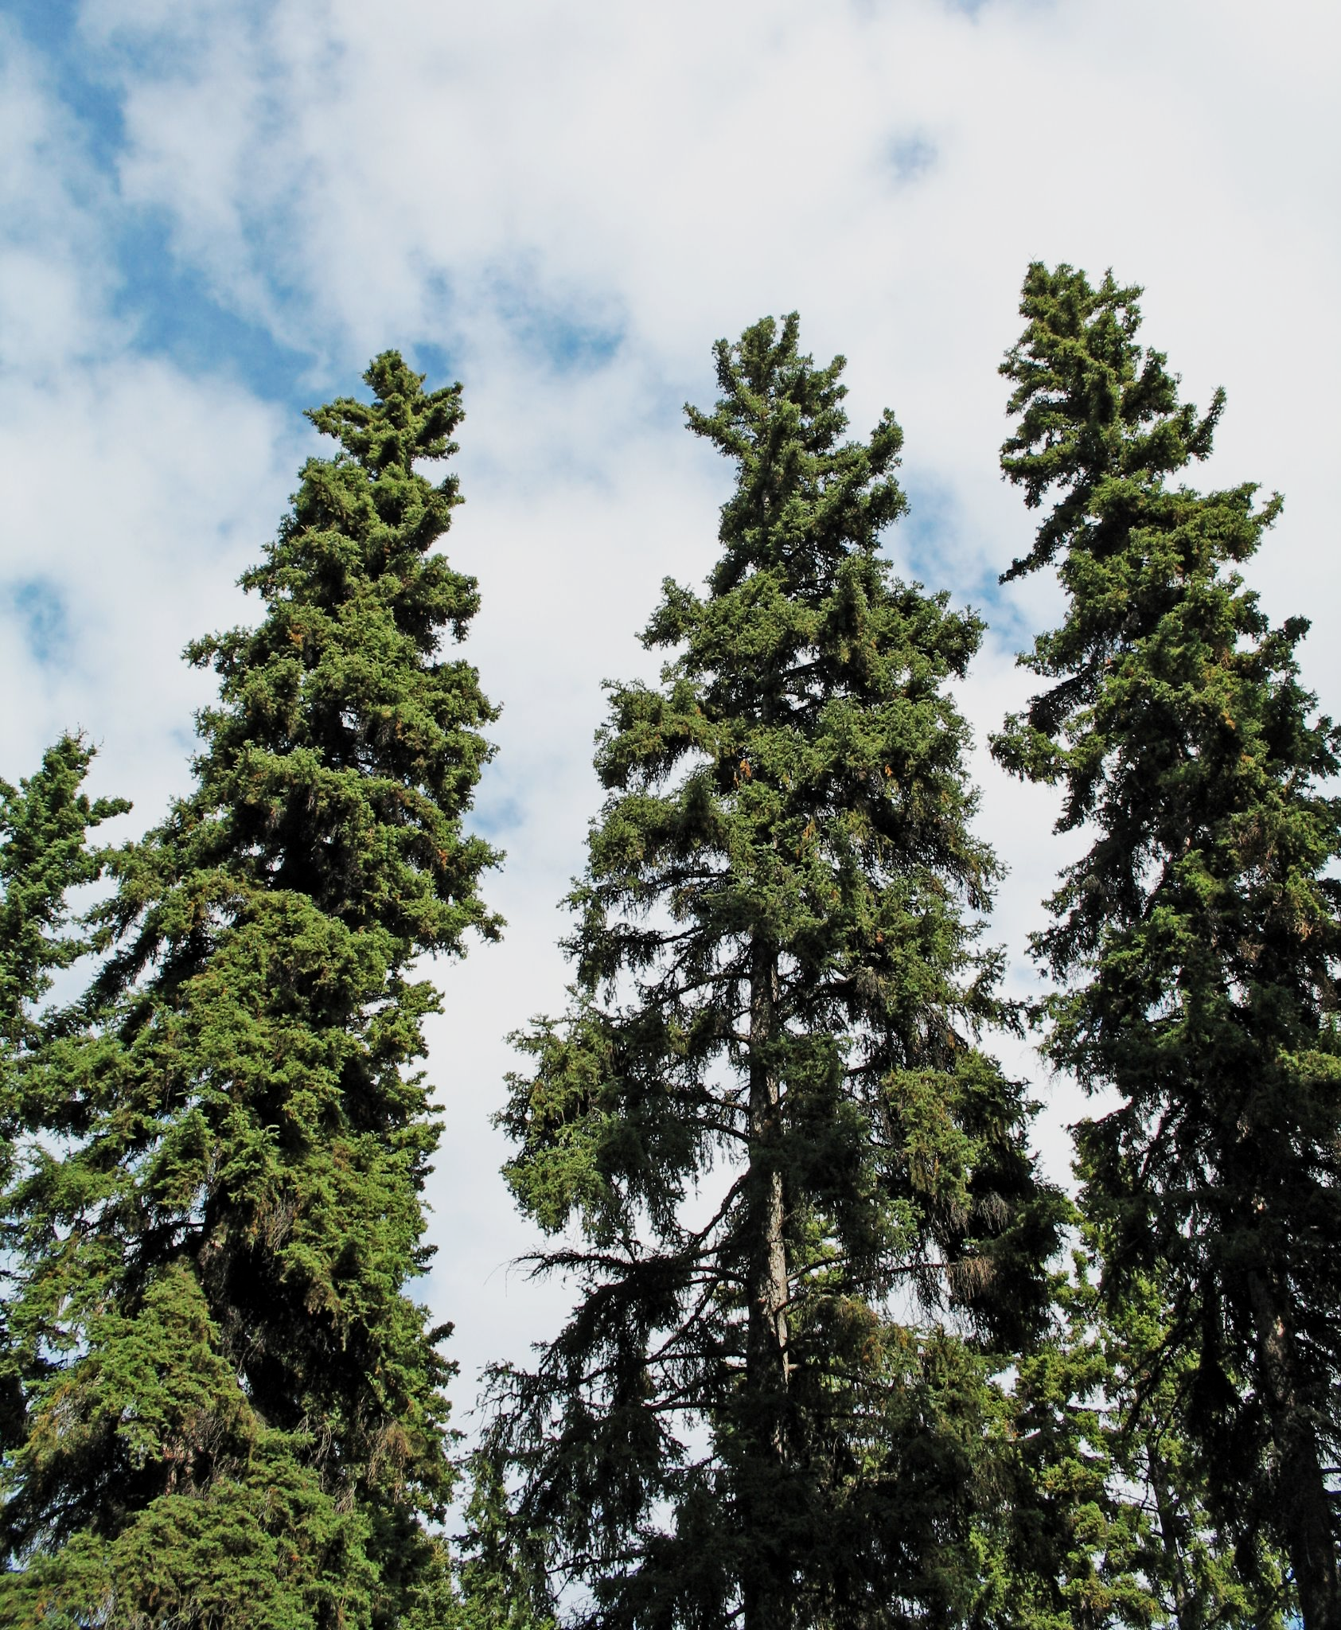
The height of trees can be affected by environmental factors such as the availability of light or nutrients.
VARIATION IN THE HEIGHT OF SPRUCE TREES
FREQUENCY →
HEIGHT →

Slide 7
Sampling Populations
Investigations into variation rely on sampling populations.
  It is often too time-consuming to look at every individual in a population.
  A small proportion (a sample) of the population is investigated and used as a model of the total population.
Sampling must be representative of the entire population.
  Sampling must represent, as accurately as possible, the variation seen throughout the population.
To avoid bias, random sampling may be used.
  Random sampling helps to avoid overrepresentation or underrepresentation of certain members of a population.
  Random sampling often involves creating a grid of the sampling area and using a random number generator to select grid squares.

Slide 8
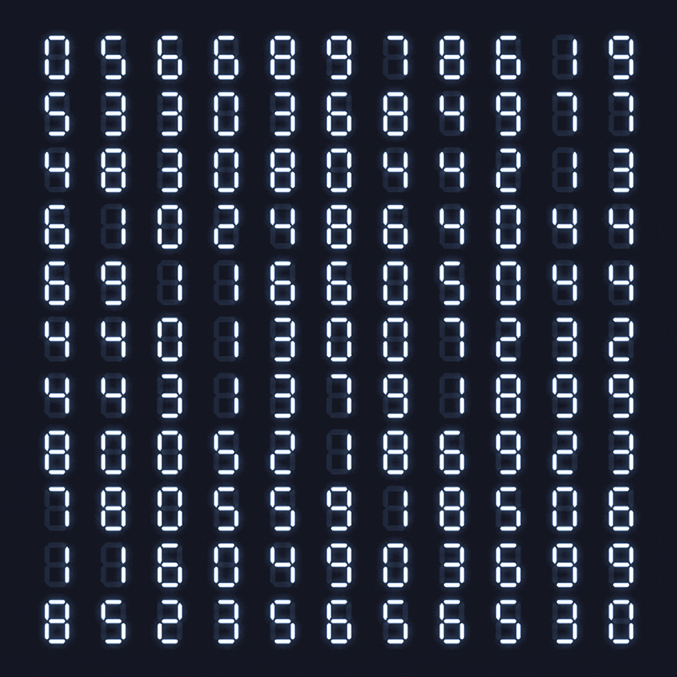
Random number generators are often used to create grid coordinates which allow ecologists to allocate sampling sites in a non-biased way.

Slide 9
Random sampling attempts to offer as representative a measure as possible of the total population. This helps to avoid bias which would skew the data in one direction.
NON-RANDOM SAMPLING
RANDOM SAMPLING

Slide 10
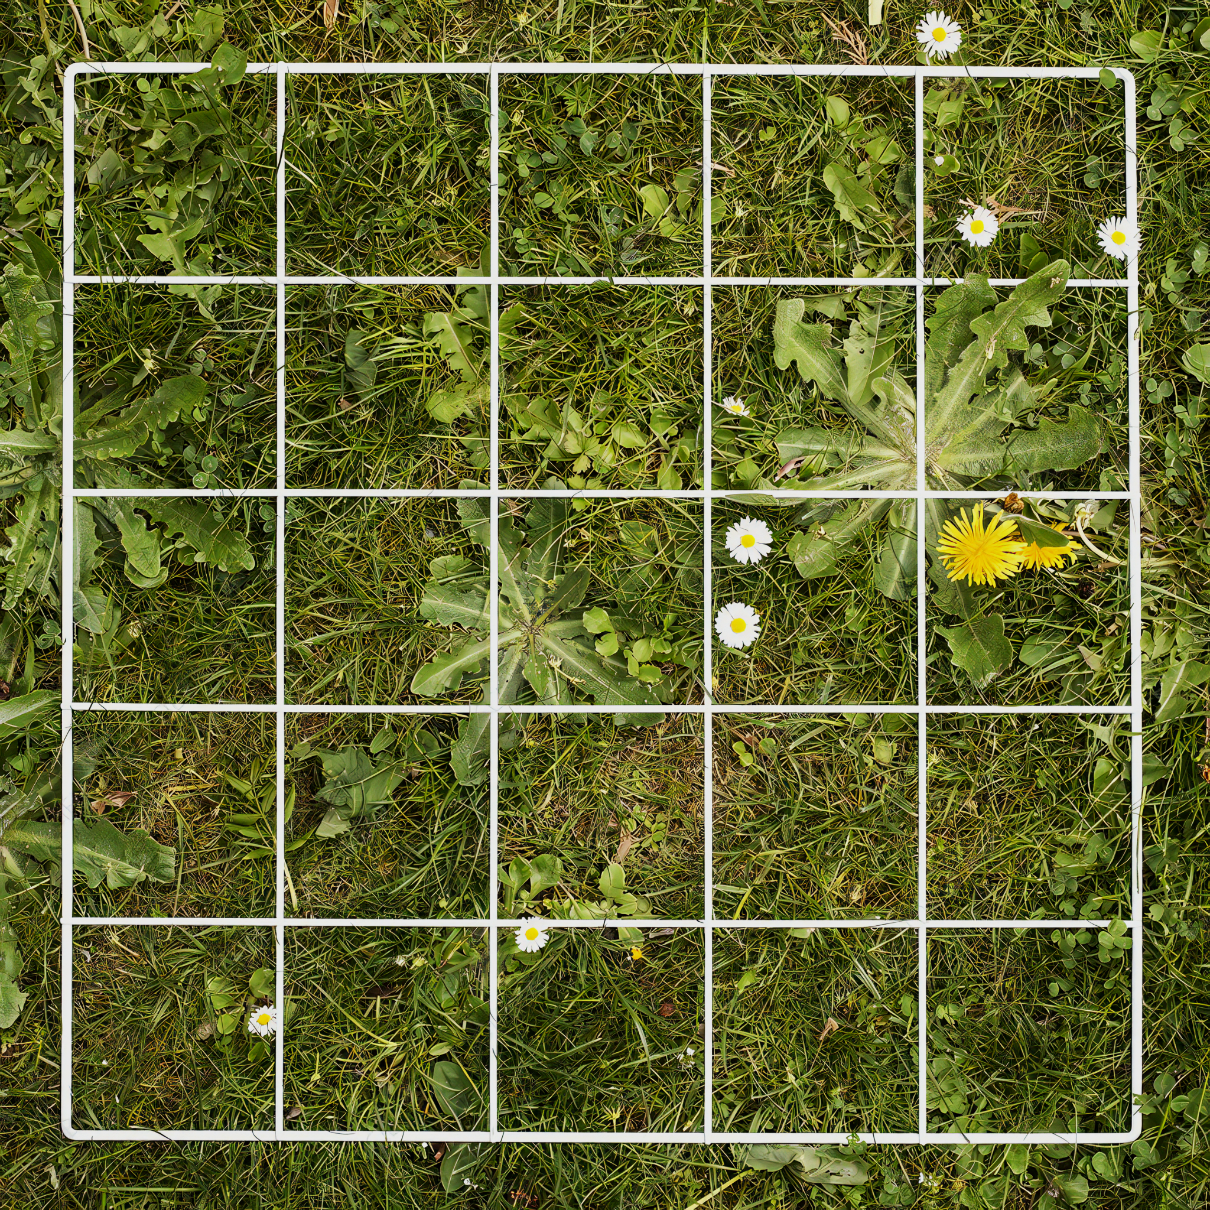
Quadrats are used to estimate the population size of different species, usually of plants.

Slide 11
Statistical Analysis
Statistical tests are used in biology to ensure that the results obtained from experiments are not due to chance.
  The arithmetic mean and standard deviation are 2 simple statistical tests.
The arithmetic mean is the mathematical average of a collection of numbers:
Most samples follow a normal distribution.
  This means that there are a relatively equal number of values either side of the mean.
  Graphs that follow a normal distribution are bell-shaped.
X̄ = mean
ΣX = sum of values
N = number of values

Slide 12
A graphical representation of a normal distribution.

Slide 13
Standard Deviation
Standard deviation is a measure of variance around the mean.
  Samples with lot of different values will have a large standard deviation.
  Samples with a lot of similar values will have a small standard deviation.
Standard deviations are sometimes written in conjunction with the mean.
  For example, if the mean value of a dataset is 15 and the standard deviation of a dataset is 5, the analysis is written as 15 ± 5.
    This means that the values are spread between 10 and 20.
Data with a small standard deviation will show little dispersion on a graph.
Data with a large standard deviation will show lots of dispersion on a graph.

Slide 14
Dataset A has a small standard deviation. Dataset B has a much larger standard deviation.

Slide 15
Calculating Standard Deviation
Standard deviation (S) can be calculated using the following formula:
Standard deviation can also be used to draw error bars on graphs.
  Error bars shown 1 standard deviation above and 1 standard deviation below the mean value.
  Larger error bars imply the dataset is more widely dispersed.
S = standard deviation
Σ = sum of equation
x̄ = mean value of dataset
n = number of values

Slide 16
An exemplar standard deviation calculation using forest densities in a variety of locations.
1. MEAN DENSITY = 42,433
A = (42,515 - 42,433)² = 6,724
B = (41,009 - 42,433)² = 2,027,776
C = (43,223 - 42,433)² = 0
D = (42,985 - 42,433)² = 304,704
2. SUM OF VALUES = 2,339,204
(NUMBER OF VALUES) - 1 = 3
3. SUM OF VALUES DIVIDED BY NUMBER OF VALUES = 779,738
4. SQUARE ROOT OF ANSWER = 883
S = 883
FOREST | DENSITY OF TREES PER KM ²
A | 42,515
B | 41,009
C | 43,223
D | 42,985

Slide 17
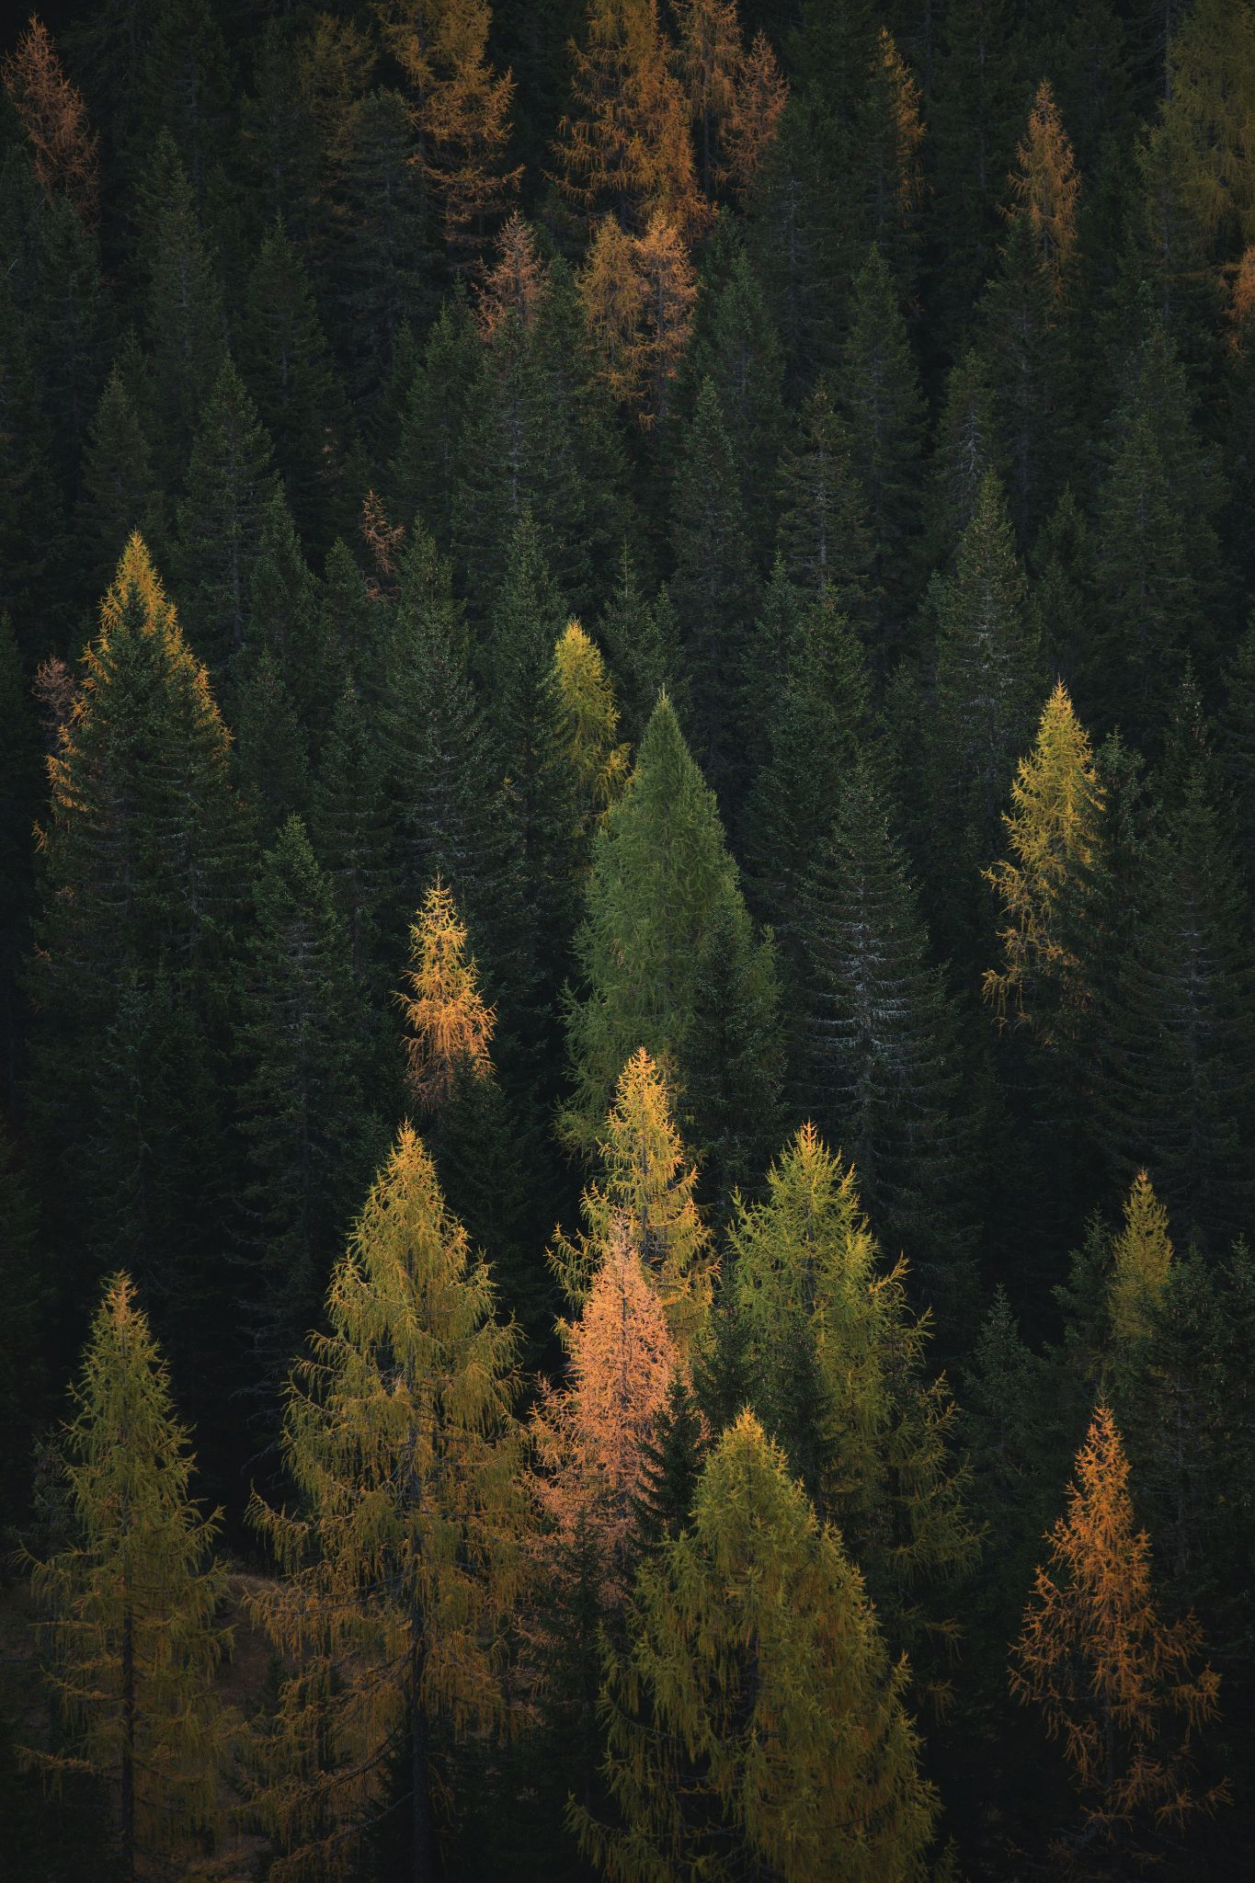
Standard deviation can be represented graphically using error bars.

