Slide 1
AQA A Level Biology
34 - Biodiversity
Measuring Biodiversity and the Effects of Agriculture

Slide 2

Biodiversity
Specification Point 3.4.6 - Biodiversity within a community.
Biodiversity measures how healthy an ecosystem is.
  Biodiversity can be defined as the variety of living organisms in an area.
Biodiversity can be measured at a local scale.
  This might be the variety of organisms in a small habitat such as a field or a lake.
    A habitat is defined as the place where an organism lives.
Biodiversity can also be measured on a global scale.
  Global biodiversity may consider the total number of different species on Earth.
    There are around 8.7 million different species by current estimations.
Biodiversity can be measured on both the local and global scales.

Slide 3
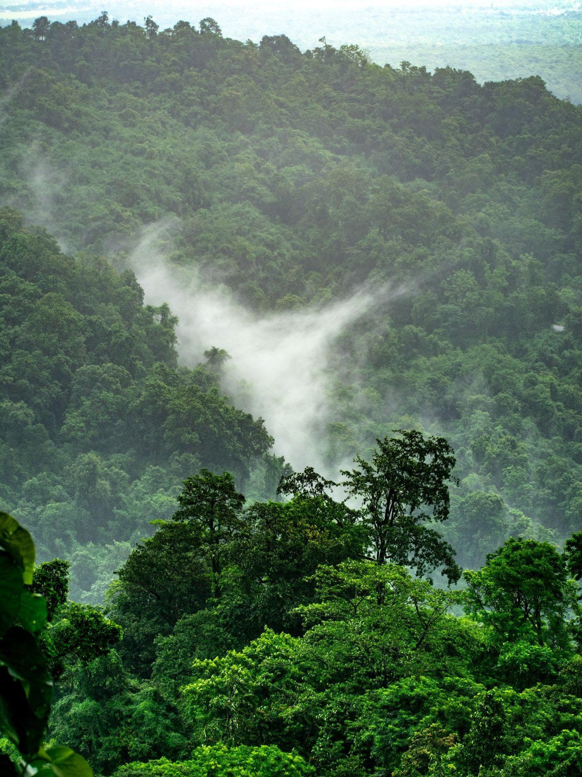
Some regions on Earth are very biodiverse. Rainforests account for less than 2% of the Earth’s surface yet are home to 50% of its plant and animal species.

Slide 4
Measuring Biodiversity
There are a number of ways to measure biodiversity.
  2 of the most common methods are through species richness or an index of diversity.
Species richness takes into account the number of different species in a community.
  Species richness can be calculated by sampling different areas of a community and counting the number of different species found.
Species richness does not take into account the population sizes of each species.
  This is called species evenness.
  Populations that have a very small number of individuals should not be considered as valuable as those with much larger populations.

Slide 5
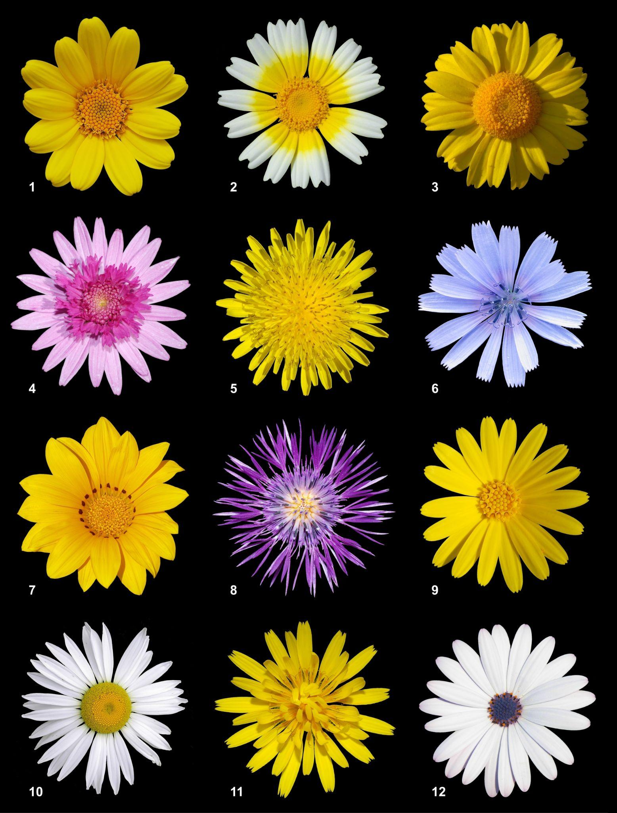
Species richness takes into account the number of different species in a particular area.

Slide 6
Indexes of Diversity
An index of diversity (D) accounts for both the number of different species, and the number of individuals of each species.
  Indexes of diversity are considered a more accurate measure of biodiversity than species richness.
Areas with a higher index will be more biodiverse than areas with a lower index.
  Areas with only a single species will have an index value of 1.
N = total number of organisms of all species
Σ = sum of equation
n = total number of organisms of 1 species

Slide 7
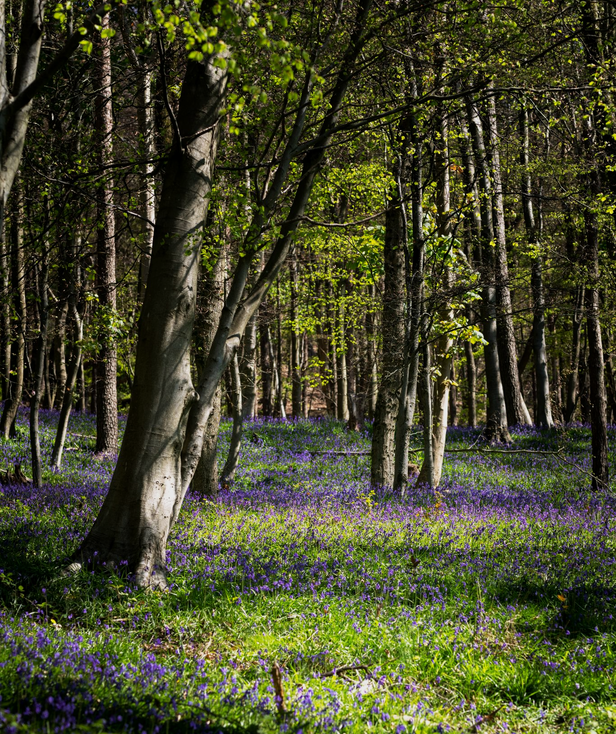
An exemplar index of diversity calculation for a woodland.
SPECIES | n (TOTAL NUMBER OF ORGANISMS IN A SPECIES) | n × (n - 1)
WOODRUSH | 2 | 2
HOLLY | 8 | 56
BRAMBLE | 1 | 0
YORKSHIRE FOG | 1 | 0
SEDGE | 3 | 6
D = 1.78

Slide 8
Agriculture and Biodiversity
Agriculture is the act of growing crops or livestock on an area of land.
  Farmers will try to maximise the amount of crop they can grow using a variety of methods.
Many of the methods farmers use to increase crop yield has a negative impact on biodiversity.
Many farmers use pesticides and herbicides.
  Pesticides reduce diversity by killing pest species that feed on crops. They may also kill non-pest species.
  Herbicides reduce diversity by killing weeds. This may also eliminate a food source for other organisms.
Farmers clear woodlands and hedgerows to make way for crops.
  These acts directly reduce the number of tree and hedge species.
  Habitats are also destroyed forcing species to migrate to another area.
  Farmers will then usually only grow a single type of crop (maize, wheat etc.) using monoculture. Only species that can live on this single food source will survive.

Slide 9
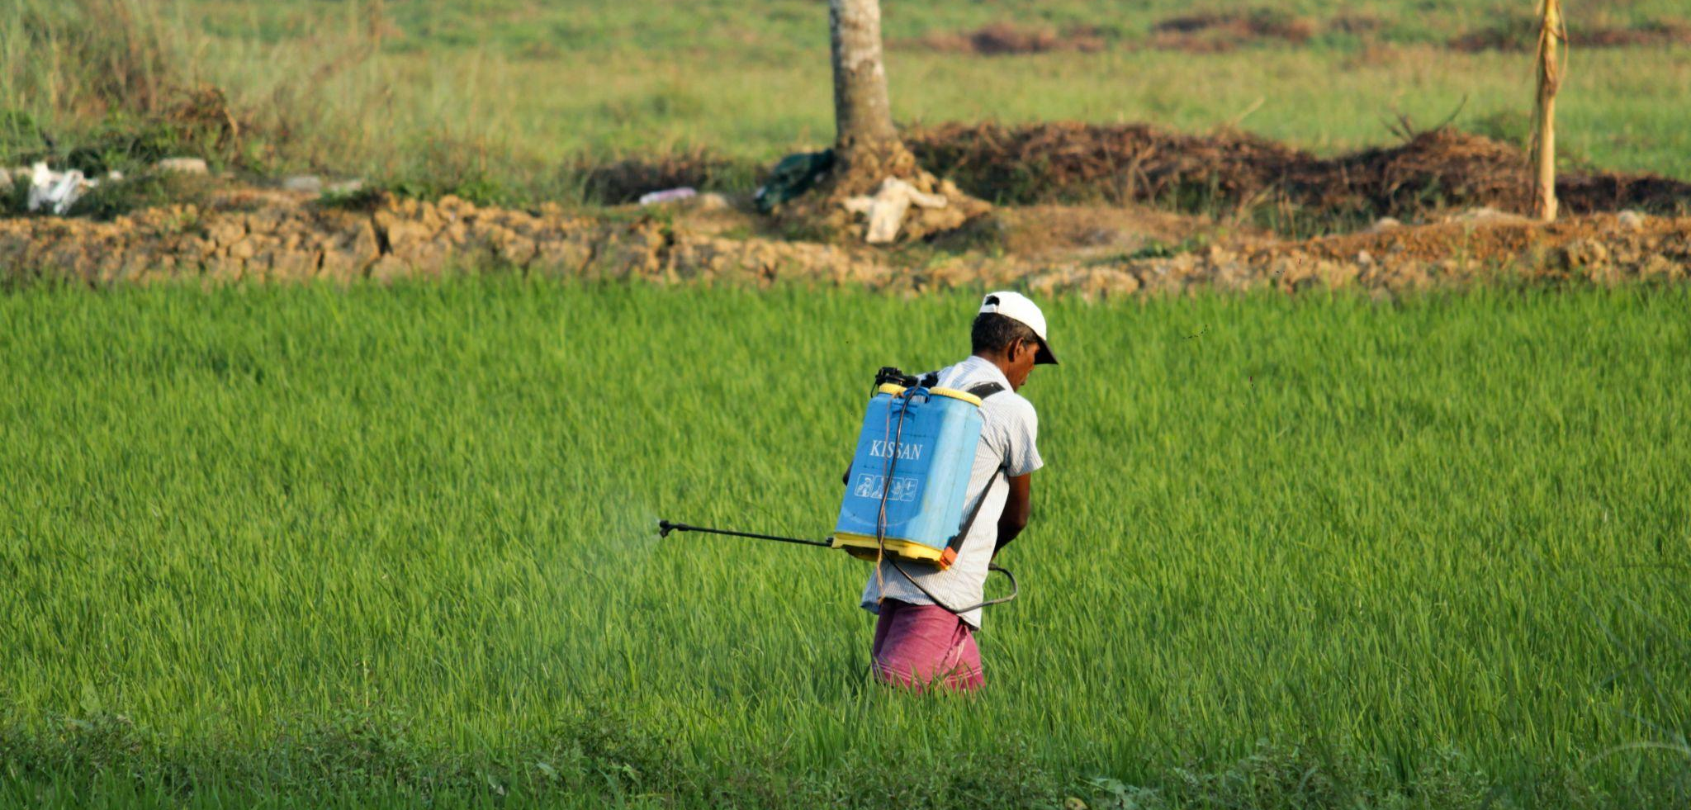
Over 95% of all agricultural crops are sprayed with pesticides to increase yields.

Slide 10
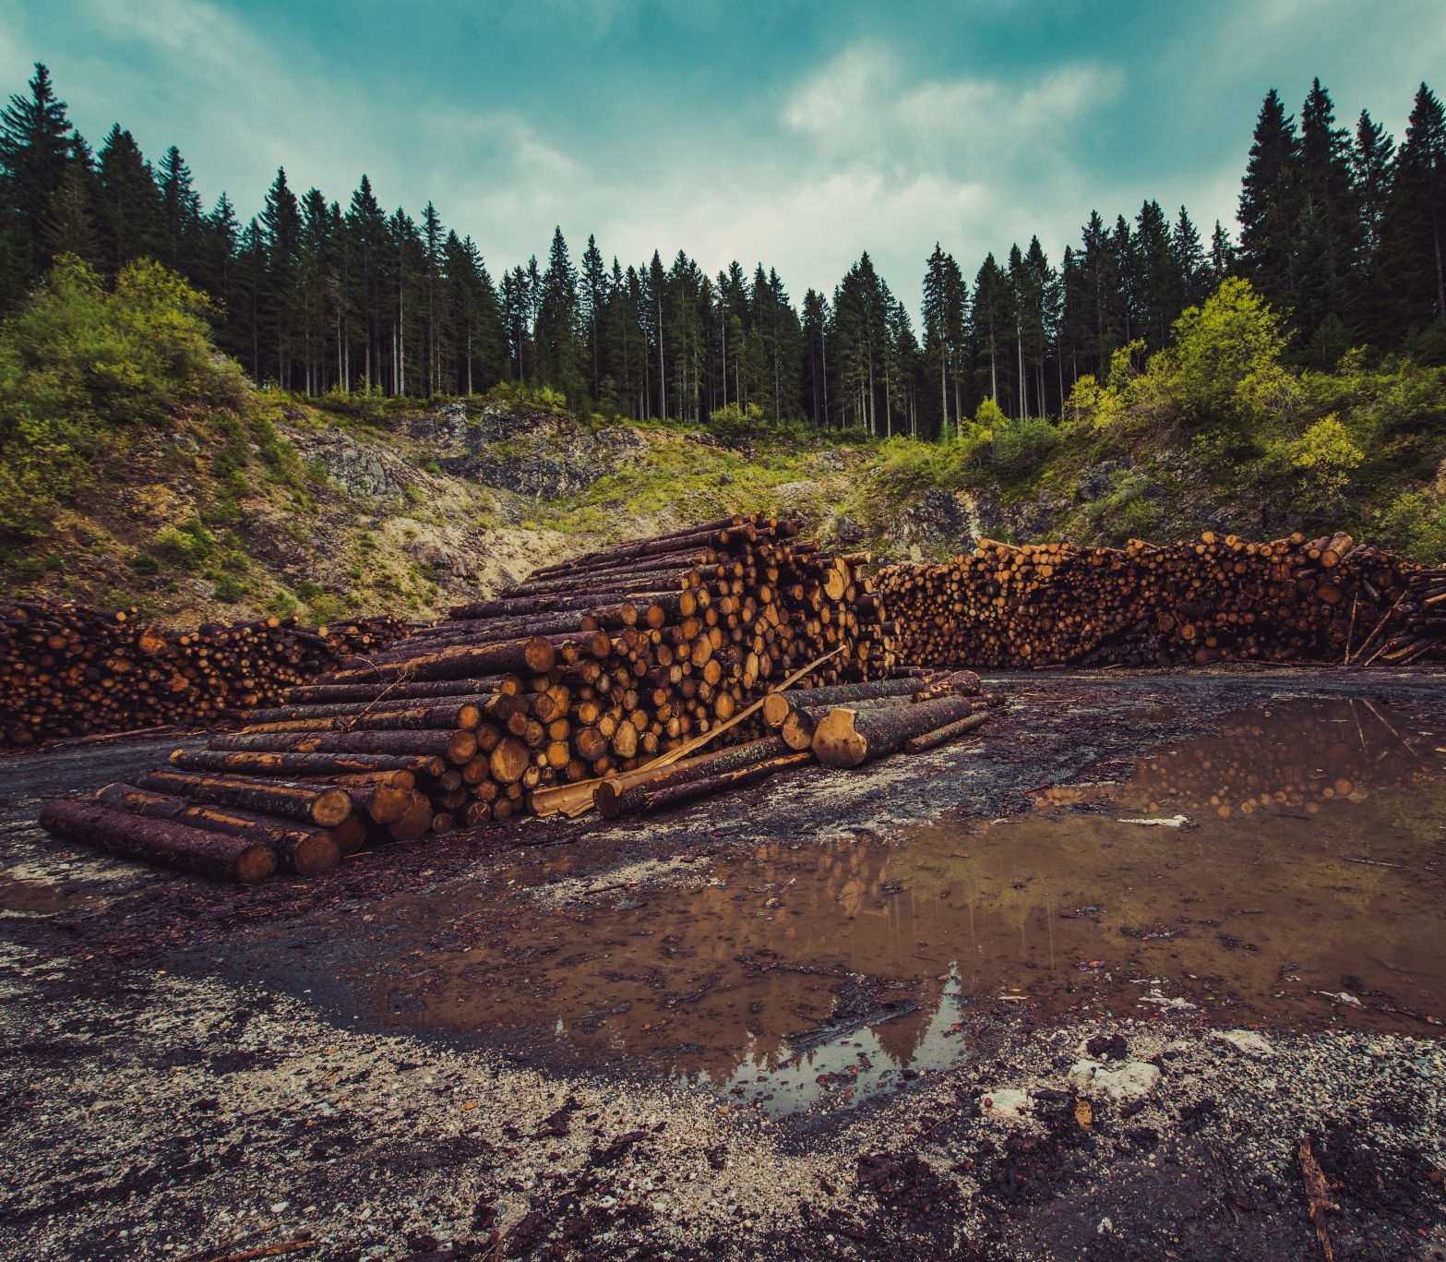
Farmers often clear forests to make way for crop fields.

Slide 11
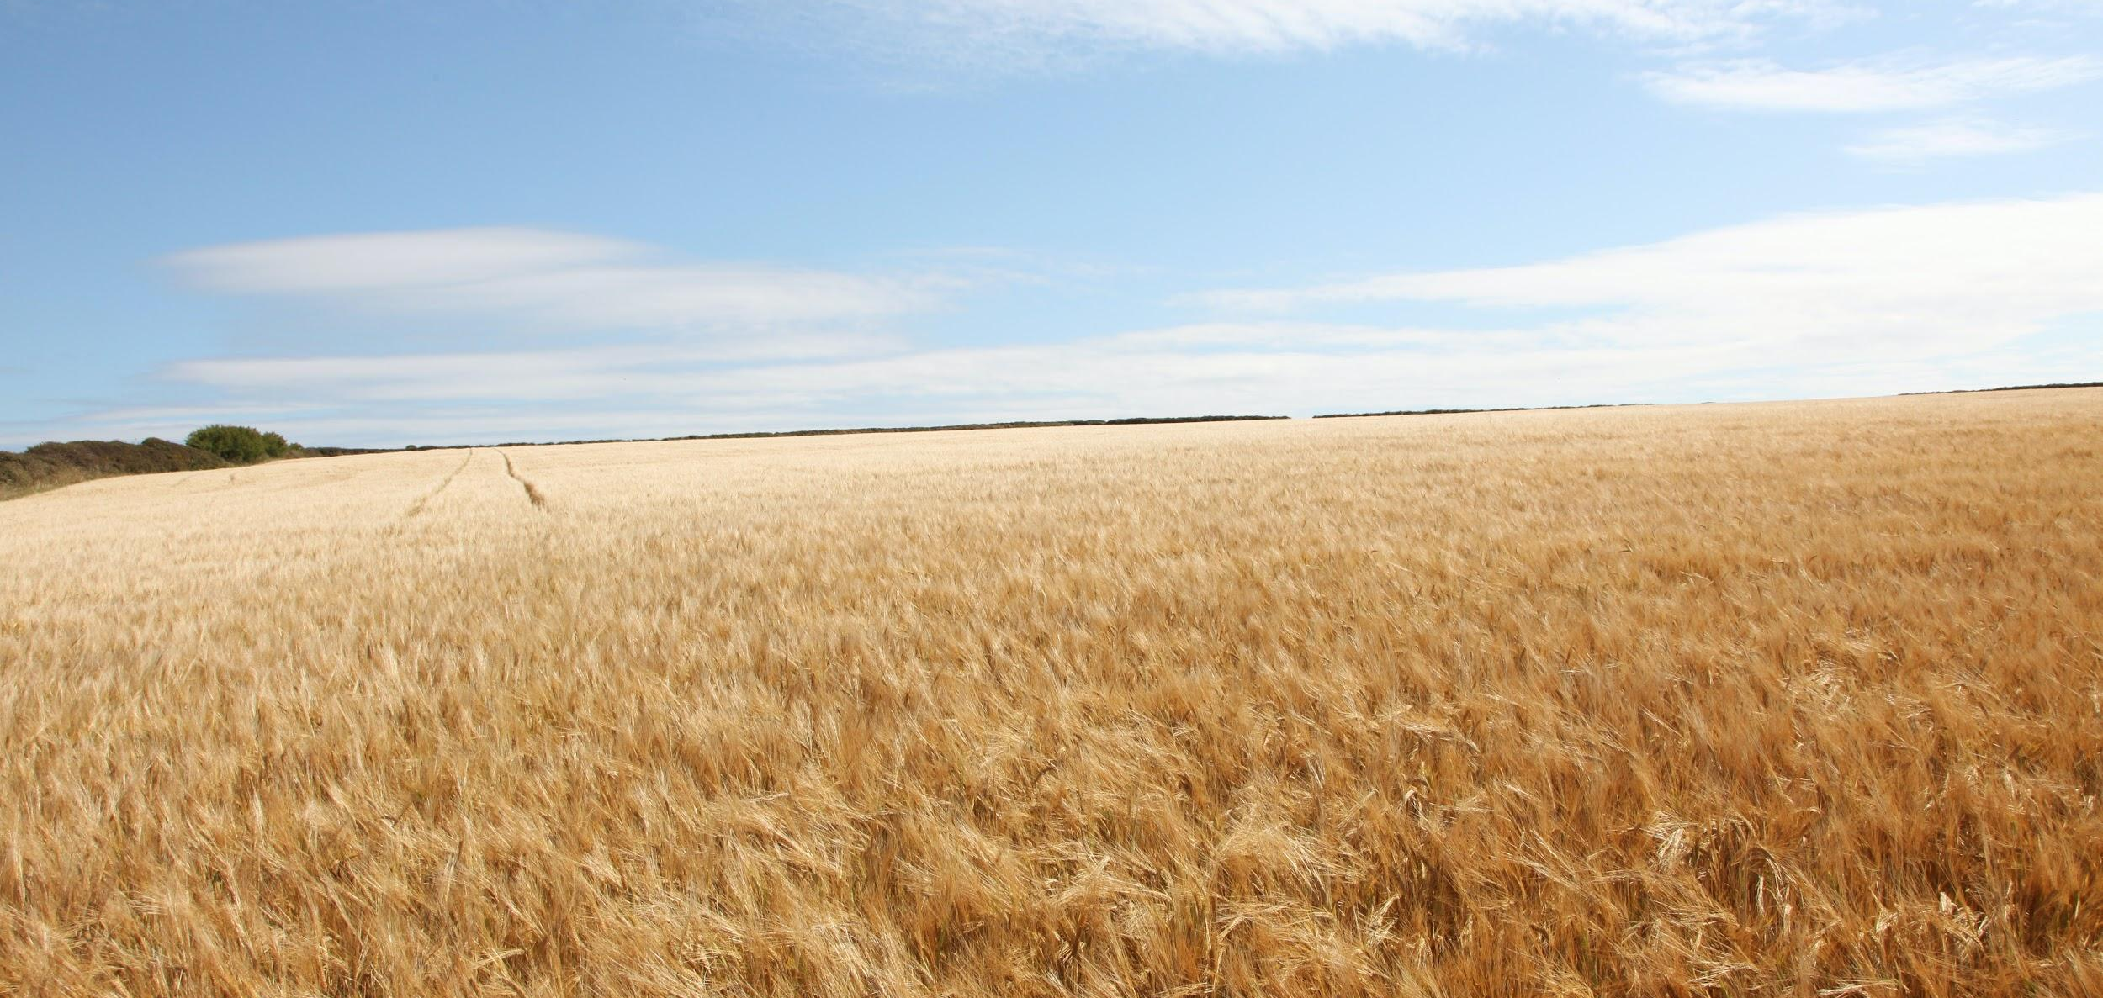
In order to maximise revenues, farmers will often use monoculture. This field is growing wheat exclusively.

Slide 12
Conservation Schemes
Agriculture is vital to our way of life.
  Agriculture provides food to support an increasing global population.
  It also supplies the resources for clothing, medicines and fuels.
Areas with high biodiversity help to maintain the environment.
  Biodiverse areas like the rainforest are sources of new foods and medicines.
  Biodiverse areas may also increase crop yields, by providing pollinators like bees.
It is important to balance increasing agricultural yields with a desire to maintain biodiversity.
Conservationists try to maintain this balance through the use of conservation schemes.
  This may include giving legal protection to endangered species.
  It may also involve protecting areas from agricultural or residential development.
    Sites of Special Scientific Interest (SSSIs) and Areas of Outstanding Natural Beauty (AONBs) both enjoy significant legal protection.

Slide 13
Sites of Special Scientific Interest (SSSIs) are given legal protections against development.
The county of Cornwall has a number of these SSSIs.

Slide 14
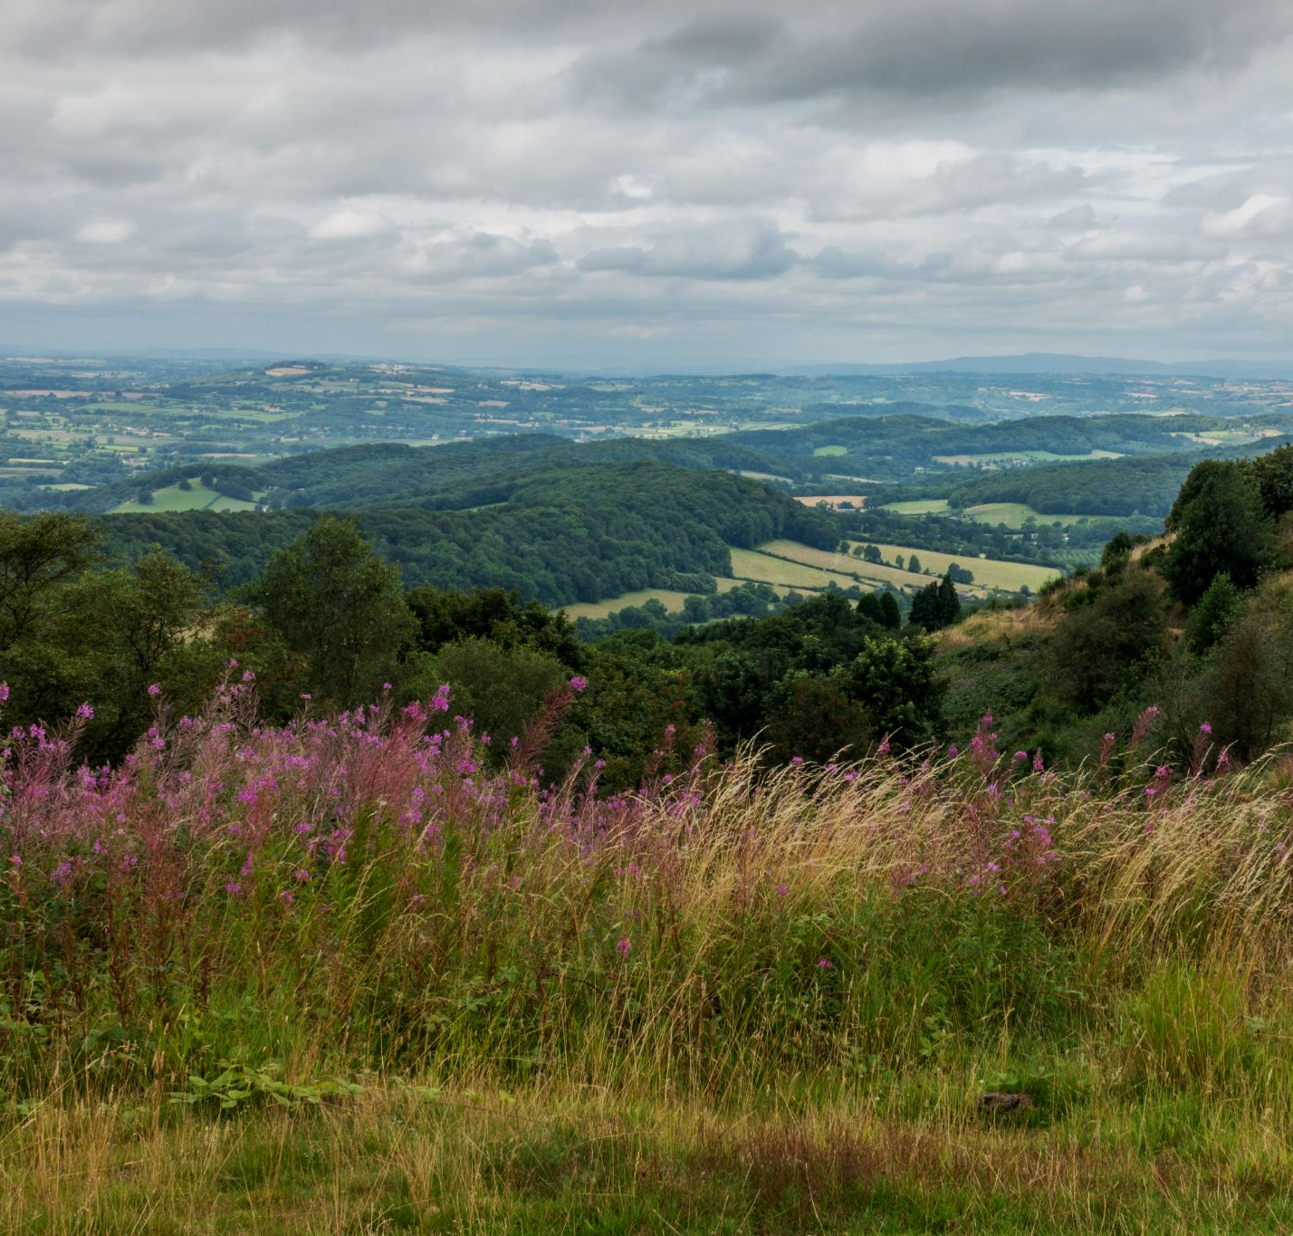
The rolling hills of the Malverns are designated as an Area of Outstanding Natural Beauty (AONB).

Slide 15
Analysing Consequences of Agriculture on Biodiversity
The correlation between 2 variables can be calculated using Spearman’s rank correlation coefficient (r_{s}).
  This statistical test determines the strength of the relationship between a pair of variables.
The r_{s} value will lie between -1 and 1.
  A perfect positive correlation will have the value +1.
  A perfect negative correlation will have the value -1
  No correlation at all will have the value 0.
d = difference in rank between data pairs
n = total number of data pairs
Σ = sum of equation

Slide 16
The r_{s} value of -0.94 indicates a strong negative correlation between the number of pesticide applications and the index of diversity.
NUMBER OF PESTICIDE APPLICATIONS | INDEX OF DIVERSITY | d ²
0 | 4.11 | 25
1 | 3.65 | 4
2 | 3.70 | 4
3 | 2.47 | 1
4 | 2.22 | 9
5 | 1.83 | 25
INDEX OF DIVERSITY →
NO. OF PESTICIDE APPLICATIONS →
r_{s} = -0.94

