Slide 1
AQA A Level Biology
33 - Classifying Organisms
Phylogeny, Taxonomy and Methods of Classification

Slide 2
Phylogeny
Specification Point 3.4.5 - Species and taxonomy.
Phylogeny is the study of the evolutionary development of organisms.
  Phylogeny looks at how closely related different species are to each other.
All organisms on Earth share a universal common ancestor.
  Several estimates place this period about 4.5 billion years ago.
  Every species on Earth has evolved from this single organism.
Evolutionary relationships can be visualised using a phylogenetic tree.
  The pattern of branches on the tree reflects how species evolved from a series of common ancestors.
A phylogenetic tree showing all the major groups of bacteria.

Slide 3
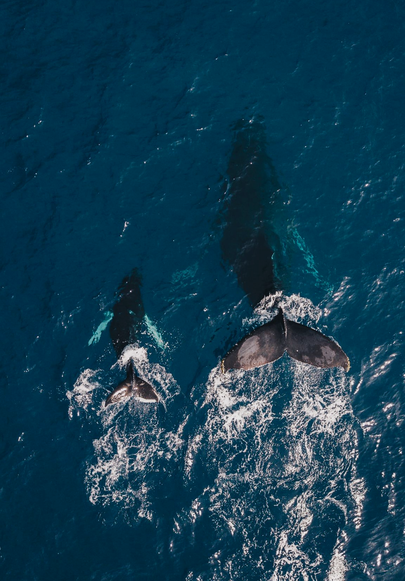
A phylogenetic tree for various species of whale. Those species that have branches closer together have diverged from each other more recently.

Slide 4
Taxonomy
Taxonomy is the branch of science concerned with the classification of organisms.
  Taxonomy involves naming organisms and assigning them to various taxonomic groups.
The phylogeny of an organism is considered when undergoing classifications.
  Organisms are often put into groups based on their evolutionary relationships with other species.
There are 8 levels of groups that are used to classify organisms.
  Each of these groups is called a taxon.
Taxonomy relies on a hierarchical system.
  The largest groups are at the top of the hierarchy.
  The smallest groups are at the bottom of the hierarchy.

Slide 5
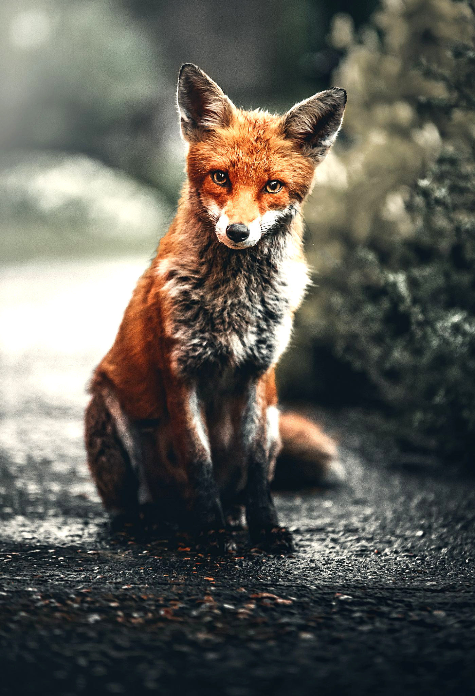
The taxonomy of the red fox (Vulpes vulpes).

Slide 6
Defining a Species
As we move down the hierarchy, each group becomes more closely related.
The lowest taxa are the ones that includes different species.
  There is only ever a single type of organism per species.
A species is a group of similar organisms that can reproduce to yield fertile offspring.
  This is referred to as the biological species concept.
Some closely related organisms from different species may be able to interbreed, but the offspring they produce will be sterile.
  A male lion may mate with a female tiger to produce a liger, but this individual will be infertile.
  As such the lion and the tiger are considered to be from different species.

Slide 7
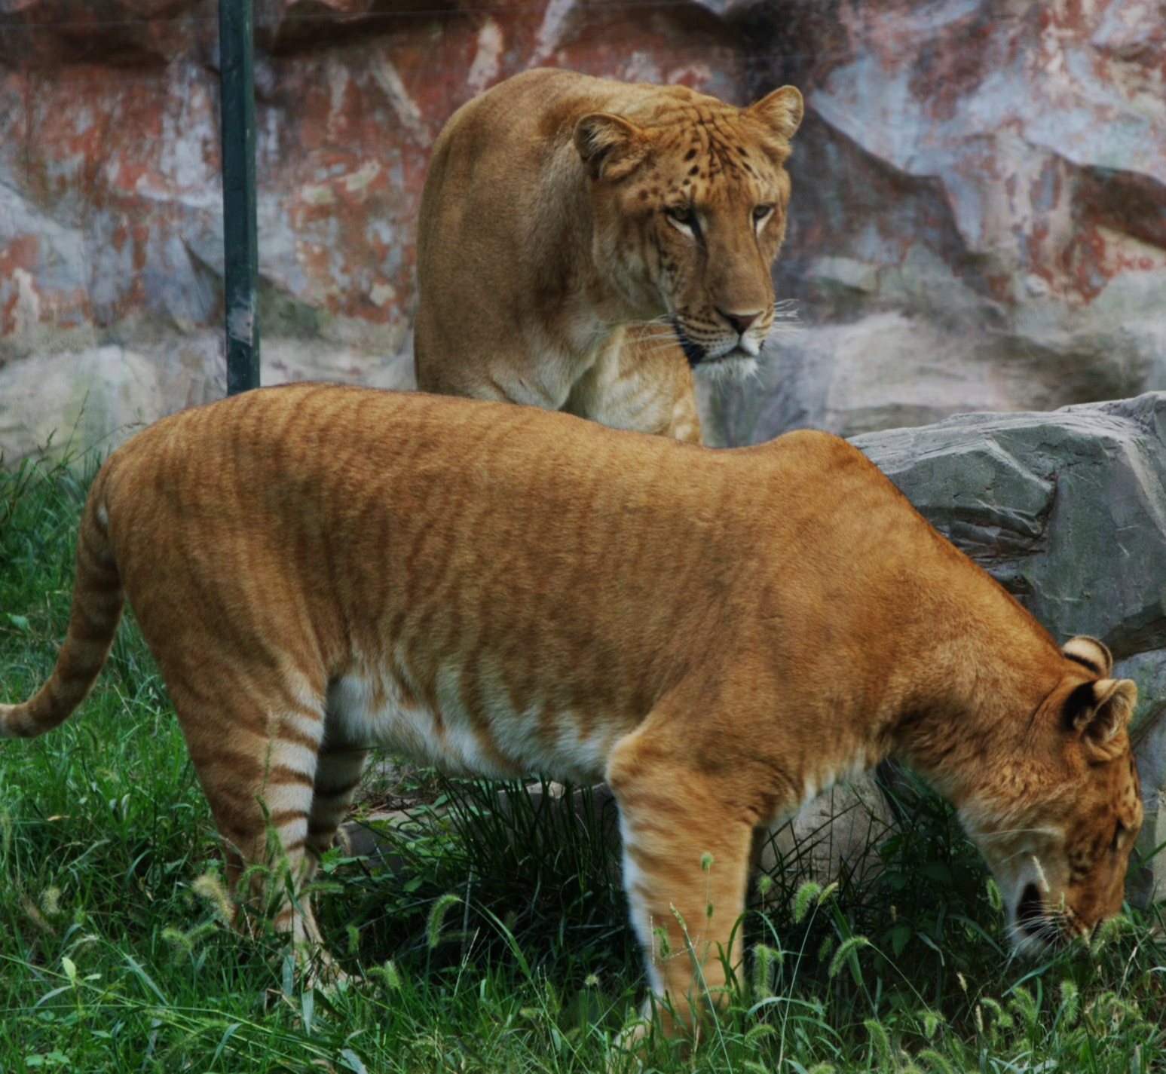
Often weighing over 500 kg, the liger is considered to be the largest big cat in the world.
Ligers are produced when a male lion mates with a female tiger.
Because ligers are sterile and unable to produce their own offspring, they are not considered to be a separate species.

Slide 8
The Binomial Naming System
The scientific standard for naming organisms is called the binomial system.
  The formation of this system is credited to the Swedish botanist Carl Linnaeus.
The binomial system is in Latin and includes 2 parts.
  A capitalised genus name.
  A lowercase species name.
  Both names are italicized.
For example, the binomial nomenclature for a human is Homo sapiens.
  Homo is the genus name and sapiens is the species name.
The binomial system was adopted to allow scientists to name organisms in a standardised way.
  For example, the fish Mugil cephalus has a number of common names, including the black mullet, the bully mullet and the common mullet.
  Using a single name in scientific literature helps to avoid confusion.

Slide 9
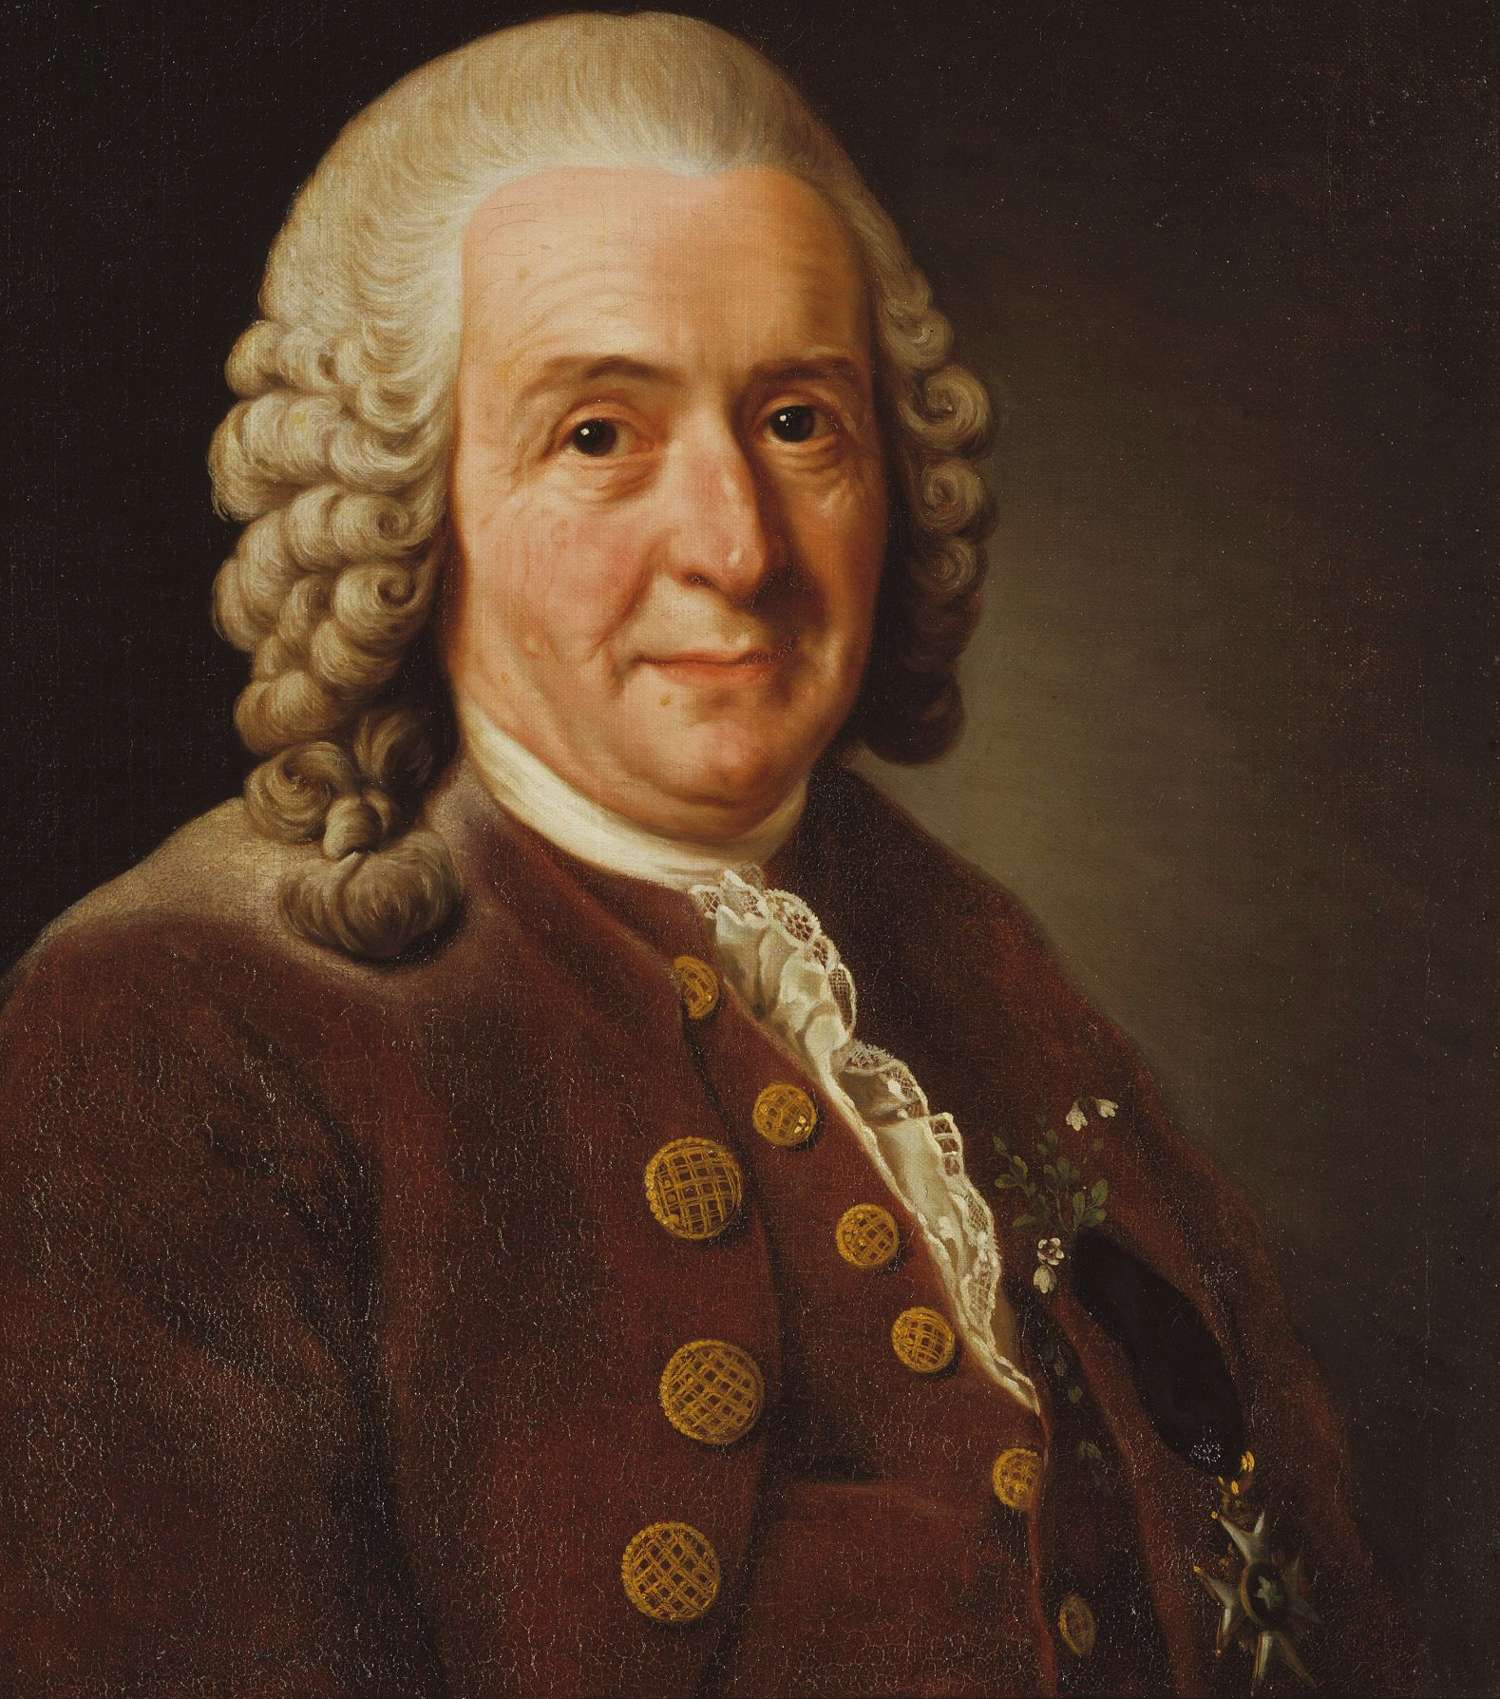
Carl Linnaeus is considered the father of modern taxonomy.
Linnaeus popularised the binomial naming system for organisms.
The binomial system is in Latin and includes a capitalised genus name and a lowercase species name. Both names are then italicized.

Slide 10
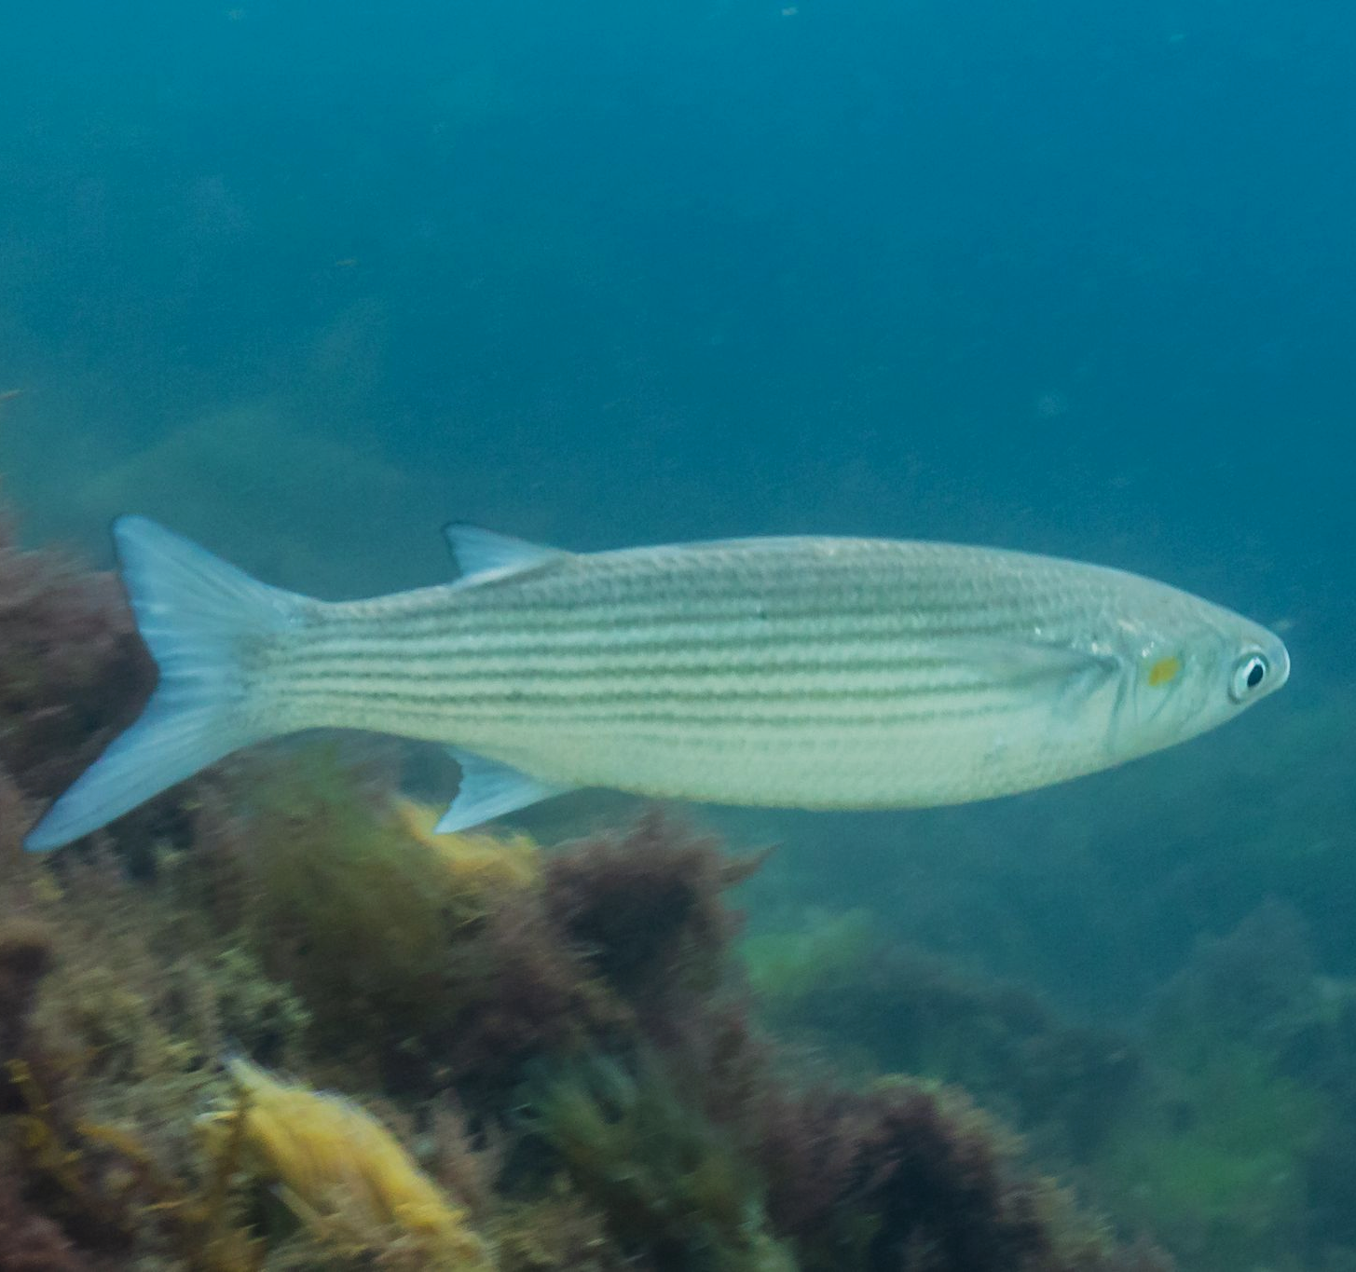
Mugil cephalus has at least 8 common names, including the common mullet.
Using the binomial naming system helps to avoid confusion in scientific literature.

Slide 11
Classifying Using Courtship Behaviour
Courtship behaviour helps an organism to attract mates.
  Some courtship rituals are simple:
    The gypsy moth (Lymantria dispar) will release chemicals called pheromones to attract mates.
  Other rituals are more complex:
    The blue-footed booby (Sula nebouxii) will perform a ritualised dance with many different components.
Courtship behaviour is specific to each species.
  Only members of the same species will respond to specific courtship rituals.
  This helps to prevent interbreeding between different species.
Scientists can use courtship behaviour to classify organisms.
  Similar organisms will have exhibit very similar displays of courtship.

Slide 12
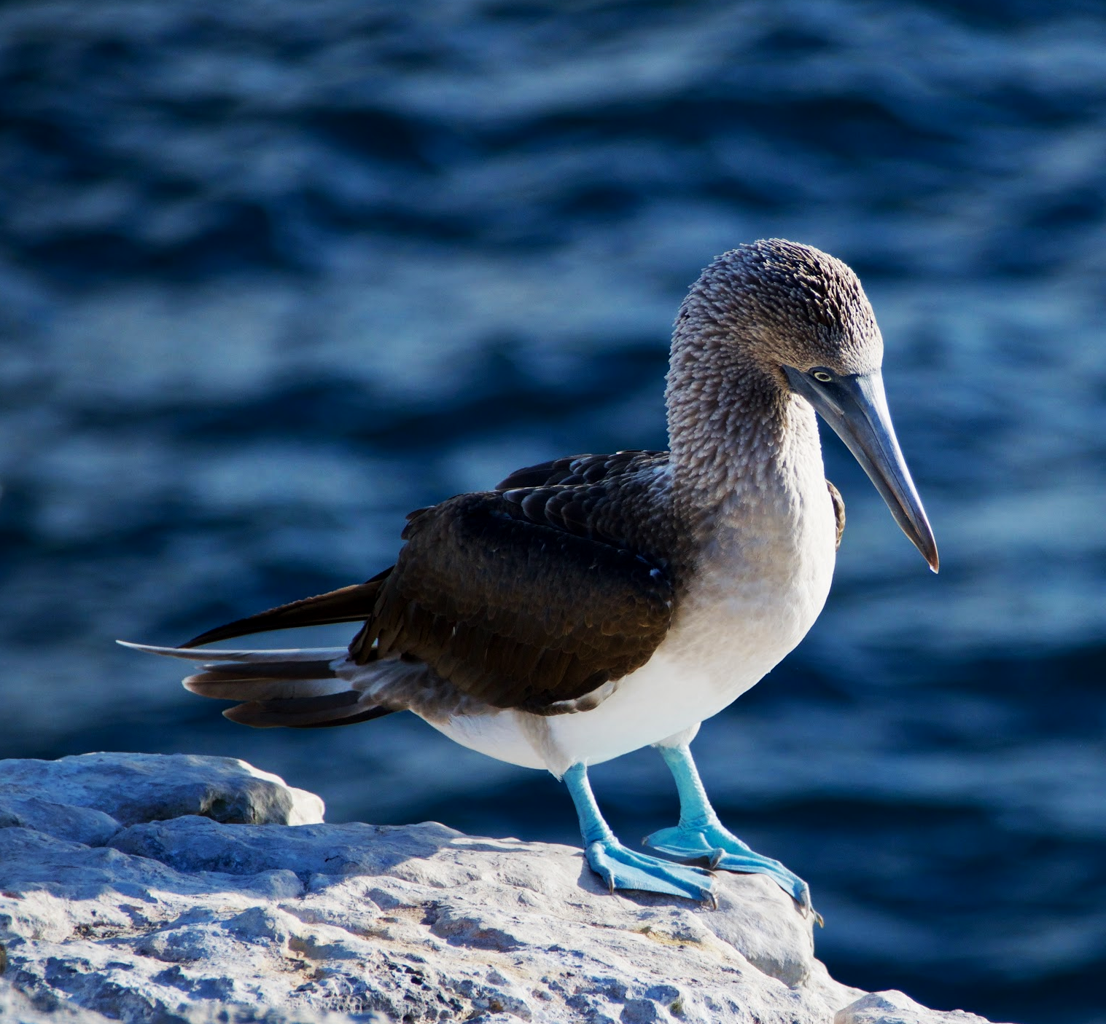
The blue-footed booby has an enormously complex mating ritual.
This form of courtship behaviour can be used to help classify organisms.

Slide 13
Classifying Organisms Using DNA or Amino Acids
Traditional methods of classification relied on morphology.
  This is how similar an organism looks to another organism.
Emerging technologies have created new ways to classify organisms.
Scientists can compare the genomes of different organisms.
  The genome is the complete collection of DNA in an organism.
  Technological advances have allowed for the genomes of different organisms to be quickly and cheaply sequenced.
  Species that are closely related to each other will have a high degree of similarity in their respective base sequences.
Scientists can also compare the amino acid sequences of different organisms.
  Proteins are coded for by the base sequence of DNA.
  Organisms that are closely related will have similar DNA sequences.
  As a result, they will have similar amino acids in their proteins.

Slide 14
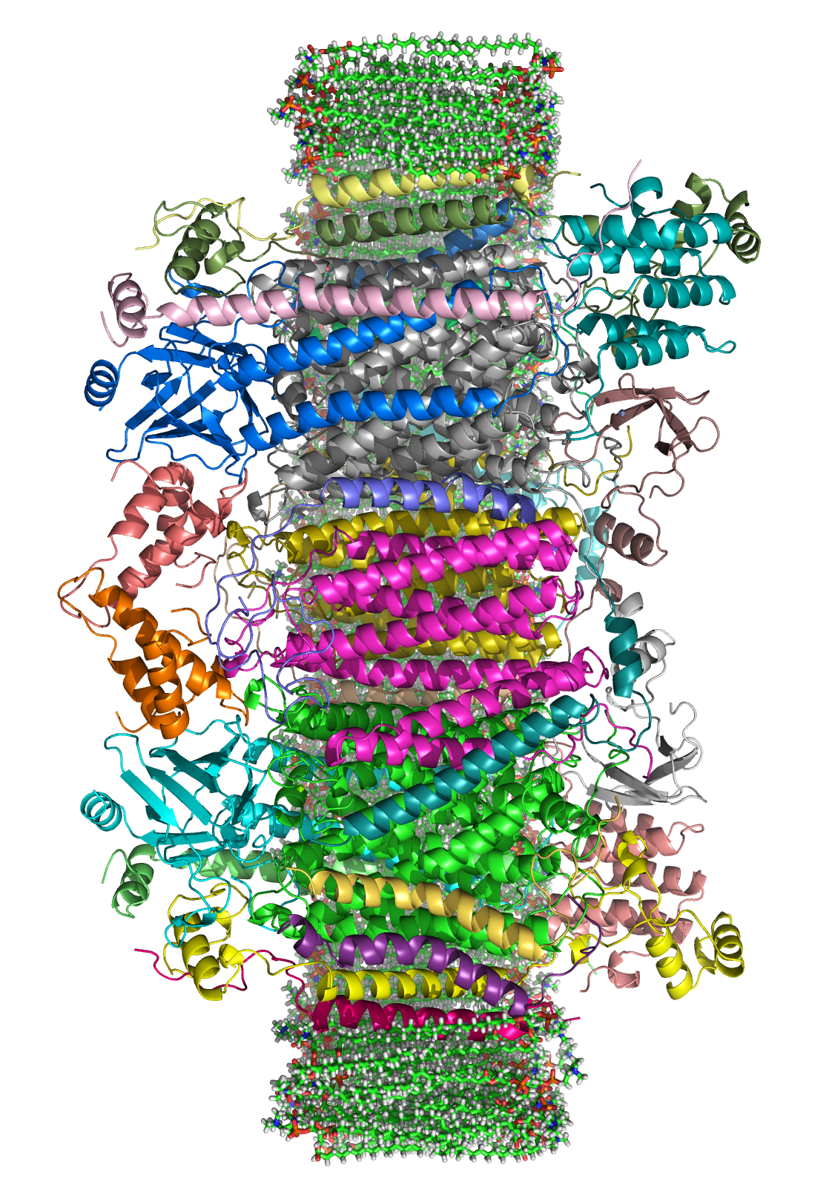
The protein cytochrome c oxidase is an enzyme found in a variety of eukaryotic and prokaryotic life.
Its amino acid sequence can be compared across different taxonomic groups to aid with classification.

Slide 15
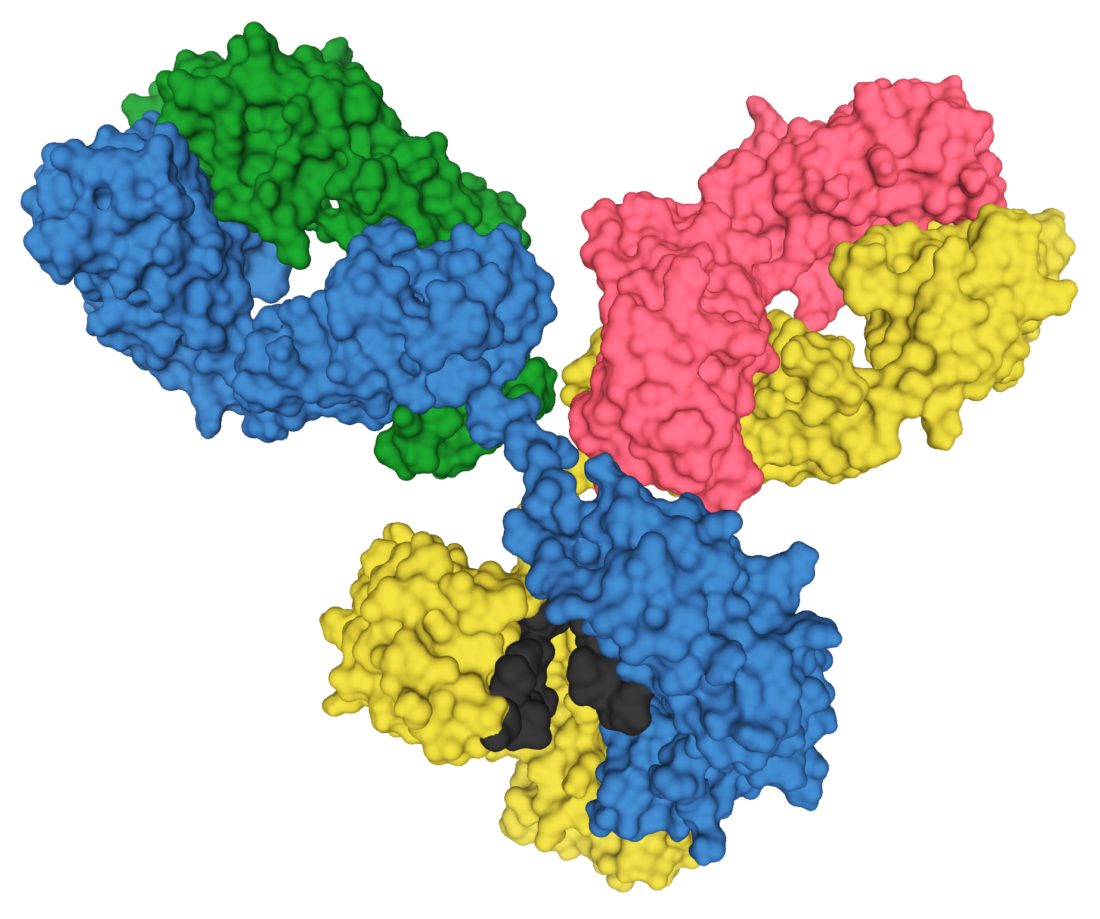
Classifying Organisms Using Immunology
The proteins from closely related organisms will bind to the same antibodies.
  Scientists can design antibodies that are complementary to a particular protein.
Any protein that is structurally similar to the original protein will also bind to the antibody.
  For example, the proteins created by a human and a chimpanzee are very similar.
  Antibodies created for the human protein will also bind to the chimpanzee protein.
Antibodies for a protein will also bind to other proteins that are similar in shape.

Slide 16
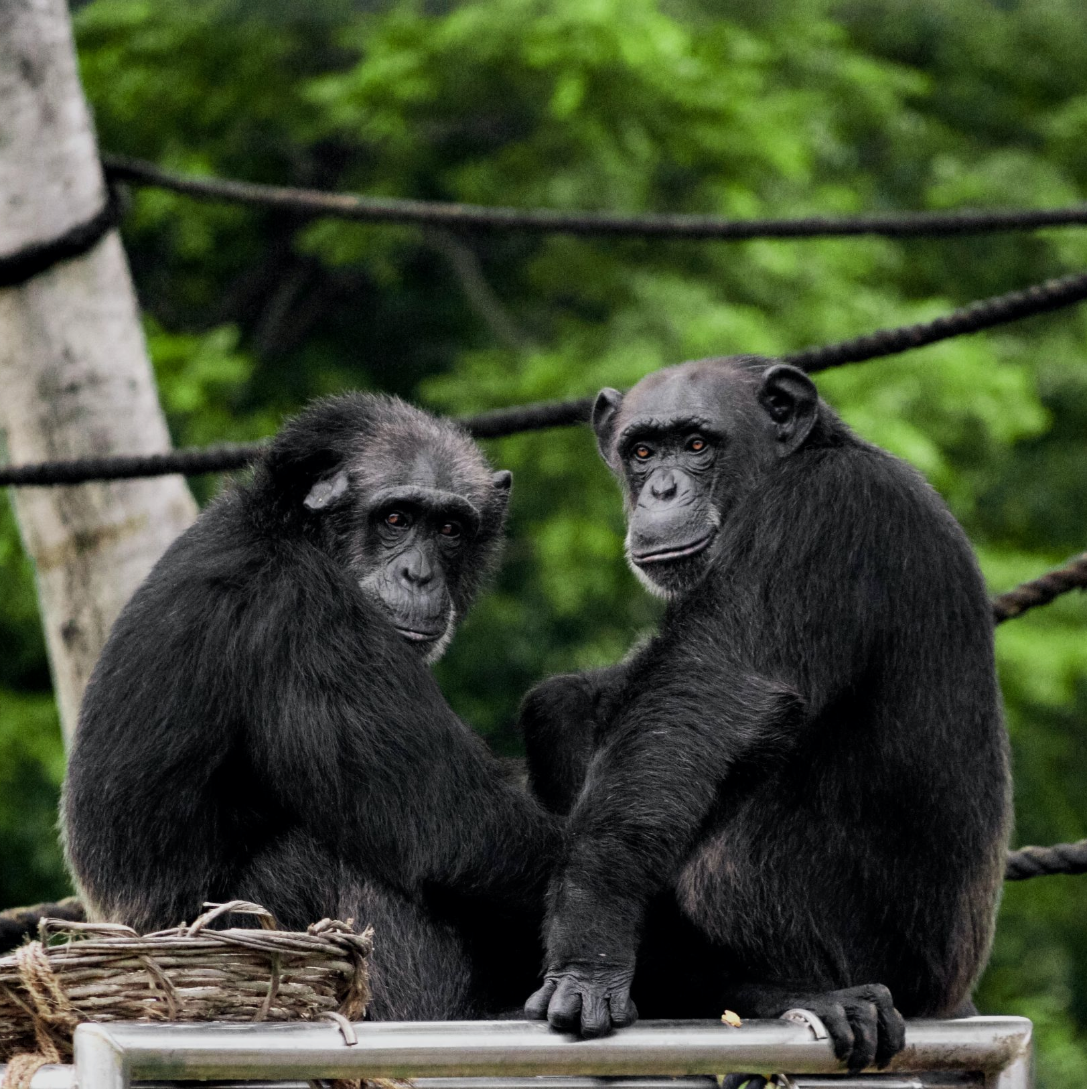
Because chimpanzees and humans have similar DNA sequences, the proteins made by both species are also similar.
This means that antibodies created for a particular human protein will most likely also bind to the same protein made by a chimpanzee.

