Slide 1
AQA A Level Biology
32 - Natural Selection
Adaptations and Mechanisms of Selection

Slide 2
Natural Selection
Specification Point 3.4.4 - Genetic diversity and adaptation.
New alleles are formed by mutations.
  This is a change to the base sequence of DNA.
Most mutations result in deleterious alleles.
  These alleles reduce the survivability of the organism.
  As a result, these alleles are quickly removed from the gene pool.
Some mutations result in beneficial alleles.
  These alleles increase the survivability of the organism.
  These alleles are passed on when the organism reproduces.
Over several generations, the frequency of a beneficial allele in a population will increase.
  This is the process of natural selection.

Slide 3
Natural Selection
The phenomenon of natural selection can be explained in several stages:
There are differing levels of reproductive success.
  Individuals with an allele that increases their chances of survival are more likely to reproduce that those without the allele.
As such, there is a greater frequency of this allele in the next generation of individuals.
  These individuals are also more likely to have reproductive success than those without the allele.
Over several generations, the allele becomes much more common in the population.
  The population thus becomes better adapted to living in a particular habitat.
  This process leads to evolution.

Slide 4
The evolution of giraffes is a good demonstration of natural selection.
Alleles for tallness gave a greater chance of survival and thus reproductive success.
Over many generations giraffes became progressively taller until they reached the average 5 metres seen today.

Slide 5
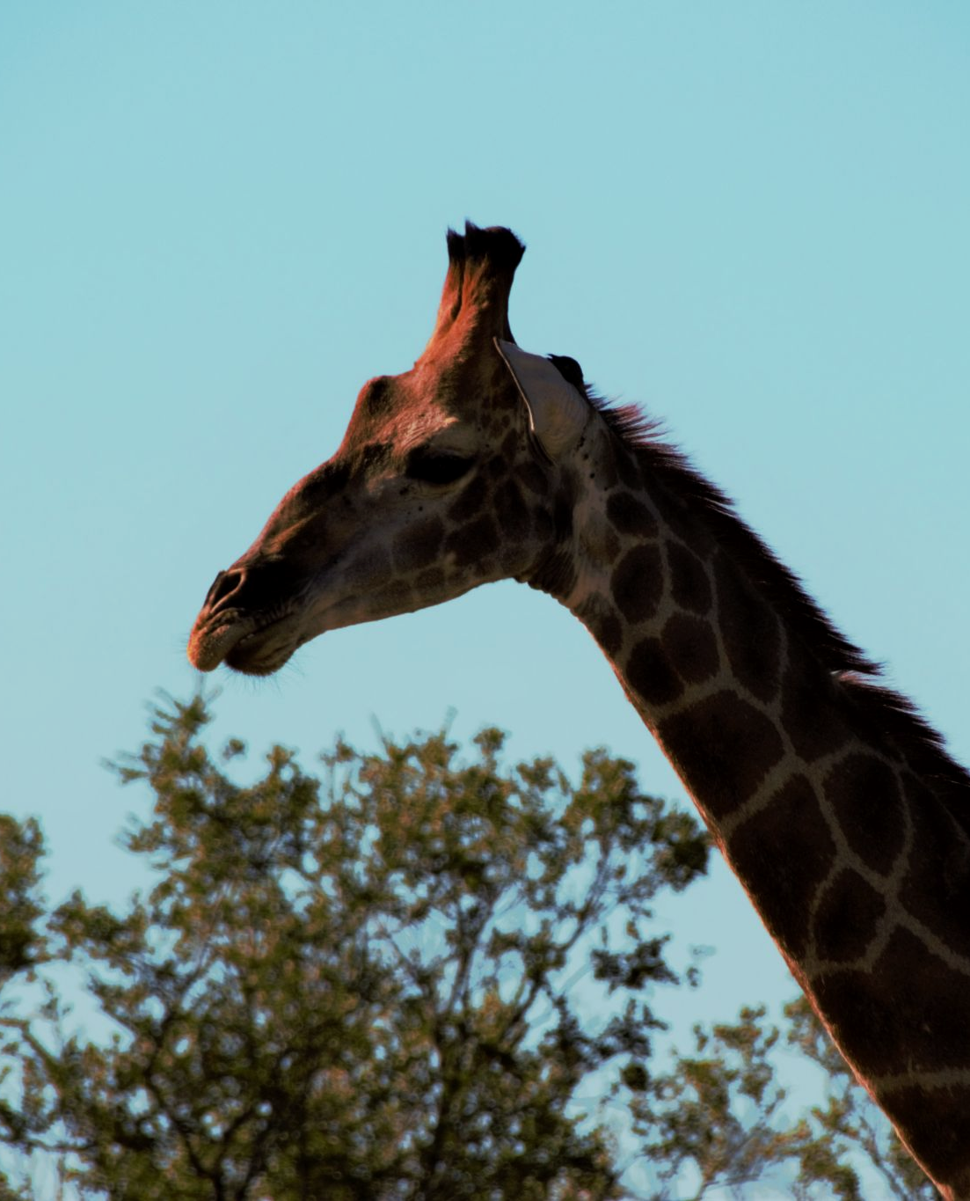
The evolution of giraffes is a good demonstration of natural selection.
Alleles for tallness gave a greater chance of survival and thus reproductive success.
Over many generations giraffes became progressively taller until they reached the average 5 metres seen today.

Slide 6
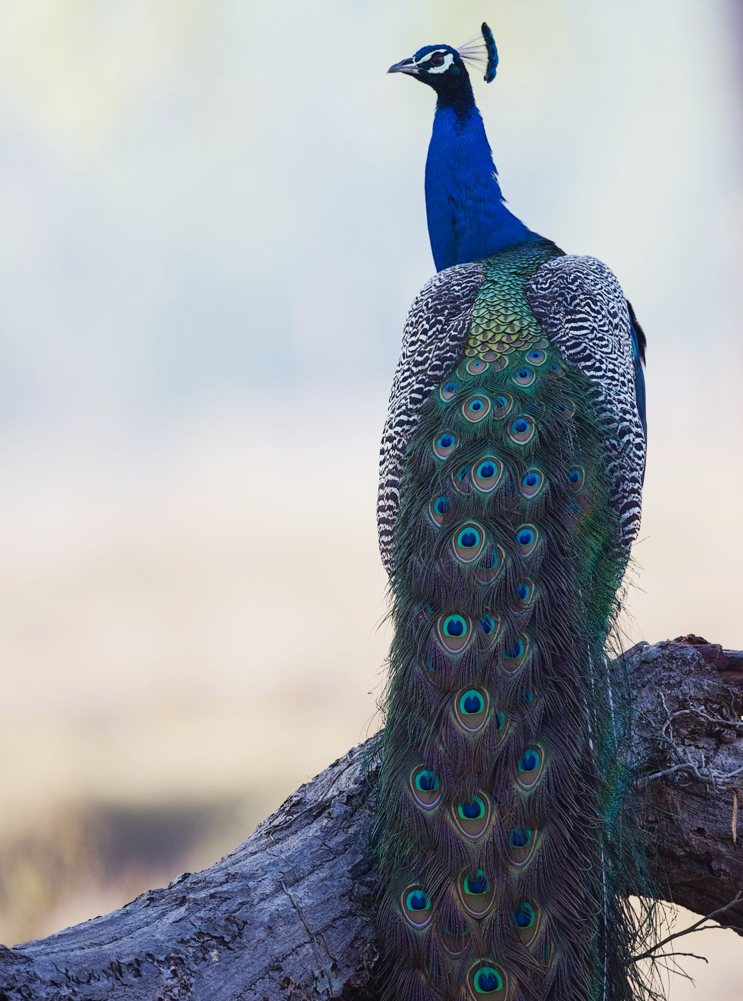
Male peacocks with brightly coloured feathers had greater reproductive success than those with dull feathers.
Over several generations the allele for brightly coloured feathers became the most common in the population.

Slide 7
Adaptations
As a population evolves, it becomes better adapted to its surroundings.
  Adaptations can be either behavioural, physiological or anatomical in nature.
Behavioural adaptations are acts made by an organism that increase its chances of survival.
  Penguins huddle together during winter to minimize heat loss.
Physiological adaptations are processes that occur inside an organism that increase its chance or survival.
  Bears hibernate over winter to conserve energy.
Anatomical adaptations are the physical features of an organism that increases its chance of survival.
  Whales have a thick layer of blubber to help insulate them against cold polar seas.

Slide 8
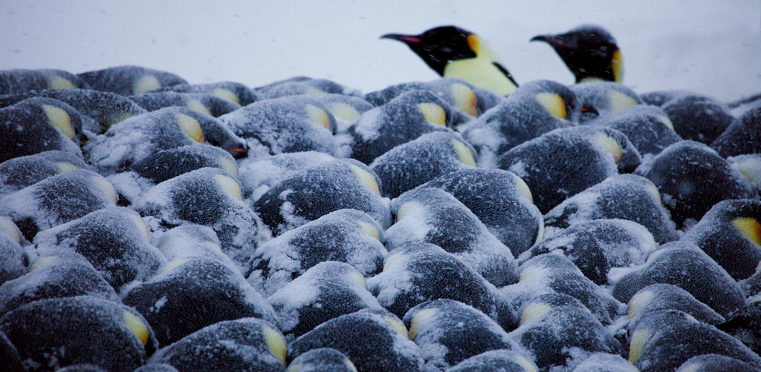
Emperor penguins huddle together to conserve body heat. This is an example of a behavioural adaptation.

Slide 9
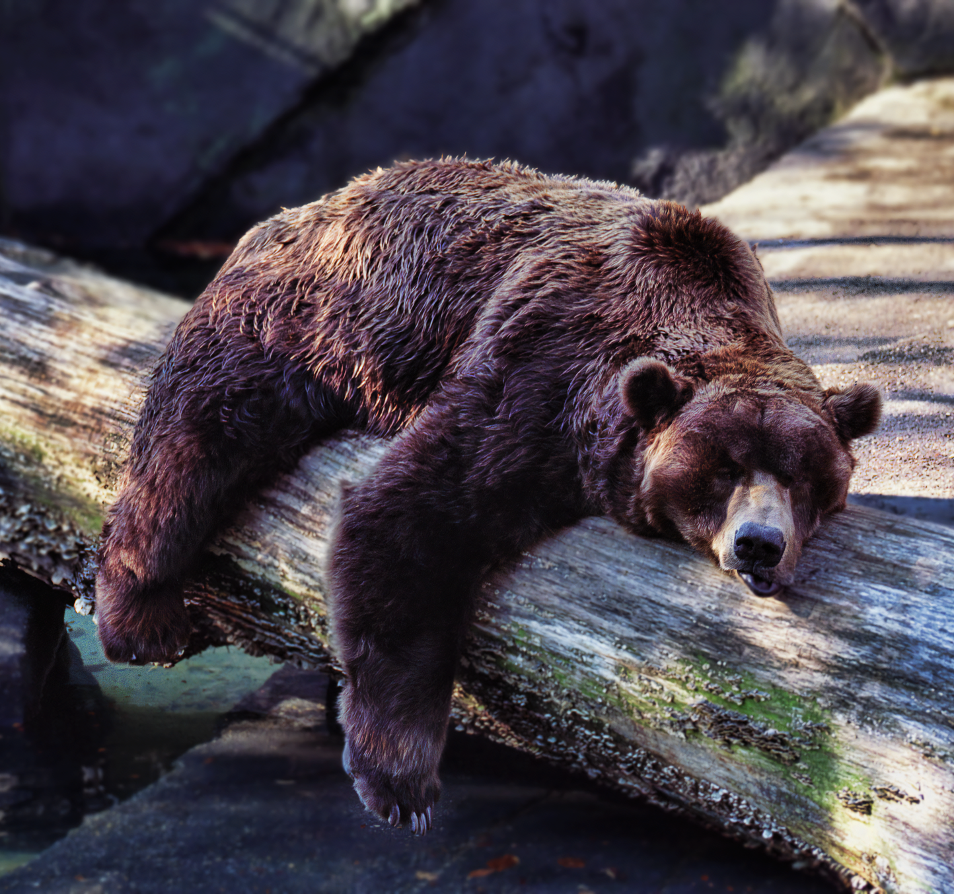
Bears hibernate over winter when food is scarce.
This is an example of a physiological adaptation.

Slide 10
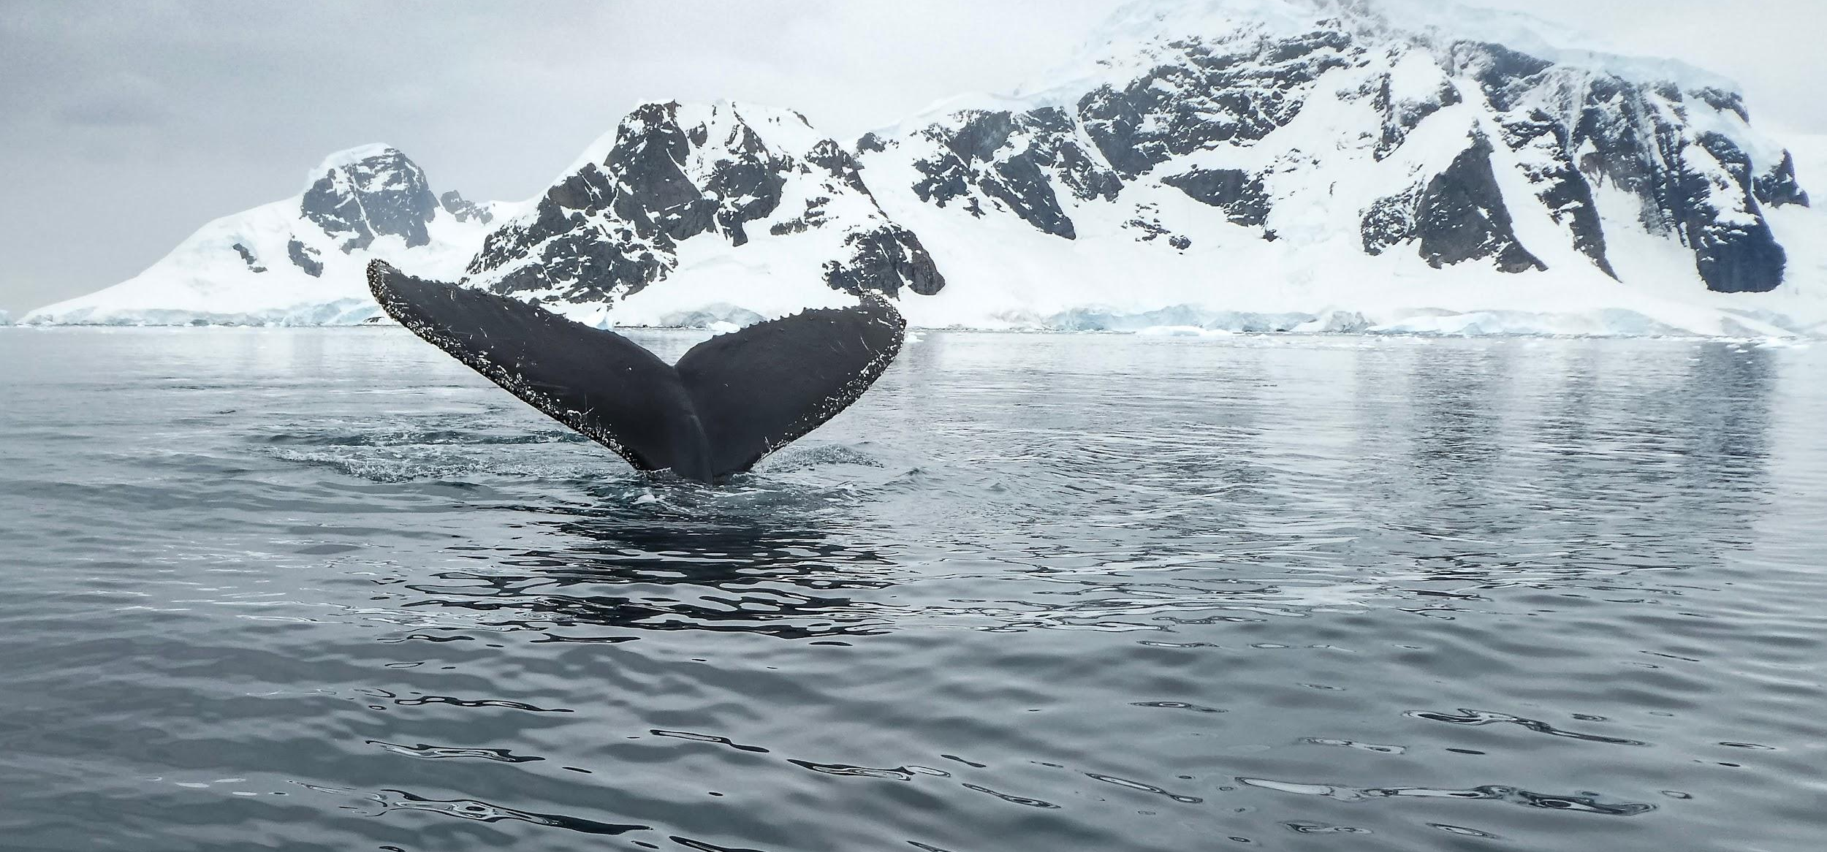
Whales have a thick layer of blubber to insulate themselves against icy seas in the Antarctic. This is an example of an anatomical adaptation.

Slide 11
Types of Selection
The frequency of a particular allele in a population can affected by natural selection.
Directional selection occurs when 1 allele is favoured over other alleles.
  This causes the frequency of this allele to increase in the population.
  This usually occurs because the allele offers a survival advantage to the individual.
  The allele may be responsible for an extreme phenotype, such as antibiotic resistance in a species of bacteria.
Stabilising selection occurs when alleles towards the middle of a particular range are favoured.
  This is because individuals with moderate phenotypes may be more likely to survive than those with extreme phenotypes.
  For example, the range of human birth weights is very narrow. This is because both very small and very large babies are less likely to survive than moderately sized babies.

Slide 12
DIRECTIONAL SELECTION
STABILISING SELECTION
BEFORE
AFTER
BEFORE
AFTER
FREQUENCY OF ALLELE →
FREQUENCY OF ALLELE →
PHENOTYPE →
PHENOTYPE →
Graphs to show the effect of directional and stabilising selection on the frequency of certain alleles. In directional selection, 1 extreme allele is selected for. In stabilising selection, the median alleles are selected for.

Slide 13
Investigating Selection
Practical 6 - The use of aseptic techniques to investigate the effect of antimicrobial substances on microbial growth.
Antimicrobial substances are substances that kill microbes.
  Antibiotics are a type of antimicrobial that kill bacteria.
The efficacy of different antibiotics on bacterial colonies can be investigated using aseptic technique.
  Aseptic technique is used to reduce the chance of contamination of bacterial cultures with unwanted microorganisms.
  These microorganisms might be pathogenic, so could cause disease.
Antibiotics practical video.

Slide 14

The rise of antibiotic-resistant bacteria is a demonstrable example of natural selection.

Slide 15
Aseptic Technique
Disinfect surfaces with an antibacterial cleaner, both before and after the experiment.
  Ensure that all utensils and equipment are also disinfected.
Work near a Bunsen flame.
  This will ensure that convection currents draw microbes away from the culture.
Ensure that all vessels containing bacteria are only open for the minimum amount of time.
  This reduces the chance of unwanted microbes contaminating the bacterial broth.
Flame the wire loop before using it to transfer bacteria.
  This will sterilise the loop to remove any lingering microbes.
Flame the neck of any bottles before using them.
  This also creates convection currents which will prevent unwanted organisms from entering the bottles.

Slide 16
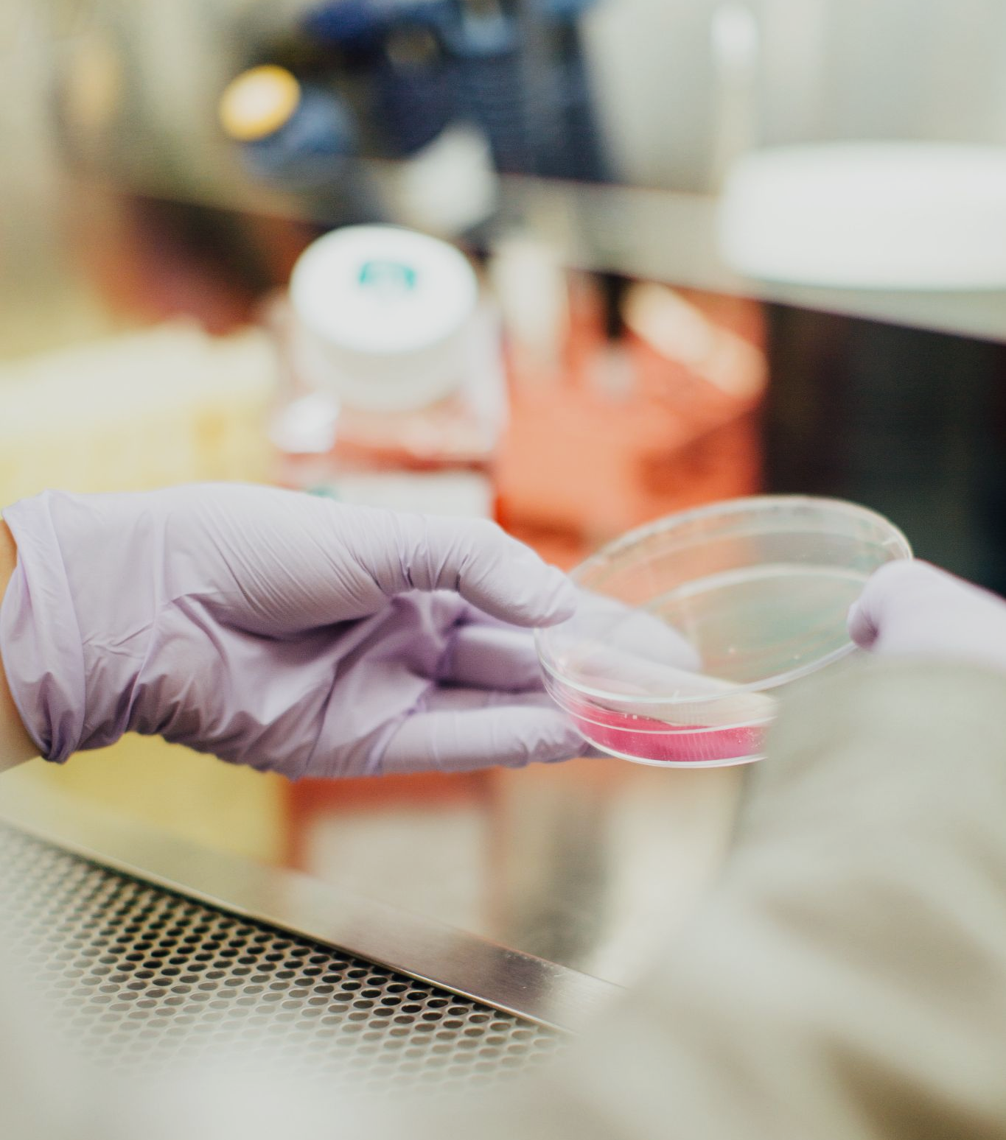
All laboratories should have a protocol for practicing aseptic technique.

Slide 17
Testing Different Antibiotics
Use a sterile pipette or wire loop to transfer bacteria from a broth to an agar plate.
  The bacterial broth is a mixture of distilled water, the bacterial colonies and nutrients.
  The agar plate contains a substance called agar jelly - a substrate to grow the bacteria on.
Spread the bacteria evenly over plate using a sterile plastic spreader.
Use sterile forceps to place a paper discs soaked with different antibiotics onto the plate.
Lightly tape a lid on the plate, invert and incubate at 25°C for 48 hours.
  Ensure that the lid is not sealed. This creates anaerobic conditions which promote the growth of pathogenic bacteria.
Different antibiotics will have different toxicities to the bacteria.
  These will create zones of inhibition where no bacteria will grow.
  The larger the zone of inhibition, the more effective the antibiotic.

Slide 18
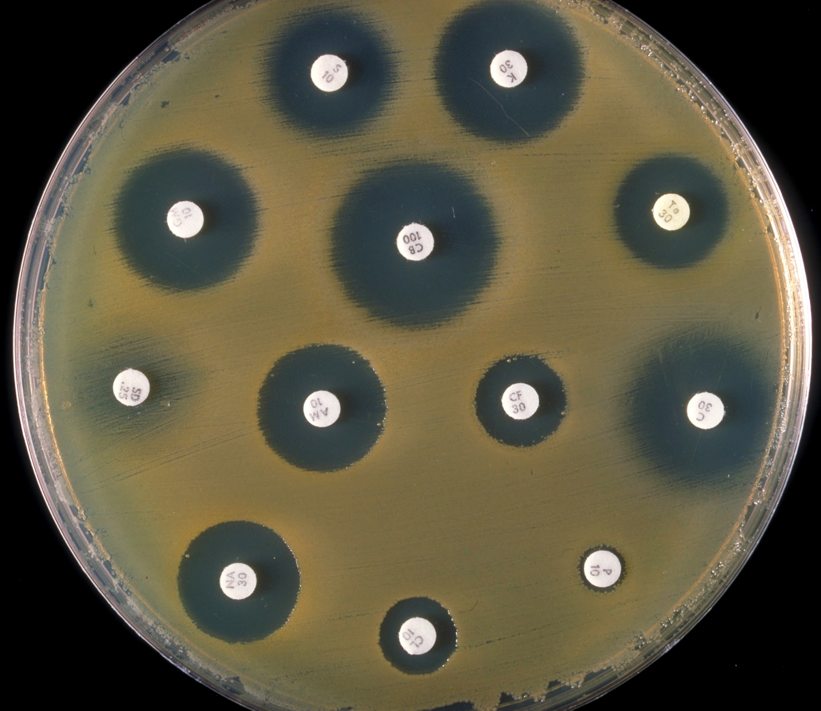
Bacterial lawns displaying zones of inhibition with different diameters.
The larger the zone of inhibition, the more effective the antibiotic.

