Slide 1
AQA A Level Biology
30 - Mutations
Gene and Chromosome Mutations

Slide 2
Mutations
Specification Point 3.4.3 - Genetic diversity can arise as a result of mutation or during meiosis.
A mutation is a change in the DNA base sequence.
  Gene mutations occur in regions of DNA that code for a protein.
A substitution mutation occurs when 1 base is substituted for another.
  For example, the sequence GACGAT becomes GAAGAT.
    In this scenario, the base cytosine (C) has been substituted for the base adenine (A).
A deletion mutation occurs when 1 base is deleted.
  For example, the sequence GACGAT becomes GACGA.
    In this scenario, the base thymine (T) has been removed.

Slide 3
Mutations
The order of amino acids in a protein is determined by the sequence of bases in the DNA.
  If a mutation occurs in a gene, this can alter the sequence and structure of the protein.
ORIGINAL SEQUENCE
AGT | CTT | GTC
SERINE | LEUCINE | VALINE
NEW SEQUENCE
AGT | CTT | GAC
SERINE | LEUCINE | ASPARTIC ACID
A single change in the DNA base sequence can change the sequence of amino acids.

Slide 4
Mutations in DNA will change the base sequence.
Different codons may be created, leading to a different amino acid sequence.
This can cause different proteins to be synthesised.

Slide 5
Mutations and Degeneracy
The DNA code is degenerate.
  There are 64 codons that code for 20 amino acids.
This means that many amino acids are coded for by more than 1 codon.
  For example, the amino acid threonine is coded for by 4 different codons: ACT, ACC, ACA and ACG.
As a result, not all substitution mutations result in a change to the sequence of amino acids.
  Many substitution mutations result in identical amino acid sequences.
  These are referred to as silent mutations.
AAA | CTT | GTC → AAG | CTT | GTC
LYSINE | LEUCINE | VALINE → LYSINE | LEUCINE | VALINE

Slide 6
Frame Shift
The DNA code non-overlapping.
  This means that DNA bases are read in groups of 3, called codons.
Deletion mutations will always lead to a change in sequence of amino acids.
If one base is deleted, the entire reading frame will shift to the left.
  This will result in an entirely new sequence of amino acids.
  This is referred to as frame shift.
AAA | CAC | GTC → AAC | ACG | TCA
LYSINE | LEUCINE | VALINE → ASPARAGINE | THREONINE | SERINE

Slide 7
Many severe genetic diseases, such as cystic fibrosis are caused by frameshift mutations.

Slide 8
Mutagens
Mutations may occur randomly.
  Errors in DNA replication may lead to misread DNA.
Mutagens increase the rate of mutation.
  Mutagens may induce errors in DNA replication, or they may damage DNA directly.
Radiation causes direct damage to DNA.
  UV and other ionising radiation can disrupt bonds in DNA.
Certain chemicals and viruses can also increase the rate of mutation.
  Cyclophosphamide is a common chemotherapy agent that induces mutation in cancer cells.
  Rous sarcoma virus is linked to increased rates of mutation.

Slide 9
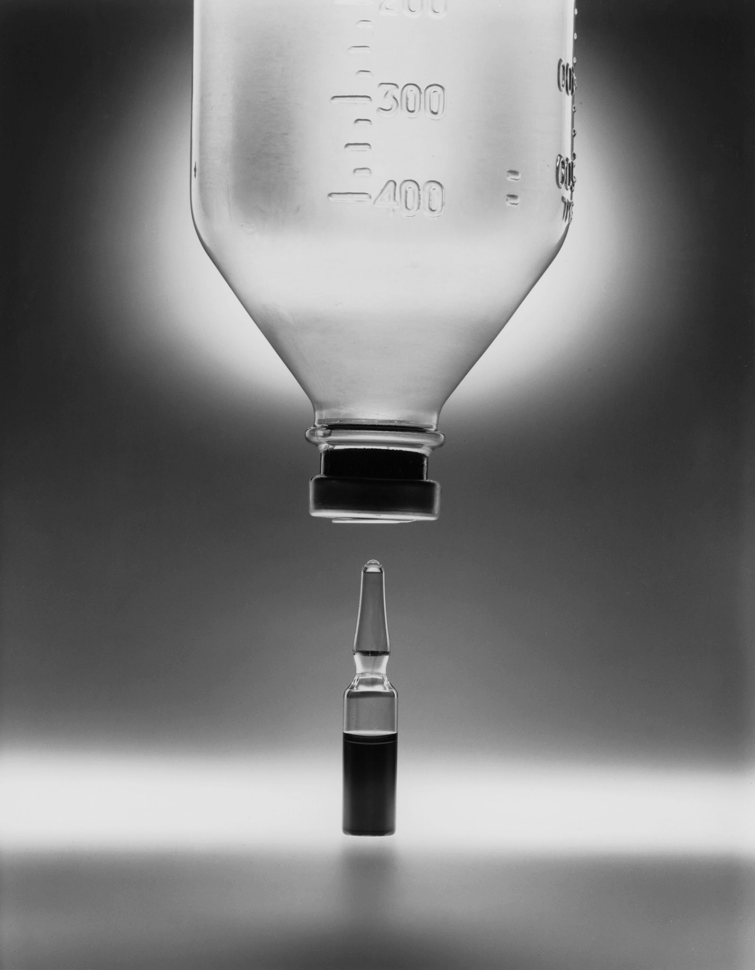
Cyclophosphamide is a common chemotherapy agent that induces mutation in cancer cells.

Slide 10
BEFORE
AFTER
UV radiation can damage cells through the formation of thymine dimers. This changes the structure of the double helix and can lead to errors when the DNA comes to replicate.
UV PHOTON

Slide 11
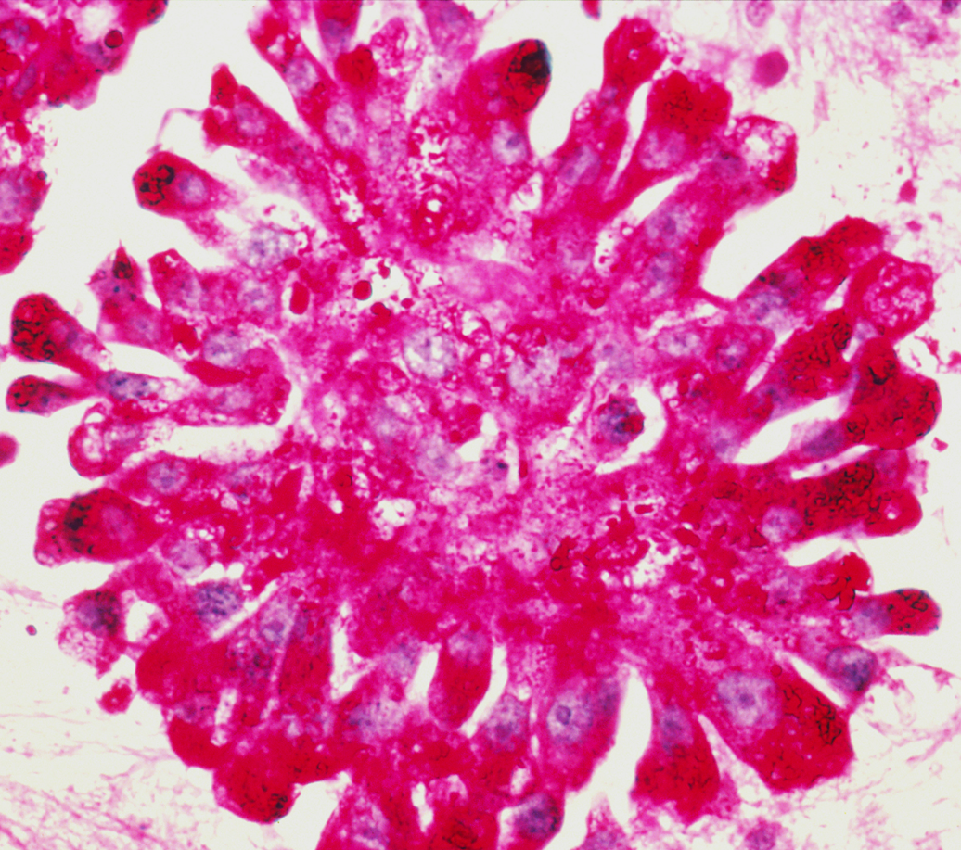
Rous sarcoma virus is linked to Ewing’s sarcoma, a cancer that affects the bones and the soft tissue.

Slide 12
Chromosome Mutations
During meiosis, each daughter cell will end up with a single set of 23 chromosomes.
If there is an error during meiosis, cells may end up with a different number of chromosomes.
  Some cells may have no copies of a particular chromosome.
  Other cells may have 2 or more copies of a particular chromosome.
  This is referred to as chromosome mutation.
One form of chromosome mutation is nondisjunction.
  This is where the chromosomes do not separate correctly.
Down’s syndrome is an example of nondisjunction.
  During meiosis, one gamete received 2 copies of a chromosome, rather than a single copy.
  When this gamete fuses with another gamete (during fertilisation), a zygote is formed with 3 copies of chromosome 21.

Slide 13
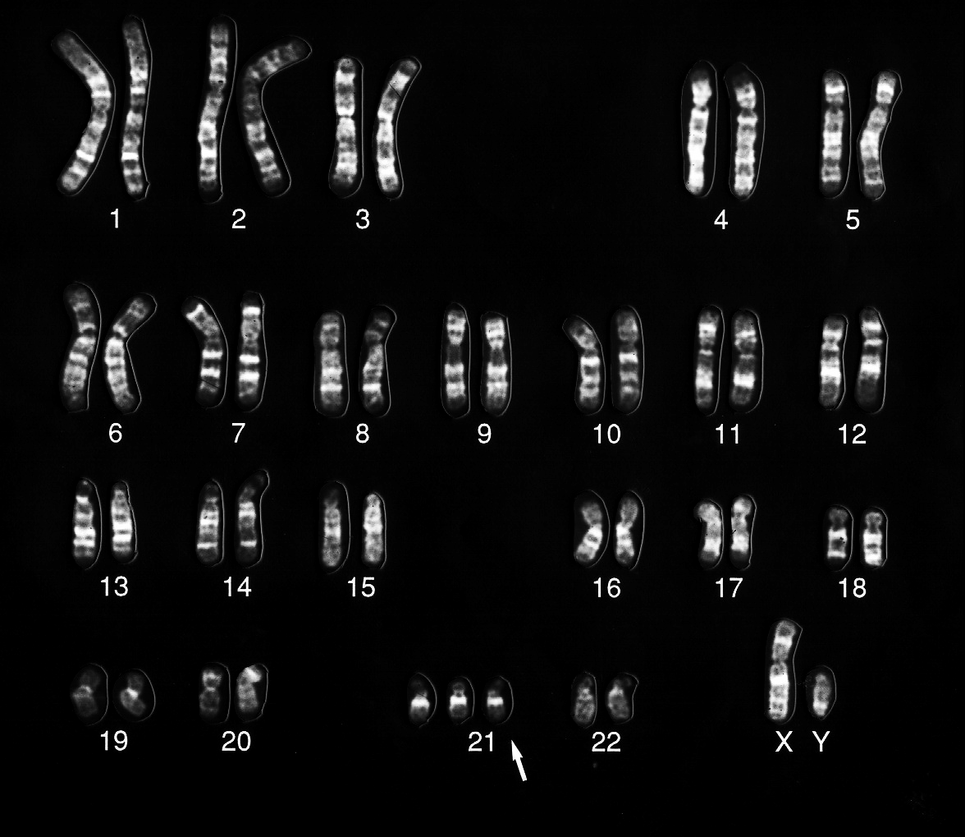
The karyotype of an individual with trisomy 21, more commonly referred to as Down’s syndrome.

