Slide 1
AQA A Level Biology
2 - Carbohydrates
Monosaccharides and Polysaccharides

Slide 2
Carbohydrates
Specification Point 3.1.2 - Carbohydrates.
All carbohydrates contain the elements carbon (C), hydrogen (H) and oxygen (O).
Monomers of carbohydrates are called monosaccharides.
  Glucose, fructose and galactose are examples of monosaccharides.
Glucose is a hexose sugar.
  This means it contains six carbon atoms.
There are two major isomers of glucose.
  Isomers are molecules with the same molecular formula (C₆H₁₂O₆) but the atoms are arranged in different ways.
The main isomers of glucose are alpha (α) and beta (β) glucose.

Slide 3
Glucose is a six-carbon (hexose) sugar.
As a monosaccharide, glucose cannot be broken down any further.

Slide 4
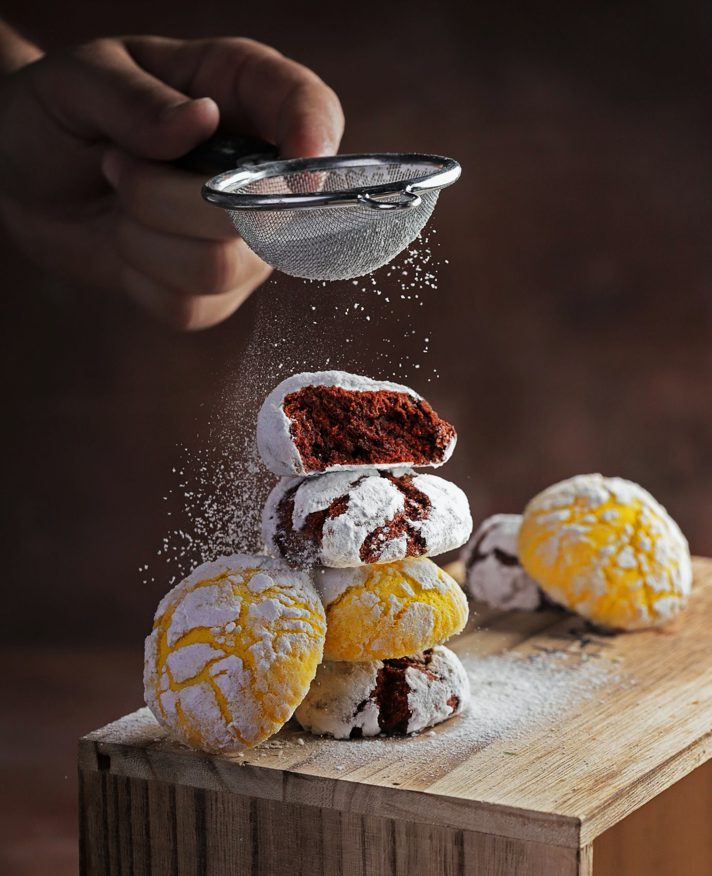
Glucose is the primary monosaccharide of many processed sugars.

Slide 5
In α-glucose, the hydroxyl (OH) groups (at C1 and C4) are positioned on the same plane of the molecule.

Slide 6
In β-glucose, the OH groups are positioned on different planes of the molecule.

Slide 7
Forming Disaccharides
A disaccharide is formed when two monosaccharides join together.
  Monosaccharides are joined together by condensation reactions.
A glycosidic bond joins the two monosaccharides.
Two glucose molecules will join together to form the disaccharide maltose.
A glucose and a fructose molecule will join together to form the disaccharide sucrose.
A glucose and a galactose molecule will join together to form the disaccharide lactose.

Slide 8
The disaccharide maltose is formed by the condensation reaction of 2 monomers of α-glucose.
Condensation reactions between monosaccharides form glycosidic bonds.
A molecule of water is also released.

Slide 9
Testing for Sugars
Sugars are classified as reducing or non-reducing.
  Reducing sugars include all monosaccharides and some disaccharides (maltose and lactose).
  Non-reducing sugars include all polysaccharides and some disaccharides (sucrose).
Benedict’s reagent can be used to test for reducing and non-reducing sugars.
To test for reducing sugars:
Heat the sample with Benedict’s reagent in a water bath at around 60°C for approximately five minutes.
  Benedict’s reagent is a pale blue solution.
If a reducing sugar is present, Benedict’s reagent will change into a brick red precipitate.
  The transition from blue to red depends on the concentration of sugar:
PALE BLUE → GREEN → YELLOW → ORANGE → BRICK RED
→ INCREASING CONCENTRATION OF GLUCOSE

Slide 10
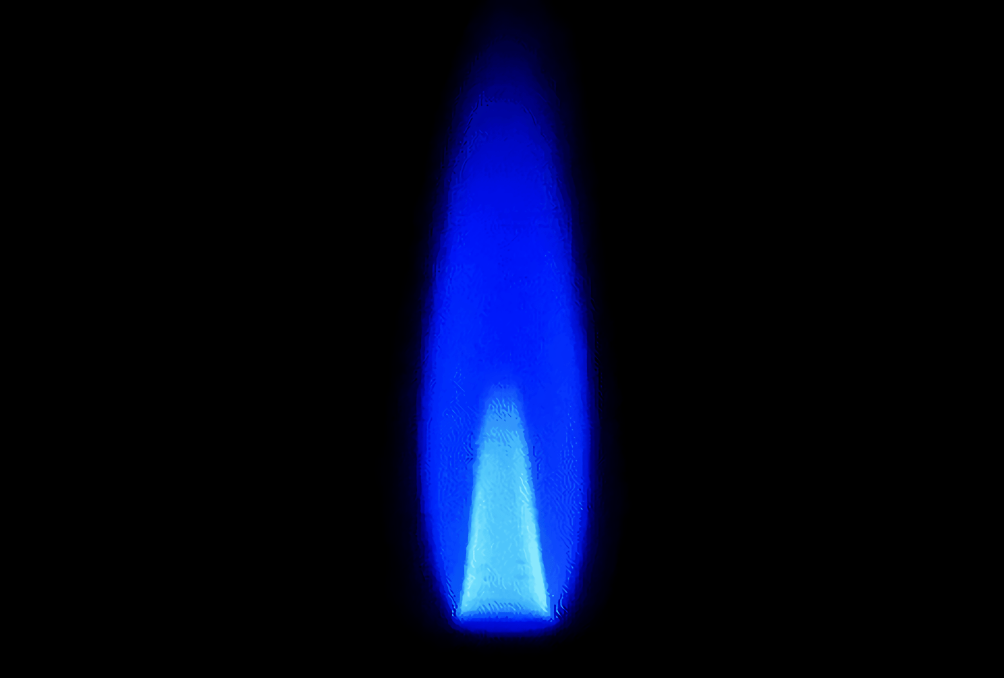
When heated in the presence of glucose, Benedict’s reagent will turn from a pale blue solution into a brick red precipitate.

Slide 11
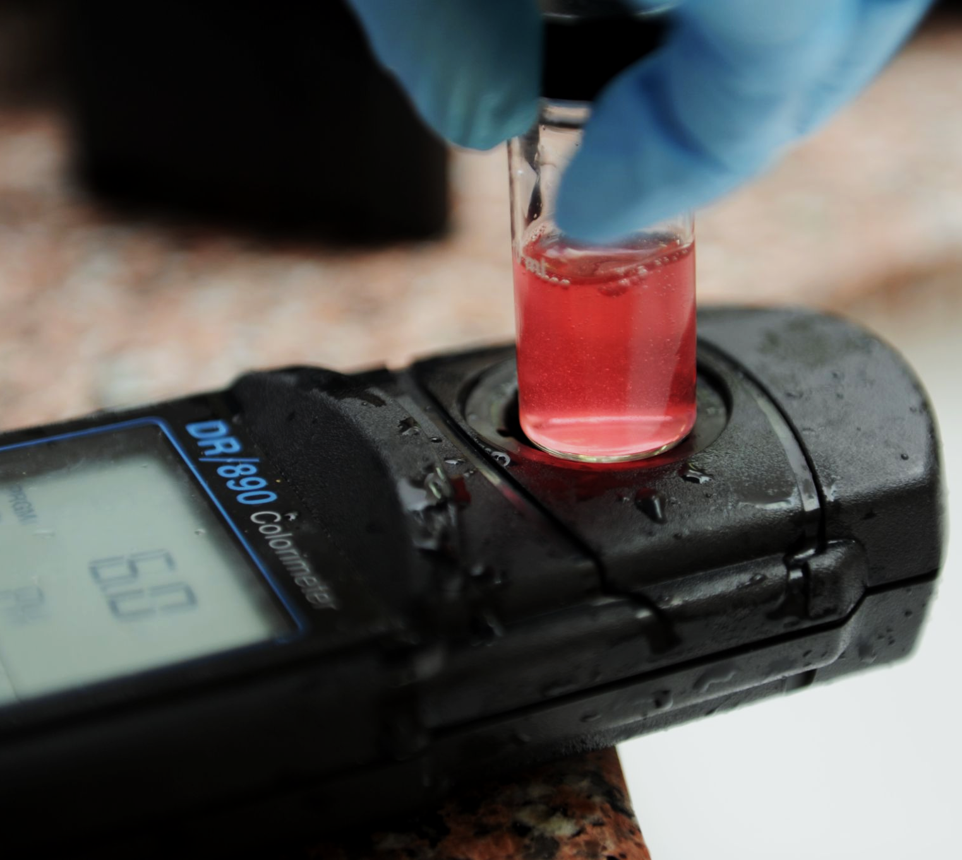
A colorimeter can be used to quantitatively measure the concentration of sugar in a food sample.

Slide 12
Testing for Non-Reducing Sugars
If the result of the reducing sugars test is negative, there still may be a non-reducing sugar present.
To test for non-reducing sugars, they must first be broken down into monosaccharides:
The glycosidic bonds can be hydrolysed by dilute hydrochloric acid (HCl).
After heating, the acid is neutralised by sodium hydrogencarbonate (NaHCO₃)
The rest of the test can be carried out as normal.
If a non-reducing sugar is present, a brick red precipitate will form.

Slide 13
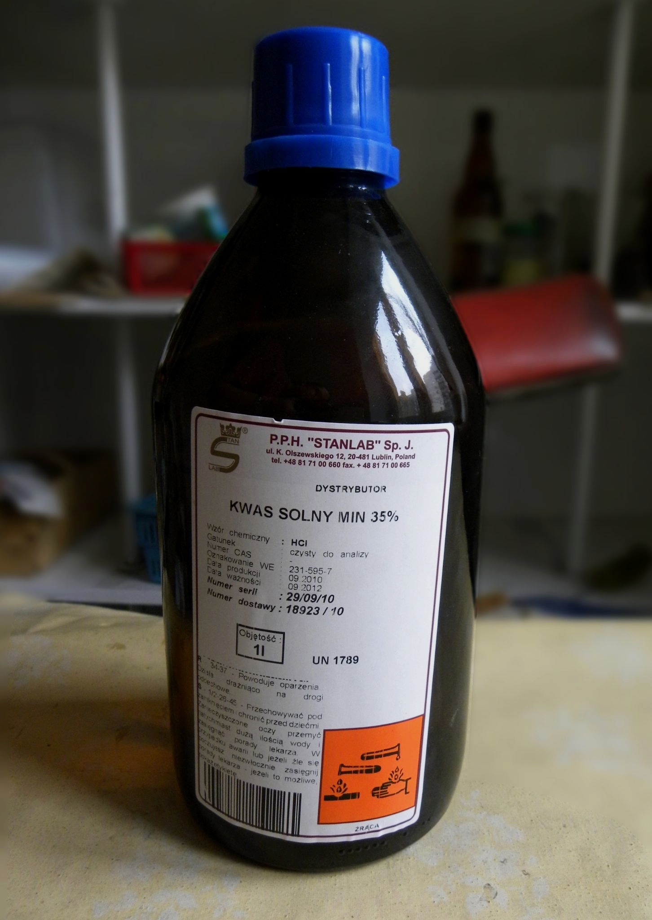
Hydrochloric acid is necessary to hydrolyse the glycosidic bonds between non-reducing sugars.
This allows for the reduction of the Cu²⁺ ion in Benedict’s reagent and the colour change from blue to brick red.

Slide 14
Polysaccharides - Amylose
Polysaccharides are made from large numbers of monosaccharides joined together by glycosidic bonds.
  Polysaccharides are formed from a number of repeating condensation reactions.
Lots of α-glucose molecules are joined together by 1-4 glycosidic bonds to form the polysaccharide amylose.
Amylose is a straight-chain polymer of α-glucose.

Slide 15
Polysaccharides - Amylopectin
Polysaccharides are made from large numbers of monosaccharides joined together by glycosidic bonds.
  Polysaccharides are formed from a number of repeating condensation reactions.
Lots of α-glucose molecules are joined together by a mixture of 1-4 and 1-6 glycosidic bonds to form the polysaccharide amylopectin.
Amylopectin is a branched-chain polymer of α-glucose.

Slide 16
Starch
Plants create glucose during photosynthesis.
Excess glucose is converted into starch by plants.
  When the plant needs more energy, it will hydrolyse starch back into glucose.
Starch is a mixture of amylose and amylopectin.
Amylose is a long, unbranched, chain of α-glucose.
  Amylose has a coiled structure.
  This makes it very compact and good for storage.
Amylopectin is a long, branched chain of α-glucose.
  Amylopectin has side branches which increase its surface area.
  This means it can be quickly broken down by enzymes.
Starch is insoluble.
  As it doesn’t affect the water potential of cells, starch is an excellent storage molecule.

Slide 17

Starch is the energy storage molecule found in plants.

Slide 18
Starch is a mixture of the polysaccharides amylose and amylopectin.
This gives starch a helical and compact structure, which is excellent for energy storage.
At the same time, starch has branched elements, allowing for enzymes to hydrolyse the polymer and release energy.

Slide 19
Glycogen
Animals package their glucose from food into the polysaccharide glycogen.
Glycogen is made up of α-glucose.
Glycogen has a very similar structure to amylopectin.
Glycogen has even more side branches than amylopectin.
  Glycogen has lots of 1-6 glycosidic bonds.
This means that glycogen can be hydrolysed much more quickly than starch.
  This is important as animals have high energy demands.
Glycogen has lots of branches. This allows for it to be very quickly hydrolysed to release energy.

Slide 20
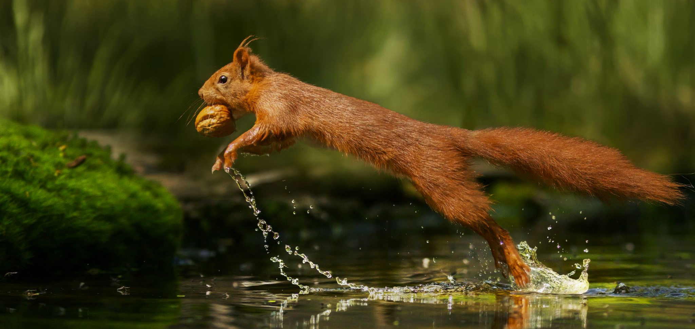
Animals store their sugars as glycogen. Glycogen is heavily branched which permits rapid energy release, important for organisms with high metabolic demands.

Slide 21
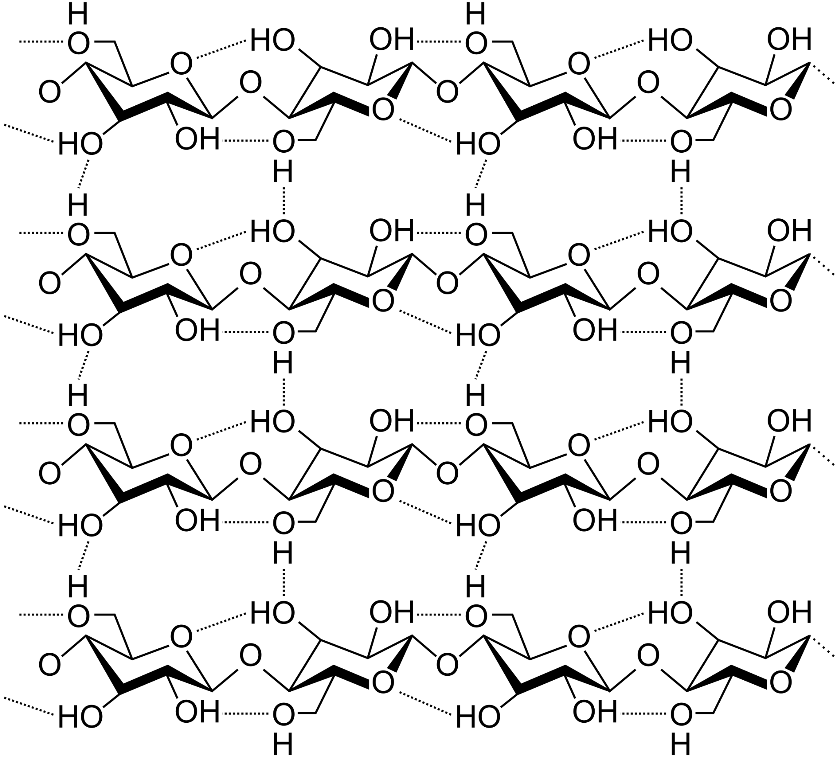
Cellulose
Cellulose is made of long, unbranched chains of β-glucose.
Cellulose chains are linked together by hydrogen bonds to form microfibrils.
Microfibrils are strong and provide structural support for plant cell walls.
Cellulose uses hydrogen bonds (---) to form strong microfibrils.

Slide 22
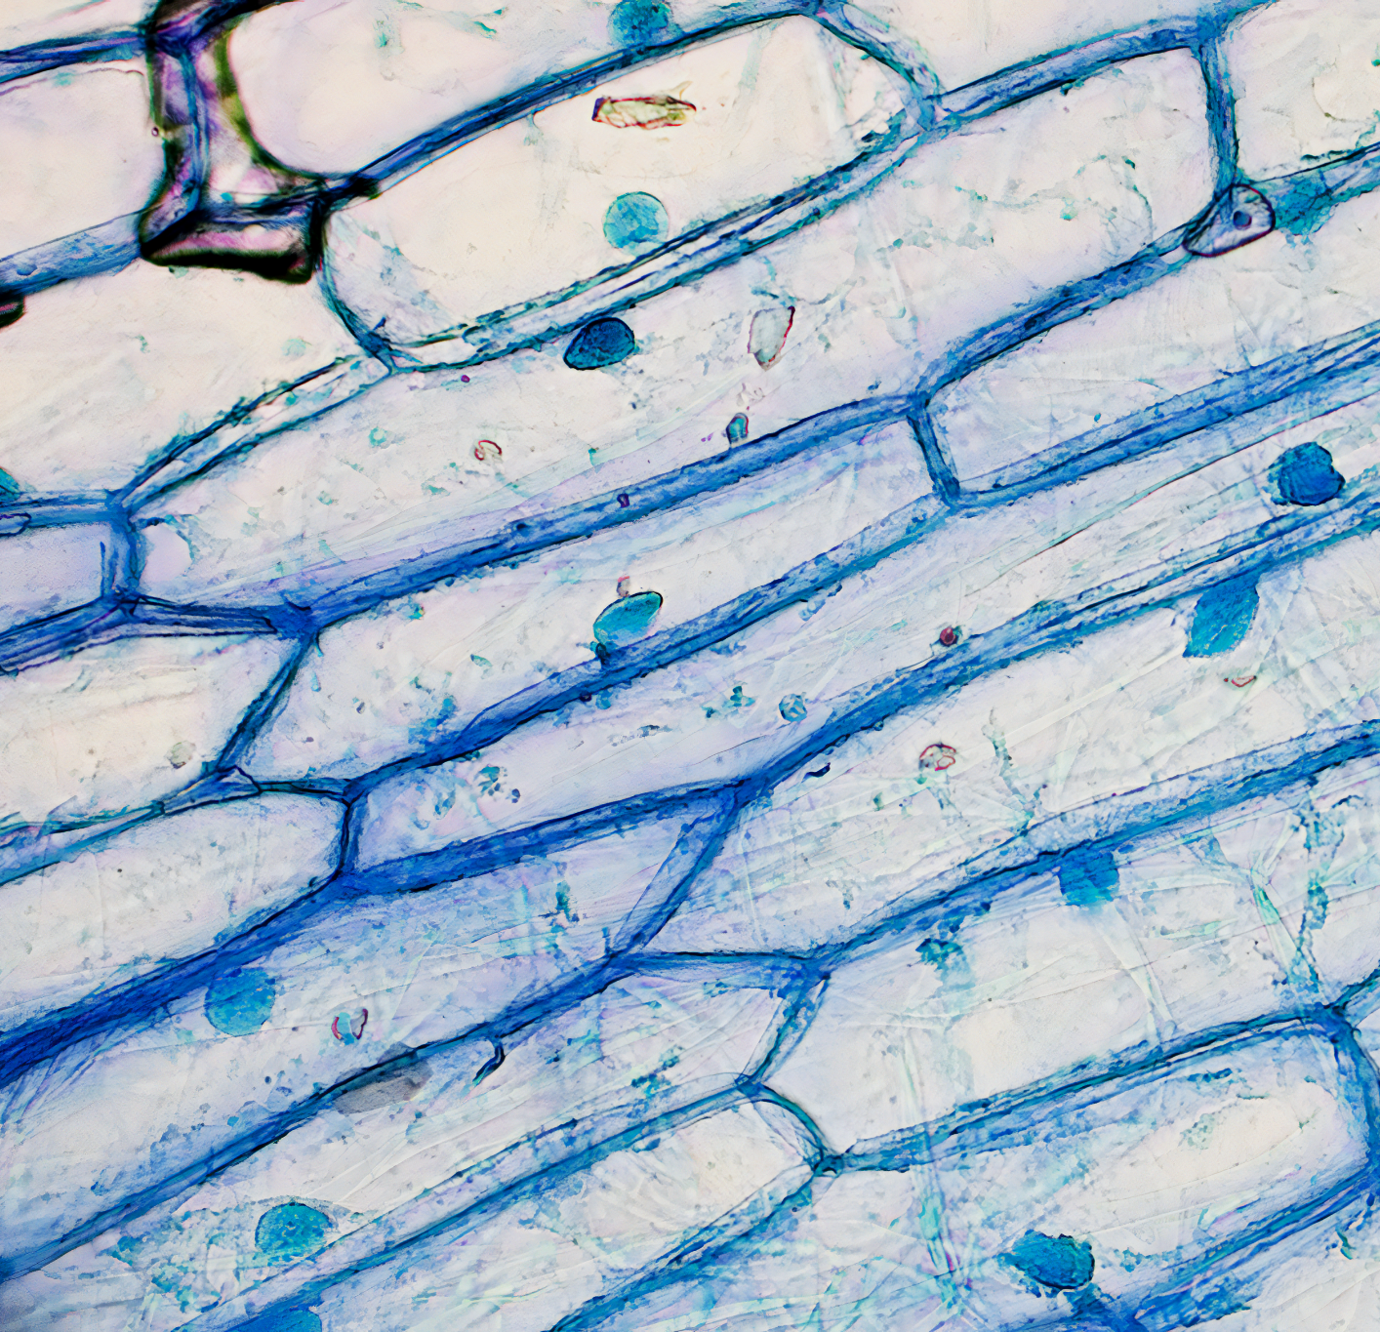
Cellulose, an extremely tough polymer, forms the basis of plant cell walls.

Slide 23
The Iodine Test for Starch
The presence of starch in a sample is determined by the iodine test.
Potassium iodide is added to a test sample.
  If starch is present, the sample will change colour from orange-brown to blue-black.
  Is no starch is present, the orange-brown colour will remain.
Iodine test video.
If starch is present in a food sample, iodine will immediately change colour from dark orange to blue-black.

Slide 24
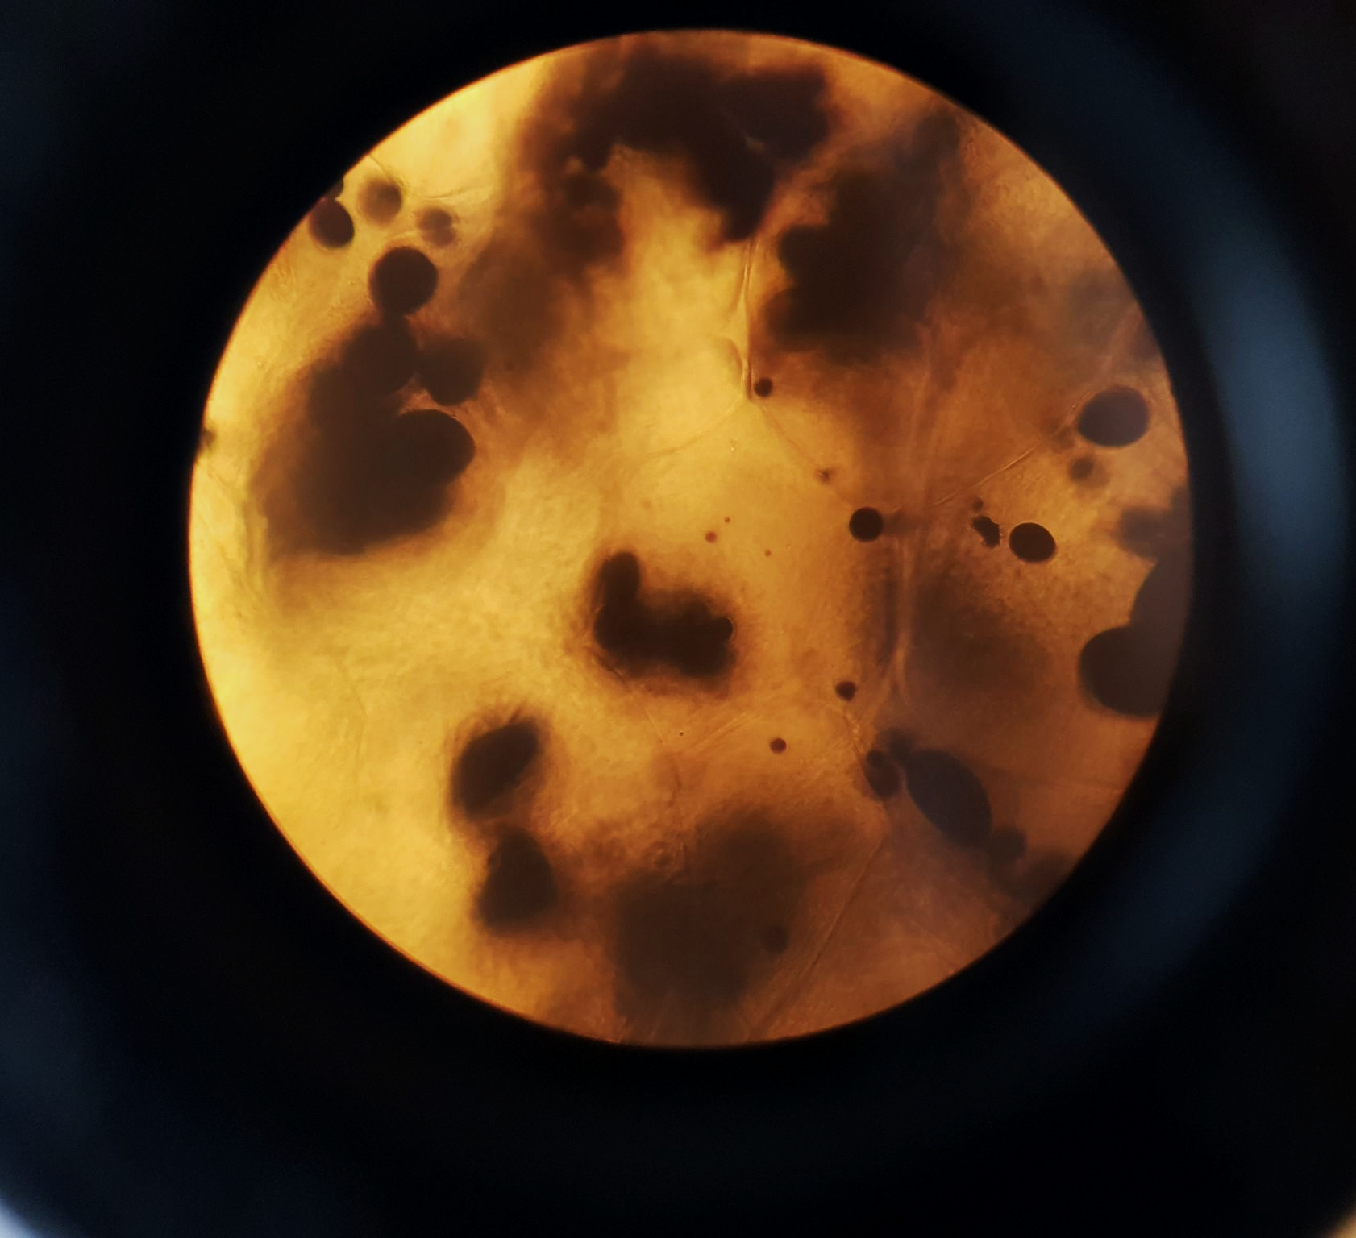
Starchy foods like potatoes cause iodine to change colour instantly.

