Slide 1
AQA A Level Biology
29 - Meiosis and Genetic Variation
Gametes, Crossing Over and Life Cycles

Slide 2
Diploid Cells
Specification Point 3.4.3 - Genetic diversity can arise as a result of mutation or during meiosis.
Most cells in the human body have 2 matching copies of each chromosome.
  These cells are said to be diploid (2n).
  One chromosome is inherited from the mother, the other from the father.
These matching copies are said to be homologous.
  Homologous pairs are the same size, shape and have the same genes.
  They may have different versions of each gene. These are called alleles.
  Humans have 23 homologous pairs of chromosomes.
  Therefore the diploid number in humans is 46.
HAPLOID CELLS HAVE A SINGLE SET OF CHROMOSOMES
DIPLOID CELLS HAVE TWO SETS OF CHROMOSOMES

Slide 3
All body cells are diploid.
This means that they contain two copies of the same chromosome.

Slide 4
Gametes
A gamete is a sex cell.
  In human males the gamete is a sperm cell.
  In human females the gamete is an egg cell.
Gametes contain a single copy of each chromosome.
  They are said to be haploid (n).
  The haploid number in humans is 23.
Gametes fuse together during fertilisation.
  During sexual intercourse, the male and female gametes may fuse to form a zygote.
  A zygote contains chromosomes from both parents, so is a diploid cell.
  Half the chromosomes come from the mother and half from the father.
Sexual reproduction is random.
  During sexual reproduction, any sperm can fertilise any egg.
  This random mixing of genetics serves to increase genetic diversity.
Gametes, such as sperm cells, only have a single copy of each chromosome and are termed haploid.

Slide 5
Fertilisation is a random process.
Any one of the billions of sperm produced by males can fertilise the egg.

Slide 6
Meiosis
Meiosis is a form of cell division.
  It takes place in the reproductive organs of eukaryotic organisms.
  Several events during meiosis lead to genetic variation.
Meiosis begins with a single diploid cell.
  In mammals, these are referred to as gametocytes.
  In males, the gametocyte is called a spermatocyte.
  In females, the gametocyte is called a oocyte.
It eventually forms 4 haploid cells.
  These are referred to as the gametes.
  In males, the gamete is a sperm cell.
  In females, the gamete is an egg cell.
Meiosis video.
Meiosis have 2 distinct stages: meiosis 1 and meiosis 2.
The products from meiosis are 4 genetically unique haploid cells.

Slide 7
Meiosis occurs in 2 distinct stages.
Chromosomes shuffle their genetic material during crossing over and distribute chromosomes randomly to 1 of 4 haploid cells.
PROPHASE 1
METAPHASE 1
ANAPHASE 1
TELOPHASE 1 AND CYTOKINESIS
PROPHASE 2
METAPHASE 2
ANAPHASE 2
TELOPHASE 2 AND CYTOKINESIS
CENTRIOLES
CENTROMERE
SPINDLE
A NEW SPINDLE FORMS AROUND THE CHROMOSOMES
CHROMOSOMES AGAIN LINE UP AT THE EQUATOR
CENTROMERES DIVIDE AND THE CHROMATIDS MOVE TO OPPOSITE POLES
NUCLEAR ENVELOPE REFORMS AROUND CHROMOSOMES
CHIASMATA
HOMOLOGOUS PAIR OF CHROMOSOMES
NUCLEAR ENVELOPE
SISTER CHROMATIDS
THE CHROMOSOMES CONDENSE AND BECOME VISIBLE. THE NUCLEAR ENVELOPE BREAKS DOWN AND CROSSING OVER OCCURS AT CHIASMATA
PAIRS OF HOMOLOGOUS CHROMOSOMES MOVE TO THE EQUATOR OF THE CELL
HOMOLOGOUS CHROMOSOMES MOVE TO THE OPPOSITE POLES OF THE CELL
CHROMOSOMES GATHER AT THE POLES AND THE CYTOPLASM DIVIDES
SISTER CHROMATIDS SEPARATE

Slide 8
Genetic Variation
Genetic variation can occur in two ways:
The crossing over of chromatids leads to genetic variation.
  During prophase 1, homologous chromosomes come together to form chiasmata.
  Sections of chromatids are exchanged with one another during crossing over.
  This creates new combinations of alleles.
The independent segregation of chromosomes also leads to genetic variation.
  Each homologous pair of chromosomes consists of a maternal and paternal chromosome.
  When homologous pairs are separated during anaphase 1, it is entirely random which chromosome from a pair ends up in which daughter cell.
  This is referred to as the independent segregation of chromosomes.

Slide 9
Genetic Variation
The crossing over of chromatids leads to genetic variation.
  During prophase 1, homologous chromosomes come together to form chiasmata.
  Sections of chromatids are exchanged with one another during crossing over.
  This creates new combinations of alleles.
Independent segregation of chromosomes also leads to genetic variation.
  Each homologous pair of chromosomes consists of a maternal and paternal chromosome.
  When homologous pairs are separated during anaphase 1, it is entirely random which chromosome from a pair ends up in which daughter cell.
  This is referred to as the independent segregation of chromosomes.

Slide 10
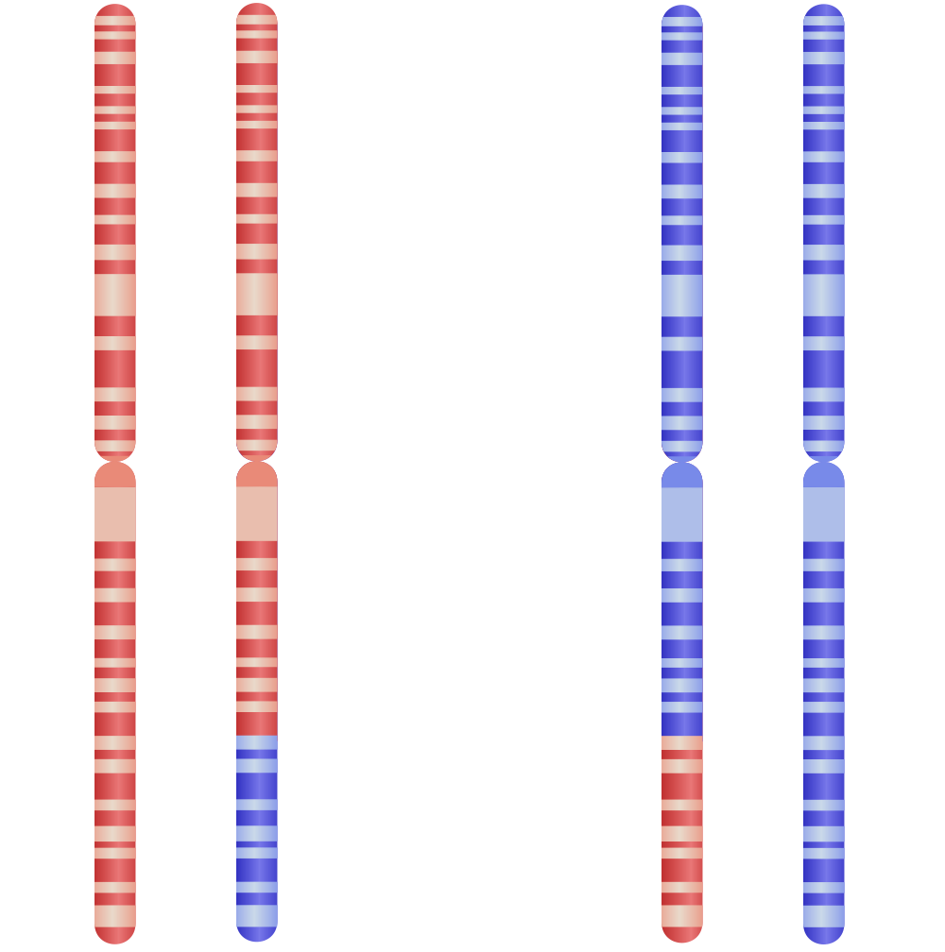
SISTER CHROMATIDS
SISTER CHROMATIDS
Pairs of homologous chromosomes will exchange genetic information at chiasmata during crossing over.
This leads to new and unique combinations of alleles.
GENETIC INFORMATION EXCHANGED BY CROSSING OVER

Slide 11
Life Cycles
Other organisms may have different life cycles to a human.
  The life cycles of insects and plants are profoundly different to mammalian life cycles.
One example is the life cycle of the parasitic protist Plasmodium falciparum.
  This organism is responsible for the disease malaria.
In P. falciparum, only the zygote is diploid.
  All other stages of its life cycle involve haploid cells.
Meiosis occurs when the zygote divides to form sporozoites.
  Sporozoites infect the salivary glands of a mosquito vector, and are injected into another host when the mosquito takes a blood meal.
  Sporozoites then divide by mitosis into haploid merozoites in a mammalian liver.
  Merozoites divide by mitosis into haploid gametocytes in red blood cells.
    Another mosquito may then feed on the mammal and ingest the gametocytes.

Slide 12
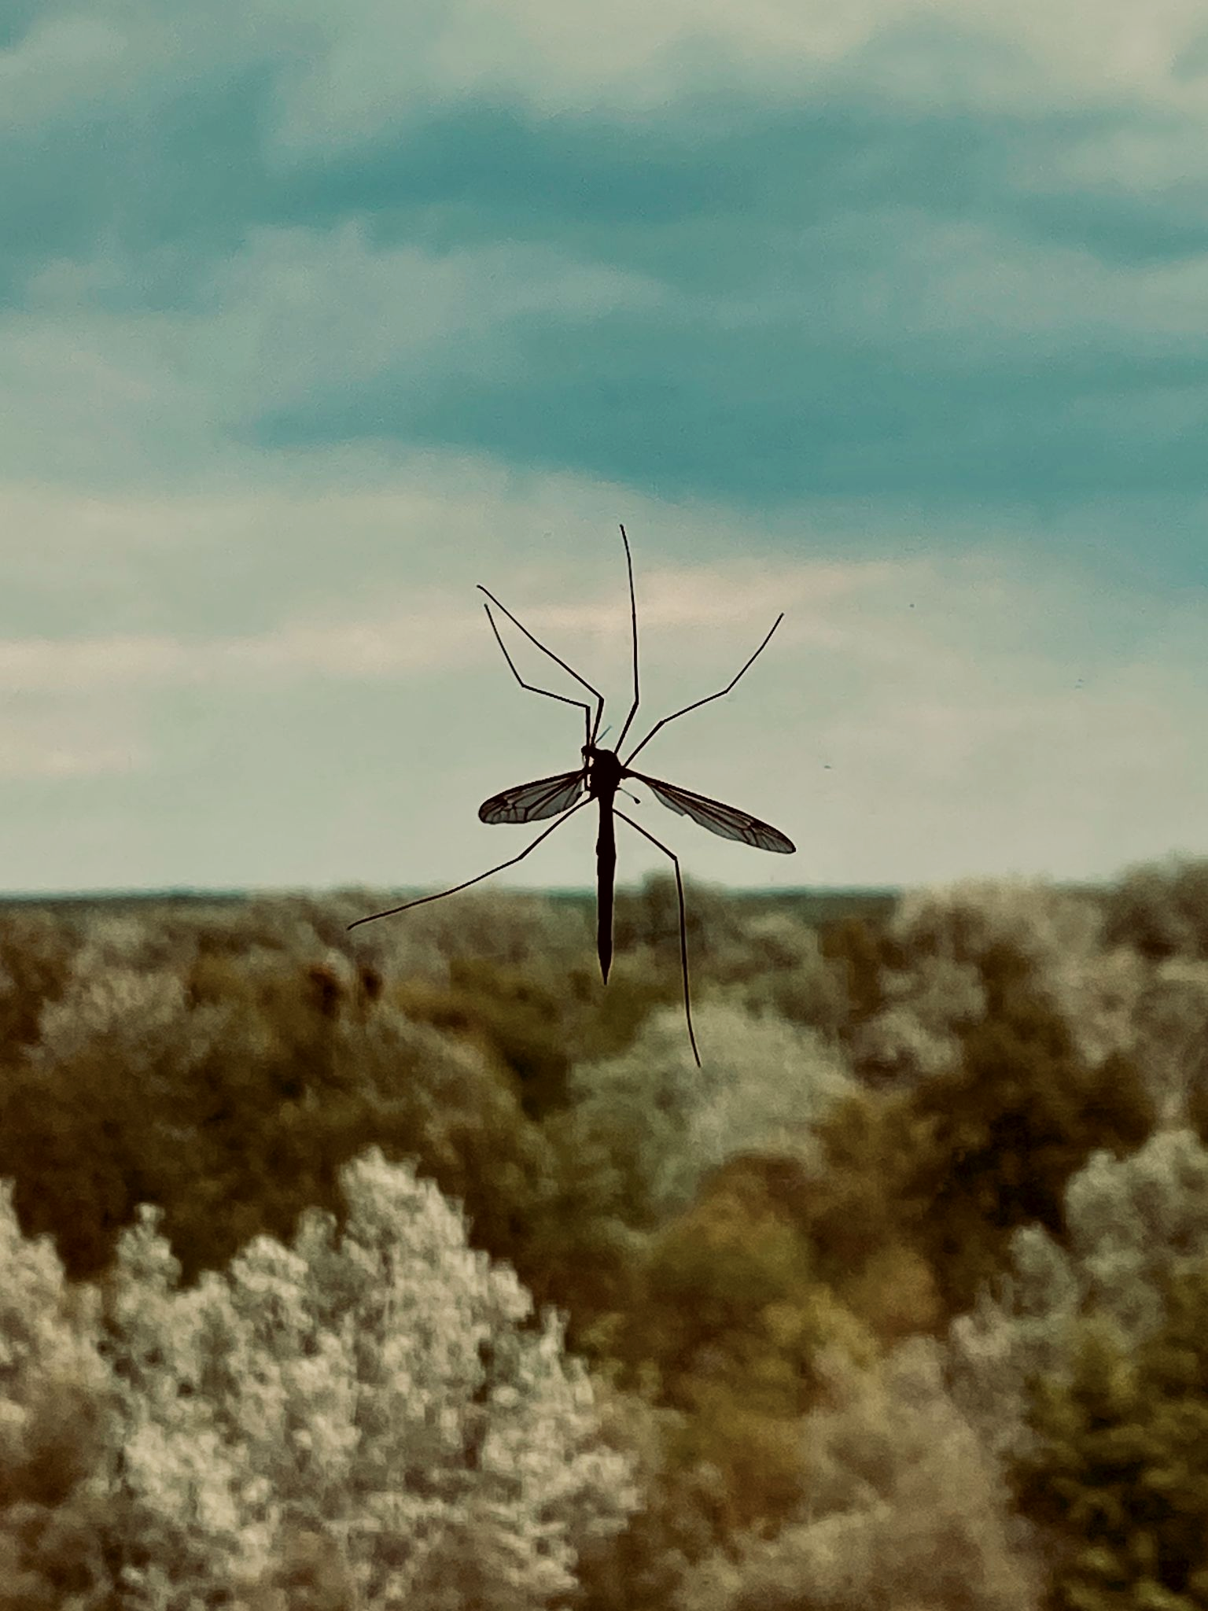
The life cycle of the P. falciparum parasite is extremely complex and involves the infection of both an insect and a mammal.

Slide 13
Comparing Mitosis to Meiosis
Mitosis and meiosis have different functions.
  Mitosis is important for the growth and repair of tissues.
  Meiosis is important for generating genetic variation.
 | Key Differences
Mitosis | 2 daughter cells are produced with 2 copies of each chromosome (diploid). | Daughter cells are genetically identical to each other and the parent cell.
Meiosis | 4 daughter cells are produced with 1 copy of each chromosome (haploid). | Daughter cells are all genetically distinct from one another and the parent cell.

