Slide 1
AQA A Level Biology
28 - Transcription and Translation
The Formation of mRNA and Proteins

Slide 2
Making Proteins
Specification Point 3.4.2 - DNA and protein synthesis.
Proteins are made during protein synthesis.
  Proteins are made using the genetic information stored in DNA.
Protein synthesis occurs in 2 main stages:
  Transcription - DNA is transcribed into a molecule of messenger RNA (mRNA).
  Translation - mRNA is translated into a protein at a ribosome.
Proteins are made through a number of steps.
The two major stages are transcription and translation.

Slide 3
RNA
Eukaryotic RNA is a single stranded molecule.
It contains the nucleobase uracil (U) rather than thymine (T).
  Uracil behaves like thymine during complementary base pairing.
  As a result, uracil will always pair with adenine (A).
Messenger RNA (mRNA) is made during transcription.
  mRNA is synthesised using a DNA template.
  An mRNA codon is a sequence of 3 bases (AUG, for example).
Transfer RNA (tRNA) is important during translation.
  tRNA carries amino acids from the cytoplasm to the ribosome.
  These amino acids are used to assemble the protein.
  tRNA is a single polynucleotide that folds to resemble a three-leafed clover.

Slide 4
PHOSPHATE
A
RIBOSE
PHOSPHATE
An mRNA polynucleotide.
mRNA codons are read in groups of 3 bases, such as AUG.
U
RIBOSE
PHOSPHATE
G
RIBOSE

Slide 5
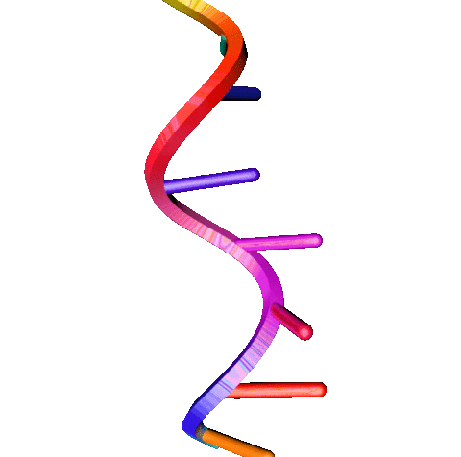
An mRNA polynucleotide.
mRNA codons are read in groups of 3 bases, such as AUG.

Slide 6
A molecule of tRNA. Hydrogen bonding between nucleotides leads to a distinctive clover-shaped molecules.
One end of the tRNA molecule contains a binding site for an amino acid. The other end contains a sequence of 3 bases called an anticodon.

Slide 7
Transcription
During transcription, a section of DNA is copied into mRNA.
  This section of DNA is often a gene that codes for a protein.
  Transcription takes place in the nucleus of a eukaryotic cell.
RNA polymerase attaches to a section of DNA.
  RNA polymerase is associated with the enzyme DNA helicase. Helicase breaks the hydrogen bonds between the 2 strands of DNA.
  The DNA molecule unwinds, exposing a number of bases.
  One of the DNA strands is used to create an mRNA copy of the gene.
    This is called the template strand.
A mRNA strand is synthesised.
  Free RNA bases in the nucleus are attracted to their exposed DNA counterparts.
  Hydrogen bonds form between complementary RNA and DNA bases.
  RNA polymerase catalyses the formation of phosphodiester bonds between neighboring RNA molecules, creating a new strand of mRNA.

Slide 8
Transcription
The DNA molecule reforms once RNA polymerase has moved past.
  Hydrogen bonds reform between DNA bases, causing the double helix to reassemble.
RNA polymerase detaches from the DNA once it reaches a stop signal.
  The region at the end of a gene is called a stop signal.
  Once RNA polymerase reaches the stop signal, it ceases to synthesise mRNA and is released from the DNA.
mRNA leaves the nucleus through nuclear pores.
  The mRNA will then associate with a ribosome so it can be translated into protein.

Slide 9
During transcription a section of mRNA is made from the template strand of DNA.

Slide 10
Splicing
Eukaryotic DNA contains regions that do not code for a protein.
  These are called introns.
  Introns are copied into pre-mRNA during transcription.
Introns are removed from pre-mRNA by splicing.
  During splicing, the introns are removed and the coding regions of mRNA (the exons) are spliced together.
  The mRNA is now referred to as mature mRNA.
  The mature mRNA then leaves the nucleus and associates with a ribosome.
Prokaryotic DNA does not contain introns.
  As such there is no mechanism for splicing in prokaryotes.

Slide 11
Introns are non-coding regions of DNA. In this gene, they have been removed by splicing. This occurs before the mRNA leaves the nucleus.
mRNA
DNA
INTRON
EXON
INTRON
EXON
INTRON
EXON

Slide 12
Translation
During translation, proteins are made from the mRNA template.
The mRNA attaches to a ribosome.
  Molecules of tRNA carry amino acids to the mRNA sequence.
  The bond between the tRNA molecule and the amino acid is formed using ATP.
The first tRNA anticodon binds to a complementary codon on the mRNA.
  Codons and anticodons will form hydrogen bonds with one another.
  The first tRNA molecule will always bind to the same codon.
  This is called the start codon. In humans it is the sequence AUG.
A second tRNA anticodon will attach to the next codon on the mRNA.
  This will occur using the same mechanism as the first tRNA molecule.
A peptide bond will form between the neighboring amino acids that are being held by the tRNA molecules.
  The first tRNA molecule will then unbind, leaving its amino acid behind.

Slide 13
Translation
This cycle will continue, producing a primary chain of amino acids.
  This is the process of elongation.
Eventually, the complex will reach a stop codon.
  A stop codon does not code for an amino acid.
  Instead it signals the protein to dissociate from the ribosome and move into a different region of the cell.
Transcription and translation video.
Proteins are synthesised at organelles called ribosomes.

Slide 14
During translation a new protein is synthesised using the molecular instructions provided by mRNA.
PROTEIN
AMINO
ACIDS
tRNA
mRNA

Slide 15
The Genetic Code
The genetic code is the means by which DNA and RNA molecules carry genetic information in cells.
  It is a sequence of triplet codons that code for specific amino acids.
The genetic code is non-overlapping.
  This means that the same letter is not used for two different codons.
  No single base can take part in the formation of more than one codon.
The genetic code is degenerate.
  This means that there are more possible combinations of triplet codons than there are amino acids. There are 4³ (64) codons but only 20 amino acids.
  This means that more than one codon codes for the same amino acid.
  There are also 3 stop codons which signal the ribosome to cease protein production.
The genetic code is universal.
  This means that the same codons code for the same amino acids in all living things.
  For example the codon GAC codes for aspartic acid in all organisms.

Slide 16
A table of the 20 amino acids and their corresponding mRNA codons.
Because the code is degenerate, more than one codon codes for the same amino acid.

