Slide 1
AQA A Level Biology
27 - DNA, Genes and Chromosomes
DNA Storage, Alleles, Introns and Exons

Slide 2
DNA Storage
Specification Point 3.4.1 - DNA, genes and chromosomes.
Eukaryotes and prokaryotes store DNA in different ways.
Eukaryotic cells contain linear DNA.
  DNA in eukaryotes exists as chromosomes.
  Chromosomes are thread-like structures made up of DNA and histone proteins.
  Chromosomes are found in the nucleus of the cell.
Prokaryotic cells contain circular DNA.
  The DNA is free-floating in the cell and is not bound to histones.
  Prokaryotic DNA fits into the cell by supercoiling.
Mitochondria and chloroplasts have their own DNA.
  Their DNA is similar to prokaryotic DNA.
  It is circular and is not bound to histones.

Slide 3
NUCLEUS
CENTROMERE
CHROMOSOME
The DNA in eukaryotic cells exist as linear molecules called chromosomes.
The DNA is wound around histone proteins to fit in the relatively small nucleus.
HISTONES
DNA DOUBLE HELIX

Slide 4
The DNA of prokaryotic cells such as bacteria are circular and unbound to histones. They exist in a central nucleoid and accessory plasmids.
NUCLEOID
PLASMID

Slide 5
Genes
A gene is a region of DNA that codes for a protein.
  The order of bases in a gene determines the order of amino acids in a protein.
  Each amino acid is coded for by a sequence of three bases.
    For example, the sequence GGA codes for the amino acid glycine.
  This is called a codon.
A gene may also code for a section of functional RNA.
  These are RNA molecules other than messenger RNA (mRNA).
    mRNA is involved in the production of proteins.
  Examples of functional RNA molecules include transfer RNA (tRNA) and ribosomal RNA (rRNA).
The complete collection of an organism’s genes is called its genome.
The complete collection of an organism’s proteins is called its proteome.

Slide 6
A prokaryotic plasmid is circular in nature.
Each different coloured region represents a different functional gene coding for a protein.

Slide 7
Introns and Exons
Much of the DNA in eukaryotes does not code for protein.
  These are referred to as non-coding regions.
Non-coding regions of a gene are called introns.
  The true purpose of introns is currently unknown.
  Introns are removed during protein synthesis.
Prokaryotic DNA does not contain introns.
The regions of a gene that do code for proteins are called exons.
Eukaryotic DNA also contains repeating regions of DNA that are located outside of genes.
  These areas are referred to as short tandem repeats or microsatellites.
  These regions are also non-coding.

Slide 8
Alleles
A gene can exist in multiple forms.
  These forms are called alleles.
  Humans usually have 2 alleles of the same gene, one on each chromosome.
The base sequence of 2 alleles of the same gene may be slightly different to one another.
This may lead to slightly different proteins being made.
  For example, different alleles for eye colour may produce blue proteins or brown proteins.
A chromosome with 2 different alleles of the same gene.

Slide 9
Introns are non-coding regions of DNA. In this gene, they have been removed by splicing. This occurs before the mRNA leaves the nucleus.
mRNA
DNA
INTRON
EXON
INTRON
EXON
INTRON
EXON

Slide 10
Homologous Chromosomes
Humans have 23 pairs of chromosomes.
  There are 46 chromosomes in total in a human cell.
  There are 2 copies of the same chromosome in a human cell.
Chromosomes that are the same size and contain the same genes arrange themselves in a homologous pair.
  Homologous pairs may have different alleles.
These chromosomes are displayed in a karyotype.
  A karyotype is a visual illustration of an organism’s collection of chromosomes.

Slide 11
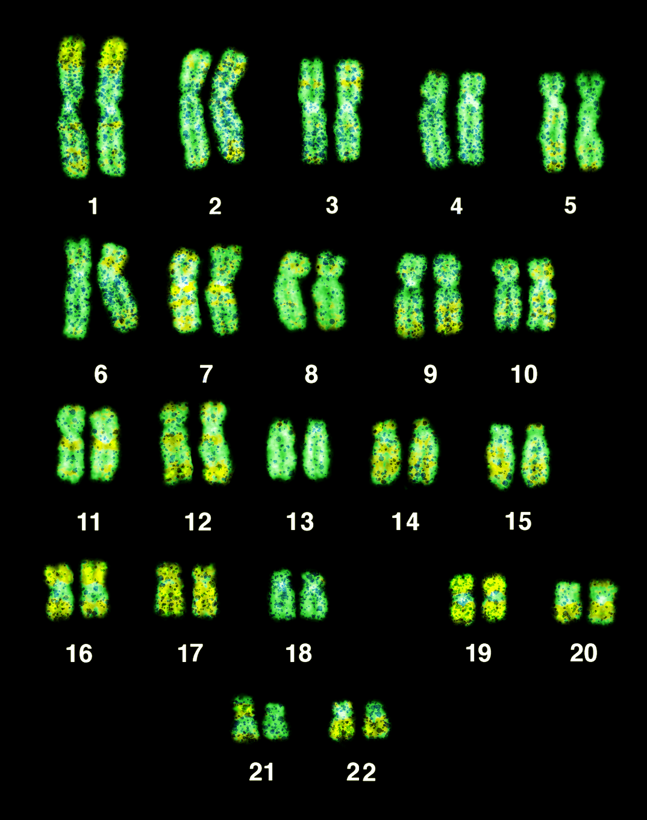
A human male karyotype with the chromosomes arranged in their homologous pairs.

