Slide 1
AQA A Level Biology
26 - Xylem and Phloem
Mass Transport in Plants

Slide 2
Mass Transport in Plants
Specification Point 3.3.4.2 - Mass transport in plants.
Plants contain 2 tissues that are involved in mass transport:
  The xylem transports water and mineral ions from the roots to the leaves of the plant.
  The phloem transports dissolved organic substances like sugars around the plant.
The xylem and phloem are found in the vascular bundle.
  The vascular bundle transports dissolved materials around the plant.
The xylem and phloem move substances across large distances.
PHLOEM
XYLEM
The vascular bundle is the major transport system in a plant.

Slide 3
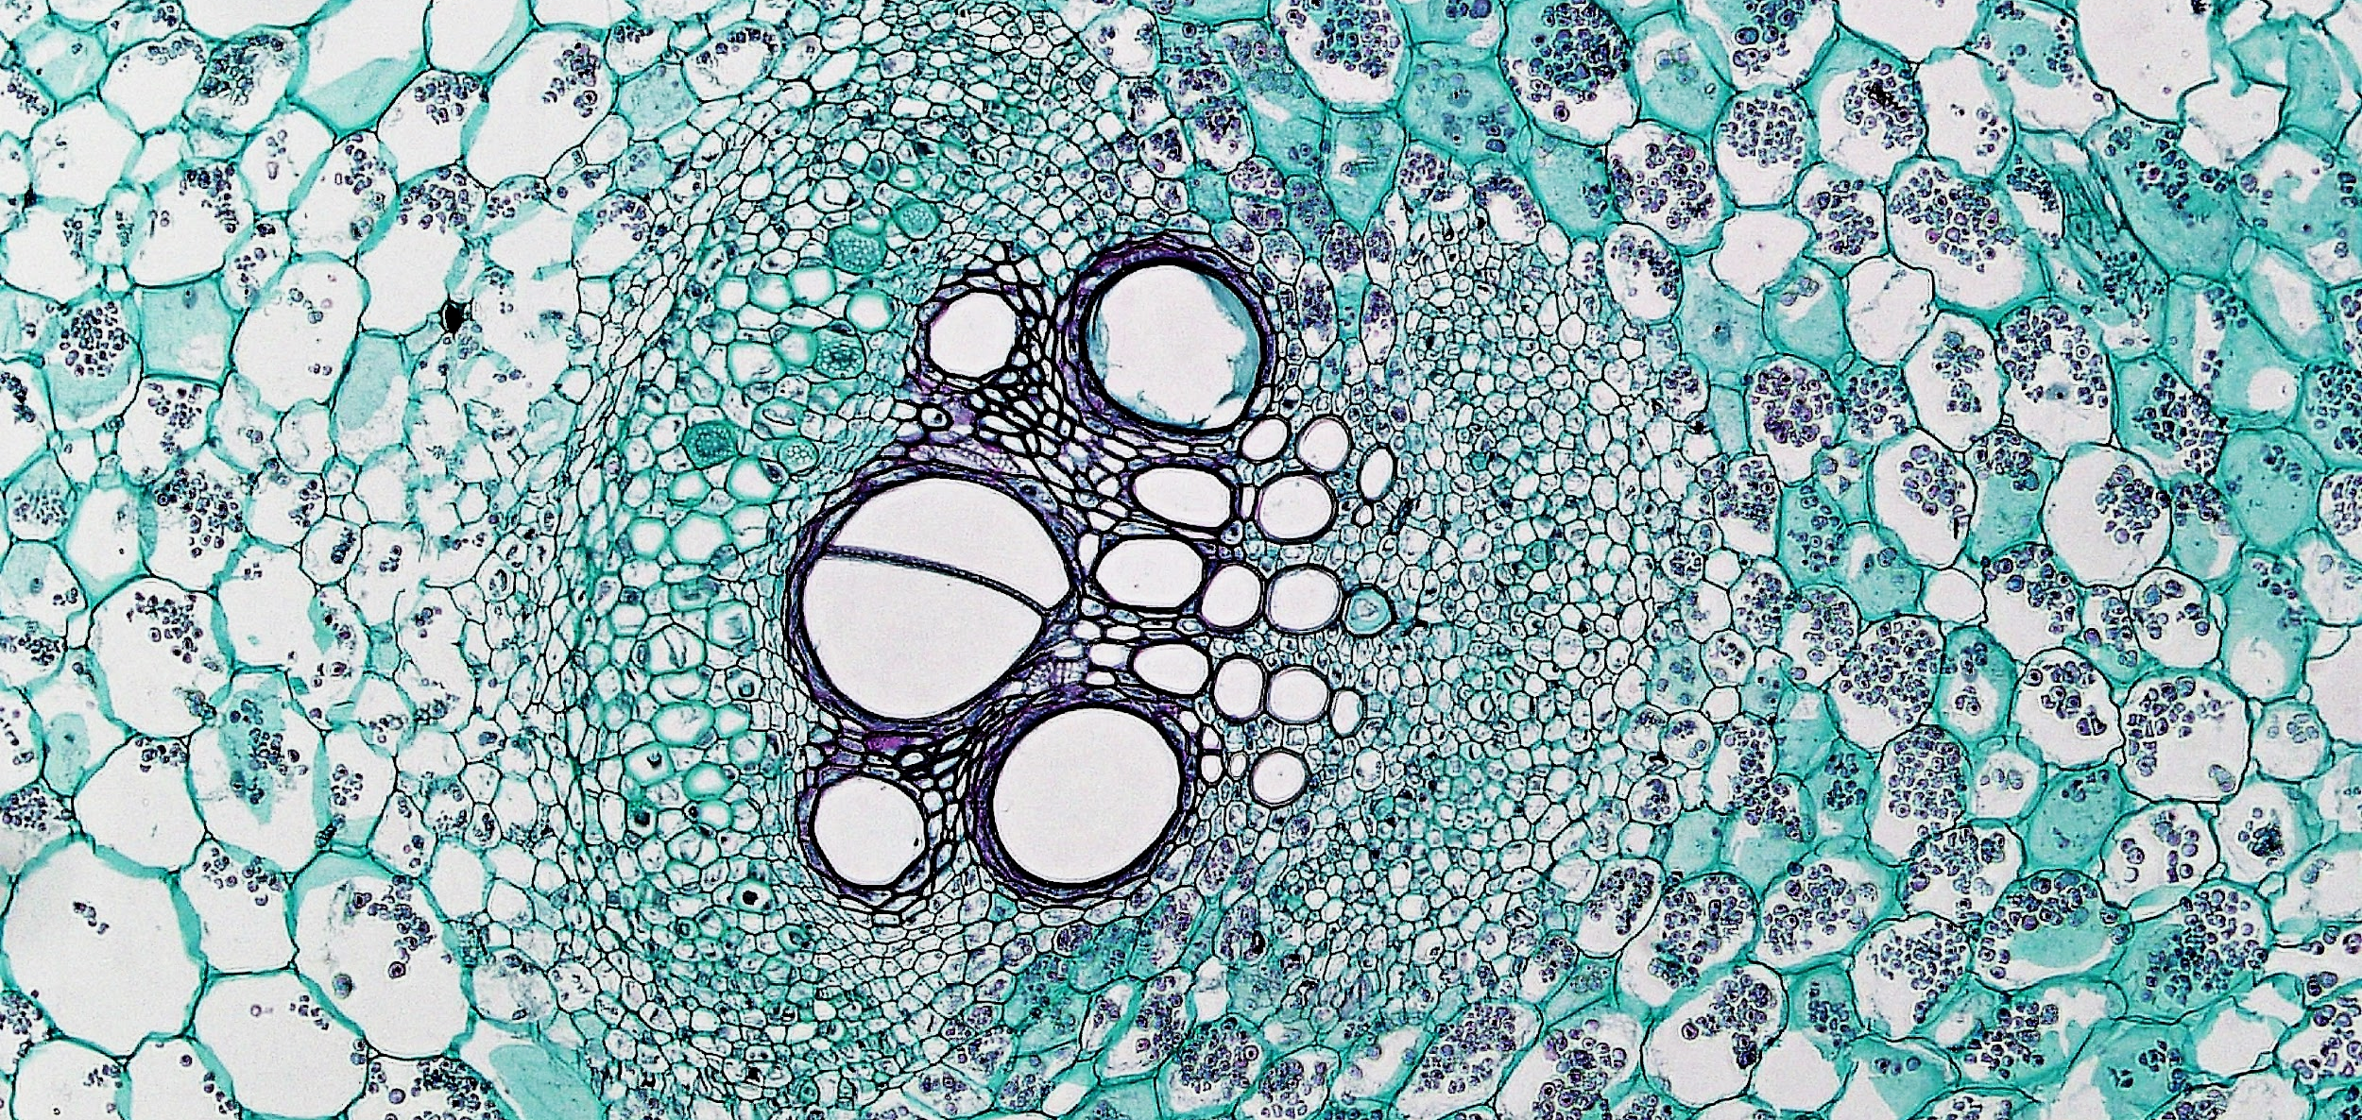
The vascular bundle helps to transport nutrients around the plant.

Slide 4
The Xylem
The xylem transports water and mineral ions from the roots to the leaves of the plant.
Xylem vessels form a long, unbroken tube.
Xylem consists of dead tissue.
There are no gaps between cells.
  This allows water to be easily transported through the xylem.
The walls of xylem vessels contain the polymer lignin.
  This makes them tough and impermeable.
WATER AND
MINERAL IONS
NO GAPS
BETWEEN CELLS
WALLS STRENGTHENED
WITH LIGNIN

Slide 5
Lignins are complex organic polymers that form key structural materials in the support tissues of most plants.
Lignins are particularly important in the xylem because they lend rigidity and impermeability.

Slide 6
Cohesion Tension Theory
Water moves up the plant against the force of gravity.
  This can be explained by cohesion tension theory.
Water evaporates from the leaves of the plant.
  This is the process of transpiration.
This creates suction in the xylem.
  This is referred to as tension.
  Tension pulls more water into the xylem.
Water is taken up from the roots.
  Water molecules are cohesive.
  This means they are attracted to one another.
  This is due to hydrogen bonds between neighboring water molecules.

Slide 7
AS WATER EVAPORATES FROM THE LEAVES, WATER IS SUCKED UP THE XYLEM
HYDROGEN BONDING OCCURS BETWEEN NEIGHBORING WATER MOLECULES. THIS CREATES AN UNBROKEN CHAIN OF WATER
Water moves up the plant through the xylem.
Cohesion tension theory helps to explain the mechanism.
WATER TRAVELS FROM ROOTS TO SHOOTS
THE WALLS OF THE XYLEM ARE LIGNIFIED FOR EXTRA STRENGTH

Slide 8
Water is described as a cohesive molecule because it sticks to other water molecules.
This is due to its ability to form hydrogen bonds with neighboring water molecules.
This allows water to be transported up the xylem in a continuous stream.

Slide 9
Transpiration
Transpiration occurs when water evaporates from the leaves of the plant.
  Water evaporates from cell walls.
  It then builds up between cells in the leaf.
Water leaves the surface of the leaf through the stomata.
  Water moves down its water potential (ψ) gradient into the air surrounding the plant.
There are a number of factors that can affect the rate of transpiration:
  Temperature - as temperature increases, the rate of transpiration increases. This is because warmer molecules have more kinetic energy. Water molecules move more quickly out of the leaf.
  Light intensity - as light intensity increases, the rate of transpiration increases. This is because the stomata open in response to light. They do this to allow carbon dioxide (CO₂) into the plant for photosynthesis.
  Wind speed - as wind speed increases, the rate of transpiration increases. This is because wind blows away water molecules from the leaves of the plant. This creates a region of dry air around the plant, increasing the ψ gradient.
  Humidity - as humidity increases, the rate of transpiration decreases. A region of damp air around the leaf reduces the ψ gradient.

Slide 10
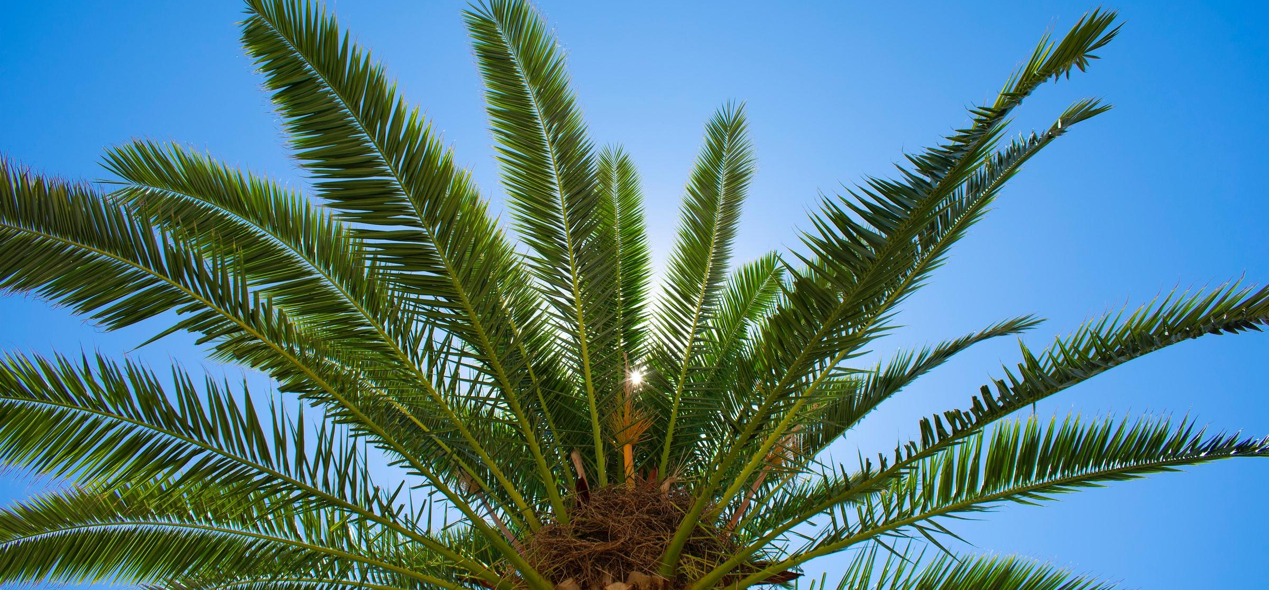
Plants and trees in tropical locations will experience high rates of transpiration.

Slide 11
The Potometer
A potometer is used to measure the rate of transpiration.
A plant shoot is cut underwater.
  This is to ensure that an air bubble does not become trapped in the xylem.
The potometer is assembled.
  This is also done underwater so no air can enter.
The apparatus is checked to see if it is airtight.
  This is to ensure that water only evaporates through the leaves.
WATER
RESERVOIR
BURETTE IS USED TO MEASURE RATE OF WATER LOSS

Slide 12
The Potometer
The leaves are allowed time to acclimatise.
The starting point of fluid in the burette is measured.
  This is called the meniscus.
A stopwatch is used to measure how long it takes for water in the burette to fall by a set amount.
  From this the rate of transpiration can be calculated.
This experiment can be repeated with a single variable changed.
  For example, temperature.
WATER
RESERVOIR
BURETTE IS USED TO MEASURE RATE OF WATER LOSS

Slide 13
The Phloem
The phloem consists of living tissue.
  Phloem consists of 2 types of cell:
    Sieve tube elements are cells that transport solutes around the plants. These cells have no nucleus and no organelles. They are divided by a molecular mesh called a sieve plate.
    Companion cells carry out functions required to keep the sieve tube elements alive. They are full of mitochondria to create ATP for active transport.
The phloem is involved in the process of translocation.
  Translocation is the movement of solutes from where they are produced to where they are needed.
  Solutes such as amino acids and sucrose are often referred to as assimilates.
  Translocation is an active process requiring energy.
DISSOLVED SUGARS
AND NUTRIENTS
HOLES IN SIEVE TUBE ELEMENTS ALLOW FOR SUGAR TO MOVE THROUGH

Slide 14
From Source to Sink
Translocation involves the movement of assimilates from source to sink.
  The source is where the assimilate is made. Sugars, for example, are made in the leaves of the plant.
  The sink is where the assimilates are used or stored. Sugars, for example, are often stored in the roots of the plant.
The movement of assimilates from source to sink can be explained by the mass flow hypothesis.
  Solutes are loaded using active transport from companion cells into sieve tube elements. This lowers the ψ inside the sieve tubes, causing water to enter from the neighboring xylem. As water enters, the hydrostatic pressure at the source end of the phloem increases.
  Solutes are removed at the sink end. This increases the ψ inside the sieve tubes. Some water leaves the tubes by osmosis, so hydrostatic pressure at the sink end decreases.
  This creates a pressure gradient between the source end and the sink end.
When solutes reach the sink end, they are either used up or stored.
  Solutes like sucrose are used up in respiration.
  They can also be packaged into polymers like starch.

Slide 15
The mass flow hypothesis helps to explain how solutes are moved throughout the plant.
COMPANION CELL
1. SUCROSE IS ACTIVELY LOADED INTO THE PHLOEM
SUCROSE MOLECULES
2. WATER FLOWS INTO THE PHLOEM
SOURCE CELL
3. AS WATER FLOWS INTO THE PHLOEM THE WATER PRESSURE INCREASES. THIS PUSHES SUCROSE FROM SOURCE TO SINK DOWN A PRESSURE GRADIENT
5. WATER MOVES BACK INTO THE XYLEM BY OSMOSIS
4. SUCROSE IS UNLOADED FROM THE PHLOEM INTO THE SINK CELL
SINK CELL

Slide 16
Evidence For and Against Mass Flow
The mass flow hypothesis has not been proven.
There are arguments for and against mass flow.
  Most of the evidence supports mass flow.
  Some evidence disagrees with mass flow.
If a ring of bark is removed, a bulge will form above the ring.
  A ring of the outer bark of a plant (containing the phloem) is removed. A bulge will form above the ring, indicating a buildup of sugars.
  This suggests that the flow of sugars must involve the phloem and it must be downwards.
A pressure gradient can be observed in the phloem.
  Aphids can be used to investigate pressure in the phloem. The aphids are allowed to pierce the phloem. Their bodies are then removed, leaving their mouthparts. Sap will flow out of the mouthparts. The rate of flow will be higher at the top of the plant than the bottom.
  This indicates that a pressure gradient is present from top to bottom.

Slide 17
Evidence For and Against Mass Flow
A radioactive tracer can track the movements of solutes from source to sink.
  The leaf is supplied with radioactively labelled carbon dioxide (CO₂).
  As the plant photosynthesises, it incorporates the radioactive carbon isotope (¹⁴C) into sugars.
  The movement of these sugars can be tracked by autoradiography. The plant is frozen and sections of it are placed on photographic film. The photographs indicate a movement of sugars from source to sink.
If a metabolic inhibitor is added, translocation stops.
  A metabolic inhibitor halts the production of ATP.
  This indicates that translocation is an active process, requiring energy.
Sugars travel to many different sinks.
  The model suggests that sugars will only travel to the sink with the highest ψ.
  This has been disproven.
The sieve plates should restrict mass flow.
  Huge amounts of pressure would be needed for solutes to move through sieve plates at a reasonable rate.

Slide 18
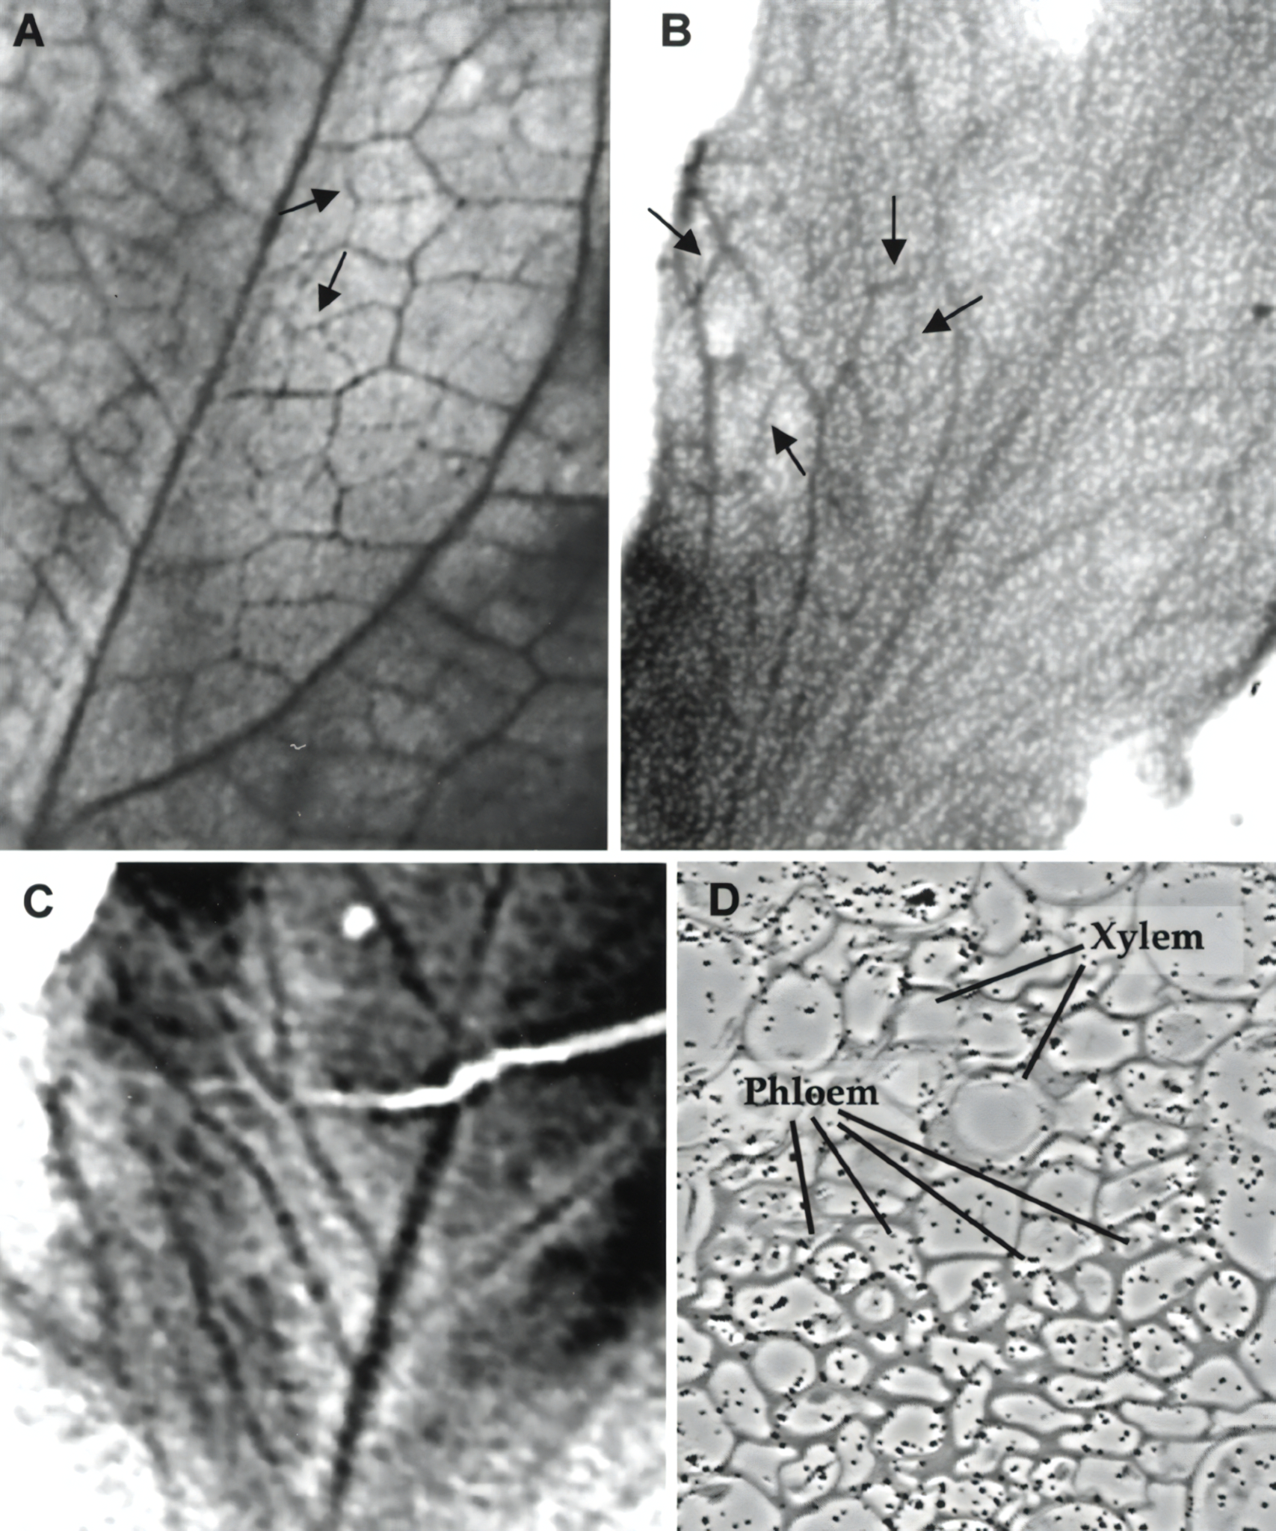
An autoradiograph. Darker areas show where the radioactive isotope has been.
Autoradiography is one discipline used to support the theory of mass flow.

